Slide 1

Inviting Belonging:
Creating Welcoming Library Spaces through Relax and Read &
Scenes from Back Home
Jennifer Nabicht & Simon Ringsmuth

Slide 2

Overview
Introductions
Edmon Low Library
Relax & Read
Scenes from Back Home
Lessons Learned
Q&A

Slide 3
Introductions
Jennifer Nabicht
Simon Ringsmuth
Bachelor’s in Creative Writing from OSU
Interlibrary Services Library Technician
Relax & Read Coordinator
Aspiring to go for an MLS/MLIS
Masters in Educational Technology
Digital Services Librarian
Former High School Teacher
4+ years library experience

Slide 4
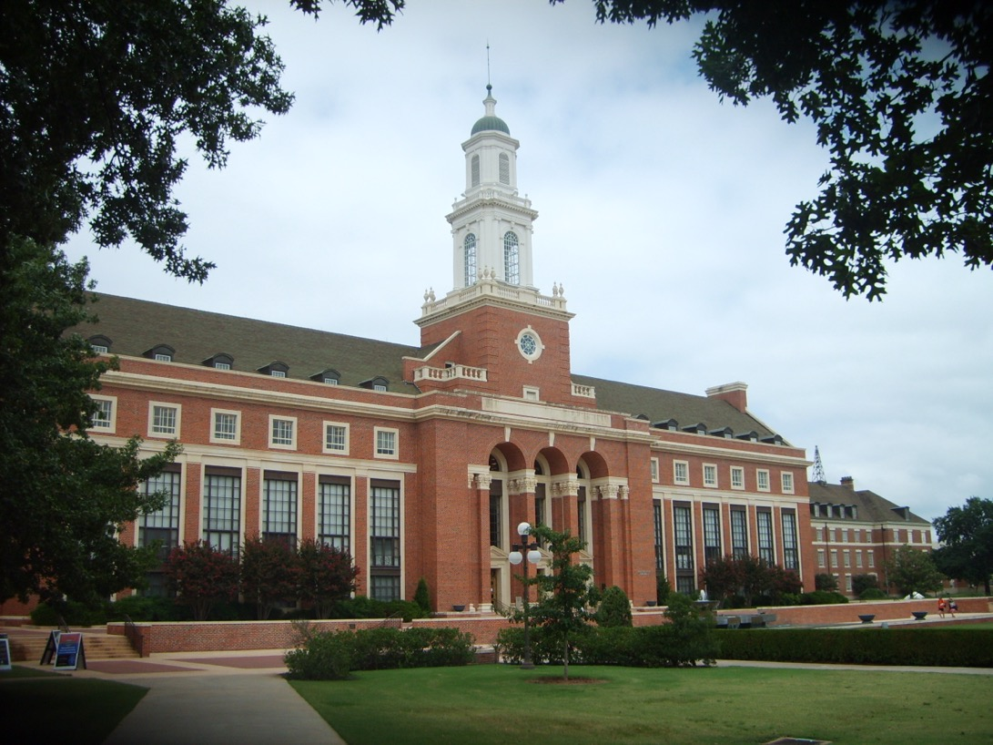
Edmon Low Library
Notes:
Built in 1953. 5 floors. About 3.2 million items in our collection. 2 large storage facilities and 3 branch libraries along with the main library.
https://upload.wikimedia.org/wikipedia/commons/a/a9/OSUEdmonLowLibrary2007.jpg

Slide 5
Relax and Read

Slide 6
Overview
Purpose: Create a welcoming, low-stress space that encourages reading for pleasure within an academic library setting.
Concept: A browsable leisure reading collection placed in the library lobby—visible, accessible, and inviting.
Message: The library supports curiosity, enjoyment, and mental wellbeing, not just research and coursework.

Slide 7
Implementation
Located in the library lobby — highly visible and accessible
Refreshed shelving layout — raised lower shelves for easier browsing and accessibility
Introduced rotating themed displays (e.g., seasonal reads, heritage month features, staff picks) to encourage discovery
Curated a diverse mix of fiction, nonfiction, and graphic novels
Simple signage and comfortable seating encourage lingering and connection

Slide 8
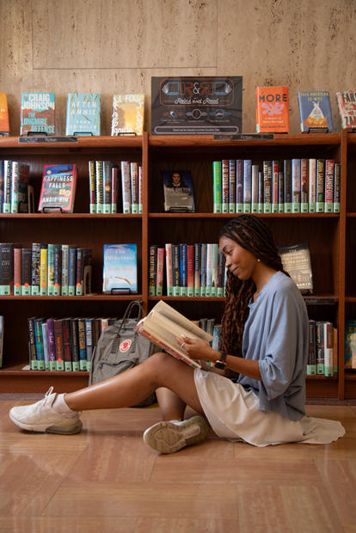
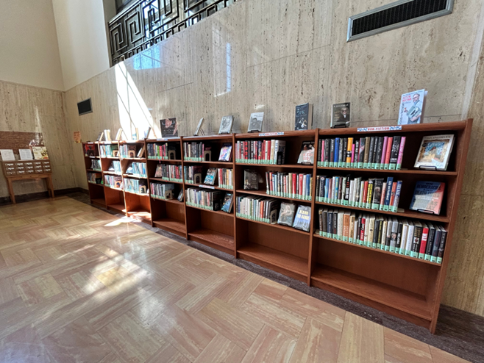
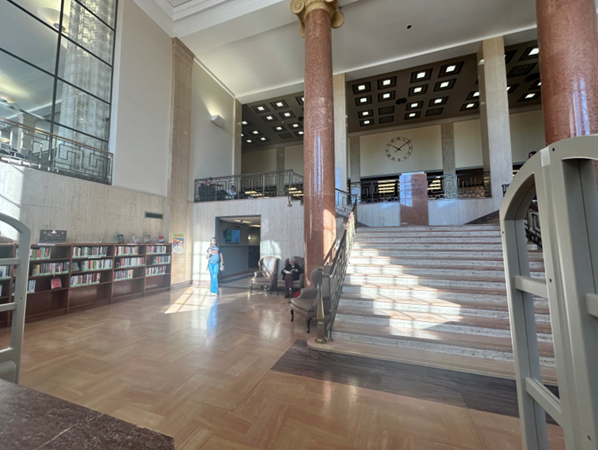
Edmon Low Lobby

Slide 9
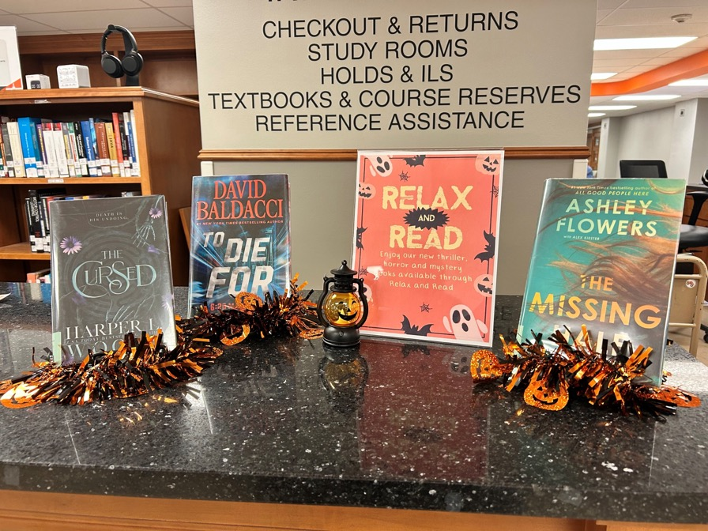
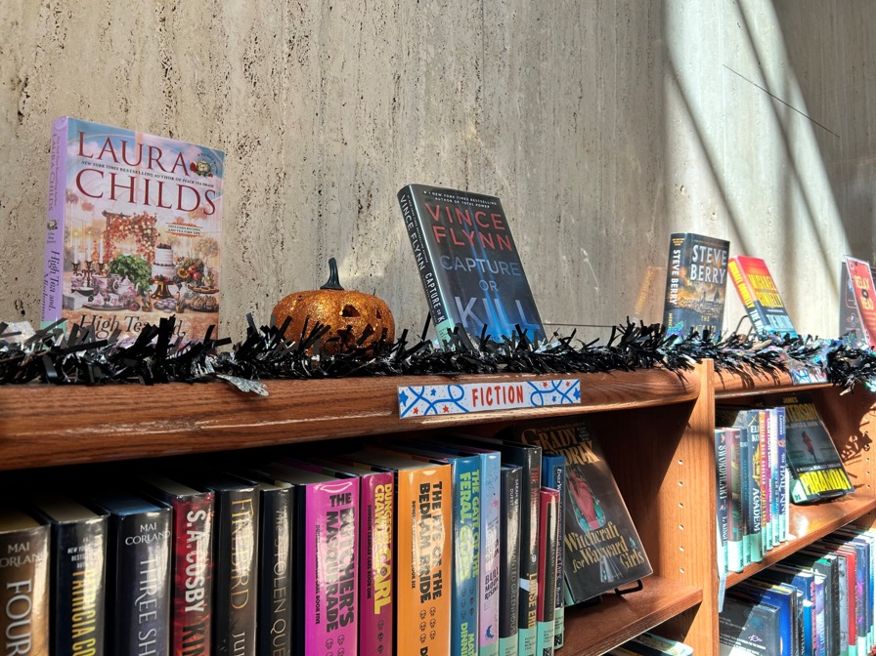
Relax & Read Displays

Slide 10
Impact
Helped reframe perceptions of the library as both academic and personal.
Increased casual foot traffic and linger time in the lobby area.
Noticeable increase in engagement — more browsing and checkouts
Accessibility changes made the space more inviting and inclusive
Themed displays spark conversation and draw repeat visitors
Positive feedback from student employees and library staff.

Slide 11
Lessons Learned
Keep collections fresh and inclusive to reflect diverse interests
Regularly gather user feedback for continued relevance
Accessibility and visibility are key — location drives participation
Displays and social media is essential to engagement.

Slide 12
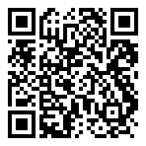
LibGuide

Slide 13
Scenes from
Back Home

Slide 14
Overview
Purpose: Create a welcoming environment in the Third floor study area
Concept: Students submit photos of their hometowns to be displayed on an 85” Frame TV
Message: The Library cares about students and wants them to be comfortable, feel welcomed, and create a connection to other students.

Slide 15
Implementation
Big Idea Pitch to Library leadership
Facilities Management installed power, ethernet, and wall mount
Locked cabinet for control box, remote
Purchase and setup of Samsung 85” Frame display
LibGuide and Form for submitting photos
Image processing pipeline
Signage and other promotion

Slide 16
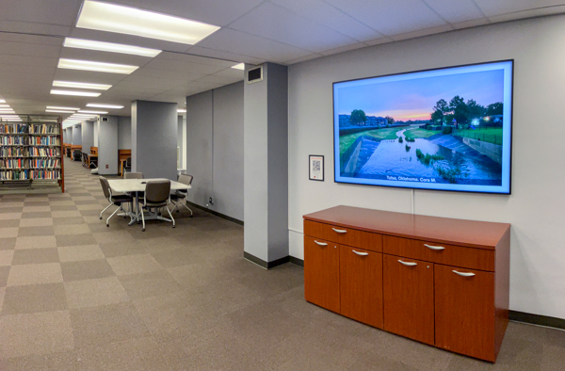
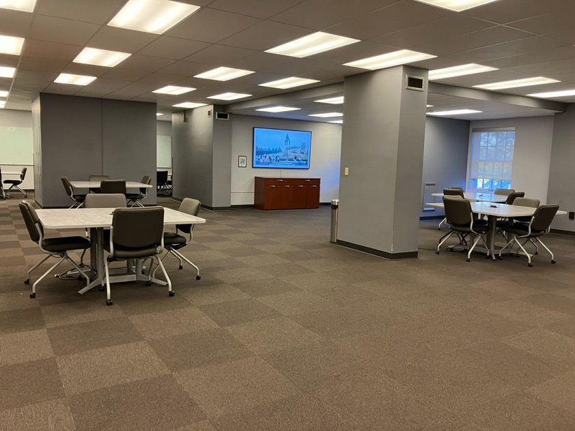
Third Floor Study Area

Slide 17
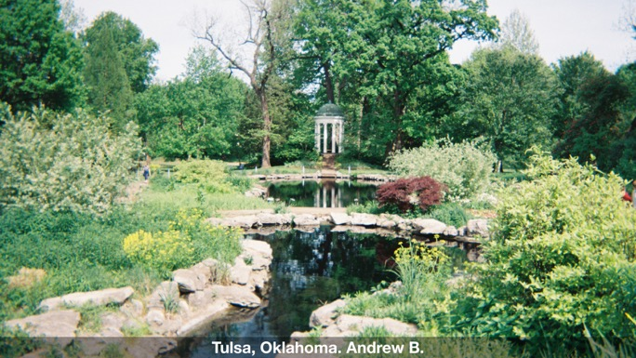
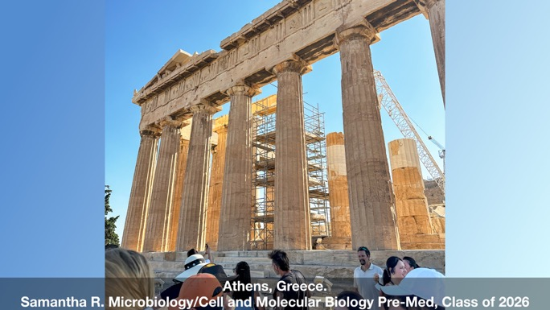
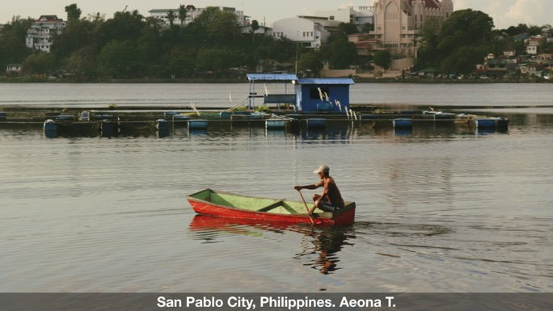
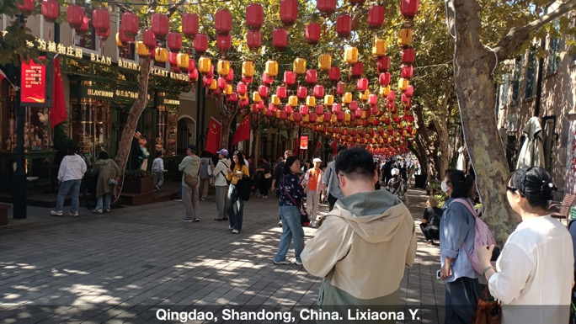
Student Submissions

Slide 18
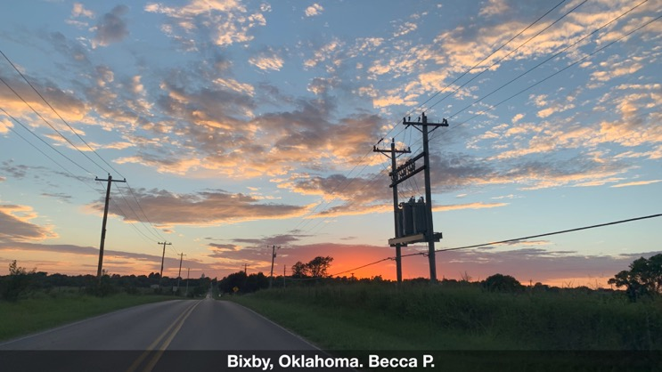
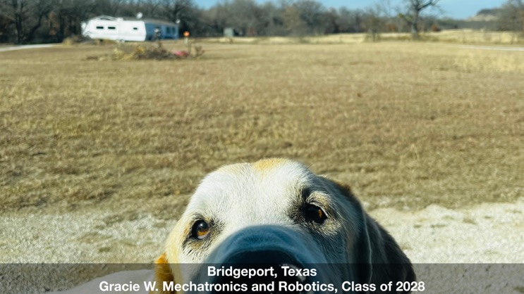
Impact
Over 60 photos submitted
Study space feels welcoming and inviting
Popular spot for visitors and tour groups
Students have ownership over their study area

Slide 19
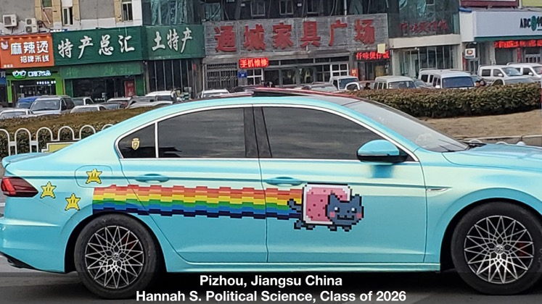
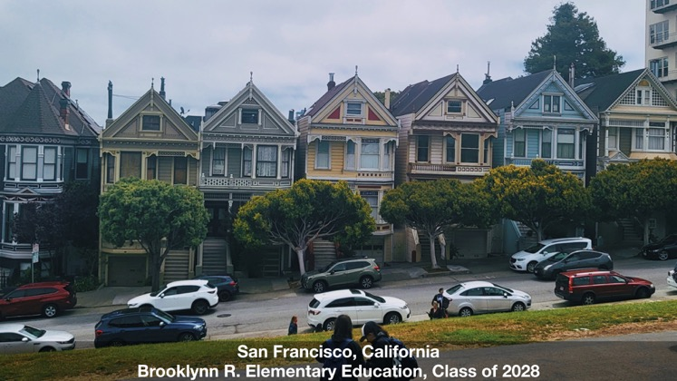
Lessons Learned
Simplify submission process (less is more)
Promotion is essential for success
TV software can be problematic
“Scenes from Back Home” → “Cowboys Around the World”

Slide 20
LibGuide and submission Form

Slide 21
Contact
Jennifer Nabicht (405) 744-7204
Jennifer.nabicht@okstate.edu
Simon Ringsmuth (405) 744-8060
Simon.ringsmuth@okstate.edu

Slide 22
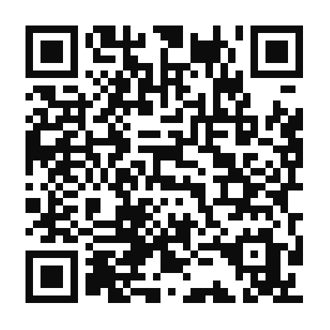

Please share your feedback!
bit.ly/okacrl2025ac

