Slide 1

Interstate Data Moving and the Last Block Problem:
Lessons Learned in the CAPS Spring Experiment 2014
Keith A. Brewster, Ph.D.
Center for Analysis and Prediction of Storms
University of Oklahoma

Slide 2

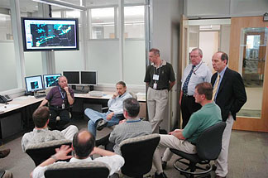


SPC/NSSL Spring Program in the Hazardous Weather Testbed
Testing and calibration of new forecasting methods in a simulated operational setting
6 weeks in spring season
Collaboration among
  NOAA research units
  NOAA operational units
  Universities
  Private sector
Testbed located between the NOAA Storm Prediction Center and Norman National Weather Service Forecast Office

Slide 3
CAPS Spring Experiment
Part of NOAA/SPC Spring Experiment at the Hazardous Weather Testbed
Run Large Ensemble of Convection-Allowing NWP Forecasts for 6-weeks in Spring
New methods for severe weather prediction in 1-2 days time frame
25 NWP models run at XSEDE Centers
2013-2014 Darter at NICS (UTenn @ Oak Ridge)

Slide 4
Goal: “Real-time” 4D Data Visualization
Procedure Since 2007
Run models at PSC or NICS
Bring 2D files and images back
2D fields and levels pre-selected
Issues
Does not allow full 3D visualization
May want to examine other fields and levels
Need to move 3D Data from NICS at UTenn CAPS at OU

Slide 5
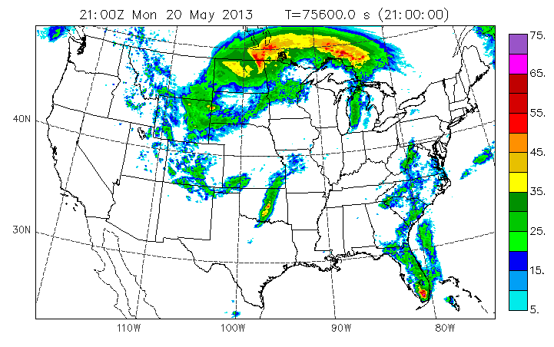
Scoping the Task
CONUS Domain at 4-km Resolution
1163 x 723 x 53
Output for one time: 4.2 GB
Domain decomposition onto 384 (6x64) processors results in 384 split files per output time, each file = 11 MB
For smooth animations, 10-minute output is generated for 5 members covering the afternoon and evening, forecast hours 18-30.
Complete Forecast:
  60-h forecast, hourly output + 10 minute output 18h-30h:
  121 output times, 508 GB
Day-1 Afternoon and Evening for Animation
  Forecast 18h-30h with 10-minute output:
  73 output times, 307 GB

Slide 6

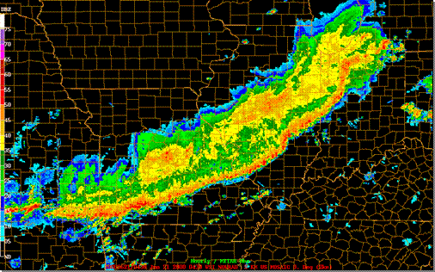
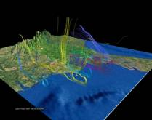
Plan “A” Workflow
WRF
Model
wrfout
split files
NICS Darter
GridFTP or bbcp
Daily
Region of
Interest
joinWRF Join and
subset
wrfout
joined files
CAPS Server
WDSS-II
Converter
vdfcreate
WDSS-II
files
VAPoR
vdf files
sftp or scp
sftp or scp
WDSS-II
VAPoR
NSSL or SPC
Machine in HWT
Notes:
Each full split file: 112MB

Slide 7
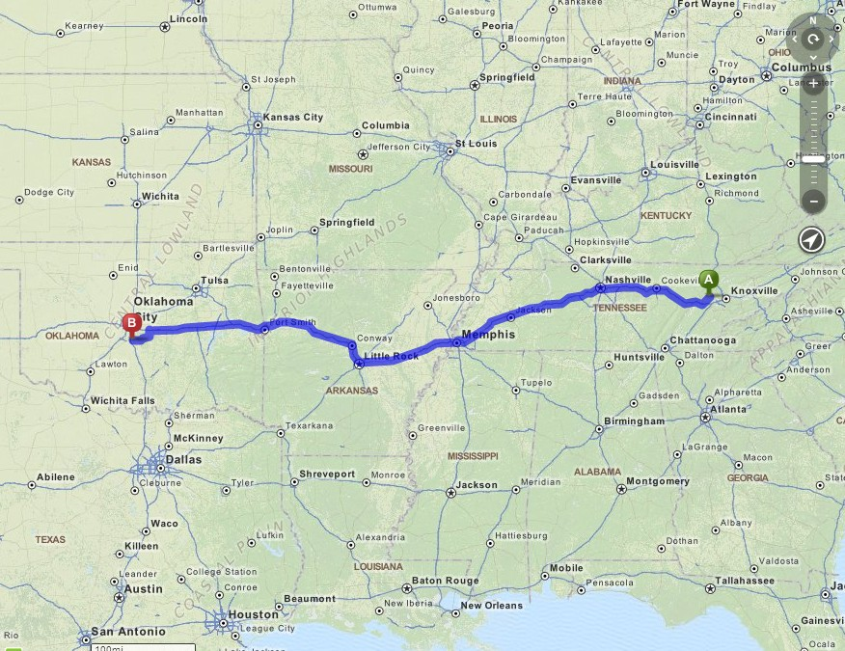



Data Route
NICS/U Tenn in Oak Ridge, Tennessee to
CAPS/OU in Norman, Oklahoma
845 miles 13 hours via MichelinNet
Map from mapquest.com

Slide 8
Internet Route

Slide 9
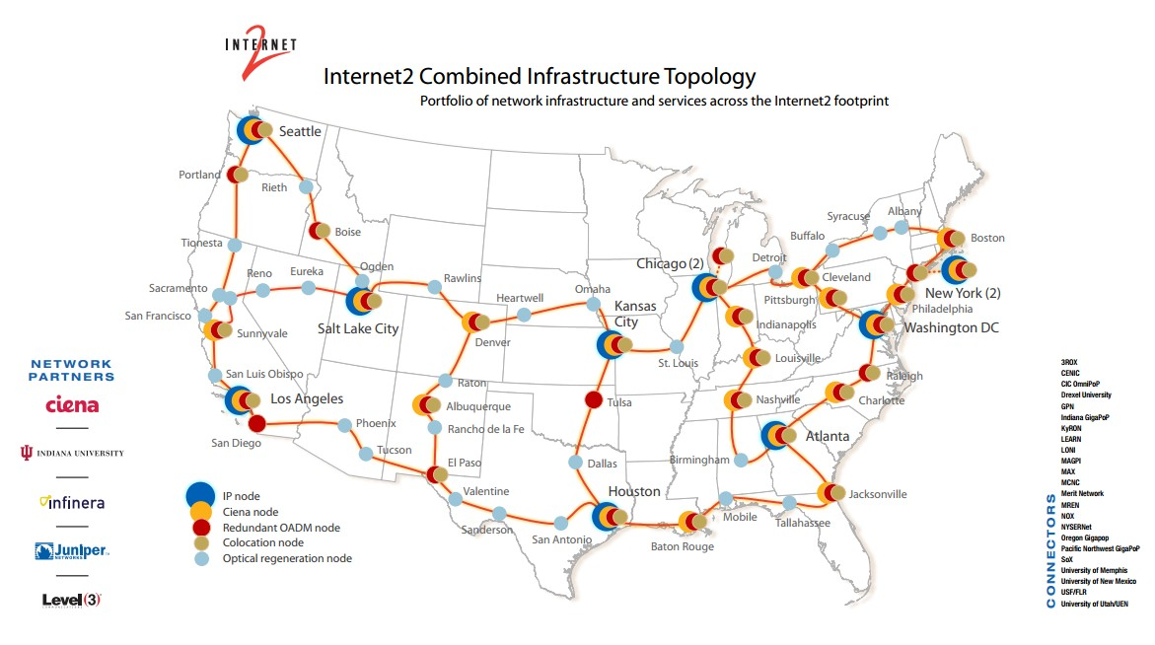
Internet2

Slide 10
Internet Route “Last Mile”
OneNet Tulsa to OU – Norman (4PP)
4PP to National Weather Center
  Across the parking lot
National Weather Center to
  CAPS Switch to File Server System
  to CAPS Office Workstation via Firewall

Slide 11
Recent Networking Initiatives
University of Tennessee BLAST
OneOklahoma Friction Free Network (OFFN)
National Weather Center Upgrade
University of Tennessee BLAST
  100 Gps Upgrade of Research Network
  Includes connections to HPC at NICS

Slide 12
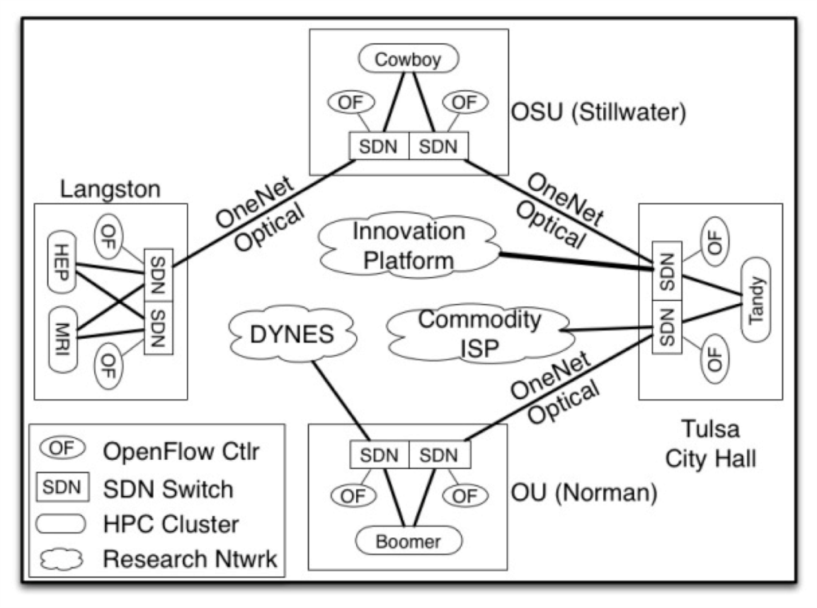
Recent Networking Initiatives
OneOklahoma Friction Free Network (OFFN) NSF Campus Cyberinfrastructure-Network Infrastructure and Engineering Program (CC-NIE)
  Establish 10 Gbps Network Ring
  OU-OSU-Langston-Tandy Supercomputing Ctr

Slide 13


Traffic & Last Block Problem
Testing revealed a “last block” problem, actually within the building itself, mostly due to a slow firewall.

Slide 14

Packing and Compression?
Try creating compressed tar file before sending?
Sending large files is faster ~100 MB/s vs ~10 MB/s
BUT! Creating a compressed tar file takes time
Test for 1-hour of Full Domain Split Files
Operation | Time
bbcp individual split files | 50 min
With Compression
Without Compression
Operation | Time
$ tar –zcvf | 22 min
bbcp | 2.5 min
Total | 24.5 min
Operation | Time
$ tar -cvf | 15 min
bbcp | 5 min
Total | 20 min

Slide 15
Plan “D” Workflow
Daily
Region of
Interest
NICS Darter
WRF
Model
joinWRF Join and
subset
wrfout
split files
wrfout
joined files
bbcp
SPC Workstation
CAPS Stratus
WDSS-II
Converter
sftp
wrfout
joined files
WDSS-II
files
vdfcreate
VAPoR
vdf files
sftp
CAPS Laptop
WDSS-II
VAPoR
Notes:
New Merged file size: 112 MB
Transfer speeds: NICS to Boomer scp ~50 Mbytes/s
Large file: NICS to data1.oscer.ou.edu bbcp ~70-100 Mbytes/s
Boomer to CAPS: 5 Mbytes/s

Slide 16
Re-Scoping the Task
Selected Subdomain of the Day
203 x 203 x 53
Output for one time: 111.5 MB
Single file for each time =
111.5 MB vs 4.2 GB
Day-1 Afternoon and Evening for Animation
  Forecast 18h-30h with 10-minute output:
  73 output times,
  8.2 GB vs 307 GB
Processing and Transfer: ~20 min

Slide 17
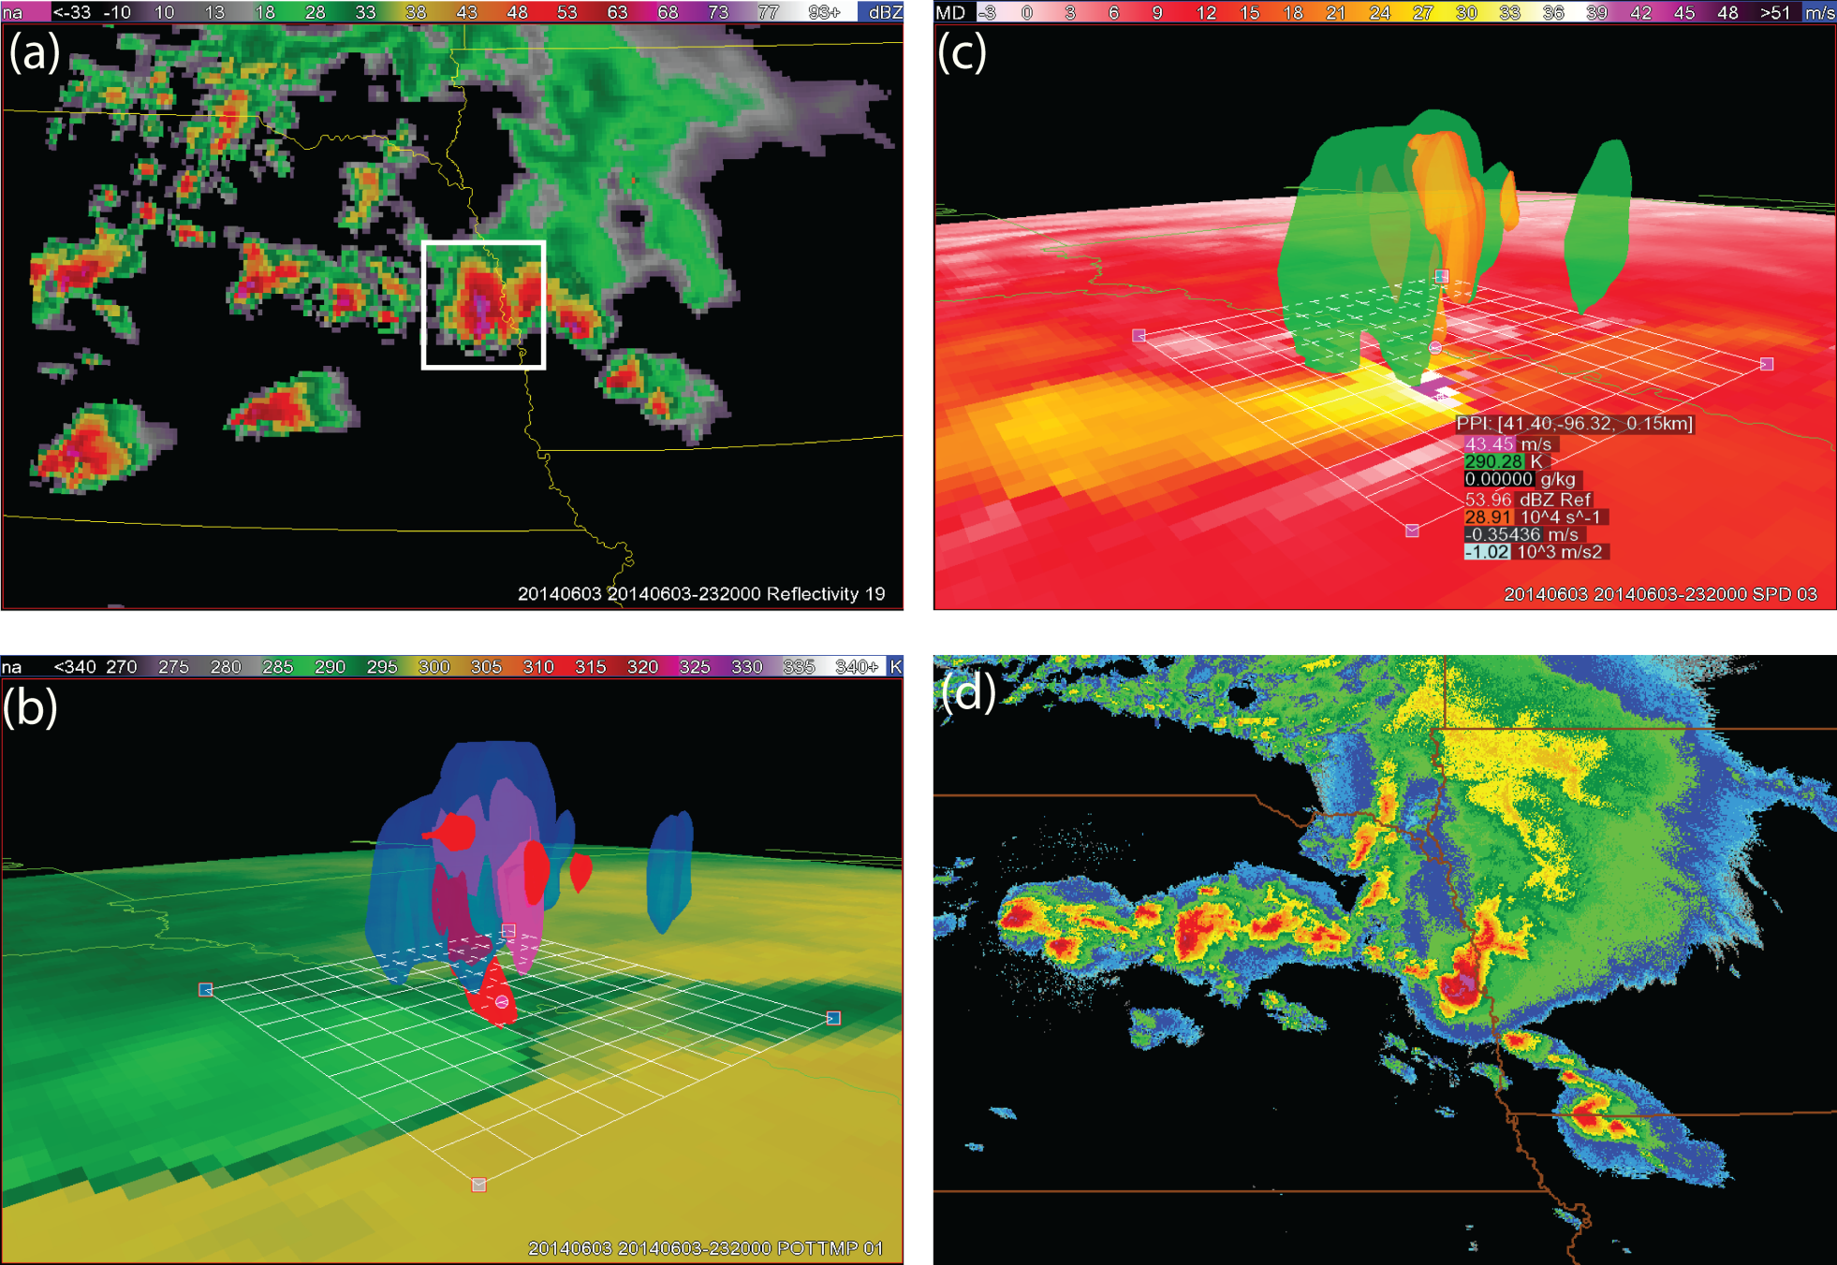
Fruits of Labor
WDSS-II

Slide 18
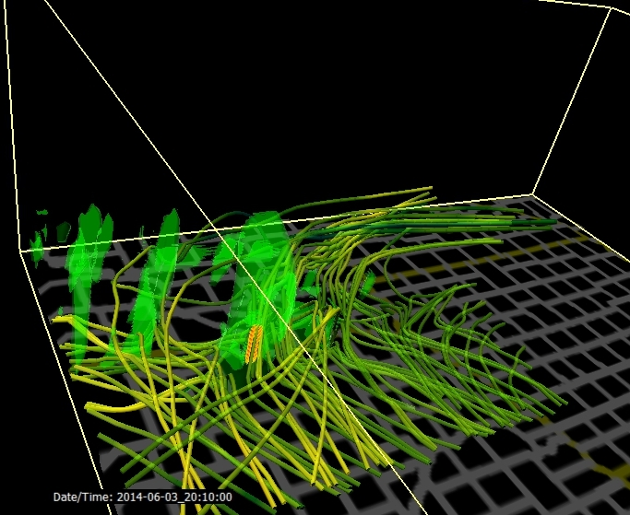
Fruits of Labor
VAPoR

Slide 19
Lessons Learned
Involve networking pros early
Your mileage (throughput) may vary
Be flexible with workflows
Evaluate overhead of all steps
Find ways to fund equipment upgrades where needed – slowest link sets your rate
Software Programmable Networks/Science DMZ’s may be needed for the largest jobs

Slide 20
Future Plans
National Weather Center (September, 2014)
  Upgrading Network to 10 Gps Switches
  Software Programmable Networking Enabled
  Replacing Slow Firewall
CAPS (September-October, 2014)
  Upgrading to Two 10 Gps Gateway Servers
  with Virtual Router Redundancy Protocol (VRRP)
  Software Programmable Networking Enabled
  Upgrading servers to 10 Gps network interfaces
For 2015
  Set Jumbo Size Maximum Transmission Unit (MTU) for route
  Explore use of Science DMZ within OneNet

Slide 21
Questions?
Thanks to:
Chris Cook, CAPS
Kevin W. Thomas, CAPS
Victor Hazlewood and his networking team, UTenn
Matt Runion & James Deaton, OneNet
Henry Neeman & OSCER Team
Mike Coniglio, NOAA/NSSL
Contact Info:
Keith Brewster
CAPS/University of Oklahoma
kbrewster@ou.edu

