Slide 1

Theatrical Intervention as a Pathway to Moral Virtue Development
Lijuan Wang, Psychology
Deborah Mower, Philosophy
Margaret Garvey, Theatre

Slide 2

Overview
Summary and Importance
Deep Integration
Methodology
Challenges and Strategies
Questions

Slide 3
1. Summary and Importance

Slide 4
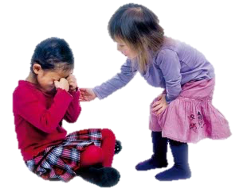

How do we foster moral virtue in young children?
1. Summary and Importance

Slide 5
Create a theatrical intervention that fosters moral character
Sensitive to needs and skills of children
Innovative approach for moral education
1. Summary and Importance

Slide 6
Practical and Theoretical Motivations
Practical moral education for parents and early childhood caregivers
Study beginnings of virtue development
1. Summary and Importance

Slide 7
2. Deep Integration

Slide 8
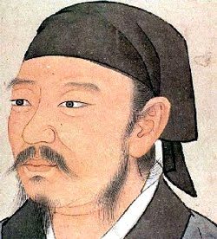
Philosophy: Confucian Virtue Ethics
  Xunzi, approx. 310-215 BC
2. Deep Integration

Slide 9

Rituals Philosophy
  Are essential for building moral character
  Structure family, personal, and social contexts
2. Deep Integration

Slide 10

Rituals Philosophy
  Are essential for building moral character
  Structure family, personal, and social contexts
2. Deep Integration

Slide 11
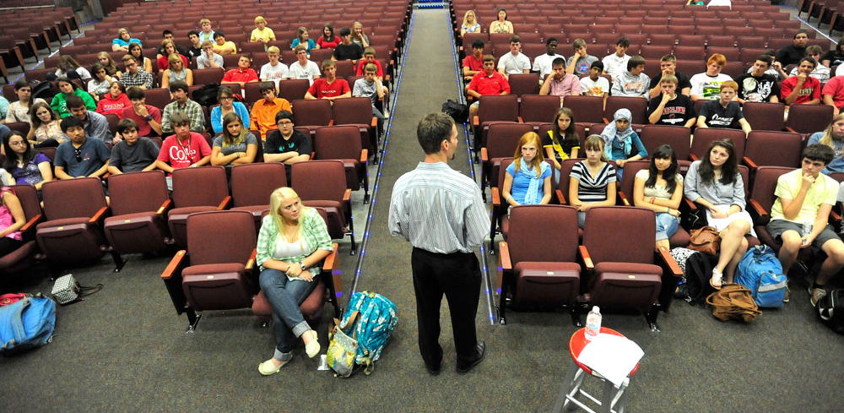
Rituals Philosophy
  Are essential for building moral character
  Structure family, personal, and social contexts
2. Deep Integration

Slide 12

Practice or Performing Rituals Philosophy & Psychology
  Builds habits and dispositions
  Builds cognitive scripts
2. Deep Integration

Slide 13
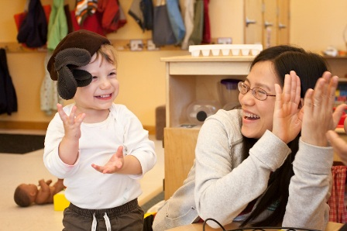
Scripts and Stories Psychology
  Mutually responsive interaction
  Children and caregivers co-construct
      (Trevarthen, 1979, 1993; Trevarthen & Aitken, 2001)
2. Deep Integration

Slide 14
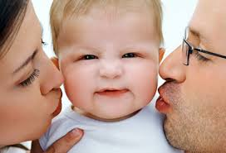
Mutual-responsiveness builds Psychology
  Moral self (e.g., conscience) (Kochanska, 2002)
2. Deep Integration

Slide 15
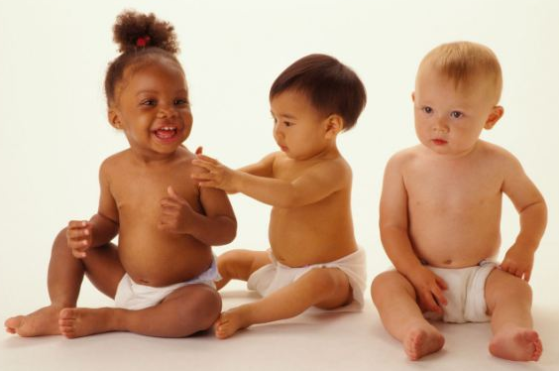
Mutual-responsiveness builds Psychology
  Social engagement
  Socioemotional intelligence (e.g., empathy)
  (Kochanska, 2002; Narvaez et al., 2013)
2. Deep Integration

Slide 16
Process of Virtue Development Psychology
Self-regulation
Socioemotional intelligence
Practice of Proto-virtues
2. Deep Integration

Slide 17
Scripts and Ritual Play Theatre
  Enhance
    Self-expression
    Connection to audience
    Responsiveness to other actors
      (Jacques Copeau, 1976)
2. Deep Integration

Slide 18
3. Methodology

Slide 19
Hypotheses
Theatre practice will promote self-regulation and parent-child mutual responsiveness in both intervention groups.
Practicing self-control scripts will be insufficient for fostering moral virtue.
Practicing virtue scripts will promote moral virtue development.
3. Methodology

Slide 20
Experimental Conditions
Two theatrical intervention conditions
  Self-enhancing Character Promotion
    Practice scripts of self-control, grit, and determination
  Moral Character Promotion
    Practice scripts of kindness, gentleness, and forgiveness
    One control condition (pre-post measures only)
3. Methodology

Slide 21
    Theatre exercises for both conditions
Self-expression (eye contact, body language)
Social playfulness
Mutual responsiveness
3. Methodology

Slide 22
Study Design
72 mother-child dyads
Each intervention condition
  Two groups of 12 dyads (3- to 5-year-old and parent)
  Meet once a week for 12 weeks (90 minutes)
Mixed methods: Pre-test, post-intervention testing, 6-month follow-up testing
3. Methodology

Slide 23
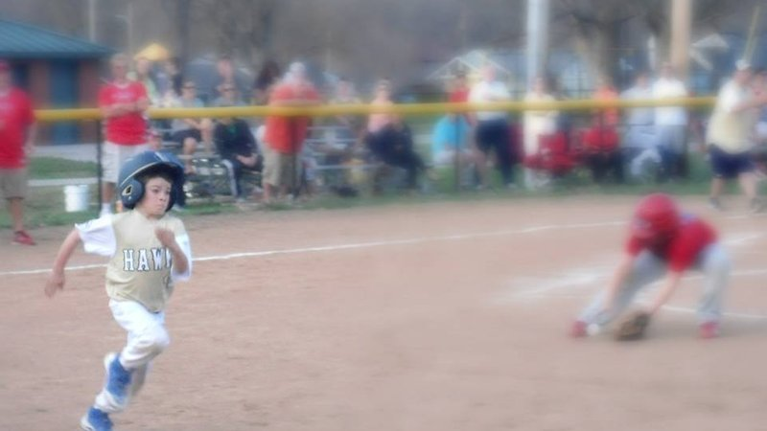

Condition 1: Self-enhancing Character
Emphasis on achievement, perseverance
(Duckworth & Quinn, 2009)
3. Methodology

Slide 24

Self-enhancing scripts practiced
Inhibitory effortful control: suppressing inappropriate responses
  whisper
3. Methodology

Slide 25

Self-enhancing scripts practiced
Attentional effortful control: maintaining focus upon task-related activities
  avoiding temptation
3. Methodology

Slide 26
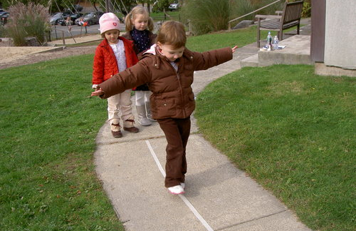
Self-enhancing scripts practiced
Motor effortful control: physical coordination for task-completion
  walking on a line
3. Methodology

Slide 27
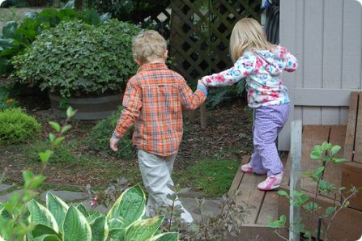
Condition 2: Moral Character Promotion
Emphasis on empathy and prosocial action
3. Methodology

Slide 28
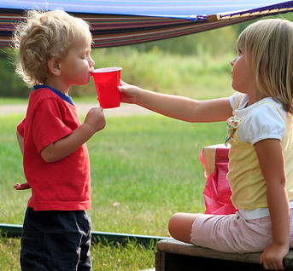
Virtue scripts practiced
Kindness: the quality of being warm, friendly, and considerate
  sharing water
3. Methodology

Slide 29
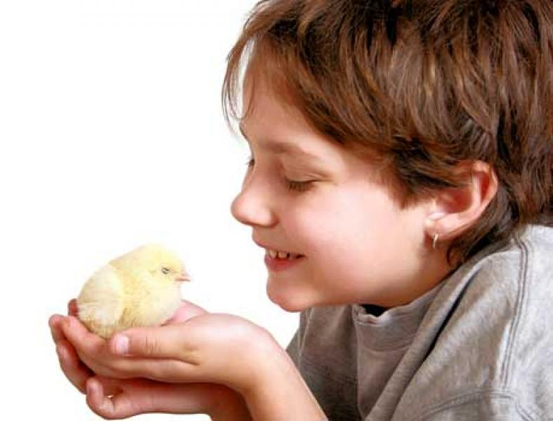
Virtue scripts practiced
Gentleness: the quality of being amiable, tender and careful
  Manner of releasing trapped animal
3. Methodology

Slide 30
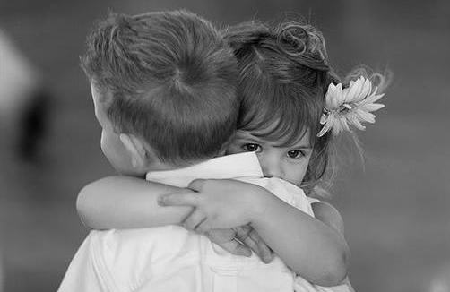
Virtue scripts practiced
Forgiveness: the quality of purposeful reconciliation
  After being bumped into
3. Methodology

Slide 31
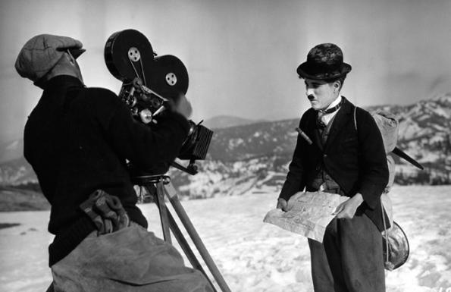
Data Collection
Observation of children, parents with children
  Video recording of pre and post observations
3. Methodology

Slide 32


Data Collection
Surveys (pre/post) & Journals
3. Methodology

Slide 33
4. Challenges and Strategies

Slide 34

Challenge: Children’s Attention Spans
Strategies:
Creative play, full body action, shifting activities
4. Challenges and Strategies

Slide 35
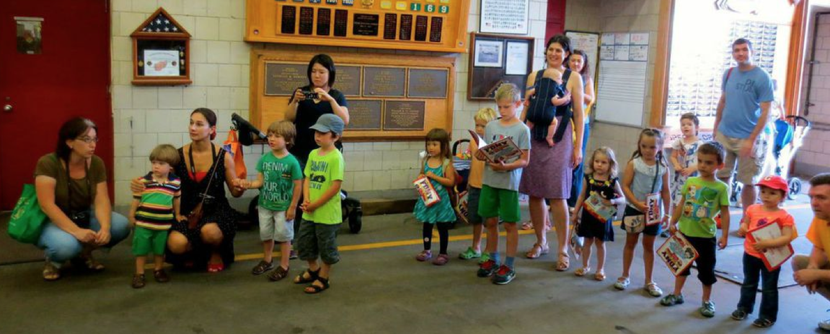
Challenge: Retention of Participants
Strategies:
Increase the size of incentives over time
Attending 3/4 of sessions is sufficient
4. Challenges and Strategies

Slide 36
5. Questions

Slide 37
Thank you!

Slide 40




