Slide 1
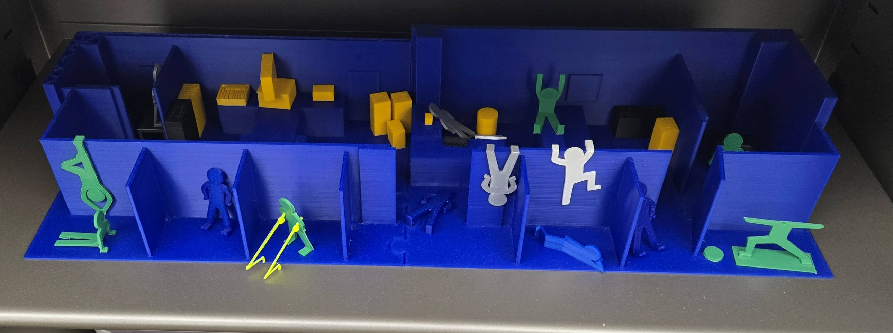
Come On In!
Making an Academic Library Makerspace More Welcoming
Karl G. Siewert, MLIS – ksiewert@uco.edu
University of Central Oklahoma Max Chambers Library

Slide 2
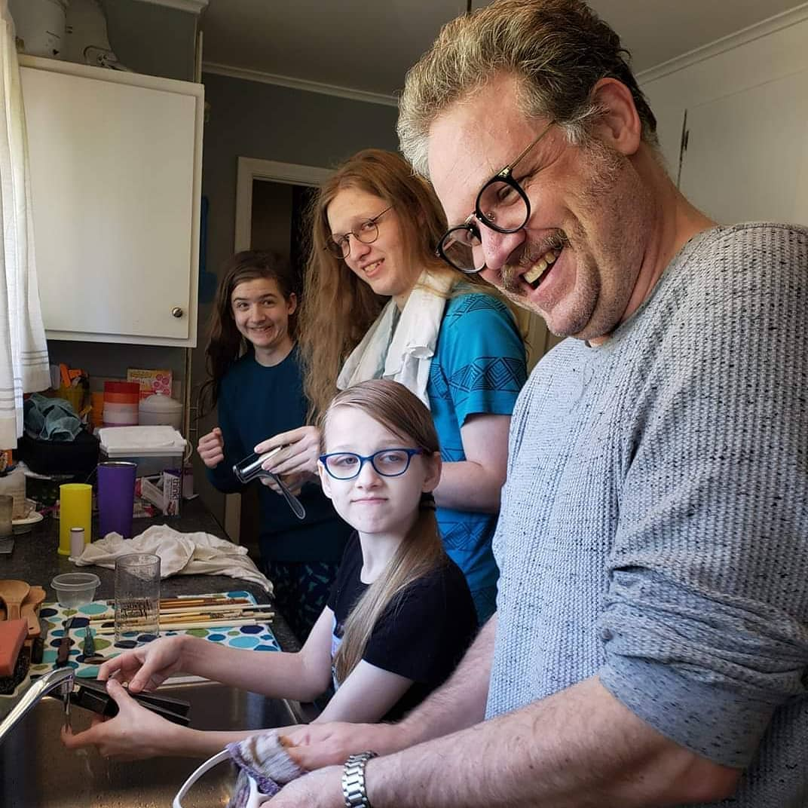
Introduction
Karl G. Siewert (they/them)
Background
  Legacy librarian
  Public
  Academic
  OK-ACRL

Slide 3
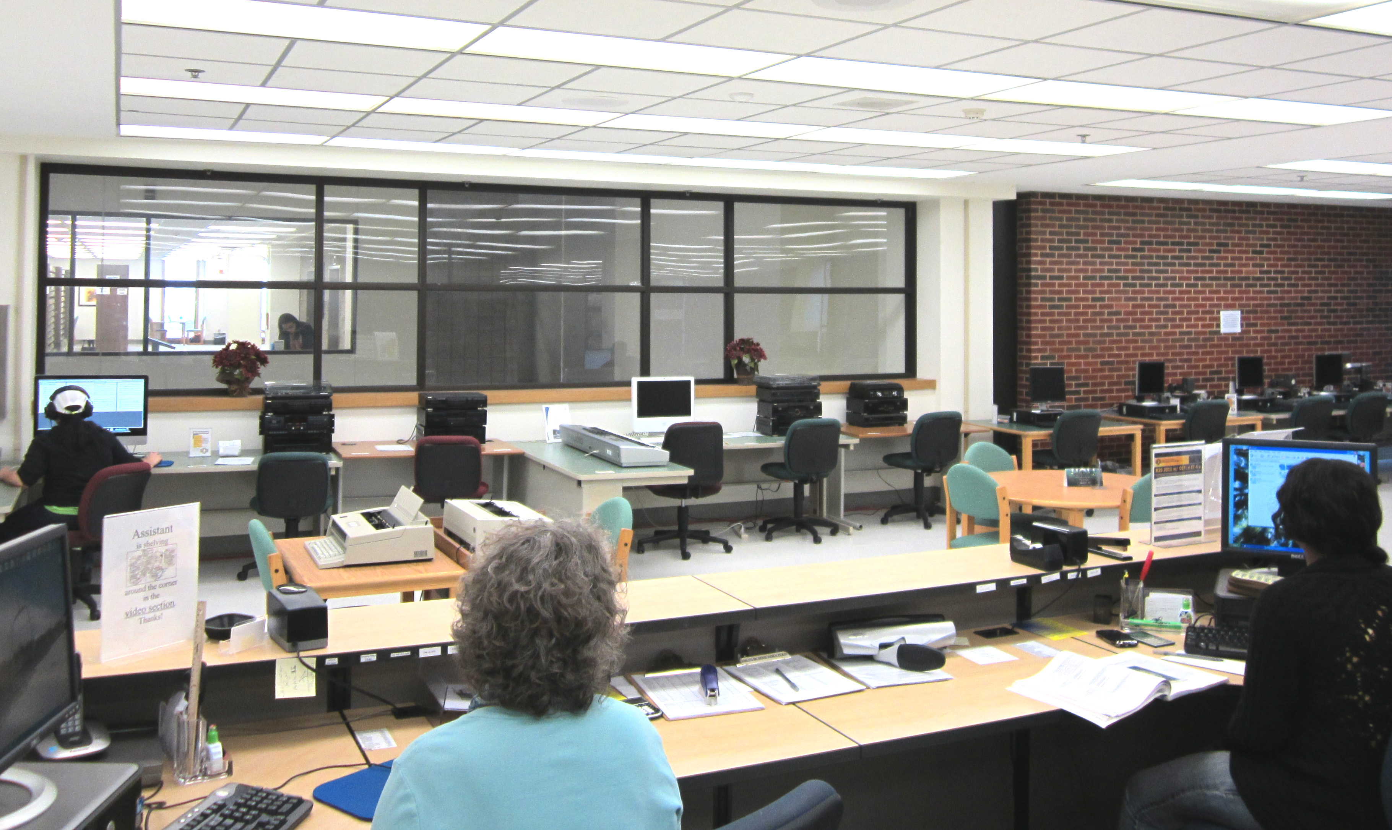
The Innovation Studio
Multimedia department
Grant from McCasland Foundation
Moved to dedicated space 2018
Passed around departments/managers
Karl took over in 2022

Slide 4
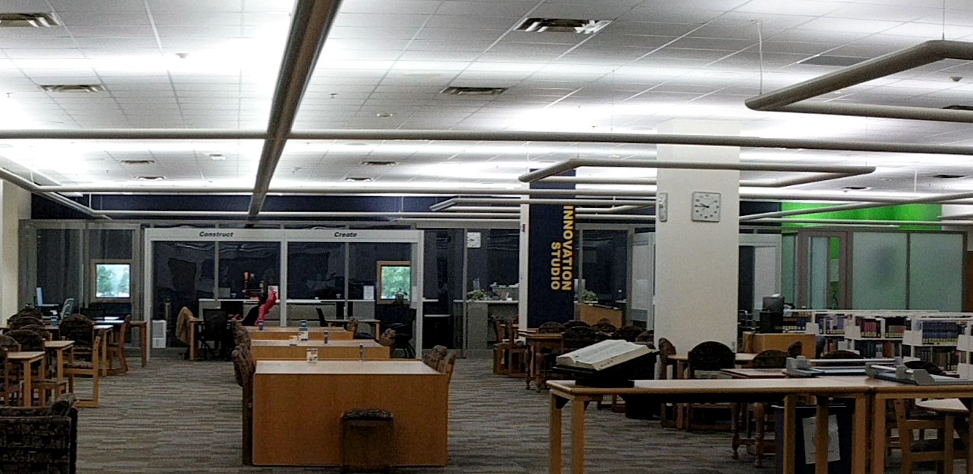
What We’ve Done
Accessibility modifications
Inviting spaces
Digital changes

Slide 5
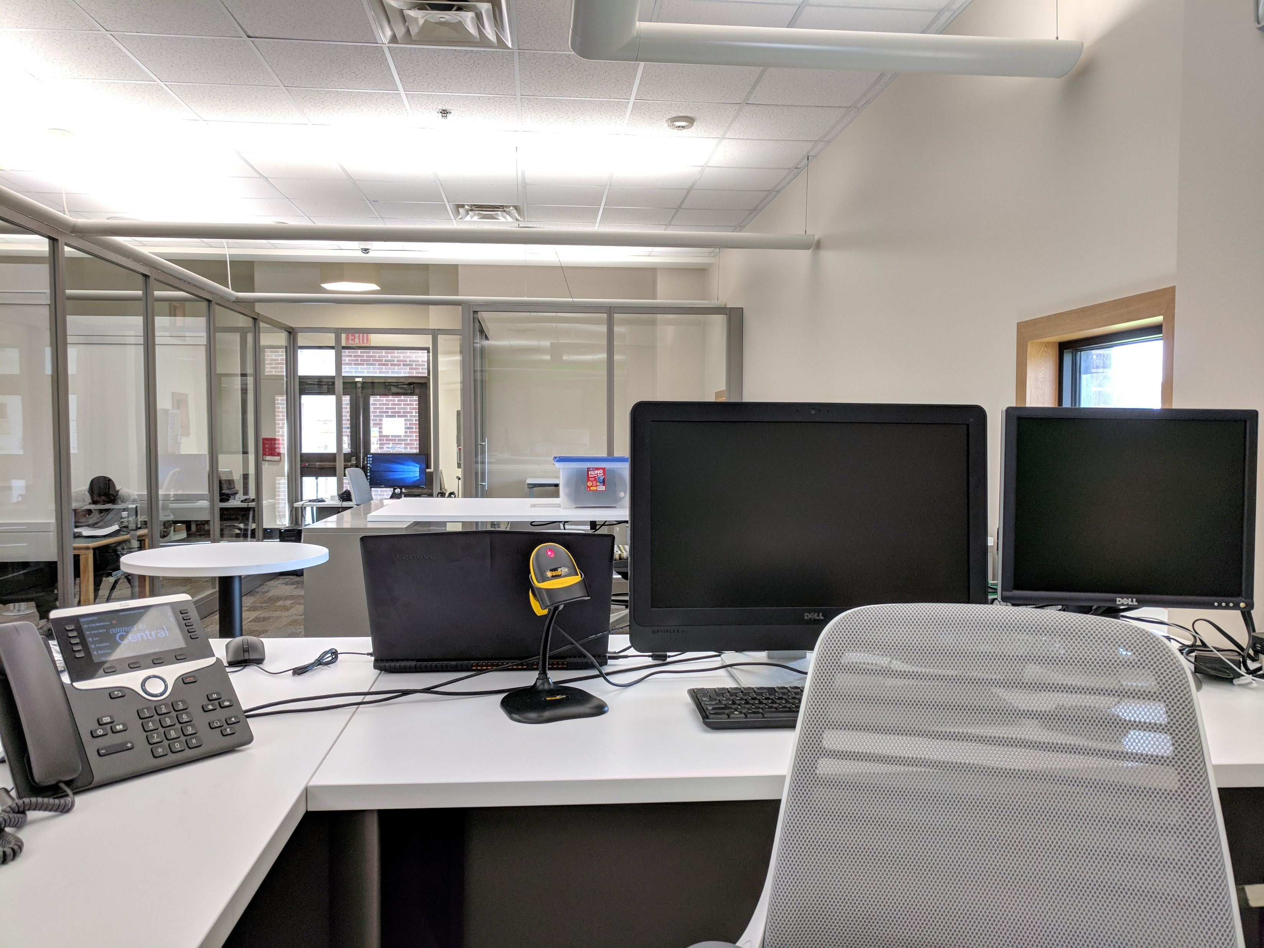
Accessibility
Furniture swaps
Desk modification

Slide 6
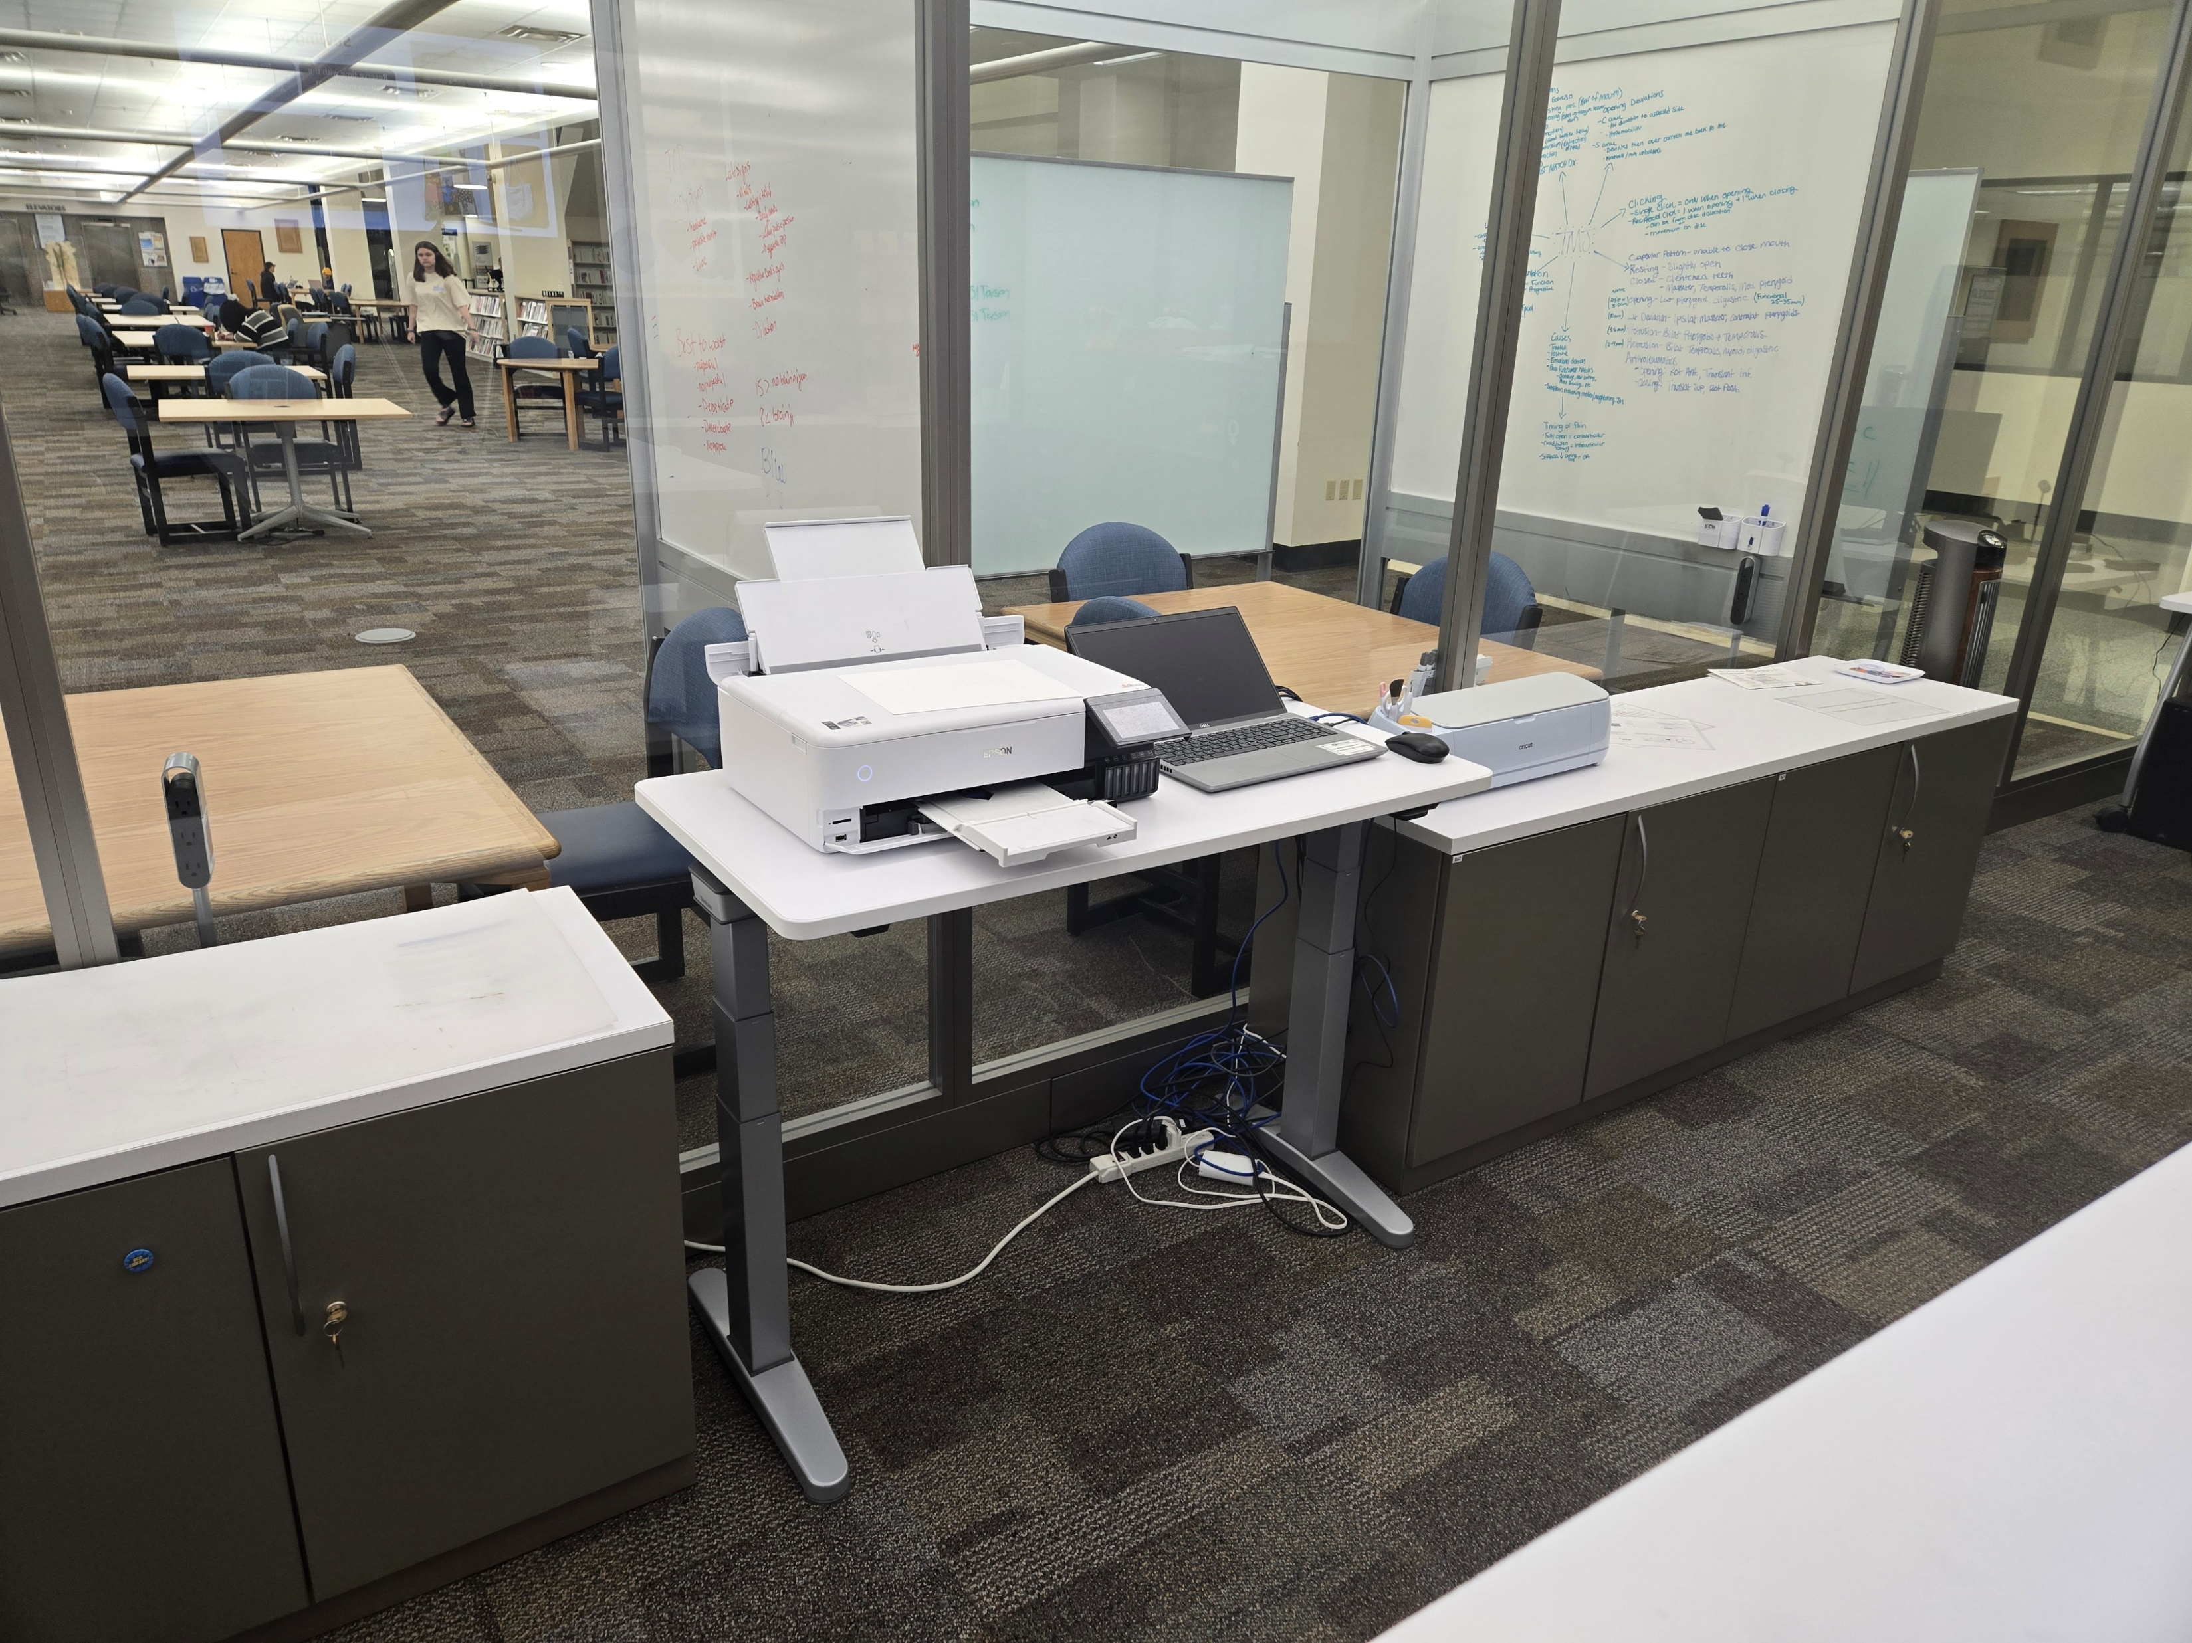
Cricut

Slide 7
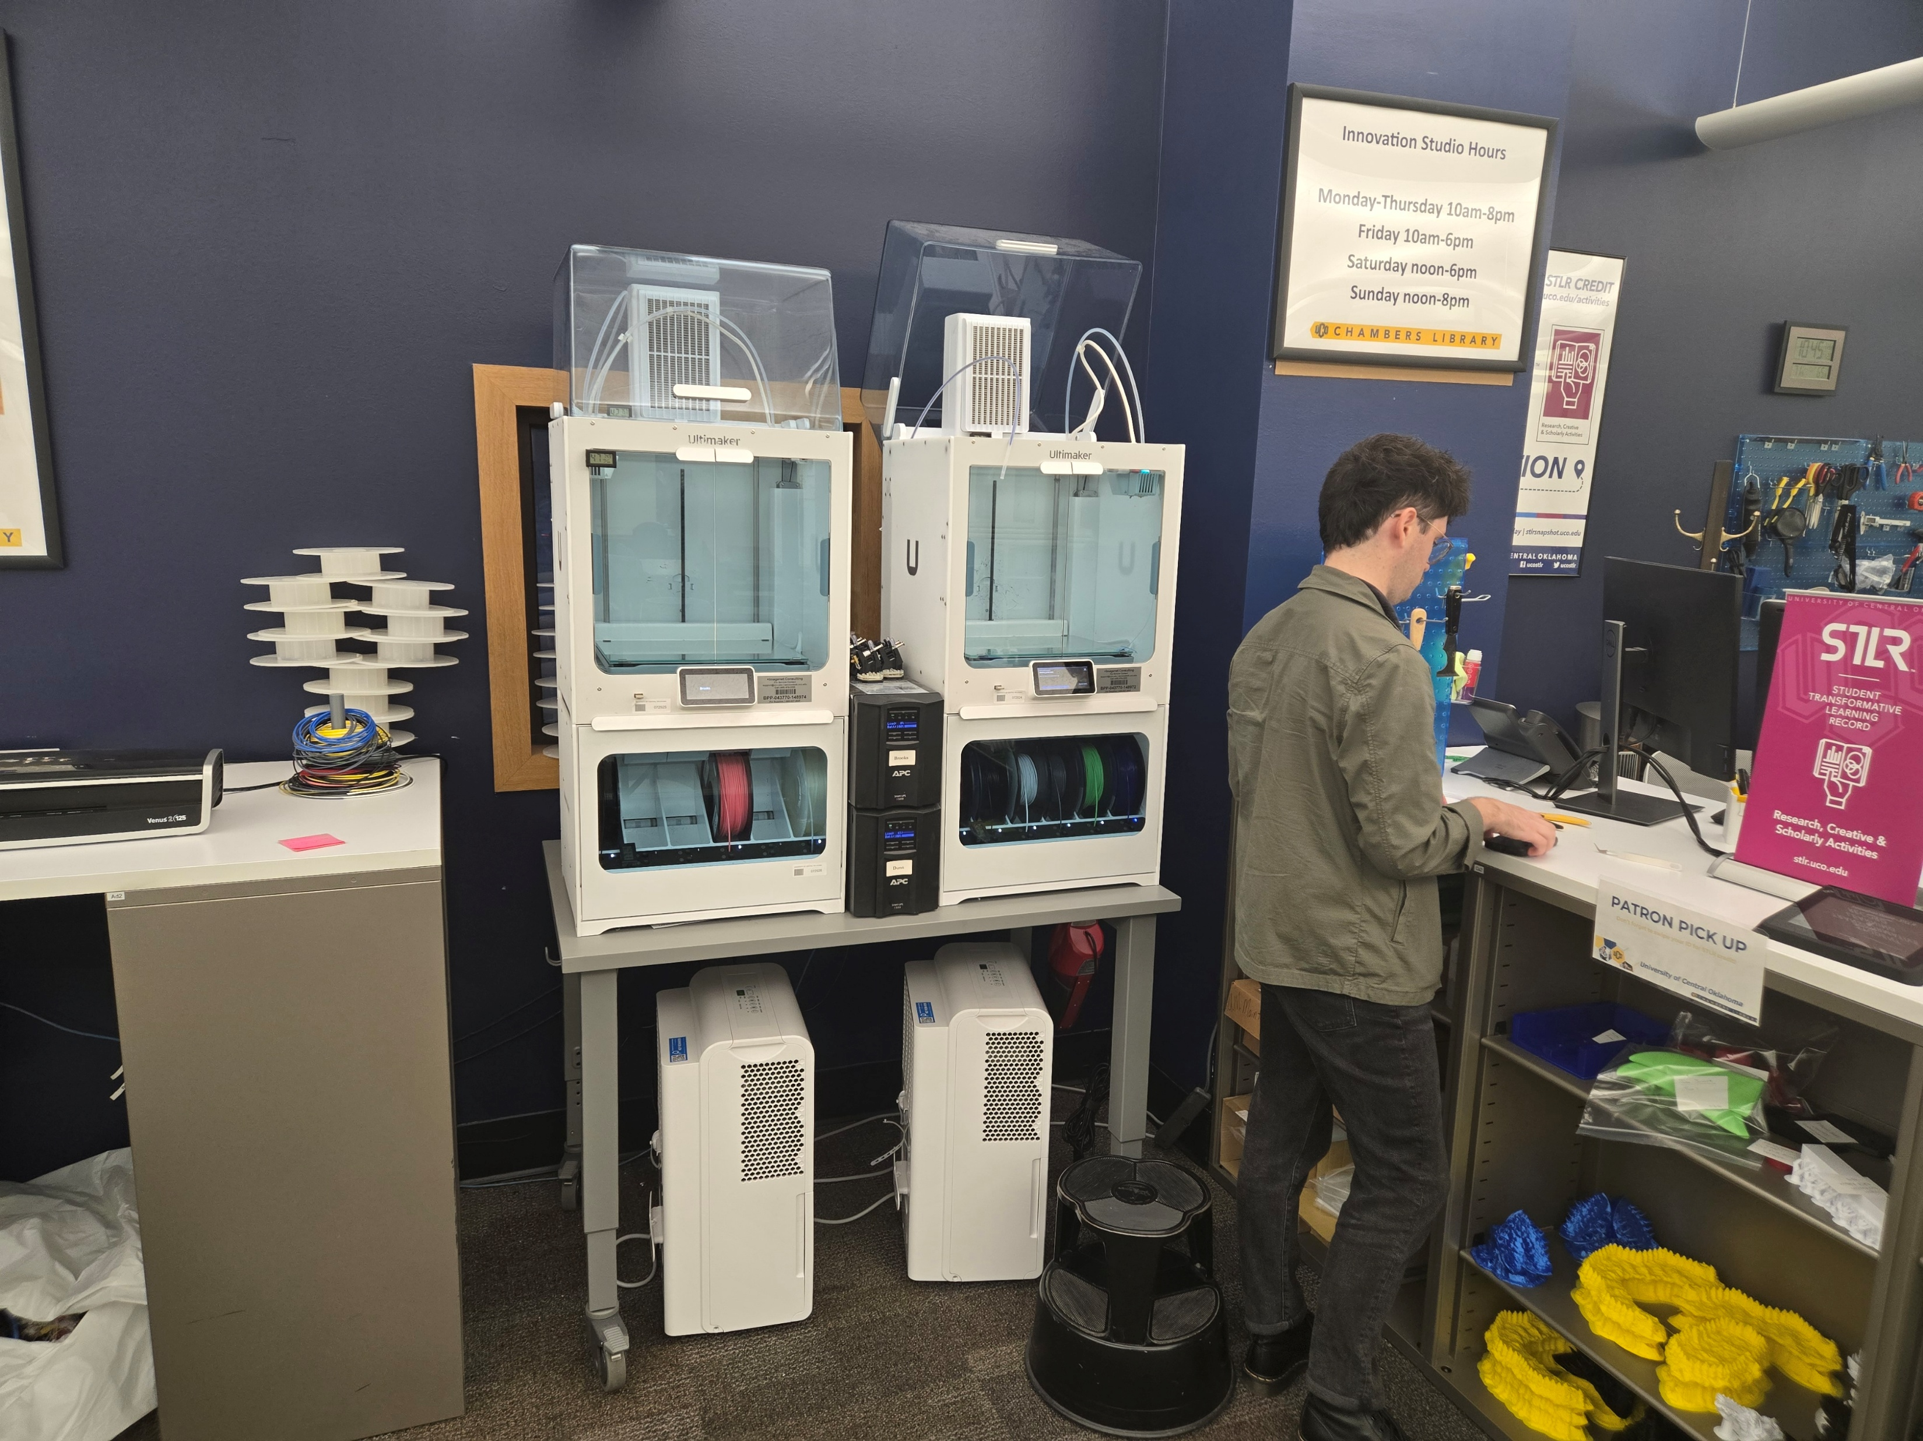
3D Printers

Slide 8
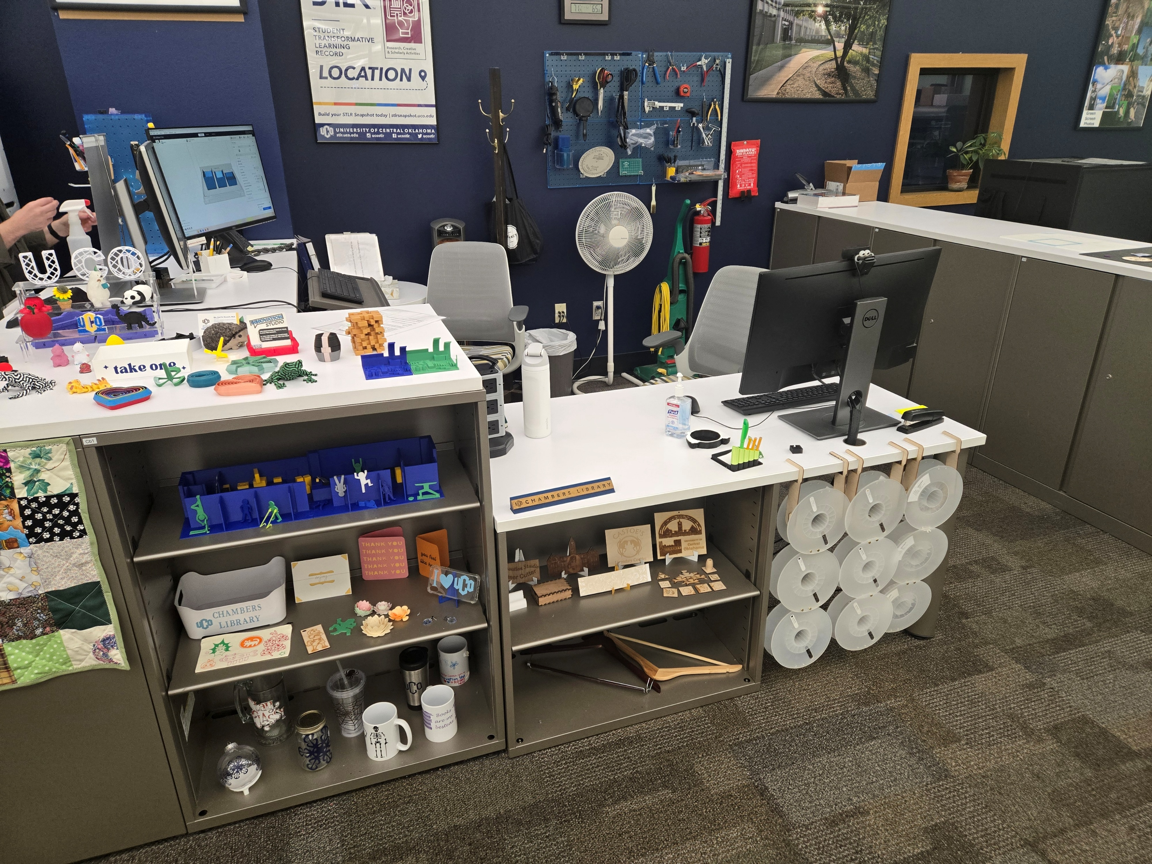
New Desk

Slide 9
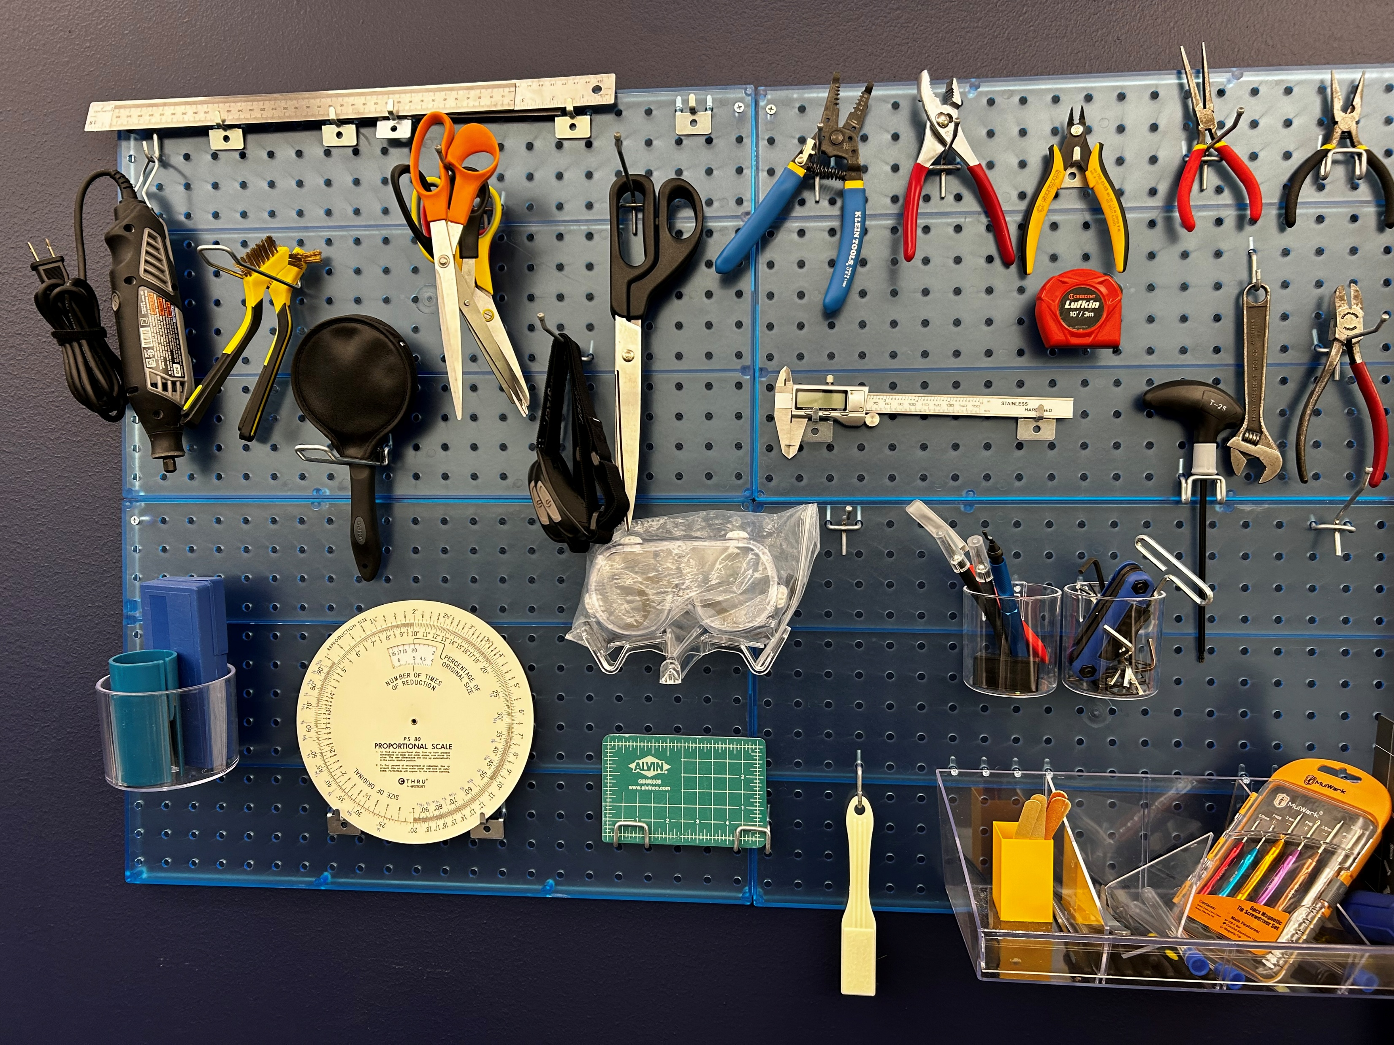

Invitation
Tool wall
Sewing machine
PowerPoint
Open houses
Info desk

Slide 10
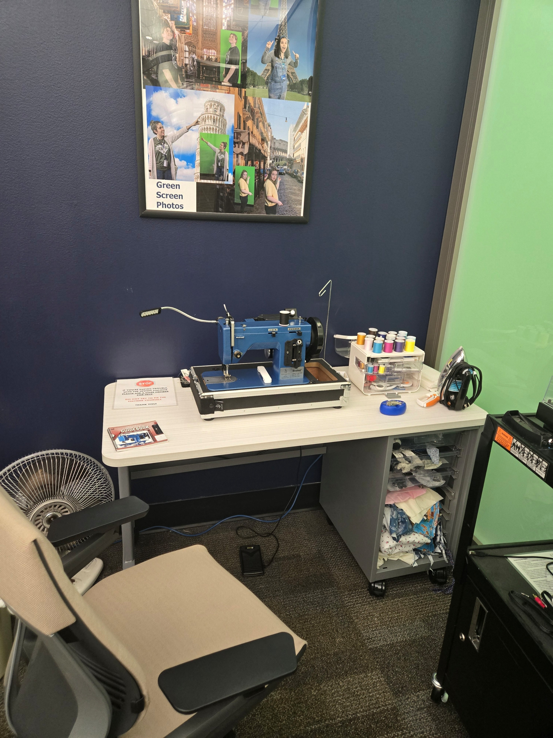
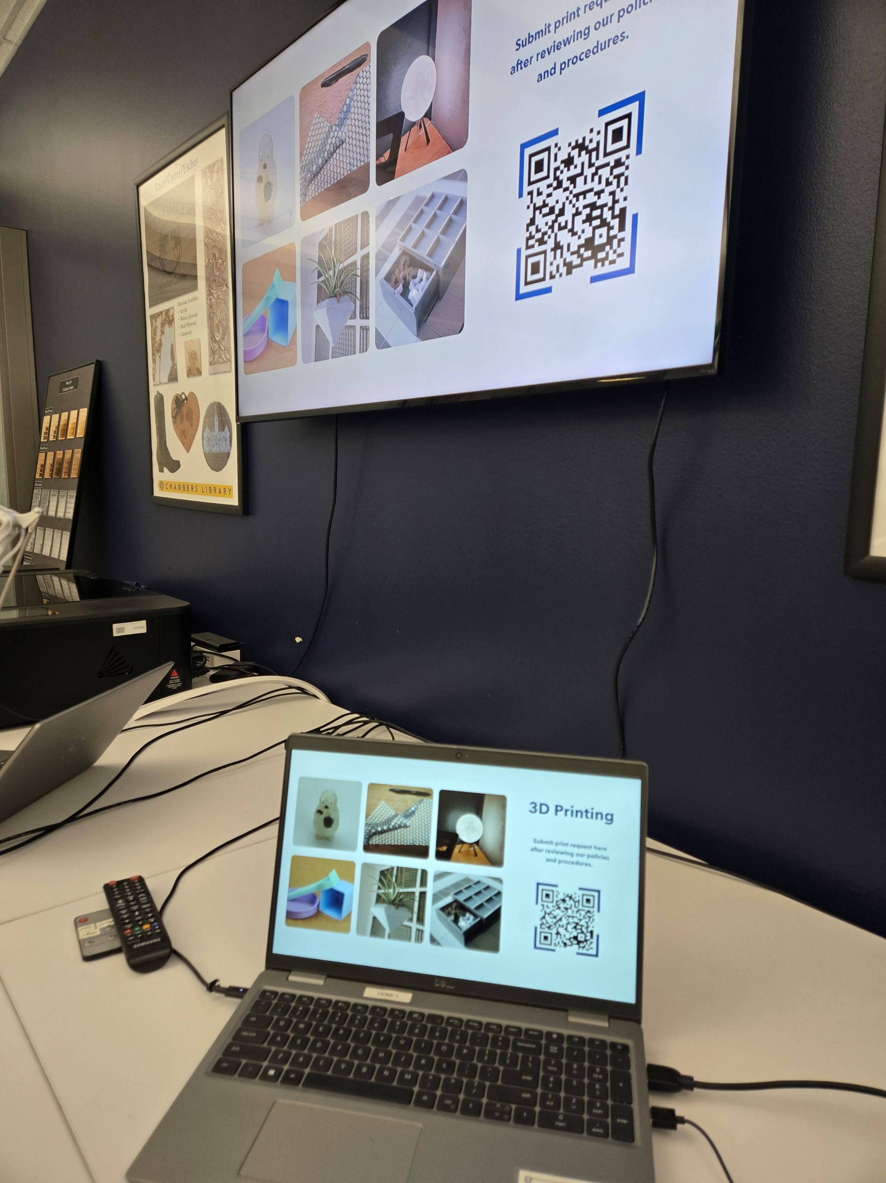
Sewing Machine and PowerPoint

Slide 11
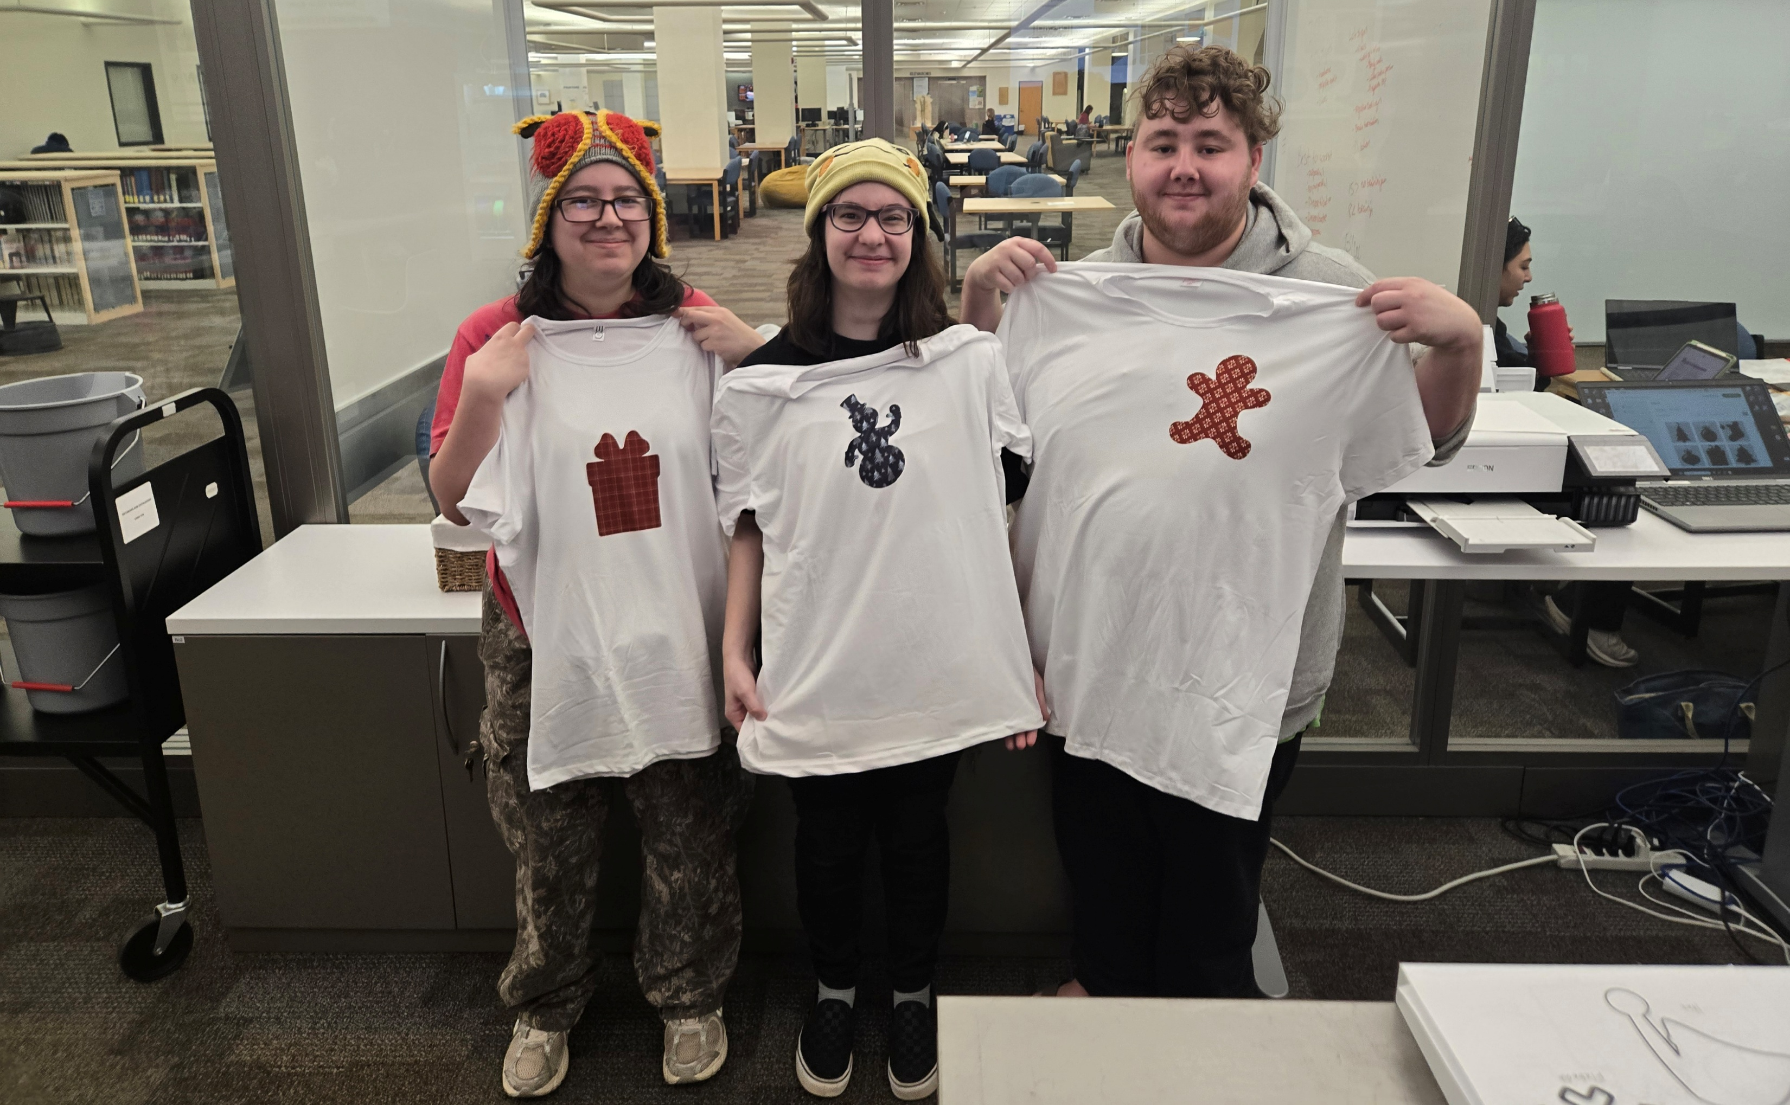
Open House

Slide 12
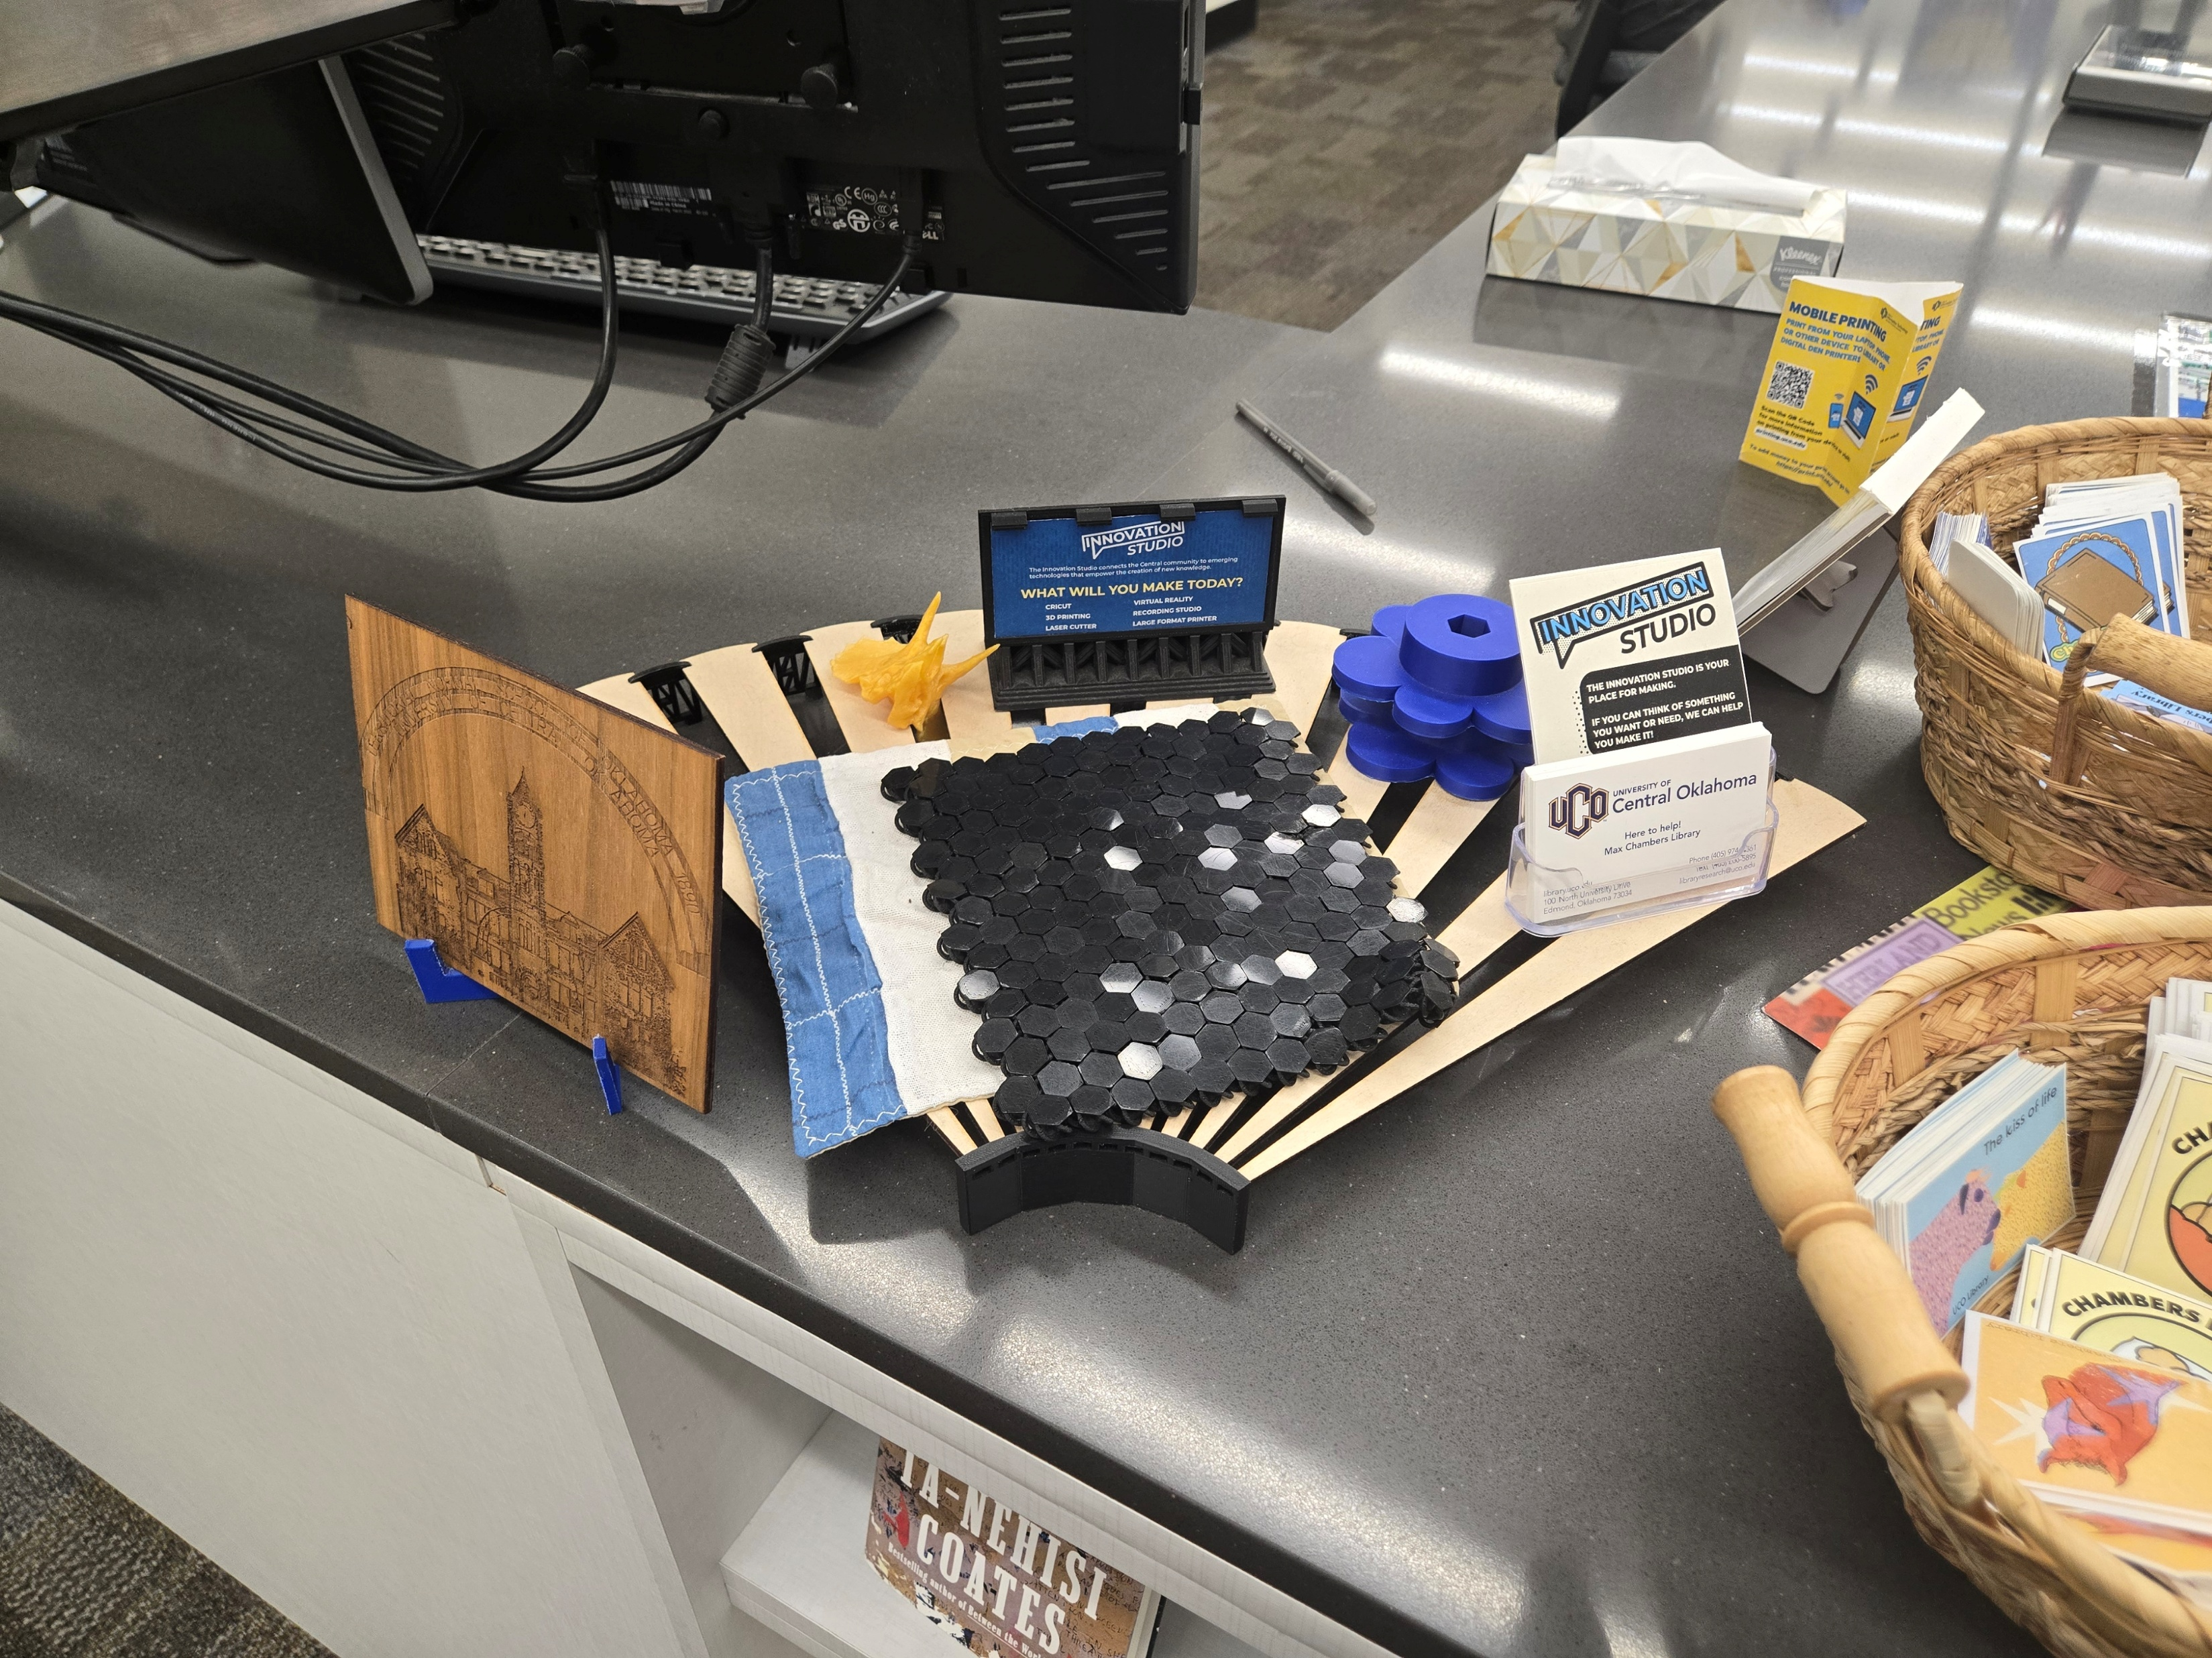
Info Desk Display

Slide 13
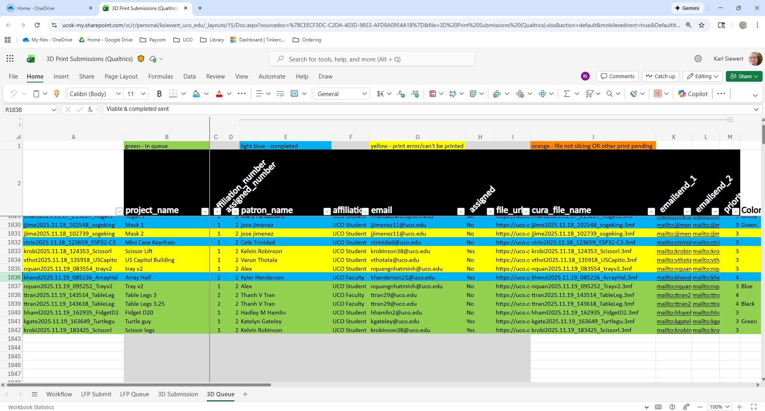
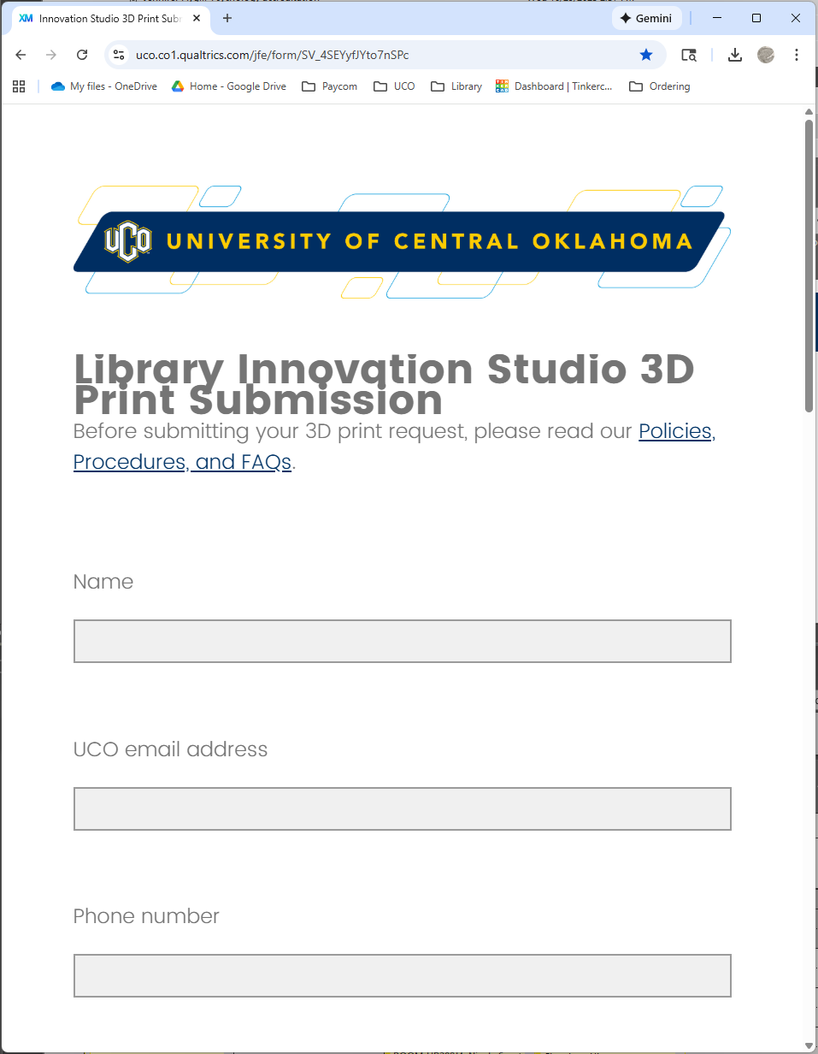
Digital
Forms
Spreadsheet

Slide 14
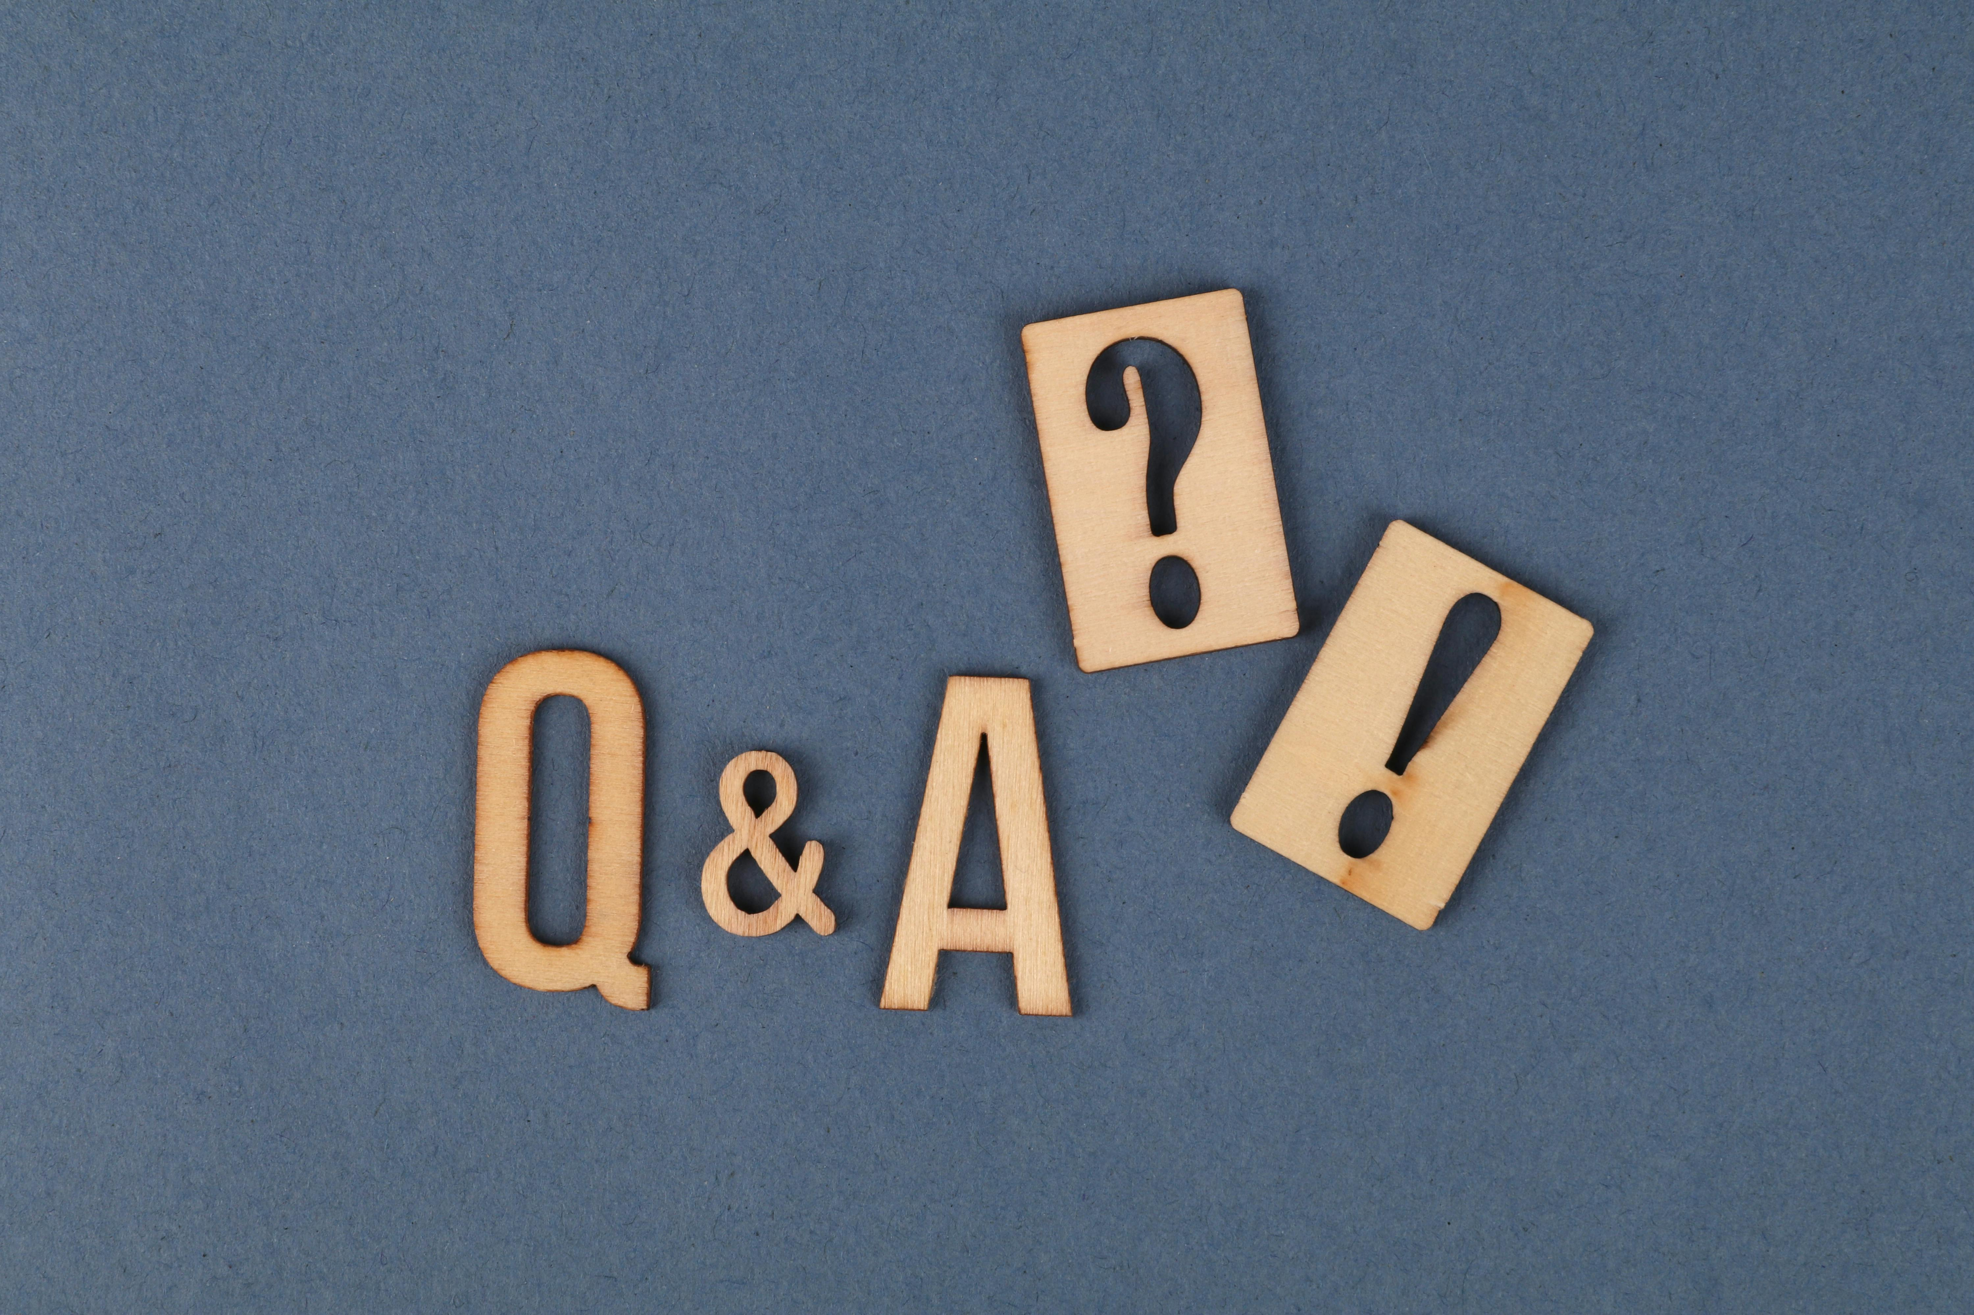
Questions?

Slide 15
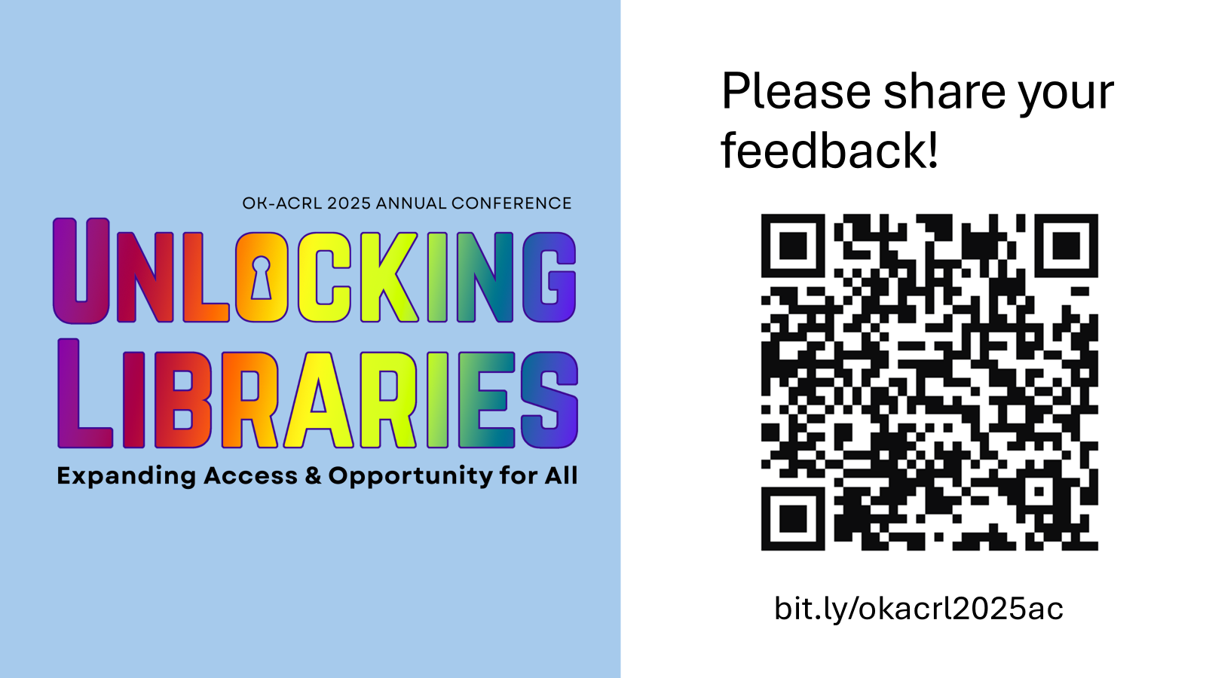
Feedback

