Slide 1
Defending the Freedom to Read:
Policies, Procedures &
Civic Engagement
Jamie LaRue <jlarue@jlarue.com>
ACRL, Stillwater OK
November 10, 2023

Slide 2
Why people censor
Personal prejudice (why I hate brussels sprouts)
  Childhood trauma
Parental panic
  4-6, 14-16 transitions
Demographic panic
  Public library as cultural mirror
The will to power and control
  Follow the money
Notes:
Brussels sprouts offend me.
“Nobody comes to the grocery store because it doesn’t have what they don’t want.” He paused. “Some people like brussels sprouts.”
Parental panic: 4-6, 14-16. End of infancy, end of childhood. Love and loss and grief. Generally short term when parents learn the library is the least of their worries, and maybe the best of their friends.
Demographic shifts: as of 2014, under the age of 5, America is majority non-white. TO some white folks, this looks like a loss of privilege and relevance. It scares them. To others–LGBTQ folks, black and brown people, it’s time to embrace the future, and reject the past. My notion is that 97% of library collections are like a mirror, looking backward on our culture. It reflects the choices of our society, much as our bodies reflect the choices of previous years. The challenges to library materials focus on the 3% of new voices. Some folks want to fend off the new voices and preserve the past. Others want to sweep away the old. Libraries are where you go to check out what’s happening the world.
Will to power: mostly, though, censorship is a heavy handed attempt to control others.

Slide 3
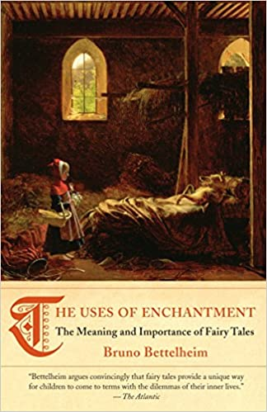
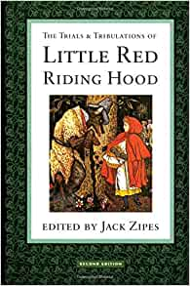
Notes:
Woods without wolves.

Slide 4

Schools
Notes:
The Beloved Bill in Virginia. Often, the complaint diminishes the book. Beloved is not about sex. It’s about rape on many levels, and roots of racism. Far deeper.

Slide 5

PEN America study
Support for intellectual freedom is declining
Support for social justice is rising
Notes:
2016 report that captured two key shifts in college student attitudes. The most diverse population in American history.
More recent reports: nuanced, both have support, but real tension between them sometimes.
Trigger warnings, professors who lose their jobs (Churchill, U of I)

Slide 6
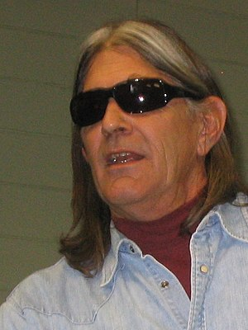
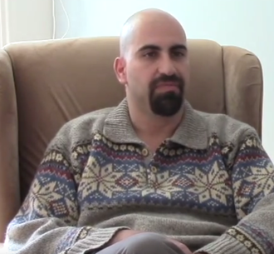

Academic freedom?
Ward Churchill, 2005 Steven Salaita, 2015 Milo Yiannapoulos, 2017
University of Colorado Boulder University of Illinois-Urbana University of California Berkeley
Notes:
Lest you think the issue doesn’t affect the academy.

Slide 7
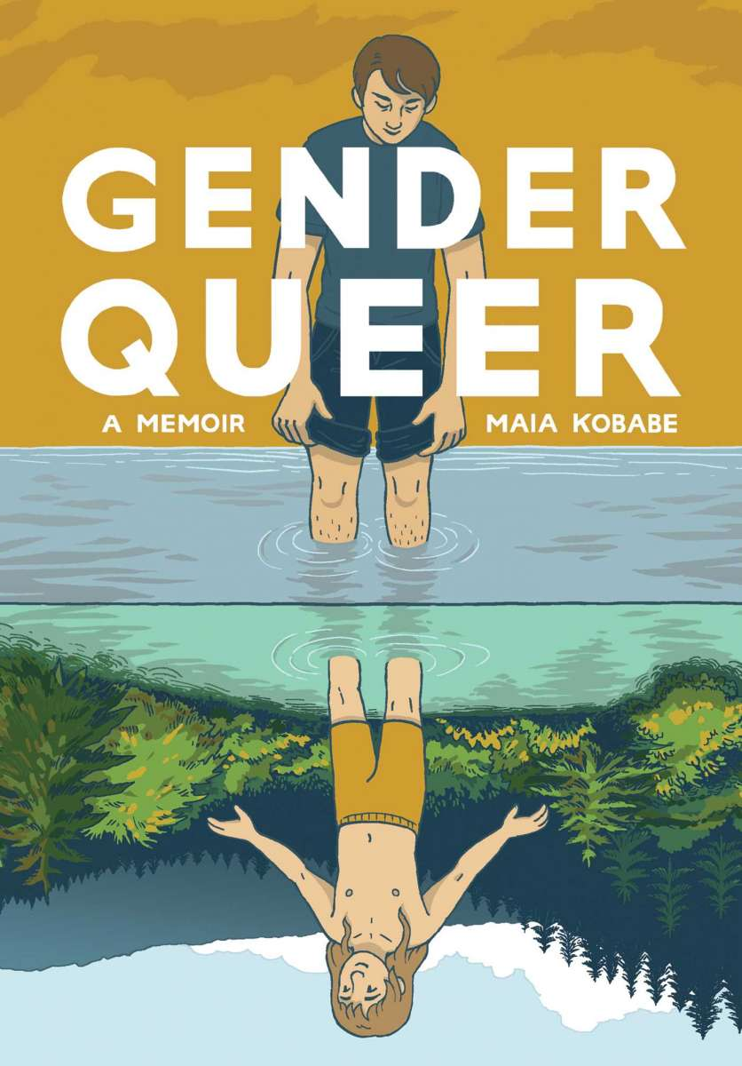
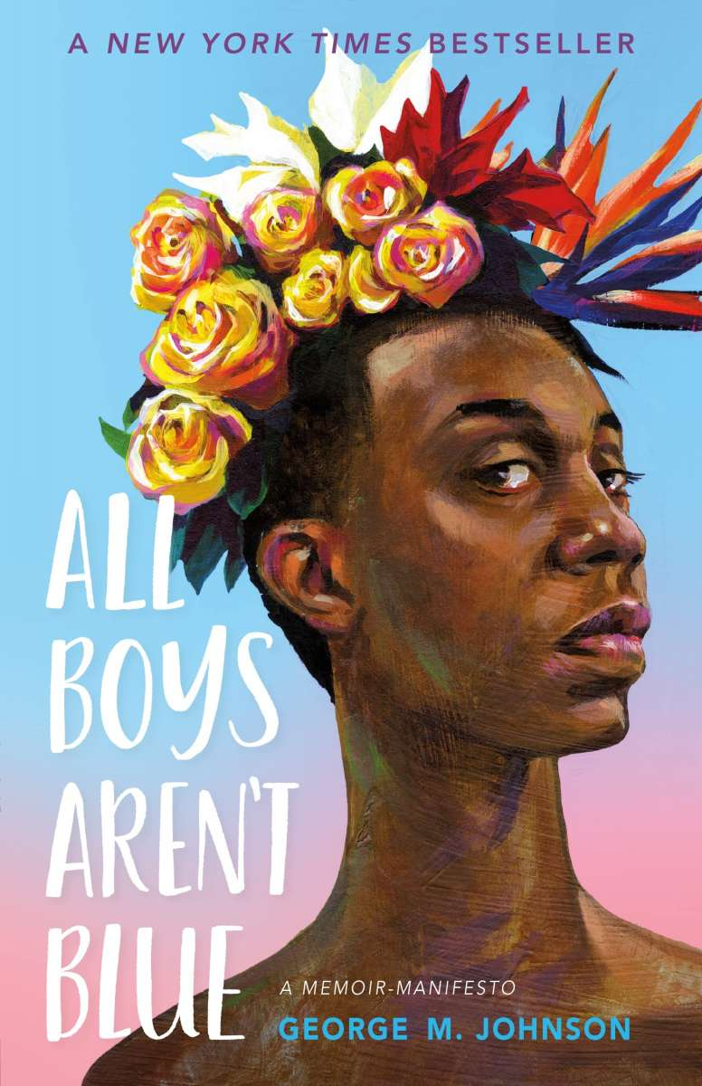
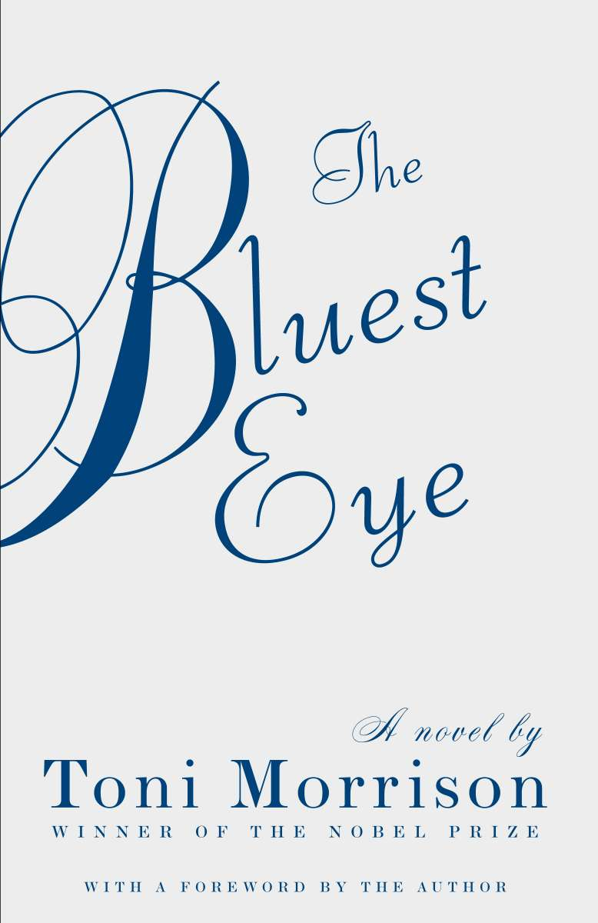
2022 Top Challenged Titles (3 of 13)
Notes:
Demographic panic. Challenges to pride displays. 3%. Challenges from two sides

Slide 8
The rhetoric of rage
(and sex)

Slide 9
pornographer
groomer
pedophile
obscene
communist
harmful to minors
human-trafficker

Slide 10
2021 and Texas: the Surge begins
October 25, 2021: Rep. Matt Krause’s letter to the Texas Education Agency asking if any of the schools in the state have the books listed on a 16 page spreadsheet, as well as how much schools had spent on these books.
House Bill 3979, anti-CRT bill that bans teaching any materials that could mean “an individual should feel discomfort, guilt, anguish, or any other form of psychological distress on account of the individual’s race or sex.”
https://bookriot.com/texas-book-ban-list/
Notes:
When you can’t bully your local institution into removing materials, you turn to the power of the state. And that would be official censorship, the state-sponsored suppression of a point of view someone doesn’t like. Beloved by Toni Morrison. But what about the discomfort of Black children reading about the Jim Crow era or Native Americans reding about Manifest Destiny in the American west? Who are we protecting, and from what? This is cancel culture: forbidding topics because of how they make people feel.

Slide 11
Florida
2021 - Florida Parental Rights in Education Act /Don’t Say Gay
2021 - Stop the Wrongs to Our Kids and Employees (W.O.K.E.) Act
2023 - Disney!
Moms for Liberty and ties to the Florida GOP
Notes:
Next up was Florida, long a hotbed for right wing legislation, stepping up its game. And maybe some political posturing for a presidential candidate.

Slide 12
Blaming the librarian (and teacher)
Oklahoma: 2022 . School employees and public library staffers can be fined up to $20,000 or serve up to 10 years in prison for facilitating “indecent exposure to obscene material or child pornography.”
Texas (again) 2023: SB13 San Antonio public school pulls 400 books. Llano public pulls 12 LGBTQ titles, restores, considers closing library altogether.
Monitoring State Legislation That Criminalizes Libraries, Schools, and Museums 2023 (Everylibrary.org)
  Alabama, Arkansas, Georgia, Iowa, Idaho, Indiana, Kansas, Maine, Minnesota, Mississippi, Montana, North Dakota, Nebraska, New Hampshire, Oklahoma, Pennsylvania, South Dakota, Tennessee, Wisconsin, West Virginia, Wyoming
Notes:
Not just banning ideas, but seeking to punish the people who provide access to the ideas.
https://www.everylibrary.org/state_obscenity_laws_23-24
Used to be that wacky legislation was introduced for show – but now they’re actually getting passed by one house, and maybe both.

Slide 13
2021 (and continuing) Surge
Target: school libraries, then public
Strategy: read naughty bits at public meetings - but always LGBTQ and race
Context free–or a reduction of theme (and infantilization of young adults)
Not one, but 20-30 titles at a time
Threats to board, superintendents, principals, teachers, librarians - the attempt to criminalize speech
Parental “notification” and parental rights
Best defense - still policies
Why now? From cancel culture to midterm elections ⇒ and beyond!
$$$

Slide 14
Responses

Slide 15
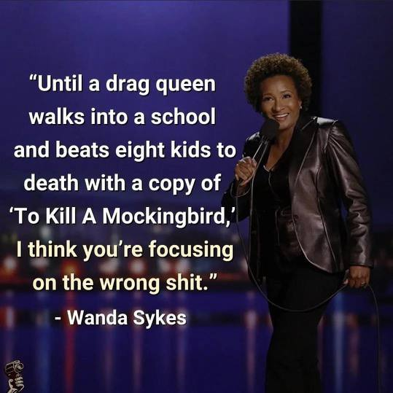
Notes:
List of

Slide 16
Concerned?
About the leading causes of death of minors in the US. So are we!
  #1 - Firearms (a little over 4,000 annually since 2020)
  Nowhere on the list: library books
About the sexual abuse and exploitation of children (reference). Us, too!
  Studies suggest that up to one in five girls and one in 20 boys will be sexually abused before they are 18 years old. More than 90 percent of child sexual abuse victims know their abuser.
  Most child abuse occurs within the family.
  Catholic clergy: abuse and coverup
  Southern Baptist Church, abuse and coverup
  Not participating in any institutional systemic abuse or coverup: libraries or the ALA
Notes:
Perfectly appropriate to be concerned about these issues. But you can’t help but feel that sometimes libraries are attacked to divert attention from the actual causes, the real threats to children. My conclusion: our children are NOT reading too much.

Slide 17
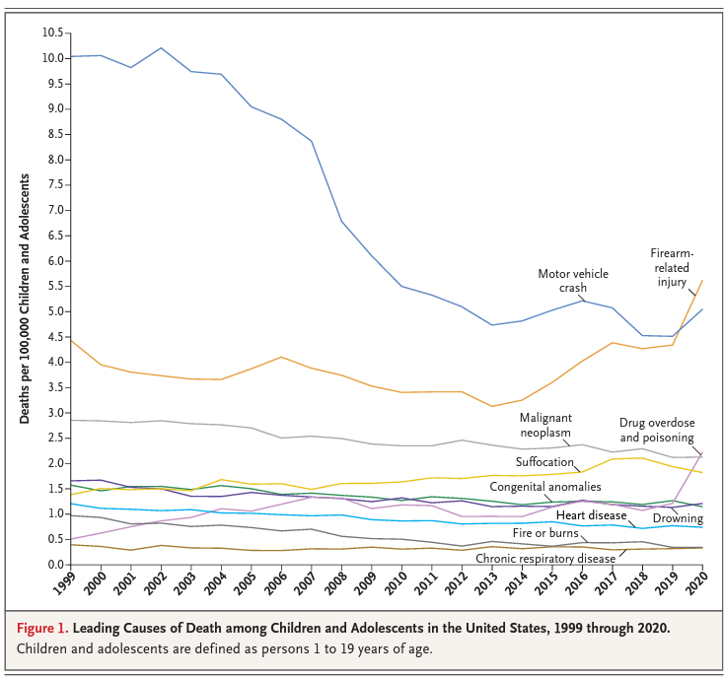
CDC. https://www.nejm.org/doi/pdf/10.1056/NEJMc2201761
Notes:
CDC. https://www.nejm.org/doi/pdf/10.1056/NEJMc2201761

Slide 18
Policies
Library Bill of Rights (and interpretations)
Freedom to Read statement (now under ALA review)
Freedom to View (movies)
Collection Development Policy / Programs & Exhibits
Request for Reconsideration
  For all library resources
  Must be a resident of the service area
  Some say: must have examined entire item
  Committee review and recommendation, Director decision, appeal
  Scope of appeal: overturn, or just examine for compliance to policy
  Limit on future reconsiderations
Public comment (next slide)
Notes:
History of LBoR: Hitler invades Poland and attacks Jews. Putin attacks Ukraine and attacks “Nazis.” But he doesn’t mean Nazis, he means anyone who doesn’t agree with him. A rising tide of authoritarianism around the world and in the US. Just like 1939, when intellectual freedom became a core value of our profession. And is still, maybe more urgently needed than ever.

Slide 19
Public comment
Name and address (Gunnison CO caution)
3 minutes (or some time - but for all speakers)
Total public comment time (may flex)
Can’t give time to someone else (may suggest spokesperson)
Board doesn’t engage in conversation (clarifying questions ok)
No action taken during meeting
No items or services pulled while reviewed
Wellington CO result
Notes:
Gunnison: woman complains about Gender Queer at County Commissioner meeting, and at school board meeting. Expectation of privacy?
Fills out a Request for Reconsideration. The local newspaper requests it under Colorado’s Open Records Act, and the library provides it.
Then the woman sued the library for violating Colorado’s patron privacy law by providing her name and address (on the form).
When the local newspaper requested a copy of ALL current requests for reconsideration, the library sought a judge’s opinion, who said that a request for reconsideration was a “library use.” So although the complaint could be shared, the name and address should have been redacted.
The newspaper then brought suit against the library, saying that the attempt to prevent other people from using the library shouldn’t be considered a library use.
And of course, the original woman, after publicly speaking at county and school meeting, had no expectation of privacy.
But I see two sides: transgender person objecting to a book targeted trans people might not want to be outed, but has a right to complain. My current approach: I tell the patron that if they appeal a judgment, I can assure their privacy if they do it in writing, but not if they do it in public. Their choice.
But in public, having someone give their name and place of residence establishes whether or not they are in fact a constituent.
The key point: don’t avoid the controversy. The community dialog is really the only way to put an issue to rest–at least until the legislature takes it up, or there’s some kind of board replacement strategy.

Slide 20
A couple of approaches
What some folks want
Public drama and brouhaha
A shot of adrenaline to the amygdala
Viral violence
Money! Fundraising appeals
What they deserve
Thoughtful attention
Measured responses
Pre-public comment follow-up
Reaffirmation of policy
Meaningful conversation
Who are we? Community identity
Keep cool and carry on. Follow your policies.
Notes:
If time, some library stories….

Slide 21
Why people censor
Personal prejudice (why I hate brussels sprouts)
  Childhood trauma
Parental panic
  4-6, 14-16 transitions
Demographic shifts / Social Justice => 3%
  Public library as cultural mirror
The will to power and control
  Follow the money
Notes:
Brussels sprouts offend me.
“Nobody comes to the grocery store because it doesn’t have what they don’t want.” He paused. “Some people like brussels sprouts.”
Parental panic: 4-6, 14-16. End of infancy, end of childhood. Love and loss and grief. Generally short term when parents learn the library is the least of their worries, and maybe the best of their friends.
Demographic shifts: as of 2014, under the age of 5, America is majority non-white. TO some white folks, this looks like a loss of privilege and relevance. It scares them. To others–LGBTQ folks, black and brown people, it’s time to embrace the future, and reject the past. My notion is that 97% of library collections are like a mirror, looking backward on our culture. It reflects the choices of our society, much as our bodies reflect the choices of previous years. The challenges to library materials focus on the 3% of new voices. Some folks want to fend off the new voices and preserve the past. Others want to sweep away the old. Libraries are where you go to check out what’s happening the world.
Will to power: mostly, though, censorship is a heavy handed attempt to control others.

Slide 22
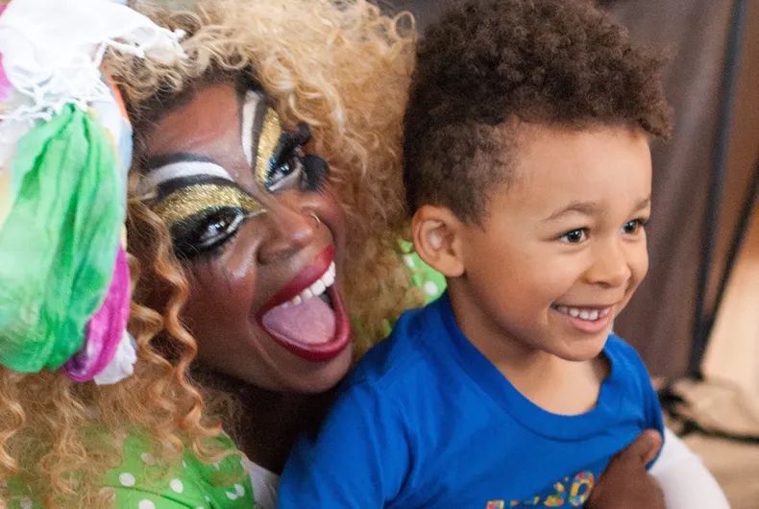
Drag Queen Story Times
the consequences of appeasement
Notes:
But let me give you some real life examples from actual challenges.
First, Appeasement doesn’t work.

Slide 23
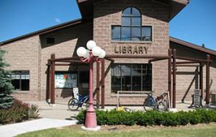

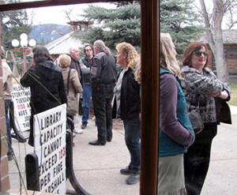
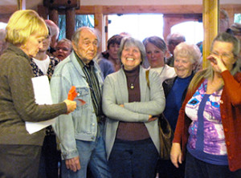
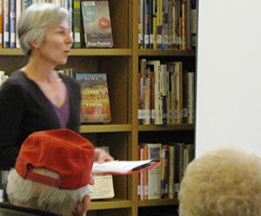
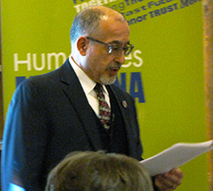
Samir
Bitar
Wendy Campbell
Notes:
Librarian as hero, library as a roomful of grownups. Confronting the issues of the day with grace, with clarity, and with respect. The interest of our community in meaningful conversations.

Slide 24

Notes:
The story of a Black woman with a biracial child. She challenged a book with a racist stereotype. Denied the removal, she was invited to join the board, became president, embraced the value of IF, and succeeded in getting the PUBLISHER to change the book.

Slide 25
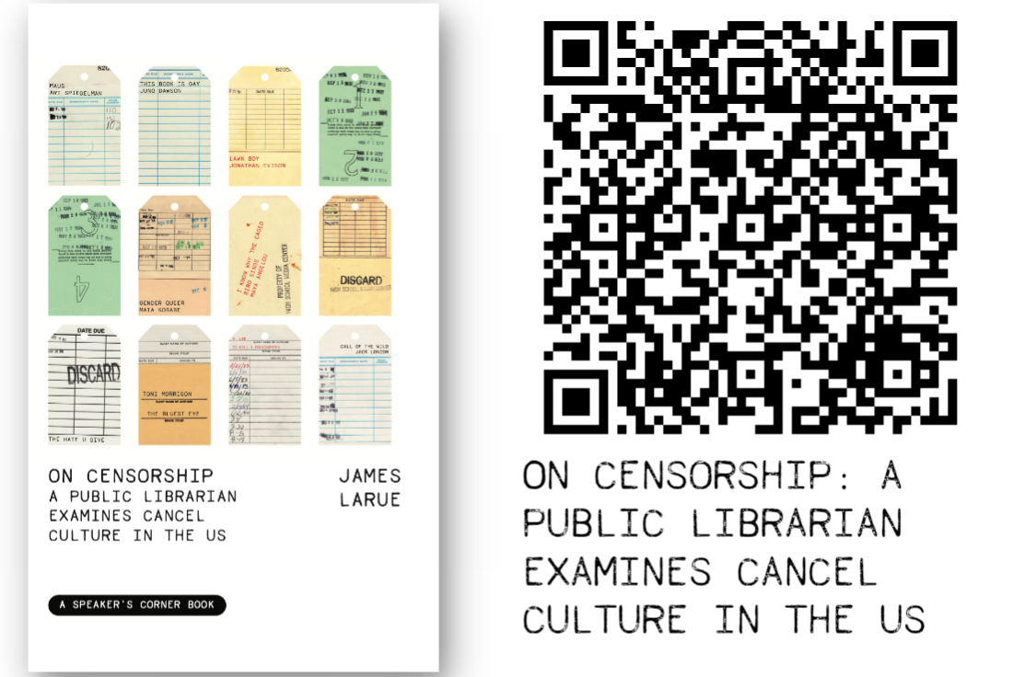
Notes:
https://www.amazon.com/Censorship-Librarian-Examines-Culture-Speakers/dp/1682753476
Out Sept 19, 2023.

Slide 26
Questions

Slide 27
jlarue@jlarue.com

