Slide 1




A Case Study for
HPC Workforce Development and
Workforce
Meta-Development
Henry Neeman
Director, OU Supercomputing Center for Education & Research (OSCER)
Assistant Vice President, Information Technology – Research Strategy Advisor
Associate Professor, College of Engineering
Adjunct Associate Professor, School of Computer Science
University of Oklahoma
HP-CAST 2015, Fri Nov 13 2015

Slide 2
HPC
Workforce Development is Hard

Slide 3
Why is HPC Workforce Dev Hard?
At the national scale, no academic discipline wants to teach HPC:
  Obvious home: Computer Science.
  Most Computer Science faculty aren’t interested in HPC.
    From their perspective, research about HPC is a tapped well.
    CS cares about big-O, but HPC is about the constant.
  Most CS departments don’t want to teach service courses primarily for the benefit of other disciplines.

Slide 4
Why is CSE Workforce Dev Hard?
At the national scale, no academic discipline wants to teach Computational Science & Engineering (CSE).
  At most institutions, if you do CSE in a CS department, your CS colleagues don’t know how to judge your papers that are published in non-CS venues.
  At most institutions, if you do CSE in a STEM domain department (e.g., Chemistry, Industrial Engineering), your department colleagues don’t know how to judge your papers that are published in journals outside your STEM domain discipline.
  So, at most institutions, you probably won’t get tenure.
  In which case, you won’t develop the current workforce, let alone the next generation of workforce developers (faculty).

Slide 5
OneOklahoma Cyberinfrastructure Initiative
(OneOCII)

Slide 6

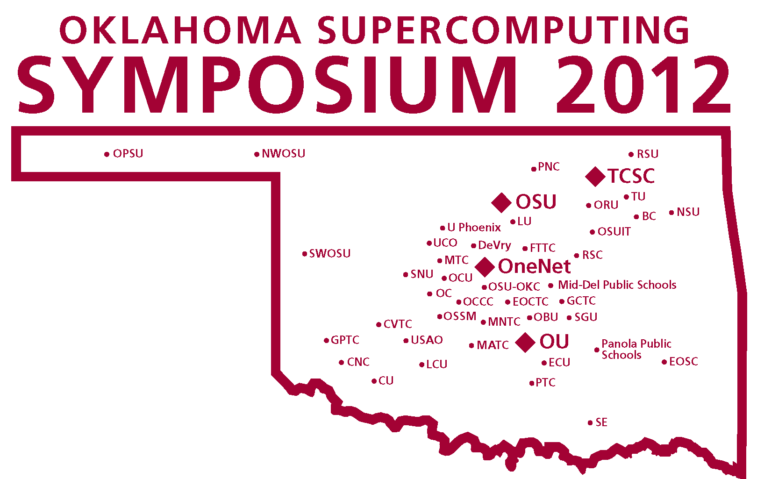
OneOK Cyberinfrastructure Initiative
All academic institutions in Oklahoma are eligible to sign up for free use of OU’s and OSU’s centrally-owned Cyberinfrastructure resources.
Other kinds of institutions (government, non-governmental) are eligible to use, though not necessarily for free.
Everyone can participate in our CI education initiative.
The Oklahoma Supercomputing Symposium, our annual conference, continues to be offered to all.
Triggered by OK’s NSF EPSCoR Research Infrastructure Improvement Track-1 2008-13.

Slide 7
OneOCII Goals
Reach institutions outside the mainstream of advanced computing.
Serve every higher education institution in Oklahoma that has relevant curricula.
Educate Oklahomans about advanced computing.
Attract underrepresented populations and institution types into advanced computing.

Slide 8

OneOCII Service Methodologies Part 1
Access (A): to supercomputers and related technologies (20 OK academic institutions to date).
Dissemination (D): Oklahoma Supercomputing Symposium – annual advanced computing conference has reached 112 academic institutions, 143 commercial, 36 government, 20 nongovernmental (25 OK academic institutions to date).
Education (E): “Supercomputing in Plain English” (SiPE) workshop series: 11 talks about advanced computing, taught with stories, analogies and play rather than deep technical jargon. Have reached 362 institutions (academic, government, industry, nonprofit) in 51 US states and territories and 17 other countries (16 OK academic institutions to date).

Slide 9
OneOCII Service Methodologies Part 2
Faculty/Staff Development (F): Workshops held at OU and OSU on advanced computing and computational science topics, sponsored by the National Computational Science Institute, the SC supercomputing conference series, the Linux Clusters Institute, the Virtual School for Computational Science & Engineering. Oklahoma is the only state to have hosted multiple events sponsored by each of these (18 OK academic to date).
Outreach (O): “Supercomputing in Plain English” (SiPE) overview talk (25 OK academic to date).
Proposal Support (P): Letters of commitment for access to OneOCII resources; collaborations with OneOCII lead institutions (4 OK academic, 1 nongovernmental).

Slide 10
OneOCII Service Methodologies Part 3
Technology (T): Got or helped get technology (e.g., network upgrade, mini-supercomputer, hi def video camera for telepresence) for that institution (14 OK academic to date).
Workforce Development (W) – (39 OK academic)
  Oklahoma Information Technology Mentorship Program (OITMP)
  “A Day in the Life of an IT Professional” presentations to courses across the full spectrum of higher education.
  Job shadowing opportunities and direct mentoring of individual students.
  Institution Types: high schools, career techs, community colleges, regional universities, PhD-granting universities.
Special effort to reach underrepresented populations:
underrepresented minorities, non-PhD-granting, rural

Slide 11
OneOCII Institution Profile
To date, OneOCII has served 103 Oklahoma institutions, agencies and organizations:
55 OK academic
48 OK non-academic

Slide 12
OneOklahoma Cyberinfrastructure Initiative
TSC
UCO
So far:

Slide 13
Supercomputing in Plain English
FREE and OPEN TO ALL
Provided every other spring (coming Spring 2017)
Available LIVE via videoconferencing
Topics
  Overview: What the Heck is Supercomputing?
  The Tyranny of the Storage Hierarchy
  Instruction Level Parallelism
  Stupid Compiler Tricks
  Shared Memory Multithreading
  Distributed Multiprocessing
  Application Types and Parallel Paradigms
  Multicore Madness
  High Throughput Computing
  GPGPU: Number Crunching in Your Graphics Card
  Grab Bag: Scientific Libraries, I/O Libraries, Visualization
http://www.oscer.ou.edu/education/

Slide 14
SiPE Participants
362 institutions, firms, agencies and organizations in 48 US states, 3 US territories and 10 other countries
  Academic: 251 institutions in 51 US states & territories and 6 other countries
    69 institutions in 23 EPSCoR jurisdictions
      16 institutions in Oklahoma
  Industry: 49 firms in the US and 4 other countries
  Government: 44 – US federal and state plus 7 other countries
  Non-Governmental: 18 (US and 1 other country)
Missing US states & territories
  EPSCoR states: RI, VT
  EPSCoR territories: Guam (no PhD-granting institution)
  Other territories: American Samoa, Northern Marianas Islands

Slide 15
More States Should Do This
More states should do intra-state collaboration for Cyberinfrastructure.
Some states already do similar things, for example:
  Florida
  Louisiana
  New York
  Ohio
We want to help other states develop their own.
We’re already scheduled to work with three other states on this in the coming 6 months.

Slide 16
ACI-REF

Slide 17
What is an ACI-REF?
Advanced Cyberinfrastructure - Research & Education Facilitator
Expertise in CI and Computational Science & Engineering
Work with research teams to get them productive and move forward the computational aspects of their research.

Slide 18
Clemson-Led ACI-REF Project
Original Proposal
  “The Condo of Condos”
  13 institutions, 4 years, $35.7M
  Included both people (ACI-REFs) and hardware (100GE)
Funded Grant
  “Advanced Cyberinfrastructure - Research & Education Facilitators”
  6 institutions, 2 years, $5.3M
  No hardware

Slide 19
Phase 1: Clemson-led ACI-REF
Phase 1 institutions
  Clemson U (SC)
  Harvard U (MA)
  U Hawaii
  U Southern California
  U Utah
  U Wisconsin Madison
    All except Harvard are 2012-13 CC-NIE awardees.
    Only Clemson U and U Hawaii are EPSCoR.
Of 2012-13 CC-NIE awards:
  23% went to institutions in EPSCoR jurisdictions;
  46% of EPSCoR jurisdictions got an award (including OK).
  (Not counting TN and UT, which have graduated EPSCoR.)

Slide 20
Phase 2: Find Other Funding
Phase 2 institutions
  Arizona State U
  Emory U (GA)
  Ohio Supercomputer Center
  Stanford U (CA)
  SSERCA (FL)
  U Oklahoma
  U Washington
OU is the only institution that is all of:
  EPSCoR
  2012-13 CC-NIE awardee
  ACI-REF Phase 2

Slide 21
OU’s ACI-REF Project

Slide 22
OU’s NSF CC*IIE Grant
“A Model for Advanced Cyberinfrastructure Research and Education Facilitators”
Grant no. ACI-1440783
NSF CC*IIE program
9/15/2014 - 9/14/2016
$400K
Totally separate from the Clemson-led ACI-REF grant

Slide 23
OU’s ACI-REF Objectives
Data-Intensive Research Facilitation: Via Software Defined Networking (SDN) across OFFN, facilitate end-to-end management, by researchers, of high bandwidth/high performance data flows through a distributed hierarchy of open standards tools, providing researchers with a new layer of transparency into network transport at OU, among OneOCII institutions, and with ACI-REF members.
Oklahoma ACI-REF project: Lead and facilitate adoption of the ACI-REF approach across Oklahoma, leveraging extant and emerging capabilities within OneOCII.

Slide 24
OU’s ACI-REF Objectives
National training regime: Provide a “virtual residency” program for Campus CI Engineers and other ACI-REFs, open to not only CC*IIE awardees and ACI-REF members but any institution that needs.
Research Experiences for Undergraduates (REU) Sites/Supplements: Foster undergraduate research at OU via a culture of integrating REU sites and supplements into Science, Technology, Engineering & Mathematics (STEM) research, including by all research themes on this proposed CC*IIE project.

Slide 25
ACI-REF Role
Research facilitation: especially in the context of SDN
Researcher training
Science DMZ administration
Statewide participation: facilitating research across the OneOklahoma Cyberinfrastructure Initiative (OneOCII)
HPC operations

Slide 26
ACI-REF
Virtual Residency

Slide 27
ACI-REF Virtual Residency: Why?
ACI-REFs have strong experience within their discipline (often non-CS).
Haven’t been faculty.
Sometimes little or no research experience (especially for SDN-focused ACI-REFs).
Even if strong research background, little or no experience with research outside their own discipline.
No local, regional or national programs to teach people how to be an ACI-REF.

Slide 28
National Level of Interest
Proposal
  Polled CC-NIE awardees, MRI CI awardees, Minority Serving Institutions.
  Interest expressed from 33 institutions in 23 states & territories expressed interest, including 3 MSIs and 19 institutions in 13 EPSCoR jurisdictions, and 7 non-PhD-granting institutions.
Applications: over 60 from 49 institutions in over 30 states and territories.
Participants: 50 total from 39 institutions in 26 states and territories (28 onsite and 22 offsite via videoconferencing), including 21 institutions in 12 EPSCoR jurisdictions, 5 Minority Serving Institutions, and 5 non-PhD-granting institutions.

Slide 29
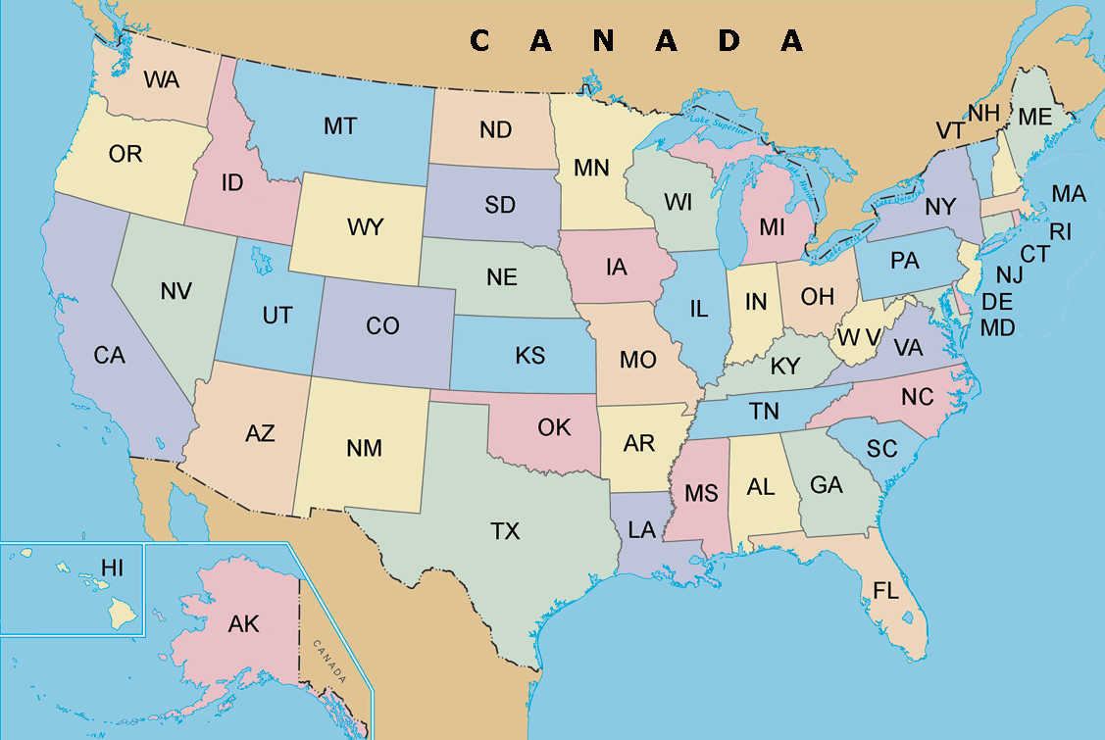
Virtual Residency Institutions

Slide 30
ACI-REF Workshop Agenda
SUNDAY (evening pizza party)
  Welcome and virtual residency overview
  Introduction to Research Cyberinfrastructure consulting
  How to Give a CI Tour
MONDAY
  Early AM: Effective Communication: How to Talk to Researchers about Their Research
  Computational and Data-enabled Science & Engineering (CDS&E) Track
    Mid AM: Deploying Community Codes
    Early PM: Real user presents their CDS&E research
  SCIENCE DMZ Track
    Mid AM: OpenFlow - Lecture
    Early PM: OpenFlow - Lab
  Mid PM: CI User Support
TUESDAY
  Very Early AM: Project Guidelines
  Early AM: Faculty: Tenure, Promotion, Reward System
  CDS&E Track
    Mid AM: Benchmarking & Tuning
    Early PM: Real users present CDS&E research
    Mid PM: Real users: CI consulting practicum (“speed dating”)
  SCIENCE DMZ Track
    Mid AM: Exploring Open Daylight - Lecture
    Early PM: Exploring Open Daylight - Lab
    Mid PM: Real users' high bandwidth research
WEDNESDAY
  Early AM: Using Videoconferencing and Collaboration Technologies for Consulting
  Mid AM: Writing Grant Proposals
  PM: BREAK (free time)

Slide 31
ACI-REF Workshop Agenda
THURSDAY
  Early AM: The Shifting Landscape of CI Funding Opportunities
  CDS&E Track
    Mid AM: Finding and Provisioning Remote Resources (XSEDE, OSG)
    Early PM: Real users present CDS&E research (“speed dating”)
    Mid PM: Catch-up on unfinished talks
  SCIENCE DMZ Track
    Mid AM: The Software in SDN - Lecture
    Early PM: The Software in SDN - Lab
    Mid PM: Real users' high bandwidth research
FRIDAY
  Early AM: So You Want to Write a CI Proposal
  Mid AM: Panel: Stories from the Trenches
  Early PM: Project work time
  Mid PM: Project work time
  Late PM: Project presentations from early departers
SATURDAY
  AM: Project presentations

Slide 32
Workforce
Meta-Development

Slide 33
Virtual Residency Conference Calls
Biweekly call via videoconferencing
All ACI-REF Virtual Residency participants are welcome, as well as some mentors.
This is where a lot of magic is happening.
We’re trying to figure out how to fund a 2nd cohort.
  The Virtual Residents have lobbied that we charge them, so that we can put some of their funds into a 2nd cohort.
  The 1st cohort’s 2nd workshop will be the 2nd cohort’s 1st workshop.
  The 1st cohort want to teach and mentor the 2nd cohort.

Slide 34
Find Us at SC15!
Recruitment Meetings Tue, Wed, Thu
  Tue Nov 17 2:00-2:30pm Great Plains Network booth # 592
  Wed Nov 18 1:30-2:00pm Great Plains Network booth # 592
  Thu Nov 19 10:30-11:00am Indiana U booth # 532
Virtual Residency All-Hands Meeting
  Wed Nov 18 2:00-3:00pm booth # 1209

Slide 35
Acknowledgements
Portions of this material are based upon work supported by the National Science Foundation under the following grants:
  Grant No. EPS-0814361, “Building Oklahoma's Leadership Role in Cellulosic Bioenergy”
  Grant No. EPS-0919466, “A cyberCommons for Ecological Forecasting”
  Grant No. EPS-1006919, “Oklahoma Optical Initiative”
  Grant No. OCI-10310029, “MRI: Acquisition of Extensible Petascale Storage for Data Intensive Research”
  Grant No. OCI-1126330, “Acquisition of a High Performance Compute Cluster for Multidisciplinary Research”
  Grant No. ACI- 1229107, “Acquisition of a High Performance Computing Cluster for Research and Education”
  Grant No. EPS-1301789, “Adapting Socio-ecological Systems to Increased Climate Variability”
  Grant No. ACI-1341028, “OneOklahoma Friction Free Network”
  Grant No. ACI-1440783, “A Model for Advanced Cyberinfrastructure Research and Education Facilitators”
Dell provided seed systems for the OU Research Cloud (“OURcloud”) and the OU Science DMZ.

Slide 36
Thanks for your attention!
QUESTIONS?

