Slide 1
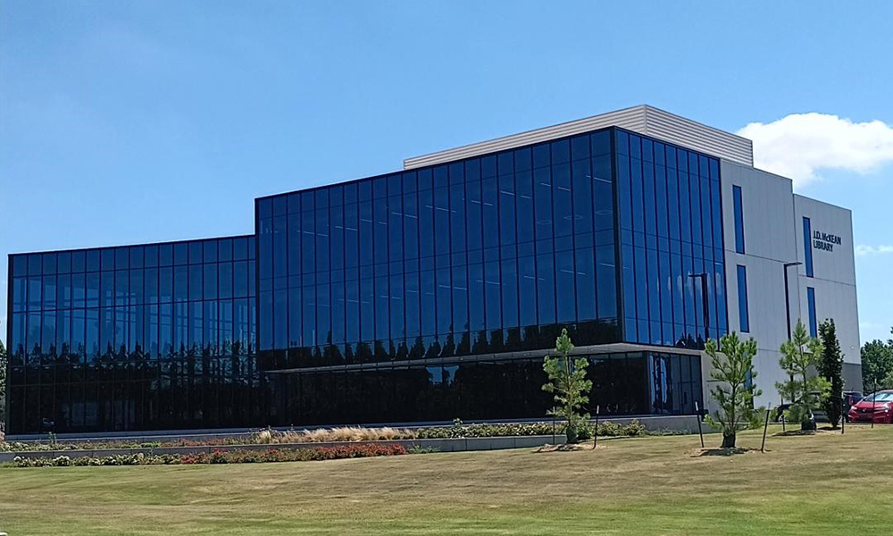
Impact of Library Visits on Undergraduate Student GPA: The Vital Role of the Library as a Contributor to Student Success
Professor Myra Bloom, Dr. Mark Hall, Dr. Angela Sample

Slide 2
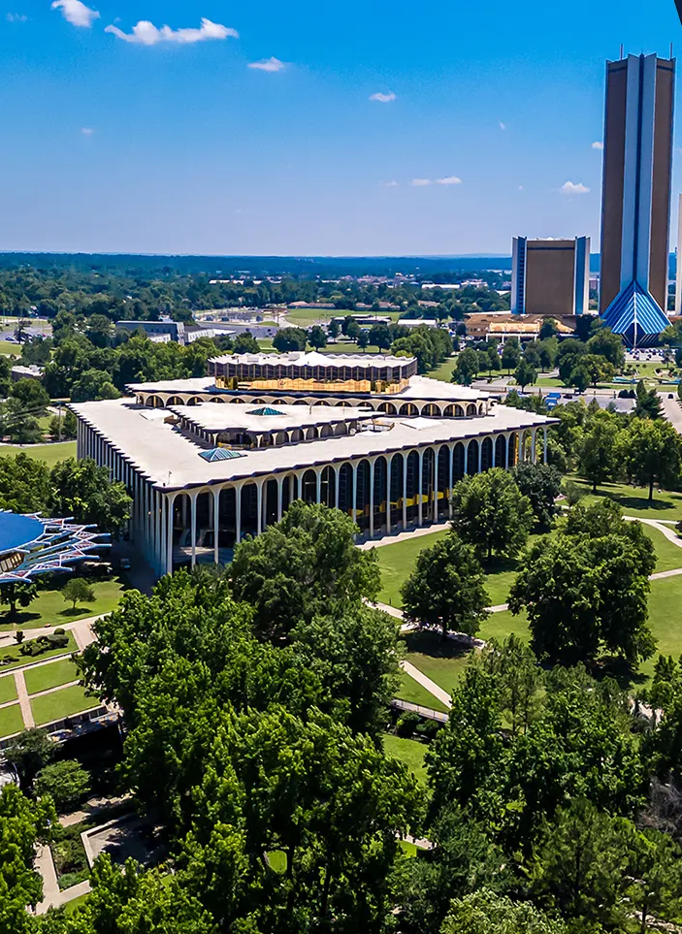
Oral Roberts University
Total Enrollment: 5,936
Current FTE: 4,474
Located in Tulsa, OK
Over 150 majors, minors, concentrations, and pre-professional programs at the bachelor’s level, ranging from business and engineering to nursing, ministry, and more
Several masters and doctoral programs
Students from all 50 states and 160 nations
Notes:
Introduce ourselves and our institution

Slide 3

The Enrollment Cliff
The number of 18-year-olds is now projected to contract after cresting at around 4.2 million people in 2033.
They are anticipated to shrink to around 3.8 million by 2039.
After that, the Census Bureau doesn’t expect the population of 18-year-olds will exceed 4 million people in any year this century. (Bauman 2024)
John Tomac for The Chronicle

Slide 4

Libraries with adaptable, flexible, and versatile spaces can positively influence a variety of student activities and needs, promoting collaboration and interaction, which in turn contributes to student engagement and learning.
Research consistently emphasizes the importance of establishing positive links between the libraries and student success.
Numerous studies have highlighted that students who engage with the library tend to achieve better academic success and improved GPAs.
Additionally, findings show that library engagement by students contributes to better retention rates.

Slide 5
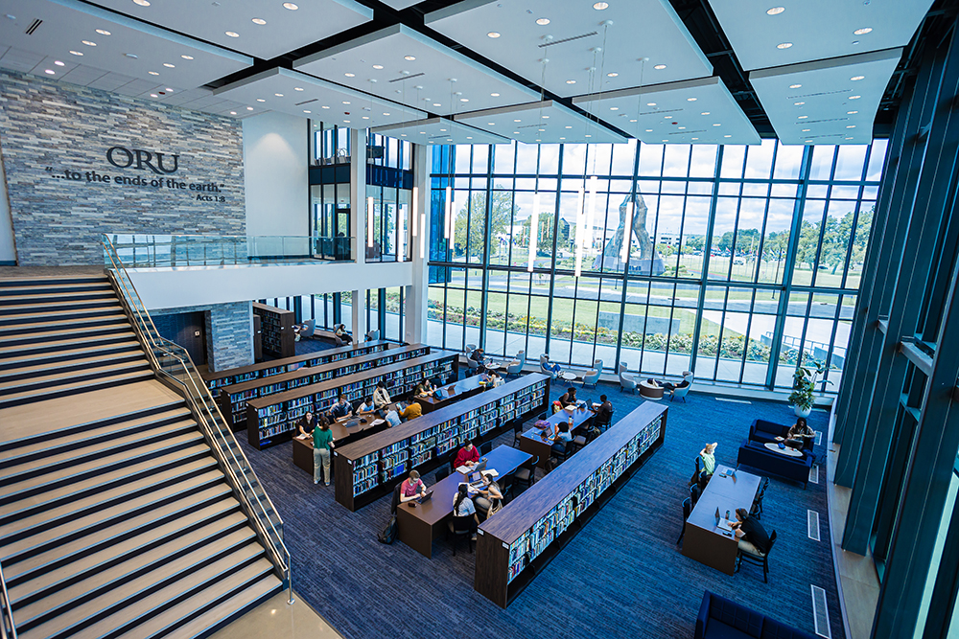
Various methodologies have been employed to study the impact of library usage on student outcomes, including regression analysis and user surveys.
Previous studies aimed to isolate the effect of library usage from other variables influencing student success.
A primary limitation in existing studies is the reliance on self-reported data, which can be subjective and prone to bias.
While user surveys provide valuable insights, they often focus on aggregate trends.

Slide 6
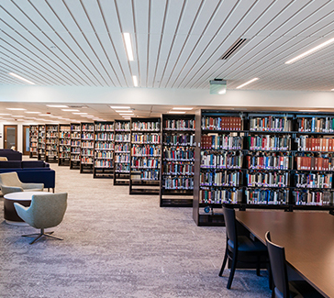
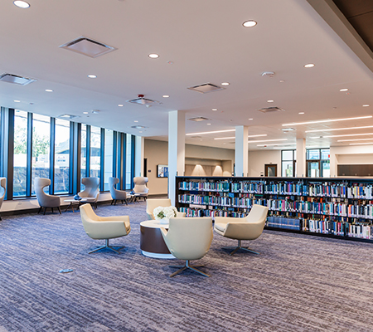
Literature Review
Research emphasizes the library’s role as a physical space, highlighting how on-site spaces and face-to-face services contribute to student outcomes.
By providing accessible, collaborative, and resource-rich environments, libraries enhance student experiences and foster academic success, underscoring their importance in higher education.

Slide 7
Historical and Modern Importance of Academic Libraries
Impact on Student Outcomes and Institutional Goals
Central Role in Academic Institutions
Libraries have traditionally been regarded as vital to universities, fostering environments that enhance student success, satisfaction, and engagement.
Evidence-Based Practice Demonstrating Library Values
With increasing emphasis on evidence-based practices, libraries now focus their impact on student outcomes, beyond collections alone.
Alignment with Institutional Goals
To secure support and funding, they must align evidence-based reports to demonstrate their role in supporting university initiatives.
Supporting Student Outcomes
Library environments that promote student use and foster collaboration, creativity, and engagement, contribute significantly to enhanced overall student success and satisfaction.

Slide 8
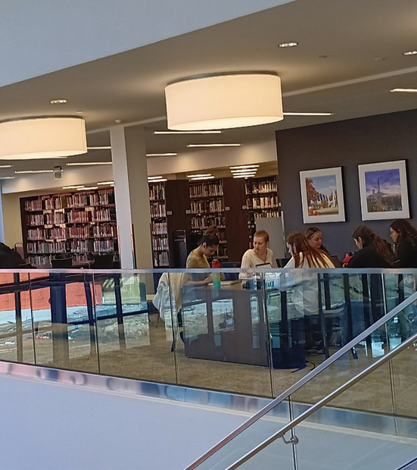

Library Usage & Academic Success
Grades and Retention
Positive correlations exist between library usage and core grades in disciplines like Marketing and HR Management (Moodley & Carte, 2019).
First-year students who use the library tend to have higher GPAs in the first semester and better retention rates from fall to spring (Soria et al., 2013).
First-time undergraduates who remained enrolled utilized library resources more frequently than those who withdrew (Haddow, 2013).
GPA improved among freshman using study rooms and research consultations (Kot & Jones, 2015).
Studies from the University of Minnesota (Nackerud et al., 2015) and the UK (Stone & Ramsden, 2013) show library use links to higher GPAs, retention, and on-time graduation rates.
Notes:
.

Slide 9
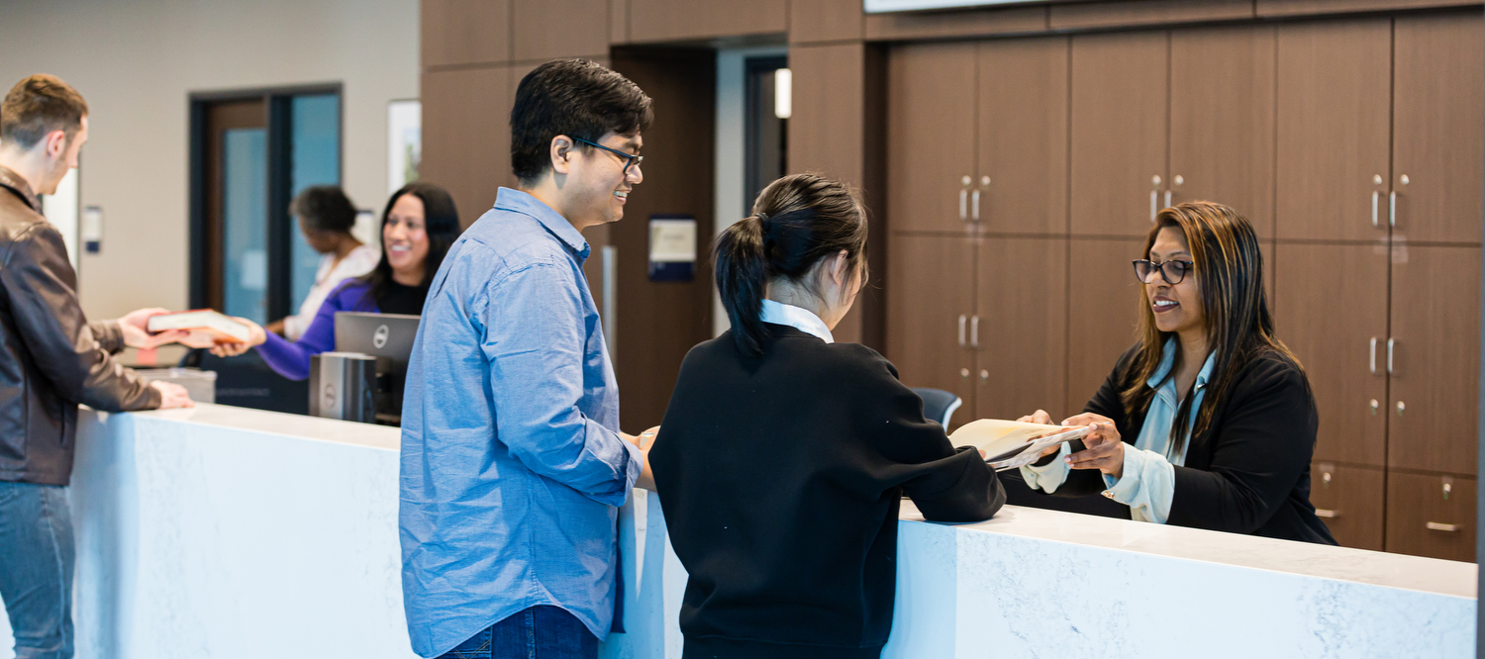
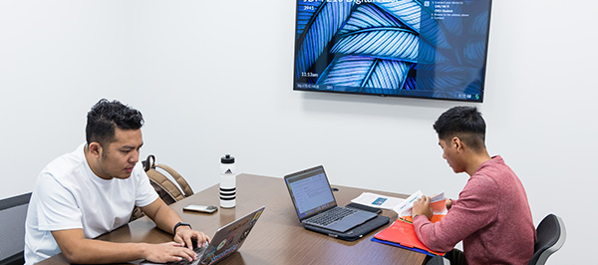

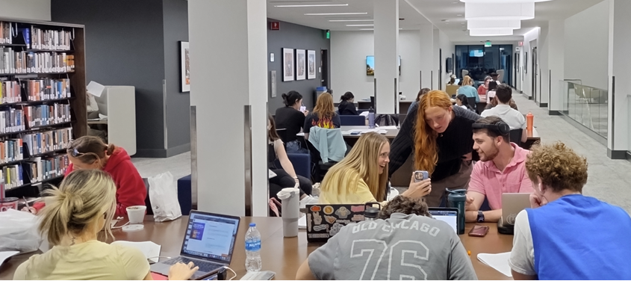
Linking Library Usage & Academic Success
Research shows a strong connection between the physical library, student usage, and academic success, which influences grades and retention.
Permeable Library Spaces
Environments where students feel connected, supported, and motivated
Not just places to study but flexible, collaborative, and student-centered spaces that foster deeper engagement and encourage active learning
In-Person Instruction & Reference
Immediate, personalized interaction
Hands-on guidance

Slide 10
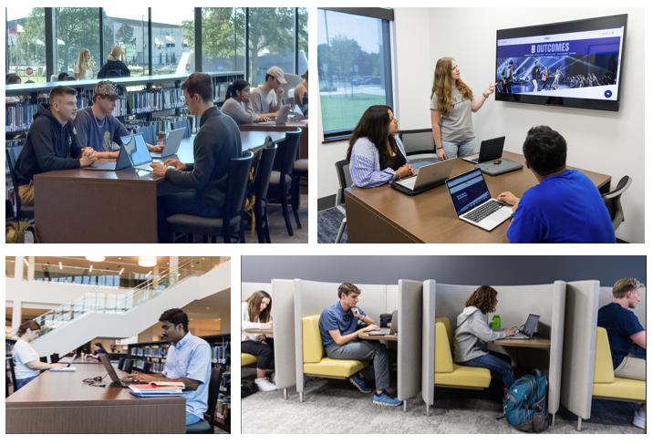
Permeable Library Spaces and Student Engagement
Flexible, Collaborative, and Student-Centered Environments
Library as a Multifunctional Space
  Beyond knowledge storage, libraries serve as places for collaboration, focus, and relaxation, maximizing productivity.
  Students purposefully use the physical library to manage academic stress (Johnson, 2023).
Flexible and Adaptable Environment
  Adaptable seating and innovation zones boost engagement, supporting diverse study needs, foster active learning, and enhance learning outcomes (Keisling & Fox, 2021).
Impact on Academic Performance
  Well-designed spaces influence study behaviors, which can enhance GPA and retention rates (Learning Spaces Collaboratory, 2019).
Designs for Well-being
  Student-centered designs reduce stress, promote mental health, and encourage effective study habits (Xiaoyun et al., 2024).

Slide 11
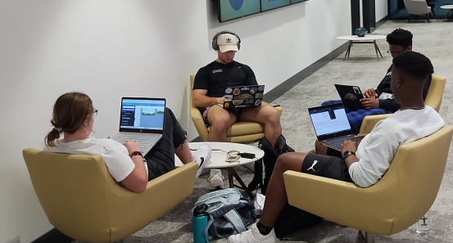
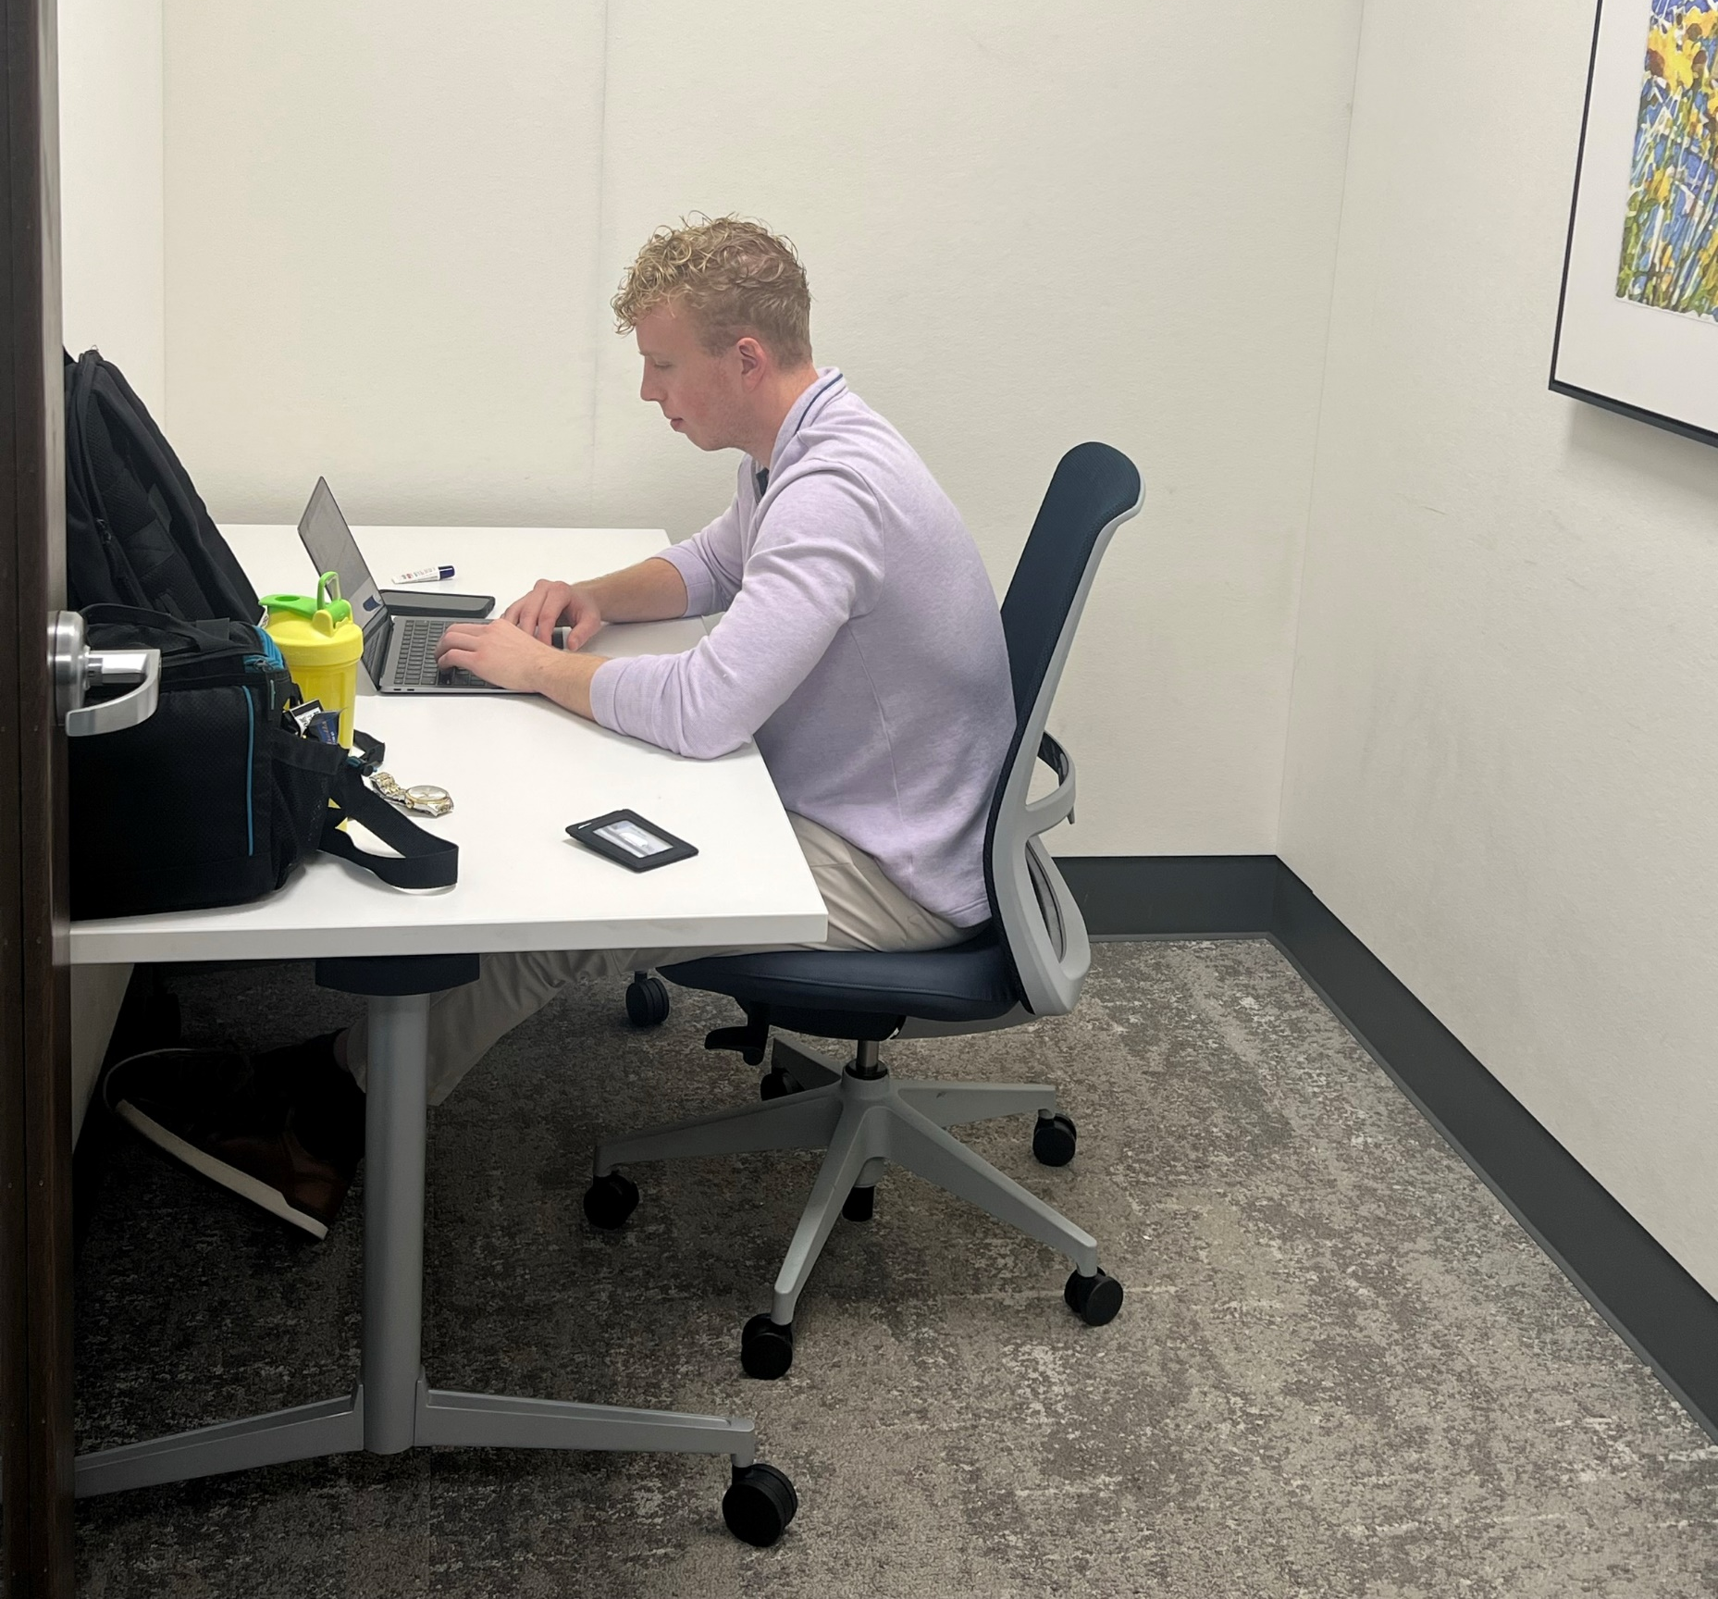
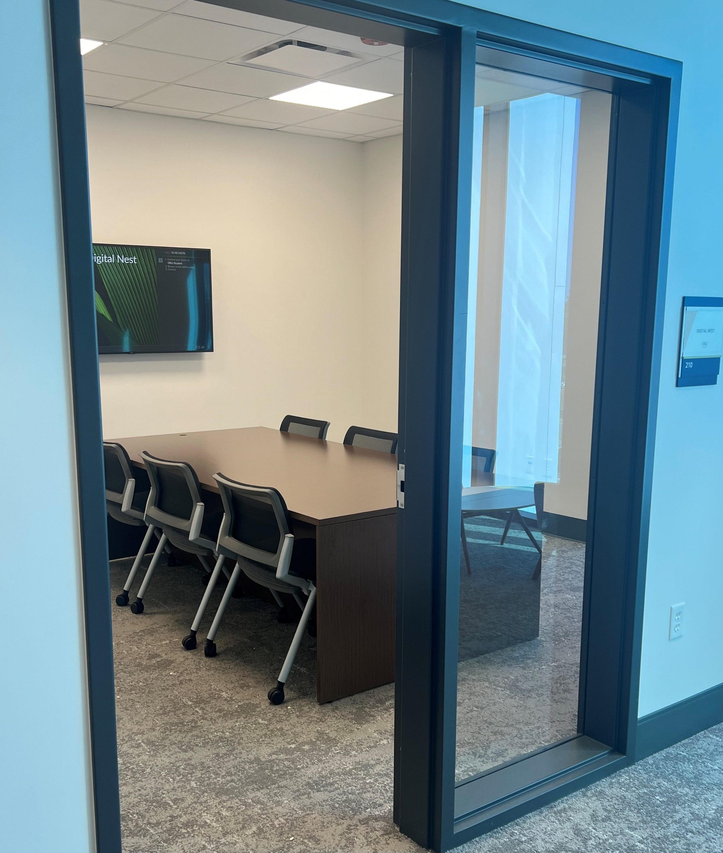
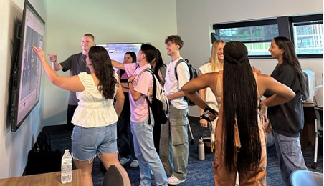
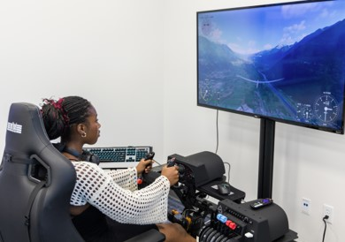
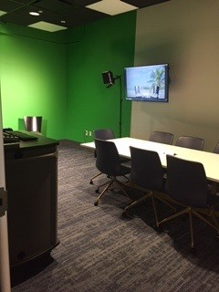

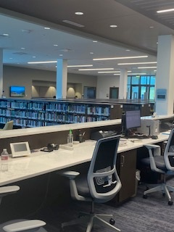
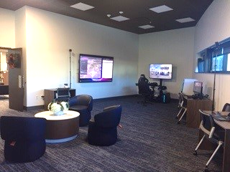
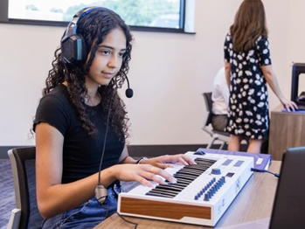
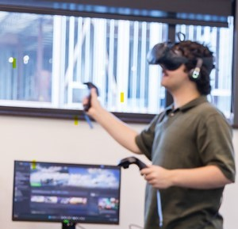
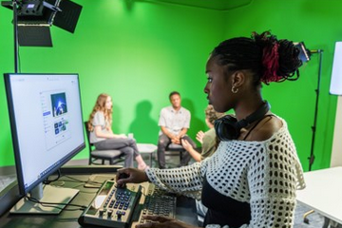
Strong Library Spaces
Importance of “Innovation Zones”
Flexible & adaptable environments (Keisling & Fox, 2021)
  Flexible seating
  Furniture variety
  Configurations to support various activities & student comfort
  Allowing food & drinks
  Consultation areas
  Zones for various learning activities (Learning Spaces Collaboratory Report, 2019)
  Collaboration/team-based spaces
  Personal/Privacy/Quiet spaces
  Technology & equipment spaces
  (VR, 3D printing, podcasting, green screen recording, music station)

Slide 12
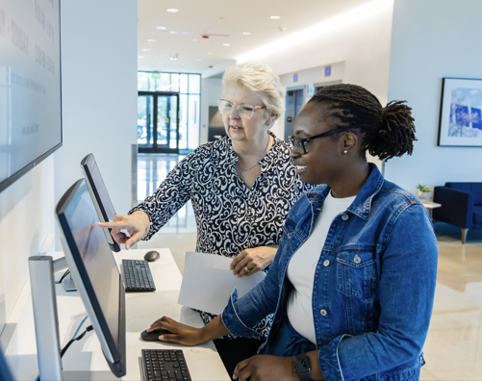
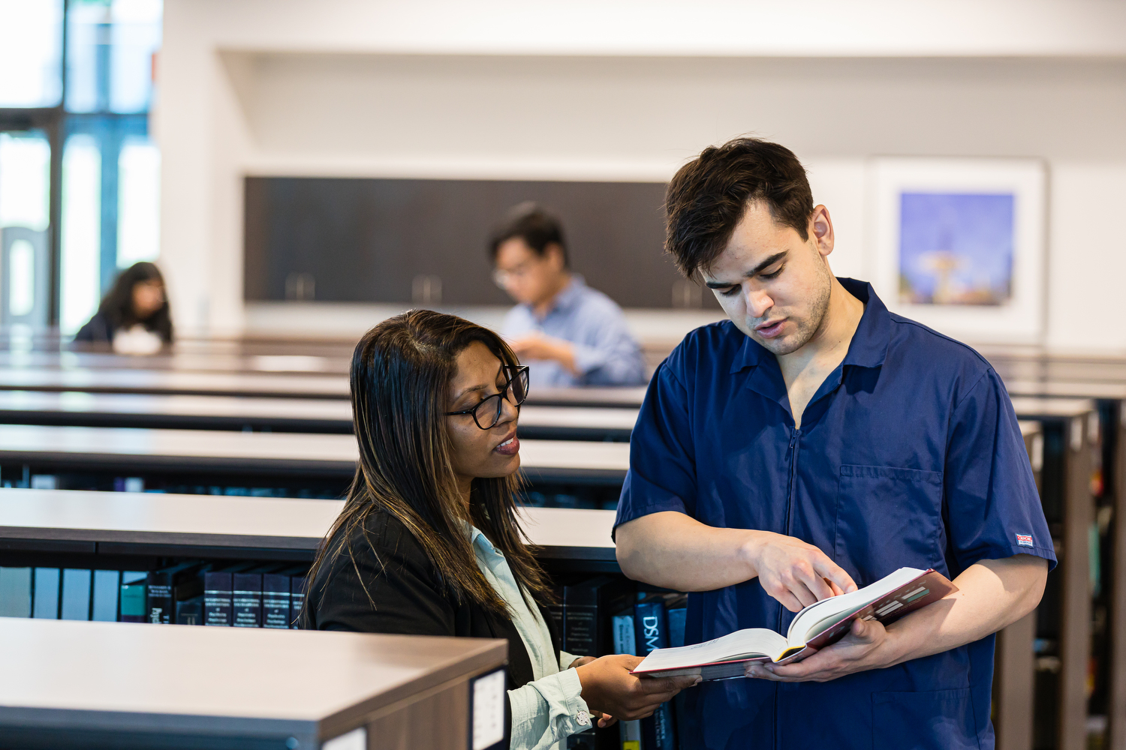
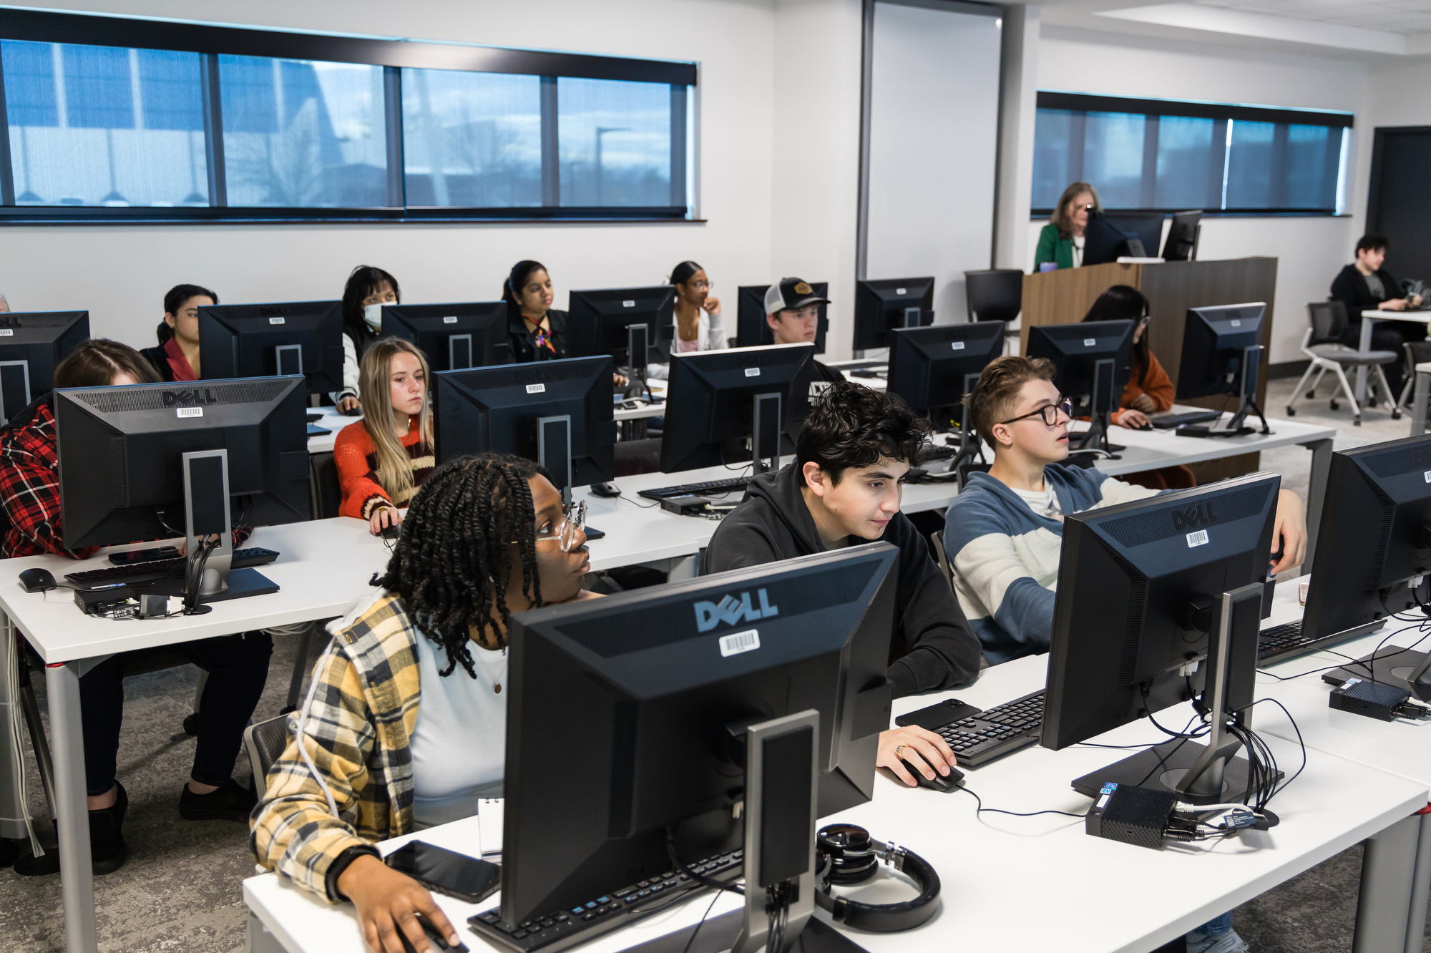
In-Person Library Sessions, Reference, & Consultations
Immediate, Personalized Interaction
Students who engaged with librarians in research consultations had higher GPAs than those who did not consult a librarian (Miller, 2018).
Students’ confidence is built through real-time instruction and feedback.
Students can practice research skills, ask questions, and get point-of-need guidance.
Hands-on, interactive learning experience helps students develop essential research skills and confidence.
Trust and rapport is built with students, making them feel at ease when asking for help.
Librarians can observe non-verbal cues and respond to the student’s immediate needs or confusion.
A sense of personal connections is fostered, encouraging students to return to the library.

Slide 13
Library Visits and Academic Performance
Highlighting the Library’s Role in Academic Success
Mao & Kinsley (2017) found that increased library use (frequency & duration) contributed to higher GPAs and retention rates past thresholds of frequency and duration for first-year students.
Sample Size: 6,380 students
Data Sources: Card swipe-in and swipe-out records Student information and academic records (Office of Institutional Research)
Thresholds for Positive Impact: Grades: 3+ visits or one hour of library use Retention: 15+ visits or 21+ hours
Kot & Jones (2015) investigated how the use of library spaces and activities, such as workstations, group study rooms, and research clinics impacted academic performance.
Sample Size: 8,652 first-time, full-time freshman students
Data Sources: Library computer logins Group study room reservation Recorded library clinic attendance Student characteristics and academic records (Office of Institutional Effectiveness)
Research Demonstrated: Positive impact on academic performance, contributing to student success Increase in term GPA associated with using group study rooms at least once during the term.

Slide 14

Our Study
In comparison to the studies mentioned in this research, our research examines the relationship between library visits and GPA.
Our study investigates the relationship between the frequency of student library visits and their academic performance.
The following section presents our study’s methodology, results, findings, and limitations, along with a data summary and suggestions for future research.

Slide 15
Overview of Data Collection Methodology
Fall 2023 & Spring 2024
Each 16 weeks long

Slide 16
Dataset
3,340 records
Undergraduate residential students aged 17 and older

Slide 17
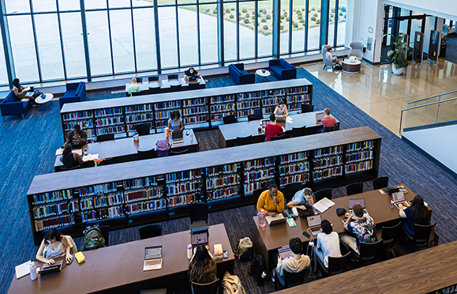
Limitations to Data
Multiple students entering on a single card swipe
Variations in data collection
Library hours extended beginning October 1, 2023
University and national holidays

Slide 18
Statistical Measures
Non-parametric Kruskal-Wallis tests applied to both semesters on
Visited
Mean Visits per Week
Weeks Visited
Term GPA
No statistically significant differences found between the two semesters

Slide 19
Results
There were 37,303 total visits to the library by 1,882 unique students.
84% visited the library at least once per semester.
On average, students visited the library 5 weeks out of 16.
The average GPA of students in this study was 3.33.

Slide 20
Summary of Data Findings
N (3,340) | Visited | Mean Visits per Week | Weeks Visited | Term GPA
mean | 0.8416 | 0.6454 | 4.976 | 3.331
median | 1 | 0.3125 | 4 | 3.538

Slide 21
Statistically Significant Correlation between Visits and GPA
Usage Factor | Beta coefficient | p-value*
Visited | 0.16361 | 0.00214
Mean Visits per Week | 0.08073 | 0.000782
Weeks Visited | 0.02097 | 0.00000543
All three usage factors were shown to have a significant positive correlation with
Term GPA.
*p values of less than .05 indicate statistical significance.

Slide 22
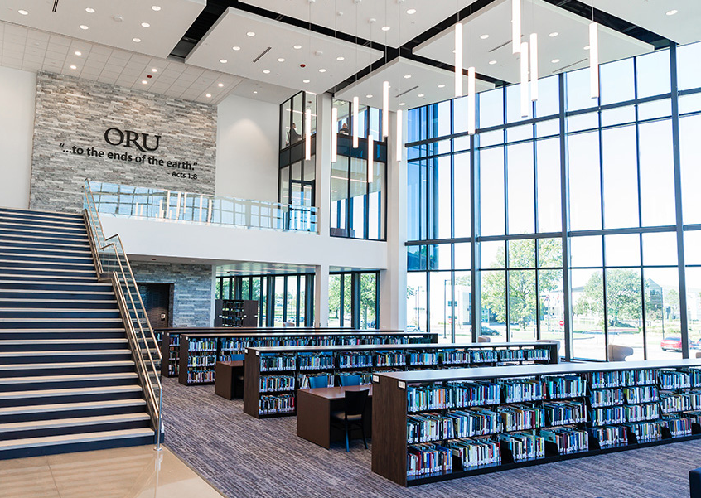
Discussion of Study Results
Do increased library visits lead to better academic performance?
Our findings show the importance of diverse study spaces and physical library facilities in promoting learning and student success.
Notes:
Our study suggests there is a strong positive correlation between library visits and GPA, does this mean visiting the library increases GPA? Our study does not show causation. But with this strong of a correlation it bears looking into closer.

Slide 23
Limitations of Study
Potential underestimation of individual library usage
Does not establish causation
Other factors influence academic performance, as well as demographics and pre-college academic background
Does not predict specific impact on individual students or exact GPA increase
Does not imply that all students will benefit equally
Focus on one academic year limits its ability to generalize long-term effects

Slide 24
Future Research Directions
Need for longitudinal studies
Exploration of diverse student demographics
Impact of digital resources on academic performance

Slide 25
Conclusion
Regular library usage correlated with higher GPAs
Libraries as essential resources for student academic success

Slide 26
Questions
Given the anticipated enrollment cliff and in light of this study, how can libraries prepare for the future?
As a result of our presentation, are there changes or strategies you could implement?

Slide 27

Question & Answers

Slide 28
Bauman, D. (2024, February 7). Colleges were already bracing for an ‘enrollment cliff.’ Now there might be a second one. The Chronicle of Higher Education. https://www.chronicle.com/article/colleges-were-already-bracing-for-an-enrollment-cliff-now-there-might-be-a-second-one
Clink, K. (2015). The academic library’s role in student retention. PNLA Quarterly, 80(1), 20–24. https://arc.lib.montana.edu/ojs/index.php/pnla/article/view/296
Haddow, G. (2013). Academic library use and student retention: A quantitative analysis. Library & Information Science Research (07408188), 35(2), 127–136. https://doi.org/10.1016/j.lisr.2012.12.002
Johnson, B. (2023). Using the physical academic library to cope with academic stress. Journal of Library Outreach and Engagement, 3, 35–49. https://doi.org/10.21900/j.jloe.v3.956
Keisling, B. L., & Fox Jr., R. E. (2021). Permeable learning environments: How developing permeability in library spaces fosters student learning and engagement. New Review of Academic Librarianship, 27(4), 440–454. https://doi.org/10.1080/13614533.2021.1906714
Kot, F. C., & Jones, J. L. (2015). The impact of library resource utilization on undergraduate students’ academic performance: A propensity score matching design. College & Research Libraries, 76(5), 566–586. https://doi.org/10.5860/crl.76.5.566
Learning Spaces Collaboratory. (2019). Libraries as spaces for 21st century learners & learning: Report of an LSC/CNI roundtable. https://www.cni.org/wp-content/uploads/2019/01/Report-of-an-LSC-CNI-Roundtable.pdf
Mao, J., & Kinsley, K. (2017). Embracing the generalized propensity score method: Measuring the effect of library usage on first-time-in-college student academic success. Evidence Based Library and Information Practice, 12(4), 129–157. https://doi.org/10.18438/B8BH35
Miller, R. E. (2018). Reference consultations and student success outcomes. Reference & User Services Quarterly, 58(1), 16–21. https://doi.org/10.5860/rusq.58.1.6836
Moodley, S. R., & Carte, S. R. (2019). Determining correlations between library usage and student success at the Durban University of Technology: a pilot study. IATUL Annual Conference Proceedings, 89–103. https://docs.lib.purdue.edu/cgi/viewcontent.cgi?article=2270&context=iatul
Murray, A., & Ireland, A. (2018). Provosts' perceptions of academic library value & preferences for communication: A national study. College & Research Libraries, 79(3), 336–365. https://doi.org/10.5860/crl.79.3.336\
Nackerud, S., Fransen, J., Peterson, K., & Mastel, K. (2015). Retention, student success and academic engagement at Minnesota (University of Minnesota). In B. Showers (Ed.), Library analytics and metrics: Using data to drive decisions and services (pp. 58–66). Facet Publishing, London, UK.
Oakleaf, M. (2010). Value of academic libraries: A comprehensive research review and report. Association of College and Research Libraries. http://hdl.handle.net/11213/17187
Soria, K. M., Fransen, J., & Nackerud, S. (2014). Stacks, serials, search engines, and students' success: First-year undergraduate students' library use, academic achievement, and retention. The Journal of Academic Librarianship, 40(1), 84–91. https://doi.org/10.1016/j.acalib.2013.12.002
Stone, G., & Ramsden, B. (2013). Library impact data project: Looking for the link between library usage and student attainment. College & Research Libraries, 74(6), 546–559. https://doi.org/10.5860/crl12-406
Xiaoyun Song, Zheyu Wang, Xue Meng, & Minghao Liu. (2024). A qualitative study on university students’ restorative experience of the library space environment. Buildings, 14(6), 1641. https://doi.org/10.3390/buildings14061641

