Slide 1

OKACRL - November 2025
“You Have to Talk to the Librarian?”
Using Required Librarian Consultations to Identify Skills Gaps in Community College Students

Slide 2
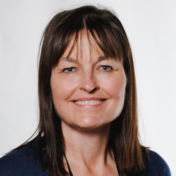
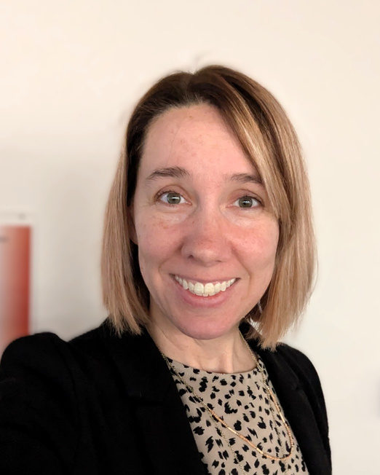

Dana Tuley-Williams
Dr. LiErin Probasco
Systems Librarian
Keith Leftwich Memorial Library
Chair and Professor
Sociology Program
Notes:
Both: introduce ourselves

Slide 3
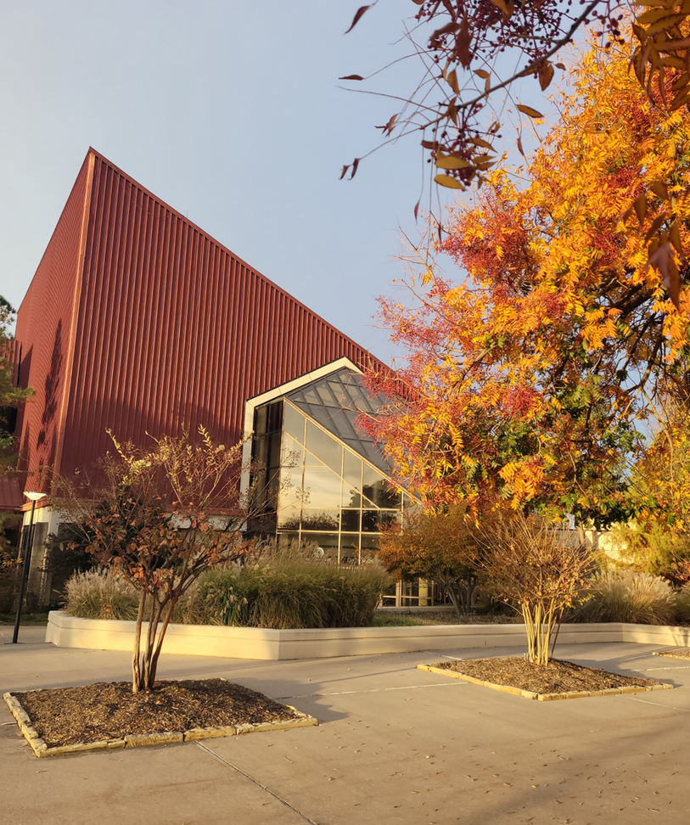
OCCC
  Urban Community College
  6500 FTE
    74% Enrolled Part-Time
    Significant concurrent enrollment
  Open Admissions
Notes:
Dana: Welcome to my college.
25 years!
5th largest school in the state
Students are younger than expected; 70% are 24 or under.
Many come from large public schools and haven't had exposure to scholarly research
Majority of our classes are 8-week terms. (Soc: Around 85% are 8 week)

Slide 4
Around 60% of credit hours are not on campus
    Concurrent
    Online
Notes:
LiErin: Might mention that our presentation will focus strictly on online students? Though I think we added that later too, so wherever works. (Remove this note if you like.)

Slide 5
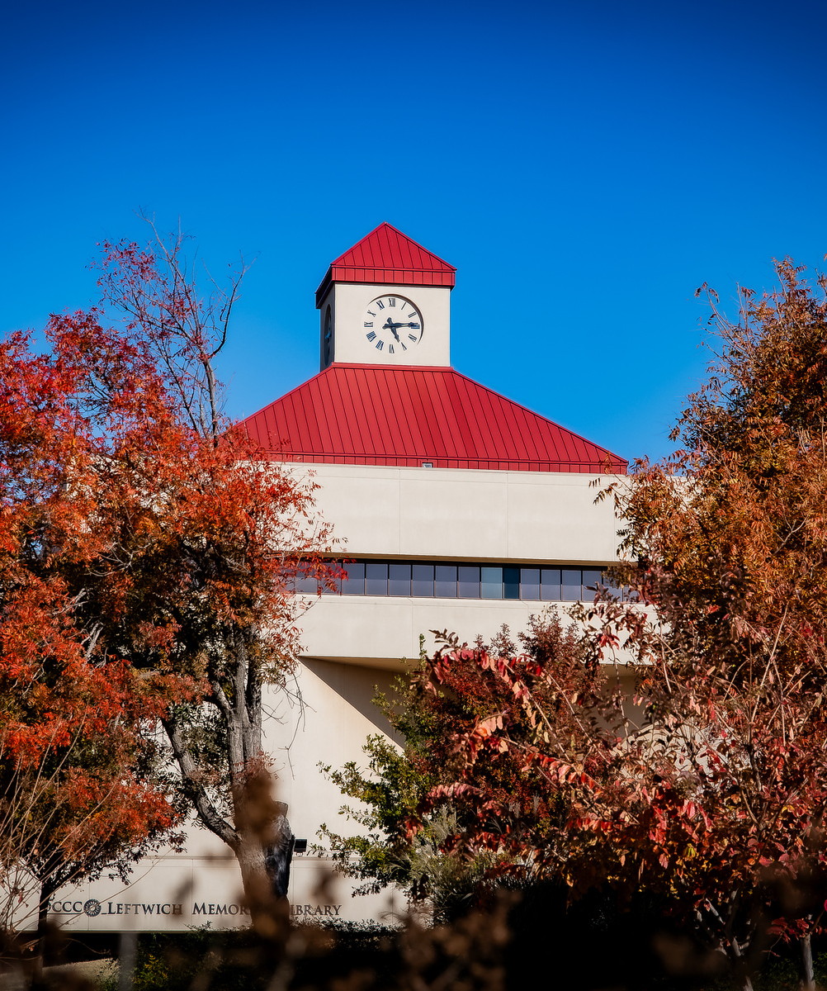
OCCC Library
  5 Full-time librarians/4 FTE staff
  Open 69.5 hours per week
  Very Springshare reliant
    LibChat
    LibAnswers
    LibGuides
  Lots of video tutorials
  Traditional Instruction
Notes:
Dana
No librarians on Sats
Fewer than 10% of our reference interactions are in person
Set up for success Liaison responsibilities (I have been around longer than any faculty members in Social Sciences)
Role of librarians with faculty in general. FA & Committee work.

Slide 6
Concerns
  Traditional Instruction doesn’t reach online students
Declining reference interactions
  Information Literacy
Notes:
Dana-
The old days of Reference
Under pressure to quantify outcomes (perhaps self-imposed but we really like stats)
Information Literacy seems to be everybody and nobody's problem.
Not even going to start on AI.

Slide 7
Librarian Wish List
  Meaningful way to introduce Library resources outside of FYE/Composition courses
  Increase stats
  Improve assessment
  Information Literacy
Notes:
Dana - Hard time getting traction with Comp classes
FYE students aren't invested -
One shot: too task oriented, hard to apply and get buy-in and doesn't reach online students
One shots on Zoom are painful and disappointing.
Tutorials for online students but never really knew how useful they were.
Librarians have been working to make Information Literacy a gen Ed requirement

Slide 8
OCCC Sociology - Why bring in the library?
  Faculty-driven task force on scaffolded research papers in gateway courses
  Emphasis on skills over content
  Prior success with 2000-level library engagement
    In person (Race & Ethnicity course)
    In person & online (Social Problems)
Notes:
LiErin

Slide 9
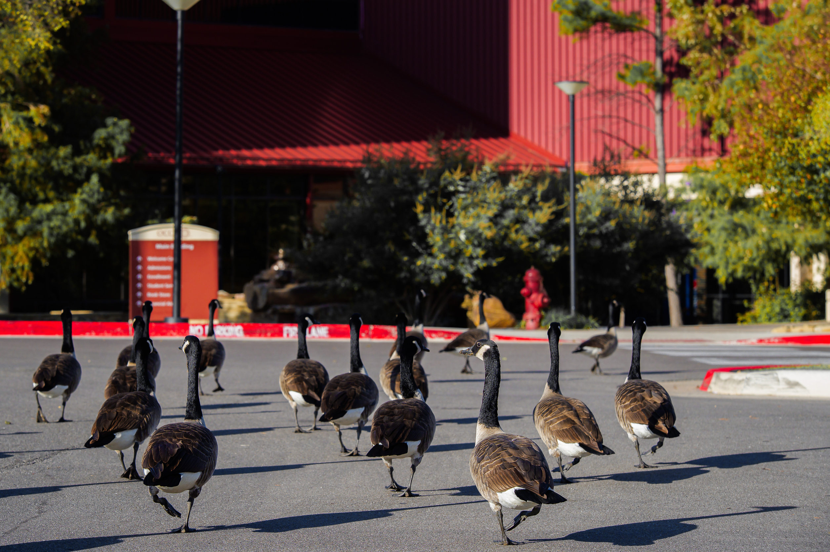
Challenges for Intro to Sociology
Translating course design successes in electives to an intro/gateway class:
  Student Preparedness
    need for added skills instruction & assessment
  Instructor Engagement
    sustainable workload
    clarity, consistency of standards
  Scaling Up
    number of students/sections:
      F24: 566/20
      Su24: 121/5
      F25: 729/27
    Modalities: (F25, % students)
      23% on campus
      70% online
      7% at high schools
      76% 8-weeks/24% 16
Notes:
LiErin

Slide 10
Sociology Department goals
Prior Structure
  Read & summarize provided article
  Annotated Bibliography
  Draft
  Final
Immediate goal
Reduce skill gap between
“recognize quality” (stage 1)
&
“locate quality research” (stage 2)
Long-term goals
  Transferrable research skills
  Value of library staff
  Differentiate sociological & empirical research from other academic writing
Create a personal connection to a librarian
Notes:
LiErin

Slide 11
How can the Library assist with this?
Notes:
Dana - We considered how we could help LiErin accomplish her goals.
The standard go-to solution to every librarian's problems...

Slide 12
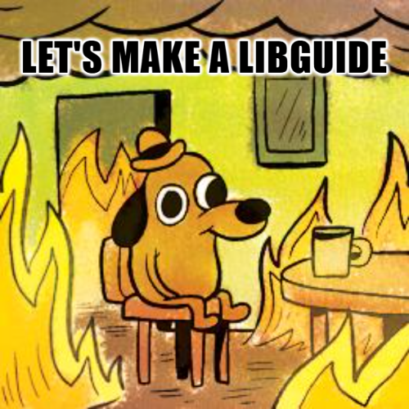
Notes:
Dana
Looking for something more substantive

Slide 13
How we decided to approach (The ask!)
Dana (and library staff): Yes, AND...
  ABCD guide
  video on finding scholarly articles
LiErin: Can every Intro to Sociology student (500+ per semester) interact with a librarian?
F2F: whole class library visit
Online: individual librarian consult
Create a personal connection to a librarian
The New Structure
  Read & summarize provided article
  Library Contact
  Annotated Bibliography
  Draft
  Final
Notes:
LiErin

Slide 14
Librarians saw this as an opportunity to introduce
Thoughtfulness when formulating a search strategy
Create a personal connection to a librarian
Concept of scholarly research
Scholarly tools
Notes:
Dana - Naive! We just looked at the great skills we were going to get to teach. Scholarly tools
Go beyond "enter keywords" &
Introduce thoughtfulness
Introduce the concept of scholarly research
Would also lay the groundwork for assessment for infolit
Make a connection to the Library & increase stats
Increase stats!

Slide 15
Library’s considerations
  Workload
  Timeline
  Methods of contact
  Turnaround time
Thoughtfulness when formulating a search strategy
Create a personal connection to a librarian
Scholarly tools
Notes:
I would like to tell you we critically approached these four considerations. We did not.
When I did consider workload I did not think it through. We are an incredibly cohesive group.
Timeline. We thought this would be two weeks and done each term FORESHADOWING!
Didn't consider all the extra work it would take to increase stats. At no point did I consider, there's a two week period where we answered nearly 400 sociology reference questions.
How students would reach us: EAL (Moodle and Website), Chat, In person (increase foot traffic!), email. Can send a transcript, this would be the proof for prof.
Turnaround time. Students told to reach out to us at least 48 hours in advance. Our goal was much quicker response time but we didn’t quantify it. We didn’t need to. GREAT LIBRARIANS

Slide 16
Trial - Summer 2025
  Four online sections (about 96 students)
  Logistics went very smoothly
  Increase in reference transactions
  Insight to thought process of students
  Crossover on disciplines
  No understanding of empirical research
  Right tools
Thoughtfulness when formulating a search strategy
Create a personal connection to a librarian
Scholarly tools
Notes:
Dana
# of reference interactions for June went up around 250% which was essentially the enrollment of the class
Prompt worded so that students frequently would tell us what strategies they had already tried.
Discovered students didn’t grasp what constituted “sociology” and we tried to struggle through this.
Explained Empirical Research
We got to talk about appropriate database (Note: for this we relied exclusively on EBSCOhost, but teaching students to select databases …THEY LISTENED!)
Note: we are heavily EBSCOhost. Lots of extras in addition to state databases.

Slide 17
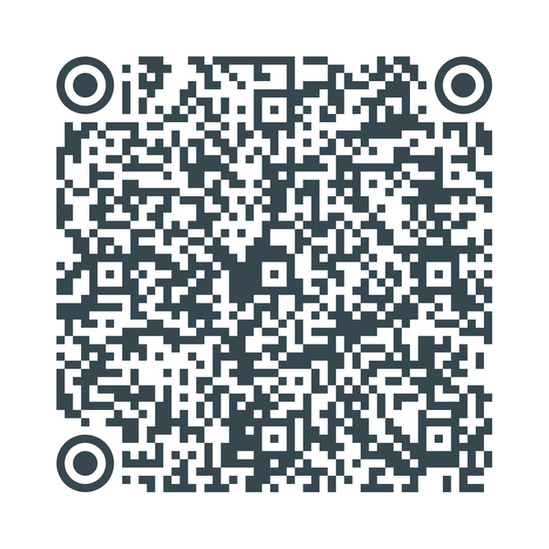

Sociology - Changes for the Fall
  With Dana, developed rubric for identifying credible sources
  Added quiz to practice using rubric before library contact
  Revised library contact instructions based on librarian feedback
Scan for rubric
Notes:
LiErin -
The rubric originated from the ACRL Information Literacy Sandbox

Slide 18
Librarians – Plans for Fall
  Pinned down the dates
  Assumed the rubric would be 100% effective in teaching students about scholarly sources
  Added canned answers
    Empirical research
    Choosing appropriate databases
    EBSCOhost description and link to video
Thoughtfulness when formulating a search strategy
Create a personal connection to a librarian
Scholarly tools
Notes:
Dana: Summer success=Fall EASY!
September+ eight sections of an 8 week course w/ three sections of a 16 week course. Around 300 students total
I delayed my vacation by a week
Thought the canned answer about empirical research would answer any questions about it (LOL!)
(If you don’t have Springshare, a shared spreadsheet would work for this.)

Slide 19
Librarians- Reality for Fall
  Fall students are NOT Summer students
  Rubric was great but…
  Timeline was more muddled
  Still lots of students conflating psychology and sociology
  “Here’s my sources. Are they empirical?”
  “Give me three articles...”
  More students just called it in
Create a personal connection to a librarian
Scholarly tools
Notes:
Dana: Summer students self select
Students were GREEN.
Rubric - still struggles
Timeline – Lots of students waited or got extensions. Students skipped this step and when they turned in a poor bibliography, their instructor let them re-do it after the original deadline.
Nonstop 3 weeks in September.
Some just copied and pasted the prompts
One asked for help with her “annoyed bibliography”

Slide 20
Librarians- Reality for Fall - The Good Stuff
  Lots of opportunities to talk about choosing keywords and adapting topics
    AI
  Choosing databases
  Students saw librarians as a resource
  Introduced thoughtfulness; academic research is not the same as Googling
  Most students did take this assignment seriously and seemed to get it
Create a personal connection to a librarian
Scholarly tools
Notes:
Dana:
It got easier!
Able to answer some using entirely canned answers, but the students never knew. We could reuse older tickets.
SOCIAL MEDIA as a topic.
World's foremost scholars at OCCC.
I think these skills will move with them.

Slide 21
Back to Concerns
Declining reference interactions
  Traditional Instruction doesn’t reach online students
  Information Literacy
Notes:
Dana-
We answered over 400 substantive reference questions first three weeks of Sept (I was gone for two of thsoe weeks.)
Our meaningful reference interaction stats went up over Fall 2024 around 253%.
Foot traffic, but only a handful came in.
Definitely reached online students
Information literacy - I think this will be a good example when we move forward with the Gen Ed requirement for information literacy

Slide 22
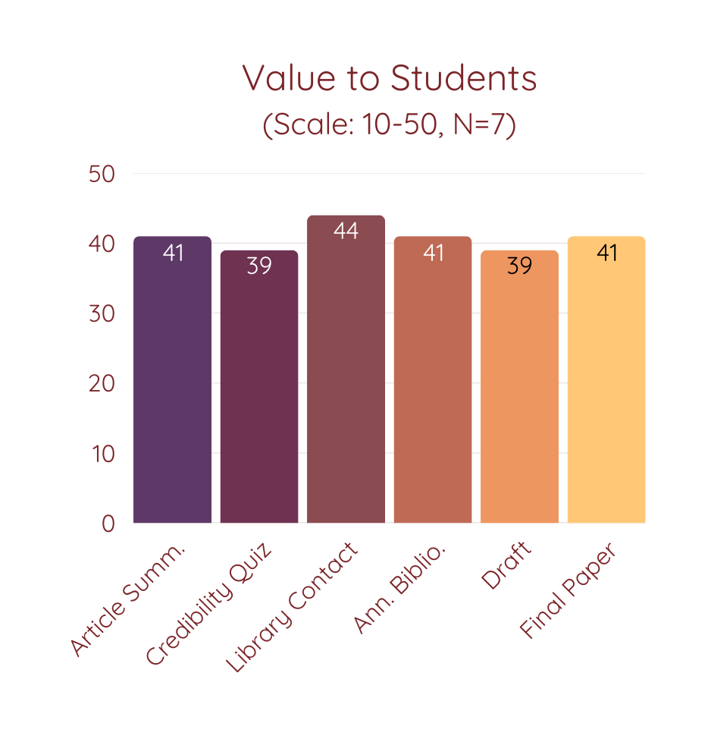
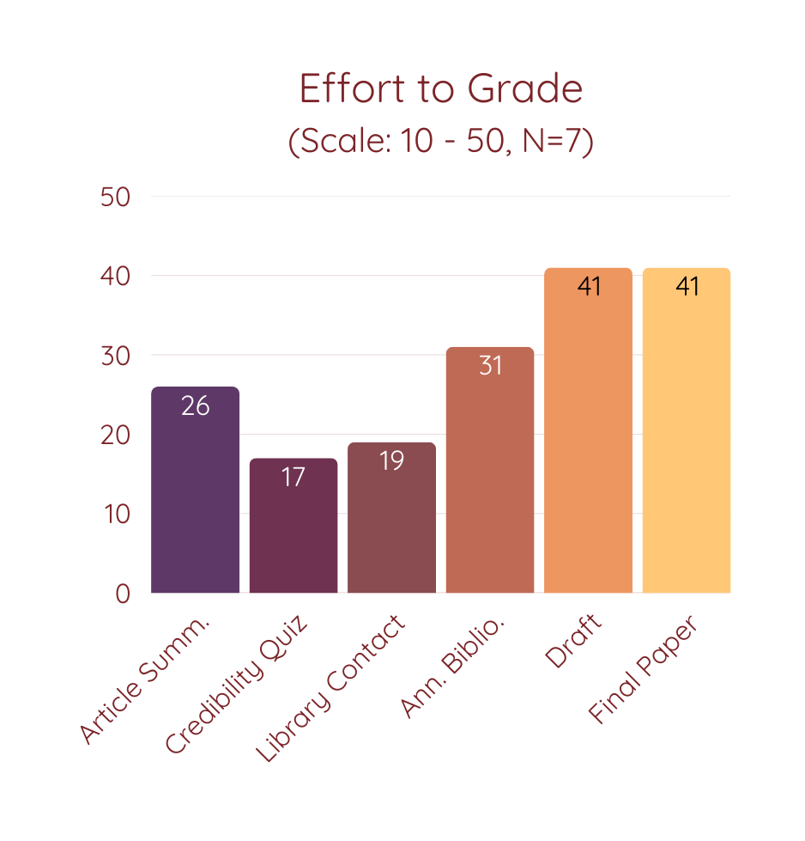
Sociology Outcomes: Instructor Feedback
Notes:
LiErin

Slide 23
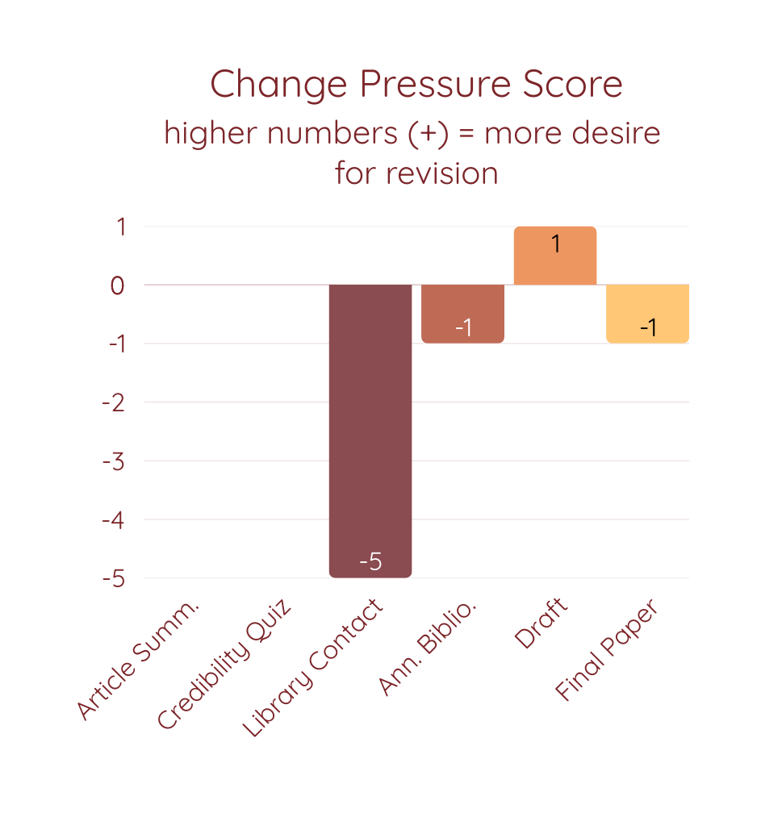
Sociology Outcomes: Instructor Feedback
fasdf
“Interactions between Librarians and students have been incredible”
“Most students state that they learned so much.”
“Students see all the extra support options on campus they can turn to throughout their studies”
Notes:
LiErin

Slide 24
Librarian Takeaways
  Worth it!
  Springshare
  Student response
  Scalable
  Value vs. other library assignments
  Partners
Create a personal connection to a librarian
Scholarly tools
Notes:
Dana: Springshare: canned answers, organization, etc. Springshare deserves a lot of credit for the success of this.
About 40% EAL link that was embedded in their Sociology course
25% website EAL
20% chat
5% direct email
Partner
Buy-in with other librarians (We are always doing continuous improvement via the strategic plan) Have political capital.
with a doer, and make sure they have buy-in from their faculty.

Slide 25
