Slide 1
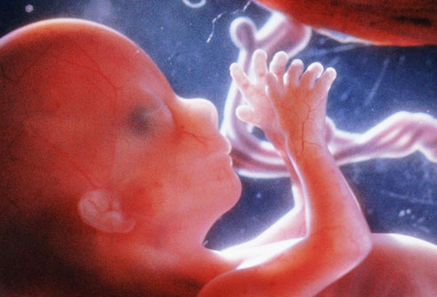
The gestation of virtue:
An examination of how experiences in the womb may build the moral self

Slide 2
Where are the origins of virtue?

Slide 3
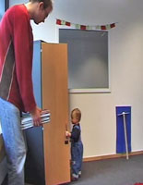
One view: Altruism (virtue?) is innate
  Early altruism is unlikely to emerge from “acculturation, parental intervention, or any other form of socialization.”
  Tomasello, 2009
  “Infants show altruistic tendencies at an age when socialization could not yet have had a major impact on their development.”
  Warneken, 2013
Warneken & Tomasello, 2006

Slide 4
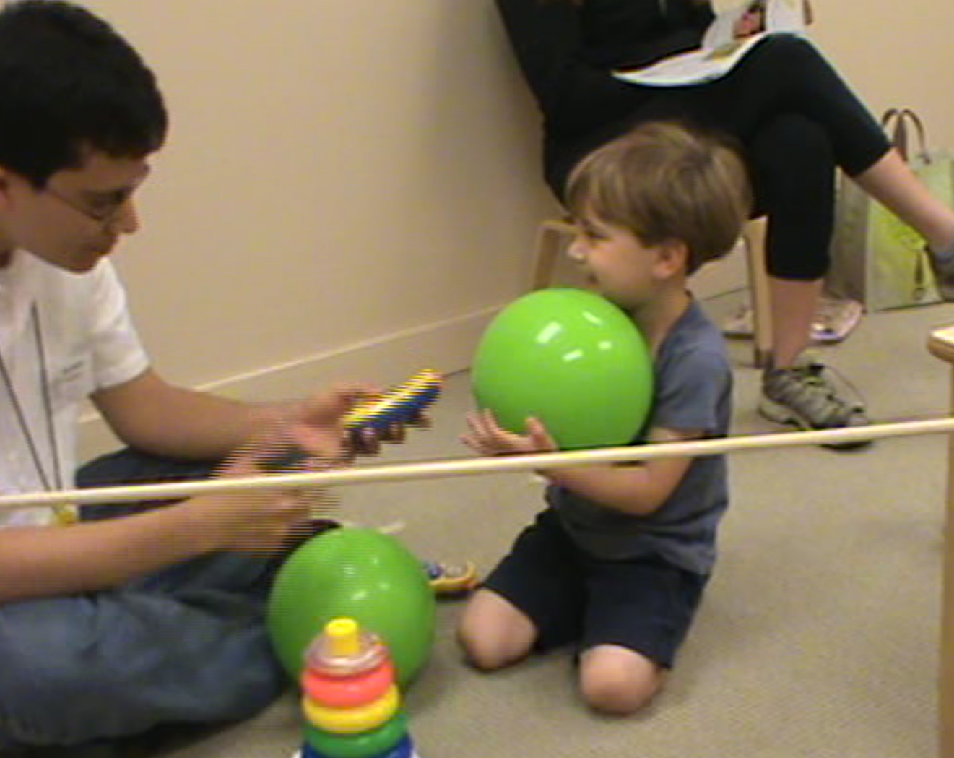
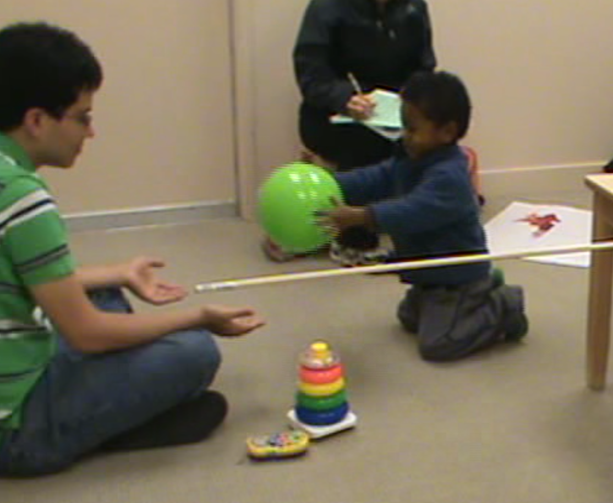
Rethinking natural altruism:
The role of the warm-up
Care-giver brings child into testing room
Play materials:
  Stacking toy, musical toy, plastic ball
One of two structured warm-ups (6 minutes)
Parallel Play
Reciprocal Play

Slide 5
Cortes Barragan & Dweck, 2014, PNAS

Slide 6
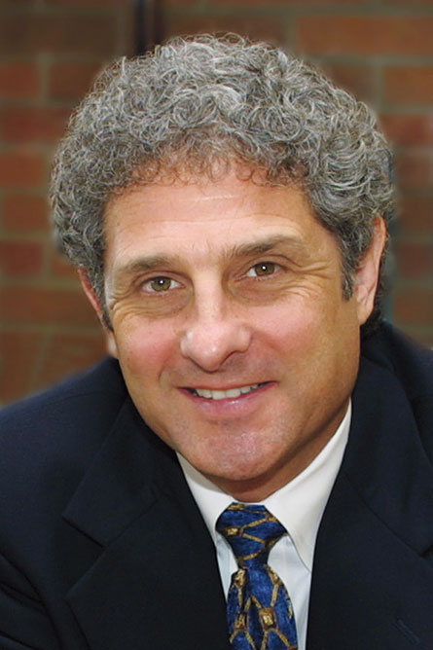
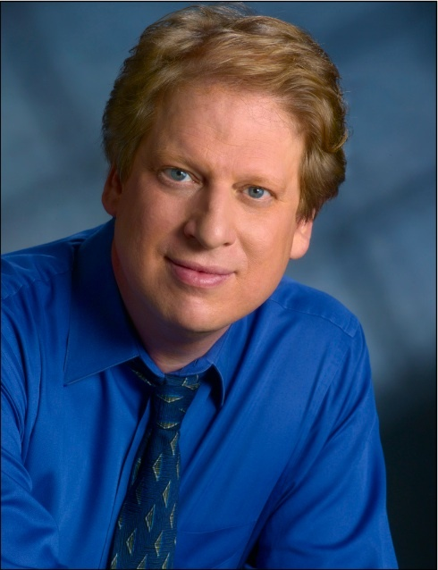
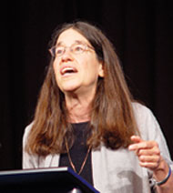
“Exceptional . . .
an instant classic.”
Andrew Meltzoff, University of Washington
“A terrific paper.”
Paul Bloom,
Yale University
“I love this research.”
Elizabeth Spelke,
Harvard University

Slide 7
Response by Warneken
  “Socialization practices and cultural norms are not foundational for early helping.”
  Warneken, 2015, PNAS
  “Infants show altruistic tendencies at an age when socialization could not yet have had a major impact on their development.”
  Warneken, 2014

Slide 8
Our reply
  “We suggest that there are numerous routes to early learning aside from direct tuition. The task before us is to understand the subtle forms of socialization embedded in social experiences and the capacity of infants to learn from those experiences.”
  Cortes Barragan & Dweck, 2015, PNAS

Slide 9
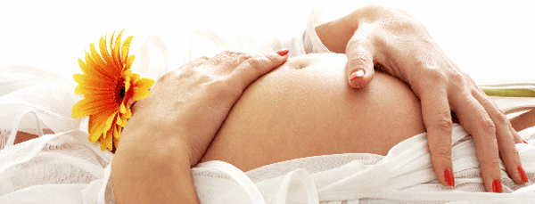

Slide 10
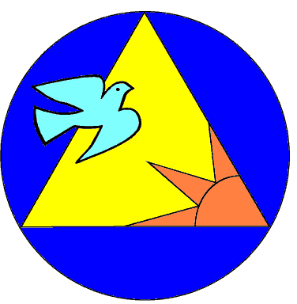
Fraternidad 2000

Slide 11
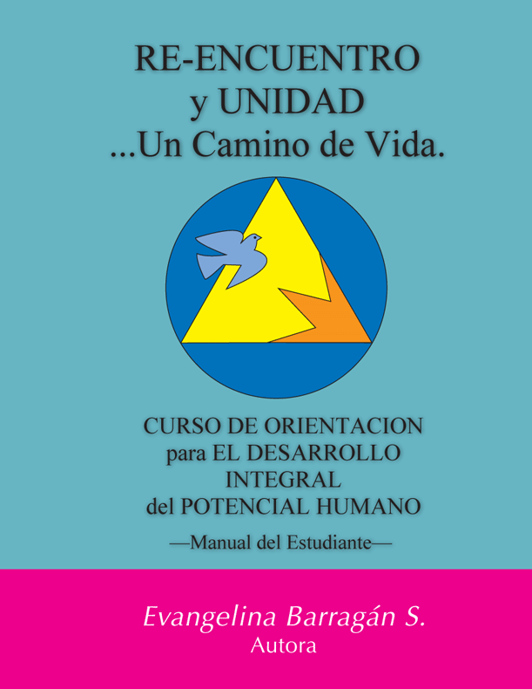





Slide 12
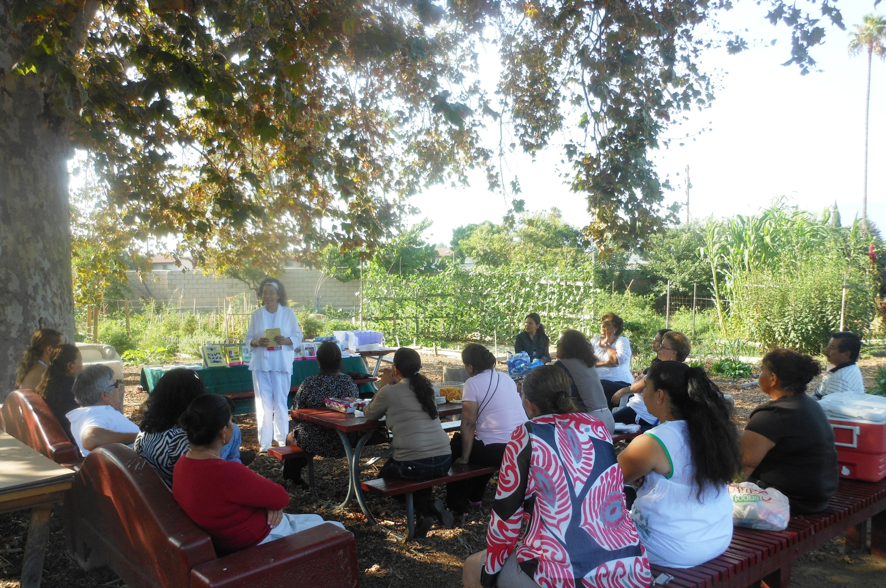

Slide 13
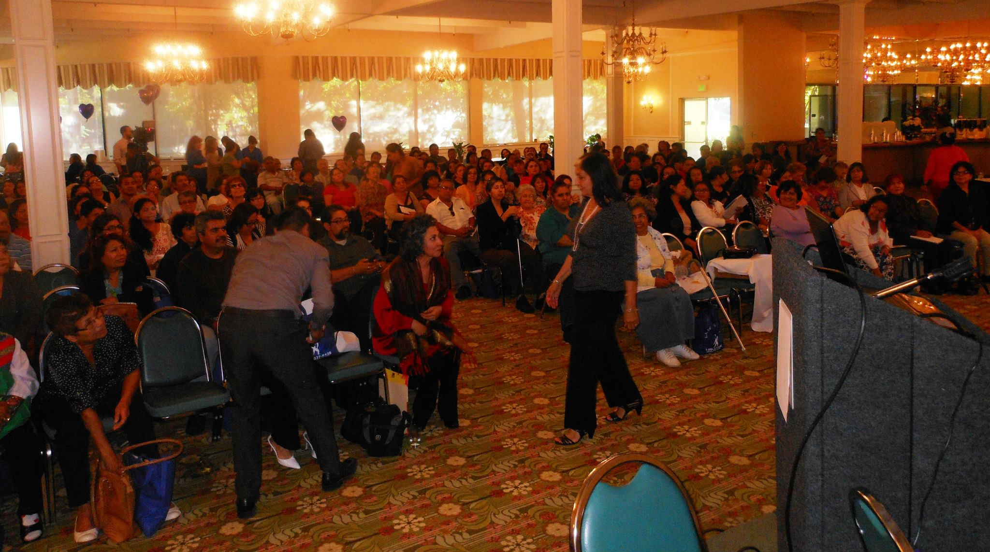

Slide 14
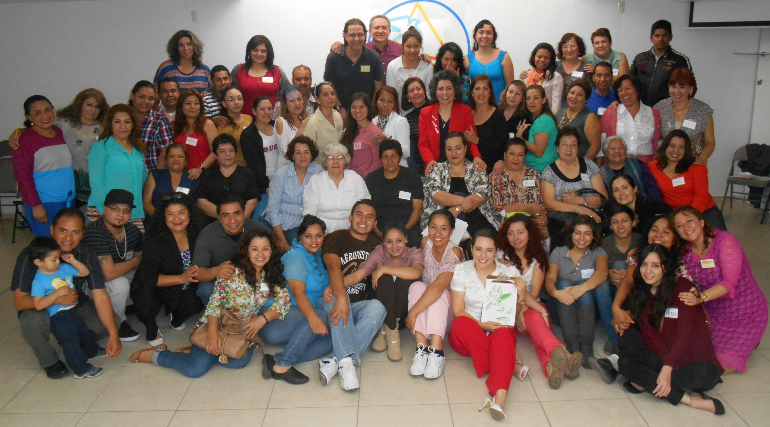

Slide 15
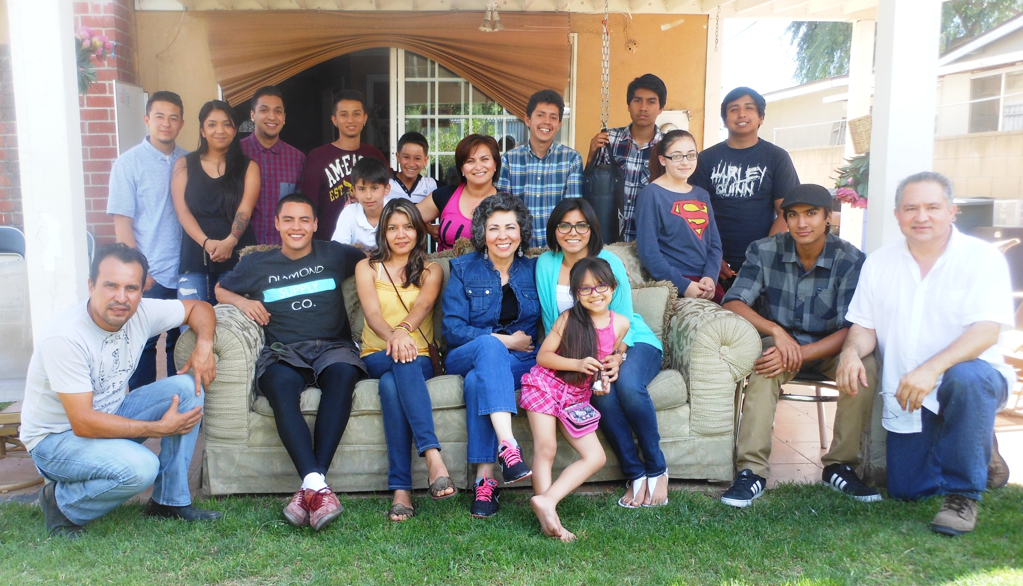

Slide 16
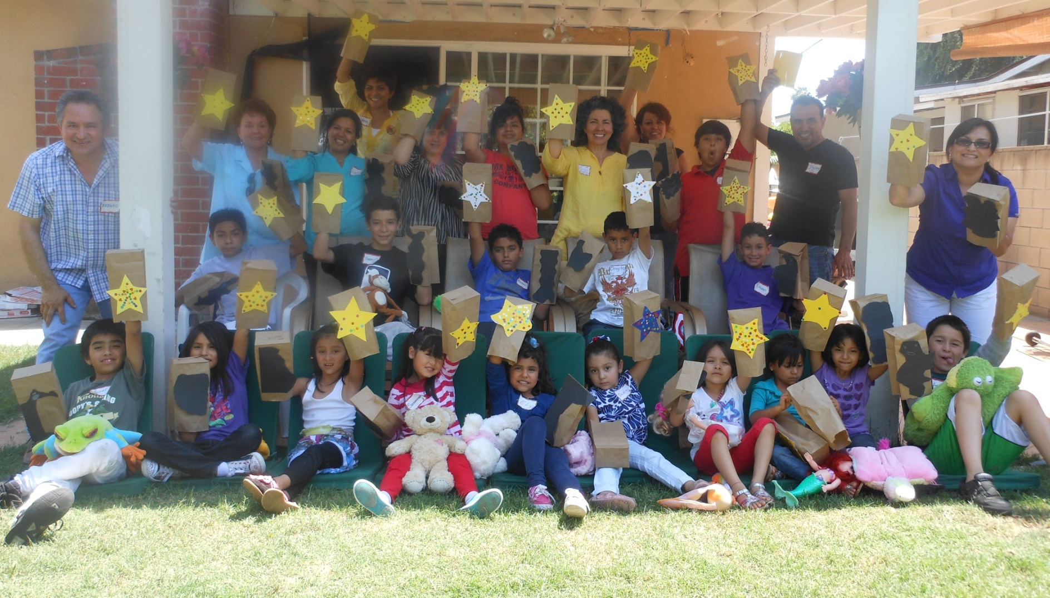

Slide 17
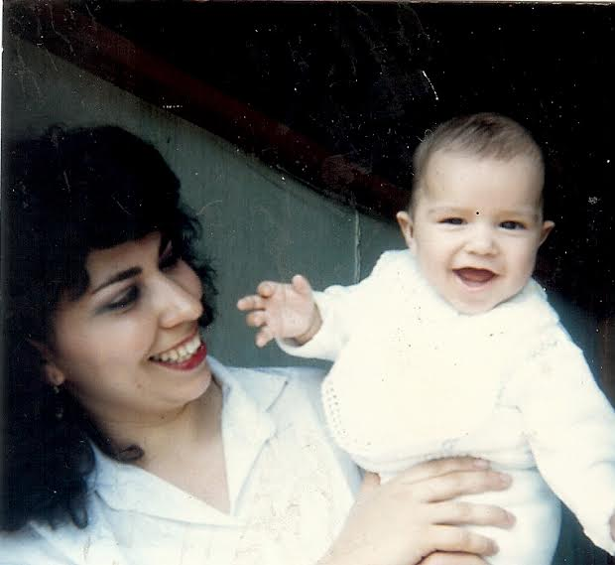
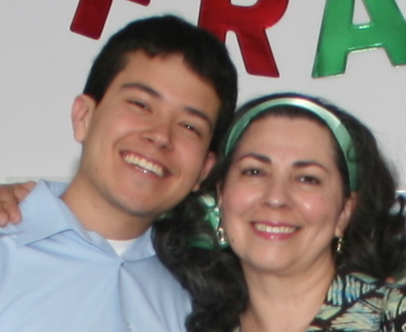

Slide 18


Slide 19
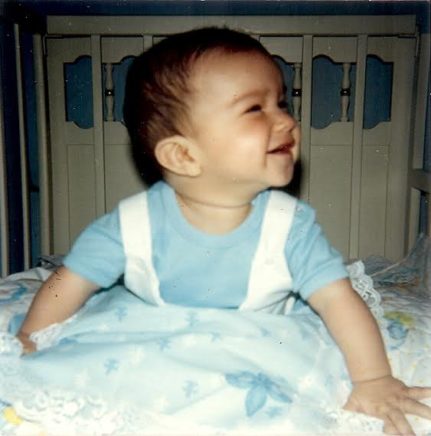

Slide 20
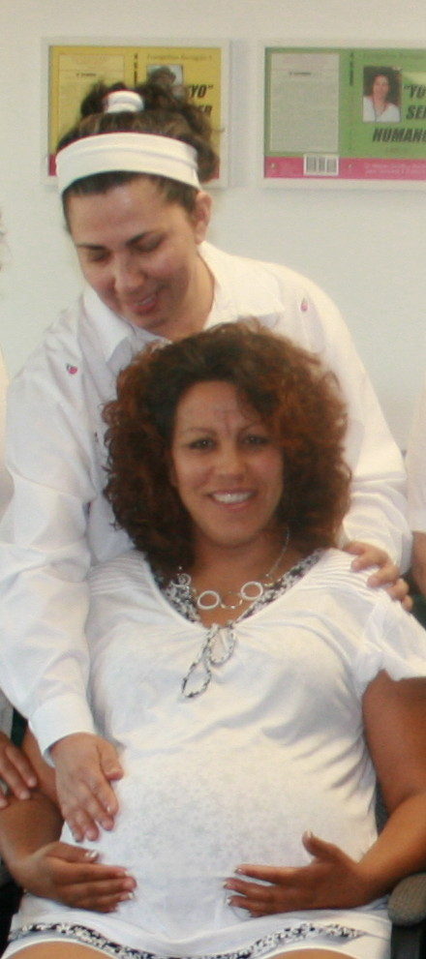
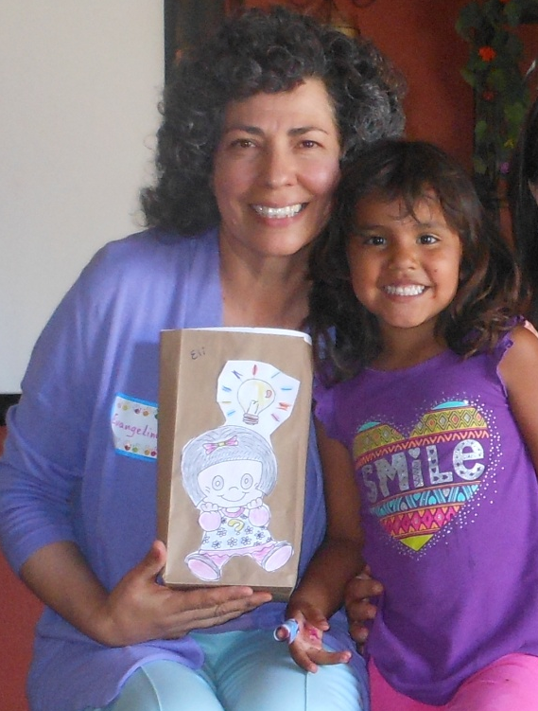
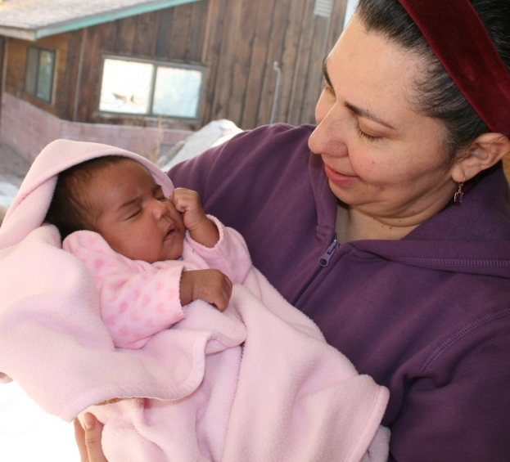

Slide 21
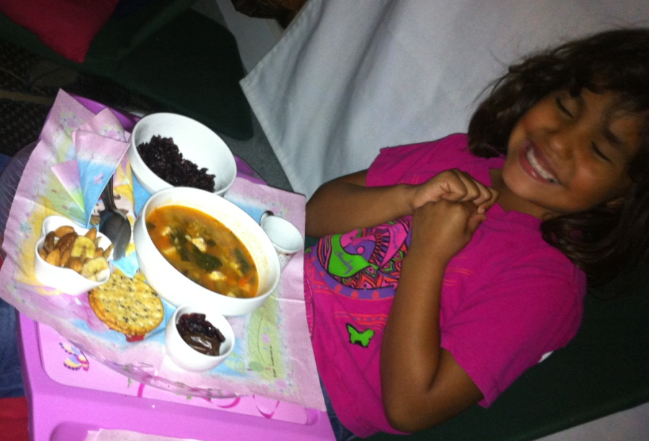


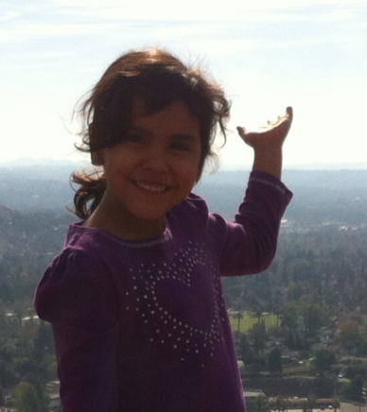

Slide 22
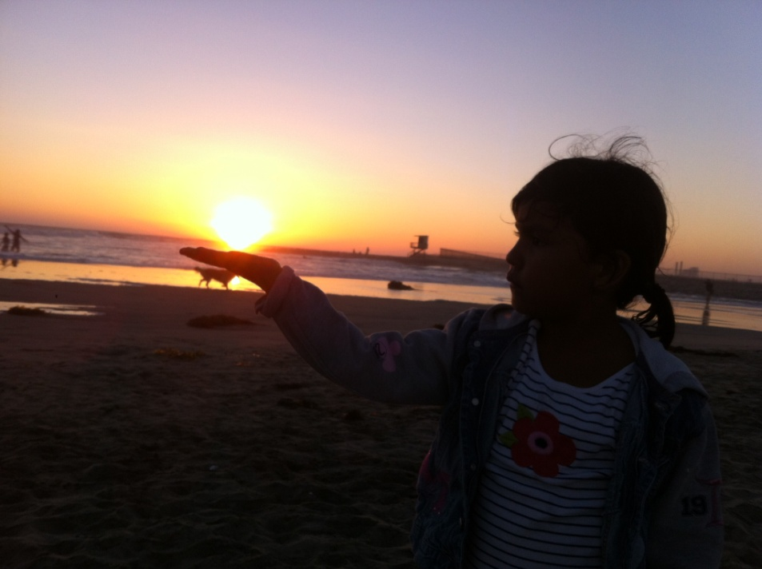
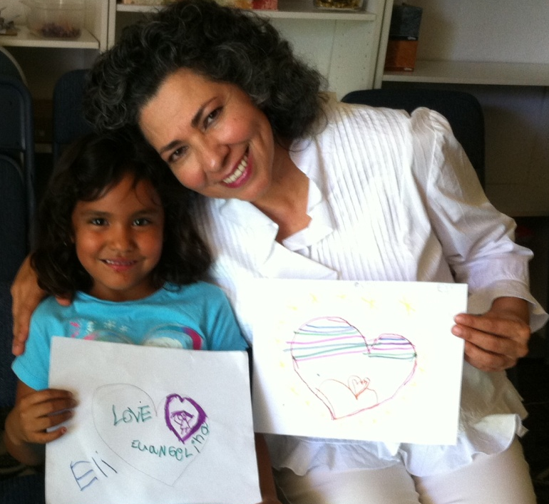

Slide 23
A theoretical model
(with correlational data)

Slide 24
Methods for collecting pre-project data
Amazon Mechanical Turk
  1,000+ mothers of babies

Slide 25
Statistical controls
Age of the mother
Age of child on assessment date
Baseline levels of fetal movement
Birth order
Birth weight
Child gender
Love for the child during early life
Nutrition during pregnancy
Race
Socio-economic status
Support from partner during pregnancy and after
Stress during pregnancy and after
Verbal engagement with the fetus

Slide 26
Where can the model begin?

Slide 27

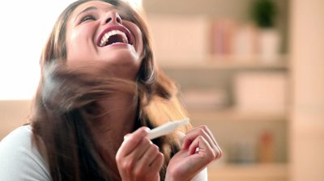
Notes:
Pregnancy is a major life-changing, life-generating event

Slide 28
First and Second Trimesters
Mothers’ Positive Attitudes
Toward Pregnancy

Slide 29
First and Second Trimesters
Third
Trimester
Mothers’ Positive Attitudes
Toward Pregnancy
0.31***
Responsive
Massaging

Slide 30
Rates of responsive massage
“When my baby moved/kicked, I would massage
over the spot where I felt the movement.”

Slide 31
Qualitative data
“I massaged slow and deep because I wanted to "touch", or feel the babies body as much as possible. (Like two hand touching in between glass!). I would usually be in bed thinking about him and
I was ecstatic!”
- Mother of 3 month old girl, rural Georgia

Slide 32
What might happen in-utero as a result of responsive massage?

Slide 33
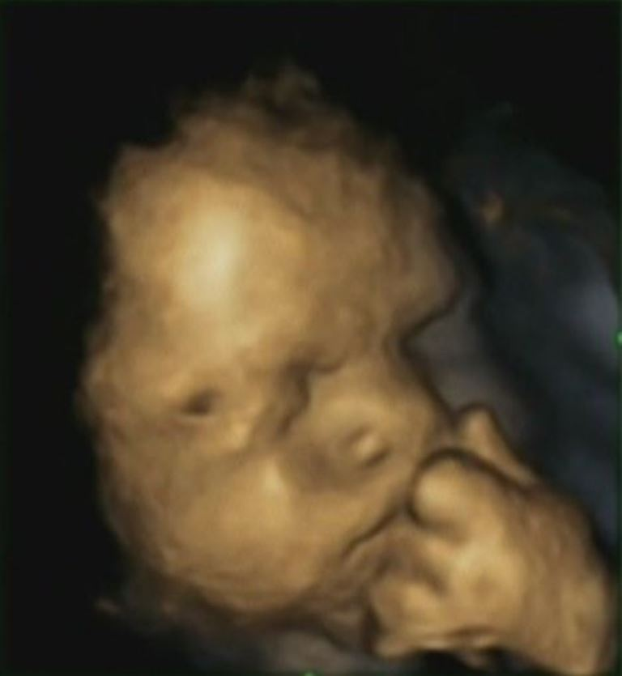
Reissland et al., 2013

Slide 34
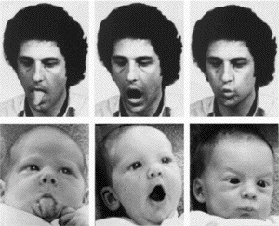
Meltzoff et al., 1977

Slide 35
First and Second Trimesters
Third
Trimester
First Year
of Life
Reported Ability
To Imitate Facial Expression
0.24**
Mothers’ Positive Attitudes
Toward Pregnancy
0.31***
Responsive
Massaging

Slide 36
First and Second Trimesters
Third
Trimester
First Year
of Life
Reported Ability
To Imitate Facial Expression
0.24**
Mothers’ Positive Attitudes
Toward Pregnancy
0.31***
Responsive
Massaging
Enhanced Socio-Emotional Abilities

Slide 37
p=0.0001,
d=0.95
p=0.001,
d=0.88
p=0.002,
d=0.73
p=0.01, d=0.58

Slide 38
First and Second Trimesters
Third
Trimester
First Year
of Life
Second Year
of Life
Enhanced Ability
to Engage Responsively with Adults
Reported Ability
To Imitate Facial Expressions
0.24**
Mothers’ Positive Attitudes
Toward Pregnancy
0.31***
Responsive
Massaging
Enhanced Socio-Emotional Abilities

Slide 39
Does the baby point to show you something interesting?
Chi-Square = 9.26,
p = 0.01

Slide 40
Does the baby reach up to signal a wish to be picked up?
Chi-Square = 6.67,
p = 0.03

Slide 41
First and Second Trimesters
Third
Trimester
First Year
of Life
Second Year
of Life
Enhanced Ability
to Engage Responsively with Adults
Reported Ability
To Imitate Facial Expressions
0.24**
Mothers’ Positive Attitudes
Toward Pregnancy
0.31***
Responsive
Massaging
More Helping, Sharing, and Generosity
in New Situations
Enhanced Socio-Emotional Abilities

Slide 42
Relationships foster the seeds of virtue
Parallel Play
Reciprocal Play
Cortes Barragan & Dweck, 2014, PNAS

Slide 43
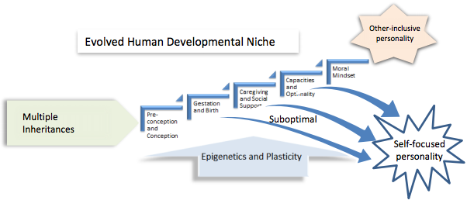
Narvaez, in press

Slide 45
An Experiment is Needed

Slide 46
Methods
Massage experimental condition:
  Mothers asked to try to massage your baby whenever you feel a move/kick, if it is possible given their day
Control condition 1:
  Mothers asked to keep a log of the amount of naturally occurring moves/kicks they feel each day
Control condition 2:
  Mothers given an interesting, helpful packet of information about pregnancy and infant development

Slide 47
First and Second Trimesters
Third
Trimester
First Year
of Life
Second Year
of Life
+ Interviews!
Enhanced Ability
to Engage Responsively with Adults
Ability
To Imitate Facial Expressions
0.24**
Mothers’ Positive Attitudes
Toward Pregnancy
0.31***
Responsive
Massaging
More Helping, Sharing, and Generosity
in New Situations
Enhanced Socio-Emotional Abilities
+ Ultrasound!

Slide 48
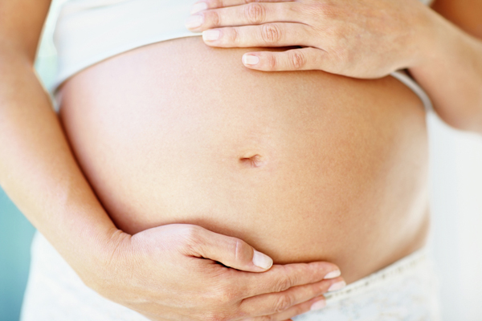
Innovative, potentially important
Potential contribution to the humanities, as well as the biological, biomedical, and social sciences

Slide 49
Deep Integration
The project team members
  Systematization of the humanistic gestation therapy described in La Vida es un Milagro
  Different sites:
    Palo Alto/Berkeley – postdoc
    Los Angeles – Fraternidad 2000
    Guadalajara, Mexico – Fraternidad 2000
  Interpret rich qualitative interview data to make sure we examine how every-day experiences during pregnancy and early motherhood may contribute to the development of virtue in the baby

Slide 50
Potential Challenges and Strategies
Vulnerable population: Could it backfire?
  Stanford doctors have approved the experiment
Challenging time for families
  High compensation to reduce attrition

Slide 51
First and Second Trimesters
Third
Trimester
First Year
of Life
Second Year
of Life
+ Interviews!
Enhanced Ability
to Engage Responsively with Adults
Reported Ability
To Imitate Facial Expressions
0.24**
Mothers’ Positive Attitudes
Toward Pregnancy
0.31***
Responsive
Massaging
More Helping, Sharing, and Generosity
in New Situations
Enhanced Socio-Emotional Abilities
+ Ultrasound!

Slide 52
Thank you!

Slide 53
Thank you!

