Slide 1
Who Am I?
Narratives
Memories
Agency
Morals
Capacities
Personality

Slide 2
Who Am I?
Narratives
Memories
Agency
Morals
Capacities
Personality

Slide 3
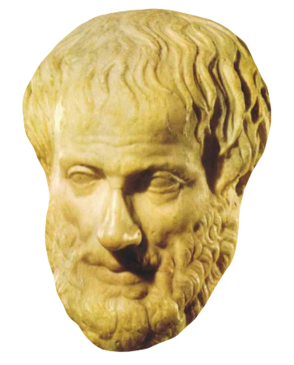
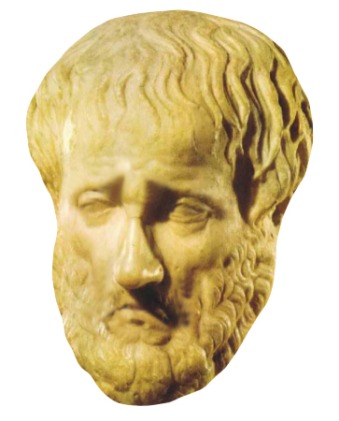


The Moral Self
Synchronic Identity
  Not limited to
  morally-oriented people
  Not restricted to virtues
  Not universal in content
Notes:
OWEN
Virtue/rule
-More significant than other factors
-Both synchronic and diachronic

Slide 4
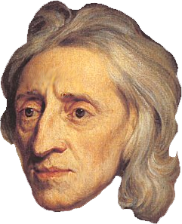

The Moral Self
Diachronic Identity
  More important than
  other traits
  Not individualistic
Notes:
OWEN
Virtue/rule
-More significant than other factors
-Both synchronic and diachronic

Slide 5
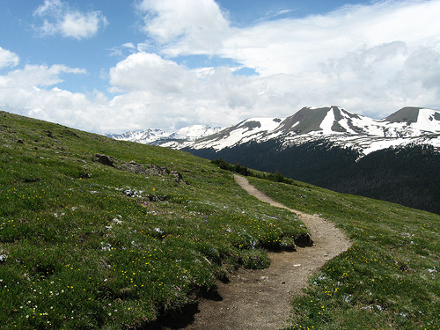

What Our Team Has Learned So Far
4.4
2.2
Morals
Memory
In this scenario, to what extent are you the
same person as before the accident?
Notes:
Imagine that you accidentally fall while walking in the mountains. The accident causes a head injury that has a profound effect on your values. Your memory and general intelligence remain the same as before the accident, but the injury causes you to stop behaving morally. For example, before the accident you used to do helpful things for people in your community, and, after the accident, you stop caring about any of that and only act to fulfill your own happiness even at the expense of others.

Slide 6


What Our Team Has Learned So Far
Strohminger & Nichols (2014)
Notes:
COGNITIIN Silver bullet study

Slide 7
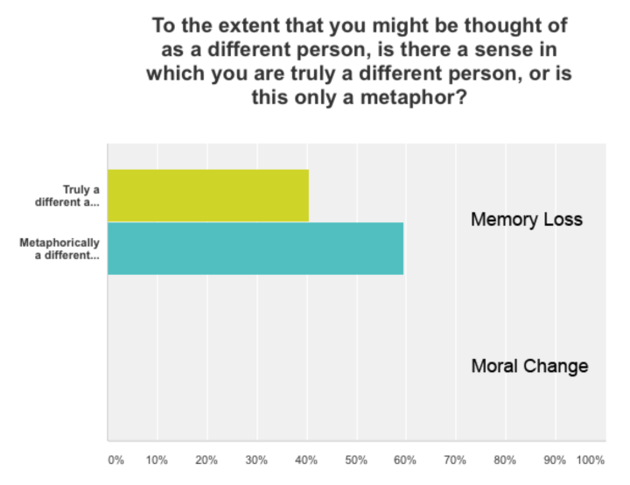
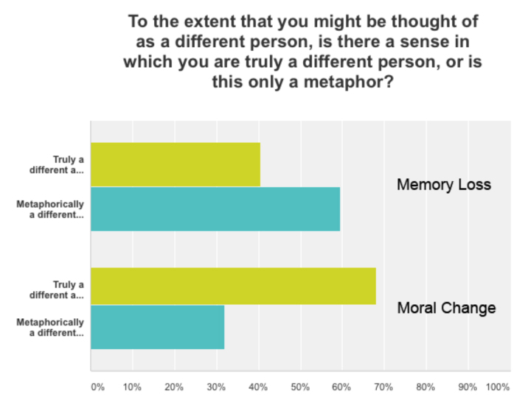

Slide 8
Morals
Work
Home
Taste
Pastimes
Notes:
Same pattern if we include only those who value each dimension highly
Means of those who are above midline in a probe to test importance of each

Slide 9
So many questions…
Bearing on
responsibility?
Individual
differences?
Relation to group identity?
Understanding of Moral Self
How is it
implemented?
Influence on
behavior?
Explicit vs. Implicit
Identification?
Mechanisms and Behavior
Notes:
JUST AN EFFECT
POP-UPS and CIRCLES
(real world)
How people comprehend the moral self
Underlying mechanisms and behavioral effects
RESPONSIBILITY
SOCIAL GROUPS
PROSOCIALITY
MECHANISMS
INDIVUDAL DIFFERENCS
IMPLICT/EXPLICIT

Slide 10
Year 1
How Do People Understand the Moral Self?

Slide 11
1
Responsibility and the Moral Self

Slide 12
Work in progress…

Slide 13
% who say a prisoner definitely deserves to remain in jail after transformation
Notes:
CONCRETE CASE
Memory case: 48% above midline for Parole board should release
Moral case: 56% above midline for Parole board should release

Slide 14
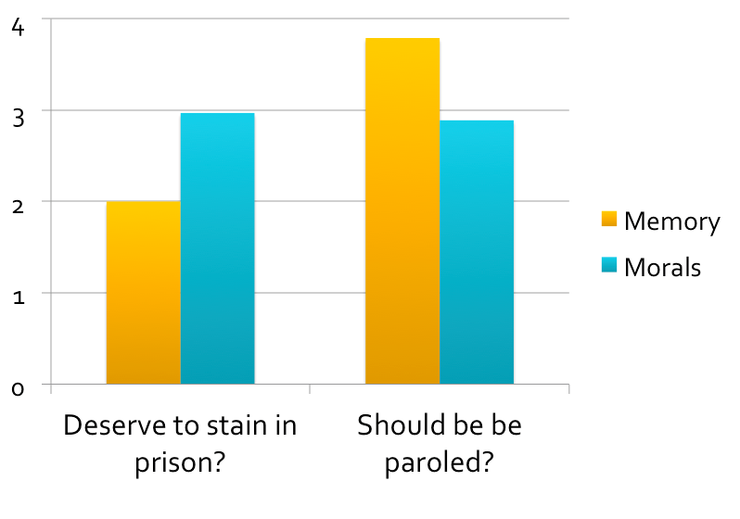
No
Yes
Notes:
ABSTRACT CASE

Slide 15
Project Directions
Corruption vs. Reform asymmetries
Reward vs. punishment asymmetries
Notes:
Prison reform
Corruption vs. Reform

Slide 16
2
Signaling and the Moral Self

Slide 17
Work in progress…

Slide 18

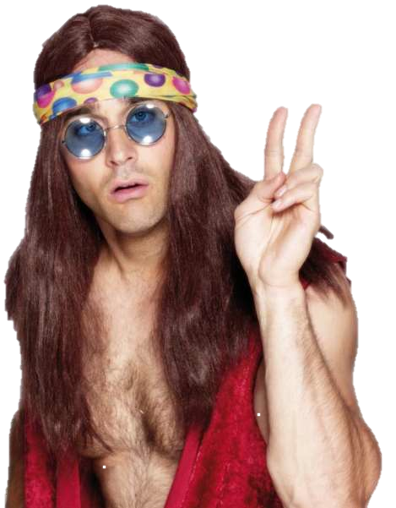
Guess My Values?

Slide 19
Conservative and Liberal Taste

Slide 20
Project Directions
Moral identity and social identity
  In-group/Out-group bias
Self-sacrifice for moral group
(cf. Swann et al. on suicide terrorism)

Slide 21
3
Variation in the Moral Self

Slide 22
Ongoing work…

Slide 23
Psychopathy

Slide 24
depression
aphasia
.15*
.033
amnesia
-.028
.77***
moral
identity
-.098
apraxia
-.005
-.015
personality
duration
Strohminger & Nichols (under review)
Strohminger & Nichols (under review)
Notes:
General shape of the model (this doesn’t include all items measured)
Big SEM model (all Ss), N = 248
numbers are standardized estimates
moral character
not just emotions

Slide 25
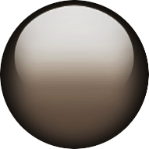
Project Directions
  Clinical populations
    Psychopathy subcomponents
    Memory deficits (Klein)
    Depression
    Autism
  Comparative populations
    Moral experts: clergy/philosophers
    Cultural differences
  Real-world transformations
    Moral injury
    Religious conversion

Slide 26
Year 2
What Are the
Mechanisms and Behavioral Effects?

Slide 27
4
Avowal and the Moral Self

Slide 28
Work in progress…

Slide 29
Avowal/Disavowal Pilot
Loss of homophobic attitudes and behavior

Slide 30
Project Directions
Moral self effect reduces for changes in disavowed values
  Selfishness
  Hypocrisy
  Intolerance
Priming moral self can reduce:
  Bias (IAT measures)
  Self-serving behaviors (above)

Slide 31
5
Mechanisms of the Moral Self

Slide 32
Hypotheses
Psychometrics
Load
Cognition: Moral self as automatic
Emotion: Affect as mediator
Arousal
Manipulation

Slide 33
6
Motivation and the Moral Self

Slide 34
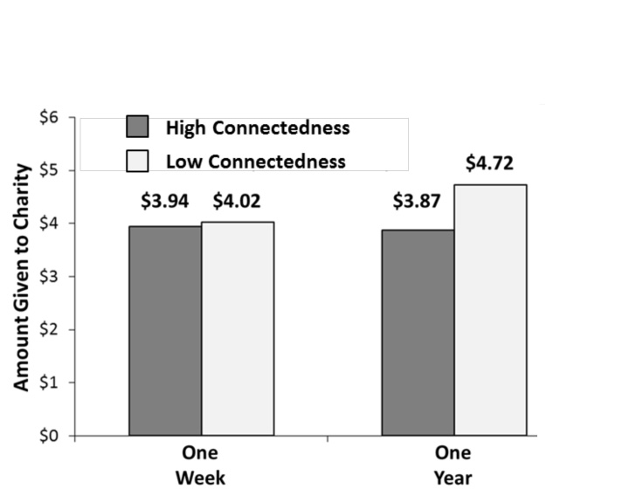
Prior Work
Notes:
Bartels Kvaran Nichols 2013 cognition

Slide 35
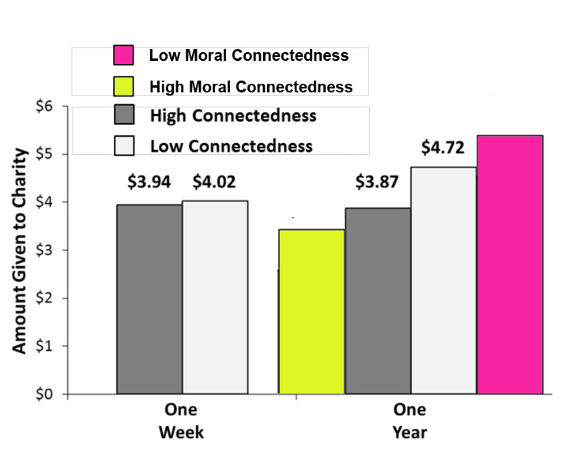
Project Directions
Notes:
And other things (MORAL SELF AS NEC AND SUFF FOR ONENESS/ALTRUSITM CONNECTION)

Slide 36
Looking Forward

Slide 37
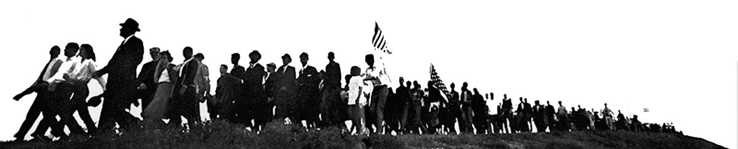
Moral Self is…
Central to identity
Crucial for responsibility
Automatic and emotional
Constrained by avowal
Fundamentally social
Crucial for real-world behavior
Notes:
Tweak bullet 2

Slide 38
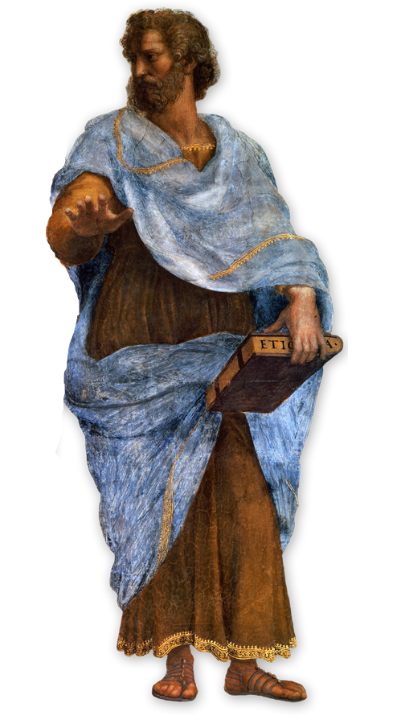
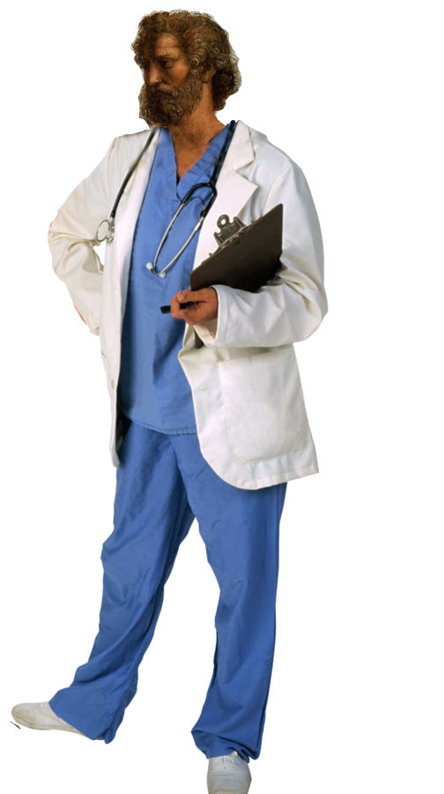
Deep Integration
Interdisciplinary Team
  Philosophy
  Psychology
Track Record of Success
  Pioneers of ex-phi
  Pioneering work on moral self
  History of collaboration
Methodological Pluralism
  All have gone beyond questionnaires
Perfect Fit with SMV Objectives

Slide 39
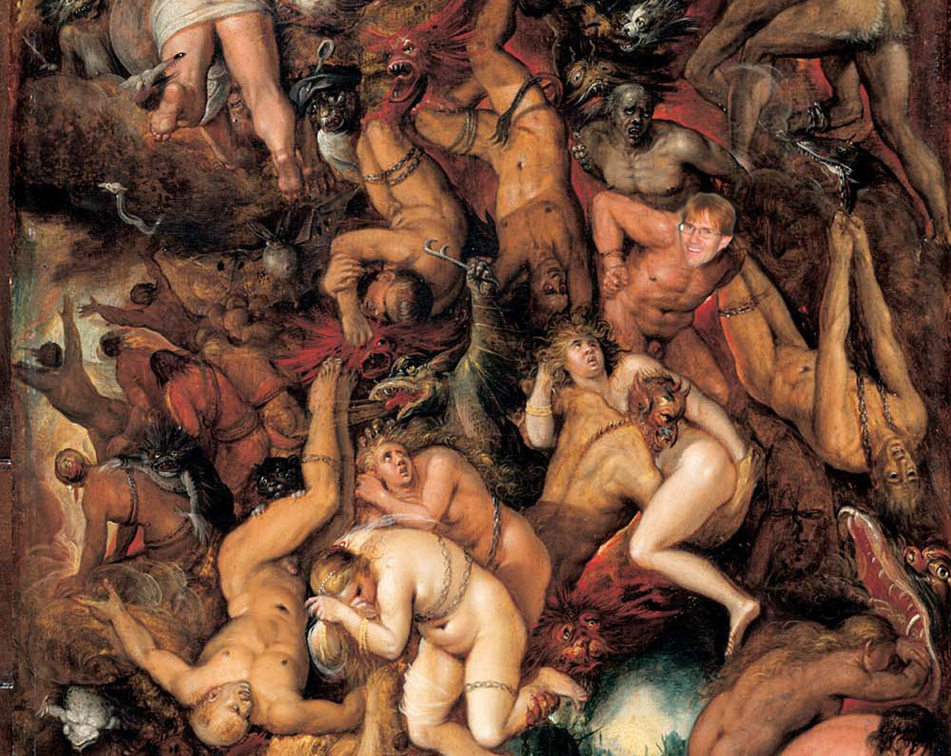
Thanks!
Notes:
We are SO excited

Slide 40
Project Directions
Oneness and moral self
  Moral ingroups and altruism
  Moral outgroups and empathy
Priming and Giving
  Biography vs. Values
  Future selves

Slide 41
Prior Work
  Cognitive control (self neglected)
  Morality and emotion (self neglected)
  Hypotheses
    Morality-Self connection as automatic
    Emotions as mediators
Notes:
Self neglected in notes, not slide

Slide 42
Prior Work
  Frankfurt et al. on identification
  IAT and implicit bias vs. explicit
  Question: Are disavowed implicit values really me?

Slide 43
Prior work
  Individual differences in moral identification (e.g., Erikson, Blasi)
  Clinical populations…

Slide 44
Morals
Work
Home
Taste
Pastimes

Slide 45
Maximum punishment allowed by school
No punishment at all
Notes:
Thierney et al. Cheated last week/year x connectness high/low
All of this is looking really good for Parfit/Buddhist. These manipulations actually change people’s economic and moral decisions. Now let’s look at how people feel about death.

Slide 46
Prior Work
Oneness and altruism (Chialdini)
Moral identity and prosociality (Hardy)
Safeguard against situations (Aquino)
Change and charity (Bartels et al.)…

Slide 47
FTD
paranoia
motivation
eating
empathy
antisocial
1.21***
moral
identity
apathy
inhibitions
.135
sex
obsessions
compulsions
attention
Strohminger & Nichols (under review)
Notes:
just FTD patients
moral behavior
not just higher cognition
sex p = .07

Slide 48
Cognitive Impairment
Age-Related Change

Slide 49

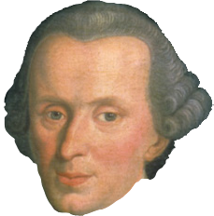
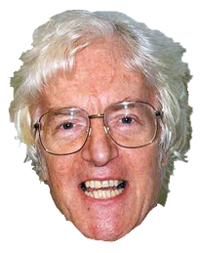
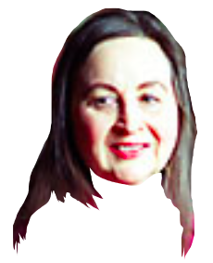
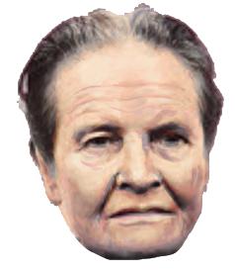
The Moral Self
Notes:
OWEN
Virtue/rule
-More significant than other factors
-Both synchronic and diachronic

