Slide 1
Policies, Models, & Trends in Open Access, Open Data & Persistent Identifiers:
An overview and update
Clarke Iakovakis , Dani Kirsch, and Matt Upson
Oklahoma Association of College & Research Libraries Conference
November 8, 2024
This slide deck is licensed by Clarke Iakovakis, Dani Kirsch and Matt Upson under a CC BY 4.0 International License.
Download Slides:

Slide 2
Federal Public Access Policies, Federal Purpose License, and Persistent IDs

Slide 3
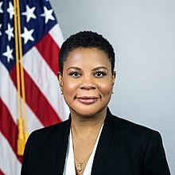
OSTP Public Access Memo: “Ensuring Free, Immediate, and Equitable Access to Federally Funded Research”
Memorandum issued by Dr. Alondra Nelson, Deputy Director for Science and Society, OSTP, on August 25, 2022
Kicks off a process to direct agencies to update/write public access policies to make publications and their supporting data resulting from federally funded research publicly accessible without an embargo
Outlines the “what” and the “when” but intentionally leaves the “how” up to the agencies, and by extension, the larger ecosystem(s) that supports the creation and dissemination of scholarly research.
We are still in a period of uncertainty
  This line has been a part of my presentation since I started giving it in 2022

Slide 4
The Nelson Memo is based on principles and vision
“Openness and security are not contradictory. They are complimentary, and mutually reinforcing... Without openness, fundamental research would never realize its potential...making fundamental research closed off — hiding more science behind walls and in the shadows — will not solve the problem. It will only stifle our own innovation, and curtail our competitive advantage — just as limiting openness will only limit the bounds of our discoveries.
“...[T]he solution isn’t more shadows. The solution is sunlight.
“...[L]et us replace the phrase “as open as possible, as secure as necessary” in the global scientific discourse with a mindset of “openness is fundamental, security is essential, and freedom and integrity are crucial.”
- Alondra Nelson, OSTP Director

Slide 5
Process
Agencies are developing plans, then the White House, Congress and the committees will discuss how those models will work for the people those members represent
  Through a series of Congressional hearings, OSTP round tables, stakeholders (public, researchers, publishers, libraries)
Agencies will petition Congress for funding; Congress will pass legislation (via Appropriations Committee and whatever riders added to that)
  We have already seen an appropriations bill with language that would prohibit federal resources from implementing the memo
Guidance associated with funding will construe the implementation of the policy

Slide 6
Not “Open Access Mandate,” but “Public Access Recommendations”
At this point it is framed as a set of recommendations/guidance rather than mandate
  Agencies are still responding as they are required to, but it remains to be seen the extent to which this will become a mandate, and how they will incorporate the memo’s guidance
The memo is not prescriptive in terms of how articles are to be made open and what versions of the article (e.g. preprint, post-reviewed manuscript, version of record), and how the work should be licensed
Also not outlined
  Who is responsible for compliance
  How compliance will be monitored
  Consequences for non-compliance

Slide 7
Timeline
Aug 2022: Memo published
Feb 2023 Policy updates due from agencies with $100m+ R&D funding
Aug 2023: Policy updates due from agencies with less than $100m+ R&D funding
Dec 2024: Deadline for agencies to publish final policies
Dec 2025: New policies in effect
Dec 2026: Policy updates due regarding provisions related to supporting research and scientific integrity

Slide 8
Updates from 2013 Holdren Memo
Holdren memo applied only to agencies with research & development budgets over $100 million; the Nelson Memo is directed at all federal grantmaking agencies
Holdren memo allowed for 12 month embargo from public access; the Nelson memo requires immediate public access
Holdren memo covered only peer-reviewed manuscripts; Nelson memo: “may include” peer-reviewed manuscripts, peer-reviewed book chapters, editorials, and peer-reviewed conference proceedings published in other scholarly outlets

Slide 9
Updates from 2013 Holdren Memo
Plans should describe how to maximize equitable reach: formats that allow for machine-readability and enabling
  broad accessibility through assistive devices
  citation tracking & harvesting
  metadata optimization for lit reviews/meta-analyses/systematic reviews
  text mining
    Quick note on new DMCA exemption issued by Librarian of Congress last month allowing for research universities to provide access to TDM corpora for use by researchers at other universities.
Plans should describe use and reuse rights, and any restrictions including attribution.
  The Nelson memo does not stipulate that articles must be openly licensed

Slide 10
Update 5: Scientific data
Defined as “The recorded factual material commonly accepted in the scientific community as of sufficient quality to validate and replicate research findings.”
Nelson memo removes much of the language associated with limitations on sharing due to “feasibility”
Data should be made freely available and publicly accessible by default at time of publication and subject to federal agency guidelines for researcher responsibilities regarding DMSPs
Agencies should also develop approaches for “sharing other federally funded research data that are not associated with peer-reviewed scholarly publication”

Slide 11
Update 5: Scientific data
Public access plans should outline policies agencies will use to establish researcher responsibilities on how federally funded scientific data will be managed
Plans to maximize “appropriate” sharing of data
Agencies should provide specific online digital repository or repositories where researcher expects to deposit relevant data, consistent with federal agency's guidelines

Slide 12
Funding the Nelson Memo
In consultation with OMB, agencies should allow researchers to
  include reasonable publication costs
  and costs associated with
    submission
    curation
    management of data
    special handling instructions
Costs can be charged against contracts, grants, and research budgets
  NIH/NSF permit this in allowable expenses
  Offsets any new financial burdens on authors
  Most federal agencies that fund scientific research currently do not explicitly set aside dedicated funding for these costs and do not track such expenditures

Slide 13
Reporting/compliance
Agencies should report to OSTP when requested on the status of public access plans, including number of all scholarly publications funded & other relevant statistics
This means that there will be some compliance/tracking mechanisms, but what that looks like is yet to be determined

Slide 14
Scientific and Research Integrity
Public should be able to identify
  Authors (by Digital Public Identifier—more on this to come), affiliations, date(s) of publication
  Which agencies support given investments
  Researchers
  Extent to which peer review was conducted
Collect and make publicly available appropriate metadata associated with scholarly publications and data resulting from research at the time of deposit in public access repository
Instruct researchers to obtain DPI (ORCID), include it in outputs and provide agencies with metadata associated with outputs
Assign DPIs to all awards and intramural research protocols with metadata linking agency and awardees through DPIs

Slide 15
Possible scenarios
Additional federal dollars, provided by US taxpayers and distributed through federal agencies, are used to fund public access
  Researchers fund APCs directly from grant research budgets
Deposit of Author Accepted Manuscript becomes normative
  In theory, focusing on public repositories that can house the accepted, peer-reviewed versions of papers allows journals to continue charging institutions subscription fees and keeping final papers behind a paywall.
  In practice, eliminating the 12-month delay before US research is made open might change that, if publishers fear losing subscription income. (Tollefson & Van Noorden)
  What about cases in which significant editing takes place after acceptance and there are differences?
Institutions fund it
  Via the library through developing local infrastructure such as institutional and data repositories and associated services
  Or paid directly to publishers on behalf of researchers, as in existing Transformative (or Read and Publish) agreements or APCs in Gold or Hybrid journals

Slide 16
Possible scenarios
For publishers
  absorb some or all of these additional costs as part of the publication process
  embrace author manuscripts deposited in repositories, hoping that the value added by discovery in their systems (and by other aggregators), the layout/pagination/formatting/copyediting offsets potential disadvantage of reviewed manuscripts available elsewhere
  enter into more transformative agreements
  advocate for stream of revenue directly from funders to publishers to make articles OA
    hybrid: subscription + OA fees (receiving some pushback from libraries and institutions seeking sustainability and balance in subscription fees)

Slide 17
Questions
What funding threshold triggers the policy? (e.g. summer or yearlong funding)
How to determine what portion of a final output was agency funded?
Where to deposit?
  Does “agency-designated repository” exclude institutional repositories?
What version?
Defining data
  e.g. a history researcher’s photographs of archival documents?

Slide 18
Questions
Is this a mandate or a recommendation?
How to address equity issues associated with transformative agreements?
What is the nature of the OSTP’s statutory authority over federal agencies? If an agency opts not to follow the terms laid out in the Nelson Memo, will there be any consequences? If so, what would they be?
Does the Nelson Memo wholly supersede the Holdren Memo, or are terms of the latter not directly altered by those of the Nelson Memo – such as, for example, the requirement that agencies incorporate in their plans a “strategy… for fostering public-private partnerships with scientific journals relevant to the agency’s research” – still in force?
  Quoted from https://scholarlykitchen.sspnet.org/2022/08/29/a-new-ostp-memo-some-initial-observations-and-questions/

Slide 19
Questions
Do institutions need to ensure grant applications include resources to support Article Processing Charges?
How will business relationships with publishers shift
  transformative agreements or other negotiated OA models

Slide 20
Need for Federal Purpose License
From the Right to Deposit:
Author ability to negotiate terms of publishing contracts is limited because as individuals they have little bargaining power.
Institutional OA policies do not reach all authors, and publishers can require authors to opt out of the policy as a precondition for publishing.
Institutional efforts to negotiate rights with publishers to deposit work with no embargo generally face tremendous resistance from publishers and tend to provide more benefit to authors at wealthier institutions versus authors at less-resourced institutions.
Some authors may have funding from multiple federal sources and could be overburdened if there are discrepancies and inconsistencies in guidance language and implementation across agencies.

Slide 21
Federal Purpose License (aka the “government use license”)
See the “Right to Deposit” initiative and this useful fact sheet from Emory
Already
Provides agencies with nonexclusive rights to articles resulting from federally funded research
  it takes effect immediately upon signing the grant agreement, meaning the agency retains it even if the author signs exclusive agreements with publishers
The license is non-exclusive, meaning authors still retain rights to their research products.
The DOE has been relying on the license for years; the government’s authority under the license has existed since at least 1976.

Slide 22
NISO US National Persistent Identifier Strategy
The National Information Standards Organization (NISO) develops national standards and best practices related to publishing, bibliographic, library applications
Sep 2024 NISO members approved the formation of a Working Group to develop a standard for a United States national PID strategy following circulation of their Developing a US National PID Strategy report

Slide 23
PIDs are:
Globally unique digital identifiers identifying an entity
Persistent
Machine resolvable
Include associated metadata schema
Can be used to disambiguate between entities
Interoperate and reference each other within research discovery and management systems

Slide 24
PID examples
Digital Object Identifiers (DOIs) : textual outputs, datasets, software
Research Organization Registry (RORs) : organizations, funders
Open Researcher and Contributor ID (ORCIDs) : researcher
Data Management Plan ID (DMP-ID) : data management and sharing plan
Grant ID : grant/award

Slide 25
PIDs should
Include freely available and open exchange of basic metadata
Use well-established resolver services (i.e. connect PID to more information about the object to which it refers)
Have documented and published policies alongside schema descriptions to provide clarity and transparency
Be actively monitored to remain functional
Have a simple proves for assigning the ID and creating record metadata
Should have standardized structures, metadata, and services allowing for community input
Allow for extensibility (adapt to new use cases)
Be accountable to the user community that adopts them

Slide 26
Recommendations
A unified strategy ensures compliance with U.S. public access policies, benefiting both federal agencies and research institutions.
  By standardizing PIDs, agencies can track research outputs, measure research impact, and improve public access to results from federally funded projects.
  For universities and research institutions, consistent PIDs facilitate compliance and ensure research data, publications, and software are traceable across organizations.
Embed open science principles to keep scholarly work open and available
Prioritize infrastructure that supports research community needs

Slide 27
Resources
NIH DMS Policy
Policy & FAQ from NIH
Key resource: Working group on NIH DMSP Guidance
VCU support site
Desirable Characteristics of Data Repositories for Federally Funded Research
State of Open Data 2022 report
DMP Tool
OSU support site
Presentation slides
  NIH DMS Policy in a Nutshell
  Preparing for the NIH DMSP: Researcher Needs and Perspectives
  Choosing a Data Repository: Interpreting the NIH DMS Policy
  Delivering on the Promises: Meeting What They Put in the NIH DMPs
  Preparing Librarians and Researchers for the NIH Data Management and Sharing Policy
NSPM-33
NSPM-33 Implementation Guidance
NSPM-33 & ORCID: Information for Research Organizations
Federal Purpose License
Right to Deposit Statement
Emory Fact Sheet
OSTP
Nelson Memo & accompanying report on Economic Landscape of Federal Public Access Policy
2021 OSTP report on progress of public access
2013 & 2022 memo comparison
Letter to OSTP from House Committee on Science, Space & Technology members
Taylor, et al. Realities of Academic Data Sharing (RADS) Initiative: Public Access Data Management and Sharing Activities for Academic Administration and Researchers. Association of Research Libraries. 2022.
Articles
  Zero Embargo
  Quantifying the Impact of the OSTP Policy
  Speculation on the Most Likely OSTP Nelson Memo Implementation Scenario and the Resulting Publisher Strategies
  The Nelson Memo: More Questions than Answers
Presentations
  OSTP Community Forum on the 2022 OSTP Public Access Policy Guidance
  Association of Research Libraries listening session
National PID Strategy
Developing a US National PID Strategy. ORFG PID Strategy Working Group. 2024. Zenodo. https://doi.org/10.5281/zenodo.10811008
  6 Episode YouTube series on Developing a National PID Strategy
Desirable Characteristics of Persistent Identifiers

Slide 28

data
data
data
Photo by Finn Hackshaw on Unsplash

Slide 29
Research Data Services @ OSU
Workshops
  Carpentries – coding & data literacy
  Data Bytes – data management & sharing, research tools
  FAST START – orientation to research support & resources at OSU
One-shot instruction (graduate & undergraduate)
  Data management, data literacy
Faculty communications
  Data check-ups, emails
Consultations
  Data management plan feedback, data repository selection, coding support, finding data sources

Slide 30
Challenges: Research Data Services
Information-Gathering –
  Differences in agency policies
  Variation in data management plan contents & formatting
Compliance –
  Uncertainty regarding follow-up and enforcement of policy compliance (if any) from agencies, program officers on data sharing & other requirements after grant is closed
Researcher-to-Support Mismatch –
  $64 million from U.S. federal government spent on research & development¹
  1,817 faculty as of Fall 2023²
  4,465 master’s & doctoral students enrolled for Fall 2024²
  1 Research Data Services Librarian
NOTE: not all faculty & graduate students conduct research
¹FY23 HERD Survey (PDF); ²OSU Institutional Research & Analytics University Quick Facts

Slide 31
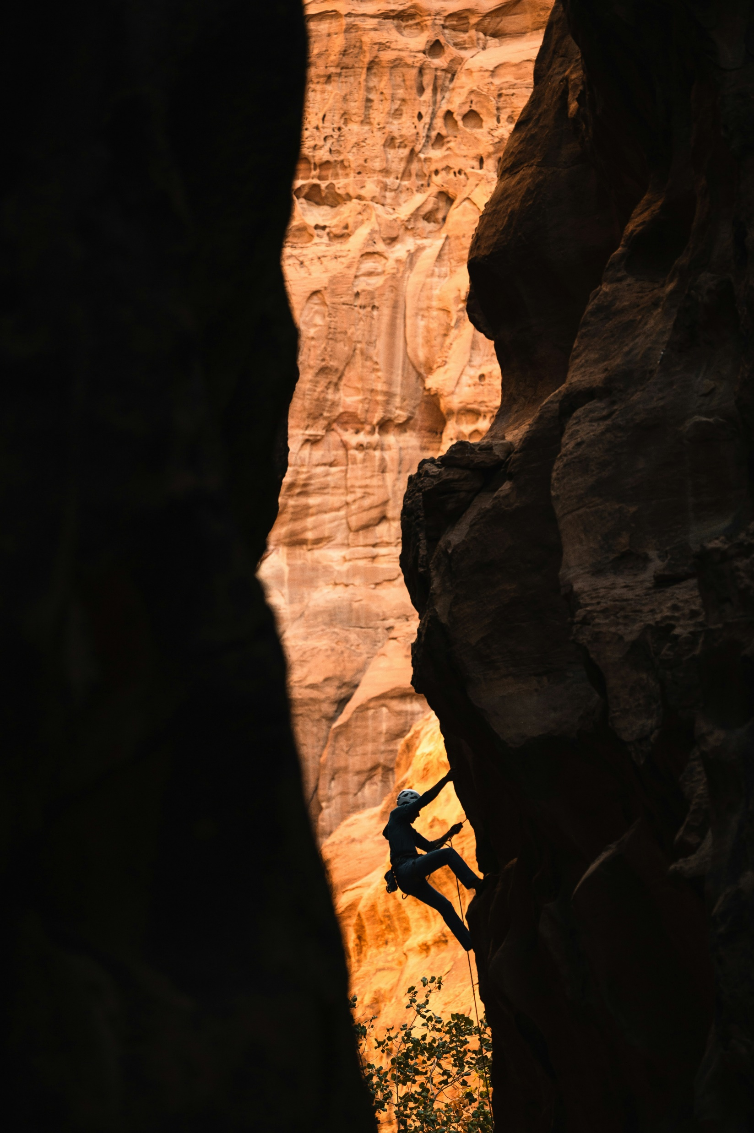
Addressing challenges
Photo by NEOM on Unsplash
Information-Gathering –
  Periodic scans & updates of agency policies
  Links to DMP templates, folder with downloaded templates & guidance
  Conversations with other data librarians (e.g., MDLS) & Sponsored Programs
Compliance –
  See what agencies are saying/doing
    e.g., insight from Sponsored Programs personnel, PIs on grants
  Internal analysis of OSU-authored DMPs from FY24
Researcher-to-Support Mismatch –
  Keep other research support units up to speed
    e.g., IRB & data sharing, Sponsored Programs & DMP contents/budgeting
  Internal support & idea-sharing from Scholarly Services & Research and Learning Engagement librarians

Slide 32
Opportunities: Research Data Services
Increased optics –
  Need for federal funding agency policy compliance could bring more researchers to research data services
    e.g., request for data management plan feedback, data sharing support
Conversation-starter –
  Creating and/or updating university policies (e.g., data ownership/stewardship) to align with federal policies
  Communicating & coordinating with other research support units about relevant information, actions, support
    e.g., Research Compliance, Sponsored Programs, other OSU librarians
Next generation support
  Strong relationship with Graduate College & major partner in professional development program

Slide 33

Taking advantage of opportunities
Increased optics –
  Timing DMP workshops around major grant deadlines
  Continued presence & content in campus newsletters, LibGuides, workshops
Conversation-starter –
  Presently co-developing a data ownership policy to present to the OSU Faculty Council Research Committee
  Internal DMP analysis will lead to conversations with Sponsored Programs
    “boilerplate” language, feedback & guidance on contents
Next generation support
  Contributing to revamping of Grad College professional development program
    “Managing & Sharing Research Data” pathway
Photo by Vasily Koloda on Unsplash

Slide 34

Researcher evaluations & promotion should incorporate research data sharing and impact
Researchers voice concerns about workplace priorities, research metrics, & competition¹
Suggest solutions such as
  Focusing on research quality (not quantity) in promotional criteria²
  Ensure systems reward what researchers value²
    e.g., high quality mentorship, open scholarly practices
Initiatives like the Declaration on Research Assessment (DORA)³ seek to broaden and improve researcher assessment & evaluation/consideration of research outputs
¹Wellcome Trust report 2020 “What researchers think…”; ²Wellcome Research Culture Townhalls 2020; ³DORA

Slide 35
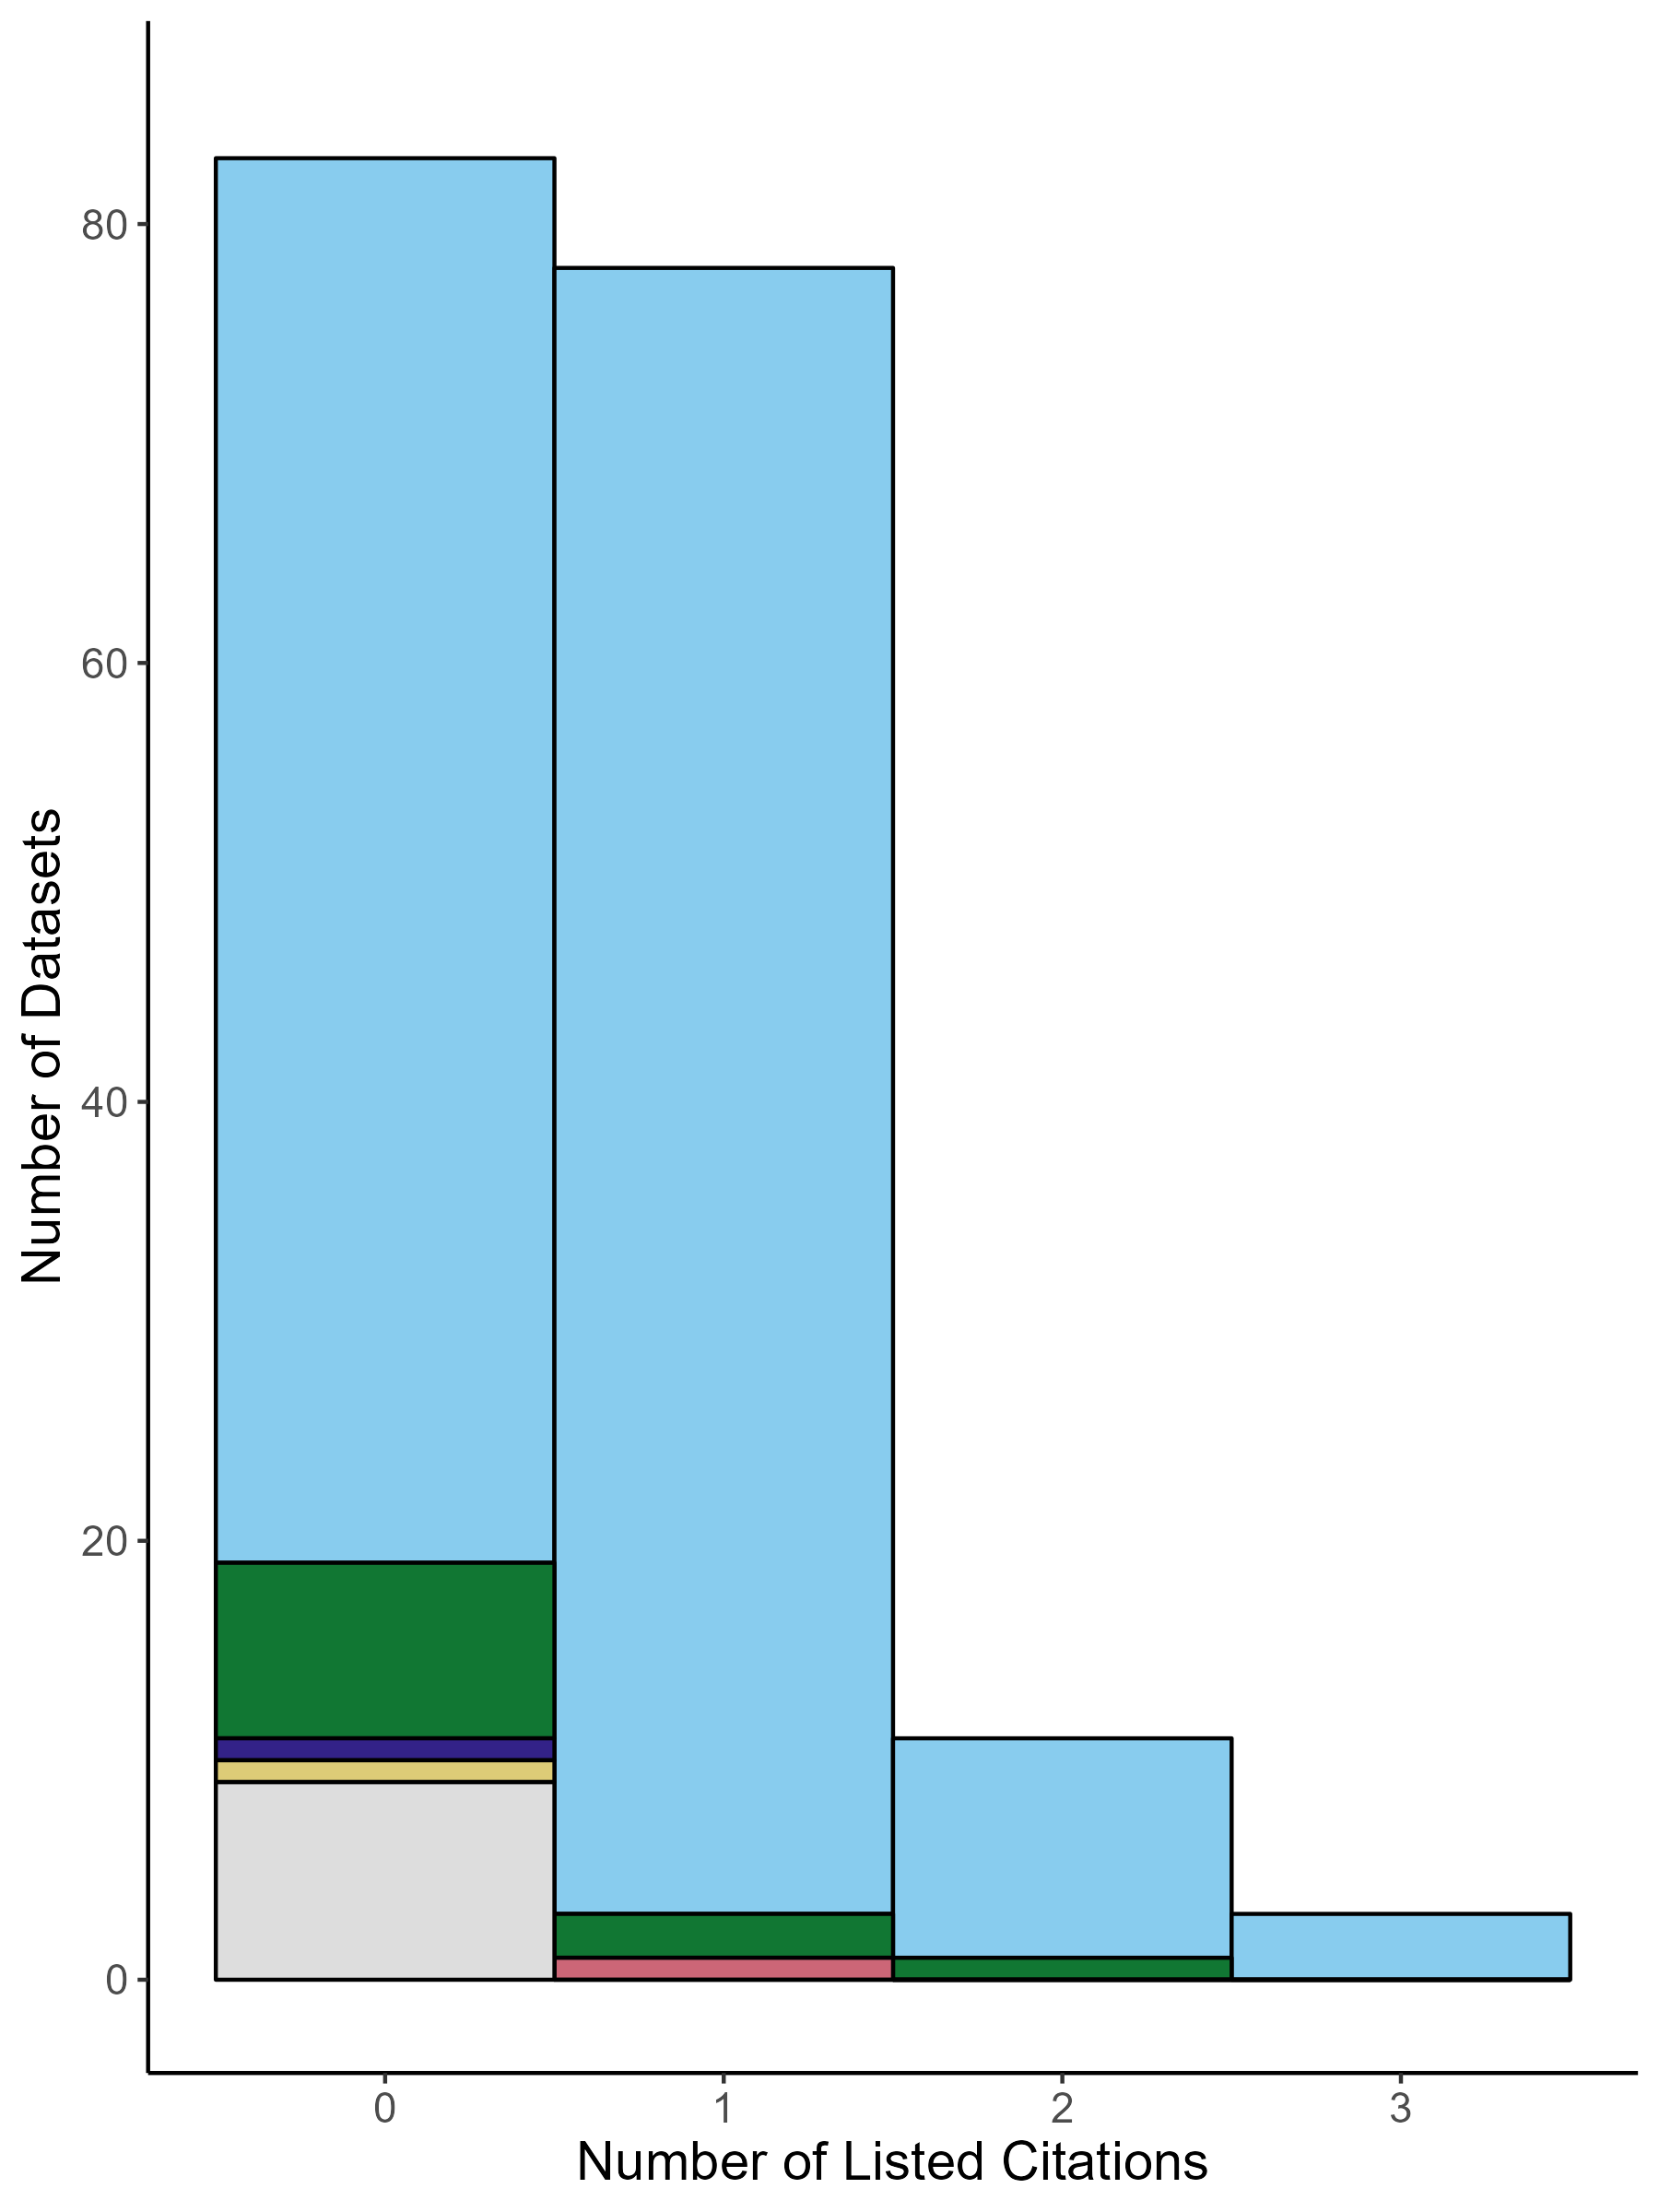
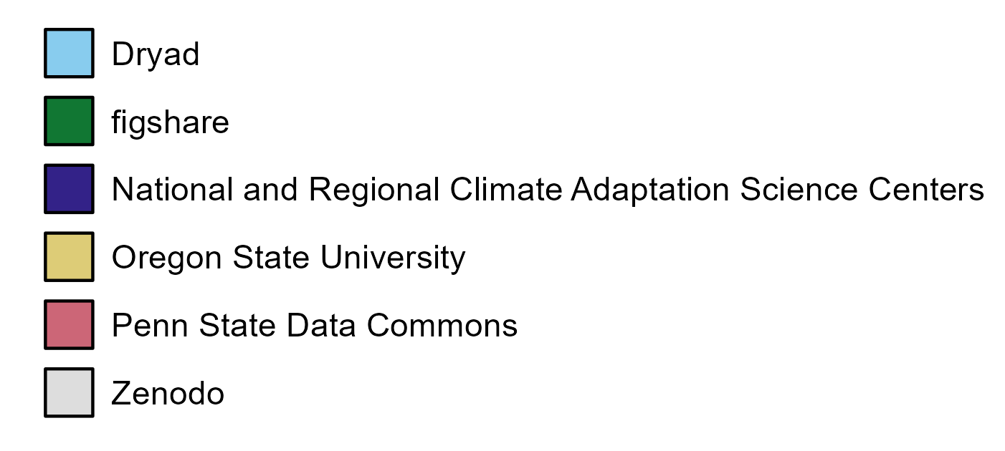
Research data sharing & impact @ OSU
Use of DataCite metadata
  Usage metrics, related works
    If repository provides to DataCite
  Upload datasets (and metadata) into faculty profile system
    Internally track faculty data sharing & impacts
Plans to expand to include other databases (e.g., Crossref)
Number of Datasets
Recorded Citation Count
Using DataCite Metadata to Understand Research Data Sharing Practices at Your Institution: https://osf.io/n9sxq/

Slide 36
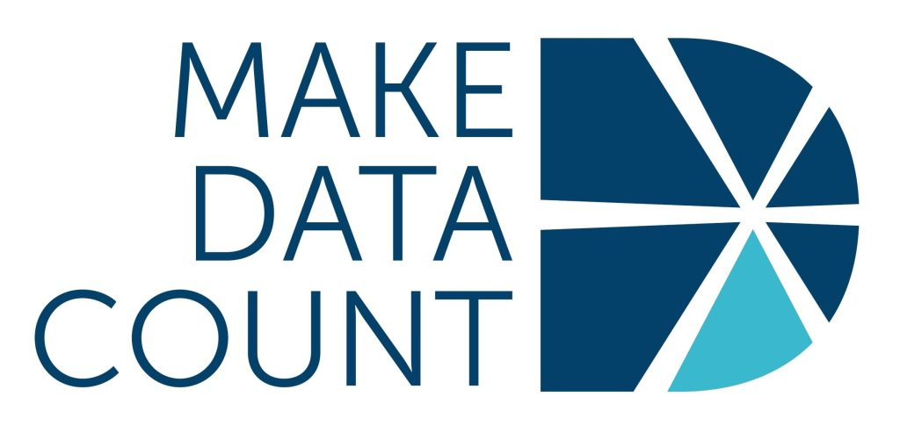
Research data sharing & impact – community efforts
Make Data Count
  Open infrastructure
    Repositories collect & share usage metrics (e.g., views, downloads, citations)
    DataCite Usage Tracker – JavaScript tracker that collects & sends usage data automatically to DataCite
  Standards & evidence
    Contextualize data metrics
    Input from researchers, repositories, & infrastructure providers
  Advocacy
    Recognition of data usage & impact
    Included in funder & institutional assessment of researchers
    Data Citation Corpus – centralized, publicly available database of data citations

Slide 37
Open Access

Slide 38
APCs, Diamond Journals, the “Failure” of OA?
Estimated $8.349 billion spent globally on APCs for six publishers (Elsevier, Frontiers, MDPI, PLOS, Springer Nature, and Wiley) from 2019 – 2023. Spend on OA fees almost tripled over that time. (Haustein et al., 2024)
Estimated that there are up to 29,000 diamond OA journals (Bosman et al., 2021)
As of 2019 - 356,000 articles per year in 10,449 diamond OA journals (based on DOAJ numbers) vs. 453,000 articles per year in 3,919 APC-based journals. In other words, diamond publishing represents 8-9% of total number of scholarly articles publisher year vs. 10-11% represented by APC-based OA (Bosman et al., 2021)
Share of diamond OA declined between 2017 and 2021 (Bosman et al., 2021)
“Pay-to-publish OA is now the dominant form of open access and looks set to increase the cost of scholarly publishing and so worsen the affordability problem. Amongst other things, this has disenfranchised unfunded researchers and those based in the global south (notwithstanding APC waiver promises).” (Anderson, 2023)

Slide 39
MODEL | ADVANTAGES | COMMON BARRIERS | ACTIONS TO REDUCE BARRIERS
Diamond (Platinum) OA Publishing in a fully OA journal funded by libraries, academic institutions, societies, volunteers and/or funders. | No cost to authors or readers. Article is immediately available open access (immediate OA). Straightforward workflow for authors. Authors typically retain copyright and control of their work. Academic governance | Less common, especially in some disciplines. Possible lower perceived prestige, often due to the fact that Diamond journals are not as well established Often relies on disparate funding sources and staffing | Libraries provide infrastructure (e.g., Open journal systems [OJS] hosting) and financial support (e.g., subscribing to 'Subscribe to Open' journals) to encourage innovative OA models and greater diversity of options for authors. Diamond OA aims to address the imbalance of power in scholarly publishing, which is largely held by five publishers, rather than just the symptoms of that monopoly (e.g., expensive article processing charges - APCs).
Adapted from "Overview of OA Publishing Models", created by: Catherine Boden, DeDe Dawson Creation Date: September 2023 This work is licensed under a Creative Commons Attribution 4.0 International License.

Slide 40
MODEL | ADVANTAGES | COMMON BARRIERS | ACTIONS TO REDUCE BARRIERS
Transformative Agreements Libraries or library consortia contract with publishers for affiliated authors to publish OA at a discount in the publisher's collection of gold or hybrid journals. | No cost to readers. Reduced cost for authors. Immediate OA. | TAs may be financially unsustainable for the library community. Can’t predict future output under agreement Workflows for authors and approvers can be complicated or difficult to understand. Publishers can exclude the most prestigious journals from these deals or only be for hybrid journals. Shifting inequity in reading to inequity in ability to publish Capped vs. uncapped | Consortial negotiation power Cost-sharing across involved departments/units
Adapted from "Overview of OA Publishing Models", created by: Catherine Boden, DeDe Dawson Creation Date: September 2023 This work is licensed under a Creative Commons Attribution 4.0 International License.

Slide 41
MODEL | ADVANTAGES | COMMON BARRIERS | ACTIONS TO REDUCE BARRIERS
Subscribe to Open (S2O) Publishers convert journals from subscription to OA based on sufficient level of participation by past subscribers (see Subscribe to Open Community) | Leverages existing library relationships and payments. No additional cost to authors. Potential for immediate OA if revenue targets are met. Encourages libraries to maintain subscriptions. Provides a pathway for traditional subscription journals to transition to OA. | Uncertainty for authors about OA status until revenue targets are met. Funder support is limited or prohibited Potential for content to remain subscription-only if targets are not met. Requires consistent support from subscribing institutions to maintain OA status year over year. | Clear communication from publishers about revenue targets and OA status. Incentives for early subscription to encourage meeting revenue targets. Collaborative efforts between libraries and publishers to promote the model and ensure its sustainability. Exploring ways to guarantee OA status even if revenue targets are not fully met.
Adapted from "Overview of OA Publishing Models", created by: Catherine Boden, DeDe Dawson Creation Date: September 2023 This work is licensed under a Creative Commons Attribution 4.0 International License.

Slide 42
FINDING OA JOURNALS
OSU OA Agreements & Discounts
OSU authors can publish OA at no or reduced Article Processing Charges (APCs).
Helpful Tools:
DOAJ: Use as a quality control database for OA journals.
Sherpa Romeo: Review copyright and archiving policies by journal.
ChronosHub Journal Guide: Compare over 40,000 journals based on criteria like funder compliance.
Journal Finder Tools: Publisher-specific finders from Elsevier, Wiley, Sage, and more.

Slide 43
Opportunities for OSU Authors
https://info.library.okstate.edu/open-access/agreements
We currently participate in the following agreements which allow OSU authors (must typically be the corresponding author) to publish their articles OA without the need to pay an article processing charge (APC). Note that some publishers may drop off or be added over time as agreements are renegotiated.
American Chemical Society
Association of Computing Machinery
Cambridge University Press
The Company of Biologists
Microbiology Society
Oxford University Press (hybrid journals only)
Royal Society of Chemistry
10% APC discounts with SAGE gold titles and MDPI

Slide 44
IMPLICATIONS FOR ACADEMIC LIBRARIES
Evolving role of academic libraries
  Labor
  Funder compliance and research integrity?
Budget and resource allocation considerations
Importance of maintaining diverse OA options
Information Literacy opportunities

Slide 45
References and Further Reading on Transformative Agreements and Diamond OA
Anderson, R. (2023, December 7). Where did the open access movement go wrong? : An interview with Richard Poynder. The Scholarly Kitchen. https://scholarlykitchen.sspnet.org/2023/12/07/where-did-the-open-access-movement-go-wrong-an-interview-with-richard-poynder/
Becerril, A., Bosman, J., Bjørnshauge, L., Frantsvåg, J. E., Kramer, B., Langlais, P.-C., Mounier, P., Proudman, V., Redhead, C., & Torny, D. (2021). OA diamond journals study. Part 2: Recommendations. Zenodo. https://doi.org/10.5281/ZENODO.4562790
Bosman, J., Frantsvåg, J. E., Kramer, B., Langlais, P.-C., & Proudman, V. (2021). OA diamond journals study. Part 1: Findings. Zenodo. https://doi.org/10.5281/ZENODO.4558704
Haustein, S., Schares, E., Alperin, J. P., Hare, M., Butler, L.-A., & Schönfelder, N. (2024). Estimating global article processing charges paid to six publishers for open access between 2019 and 2023 (arXiv:2407.16551). arXiv. http://arxiv.org/abs/2407.16551
Hinchliffe, L. J. (2024, October 21). Leveraging transformative agreements for research integrity. The Scholarly Kitchen. https://scholarlykitchen.sspnet.org/2024/10/21/leveraging-transformative-agreements-for-research-integrity/
Kemp, J., & Skinner, K. (2024). The cost and price of public access to scholarly publications: A synthesis. Invest in Open Infrastructure. https://doi.org/10.5281/ZENODO.14013059
Klebel, T., & Ross-Hellauer, T. (2023). The APC-barrier and its effect on stratification in open access publishing. Quantitative Science Studies, 4(1), 22–43. https://doi.org/10.1162/qss_a_00245
Market watch – esac initiative. (n.d.). Retrieved November 1, 2024, from https://esac-initiative.org/market-watch/

