Slide 1
Creating an open-source solution for tracking library door traffic counts.
Damith Perera - Research Professional - charmdm@okstate.edu
Oklahoma State University – Edmon Low Library
OK-ACRL Pre-Conference Webinar 2024 - Virtual

Slide 2
Index
Bit of history
Live demo
How is this tool useful for your library?

Slide 3
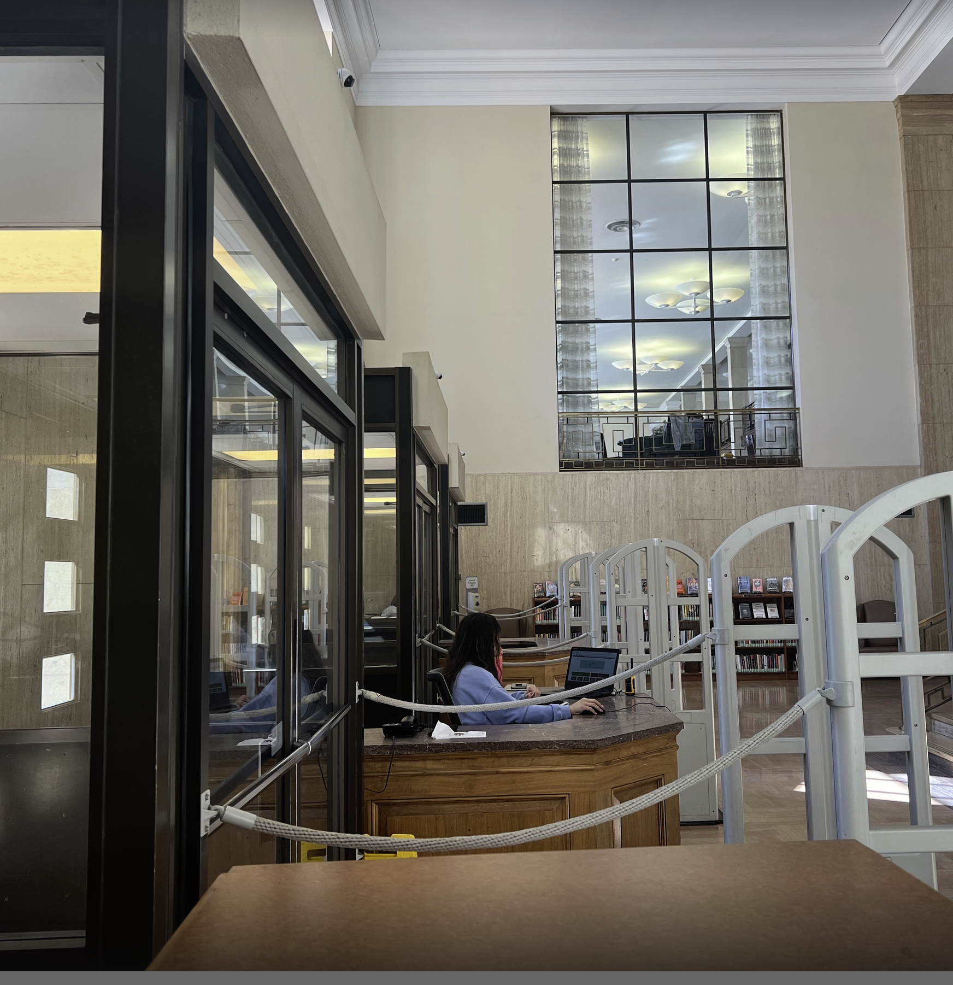
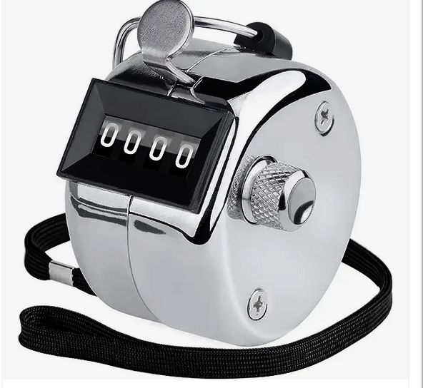
Bit of history - Manual Process
Tally counter
Student works at the Library door

Slide 4
Bit of history - Semi-automated system
In response to the challenges posed by Covid-19, OSU took proactive measures by developing an application designed to improve the manual door traffic counting system.
There are various vendor solutions, OSU opted to develop the application internally, leveraging cost-effectiveness, rapid implementation.
The application aims to enhance efficiency by providing real-time insights into the capacity of the library's physical building.
By making the application open-source, empowering other libraries and organizations to utilize its full potential for their unique needs.

Slide 5
Live Demo

Slide 6
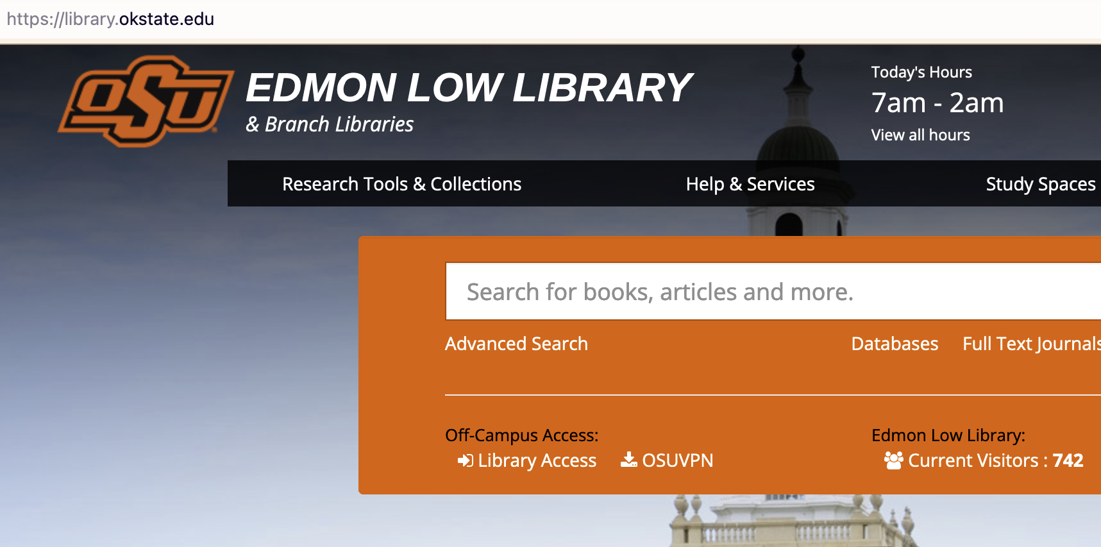
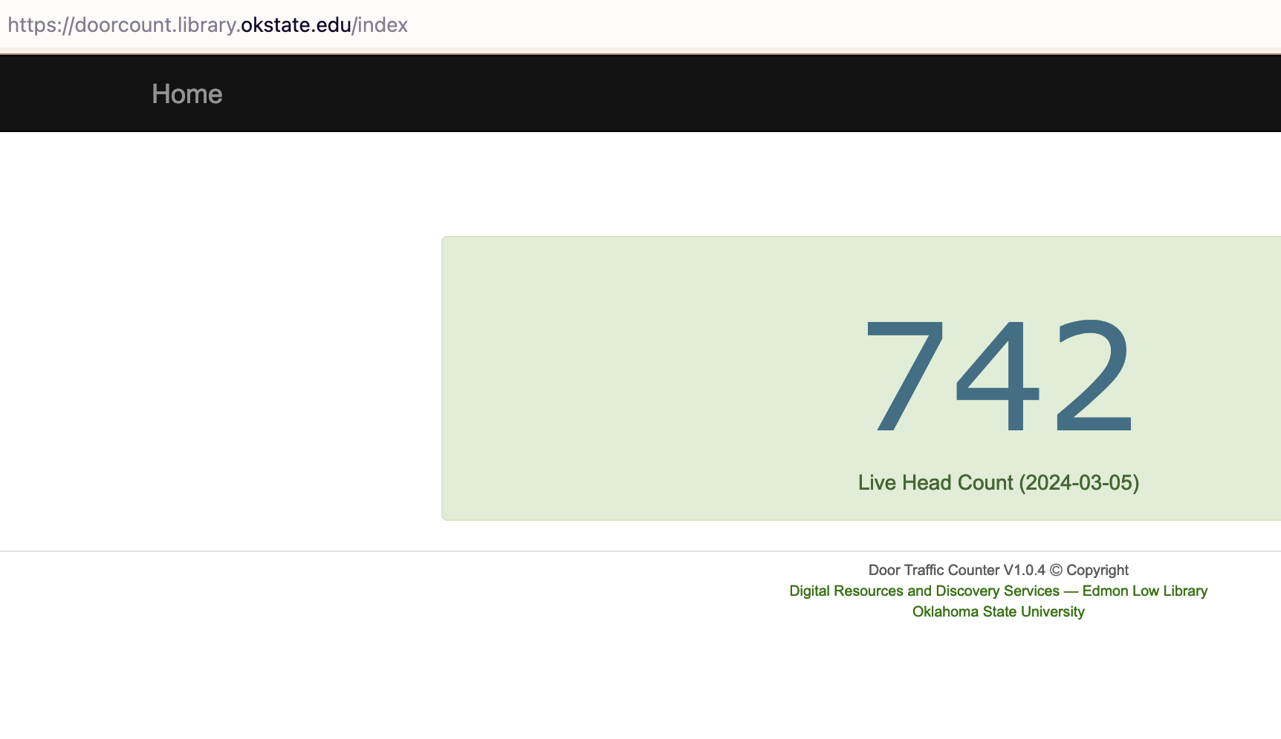
Live Demo - Screen shots of Library and Application Home pages
Library home page
Application Home page

Slide 7
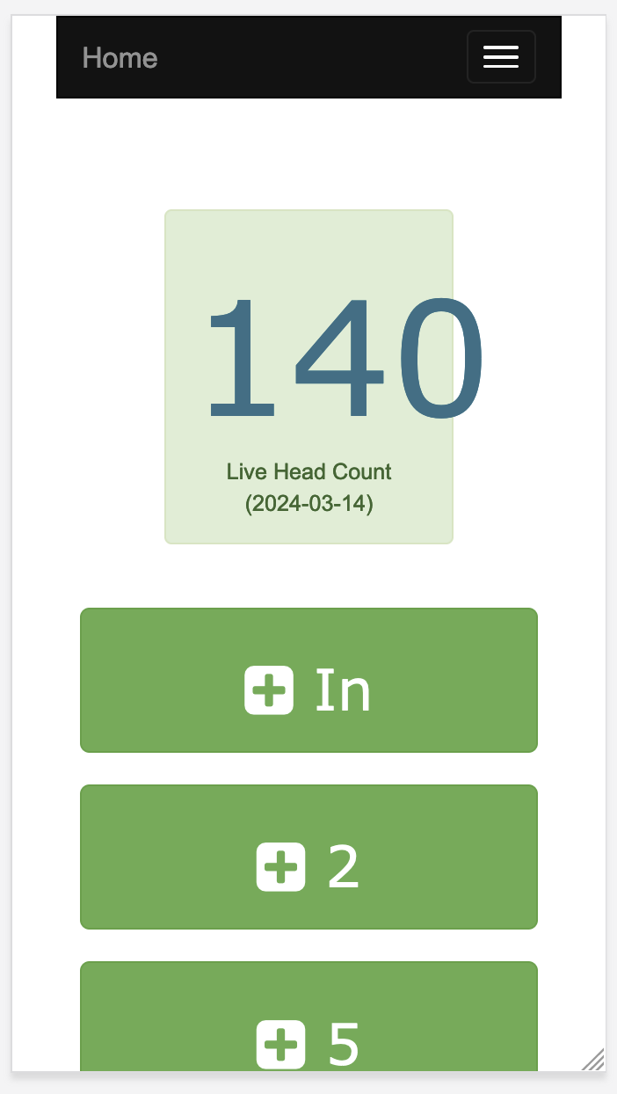
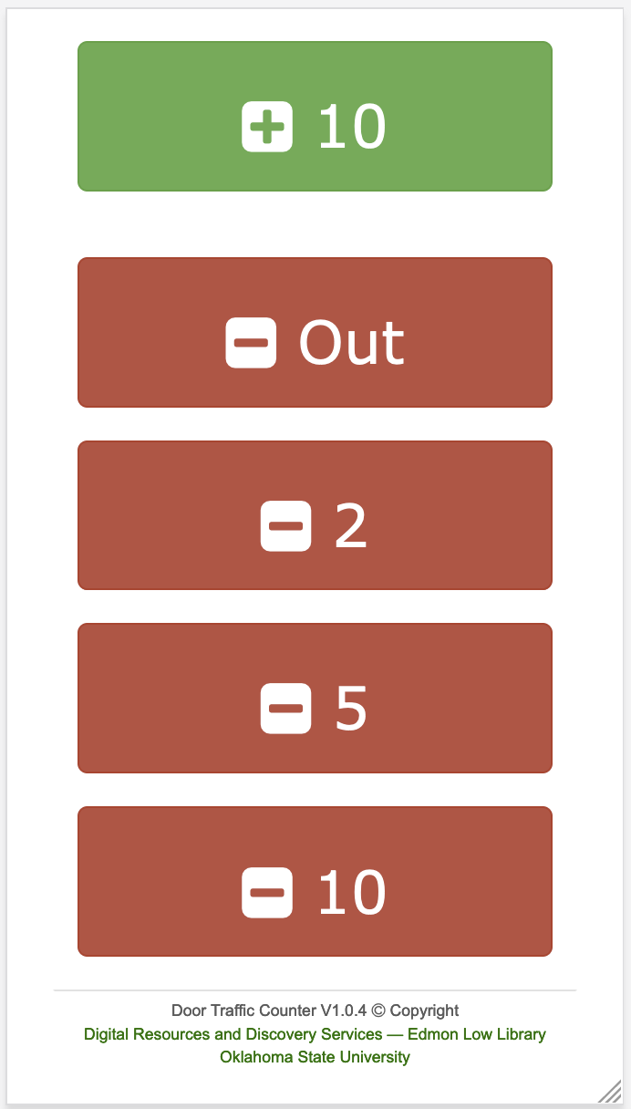
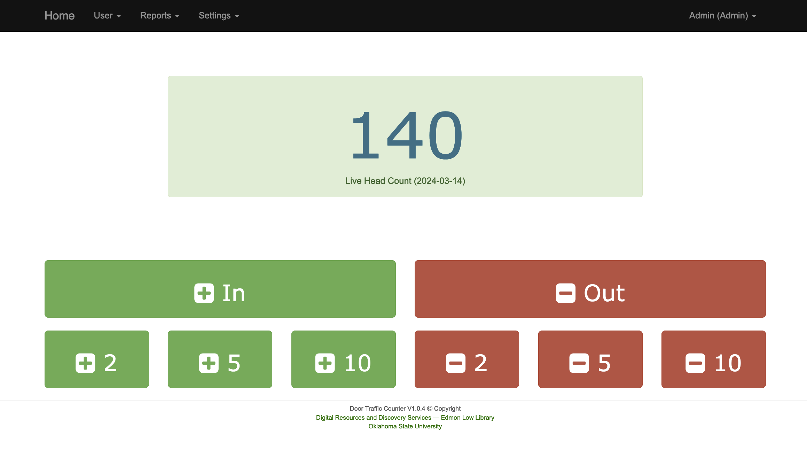
Live Demo – Home page of the application.
Home page when user login Web view
Home page when user login Mobile view

Slide 8
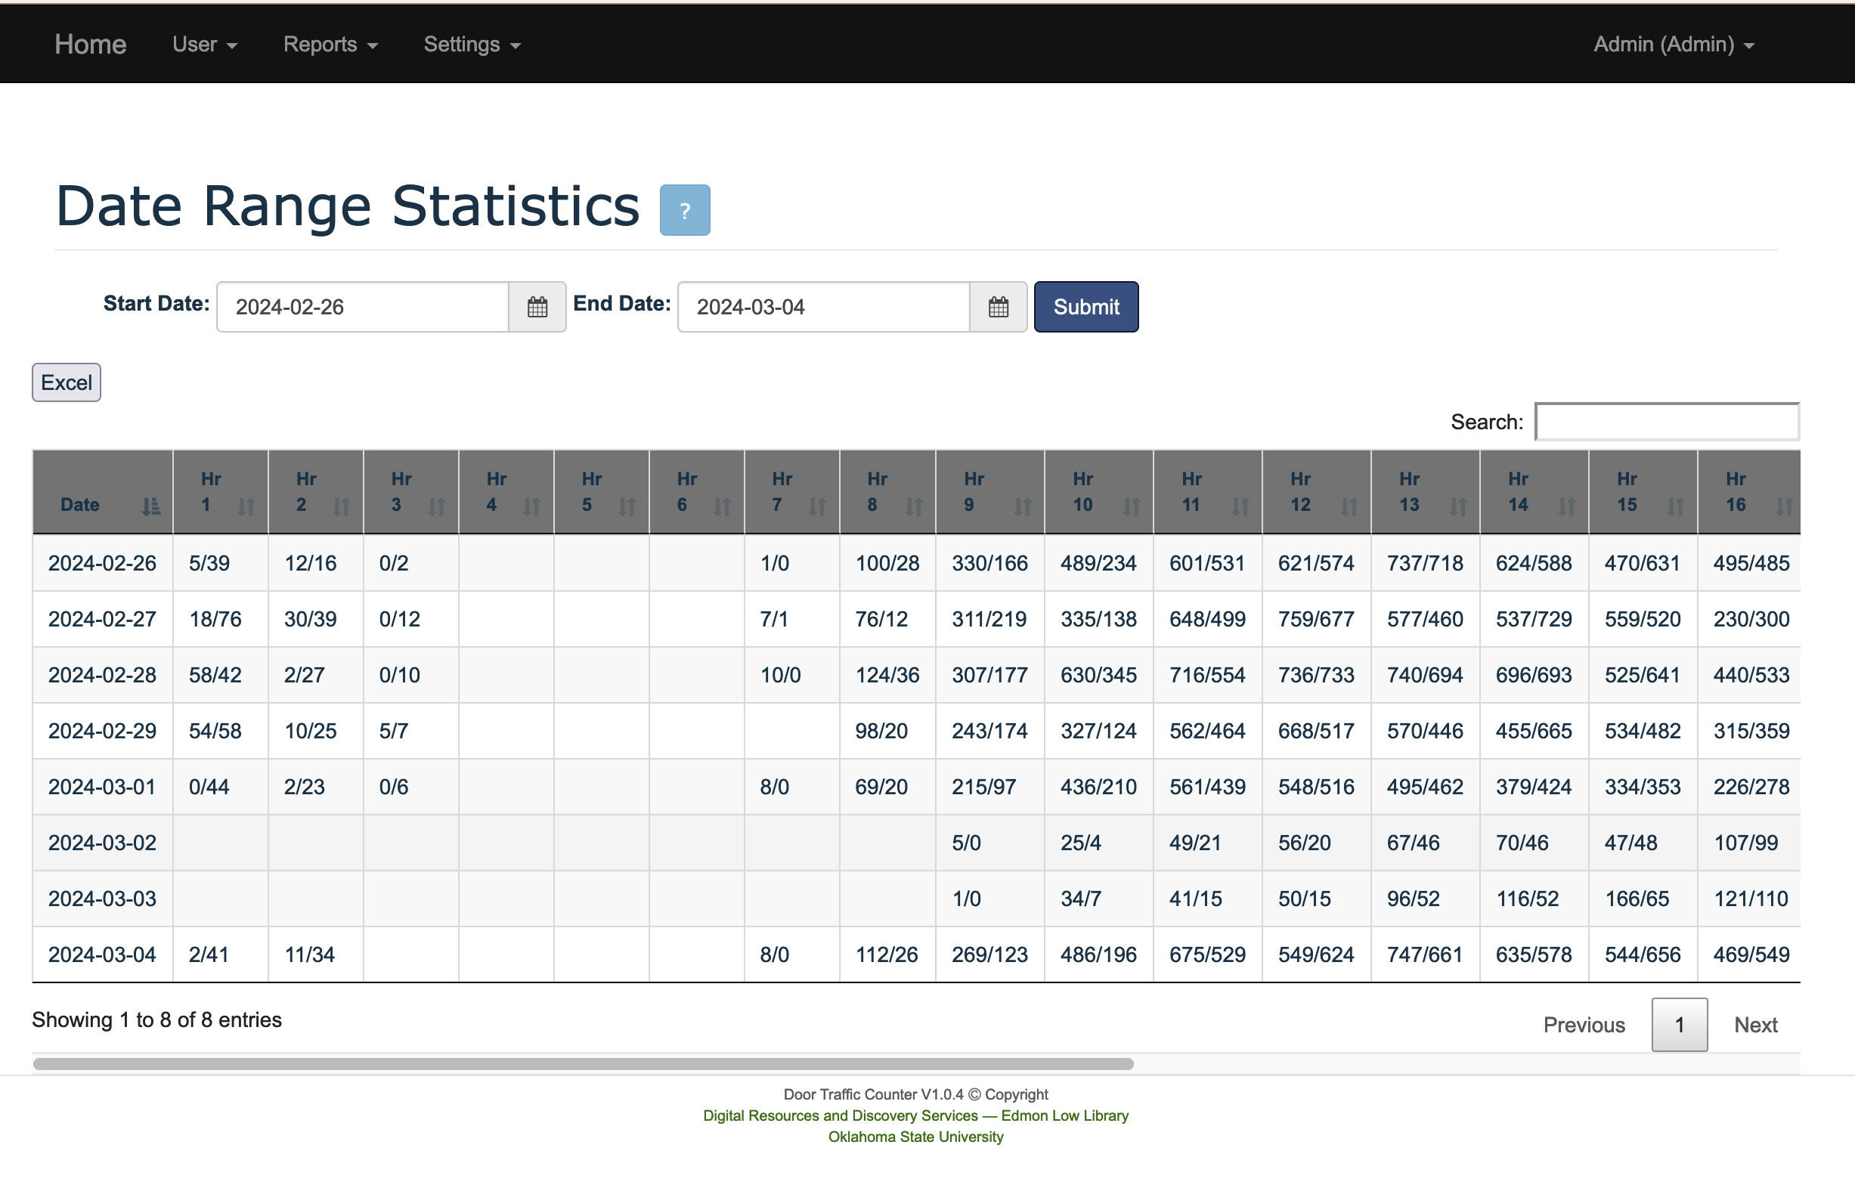
Live Demo – Screen shots of data range Statistics
Date Range Statistics from 2024-02-26 to 2024-03-04

Slide 9
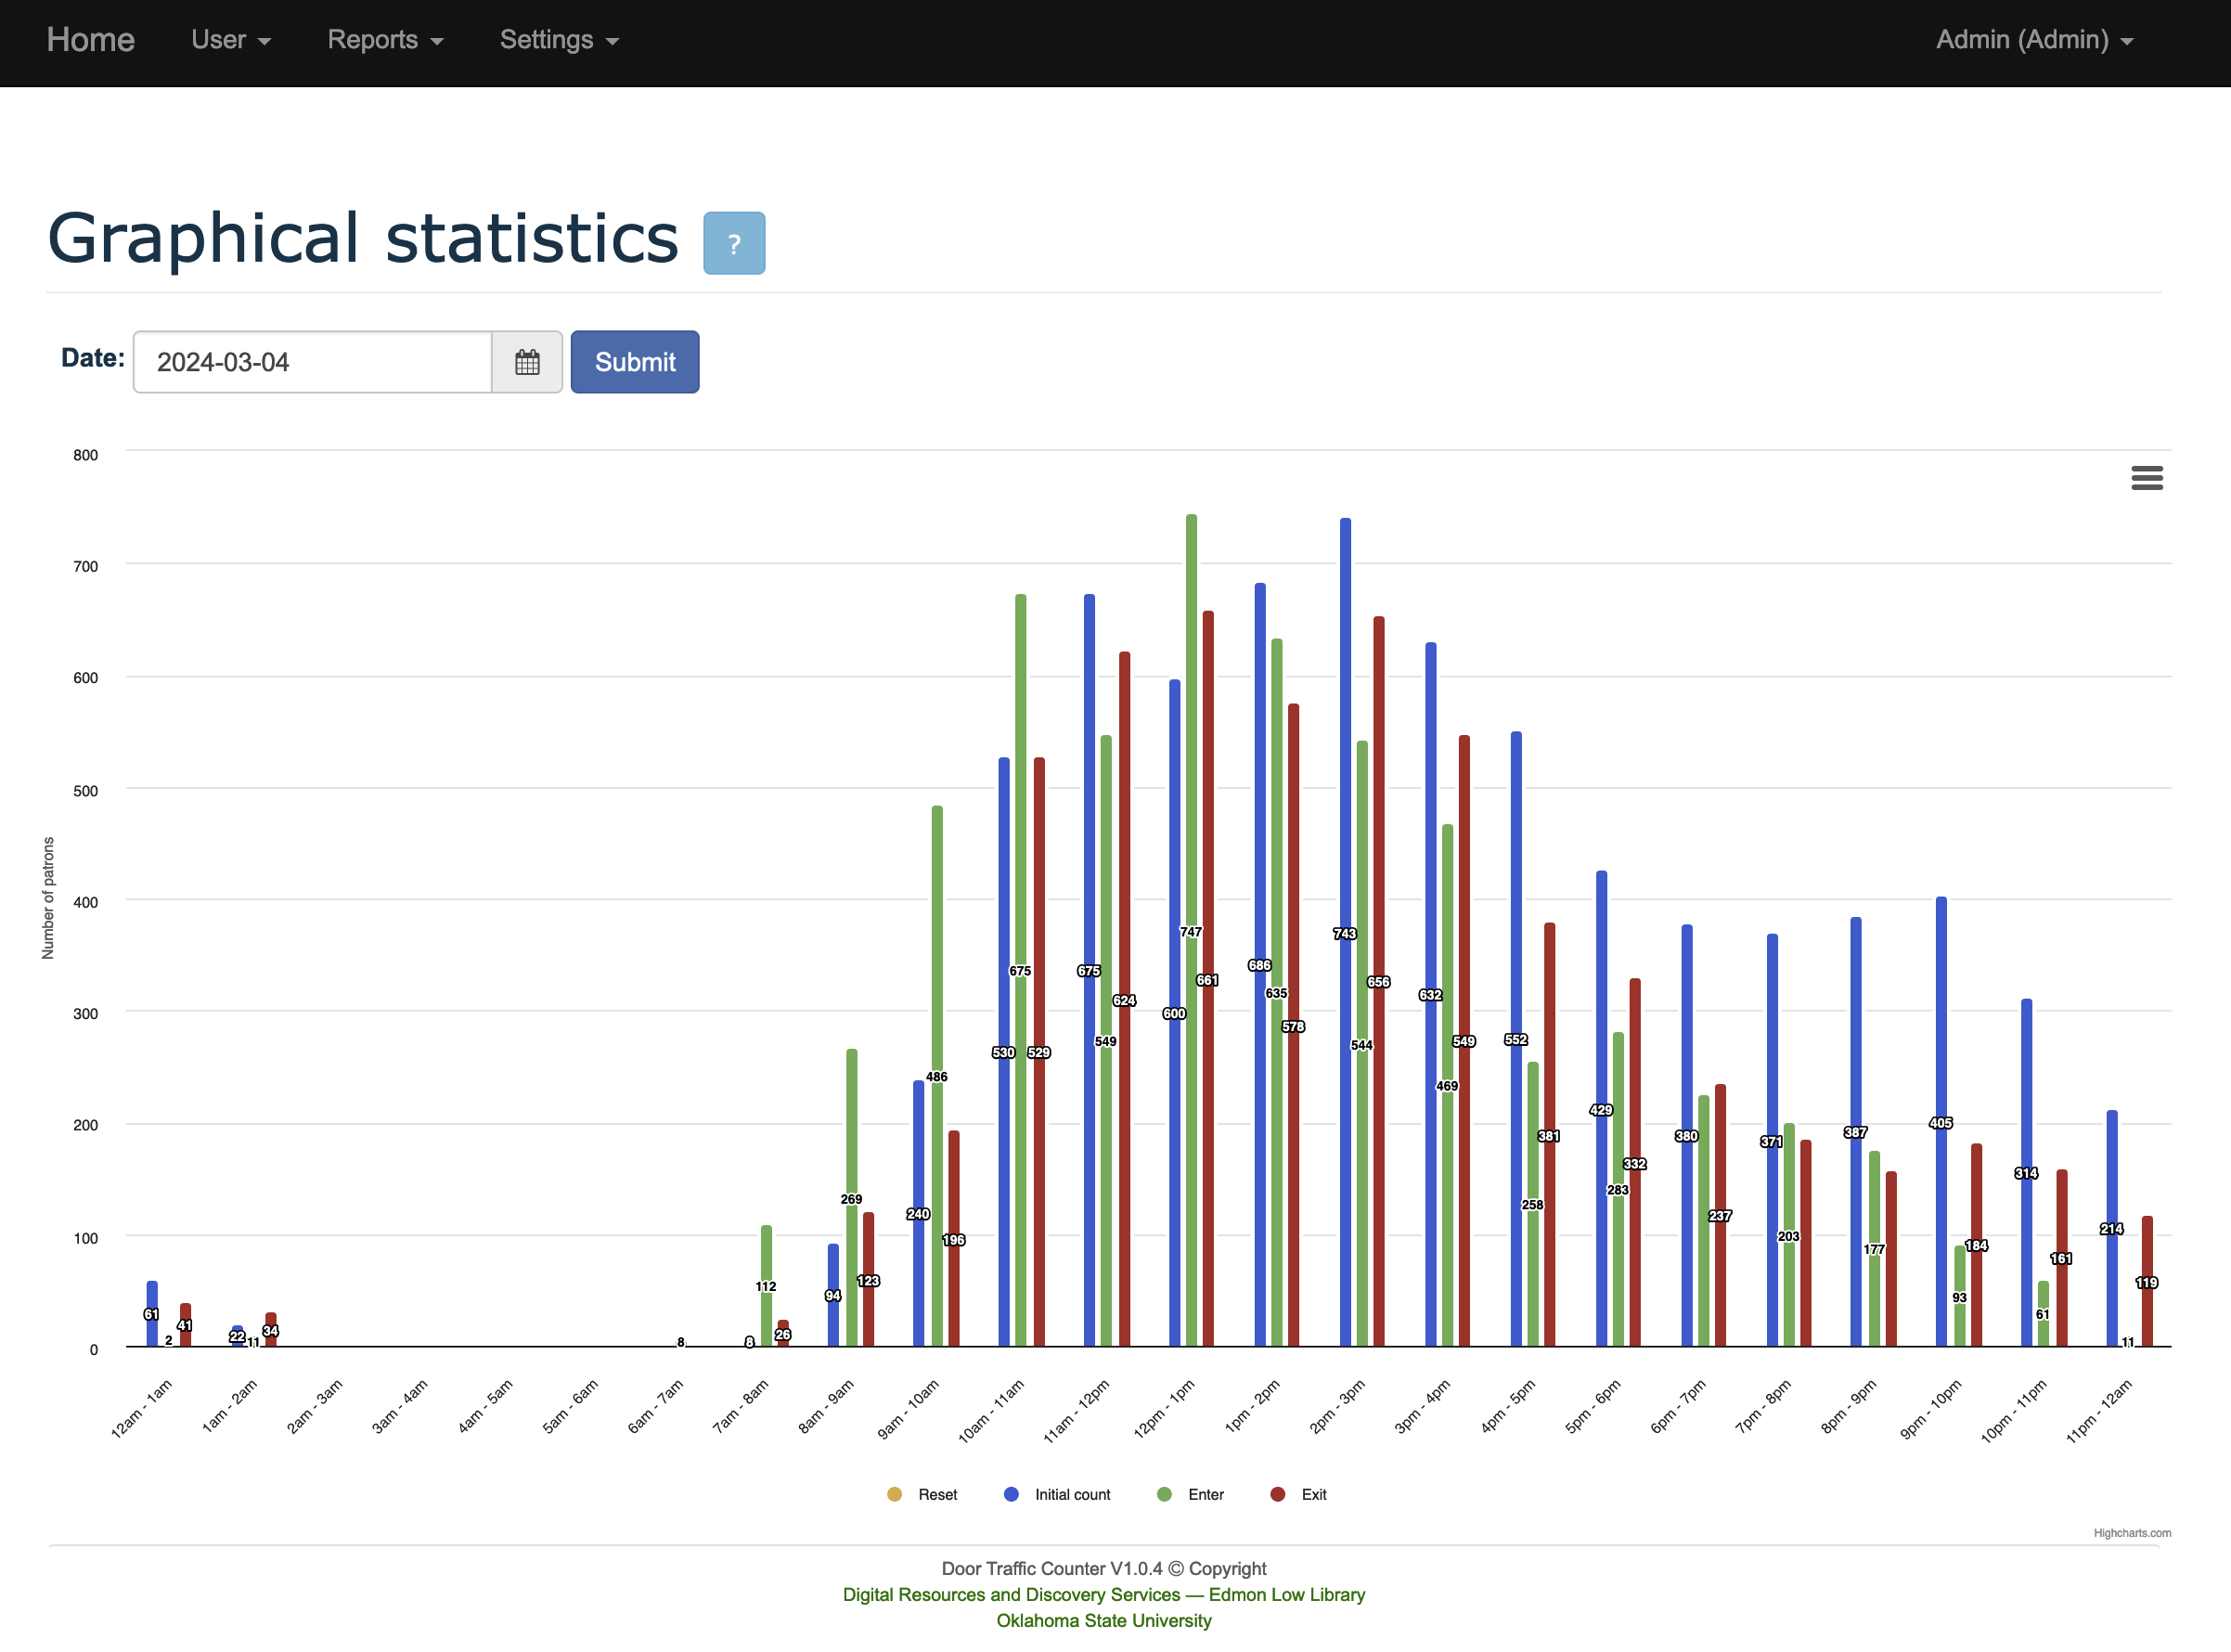
Live Demo – Screen shots of graphical statistics
Graphical statistics on 2024-03-04

Slide 10
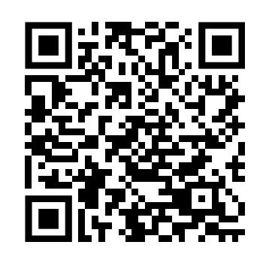
How is this tool useful for your library?
GitHub repository URL
https://github.com/okstate-library/door-traffic-counter
Contact details:
  Damith Perera
  Email : charmdm@okstate.edu

Slide 11
Q&A – Thank You

