Slide 1
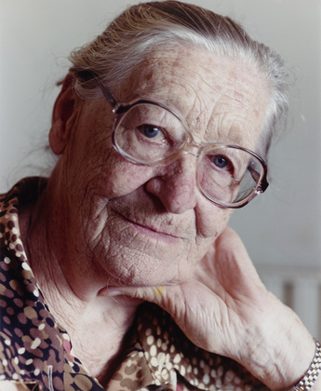
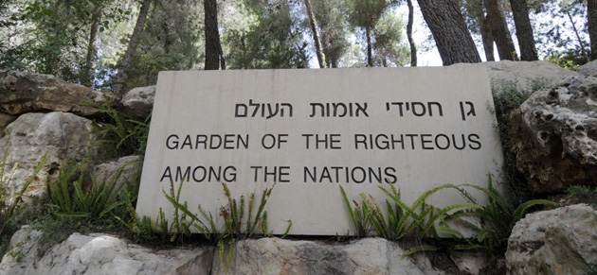
Investigating Implicit Aspects of Virtue: Understanding Humility Among Moral Exemplars
James Van Slyke# & Mark Graves^{*+}
#Fresno Pacific University
*Fuller Theological Seminary, ⁺Caltech

Slide 2


Humility of Rescuers
Holocaust rescuers (Monroe 2004) demonstrate several factors associated with contemporary definitions of humility
  Focused on/open to others (Tangney 2000)
    Suffering of another creates a sense of moral salience that requires action
    See themselves as part of a universal humanity
Notes:
Tangney’s (2000) overview of facets of humility (p. 74)
Accurate assessment of one’s abilities and achievements (not low self-esteem, self-deprecation)
Ability to acknowledge one’s mistakes, imperfections, gaps in knowledge, and limitations (often vis a vis a higher power)
Openness to new ideas, contradictory information, and advice
Keeping of ones abilities and accomplishments – one’s place in the world – in perspective (e.g. seeing onself as just one person in the larger scheme of things)
Relatively low self-focus, a “forgetting of the self”, while recognizing that one is but one part of the larger universe
Appreciation of the value of all things, as well as the many different ways that people and things can contribute to the world.
Halling et. al. 1994 Doing research on humility is humbling
Humility is a relatively stable disposition, which is a component of one’s personality and is acted out by the person in a number of situations Tangney 2000, p. 76
Humility is relatively rare Tangney 2000, p. 78

Slide 3
Humility of Rescuers
Holocaust rescuers (Monroe 2004) demonstrate several factors associated with contemporary definitions of humility
  Accurate assessment of themselves (Tangney 2000)
    No elevated sense of moral superiority
    Most exemplars did not see themselves as doing anything extraordinary
Notes:
Tangney’s (2000) overview of facets of humility (p. 74)
Accurate assessment of one’s abilities and achievements (not low self-esteem, self-deprecation)
Ability to acknowledge one’s mistakes, imperfections, gaps in knowledge, and limitations (often vis a vis a higher power)
Openness to new ideas, contradictory information, and advice
Keeping of ones abilities and accomplishments – one’s place in the world – in perspective (e.g. seeing onself as just one person in the larger scheme of things)
Relatively low self-focus, a “forgetting of the self”, while recognizing that one is but one part of the larger universe
Appreciation of the value of all things, as well as the many different ways that people and things can contribute to the world.
Halling et. al. 1994 Doing research on humility is humbling
Humility is a relatively stable disposition, which is a component of one’s personality and is acted out by the person in a number of situations Tangney 2000, p. 76
Humility is relatively rare Tangney 2000, p. 78

Slide 4
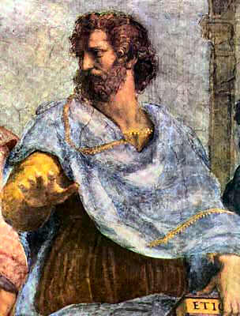
Implicit Aspects of Virtue
  Habits (Aristotle) form the basis for moral schemas & moral identity
    Novices and experts demonstrate differences in moral judgment based on schema effects (Narvaez & Gleason 2007)
    Among a sample of humanitarian worker, experts demonstrated more stable and sophisticated moral schemas (Reimer et. al. 2011)
  For Monroe (2012), moral identity was the most important factor for holocaust rescuers

Slide 5
Moral Identity & the Self
Close associations between moral identity and self identity increases moral behavior
  Students donated more food & volunteered more (Aquino & Reed 2002)
  Associations with religious commitment increased empathy and decreased aggression (Hardy et. al. 2012)
  Stronger associations with moral identity decreased negative perceptions of out-groups (Smith et. al. 2014)
  Higher moral obligation and support of out-groups (Reed & Aquino 2003)

Slide 6
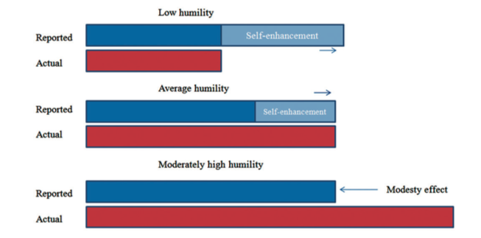
Problems with current measures of Humility (Davis, Worthington, & Hook 2010)
Persons with low humility are likely to over-report while persons with high humility are likely to under-report

Slide 7
Problem with Moral Exemplars in General
Moral exemplars in a variety of domains often under-report the extent of their moral action for a variety of domains
We need to develop new methods for investigating moral exemplarity
  Narrative interviews provide a contextually rich data set in their own words
  LSA allows for a third person empirical analysis

Slide 8
Deep Integration – Theory
Psychological
  Implicit Habits > Moral Schemas > Moral Identity > Moral Action
Philosophical
  Aristotle – Importance of moral exemplars
  Zagzebski (2010) Moral exemplars should be starting point of ethics

Slide 9
Methodology
Hypotheses
Humility is a virtue that affects moral action and self identity
Humans have a prototype concept of humility
Humility is implicitly embedded within self narratives, not explicitly stated
Semantic analysis can find markers of implicit humility within self narratives
The implicit markers of humility relate to the explicit concept of humility, but is not identical with it
Research Plan
Develop explicit prototype of humility from term descriptors
Use semantic analysis of exemplar narratives to discover implicit markers of humility
Compare implicit and explicit characterizations of humility using empirical, philosophical, and computational methods
Distribute exemplar narratives annotated/coded with humility measures

Slide 10
Research Method
Develop descriptors of humility
    Walker’s method of “folk” prototype construction
    Data mining of Big Data resources
Generate prototypicality ratings
    Likert-style centrality ratings
    Computational similarity scores
Use prototypical descriptors as LSA probes of exemplar narratives
Generate additional LSA probes from moral psychology instruments and moral philosophy literature
Compare LSA results from survey instruments, folk prototypes & data mining against exemplar narratives
Generate conceptual model of implicit humility from empirical findings

Slide 11
Deep Integration – Design & Team
Methodological Design
Data Sources
Cognitive prototypes from moral descriptors
Computational data mining
Philosophical literature
Analysis Methods
Empirical study of human subjects
Computational methods for semantic analysis
Philosophical construction of ontology for implicit humility
Interdisciplinary Team
Science
  Computer Science (MG, PhD, 1 book)
  Biology/genetics & neuroscience (MG, postdoc, research)
  Psychology (JVS, assist prof; MG, postdoc; KM)
Humanities
  Philosophical & Systematic Theology (JVS, PhD, 2 books; MG, M.A., adjunct teaching, 2 books; KT)
Bridge Models
Emergent human systems for theological anthropology (MG, Ashgate, 2008)
Emergent religious cognition (JVS, Ashgate, 2011)
Conceptual modeling for database design (MG, Comp Bio Med, 1996)
Roycean community of scientists and scholars (MG, Zygon, 2009)

Slide 12
Challenges & Response – Method
Lack of difference between descriptors or probes generated from, folk listing, data mining, or survey instruments – Merge descriptor lists and/or probes
Lack of consistency between data generation approaches – Continue process, but increase numbers to enable characterization of descriptor subsets
Latent Semantic Analysis has insufficient explanatory power – Use newer, more sophisticated methods, such as probabilistic LSA, Google’s word2vec, or Stanford’s GloVe
Multiple methods fail to deliver results – Use Walker’s HCA/MDS similarity sorting method to create clusters and dimensions of humility and use those results to refine analysis
Multiple semantic analysis methods fail, even with additional data generation and subgroup analysis – Use manually coding to identify implicit humility excerpts and use Topic Modeling and/or HCA to create novel concept definitions

Slide 13
Challenges & Response – Project
Collected exemplar narratives do not exhibit sufficient implicit humility – Identify and extract passages that do exhibit humility and, if needed, augment with additional exemplar and published narratives
Unsupervised computational methods cannot discover implicit humility – Code transcripts manually and use code applications to guide semantic analysis
Resource or time limitations – Because research steps include incremental evaluation, choose best approach so far to push toward non-comparative publication

Slide 14
Summary
  Investigate implicit and explicit aspects of moral & self schemas using computational analysis
  Understand the implicit values of humility that initiated extraordinary moral actions
  Investigate the role of schemas in forming the moral self and its relationship to virtue
  Distribute rescuer transcripts to a wider audience
James.VanSlyke@fresno.edu
markgraves@fuller.edu

