Slide 1

Librarians and Immersive Learning: Opportunities for Collaboration Using Virtual Reality
Kristal S. Boulden, MLIS
Social Sciences & Humanities Librarian
LOEX 2017

Slide 2
Agenda
Innovation @ The Edge
Anthropology VR Assignment
Librarian-Faculty-Technologist Partnership
Lessons Learned
Strategies for Collaboration
Making New Partnerships

Slide 3
Let’s Get Started!
Does your library or university have a makerspace or emerging technologies like 3D modeling and virtual reality?
What projects are you interested in pursuing using these technologies?
Visit https://www.nearpod.com and enter code: XBNLI

Slide 4
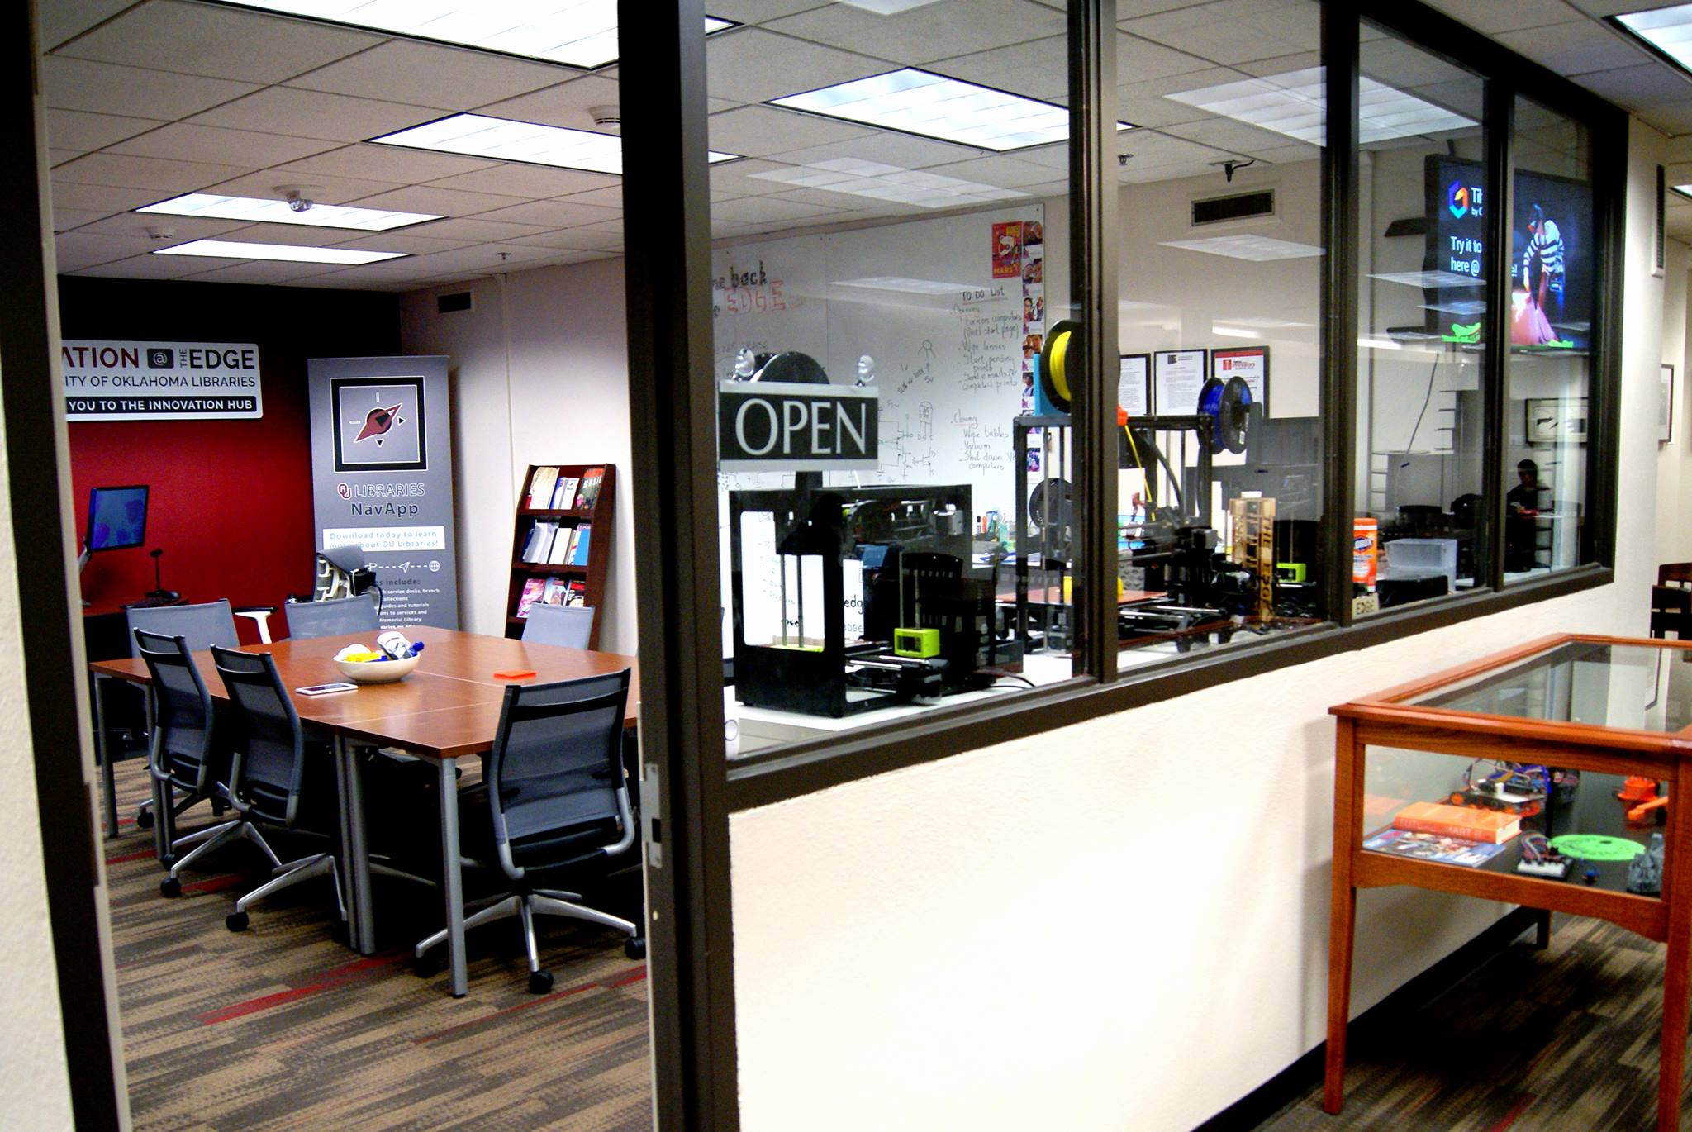
Innovation @ The Edge

Slide 5
Innovation @ The Edge
Oculus Rift Stations
3D Printers
Microelectronics
3D Scanning

Slide 6
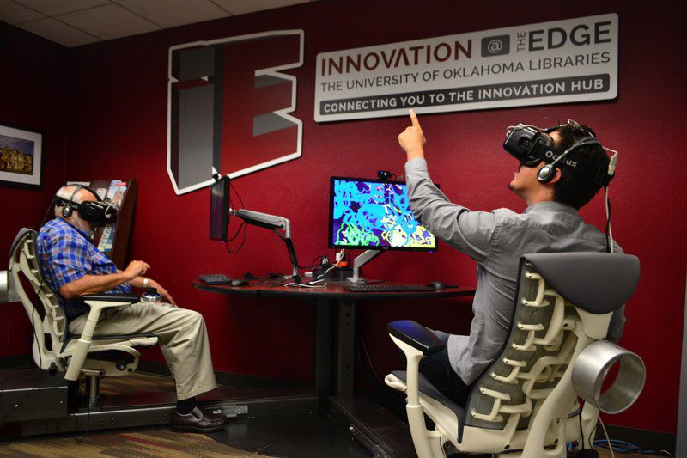
Innovation @ The Edge
https://libraries.ou.edu/edge

Slide 7
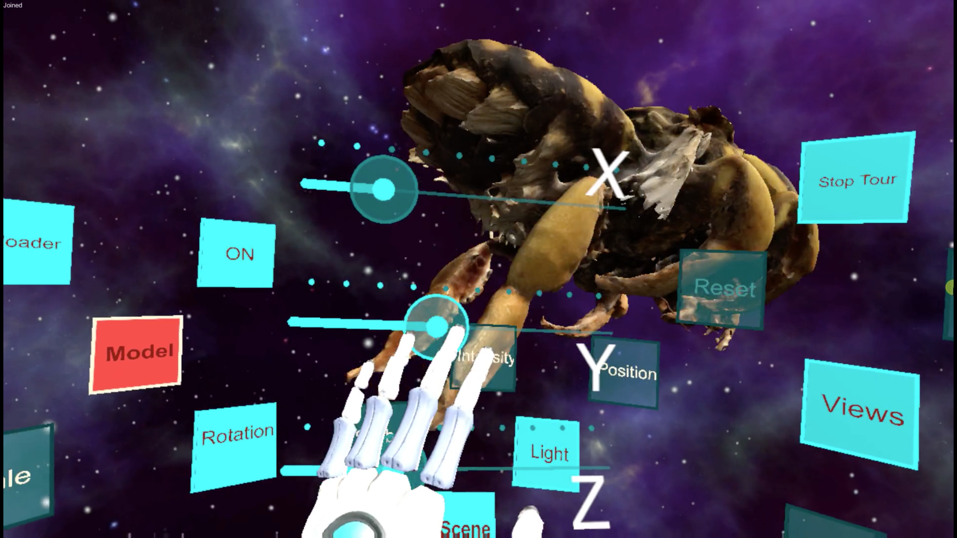
Innovation @ The Edge

Slide 8
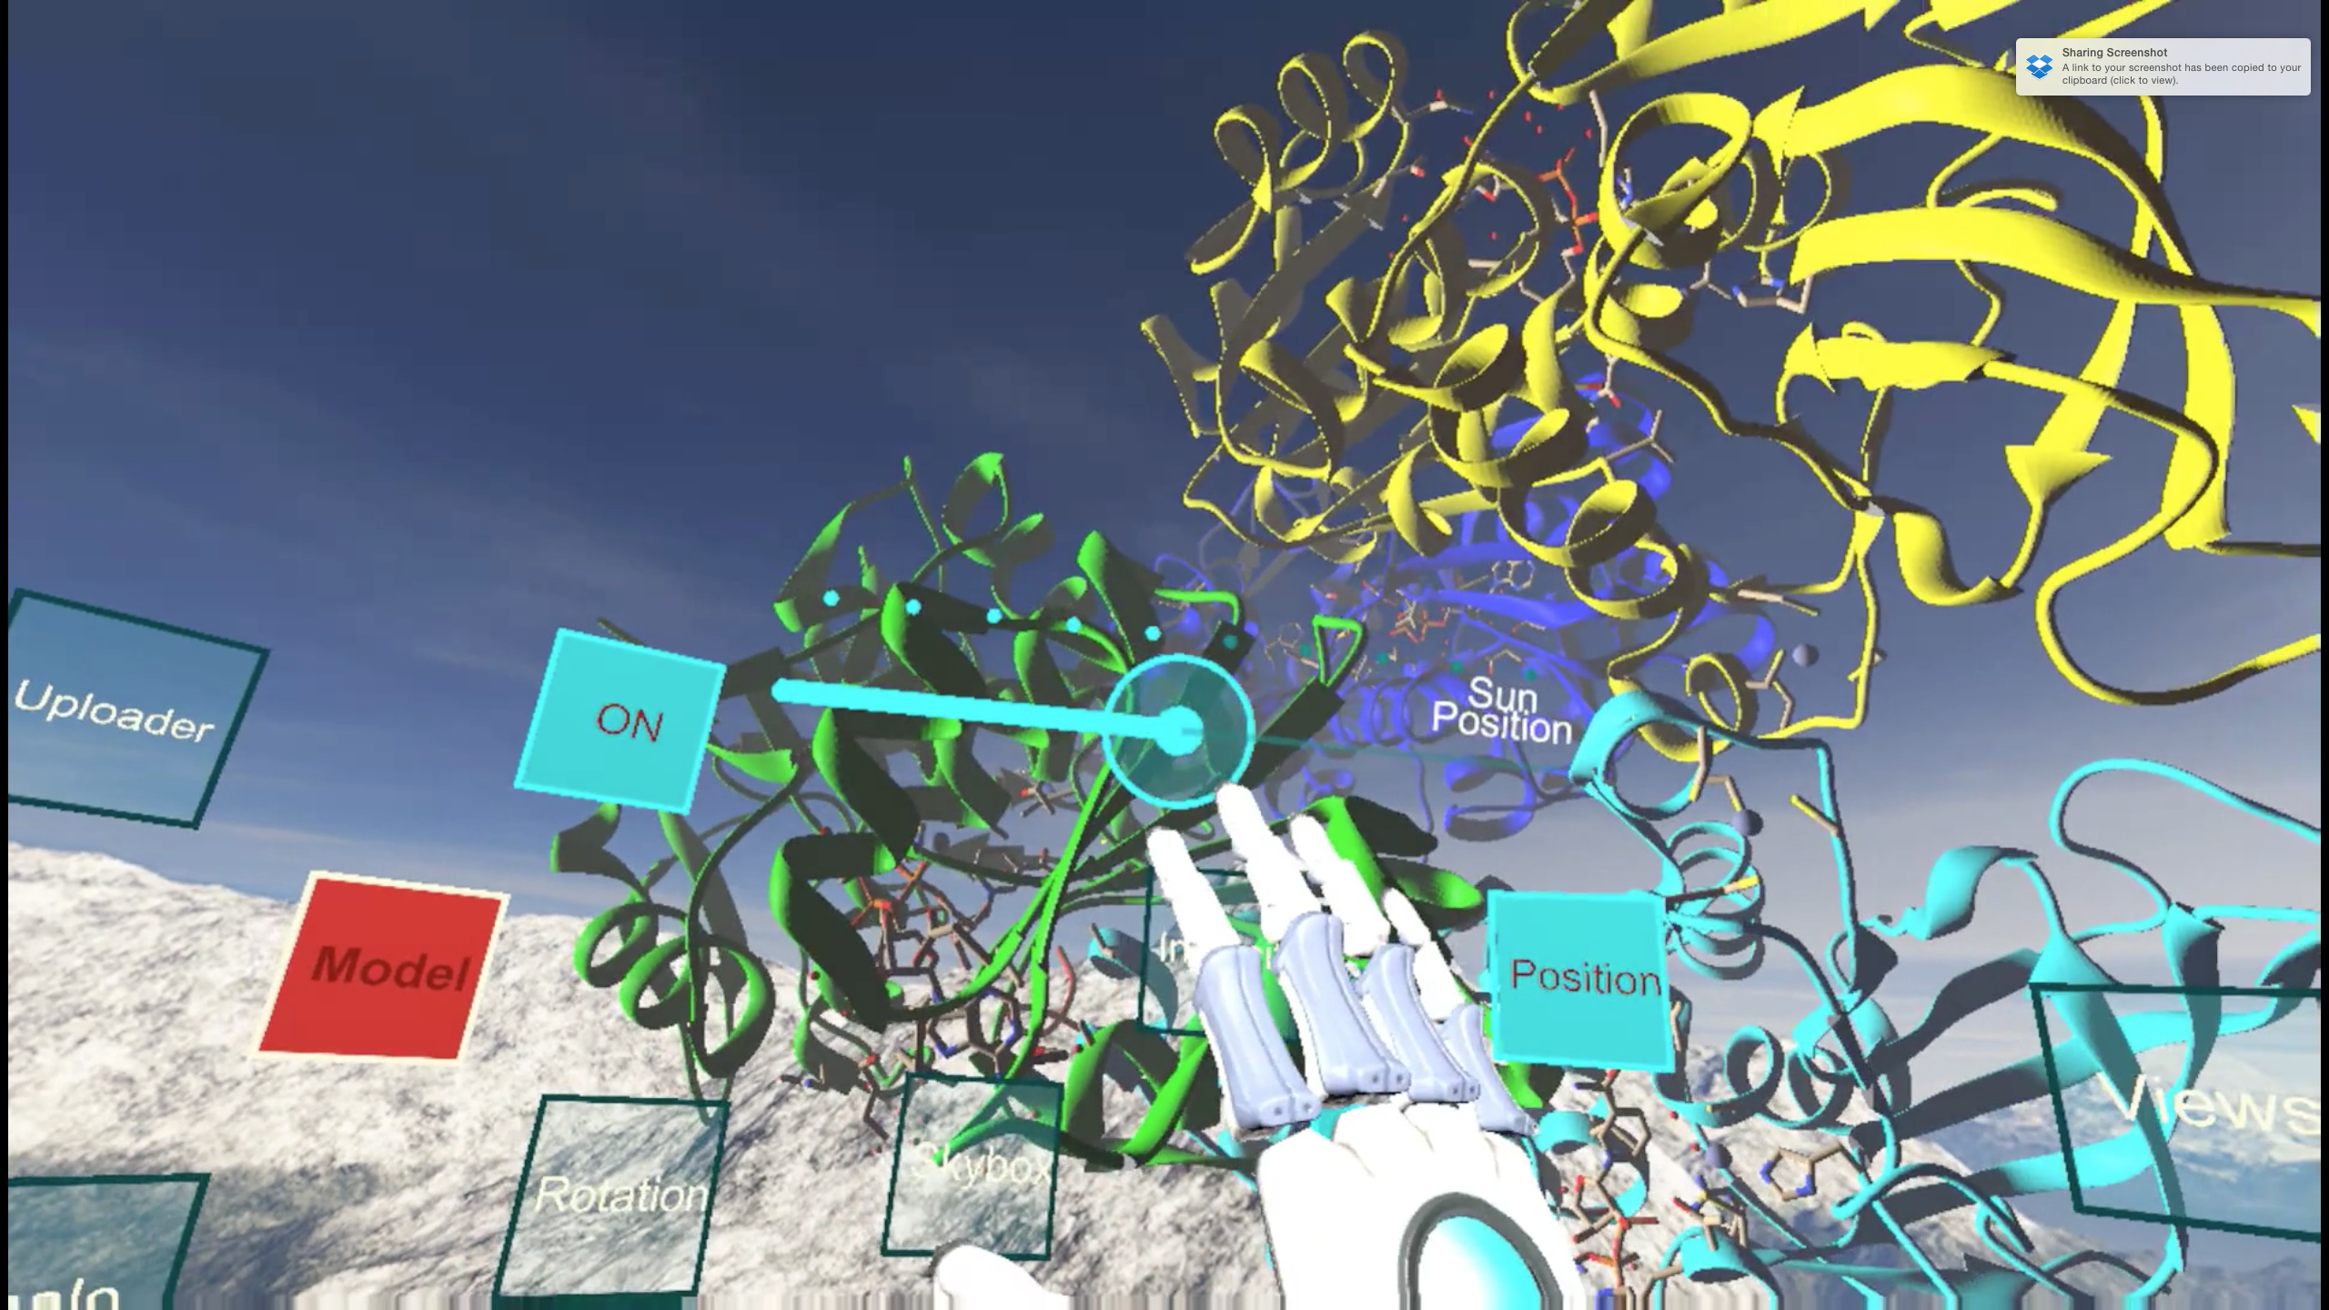
Innovation @ The Edge

Slide 9
General Anthropology Class
General Anthropology 1114
General Education Course
30 students
Mostly non-anthropology majors

Slide 10
General Anthropology VR Assignment
Analyze and compare skull models
Screenshots of models
Do specimens belong in same genus?
Age of Taung Child at death?
Differences in teeth

Slide 11
Skull Models
Taung Child
Australopithecus africanus https://skfb.ly/6nr7J
Homo habilis
http://bit.ly/1WWpSf4

Slide 12
Librarian-Faculty-Technologist Partnership
CLIR Post Doctoral Fellow
Emerging Technologies Coordinator
Social Sciences & Humanities Librarian
Anthropology Professor

Slide 13
Collaboration Timeline
August 2016
Anthropology professor contacts ETC about VR
September 2016
October 2016
October - November 2016
ETC contacts librarian about collaboration
Students receive library instruction + intro to Edge
Consultation with professor, librarian, ETC, and Post Doc
Librarian, ETC and Post Doc test VR assignment
Students complete VR assignment

Slide 14
Collaboration Network
Librarian
Anthropology Professor
Technologists
Students

Slide 15
Lessons Learned
What does success look like?
Increased student interaction with librarian + technologists
Reimagine instruction session
Assessment
Critical skills for students?
Faculty expectations

Slide 16
Unexpected Collaboration Outcomes
Presentation of 3D modeling and virtual reality tools to anthropology department (December 2016)
Fiber Arts Workshop at the Edge (March 2017)

Slide 17
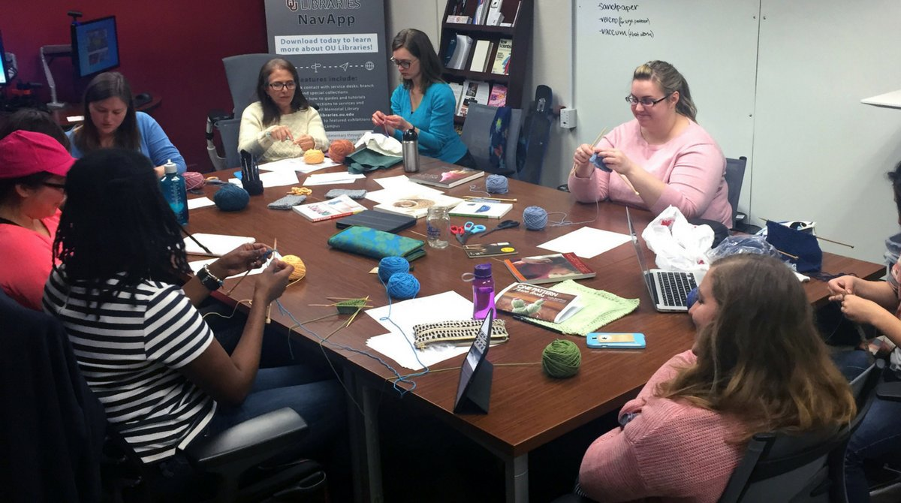
Fiber Arts Workshop
Photo: @InnovateEdge

Slide 18
Strategies for Successful Collaborations
Create action items during consultation
Create collaboration tools needed for project
Use every interaction with faculty + students to learn about their interests, projects, and research needs
Follow up with collaborators regularly

Slide 19
Strategies for Successful Collaborations
Post-project meeting with collaborators
Keep the momentum going! Follow up with new ideas, collaborations
Take risks and don’t be afraid to fail
Let your interests inform your collaborations

Slide 20
Making New Partnerships
Supervisors
Require librarians to attend technology workshops
Identify possible collaborations across campus
Librarians
Identify possible collaborations based on interests
Make the makerspace your own
Technologists
Contact librarians when there are new projects
Explain how technology supports student learning

Slide 21
3D + VR Resources
African Fossils http://africanfossils.org/
Smithsonian National Museum of Natural History 3D Collection http://humanorigins.si.edu/evidence/3d-collection
Smithsonian X 3D https://3d.si.edu/
Sketchfab https://sketchfab.com/
NYTVR http://www.nytimes.com/marketing/nytvr/
Nearpod 3D and VR www.nearpod.com/

Slide 22
Thank You!
Kristal S. Boulden, MLIS
Social Sciences & Humanities Librarian
ksb@ou.edu
@ksboulden

