Slide 1
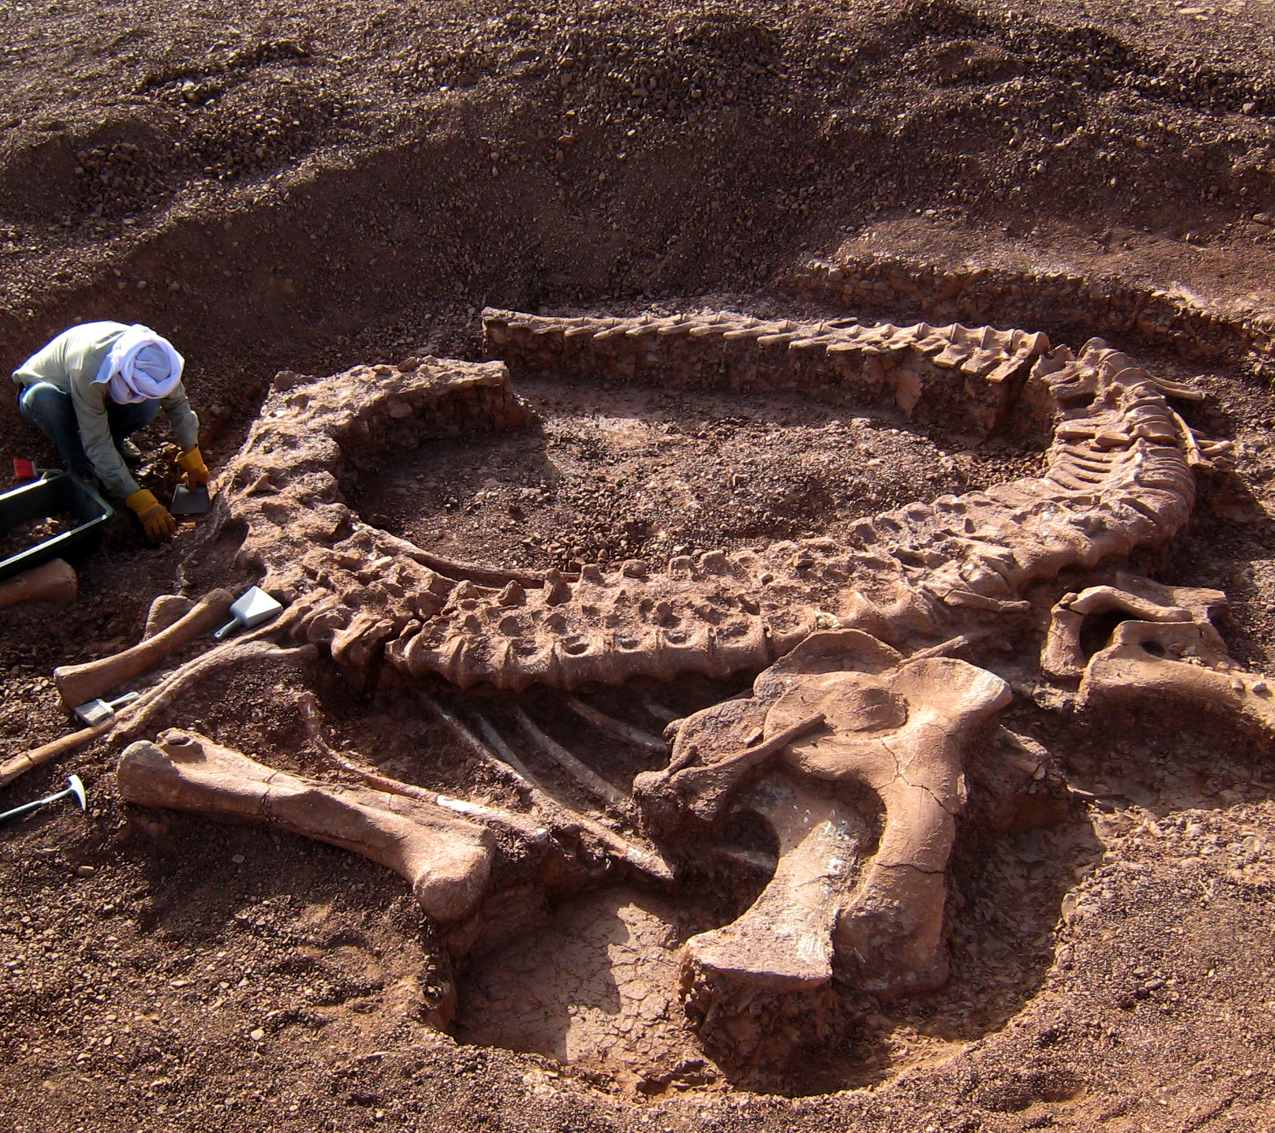
Digging for FOSLs
Launching a successful
library friends group
Stewart Brower, Director, Schusterman Library
University of Oklahoma-Tulsa
ThePhoto by PhotoAuthor is licensed under CCYYSA.

Slide 2

Objectives
Defining "Friends" of libraries
History of FOSL
FOSL activities and fundraising
Lessons learned
Future of FOSL

Slide 3
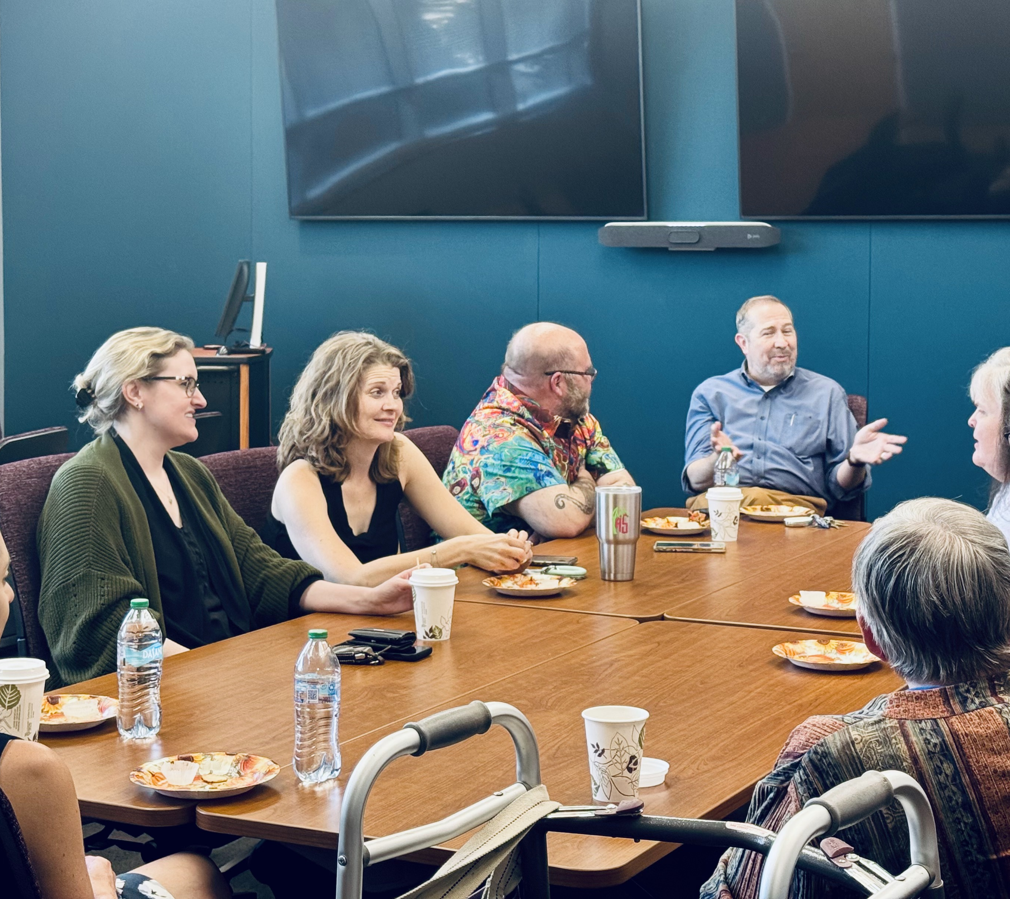
Defining "Friends"
"...an organization established to promote and financially support the resources, services, and needs of the academic library and to serve as advocates for the value of the library."
Hanson, C. D. (n.d.). Academic Library Friends (ALA Toolkit)
Currently defined as 58 non-dues-paying members
Including 26 former Schusterman employees, 3 former campus presidents, a former Tulsa mayor, and the current VP OU-Tulsa

Slide 4
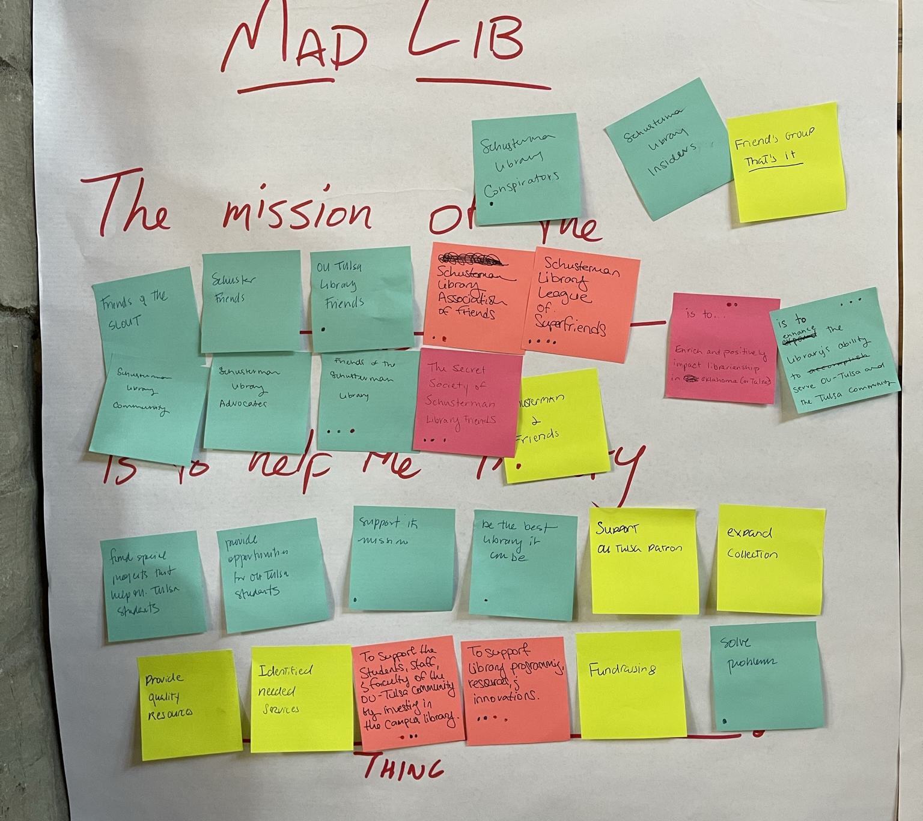
Brainstorming FOSL
The mission of the:
  "SchusterFriends"
  "Schusterman Library League of SuperFriends"
  "The Secret Society..."
  "Schusterman Library Advocates"
  "Insiders"
Is to help the library…
"support library," "fund special projects," "solve problems," "enrich & positively impact librarianship in Oklahoma" …

Slide 5
FOSL Founders Meeting - Fall 2022
The mission of the Friends of the Schusterman Library (FOSL)
is to work as a problem-solving team to advise library leadership, develop and execute fundraising opportunities, and advocate on behalf of the library.
FOSL is committed to supporting programming, resources, and innovations provided by the library to our campus and our community, as well as promoting and championing the field of librarianship.

Slide 6
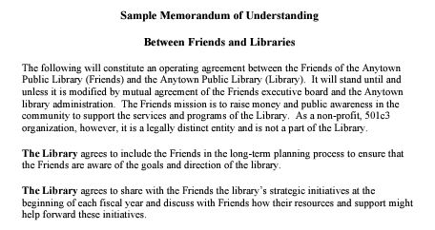
The 501c3

Slide 7
Should my Friends group be a separate non-profit?
Donors want tax deductions for their donations
Some major donors will not give to government agencies
Public libraries, in particular, often benefit from a separate friends group

Slide 8
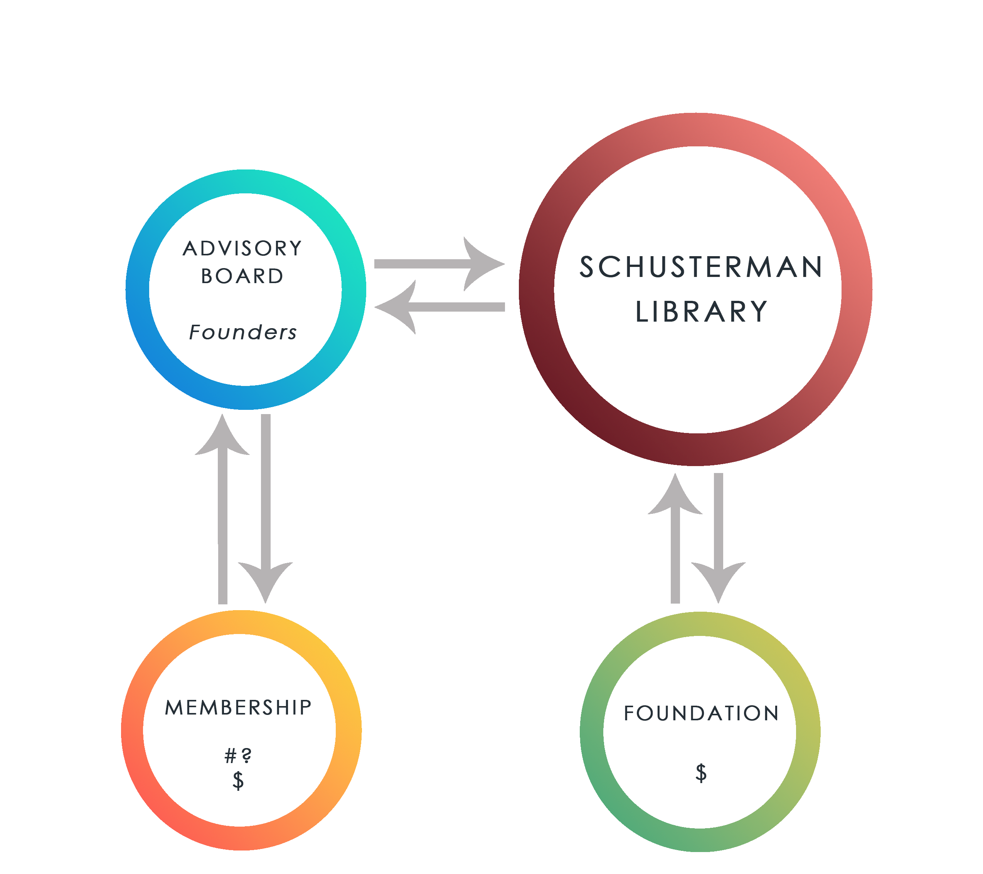
Model adopted in early 2023
Membership drive – Every Founder would recruit five members
Membership would be free of charge
Membership roster would receive newsletters and announcements
FOSL-only events, 2 per year
Fundraising push for Giving Day
What about the OU Foundation and MOUs?

Slide 9
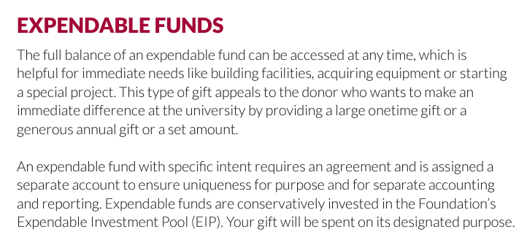

Slide 10
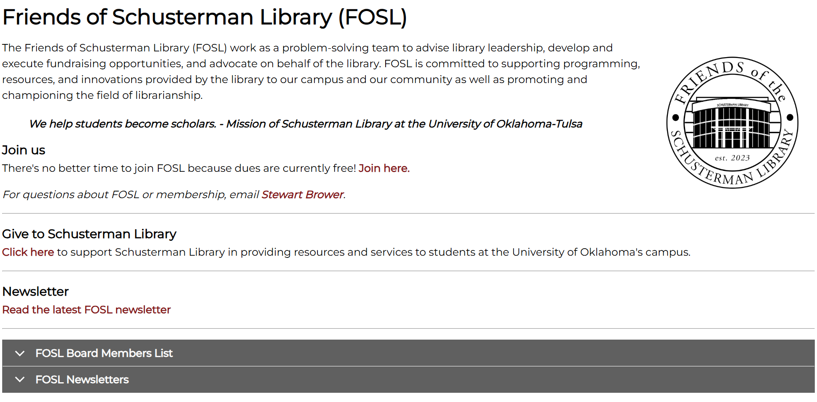
FOSL web page
Dues-free membership structure emphasizes "giving" over "paying"
Newsletter published three times a year on Microsoft Sway platform: https://sway.cloud.microsoft/H2gmAfBcAFDAET1J?ref=Link
Sway optimized for web/mobile and produces basic usage stats

Slide 11
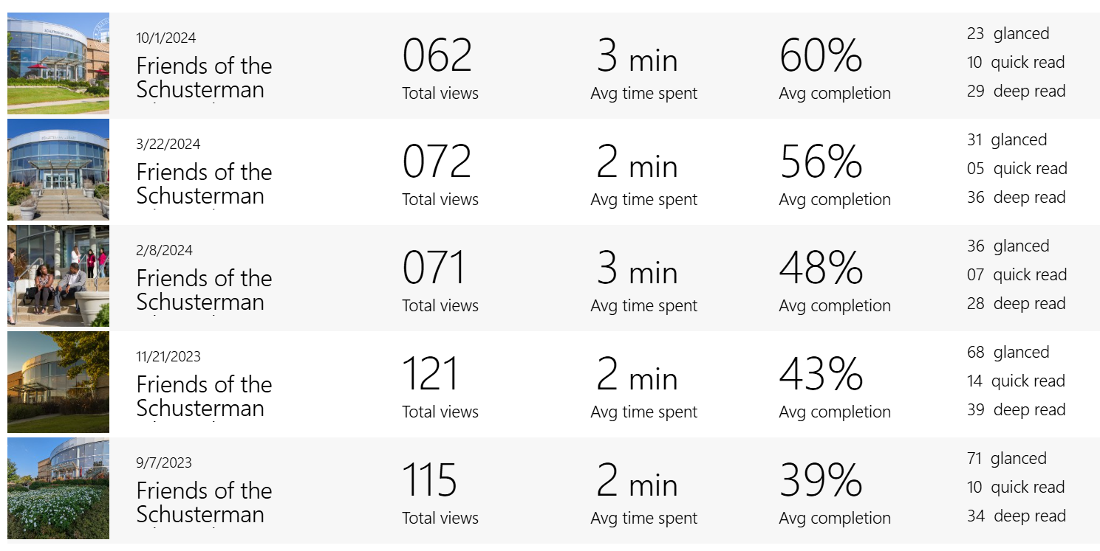

Slide 12
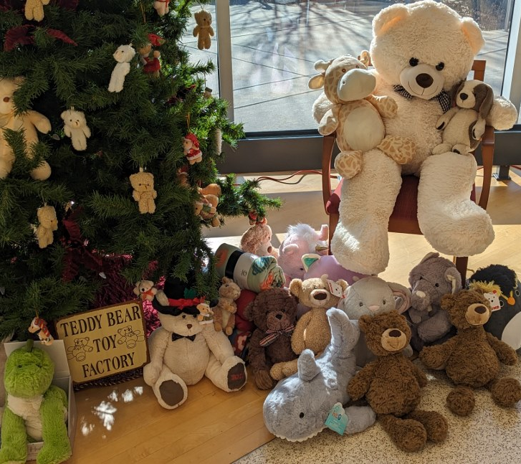
Janet Minnerath Teddy Bear Drive 2023
Collected 154 items to donate to the Child Abuse Network
All delivered in early January
Announced in Jan/Feb newsletter with note about increasing the goal to 200 items for 2024
FOSL sponsoring a Teddy Bear Day reception to kick off donation campaign, early December 2024

Slide 13
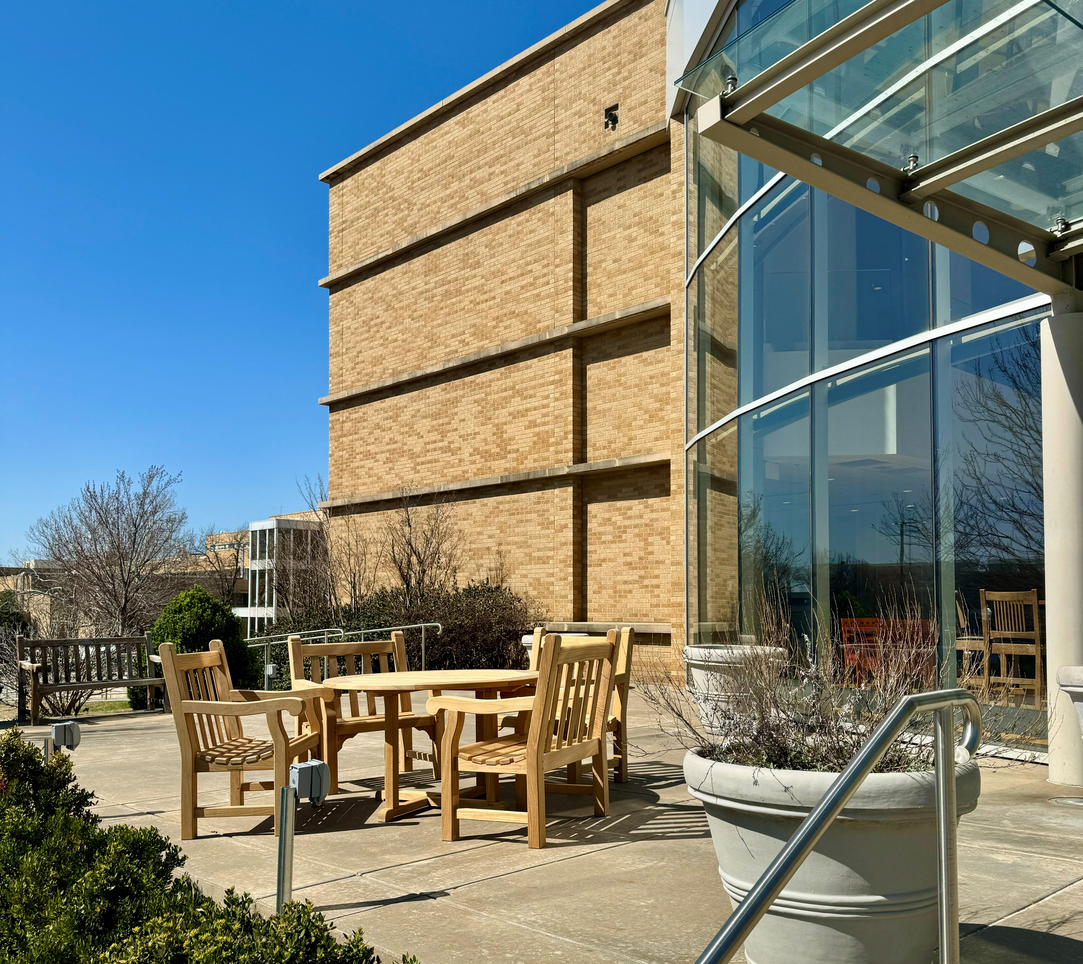
Library Patio Update
Weatherproof electrical outlets every 8 feet
New set of outdoor furniture with umbrella to match existing two
Outdoor WiFi range extended during 2020
Cost of $3614 – Was highlighted on Giving Day as a FOSL sponsored library improvement

Slide 14
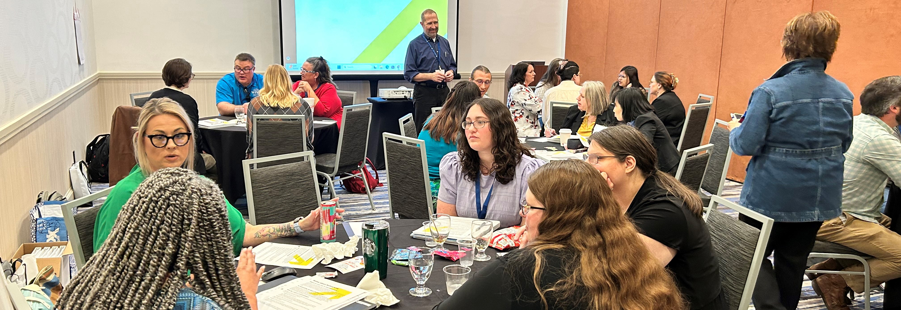
Hire Me Preconference at OLA 2024
Full day preconference included workshop, headshots, speed networking, resume review clinic, and mock interview sessions
19 attendees
Hire Me workshop conducted by Brower, Buffy Edwards, Allison Embry-Saenz, Alyssa Migdalski, and Andy Taylor
Estimated cost of $4600, incl. registration, food and photos

Slide 15

OU Giving Day
One-day campaign for financial gifts to OU
Sponsored "Challenges" throughout the day include opportunities just for OU-Tulsa campus
FOSL Newsletter reminds members of event and spotlights challenges that would award the library additional funds

Slide 16
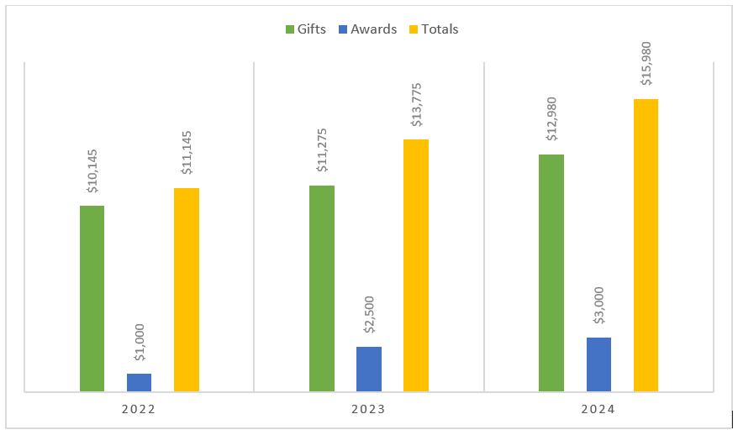
Giving Day Tallies
2024: A major $10,000 gift won us the "Biggest Gift to OU-Tulsa" challenge for an add'l $2000.
We also rec'd:
  A gift for $1000 (first time donor)
  Two gifts for $500 (each first-time donors)
  Five $100 gifts (two first-time donors)
  48 individual gifts
Incl. one donor who made twenty-one $10 gifts during the "Most Gifts OU-Tulsa" challenge – Second place for an add'l $1000

Slide 17
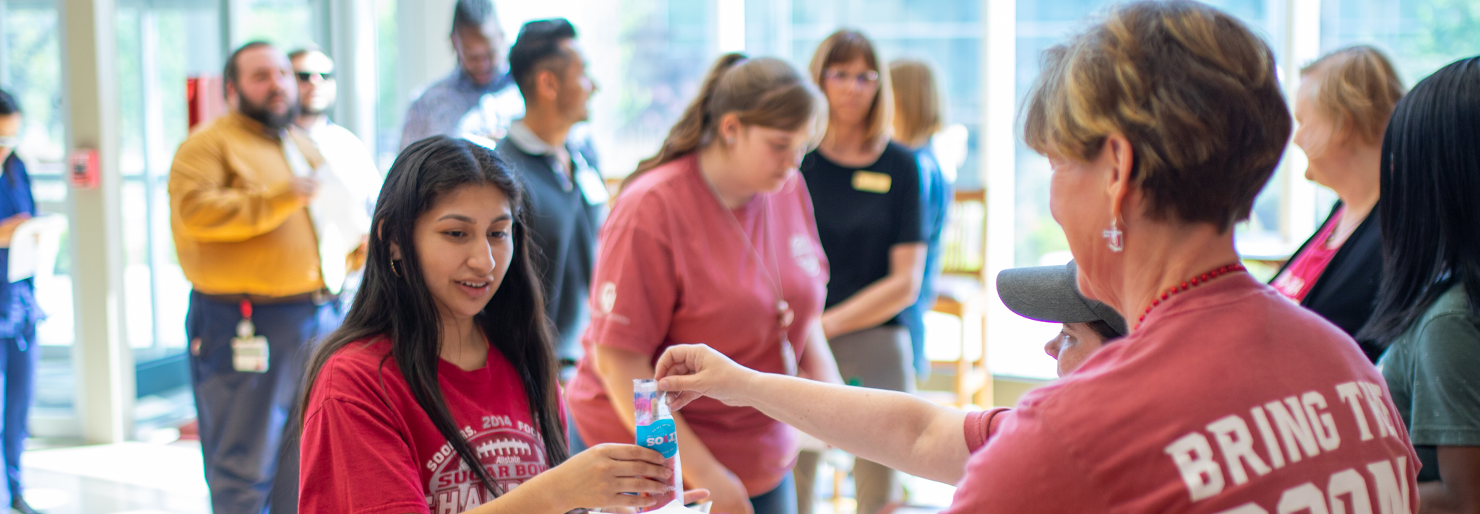
Popsicles and T-Shirts
Lessons Learned

Slide 18
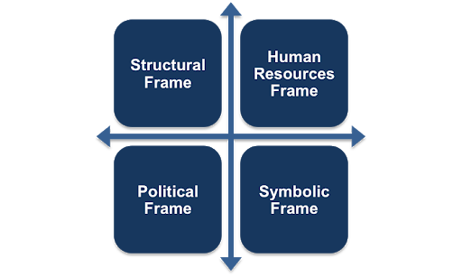

Slide 19
Academic Library Friends: A toolkit for getting started
When all is said and done, developing an academic Friends group requires ongoing support from library administration.
The fact is, the library director/dean is the driving force behind the continuation of the Friends and the one primary factor leading to the success of the Friends.
To be or not to be depends so much on energy, dedication, and enthusiasm for getting things accomplished.
You can do this!
Charles D. Hanson, Director of Kettering Library Services, Kettering University

Slide 20
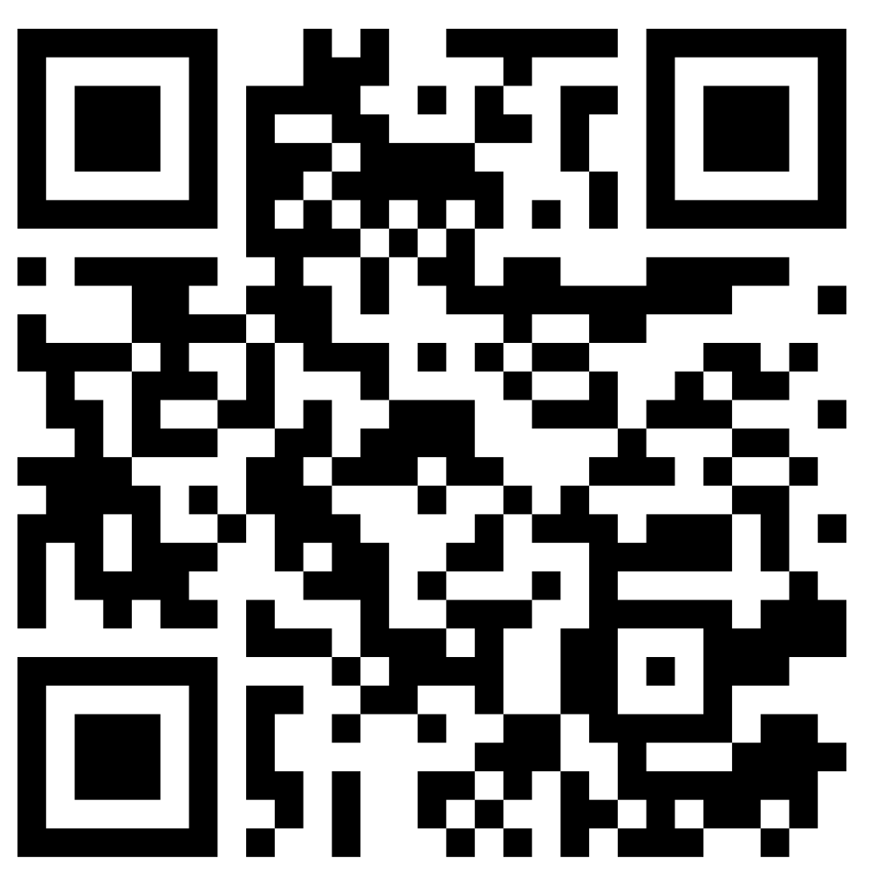
The Future of FOSL... is you!
https://library.tulsa.ou.edu/fosl
Thanks for listening!

