Slide 1
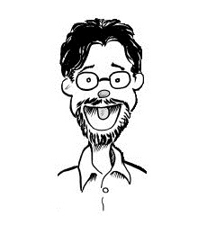
Framework Literacy Understanding, Implementing and Integrating the ACRL Framework for Information Literacy for Higher Education
Jay Edwards
Instruction Librarian OU Libraries

Slide 2
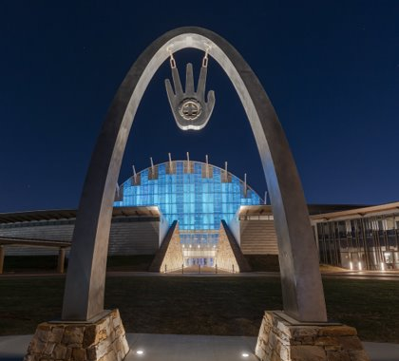
Land Acknowledgement
I want to respectfully acknowledge and honor the indigenous communities whose traditional, ancestral, and sovereign lands we live and work on today. Librarians have an important role in providing plentiful resources and education about America’s rich indigenous heritage and the current contributions of tribal nations.​
​Please consider visiting or donating to:​
First Americans Museum Oklahoma famok.org​

Slide 3

ACRL Framework for Information Literacy for Higher Education
www.ala.org/acrl/standards/ilframework

Slide 4
ACRL Framework for Information Literacy for Higher Education
Authority Is Constructed and Contextual
Information Creation as a Process
Information Has Value
Research as Inquiry
Scholarship as Conversation
Searching as Strategic Exploration

Slide 5
Framework Jargon
Threshold Concepts
Metacognition
Metaliteracy
Knowledge Practices
& Dispositions

Slide 6
Frequency of vocabulary / taxonomy
Knowledge Practices
7 understand
6 recognize
3 use
3 articulate
3 determine
3 identify
2 assess
2 monitor
Dispositions
8 recognize
5 seek
5 value
3 understand
2 develop
2 maintain
2 accept
2 see

Slide 7
Frequency of vocabulary / taxonomy
Knowledge Practices
(1 appearance each)
Dispositions
(1 appearance each)
acknowledge
break
cite
contribute
credit
critically
deal
decide
define
design
develop
draw
evaluate
formulate
manage
match
organize
participate
refine
respect
seek
summarize
synthesize
transfer
utilize
appreciate
conscious
consider
demonstrate
evaluate
examine
exhibit
follow
know
motivate
persist
question
realize
resist
respect
suspend

Slide 8
7th Frame: Information as Human Right and Social Justice
Not (yet?) part of the ACRL Framework
“Everyone has the right to freedom of opinion and expression; this right includes freedom to hold opinions without interference and to seek, receive and impart information and ideas through any media and regardless of frontiers.”
- Article 19 of the U.N. Universal Declaration of Human Rights (1948)
“The Association will acknowledge and address historical racial inequities, challenge oppressive systems within academic libraries, value different ways of knowing, and identify and work to eliminate barriers to equitable services, spaces, resources, and scholarship.”
- ACRL Plan for Excellence (2019)

Slide 9

ACRL Companion Documents
The Framework for Visual Literacy in Higher Education (April 2022)
Instruction for Educators (June 2023)
Journalism (April 2022)
Politics, Policy, and International Relations (June 2021)
Research Competencies in Writing and Literature (November 2021)
Science, Technology, Engineering, and Mathematics (August 2022)
Social Work (June 2021)
Sociology (January 2022)
Women's and Gender Studies (June 2021)
www.ala.org/acrl/standards/alphabetical

Slide 10

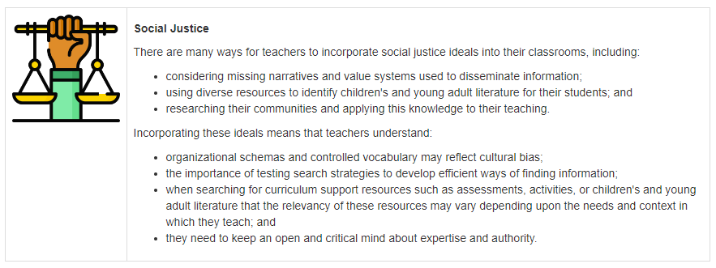
Companion Document:
Instruction for Educators
acrl.libguides.com/ed

Slide 11


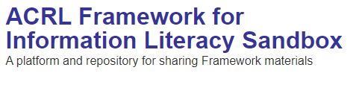
Implementation: Sandbox
sandbox.acrl.org

Slide 12
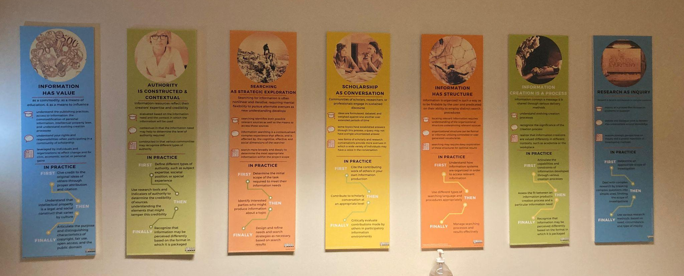
Implementation Spotlight:
OSU Passive Programming

Slide 13
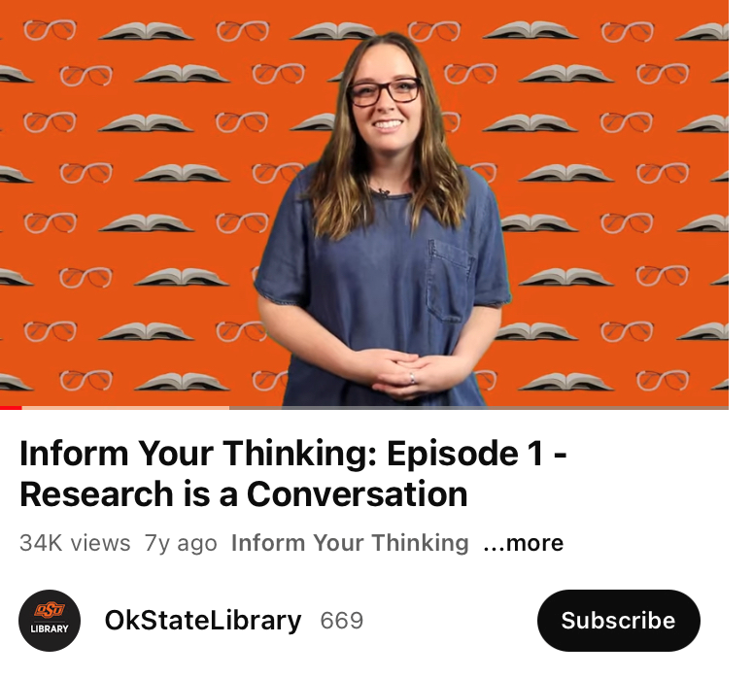
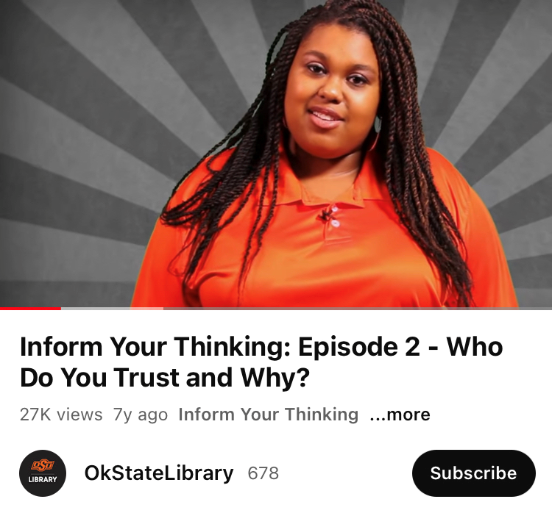
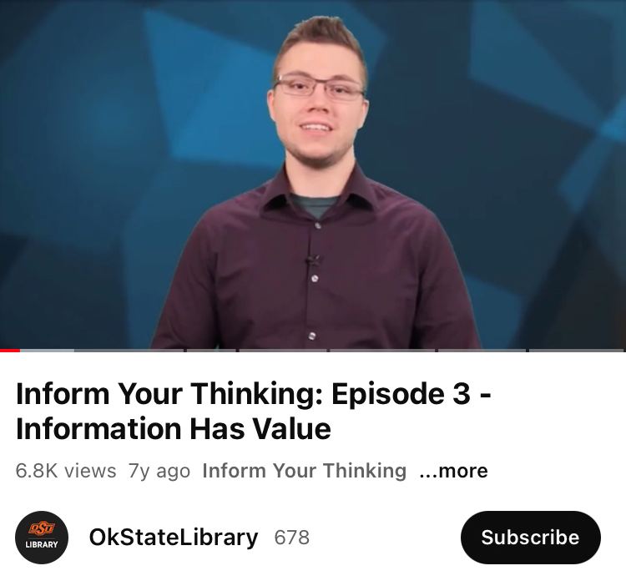
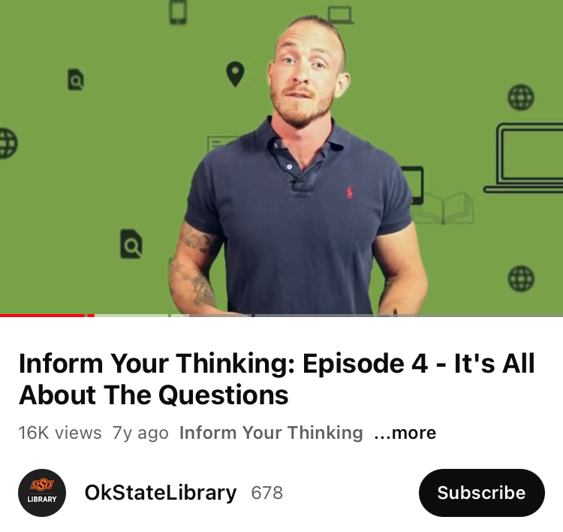
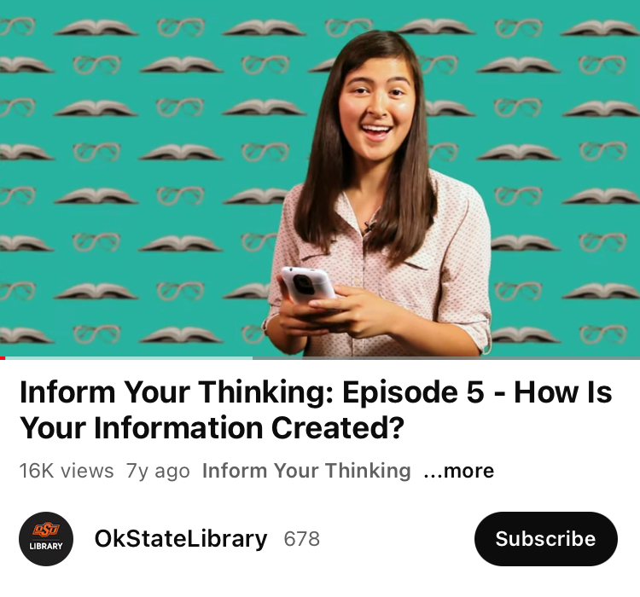
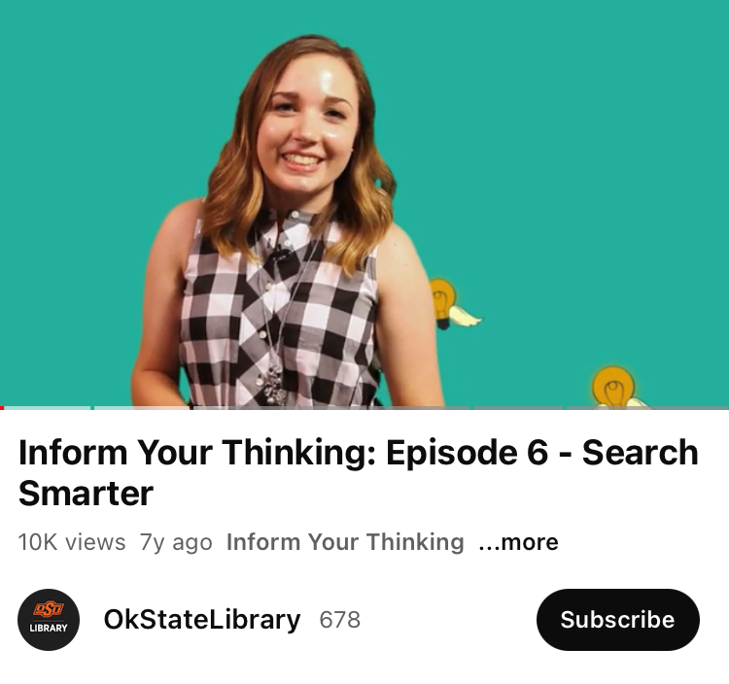
Implementation Spotlight: OSU Video Tutorials
attributed to Cristina Colquhoun and Matt Upson

Slide 14
Integrating the Framework into Previous Practice
Activity: Academic vs Popular Sources
Look at these two sources [provided in class]. What differences do you see?
Response Frame Question
Advertisements Information Has Value Who pays for this?
Cites Sources Information Has Value Where did they get their info?
Scholarship as Conversation How are they interacting?
Formal vs Informal Writing Info Creation as Process “Packaging”: Audience, purpose,
dissemination
Written by Scholars vs. Others Authority is Constructed, Contextual What are their qualifications?
Authority is Constructed, Contextual What context makes each useful?
Info Creation as Process How did they get their info?
(Peer review, interviews, etc.)

Slide 15
Authority is Constructed and Contextual
Information resources reflect their creators’ expertise and credibility,
and are evaluated based on the information need
and the context in which the information will be used.
Authority is constructed in that various communities may recognize different types of authority.
It is contextual in that the information need may help to determine the level of authority required.

Slide 16
Information Creation as a Process
Information in any format is produced to convey a message and is shared via a selected delivery method.
The iterative processes of researching, creating, revising, and disseminating information vary, and the resulting product reflects these differences.

Slide 17
Information Has Value
Information possesses several dimensions of value, including
as a commodity,
as a means of education,
as a means to influence, and
as a means of negotiating and understanding the world.
Legal and socio-economic interests influence information production and dissemination.

Slide 18
Research as Inquiry
Research is iterative
and depends upon asking
increasingly complex or new questions
whose answers in turn develop additional questions
or lines of inquiry in any field.

Slide 19
Scholarship as Conversation
Communities of scholars, researchers, or professionals
engage in sustained discourse
with new insights and discoveries occurring over time
as a result of varied perspectives and interpretations.

Slide 20
Searching as Strategic Exploration
Searching for information is often nonlinear and iterative, requiring
the evaluation of a range of information sources, and
the mental flexibility to pursue alternate avenues
as new understanding develops.

Slide 21
Discussion
What’s surprising?
What concepts can you add into instruction or your practice?
How have you implemented this into instruction
or your practice?
How has your institution implemented this?
What’s missing?
What concepts would you add?
Do you include non-Framework concepts in instruction
or your practice?

Slide 22

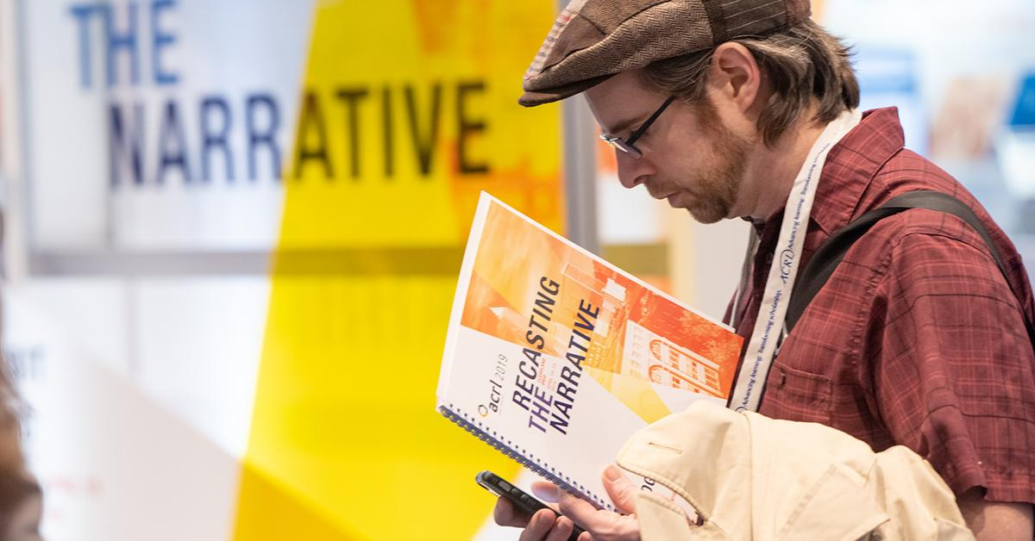

Thank you!
Library Profile
Jay Edwards
Instruction Librarian, OU Libraries
Improv Director, Medieval Fair of Norman
MLIS, University of Oklahoma
jae@ou.edu
LinkedIn Profile

