Slide 1

Self and desire as seeds of virtue
Paul Condon
John Dunne
Christine Wilson-Mendenhall
Wendy Hasenkamp
Karen Quigley
Lisa Feldman Barrett

Slide 2
Self-Transcendence, De-Reification & Flourishing
Paul Condon
John Dunne
Christine Wilson-Mendenhall
Wendy Hasenkamp
Karen Quigley
Lisa Feldman Barrett

Slide 3
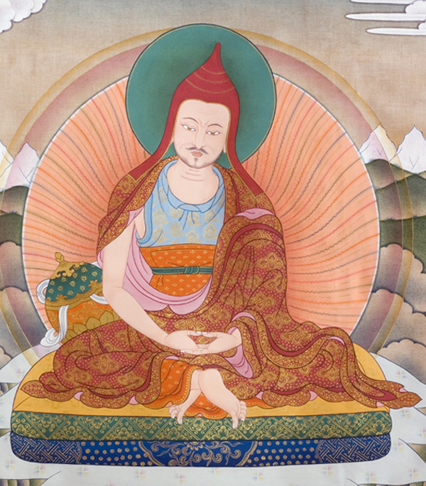
A model of Self/not-Self
Critique of a hypostasized self as owner/controller
Development of relational self mutually constituted with virtues

Slide 4

Core Virtues
Wisdom
  Yathābhūtadarśana (“seeing truly”)
  Deconstructive: embracing the humbling aporia of relations
Compassion
  Empathy and action
  World-making through other-centered relations.

Slide 5
Balance & Integration
Compassion can become an enemy (སྙིང་རྗེ་དགྲར་ལངས་)
Wisdom can become an enemy (སྟོང་པ་དགྲར་ལངས་)

Slide 6
Examining Wisdom and Compassion
Self-transcending desires and emotions as “conducive to compassion.”
Dereification as “conducive to wisdom.”

Slide 7

Reification
A reified thought is “fused” with the world; it is experienced as real.

Slide 8
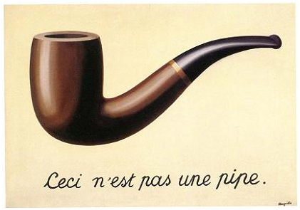
Dereification
A dereified thought is experienced as a representational mental event that is not felt to be what it represents.

Slide 9




Relationships

Slide 10
Aims
Aim 1: Integrate Buddhist framework with psychological literature
Aim 2: Assess quality of intentions using psychological methods
Aim 3: Assess whether quality of intentions predicts prosocial action and flourishing
Notes:
In this project, we will do XYZ.

Slide 11


Aim 1: Theory
Positive psychology and wellbeing
Self-threat, stress, self-control
Social emotions and prosocial behavior

Slide 12
Aim 2: Intention
Investigate the quality of intentions in daily life and relationships with an innovative approach
  Desire
  Thoughts
  Emotion
A continuum from virtuous to non-virtuous
Notes:
Not the actual content of intention, but the context in which it is arising
Not what is intended, but how it is intended

Slide 13


Psychological approach
Indirect measurement
Experience sampling
Person and couple centered approach
  Couples from Boston community (n=100)

Slide 14
Context of Intention
Reification / Dereification
  Example: Self-esteem lability
  (Pietromonaco & Barrett, 2009)
Desire
  Example: What do you want at this moment?
Emotions
  Example: Self- and other-focused emotion

Slide 15
Aim 3: Quality of Intentions and Action
Does the quality of intentions predict prosocial behavior and flourishing?
  Prosocial behavior
  Flourishing
Hypothesis: dereification, self-transcendent desires, and other-focused emotions together predict prosocial behavior and flourishing

Slide 16
Prosocial behavior toward stranger
Condon et al. (2013). Psychological Science.

Slide 17
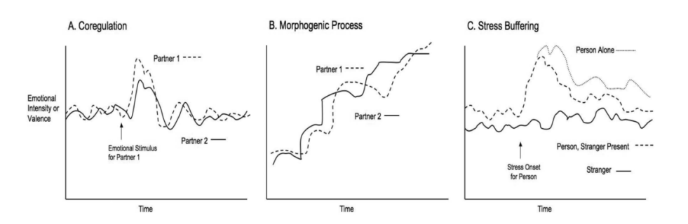
Flourishing
Psychophysiology measures
  Sympathetic synchrony as a proxy of poor relationship quality
  (Levenson & Gottman, 1983)
  Parasympathetic synchrony as a proxy of high relationship quality
  (Helm et al., 2014)
Butler & Randall (2013)

Slide 18
Challenges & Anticipated Strategies

Slide 19
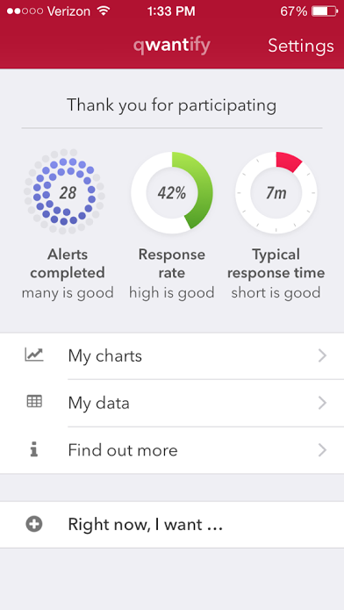
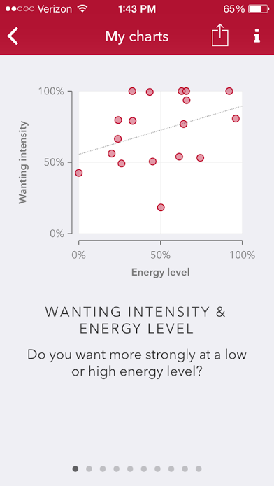
Challenge 1: Feasibility
Strategy
  Lab expertise
    (n=92) with 8-week meditation intervention, experience sampling, psychophysiology, and social behavior yielded attrition rate <20% and compliance >80% (Condon et al., in prep)
App with feedback

Slide 20
Challenge 2: Analyses
Strategy
    Lab expertise
      Combination of Structural Equation Modeling and Multi-Level Modeling
      Cross-lagged analyses

Slide 21
Challenge 3:
Measuring intention
Strategy
  Infer the quality of intentions (even unconscious ones) by evidence of self-transcendence and dereification
  Use established methods for indirectly assessing self-transcendence in desire and emotion.
  Develop innovative strategies for assessing (de-)reification (Papies et al., 2012)

Slide 22

Impact

Slide 23
Impact
Implications for the use of empirical methods to examine Buddhist moral theory.
  What other features of theory and practice can be modeled in a way amenable to empirical study?
(Dis)confirmation of a particular model for virtue and flourishing in Indo-Tibetan Buddhism.

Slide 24
Thank you
Paul Condon
John Dunne
Christine Wilson-Mendenhall
Wendy Hasenkamp
Karen Quigley
Lisa Feldman Barrett

Slide 25
Supplemental slides

Slide 26
Challenge 3: Deep Integration
Mapping constructs across disciplines
Design & measurement
Ongoing collaboration
  Lab culture
  Papers on emotion, compassion

Slide 27
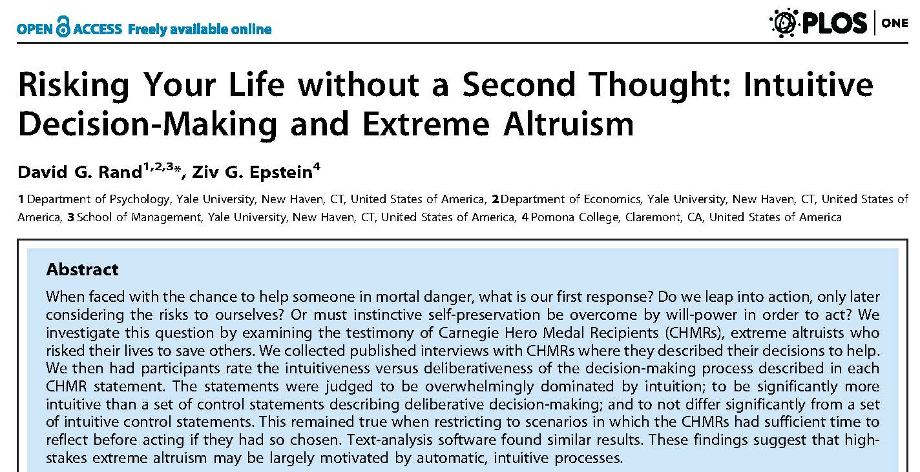

Slide 28

Experience Sampling
Overcomes unreliable self-reports from estimating over days, weeks, months (Barrett, 1997)
Usually outperforms traditional self-report measures (Connor & Barrett, 2012)
Notes:
Self-reports are problematic when they rely on aggregated or retrospective recall. Momentary reporting, however, has great predictive power and usually outperforms traditional self-report measures. For example, research has shown that momentary reporting of emotions are valid predictors of real physical health and behavioral outcomes. This project will leverage the power of experience sampling to assess virtuous intentions through repeated assessment of reification, desire, and emotions as they occur in daily life and during the dynamic fluctuations within relationships.
To accomplish this, our laboratory has worked with a software company to develop an mobile-based experience sampling application to assess desires, emotions, and related states in daily life.
We will use the app to measure momentary experience over a two- to three-week duration. Each sampling instance will assess experiences of emotion, desires,

Slide 29
Experience Sampling measures
Context
Dereification
Desires
Emotions
Dereification
Rumination
Relationship satisfaction
Wellbeing
Notes:
10-15 items per sampling instance

Slide 30

Measuring reification
What comes to mind when you think of your partner/self/relationship? (open-ended responses)
How confident are you in the accuracy of your thoughts?
  Not very confident--------Very confident

Slide 31
Measuring desire
What did you want most?
  Intensity (very weak to very strong)
Did you want to feel… [from list]
  Praised/acknowledged
  Connected with others
  Comfort/relief
  Nothing in particular
Notes:
How will we actually measure desire using the iphone app? Participants will be asked if they were experiencing a desire just before the alert and, if so, asked the open ended question “what did you want most?,” like in the pilot. Whenever the report a desire, they will be asked to rate the intensity – how strong or weak the desire felt to them. In the next two blocks, participants will be presented with lists of desires and asked to select any that they were experiencing (up to the 3 most intense). The first list will include the more behavior-focused desires from previous research. The second list will include more psychological and social desires, including desires targeted as more self-focused or more self-transcendent so we can examine the conceptual framework.

Slide 32
Measuring emotions
Affect
  How were you feeling? (Very bad----very good)
Were you feeling any of the following emotions?
  Angry, restless, annoyed, jealous, proud, resentful
  Happy, kind-hearted, grateful, compassionate

Slide 33
Desire in the Moment
What do you want most right now (if anything)?
Psychological & social desires substantial
  Biological (food, substance, sex, health)
  Material (money, goods)
  Psychological (achievement, leisure, lifestyle, less stress, well-being)
  Social (relationships)
Notes:
To get a better idea of the range of desires that people experience in the moment, we did an initial pilot in which ~120 people on an online platform reported what they wanted most at that moment (if anything)? We then did a simple coding of their responses into categories.
Doesn’t change when limit to most intense desires (6 & 7 on 7-pt scale)

Slide 34
Social Desires
What do you want most right now (if anything)?
“I want to be at-ease socializing with people”
“A relationship with my father. For him to realize how stubborn and mistaken he is about many things”
“Family time”
Notes:
To give you a better idea of what people actually reported, here are some of the social desires
Doesn’t change when limit to most intense desires (6 & 7 on 7-pt scale)

Slide 35
Psychological Desires
What do you want most right now (if anything)?
“I want to be a famous vocalist in a metal band”
“I want to be self-employed and have more free time”
“I want some peace in my life.”
Notes:
And here are some of the psychological desires
Doesn’t change when limit to most intense desires (6 & 7 on 7-pt scale)

Slide 36
Prosocial behavior toward partner
Response to partner’s positive news (Gable et al., 2006)
  Active-constructive
  Passive-constructive
  Active-destructive
  Passive-destructive
Notes:
Active-constructive: involvement, excitement, enthusiasm; asking questions, seeking additional details, elaborating on implications and benefits; express interest, happiness, or pride
Passive-constructive: responder says very little or is silent (e.g., a pleasant but short or quiet exchange; lower level of involvement; no questions, no elaboration.
Active-destructive: involvement, but feedback is negative in valence, pointing out negative implications of event, reframing the event as less favorable than discloser did, minimizing significance
Passive-destructive: Disclosure of the event is minimally acknowledged; little or no interest conveyed; e.g., change the subject or direct conversation to something that happened to self.

Slide 37
Helping after eight-week meditation course.
DID NOT HELP
HELPED
3
16
Non-meditation
10
10
Meditation
χ²(1)=5.13, p<.03, r=.36
Condon et al. (2013). Psychological Science.

Slide 38
Helping after smartphone-based training.
DID NOT HELP
HELPED
4
25
Non-meditation
10
17
Meditation
χ²(1)=4.03, p<.05, r=.27
Lim, Condon, & DeSteno (2015). PLoS ONE

