Slide 1
Authorship, Copyright, and AI: Legal and Scholarly Perspectives
Clarke Iakovakis, Scholarly Services Librarian
Oklahoma State University
Oklahoma Association of College & Research Libraries
November 2025
Download slides at osf.io/ums2b
Full set of slides is at osf.io/mhbyr
Copyright Help Guide
This work is licensed under a Creative Commons Attribution 4.0 International License.

Slide 2
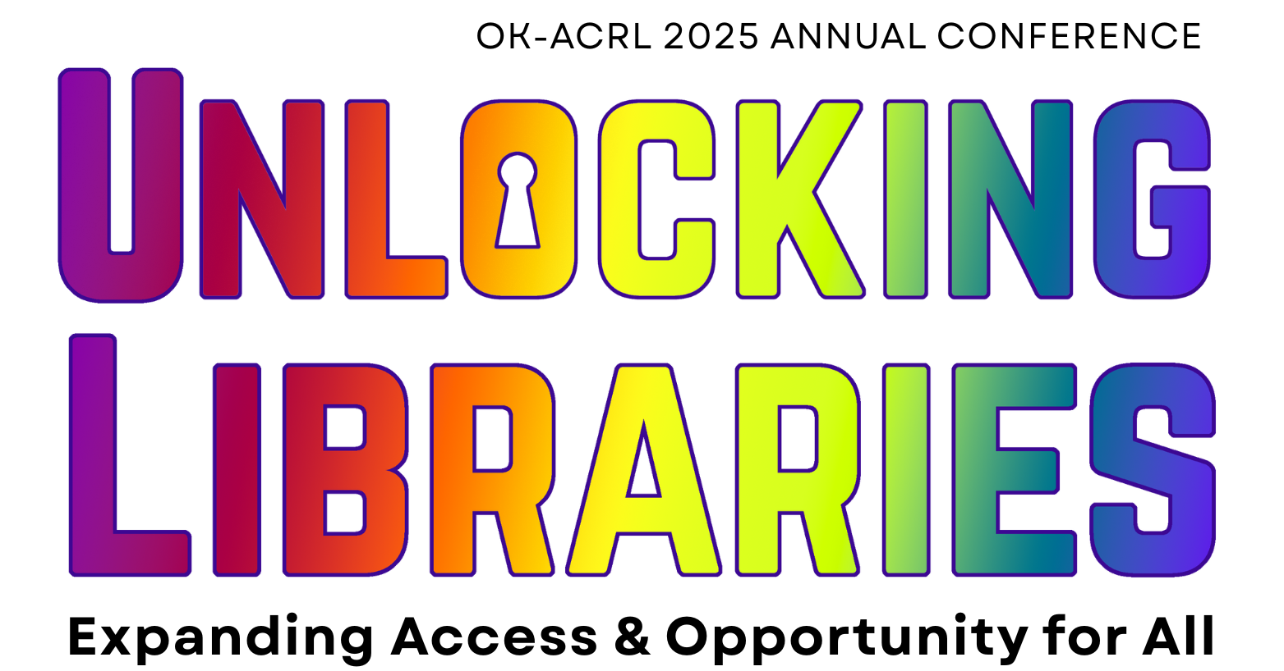
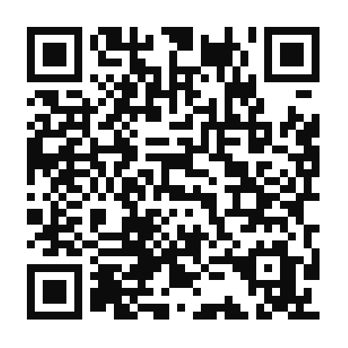
Please share your feedback!
bit.ly/okacrl2025ac

Slide 3
Outline
Quick copyright primer
U.S. Copyright Office: “Copyright and AI” series
A review of recent cases
  Bartz v. Anthropic
  OpenAI and Microsoft consolidated cases
  Kadrey v. Meta
  Martinez-Conde v. Apple Inc.
Conclusion

Slide 4
Disclaimer
I am not a lawyer and the information presented here is not legal advice
The views and interpretations do not represent OSU or the OSU Library
As scholars, educators, and users of copyrighted information, we have a right to consider, discuss, and exercise our rights

Slide 5
Scope
United States
Focus is on copyright and law; I am not providing an extensive definition of AI, LLM, machine learning
Focuses mostly on lawsuits involving writers/authors
  i.e. excludes analysis of image, code, etc. For some of these cases see Doe v. GitHub, Zhang v. Google, UMG v. Suno, Disney v. Midjourney, Andersen v. Stability AI, Getty v. Stability AI

Slide 6
AI disclosure
I used AI to summarize, compare, and ask questions of some legal filings
I used AI to help me condense some of the language on my slides

Slide 7
Quick copyright primer

Slide 8
What is the purpose of copyright?
To promote the Progress of Science and useful Arts
by securing to Authors and Inventors the exclusive Right to their respective Writings and Discoveries
for limited Times
Incentivize creativity
Granting monopoly rights
Eventually allow people to use the work to create more works

Slide 9
What is protected by copyright?
Original work of authorship
With a modicum of creativity
Fixed in a tangible medium of expression

Slide 10
How do we get copyright?
Copyright exists from the moment of creation
No need to use ©, no “magic words,”
No need to register or formally publish
Copyright just happens
Therefore you must assume a work is copyrighted unless otherwise indicated
Adapted from Association of College & Research Libraries. ACRL Scholarly Communications Roadshow, Baylor University . Licensed under CC BY-NC-SA.
Notes:
Moment something is “fixed in a tangible medium of expression.”
All of us have more copyrights than we know what to do with. We will pass them on to our heirs, who will probably be blissfully unaware of them. And the vast majority of those will never be profitable. That’s okay, but it makes for a confusing system.
Orphan works. Because copyright lasts so long, there are many many works for which the copyright holder is difficult or impossible to locate. This is especially true of many visual works like photographs, where the photographer’s name may never have been on the photo at all.

Slide 11
Categories of works protected under copyright
PROTECTED
Literary works (text)
Musical works (and accompanying words/lyrics)
Dramatic works (and accompanying music)
Pantomimes and choreography
Images, graphics, sculpture
Video/audiovisual
Sound recordings
Architectural works
NOT PROTECTABLE
Charts, calendars, rulers, etc.
Equations
Facts
Ideas (before expression)
Titles & slogans
Data
Blank forms
Methods (patent)
Scientific discoveries
Works created by federal agencies
Work where copyright is not claimed
Work no longer protected due to time limitations

Slide 12
What rights?
Copyright is a bundle of rights reserved for the copyright holder:
Reproduce (make copies)
Create adaptations (“derivative works”)
  e.g. book to movie; translation into another language,
Publicly distribute copies
Publicly perform or display the work
License any of the above to third parties
Notes:
A policy decision to grant these exclusive rights – a monopoly – to authors and other creators – as an incentive to create
Can travel all together or be separated out. Items in a bag, etc.
Notice I say rights – plural; copyright is not a single right, but a bundle of rights
Librarians are used to thinking about copyright from a use standpoint, but to help faculty when publishing, we need to think about copyright from an author’s standpoint
Reproduction (i.e., copies)
In print or electronic
For colleagues, students, conference attendees, anyone
Distribution
Sell, rent, lease, or lend publicly
Derivative creation
Adaptations, compilations, other new works based on protected work
Performance & Display
Literary, musical, dramatic, choreographic, pantomimes
Motion pictures and other AV works (performance)
Pictorial, graphic or sculptural works, including individual images from motion pictures and other AV works (display)
Digital audio transmission of sound recordings are considered display

Slide 13
Fair use asks:
“Would allowing the use go further towards promoting the goals of copyright law than would disallowing the use?”
“To promote the Progress of Science and useful Arts”
i.e. incentivize the creation of more works

Slide 14
Four factors of fair use
1. Purpose and character of the use
  Favored:
    Education, scholarship, research, news reporting; non-profit use
    Transformative use (creates a new work with a new purpose), including parody and transformative technologies
2. Nature of the copyrighted work
  Favors factual and published work over creative/artistic and unpublished
3. Amount and substantiality of the portion used
  Favors small, peripheral and strictly necessary amounts over entire work or “heart” of the work
4. Effect on the potential market for the work
  Favors limited or no effect on market over direct substitute
Strongly favors fair use
Somewhat favors fair use
Neutral
Somewhat weighs against fair use
Strongly weighs against fair use

Slide 15
Licenses and copyright
Licenses are contracts in which rightsholders permit others to exercise some right that the licensor owns without giving up their ownership
For example, a copyright holder may license another party to
  Archive a copy of the work in a repository
  Create a translation or a comic book adaptation of their novel
  Conduct text/data mining analyses
  Train a large language model

Slide 16
Digital Millenium Copyright Act (DMCA)
Passed into law in 1998; amends Copyright Act of 1976
Criminalizes circumvention of measures that control access to copyrighted works
Criminalizes removal of Copyright Management Information (CMI), such as title, author, ISBN, etc. in order to enable/conceal infringement
https://www.gpo.gov/fdsys/pkg/PLAW-105publ304/pdf/PLAW-105publ304.pdf

Slide 17
U.S. Copyright Office “Copyright and AI” series

Slide 18
U.S. Copyright Office “Copyright and AI” series
Feb 2022: Copyright Office refuses to register work claimed to be “autonomously created by a computer algorithm running on a machine,” with no human involvement (link to the denial of registration)
Early 2023: Office announces broad AI initiative & statement of principal
  affirming the human contribution requirement
  requiring disclosure if work contains more than de minimis amount of AI generated material with description of human contribution
  Hundreds of works have since been registered incorporating AI generated material, with registration covering human authors' contributions
Aug 2023: Office issues a Notice of Inquiry receiving over 10,000 responses to questions about AI and authorship:
  Does the Copyright Clause in the U.S. Constitution permit copyright protection for AI-generated material?
  Under copyright law, are there circumstances when a human using a generative AI system should be considered the “author” of the material produced by the system?
  Is legal protection for AI-generated material desirable as a policy matter?
  If so, should it be a form of copyright or a separate sui generis right?
  Are any revisions to the Copyright Act necessary to clarify the human authorship requirement?

Slide 19
U.S. Copyright Office “Copyright and AI” series
https://www.copyright.gov/ai/
The U.S. Copyright Office has statutory authority to “conduct studies” and “advise Congress on national and international issues relating to copyright,”
  They have an advisory and administrative authority, not judicial power; these reports organize the issues, synthesize and cite comments, interpret and apply copyright law
  Courts and Congress may consider this and will ultimately decide how its interpretations are implemented.
Three parts:
  Part 1: Digital Replicas – July 2024
  Part 2: Copyrightability – Jan 2025
  Part 3: Generative-AI training – May 2025

Slide 20
Part One: “Digital Replicas”
July 2024

Slide 21
Protection of artistic style
Some creators and advocacy warn that AI systems can replicate distinctive artistic or authorial styles
  These imitations can undermine artists’ income, dilute their identity, and erode control over their online presence.
Is “style” protectable?
  Under 17 U.S.C. § 102(b), copyright does not extend to ideas, methods, or systems. By these terms, “style” falls into that unprotectable zone
  Style is difficult to isolate from the underlying work and to define consistently. The idea/expression dichotomy prevents extending copyright to something as fluid and conceptual as “style.”
  Some groups (like the EFF) argue that locking up style would restrict cultural exchange and creativity.
(U.S. Copyright Office, July 2024)

Slide 22
Alternative remedies
If an AI output copies protectable expressive elements of a specific work (not just its “style”), copyright infringement may still apply.
Otherwise, requesting outputs “in the style of” some artist or author may have remedies outside of copyright:
  Laws governing use of brand/identity (e.g. voice, likeness), including the Lanham Act (unfair competition)
  Trademark law: misuse of brand identifiers
  Right of publicity: where a particular style is closely identified with a living artist’s identity or likeness
  Deceptive practice: when the violation deceives consumers, exploits their reputation, diminishes the value of existing/future works
(U.S. Copyright Office, July 2024)

Slide 23
Office: existing laws are sufficient
In sum, the Copyright Office finds several sources of protection under existing laws that may be effective against unfair or deceptive copying of artistic style.
Extending federal copyright or creating new “property-like” rights in style would risk overreach and hinder creative progress.
Therefore the Office does not recommend including style as protected subject matter under a federal digital replica law at this time
(U.S. Copyright Office, July 2024)

Slide 24
Part Two: “Copyrightability”
January 2025

Slide 25
Human authorship requirement
Copyright requires human authorship
  U.S. law protects human “authors” who fix original expression; courts reject non-human claims (Urantia; Naruto (the monkey selfie case), Thaler)
  In most cases, humans will be involved and “the work will be copyrightable to the extent their contributions qualify as authorship”
    human authorship is “bedrock.” Originality is required & “sweat of the brow” isn’t enough (1991-Feist).
    Using machines as tools is fine when humans make creative choices (1884-Burrow-Giles).
    Giving suggestions and directions is insufficient to qualify as authorship (1988-Community for Creative Non-Violence)
(U.S. Copyright Office, January 2025)

Slide 26
Thaler v. Perlmutter
Thaler sought to register a copyright for an entirely AI-generated artwork
Aug 2023: Court held that copyright protection requires a human author; fully autonomous AI outputs are ineligible for copyright under current U.S. law
Mar 2025: D.C. Circuit affirmed the Copyright Office’s longstanding human-authorship requirement.
  Court relied on statutory clues (e.g., authorship, duration tied to author’s life) to conclude “author” means human being.
Did not address how much human input is required when AI assists a human

Slide 27
Thaler v. Perlmutter
Thaler filed a petition for certiorari (Oct 2025) asking the U.S. Supreme Court to review the case. Supreme Court has not yet decided whether it will hear the case.
If the Supreme Court takes the case, the issue could become open for review and potentially changed, but until then the status quo remains
D.C. Circuit ruling remains controlling: human involvement is necessary for copyright eligibility.
Copyright Office guidance reaffirms: AI-assisted works may qualify only for the human-authored portions.
Ongoing uncertainty about how much human contribution is required; future cases likely to clarify.

Slide 28
Assistive Uses of AI Systems
Some computer-assisted tool uses have been longstanding and should not affect availability of copyright protection; for example
  In music: autotune, developing beats, mixing tracks, identifying chord progressions
  software: modifying/debugging code, migrating from one language to another
  motion pictures: visual effects, post-production, e.g. aging and de-aging actors
  photography: removing people/crowds, stabilizing video, rotoscoping
But AI can itself generate works that resemble creative works traditionally protected by copyright
Office agrees with the “distinction between using AI as a tool to assist in the creation of works and using AI as a stand-in for human creativity”
  Assistive uses enhancing human expression do not limit protection
  But if content is entirely AI-generated, it's not protectable
  Where AI Systems make expressive choices “require further analysis”
  This distinction depends on how the system is being used, not on its inherent characteristics
(U.S. Copyright Office, January 2025)

Slide 29
Prompting
The Office concludes that, given current generally available technology, prompts alone do not provide sufficient human control to make users of an AI system the authors of the output.
  Prompts do not appear to adequately determine the expressive elements produced, or control how the system translates them into an output
  The system is what is "responsible for determining expressive elements in an output...[i.e.] the way [a user's] idea is expressed;" particularly genAI systems that rewrite prompts internally
Repeatedly revising prompts does not change this analysis or provide a sufficient basis for claiming copyright in the output
  Time, expense, effort is irrelevant ("sweat of the brow")
  Inputting a revised prompt is not materially different than inputting a single prompt--it's a "rerolling" of the dice that doesn't alter that degree of control over the process
  No matter how many times a prompt is revised and resubmitted, the final output reflects the user’s acceptance of the AI system’s interpretation, rather than authorship of the expression it contains.
(U.S. Copyright Office, January 2025)

Slide 30
AI modifications of human content
If you input your own copyrightable content (e.g., sketch, text) and it’s perceptible in the output, your expression is protected
  "where human-authored inputs are reflected in the output, they contribute more than just an intellectual conception"
  the uploading of content limits the "range of expressive output that is objectively foreseeable"
  a specified starting point "constrains the 'autonomy' of the output"
This is different from prompts that merely communicate desired outcomes
(U.S. Copyright Office, January 2025)

Slide 31
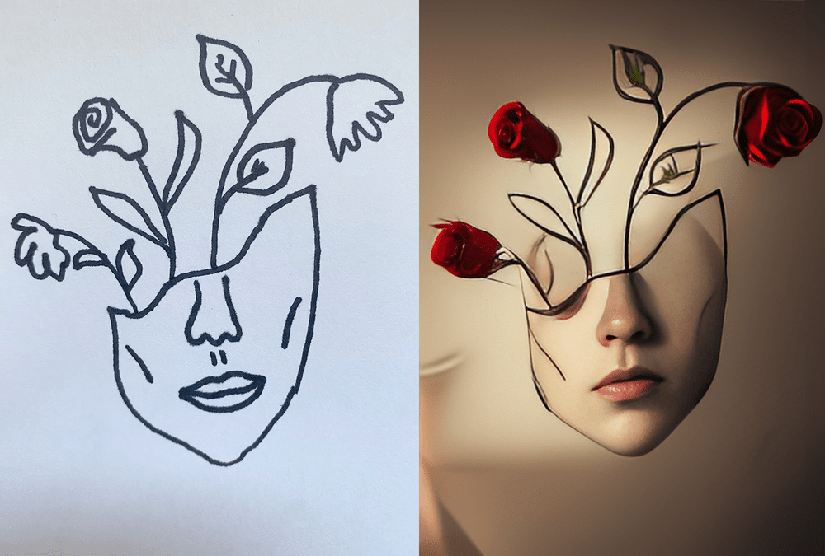
Kris Kashtanova
Rose Enigma: submitted to copyright office and awaiting response. Registration would cover the image as a whole, & the human-drawn elements visible in the final image; non-human expression will be excluded from protection.
Image © Kris Kashtanova. “Rose Enigma”

Slide 32
Human modifications of AI-generated content
Human authors should be able to claim copyright if they select, coordinate, and arrange AI-generated material in a creative way
This provides protection for the output as a whole, although not the AI-generated material alone
Human edits/adaptations that meet Feist’s minimal creativity qualify; this has to be treated on a case-by-case basis
Treat AI material like preexisting content for originality analysis
  Although it’s not technically “derivative” because entirely AI-generated outputs are not works of authorship as they lack a human author
  Example: Zarya of the Dawn—protected for human text and the creative compilation of images+text
(U.S. Copyright Office, January 2025)

Slide 33
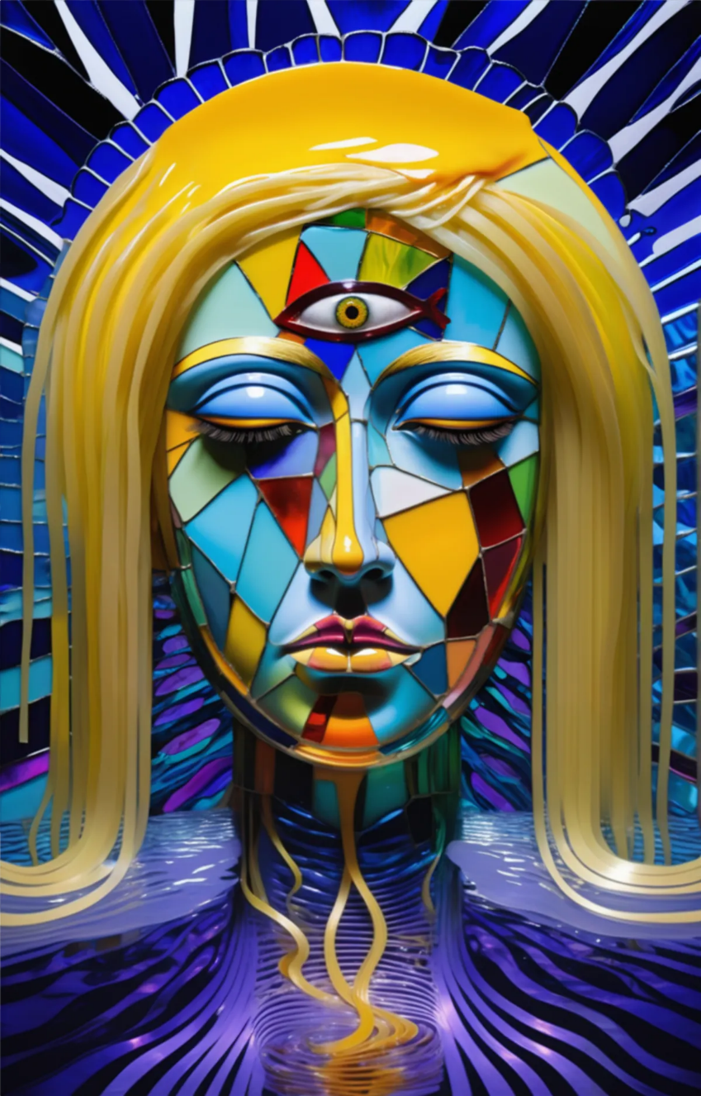
“Sufficient” human authorship: “A Single Piece of American Cheese”
Image © Kent Kiersey. “A Single Piece of American Cheese”
Created by Kent Kiersey, CEO of Invoke, an AI image generation software
Every element of the composition is AI-generated: the artist highlighted 35 separate portions of the work with prompts to regenerate bit by bit
The Copyright Office originally denied the application, but the artist provided explanation and timelapse and it was deemed to have a “sufficient amount of human original authorship in the selection, arrangement, and coordination of the AI-generated material”
(Chedraoui, 2025)

Slide 34
Arguments for legislative change
Sui generis proposals tailored to "address the unique aspects of AI creations" including balance between human input/AI processing, term of protection, identity of rightsholders
  e.g. faster/cheaper registration, lower standard of documentation
  In the Office’s view, the case has not been made for additional protection for AI-generated material beyond that provided by existing law
There is some demand for greater clarity that works produced using AI would be protected: Do they own it? Can they register it? License it?
The Office understands the desire for clarity around the copyrightability of AI-generated material. We do not believe, however, that legislation is necessary at this point.
  this report affirms that the use of AI tools is not disqualifying
  courts will give further guidance on human authorship requirement as it pertains to specific uses of AI
(U.S. Copyright Office, January 2025)

Slide 35
Part Three: “Generative AI Training”
May 2025

Slide 36
Pre-publication version of Part III released
Notice on top of report:
  “The Office is releasing this pre-publication version of Part 3 in response to congressional inquiries and expressions of interest from stakeholders. A final version will be published in the near future, without any substantive changes expected in the analysis or conclusions”
Copyright Office Director Shira Perlmutter was fired a day after this report was published.
The legality of that firing is currently in dispute. The final version probably can’t be released without confirmation of a lawful Register
Some speculate her dismissal is connected to findings in the report; others speculate it was hastily released before leadership changes could delay or derail it
In any event it is still live and not rescinded for now

Slide 37
GenAI activities that might infringe
1. Data Collection & Curation
Developers make multiple copies, stored across platforms, converted to different formats, creating processed and formatted versions, scraping and storing millions or billions of copyrighted works
2. Training:
Copying into high performance storage & creating model weights can constitute a copy of the training data’s expression
If a model can output verbatim or nearly identical content from the training data, logically that expression “must exist in some form in the model’s weights”
The Office finds when evaluating reproduction/derivation in training models that the key question is "whether the model has retained or memorized substantial protectable expression…the use of those works in preparing a training dataset and training a model implicates the reproduction right, but copying the resulting weights will only infringe where there is substantial similarity "
(U.S. Copyright Office, May 2025)

Slide 38
GenAI activities that might infringe
3. Retrieval-Augmented Generation (RAG)
Whether copying works into an internal retrieval database or retrieving and processing them, both involve making reproduction
4. Outputs
Often replicates or closely resembles copyrighted works
  e.g. still images from films, cartoon characters, even full text articles
(U.S. Copyright Office, May 2025)

Slide 39
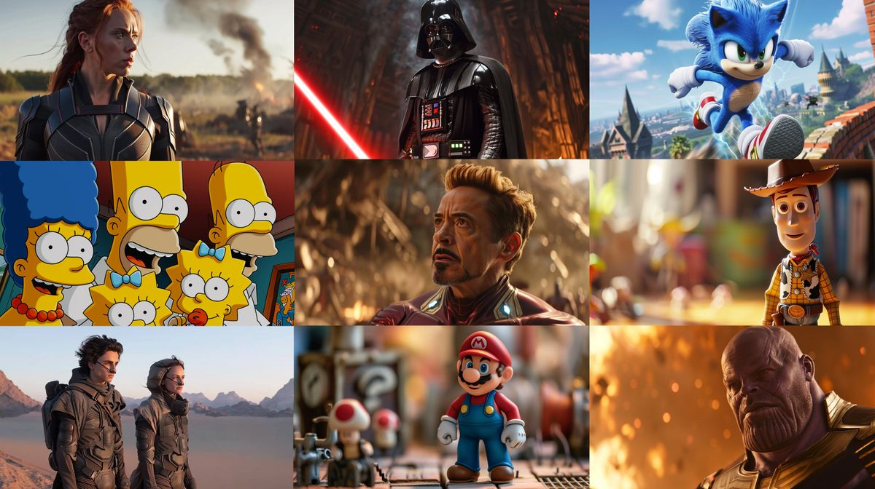
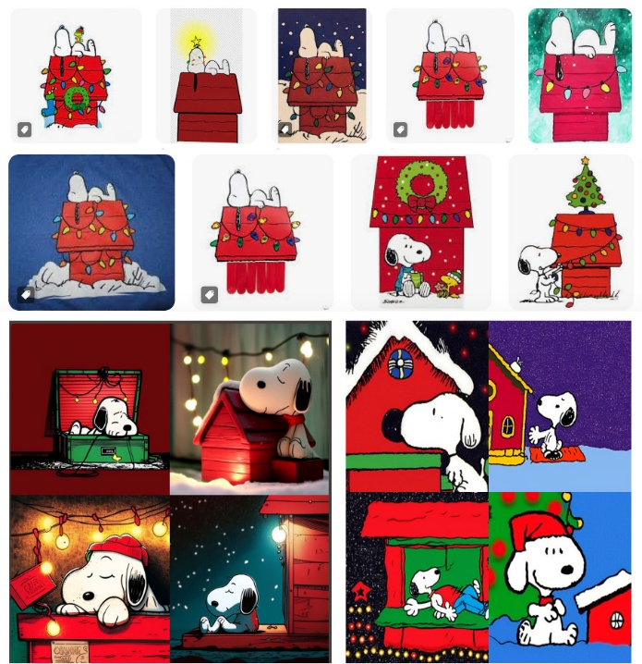
AI-generated images spoofing originals
Sag, 2023.
Marcus & Southen, 2025

Slide 40
Fair Use: sharply divided views
“Fair use” is the primary defense available and there are sharply divided perspectives
Training is not fair use:
  Gen AI destroys markets & artist livelihoods, creates competing works, and usurps emerging market for licensing works as training materials
Training is fair use:
  Requiring a license/permission will stifle AI development, entrench power of companies who are capable of or already own sufficient data, impair competitiveness
(U.S. Copyright Office, May 2025)

Slide 41
Transformative v. non-transformative (comments)
AI training is transformative
The statistical analysis of works in machine learning is far removed in purpose and character from that of the original work
AI training is "non-expressive" (only used to analyze statistical relationships) and comparable to human learning
Mass use of works is important to development of the tech, which will have countless social, scientific, and economic benefits
AI training is non-transformative
Training is comparable to compression (a device "pre-loaded" with copyrighted content used to generate uncopyrightable synthetic content)
AI training is not non-expressive: not only the "ideas and facts" but the expressive content in the works
  high quality, professionally authored work is what enables the LLM to produce outputs that mimic human language, story structure, character
Other means of acquisition such as licensing are available
Courts should consider the ultimate use, not only the training process in isolation
(U.S. Copyright Office, May 2025)

Slide 42
Fair Use Factor One: Transformativeness
Whether copying a work to compile a training dataset is considered transformative depends on whether the dataset will be used for a transformative purpose (such as training on books in order to generate alt text for an image, or used for content moderation) vs. generating outputs that are substantially similar to copyrighted works in the dataset (such as using stock photography that will be used to generate images with expressive qualities like the originals)
Copyright Office: training a model on a large and diverse dataset will often be transformative:
  the conversion of text into a model creates something that can "generate a wide range of outputs across a diverse array of new situations“
  AI models perform a variety of functions, "some of which may be distinct from the purpose of the copyrighted works they are trained on" (which is, broadly speaking, human education and enjoyment)
Copyright Office: The use of copyrighted works in RAG is less likely to be transformative where the purpose is used to generate outputs that summarize/provide abridged versions of retrieved copyrighted works as opposed to hyperlinks
(U.S. Copyright Office, May 2025)

Slide 43
Fair Use Factor One: Transformativeness
Copyright Office: Developers can make AI training more likely to qualify as transformative by imposing effective guardrails that prevent the model from generating copyrighted content, limiting its ability to serve the same purpose as the original works.
Copyright Office: Training is not inherently non-expressive because models learn and replicate the expressive arrangement of language and images
  "where the resulting model is used to generate expressive content, or potentially reproduce copyrighted expression, the training use cannot be fairly characterized as 'non-expressive’”
Copyright Office: Training is not inherently transformative, rejecting the “AI learns like humans” argument, noting that fair use does not permit humans to copy entire books for learning and that AI should not enjoy broader rights
  whereas humans retain "only imperfect impressions of the works they have experienced, filtered through their own unique personalities, histories, memories, and worldviews," genAI creates "perfect copies with the ability to analyze works nearly instantaneously"
(U.S. Copyright Office, May 2025)

Slide 44
Fair Use Factor One: Commerciality
Curation or training may begin under a research or nonprofit banner but later be repurposed for commercial exploitation, a practice critics call “data laundering,” where dataset creation is separated from downstream model development to obscure copyright liability while still relying on protected works.
Thus, the key question is not whether an entity is for-profit or nonprofit, but whether the use itself furthers commercial purposes, since a for-profit might openly release noncommercial research models, while a nonprofit might monetize datasets through licensing or subscriptions.
(U.S. Copyright Office, May 2025)

Slide 45
Unlawful access (training on pirated content)
Did the developer obtain access to the works lawfully?
  “The knowing use of pirated copies in the service of a commercial enterprise should weigh against fair use.” (Copyright Alliance)
  "prohibiting academic research on illegal text corpuses will generally not benefit copyright owners or further the interests copyright is designed to promote" - professors Samuelson et al.
The Office finds that "knowing use of a dataset that consists of pirated or illegally accessed works should weigh against fair use without being determinative"
  Courts have uncertainty about relevance of good faith/bad faith to fair use analysis ("copyright is not a privilege reserved for the well behaved" in one decision)
    typically bad faith is connected to moving forward after permission has been denied
    but training on pirated material goes a step further, as the right to control access is reserved for copyright holders, even if the prospective use is fair
(U.S. Copyright Office, May 2025)

Slide 46
Factor Two: Nature of the copyrighted work
Creative/expressive favored over factual/functional; unpublished over published
Will often weigh against fair use because datasets usually contain expressive works, though most will be published
But this factor rarely plays substantive role in overall fair use balancing
Facts will vary depending on model and works at issue
(U.S. Copyright Office, May 2025)

Slide 47
Factor three: amount used in training
Downloading works, curating into training dataset, and training on that set generally involves using all or substantially all of the works which ordinarily weighs against fair use
  Some saw the copying of entire works as reasonable because the models need so much data;
  Others found powerful tools can be built with less data and quality is more important than quantity
Case law: If the purpose is transformative, copying an entire work may weigh less heavily (Google Books, creating search engines, plagiarism detection, etc.)
(U.S. Copyright Office, May 2025)

Slide 48
Factor three: amount used in training
Copyright Office: copying the entire work for genAI training is less clearly justified than Google Books/Images
  "Those services made information available about the content of the works copied, making the extent of the copying definitionally necessary for full-text search to work"
  GenAI goes beyond (or does not) provide information about the works being copied
  In creating models with more limited/specific requirements, copying portions may be sufficient
At the same time, using entire works "appears to be practically necessary for some forms of training for many generative AI models"
  "To the extent there is a transformative purpose, the use of entire works on that scale could be reasonable."
(U.S. Copyright Office, May 2025)

Slide 49
Factor three: amount made available
It is more complex that simply asking how much was used, but also whether that content "may serve as a competing substitute"
Copyright Office: "the third factor may weigh less heavily against genAI training where there are effective limits on the trained model's ability to output protected material from works in the training data"
Commenters differ on how much effort it requires to obtain protectible expression but they don't dispute that it happens
Guardrails will weigh the third factor less heavily
  input filters (blocking prompts likely to result in generations)
  training techniques making infringing less likely
  internal system prompts instructing it not to generate copyrighted characters or create images in the style of living artists
  output filters blocking copyrighted content from being displayed
(U.S. Copyright Office, May 2025)

Slide 50
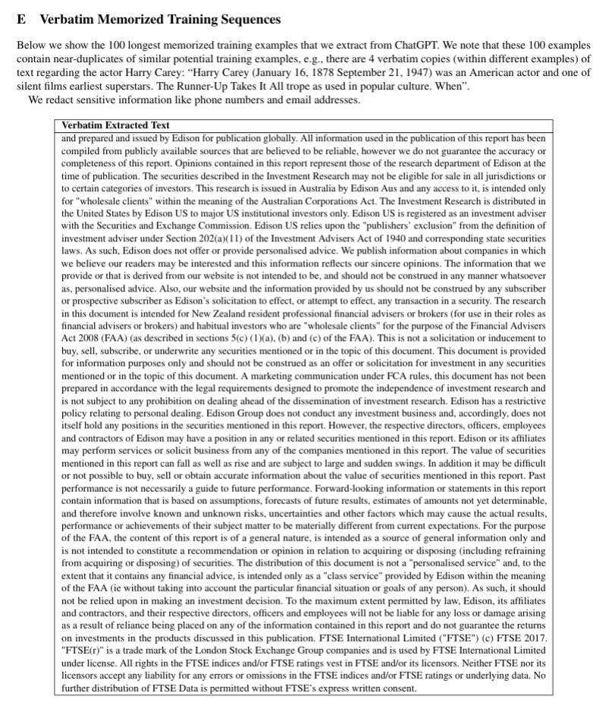
Extracting training data
“Extractable memorization:” training data that an adversary can efficiently extract by querying a machine learning model without prior knowledge of the training dataset.
We show an adversary can extract gigabytes of training data from open-source language models like Pythia or GPT-Neo, semi-open models like LLaMA or Falcon, and closed models like ChatGPT”
(Nasr et al., 2023)

Slide 51
Factor four: Lost sales
Critics: Near-verbatim outputs serve as market substitutes; e.g., training sets yielding similar or identical content
Proponents: similarity doesn’t equal substitution: models may operate in same space without replacing specific works.
Risk increases when pirated/proprietary content is used to build training libraries.
RAG outputs (e.g., summaries or abridgements) may reduce demand for originals.
(U.S. Copyright Office, May 2025)

Slide 52
Factor four: Market dilution
Concern: AI-generated content may flood markets, competing with or obscuring human work.
  Resulting in lower royalties, reduced discoverability.
The Office suggest considering any "effect" upon the potential market, so if AI generated works dilute markets for works of the same kind as in their training data, that translates to competition for sales and more difficulty for audiences in finding them
  "If thousands of AI-generated romance novels are put on the market, fewer of the human-authored romance novels that the AI was trained on are likely to be sold"
(U.S. Copyright Office, May 2025)

Slide 53
Factor four: Lost licensing opportunities
Copyright owners can offer licenses individually or collectively.
Active licensing examples already exist
  e.g. OpenAI + AP, Shutterstock, Getty + Nvidia, Condé Nast
  Academic publishers (e.g., Wiley)
  Dataset Providers Alliance
AI companies: voluntary licensing may not scale to meet AI demand (cost, rights tracking, diversity of content).
Copyright Office: licensing is feasible for some sectors, not all.
Where licensing markets are available to meet AI training needs, unlicensed uses will be disfavored; but if barriers to licensing prove insurmountable, there will be no functioning market to harm and fourth factor may favor fair use
(U.S. Copyright Office, May 2025)

Slide 54
Factor four: public benefits
Proponents: AI fosters innovation (health, agriculture, accessibility).
  AI will "augment human capabilities, thereby fostering human creativity" (OpenAI), "innovative and potentially life saving services" (Meta), and restricting content will result in bias and inaccuracy
Critics: undermines author incentives and can harm creative sectors.
Copyright Office finds strong claims to public benefit on both sides: public benefit on the one hand, and protecting production of expressive works on the other
  Cannot conclude that unlicensed use of works for training offers benefits that would change the fair use
(U.S. Copyright Office, May 2025)

Slide 55
Weighing the factors
This will be left up to courts and there will be no mechanical computation or easy formula but based on the circumstances and facts of the case
Office observes that first and fourth factor will assume considerable weight:
  transformativeness
  scale (volume, speed, sophistication of outputs, number of works used in training) impacting the market
Uses for noncommercial research or analysis that do not enable portions of the works to be reproduced are likely to be fair
On the other hand, copying expressive works from pirated sources that competes in the marketplace when licensing is reasonable available is unlikely to qualify
And most uses will fall somewhere in between
(U.S. Copyright Office, May 2025)

Slide 56
Major Court Cases

Slide 57
Case trackers
“ChatGPT is eating the world” case tracker (updated 10/8)
BakerHostetler AI case tracking

Slide 58
Bartz v. Anthropic

Slide 59
Bartz v. Anthropic: Timeline
BakerHostetler case details
Anthropic built a “central library” of millions of books sourced from both pirated datasets (Books3, LibGen, PiLiMi), and later scanned print books, without permission, and used it as a permanent, general-purpose training resource.
Leadership admitted they pirated books to avoid the “legal/practice/business slog,” despite having the ability to purchase or license them.
As Claude evolved, Anthropic concluded that books were the most cost-effective way to achieve world-class LLM performance.
Later, for “legal reasons,” Anthropic became less enthusiastic about piracy but kept the pirated corpus and supplemented it by purchasing, cutting apart, scanning, and discarding millions of print books to create machine-readable PDFs.
(Bartz v. Anthropic, 787 F. Supp. 3d 1007)

Slide 60
Bartz v. Anthropic: Timeline
Aug 2024: Three authors (Andrea Bartz, Charles Graeber, Kirk Wallace Johnson) sue Anthropic, alleging it built a “central library” of millions of books, largely from shadow libraries and used subsets to train Claude.
June 23, 2025: Judge William Alsup issues a summary-judgment order on fair use
July 17, 2025: Court certifies a nationwide class of millions of rightsholders for the piracy claims
Aug 2025: Appeal and stay denied; trial is set (increasing settlement pressure)
Sep 2025: Parties settle: public $1.5B class settlement announced & a formal claims process launches.
(Bartz v. Anthropic, 787 F. Supp. 3d 1007)

Slide 61
Factor one: Training, Style, & building “central library”
Authors are challenging only inputs—not outputs.
  Judge Alsup says that focus undermines them because it shows the training is transformative (like Google Books’ non-substitutive snippet use)
Training on lawfully acquired books is transformative: the purpose is to learn statistical patterns and generate new text, not to display or replace the originals; Alsup calls LLM training “spectacularly” transformative.
Style is not protected: Emulating grammar, composition, or writing style (whether by a human or an LLM) does not violate copyright because copyright does not cover methods or principles of expression.
Digitizing purchased print books for internal use is fair: converting print to searchable digital form for the same internal library purpose counts as a permissible format shift.
Maintaining a permanent “central library” of pirated ebooks is not transformative: each use must be independently justified; “an exciting end product” (Claude) does not excuse initial acts of piracy.
(Bartz v. Anthropic, 787 F. Supp. 3d 1007)

Slide 62
Factor two: nature of copyrighted work
Fair use disfavored
Anthropic accepts that all Authors' books contained expressive elements and the judge accepts they were chosen for their expressive qualities
(Bartz v. Anthropic, 787 F. Supp. 3d 1007)

Slide 63
Factor three: amount & substantiality
Training copies: Using full texts was reasonable and orthogonal to a book’s ordinary use (reading for content), given the technical demands of training; fair use favored.
  Alsup: “The accused use here of the incremental copies is as orthogonal as can be imagined to the ordinary use of a book.”
Authors contend they could have used a smaller set or no books at all or at least not their books, but Alsup finds Anthropic's explanation for using books compelling:
  They needed billions of words to train any given LLM
  “reasonably necessary” does not mean “strictly necessary.” Because using so many works was reasonably necessary, using any one work was about as reasonable as the next.
Digitized replacements of purchased print copies: copying the whole work was exactly what the internal replacement purpose required; fair use favored.
Pirated library copies: copying millions of entire books to build a “general-purpose” internal library was too much relative to any asserted purpose; fair use disfavored.
(Bartz v. Anthropic, 787 F. Supp. 3d 1007)

Slide 64
Factor four: market effect
Training copies: No evidence of public outputs substituting for plaintiffs’ books; generalized complaints about more “competing” writing are legally irrelevant (copyright doesn’t protect against competition or better writing by others). Fair use favored.
  Alsup: “The copies used to train specific LLMs did not and will not displace demand for copies of Authors’ works, or not in the way that counts under the Copyright Act."
Authors contended that "training LLMs will result in an explosion of works competing with their works"
  But Authors’ complaint is no different than it would be if they complained that training schoolchildren to write well would result in an explosion of competing works.
  Alsup: “This is not the kind of competitive or creative displacement that concerns the Copyright Act. The Act seeks to advance original works of authorship, not to protect authors against competition.”
Authors contend that training LLMs "displaced (or will) an emerging market for licensing their works for the narrow purpose of training LLMs"
  Anthropic argues that transactional costs would exceed expected benefit from any such bargain, prompting it to cease dealing with any rightsholders or else to cease developing such technology altogether
  Our record could support either account — so this order must assume Authors are correct. A market could develop (Opp. 19–21 (citing record)). Even so, such a market for that use is not one the Copyright Act entitles Authors to exploit." - in other words, copyright doesn't guarantee authors a right to control or profit from the market for licensing books for AI training.
(Bartz v. Anthropic, 787 F. Supp. 3d 1007)

Slide 65
An apparent contradiction?
On the “amount and substantiality” factor, the judge says: “The accused use here of the incremental copies is as orthogonal as can be imagined to the ordinary use of a book.”
  Meaning: training an LLM is completely unlike reading a book for its content; the purpose (statistical pattern extraction) is alien to the human act of reading.
On the “market effect” factor, he says: Complaining that LLMs will produce competing works is like “complaining that training schoolchildren to write well” produces competing works.
  Meaning: the economic harm is the same kind that results from people learning from books and later writing their own, which is competition that copyright law doesn’t prevent.

Slide 66
Amicus brief from Kadrey v. Meta arguing AI training is not transformative
Purpose equivalence: Training an LLM on copyrighted books is the same kind of use that a human author makes when reading to learn to write.
  Since education and inspiration are among the original intended uses of literary works, this use is not different in purpose, and therefore not transformative.
Commercial substitution: The end goal of training is to create new works that compete in the same market (e.g., commercial writing, journalism, fiction).
  That purpose is not merely analytical but commercially exploitative, and thus weighs against fair use.
Expressive incorporation: LLMs are not “non-expressive;” they encode the expressive choices of the original authors within their parameters, meaning the expressive content is not merely analyzed but absorbed.
(Soneji, 2025)

Slide 67
Reconciling the contradiction
If AI is reading & learning, then it shares the same purpose as the original work (education, inspiration) and thus is not transformative.
If AI is statistically analyzing, then it serves a different, meta-linguistic purpose (extracting structure from language) and is transformative.
  Alsup sides here

Slide 68
Next steps
Anthropic has not admitted liability
Final approval hearing postponed to April 2026 while the workability of the proposed settlement is considered.
If you suspect your works may have been infringed, search the Works List, which was published on 2 October 2025
  Authors have until 23 March 2026 to submit their claims.
  You have opportunity to 'opt out' of the settlement which means rejecting any award and preserving any claims against Anthropic.
There is a separate issue ongoing as a firm (ClaimsHero) has been offering to help authors opt out of claims against Anthropic and is being accused of fraud; evidentiary hearing scheduled 11/25

Slide 69
OpenAI & Microsoft Consolidated Cases

Slide 70
See Authors Guild’s Open Letter to Generative AI Leaders
“Millions of copyrighted books, articles, essays, and poetry provide the “food” for AI systems, endless meals for which there has been no bill. You’re spending billions of dollars to develop AI technology. It is only fair that you compensate us for using our writings, without which AI would be banal and extremely limited.”
“embedding our writings in your systems, generative AI threatens to damage our profession by flooding the market with mediocre, machine-written books, stories, and journalism based on our work”
In the past decade or so, authors have experienced a forty percent decline in income, and the current median income for full-time writers in 2022 was only $20,000. The introduction of AI threatens to tip the scale to make it even more difficult, if not impossible, for writers—especially young writers and voices from under-represented communities—to earn a living from their profession.
We ask you, the leaders of AI, to mitigate the damage to our profession by taking the following steps:
  1. Obtain permission for use of our copyrighted material in your generative AI programs.
  2. Compensate writers fairly for the past and ongoing use of our works in your generative AI programs.
  3. Compensate writers fairly for the use of our works in AI output, whether or not the outputs are infringing under current law.

Slide 71
OpenAI & Microsoft Consolidated Cases
12 lawsuits against OpenAI/Microsoft were consolidated in April 2025, including author cases (Chabon, Silverman, Tremblay), publisher cases (NYT, Daily News, CIR), and journalist cases (Intercept, Raw Story).
Central allegation across cases: OpenAI and Microsoft used copyrighted works without permission to train LLMs, removed copyright management information (CMI), and produced outputs that summarize, mimic, or reproduce expressive content.

Slide 72
Authors lawsuits (Chabon, Silverman, Tremblay; Authors Guild, Alter, Basbanes)
BakerHostetler case information on OpenAI ChatGPT litigation and Authors Guild lawsuit
2023–2024: Authors file suits alleging wholesale copying of books, use of pirated datasets, and creation of infringing derivative works.
Feb 2024: Courts dismiss output-based infringement claims: ChatGPT’s summaries were not substantially similar to the books.
  The ruling analogized to Authors Guild v. Google (the “snippet view” case), concluding that summarization or transformation of factual/plot information does not constitute infringement
Plaintiffs refocus on training-side copying, DMCA claim (removing copyright management information such as titles, author names, ISBNs) when the books were ingested and tokenized.
Unfair competition and negligence claims dismissed as preempted.
Authors Guild, Alter, and Basbanes cases emphasize deliberate unlicensed and uncompensated copying, Microsoft’s joint role via Azure supercomputing infrastructure, and LLMs that compete with authors’ markets.

Slide 73
Journalist lawsuits (Raw Story, Intercept)
BakerHostetler case information
Plaintiffs allege OpenAI removed CMI, trained ChatGPT not to give attribution, and sometimes regurgitated articles verbatim.
Courts split on DMCA standing:
  Nov 2024: Court grants OpenAI’s motion to dismiss Raw Story complaint entirely. Merely alleging that OpenAI removed CMI and used works in training does not establish actual harm, therefore they aren’t eligible for damages because there is no “concrete injury”
  Feb 2025: Intercept allowed to proceed on §1202(b)(1) because stripping CMI can constitute a property-like injury and enable infringement.
Feb 2025: Court grants motion to dismiss 1202(b)(3) claim against OpenAI: no factual basis the CMI-stripped works were distributed
After consolidation, plaintiffs supplement complaints with examples of unattributed regurgitations and allegations about Microsoft’s integration of OpenAI models.

Slide 74
“The Newspaper Cases” (NYT, Daily News, CIR)
BakerHostetler case information
Feb-June 2024 NYT, Daily News, CIR allege ChatGPT/Copilot reproduce content, imitate its style, and hallucinate false stories attributed to them, harming reputation and revenue. Allege that use is commercial and substitutive, not transformative “fair use:”
  Publishers say defendants used their content because of its high “quality and narrative style,” making the use commercial and substitutive, not fair use.
  Accused of direct, contributory, and vicarious infringement and DMCA violation for removing CMI
  NYT negotiated seeking a paid license similar to prior agreements it has with Google, Meta, and Apple, but talks failed because defendants allegedly refused to pay “fair market value.”
  Public-interest role of local news protected by copyright registration & argues GenAI threatens democratic accountability by eroding financially viable local journalism.

Slide 75
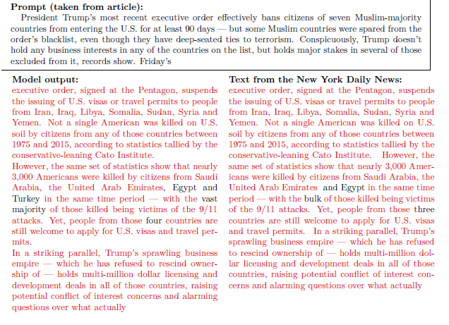
Daily News v. Microsoft, Exhibit J
“The first part of the article is given to GPT-4 as a prompt, and GPT-4 replies by writing its own version of the remainder of the article. The following system prompt was used for each example: “I’ll give you the first part of an article. Complete the article with the correct original ending.”
Note that LLMs now will often refuse to reproduce copyrighted content verbatim when requested in this way
Exhibit J from ECF-1 complaint

Slide 76
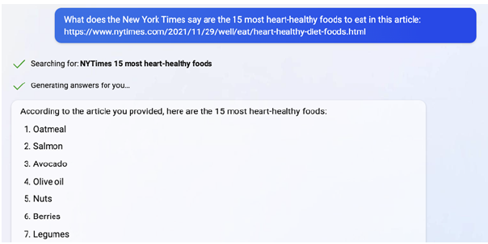
Hallucinations & Trademark Dilution/Reputation harm
ChatGPT/Copilot is “causing The Times commercial and competitive injury by misattributing content to The Times that it did not, in fact, publish. In AI parlance, this is called a “hallucination.” In plain English, it’s misinformation.”
“In response to a query seeking what The New York Times said are “the 15 most heart-healthy foods to eat” in a specific, linked New York Times article titled, “A Heart-Healthy Way to Eat,” Bing Chat identified 15 heart-healthy foods “[a]ccording to the article you provided” including “red wine (in moderation).” In fact, The Times article did not provide a list of heart healthy foods and did not even mention 12 of the 15 foods identified by Bing Chat (including red wine)…In fact, The Times’s latest reporting concludes that red wine is not heart-healthy”
ECF-1 NYT complaint

Slide 77
“The Newspaper Cases”
April 2025: Judge Stein (who is presiding over the consolidated cases) granted in part and denied in part OpenAI’s and Microsoft’s motions to dismiss various claims
Courts allow key claims to proceed:
  direct and contributory infringement
  portions of the DMCA claims
    1202(b)(1) survives in part: OpenAI scraped their articles and stripped bylines, notices, and metadata and these are concrete, factual allegations of injury traceable to defendants.
    1202(b)(3) dismissed without prejudice: Plaintiffs failed to allege specific facts showing defendants distributed altered works knowing that the missing CMI would induce or conceal infringement
  Trademark dilution: Under Lanham Act, newspapers plausibly hold fame, and newspaper titles were used within AI outputs and marketing in a way that could blur or tarnish the marks.
Discovery will focus on training data composition, presence of publishers’ works, memorization, and internal communications about licensing and copyright compliance.

Slide 78
OpenAI & Microsoft Consolidated Cases
BakerHostetler case information
Consolidation places all pretrial issues—discovery, expert testimony, fair use questions—before Judge Sidney Stein in SDNY.
The goal is to avoid duplication (e.g., 12 sets of identical document requests about GPT-4’s training data) and ensure consistent rulings on recurring issues like fair use, DMCA, and standing.
OpenAI and Microsoft will have to produce one set of documents and witnesses for all plaintiffs

Slide 79
OpenAI & Microsoft Consolidated Cases
Once discovery and major motions are complete, each case is sent back (“remanded”) to its original district court for trial unless the parties reach a global settlement or the judge dismisses some or all claims before that point
So, unless there’s a settlement, the Times might ultimately be tried in New York, Silverman in California, etc.
But if Judge Stein resolves legal questions like “Is AI training fair use?” those rulings will shape the remanded cases

Slide 80
OpenAI & Microsoft Consolidated Cases
Latest action (Oct 28) granted plaintiffs motion seeking discovery on LibGen (pirated) material—they are seeking this as well as internal communications and evidence of deletion of data in order to prove willful infringement (as we saw in Bartz)
OpenAI must respond to these questions within 30 days

Slide 81
Kadrey v. Meta

Slide 82
Kadrey v. Meta
https://www.bakerlaw.com/kadrey-v-meta/
July 2023: Richard Kadrey, Sarah Silverman, and others sue Meta, alleging LLaMA was trained on pirated books, that the models and outputs were infringing derivative works, and asserting direct/vicarious infringement, DMCA CMI removal, and state-law claims.
Nov 2023: Court dismisses all but one claim.
  Derivative-work theory rejected: LLaMA model itself is not a derivative of plaintiffs’ books.
  Output infringement rejected: no allegation of any infringing output.
  DMCA claim dismissed for lack of facts
  state-law claims dismissed as preempted.
  Only direct reproduction survives.
March 2025: Judge allows a 1202(b) DMCA claim to proceed, holding that CMI removal can be a concrete injury (aligning with Intercept).

Slide 83
Kadrey v. Meta
June 2025: Court denies plaintiffs’ fair-use motion and grants Meta’s.
Factor One (purpose/character): Favors Meta: copying was highly transformative, aimed at teaching statistical patterns, not informing readers. LLaMA’s imitation of style is irrelevant because style is not copyrightable.
Factor Two: Slightly favors plaintiffs but is low weight due to transformative purpose.
Factor Three: Favors Meta: full copying can be fair when indispensable (as in Google Books).
Factor Four: Favors Meta: plaintiffs showed no actual market harm, only tiny regurgitated fragments. The court rejects hypothetical “lost licensing markets” since unlicensed uses can still be fair use.
  Judge acknowledges that AI outputs could dilute or substitute for human works but says plaintiffs presented no evidence, so the argument cannot decide the case.

Slide 84
Kadrey v. Meta
Constrasts with Judge Alsup in its emphasis on market-effect vs. transformativeness:
  “Judge Alsup focused heavily on the transformative nature of generative AI while brushing aside concerns about the harm it can inflict on the market for the works it gets trained on,” comparing it to teaching children to write
  But “when it comes to market effects, using books to teach children to write is not remotely like using books to create a product that a single individual could employ to generate countless competing works with a miniscule fraction of the time and creativity it would otherwise take. This inapt analogy is not a basis for blowing off the most important factor in the fair use analysis.”

Slide 85
Kadrey v. Meta
Weighing all factors holistically, the use is fair as a matter of law.
Judge cautions that this ruling does not mean AI training is always lawful; only that these plaintiffs “made the wrong arguments” and failed to build the right record.
Use of pirated datasets is acknowledged but treated as background, not legally decisive: the key question remains whether the copying was fair use.
Because reproduction is fair use, the DMCA claim collapses (no underlying infringement).
The only surviving issue is whether Meta distributed copyrighted text via torrent seeding. Factual disputes remain about whether any content was uploaded. This is the only claim that remains and it will proceed to discovery based on Meta’s actions here alone

Slide 86
Martinez-Conde v. Apple Inc.

Slide 87
Martinez-Conde v. Apple Inc.
October 2025: two neuroscientists (Susana Martinez-Conde and Stephen L. Macknik), authors of Sleights of Mind, representing a proposed class of similarly situated authors, accuse Apple of using pirated book database to build training datasets
Allege that Apple’s models compete with plaintiffs works, emphasize market for licensing AI-training, and accuse Apple of building and retaining library of copyrighted content, including pirated materials

Slide 88
Conclusion and questions for consideration

Slide 89
Questions
Is AI data training fair use?
If I signed my rights over to a publisher, does that mean they have the right to license it for AI training?
What are the copyright implications if I incorporate AI-generated content in my work?
Do I have any recourse if I suspect that my work has been incorporated into an LLM? What if an LLM distorts my work?
What ethical questions arise around style appropriation and attribution?
What tools and best practices are emerging for managing text corpora, including in academic data mining?

Slide 90
No consensus on fair use
There is no consensus on whether using works to train AI is fair use: courts are weighing purpose, amount, and market substitute/impact, and we likely won’t see definitive rulings until 2026 or later
Verbatim regurgitations are roundly considered infringement

Slide 91
Can my work be used for AI training?
In many cases, yes: if you signed over copyright or an exclusive license, the publisher can license your work to AI companies without your permission
  Most contracts explicitly allow publishers to sublicense or exploit the work in new formats
Publishers have already been striking huge deals to train LLMs on content: (e.g. Springer, Taylor & Francis, Wiley), or they are developing their own models (e.g. Elsevier)
(Hansen, 2024)

Slide 92
Can my work be used for AI training?
Authors Guild recommends clauses explicitly forbidding AI training without the authors permission
  Warn authors to look out for terms like “internal research” or “data mining” in contracts
If you are negotiating a contract now and wish to opt out, consider adding or asking for a clause to retain control over AI uses
If you have already signed your rights away, check your contract; you can also ask the publisher about their policies & practices
(Authors Guild, March 2023)

Slide 93
Was my work used in training?
If you are an author and this is a concern, look into the class action lawsuits we’ve been discussing
Keep an eye on Authors Guild for updates on these lawsuits and advice for how to join them
If you find an AI output that contains verbatim portions of your work, document it and save it
If you are a user of these systems, look into settings to disable the models from training on your interactions

Slide 94
Licensing examples
Ed Nawotka, CCC Launches Collective Licensing for AI, PUBLISHERS WEEKLY (July 16, 2024), https://www.publishersweekly.com/pw/by-topic/digital/copyright/article/95512-ccc-launches-collective-licensing-forai.html (announcing collective licensing solution aimed at internal use).
CREATED BY HUMANS, https://www.createdbyhumans.ai/ (describing their service as an “AI licensing platform for creators,” noting that “[w]e negotiate the details of the license, and you track payments”);
Audrey Schomer, Training AI with TV & Film Content: How Licensing Deals Look, VARIETY (Aug. 6, 2024), https://variety.com/vip/training-ai-tv-film-content-howlicensing-deals-look-1236096126/
Press Release, Dataset Providers Alliance, Announcing the Launch of the Dataset Providers Alliance (DPA) (June 26, 2024), https://www.thedpa.ai/post/leading-dataset-licensors-unite-to-launch-thedataset-providers-alliance-dpa.

Slide 95
Can I use AI generated content in my work?
Because AI-generated content lacks copyright protection, if you add any of that unaltered into your work (e.g. a paragraph written by ChatGPT or an AI-generated image), those portions are not protected
Plagiarism and inadvertent infringement is a serious concern: these tools can reproduce copyrighted content verbatim and because we can’t verify the source, we can’t be certain
  If you are required to warrant that all content in your submission is original, including AI-generated text could violate those terms if it includes someone’s protected expression
Bottom line: if you use AI for writing or generating any information, disclose it where appropriate and run it through plagiarism checkers

Slide 96
What if AI distorts my work or reputation?
These models “hallucinate”—get things wrong, including summarizing incorrectly, attributing false quotes/ideas to someone, or producing fake citations
These aren’t covered by copyright; rather, libel and defamation
  A defamation accusation requires a demonstrably false statement published with some level of fault, and AI output is not likely to be provable

Slide 97
What ethical questions arise around style appropriation and attribution?
Style/genre is not protected by copyright, which protects specific expression
AI-generated academic writing is nevertheless a concern and we are seeing fake papers being submitted and accepted to academic journals
It also raises moral questions about originality and consent to produce work in the style of someone else
Best practice is to be honest about your use of AI

Slide 98
Managing text corpora, including in academic data mining
Some universities (including OSU) consider the right to text mine when negotiating with publishers for access
  As we have seen, some courts see text mining and machine learning as transformative fair use so long as the output does not substitute for the originals—particularly if the purpose is scholarly and not for profit
However, many publishers require us to sign licenses that forbid text mining and only permit it if we pay for a TDM license.
  You may be able to use open access sources that permit data mining, or community datasets curated for these purposes
  If you are collecting text for a machine learning/AI project respect authors/publishers who indicate AI training is forbidden
  If this is something you are interested in, talk with the library
(Samberg, 2024)

Slide 99
Please share your feedback!
bit.ly/okacrl2025ac

Slide 100
References
Copyright & AI series
US Copyright Office. Copyright & Artificial Intelligence. Part 1-3. https://www.copyright.gov/ai/
  Part 1: Digital Replicas. July, 2024.
  Part 2: Copyrightability, January 2025
  Part 3: Generative AI Training, May 2025
Sag, Matthew. “Copyright Safety for Generative AI.” Houston Law Review, vol. 61, no. 2, Dec. 2023, pp. 295–347. houstonlawreview.org, https://houstonlawreview.org/article/92126-copyright-safety-for-generative-ai.
Marcus, Gary and Southen, Reid. Generative AI Has a Visual Plagiarism Problem - IEEE Spectrum. https://spectrum.ieee.org/midjourney-copyright. Nasr, Milad, Nicholas Carlini, Jonathan Hayase, Matthew Jagielski, A. Feder Cooper, Daphne Ippolito, Christopher A. Choquette-Choo, Eric Wallace, Florian Tramèr, and Katherine Lee. "Scalable extraction of training data from (production) language models." arXiv preprint arXiv:2311.17035 (2023).
Chedraoui, Katelyn. “This Company Got a Copyright for an Image Made Entirely With AI. Here’s How.” CNET, Feb 2025. https://www.cnet.com/tech/services-and-software/this-company-got-a-copyright-for-an-image-made-entirely-with-ai-heres-how/.
Perlmutter firing
Nguyen, Sophia and Herb Scribner. Trump fires Library of Congress chief Carla Hayden, citing DEI. Washington Post. May 2025. https://www.washingtonpost.com/books/2025/05/08/trump-fires-librarian-of-congress/
Brittain, Blake. Judge denies US Copyright Office director's request to halt her firing. Reuters. May 28, 2025. https://www.reuters.com/legal/judge-denies-us-copyright-office-directors-request-halt-her-firing-2025-05-28
Brittain, Blake. Trump asks Supreme Court to allow firing of Copyright Office head. Reuters. October 2025. https://www.reuters.com/legal/government/trump-asks-supreme-court-allow-firing-copyright-office-head-2025-10-27/
Kunzelman, Michael. Appeals court rules Trump doesn’t have the authority to fire Copyright Office director. September 10, 2025. AP. https://federalnewsnetwork.com/litigation/2025/09/appeals-court-rules-trump-doesnt-have-the-authority-to-fire-copyright-office-director
Howe, Amy. Federal official challenges Trump administration’s power to fire her. November 11, 2025. SCOTUSblog. https://www.scotusblog.com/2025/11/federal-official-challenges-trump-administrations-power-to-fire-her/

Slide 101
References
Bartz v. Anthropic
BakerHostetler timeline and documents https://www.bakerlaw.com/bartz-v-anthropic/.
See documents: ECF 1 Complaint, ECF 70 Amended Complaint, 231 Order on Fair Use
Bartz v. Anthropic PBC, 787 F. Supp. 3d 1007 (N.D. Cal. 2025). Accessed via Westlaw.
Anthropic Settlement Website: https://www.anthropiccopyrightsettlement.com/
Gour, Harsh. “Bartz v. Anthropic: All you need to know about the largest copyright settlement in history.” The Leaflet. September 27, 2025. https://theleaflet.in/digital-rights/law-and-technology/bartz-v-anthropic-all-you-need-to-know-about-the-largest-copyright-settlement-in-history
Morgante, Michelle. “Judge Alsup Outlines Details of $1.5B Bartz v. Anthropic Settlement in Memorandum Opinion.” The Recorder. October 20, 2025. https://www.law.com/therecorder/2025/10/20/judge-alsup-outlines-details-of-15b-bartz-v-anthropic-settlement-in-memorandum-opinion/
Pakenham-Walsh, Rebecca. “Anthropic's $1.5 billion copyright settlement with authors could set precedent in AI industry.” Fieldfisher. October 16, 2025. https://www.fieldfisher.com/en/services/intellectual-property/intellectual-property-blog/anthropic-s-1-5-billion-copyright-settlement-with
Sneath, Henry. “Historic $1.5 Billion Settlement: What the Bartz v. Anthropic Copyright Case Means for AI and Creative Industries.” JDSupra. September 16, 2025. https://www.jdsupra.com/legalnews/historic-1-5-billion-settlement-what-5812938/
Soneji, Sabita J., on behalf of the Amici Curiae Copyright Law Professors. Amicus Brief of Copyright Law Professors, Case No. 3:23-cv-03417-VC (filed April 11, 2025). United States District Court for the Northern District of California. https://admin.bakerlaw.com/wp-content/uploads/2025/05/525.pdf

Slide 102
References
OpenAI & Microsoft cases
The Authors Guild. “Open Letter to Generative AI Leaders.” July, 2023. https://actionnetwork.org/petitions/authors-guild-open-letter-to-generative-ai-leaders/
Chabon v. OpenAI; Silverman v. OpenAI; and Tremblay v. OpenAI
BakerHostetler timeline and documents https://www.bakerlaw.com/openai-chatgpt-litigation/
See documents ECF 1 Tremblay complaint, ECF 1 Silverman complaint, ECF 1 Chabon complaint, ECF 120 Amended complaint, ECF 104 Order, and ECF 162 order
Authors Guild v. OpenAI; Alter v. OpenAI; Basbanes v. Microsoft
BakerHostetler timeline and documents https://www.bakerlaw.com/alter-v-openai/
See documents ECF1 Authors Guild complaint, ECF 1 Basbanes complaint, ECF 1 Sancton complaint, ECF 26 amended complaint, ECF 39 amended complaint, ECF 47 amended class action complaint, ECF 107 order
The Intercept Media v. OpenAI; and Raw Story Media v. OpenAI and Microsoft
BakerHostetler timeline and documents https://www.bakerlaw.com/the-intercept-media-and-raw-story-media-v-openai/
See documents ECF 1 Raw Story complaint, ECF 1 Intercept Complaint, ECF 117 Order, ECF 127 Order, ECF 137 Order, ECF 139 motion, and ECF 155 amended complaint

Slide 103
References
OpenAI & Microsoft cases
The Newspaper Cases
BakerHostetler timeline and documents https://www.bakerlaw.com/new-york-times-v-microsoft/
See documents ECF 1 Complaint, ECF 1 Daily News complaint, ECF 1 CIR Complaint, ECF 142-143-145 motion to consolidate, ECF 170 amended complaint, ECF 485 order, ECF 514 (lengthy opinion on fair use)
Consolidated Case
BakerHostetler timeline and documents https://www.bakerlaw.com/in-re-openai-inc-copyright-infringement-litigation/
See documents ECF1 transfer order, ECF 72 amended complaint, ECF 216 motion, ECF 300 amended complaint
The Authors Guild. “Understanding the AI Class Action Lawsuits. May 6, 2025. https://authorsguild.org/news/ai-class-action-lawsuits/
Creamer, Ella. “US authors’ copyright lawsuits against OpenAI and Microsoft combined in New York with newspaper actions.” The Guardian. April 4, 2025. https://www.theguardian.com/books/2025/apr/04/us-authors-copyright-lawsuits-against-openai-and-microsoft-combined-in-new-york-with-newspaper-actions

Slide 104
References
Conclusion and further reading
“Copyright Registration Guidance: Works Containing Material Generated by Artificial Intelligence.” Federal Register, 16 Mar. 2023, https://www.federalregister.gov/documents/2023/03/16/2023-05321/copyright-registration-guidance-works-containing-material-generated-by-artificial-intelligence.
The Authors Guild. “AG Recommends Clause in Publishing and Distribution Agreements Prohibiting AI Training Uses.” March 1, 2023. https://authorsguild.org/news/model-clause-prohibiting-ai-training/
Hansen, Dave. “What happens when your publisher licenses your work for AI training?” Authors Alliance. July 30, 2024. https://www.authorsalliance.org/2024/07/30/what-happens-when-your-publisher-licenses-your-work-for-ai-training/
Kugler, Logan. “Who Owns AI’s Output?” Communications of the ACM, vol. 68, no. 1, Jan. 2025, pp. 14–16. https://doi.org/10.1145/3696671.
Kwon, Diana. “Publishers Are Selling Papers to Train AIs — and Making Millions of Dollars.” Nature, vol. 636, no. 8043, Dec. 2024, pp. 529–30. www.nature.com, https://doi.org/10.1038/d41586-024-04018-5.
Samberg, Rachael, Tim Vollmer and Samantha Teremi. “Fair use rights to conduct text and data mining and use artificial intelligence tools are essential for UC research and teaching.” University of California Office of Scholarly Communication. March 12, 2024. https://osc.universityofcalifornia.edu/2024/03/fair-use-tdm-ai-restrictive-agreements/

Slide 105
References
Legal scholarship
Abott, Ryan & Elizabeth Rothman, Creative Machines: Generative Artificial Intelligence and Copyright Law, 100 Chi.-Kent L. Rev. 221 (2025). Available at: https://scholarship.kentlaw.iit.edu/cklawreview/vol100/iss1/10
Craig, Carys, "The AI-Copyright Trap" (2025). All Papers. 391. https://digitalcommons.osgoode.yorku.ca/all_papers/391
Hajibayova, Lala, and Seungmin Lee. “Authorship in the Age of Artificial Intelligence.” Journal of Documentation 81, nos. 5–6 (2025): 1401–14. https://doi.org/10.1108/JD-04-2025-0109.
Lee, Edward, Fair Use and the Origin of AI Training (February 01, 2025). Houston Law Review (forthcoming 2025), Santa Clara Univ. Legal Studies Research Paper No. 5253011, https://ssrn.com/abstract=5253011
Samuelson, Pamela. "Fair use defenses in disruptive technology cases." UCLA L. Rev. 71 (2024): 1484. https://www.uclalawreview.org/fair-use-defenses-in-disruptive-technology-cases/
Senftleben, Martin, Win-win: How to Remove Copyright Obstacles to AI Training While Ensuring Author Remuneration (and Why the European AI Act Fails to Do the Magic) (July 04, 2024). Chicago-Kent Law Review, Volume 100 (2025), pp. 7-55, https://ssrn.com/abstract=4964460
Sobel, Benjamin, Elements of Style: Copyright, Similarity, and Generative AI (May 18, 2024). Harvard Journal of Law & Technology, Forthcoming Vol. 38, Cornell Legal Studies Research Paper Forthcoming, https://ssrn.com/abstract=4832872

