Slide 1





OSCER:
State of the Center
Henry Neeman, OSCER Director
hneeman@ou.edu
OU Supercomputing Center for Education & Research
A Division of OU Information Technology
Wednesday October 6 2010
University of Oklahoma

Slide 2
Preregistration Profile
Organizations
  Academic: preregistered 32 institutions in 7 states (AR,IL,IN,KS,LA,OK,TX)
    Includes 25 institutions in 4 EPSCoR states (AR,KS,LA,OK)
  Industry: preregistered 21 firms
  Government: preregistered 11 agencies (federal, state, local)
  Non-governmental: preregistered 6 organizations
Demographics (preregistrations)
  46% OU, 54% non-OU
  77% Oklahoma, 23% non-Oklahoma
  85% from EPSCoR states, 15% non-EPSCoR
  81% academic, 19% non-academic

Slide 3
Some Accomplishments
NSF EPSCoR C2, MRI grants
Over 4 million batch jobs run already on Sooner, the cluster that we deployed a year ago – over 3 times all of the jobs on the previous cluster, Topdawg, over its entire lifetime!
In Oklahoma, we’ve now given the “Supercomputing in Plain English” overview talk to 11 of 13 public universities, 7 private universities, 1 tribal college and 1 high school.
Outside Oklahoma, we’ve given that talk to 9 universities in other states and one in another country.
MATLAB on our cluster is now available to non-OU users.

Slide 4
Outline
Who, What, Where, When, Why, How
What Does OSCER Do?
  Resources
  Education
  Research
  Dissemination
OSCER’s Future

Slide 5
OSCER:
Who, What, Where, When, Why, How

Slide 6

What is OSCER?
Multidisciplinary center
Division of OU Information Technology
Provides:
  Supercomputing education
  Supercomputing expertise
  Supercomputing resources: hardware, storage, software
For:
  Undergrad students
  Grad students
  Staff
  Faculty
  Their collaborators (including off campus)

Slide 7
Who is OSCER? Academic Depts
Aerospace & Mechanical Engr
Anthropology
Biochemistry & Molecular Biology
Biological Survey
Botany & Microbiology
Chemical, Biological & Materials Engr
Chemistry & Biochemistry
Civil Engr & Environmental Science
Computer Science
Economics
Electrical & Computer Engr
Finance
Health & Sport Sciences
History of Science
Industrial Engr
Geography
Geology & Geophysics
Library & Information Studies
Mathematics
Meteorology
Petroleum & Geological Engr
Physics & Astronomy
Psychology
Radiological Sciences
Surgery
Zoology
E
E
E
E
More than 150 faculty & staff in 26 depts in Colleges of Arts & Sciences, Atmospheric & Geographic Sciences, Business, Earth & Energy, Engineering, and Medicine – with more to come!

Slide 8
Who is OSCER? OU Groups
Advanced Center for Genome Technology
Center for Analysis & Prediction of Storms
Center for Aircraft & Systems/Support Infrastructure
Cooperative Institute for Mesoscale Meteorological Studies
Center for Engineering Optimization
Fears Structural Engineering Laboratory
Human Technology Interaction Center
Institute of Exploration & Development Geosciences
Instructional Development Program
Interaction, Discovery, Exploration, Adaptation Laboratory
Microarray Core Facility
OU Information Technology
OU Office of the VP for Research
Oklahoma Center for High Energy Physics
Robotics, Evolution, Adaptation, and Learning Laboratory
Sasaki Applied Meteorology Research Institute
Symbiotic Computing Laboratory
E
E
E
E

Slide 9
Oklahoma Collaborators
Cameron U (masters)
East Central U (masters)
Langston U (minority-serving, masters)
NOAA National Severe Storms Laboratory
NOAA Storm Prediction Center
Northeastern State U (masters)
Oklahoma Baptist U (bachelors)
Oklahoma City U (masters)
Oklahoma Climatological Survey
Oklahoma Medical Research Foundation
NEW! Oklahoma Panhandle State U
Oklahoma School of Science & Mathematics (high school)
Oklahoma State U (Stillwater)
Rogers State U (masters)
St. Gregory’s U (bachelors)
Samuel Roberts Noble Foundation
Southeastern Oklahoma State U (masters)
NEW! Southern Nazarene U (masters)
Southwestern Oklahoma State U (masters)
U Central Oklahoma (masters)
U Tulsa
YOU COULD BE HERE!

Slide 10
National Collaborators (22 states)
California State Polytechnic U Pomona (minority-serving, masters)
Colorado State U
Contra Costa College (CA, minority-serving, 2-year)
Delaware State U (EPSCoR, masters)
Earlham College (IN, bachelors)
Emporia State U (KS, EPSCoR, masters)
Florida State U
Georgia Institute of Technology
Great Plains Network
Harvard U (MA)
Indiana U
Kansas State U (EPSCoR)
Kean U (NJ)
Longwood U (VA, masters)
Marshall U (WV, EPSCoR, masters)
Navajo Technical College (NM, tribal, EPSCoR, 2-year)
Purdue U (IN)
Riverside Community College (CA, 2-year)
St. Cloud State U (MN, masters)
Syracuse U (NY)
Texas A&M U
Texas A&M U-Corpus Christi (masters)
U Arkansas (EPSCoR)
U Arkansas Little Rock (EPSCoR)
U California Santa Barbara
U Illinois at Urbana-Champaign
U Kansas (EPSCoR)
U Nebraska-Lincoln (EPSCoR)
U North Dakota (EPSCoR)
U Northern Iowa (masters)
U Utah (EPSCoR)
Widener U (masters)
Worcester Polytechnic Institute (MA)
YOU COULD BE HERE!
E
E
E
E

Slide 11
Who Are the Users?
Over 700 users so far, including:
Roughly equal split between students vs faculty/staff (students are the bulk of the active users);
many off campus users (roughly 20%);
… more being added every month.
Comparison: TeraGrid, consisting of 11 resource provide sites across the US, has ~5000 unique users.
Fun Fact: Oklahoma’s HPC user density per 100,000 population is roughly 9 times as high as TeraGrid’s.

Slide 12


Biggest Consumers
Center for Analysis & Prediction of Storms: daily real time weather forecasting
Oklahoma Center for High Energy Physics: simulation and data analysis of banging tiny particles together at unbelievably high speeds
Chemical Engineering: lots and lots of molecular dynamics

Slide 13
Who? OSCER Personnel
Director: Henry Neeman
Associate Director for Remote & Heterogeneous Computing: Horst Severini
Manager of Operations: Brandon George
System Administrator: David Akin
System Administrator: Brett Zimmerman
HPC Application Software Specialist: Josh Alexander
A little bit of OU IT sysadmin Chris Franklin to run the Condor pool.

Slide 14
Why OSCER?
Computational Science & Engineering has become sophisticated enough to take its place alongside experimentation and theory.
Most students – and most faculty and staff – don’t learn much CSE, because CSE is seen as needing too much computing background, and as needing HPC, which is seen as very hard to learn.
HPC can be hard to learn: few materials for novices; most documents written for experts as reference guides.
We need a new approach: HPC and CSE for computing novices – OSCER’s mandate!

Slide 15
Why Bother Teaching Novices?
Application scientists & engineers typically know their applications very well, much better than a collaborating computer scientist ever would.
Commercial software lags far behind the research community.
Many potential CSE users don’t need full time CSE and HPC staff, just some help.
One HPC expert can help dozens of research groups.
Today’s novices are tomorrow’s top researchers, especially because today’s top researchers will eventually retire.

Slide 16
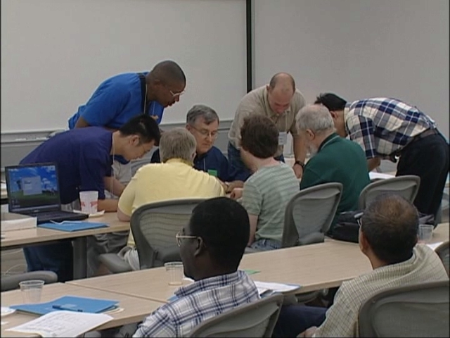
What Does OSCER Do? Teaching
Science and engineering faculty from all over America learn
supercomputing at OU by playing with a jigsaw puzzle (NCSI @ OU 2004).

Slide 17
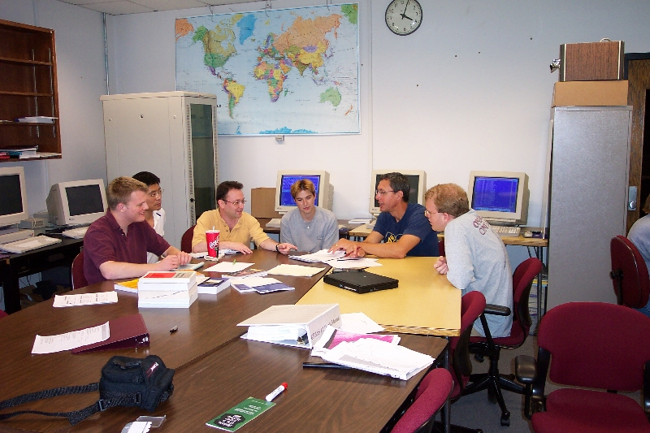
What Does OSCER Do? Rounds
OU undergrads, grad students, staff and faculty learn
how to use supercomputing in their specific research.

Slide 18
OSCER Resources
(and a little history)

Slide 19
2002 OSCER Hardware
TOTAL: 1220.8 GFLOPs*, 302 CPU cores, 302 GB RAM
Aspen Systems Pentium4 Xeon 32-bit Linux Cluster (Boomer)
  270 Pentium4 Xeon CPUs, 270 GB RAM, 1080 GFLOPs
IBM Regatta p690 Symmetric Multiprocessor (Sooner)
  32 POWER4 CPUs, 32 GB RAM, 140.8 GFLOPs
IBM FAStT500 FiberChannel-1 Disk Server
Qualstar TLS-412300 Tape Library
Internet2
* GFLOPs: billions of calculations per second

Slide 20
2005 OSCER Hardware
TOTAL: 8009 GFLOPs*, 1288 CPU cores, 2504 GB RAM
Dell Pentium4 Xeon 64-bit Linux Cluster (Topdawg)
  1024 Pentium4 Xeon CPUs, 2176 GB RAM, 6553.6 GFLOPs
Aspen Systems Itanium2 cluster (Schooner)
  64 Itanium2 CPUs, 128 GB RAM, 256 GFLOPs
Condor Pool: 200 student lab PCs, 1200 GFLOPs
National Lambda Rail (10 Gbps network), Internet2
Storage library: Qualstar (10 TB, AIT-3)
* GFLOPs: billions of calculations per second

Slide 21
Current OSCER Hardware
TOTAL: 54,626.88 GFLOPs; 6304 cores; 12,390 GB RAM
Dell Xeon Quad Core Linux Cluster (Sooner)
  531 Xeon 2.0 GHz Harpertown dual socket quad core, 16 GB RAM
  3 Xeon 2.33 GHz Clovertown dual socket quad core, 16 GB RAM
  2 Xeon 2.4 GHz quad socket quad core nodes, 128 GB RAM each
  34,514.88 GFLOPs
  24 NVIDIA Tesla C1060 cards (933/78 GFLOPs each)
Condor Pool: 795 lab PCs, 20,112 GFLOPs, 3590 GB RAM
  205 x Intel Core i7 quad 2.4 GHz with 6 GB RAM each
  400 x Intel Core2 Duo 2.4 GHz with 4 GB RAM each
  190 x Intel Core2 Duo 3.0 GHz with 4 GB RAM each
National Lambda Rail, Internet2 (10 Gbps networks)

Slide 22
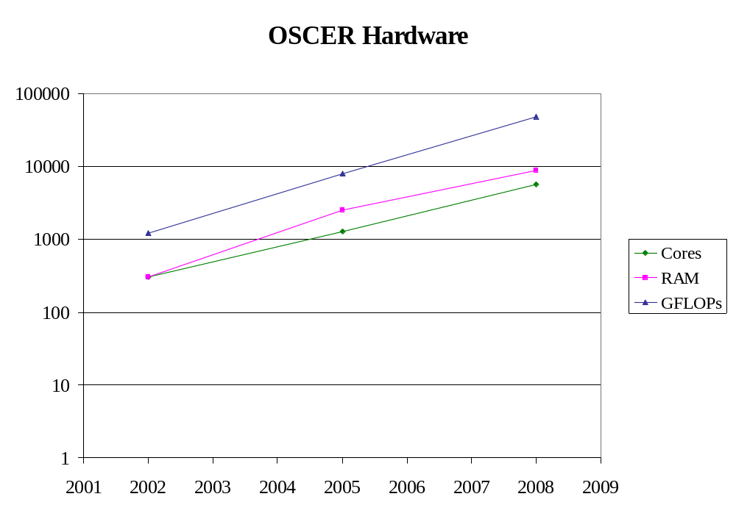
Improvement in OSCER Hardware
GFLOPs: 2008 = 39 x 2002
RAM: 2008 = 29 x 2002
CPU cores: 2008 = 19 x 2002
Moore’s Law: 2008 = 16 x 2002

Slide 23
OK Cyberinfrastructure Initiative
All academic institutions in Oklahoma are eligible to sign up for free use of OU’s and OSU’s centrally-owned CI resources.
Other kinds of institutions (government, NGO, commercial) are eligible to use, though not necessarily for free.
Everyone can participate in our CI education initiative.
The Oklahoma Supercomputing Symposium, our annual conference, continues to be offered to all.

Slide 24
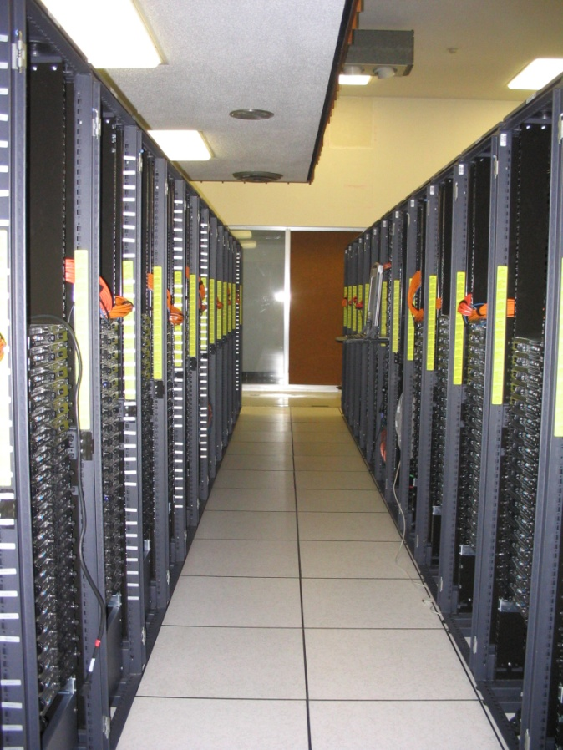
Dell Intel Xeon Linux Cluster
1,076 Intel Xeon CPU chips/4288 cores
528 dual socket/quad core Harpertown 2.0 GHz, 16 GB each
3 dual socket/quad core Harpertown 2.66 GHz, 16 GB each
3 dual socket/quad core Clovertown 2.33 GHz, 16 GB each
2 x quad socket/quad core Tigerton, 2.4 GHz, 128 GB each
8,800 GB RAM
~130 TB globally accessible disk
QLogic Infiniband
Force10 Networks Gigabit Ethernet
Red Hat Enterprise Linux 5
Peak speed: 34.5 TFLOPs*
*TFLOPs: trillion calculations per second
sooner.oscer.ou.edu

Slide 25
Dell Intel Xeon Linux Cluster
DEBUTED NOVEMBER 2008 AT:
#90 worldwide
#47 in the US
#14 among US academic
#10 among US academic excluding TeraGrid
#2 in the Big 12
#1 in the Big 12 excluding TeraGrid
sooner.oscer.ou.edu

Slide 26
Dell Intel Xeon Linux Cluster
Purchased mid-July 2008
First friendly user Aug 15 2008
Full production Oct 3 2008
Christmas Day 2008: >~75% of nodes and ~66% of cores were in use.
sooner.oscer.ou.edu

Slide 27
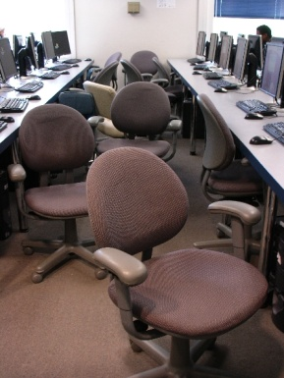
Condor Pool
Condor is a software technology that allows idle desktop PCs to be used for number crunching.
OU IT has deployed a large Condor pool (795 desktop PCs in IT student labs all over campus).
It provides a huge amount of additional computing power – more than was available in all of OSCER in 2005.
20+ TFLOPs peak compute speed.
And, the cost is very very low – almost literally free.
Also, we’ve been seeing empirically that Condor gets about 80% of each PC’s time.

Slide 28
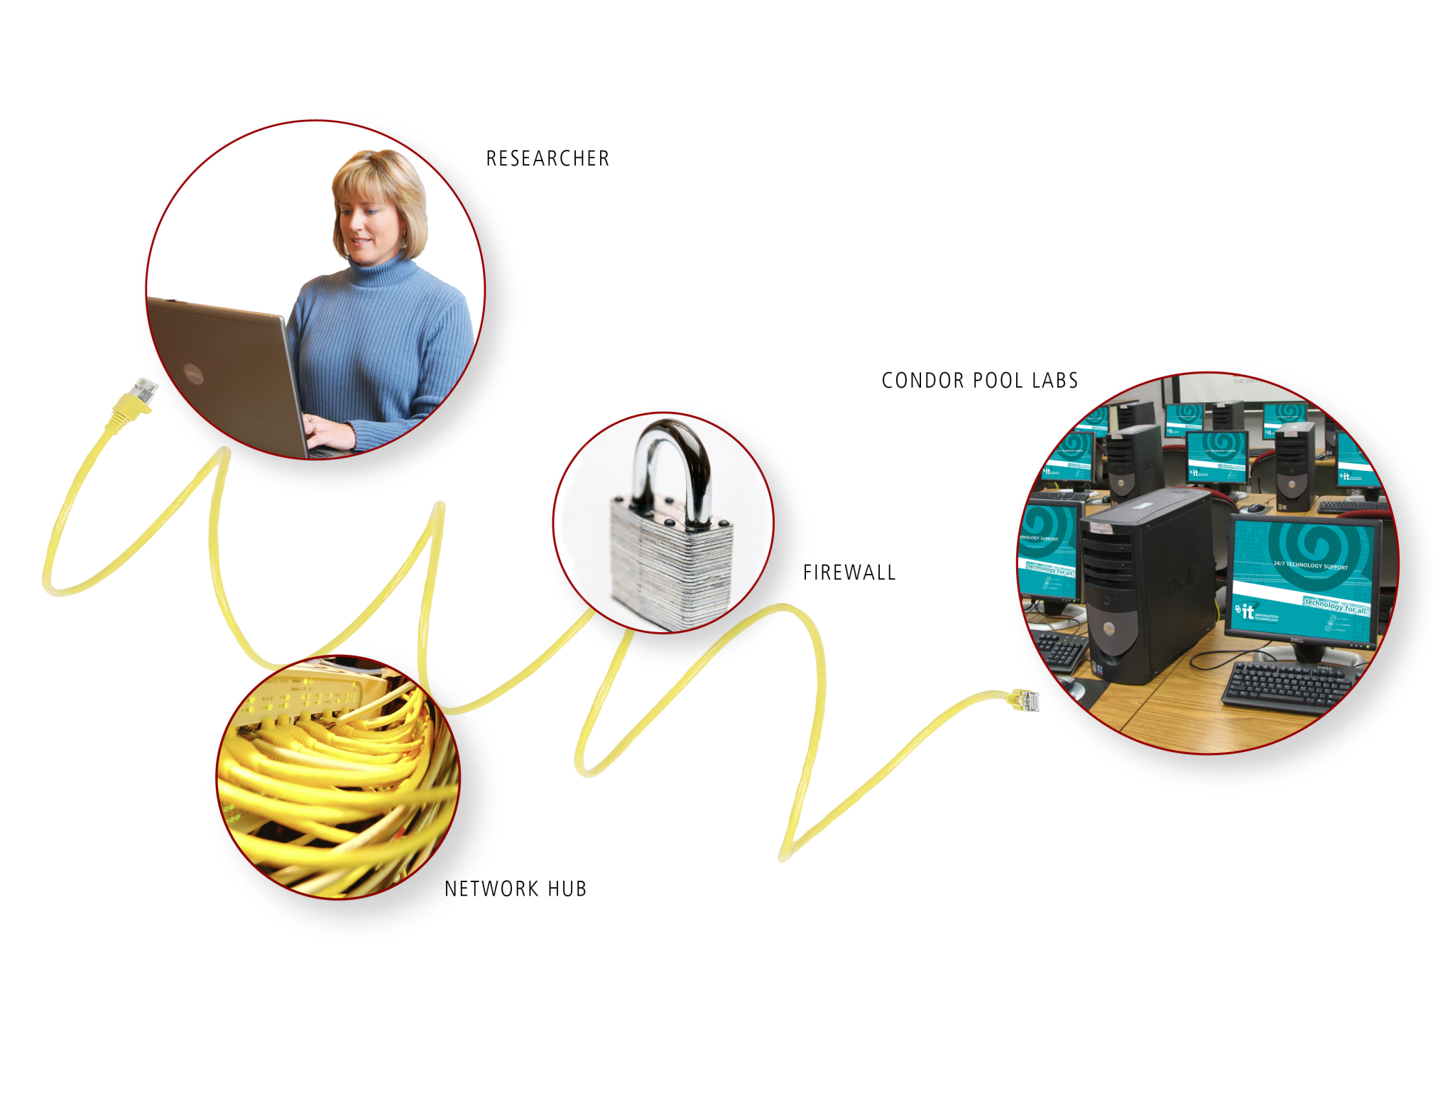
Condor Pool

Slide 29
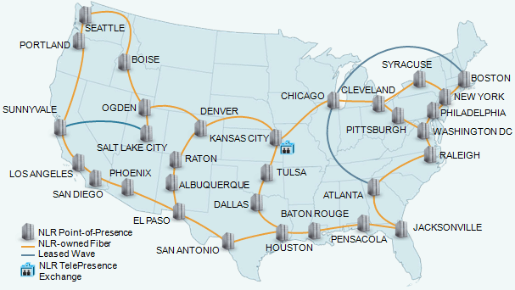
National Lambda Rail

Slide 30
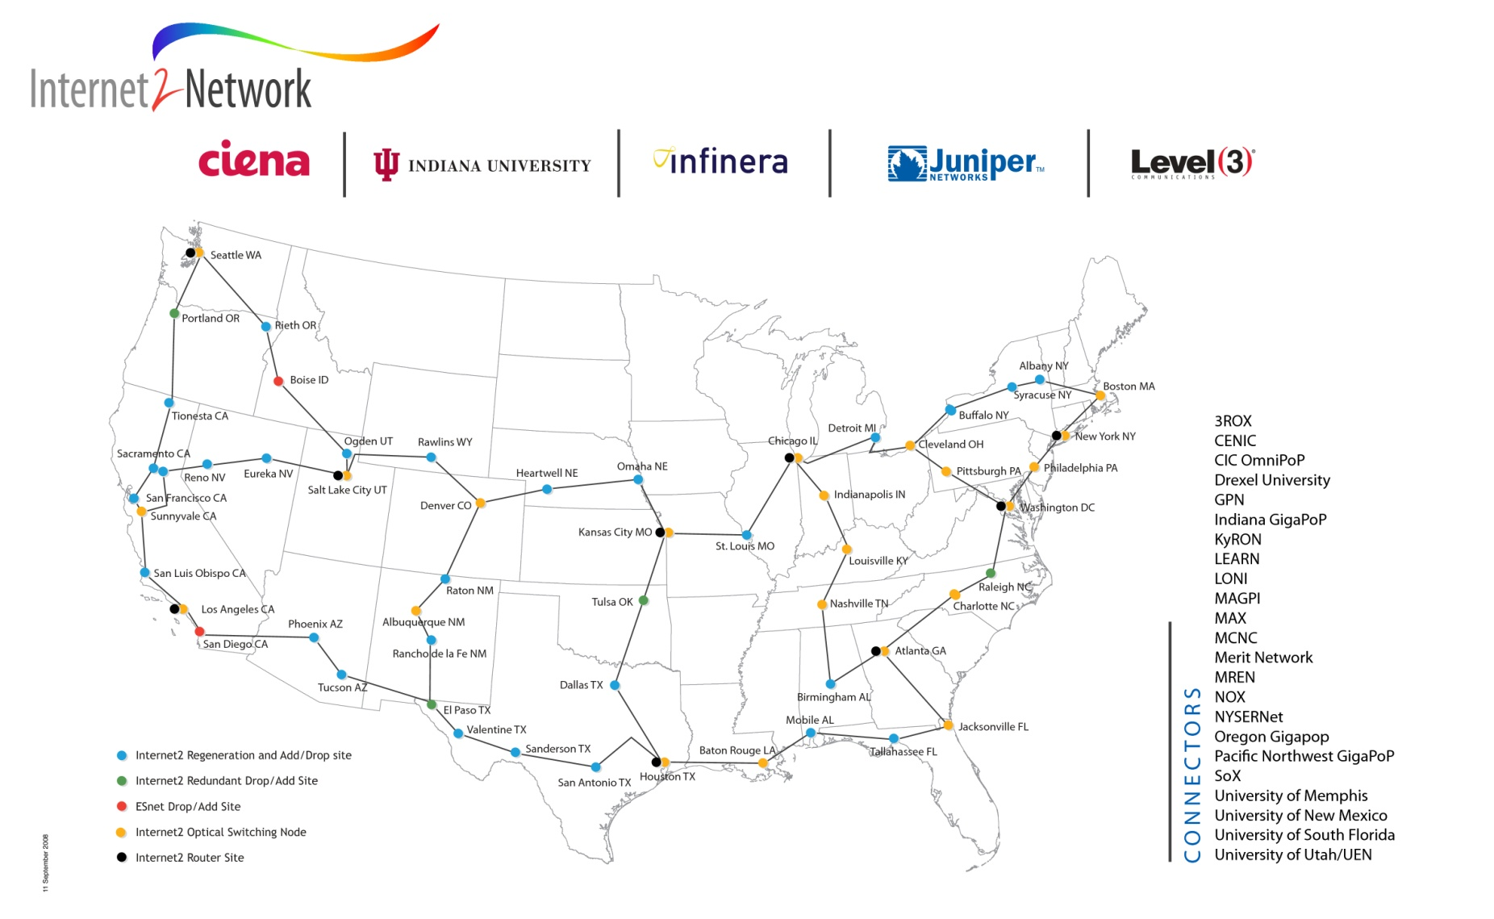
Internet2
www.internet2.edu

Slide 31
What Does OSCER Do?

Slide 32
What Does OSCER Do?
Resources
Teaching
Research
Dissemination
Oklahoma Cyberinfrastructure Initiative

Slide 33
OSCER Teaching

Slide 34
What Does OSCER Do? Teaching
Science and engineering faculty from all over America learn
supercomputing at OU by playing with a jigsaw puzzle (NCSI @ OU 2004).

Slide 35
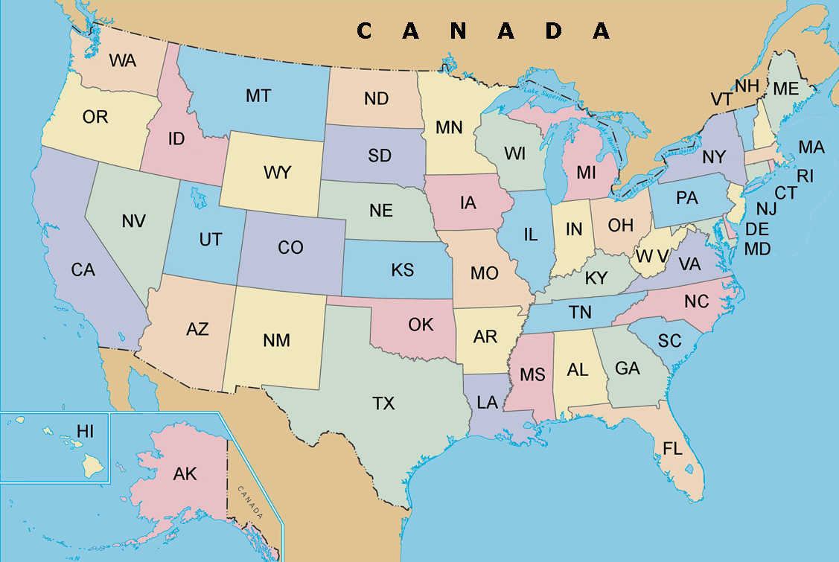
SiPE Workshop Participants 2007
PR

Slide 36
SiPE Workshop Participants 2009
India
Switzerland
Argentina
PR

Slide 37
What Does OSCER Do? Rounds
OU undergrads, grad students, staff and faculty learn
how to use supercomputing in their specific research.

Slide 38
OSCER’s Education Strategy
“Supercomputing in Plain English” workshops
Supercomputing tours (like last night)
Rounds

Slide 39
Supercomputing in Plain English
Supercomputing in Plain English workshops target not only people who are sophisticated about computing, but especially students and researchers with strong science or engineering backgrounds but modest computing experience.
Prerequisite: 1 semester of Fortran, C, C++ or Java
Taught by analogy, storytelling and play, with minimal use of jargon, and assuming very little computing background.
Streaming video: http://www.oscer.ou.edu/education.php
Registrations: over 800 from 2001 to 2009

Slide 40
Workshop Topics
Overview
The Storage Hierarchy
Instruction Level Parallelism
High Performance Compilers
Shared Memory Parallelism
Distributed Parallelism
Applications & Types of Parallelism
Multicore
High Throughput Computing
GPGPU: Number Crunching in Your Graphics Card
Grab Bag: Scientific Libraries, I/O libraries, Visualization

Slide 41
Teaching: Workshops
Supercomputing in Plain English: 746 so far!
  Fall 2001: 87 registered, 40 – 60 attended each time
  Fall 2002: 66 registered, c. 30 – 60 attended each time
  Fall 2004: 47 registered, c. 30-40 attend each time
  Fall 2007: 41 @ OU, 80 at 28 other institutions
  Spring 2009: 65 @ OU, 360 at over 70 other institutions
NCSI Parallel & Cluster Computing workshop (summer 2004, summer 2005)
Linux Clusters Institute workshop (June 2005, Feb 2007)
Co-taught at NCSI Parallel & Cluster Computing workshop at Houston Community College (May 2006)
SC08-09 Education Program Parallel Programming & Cluster Computing workshop Aug 2008, Aug 2009
SC08 Education Program Parallel Programming & Cluster Computing daylong workshop at OK Supercomputing Symposium 2007, 2008, 2009
NEW! NCSI Intermediate Parallel & Cluster Computing workshop (summer 2010)
… and more to come.
OU is the only institution in the world to host and co-instruct multiple workshops sponsored by each of NCSI, LCI and the SC education program.

Slide 42
Teaching: Academic Coursework
CS: Empirical Methods (A. Fagg)
CS: Scientific Computing (S. Lakshmivarahan)
CS: Computer Networks & Distributed Processing (S. Lakshmivarahan)
Meteorology: Computational Fluid Dynamics (M. Xue)
Chemistry: Molecular Modeling (R. Wheeler)
Electrical Engr: Computational Bioengineering (T. Ibrahim)
Chem Engr: Nanotechnology & HPC (L. Lee, G. Newman, H. Neeman)
Parallel Computing course at Cameron U (OK)
Software Engineering course at Oklahoma City U
NEW! Bioinformatics course at U Tulsa (OK)
NEW! Parallel Computing course at East Central U (OK)
PLANNED: Chemistry course at Northeastern State U (OK), Fall 2010
PLANNED: Chemistry course at Rogers State U (OK), Spring 2011

Slide 43
Teaching: Presentations & Tours
Courses at OU
  Chem Engr: Industrial & Environmental Transport Processes (D. Papavassiliou)
  Engineering Numerical Methods (U. Nollert)
  Math: Advanced Numerical Methods (R. Landes)
  Electrical Engr: Computational Bioengineering (T. Ibrahim)
Research Experience for Undergraduates at OU
  Ind Engr: Metrology REU (T. Reed Rhoads)
  Ind Engr: Human Technology Interaction Center REU (R. Shehab)
  Meteorology REU (D. Zaras)
External
  American Society of Mechanical Engineers, OKC Chapter
  Association for Computing Machinery (ACM) Special Interest Group on Computer Science Education (SIGCSE) 2010
  Oklahoma State Chamber of Commerce
  National Educational Computing Conference 2006 (virtual tour via videoconference)
  Norman (OK) Lions Club
  Society for Information Technology & Teacher Education conference 2008, 2009, 2010
  Acxiom Conference on Applied Research in Information Technology 2008
  Shawnee (OK) Lions Club
  NEW! Oklahoma Louis Stokes Alliance for Minority Participation (@ OSU) 2010 (Keynote)
Other Universities
  SUNY Binghamton (NY)
  Bradley University (IL)
  Cameron University (OK)
  NEW! The Citadel (SC)
  NEW! College of the Muscogee Nation (OK)
  DeVry University (OK)
  East Central University (OK)
  El Bosque University (Bogota Colombia)
  Southwestern University (TX)
  Langston University (OK)
  Louisiana State University
  Midwestern State University (TX)
  Northeastern Oklahoma State University
  Northwestern Oklahoma State University
  Oklahoma Baptist University
  Oklahoma City University
  Oklahoma State University x 2
  Oklahoma State University – OKC
  Oral Roberts University (OK) x 2
  St. Gregory’s University (OK) x 2
  Southeastern Oklahoma State University x 2
  NEW! Southern Nazarene University (OK)
  Southwestern Oklahoma State University x 2
  Texas A&M-Commerce
  University of Arkansas Fayetteville
  University of Arkansas at Little Rock
  NEW! University of Central Oklahoma
  NEW! University of Tulsa (OK)
High Schools and High School Programs
  Oklahoma School of Science & Mathematics x 2
  Oklahoma Christian University’s Opportunity Bytes Summer Academy
  Dept of Energy National Scholarship Finalists
  Ardmore High School (OK)
E
E
E
E

Slide 44
What Does OSCER Do? Rounds
OU undergrads, grad students, staff and faculty learn
how to use supercomputing in their specific research.

Slide 45
Research & Teaching: Rounds
Rounds: interacting regularly with several research groups
Brainstorm ideas for applying supercomputing to the group’s research
Code: design, develop, debug, test, benchmark
Learn new computing environments
Write papers and posters
Has now evolved into supercomputing help sessions, where many different groups work at the same time.

Slide 46
OSCER Research

Slide 47
OSCER Research
OSCER’s Approach
Rounds
Grants
Upcoming Initiatives

Slide 48
What Does OSCER Do? Rounds
OU undergrads, grad students, staff and faculty learn
how to use supercomputing in their specific research.

Slide 49
Research: OSCER’s Approach
Typically, supercomputing centers provide resources and have in-house application groups, but most users are more or less on their own.
OSCER’s approach: we partner directly with research teams, providing supercomputing expertise to help their research move forward faster (rounds).
This way, OSCER has a stake in each team’s success, and each team has a stake in OSCER’s success.

Slide 50
Research & Teaching: Rounds
Rounds: interacting regularly with several research groups
Brainstorm ideas for applying supercomputing to the group’s research
Code: design, develop, debug, test, benchmark
Learn new computing environments
Write papers and posters
Has now evolved into supercomputing help sessions, where many different groups work at the same time.

Slide 51
Research: Grant Proposals
OSCER provides text not only about resources but especially about education and research efforts (workshops, rounds, etc).
Faculty write in small amount of money for:
  funding of small pieces of OSCER personnel;
  storage (disk, tape);
  special purpose software.
In many cases, OSCER works with faculty on developing and preparing proposals.
OSCER has a line item in the OU proposal web form that all new proposals have to fill out.

Slide 52
Spring Storm Experiment 2010
As usual, OSCER played a major role in the Spring Storm Experiment, which involved the Center for Analysis & Prediction of Storms, the NOAA Storm Prediction Center, Oak Ridge National Laboratory, and others.
We were the primary HPC provider for the part of the project run by the Center for Collaborative Adaptive Sensing of the Atmosphere (CASA).
This project consumed 20-60% of Sooner every day for 3 months.

Slide 53
High Energy Physics
Dzero project: #1 most productive US academic site, 2010
ATLAS project: #5 most productive US academic site, 2010

Slide 54
External Research Grants
H. Neeman, D. Brunson (OSU), J. Deaton (OneNet), J. He (Noble Foundation), D. Schoenefeld (TU), J. Snow (Langston U), M. Strauss (OU), X. Xiao (OU), M. Xue (OU), “Oklahoma Optical Initiative,” NSF, $1.17M
H. Neeman, M. Jensen, M. Strauss, X. Xiao, M. Xue, E. Baron, K. Dresback, R. Kolar, A. McGovern, R. Palmer, D. Papavassiliou, H. Severini, P. Skubic, T. Trafalis, M. Wenger, R. Wheeler (Duquesne U), “MRI: Acquisition of Extensible Petascale Storage for Data Intensive Research,” NSF, $793K
D. Resasco, J. Harwell, F. Jentoft, K. Gasem, S. Wang, “Center for Interfacial Reaction Engineering (CIRE),” DOE EPSCoR, $3M ($2M OU)
P. Skubic, M. Strauss, B. Abbott, P. Gutierrez, “Experimental Physics Investigations Using Colliding Beam Detectors at Fermilab and the Large Hadron Collider (LHC) (TASK A) 2010-2013 Renewal,” DOE, $2.8M
R. Palmer, Y. Zhang, G. Zhang, T. Yu, M. Yeary, Y. Hong, J. Crain, P. Chilson, “Next Generation Phased Array,” NSSL, $2M
P. Skubic, M. Strauss, B. Abbott, P. Gutierrez, “Experimental Physics Investigations Using Colliding Beam Detectors at Fermilab and the Large Hadron Collider (LHC) (TASK A) 2010-2013 Renewal-Revision,” DOE, $1.52M
D. Cole, Alberto Striolo, “Structure and Dynamics of Earth Materials, Interfaces and Reactions,” DOE, $1.5M ($90K OU)
R. Sigal, F. Civan, D. Devegowda, “Simulation of Shale Gas Reservoirs Incorporating the Correct Physics of Capillarity and Fluid Transport,” Research Partnership to Secure Energy for America (RPSEA), $1.05M
M. Biggerstaff , J. Straka, L. Wicker, Zrnic, Zahari, “MRI Development of C-Band Mobile Polarimetric Weather Radars,” NSF, $989K ($439K OU)
D. Resasco, D. Papavassiliou et al, “Carbon Nanotube Technology Center,” DOE, $925K
M. Saha, D. Papavassiliou, A. Striolo, K. Mullen, B. Grady, C. Altan, D. Resasco, “Experimental and theoretical studies of carbon nanotube hierarchical structures in multifunctional polymer composites,” DoD-EPSCoR, $897K
E. Mansell , J. Straka, C. Ziegler, D. MacGorman, “Numerical modeling studies of storm electrification and lightning,” NSF, $817K
E. Rasmussen, J. Straka, K. Kanak, “Collaborative Research: Challenges in understanding tornadogenesis and associated phenomena, $755K ($489K OU)
J. Straka, K. Kanak, “Challenges in tornadogenesis and associated phenomena,” NSF, $584K
OSCER-RELATED FUNDING TO DATE:
$186M total, $99M to OU
E
E
E
E

Slide 55
External Research Grants (cont’d)
M. Xue, F. Kong, “Advanced Multi-Moment Microphysics for Precipitation and Tropical Cyclone Forecast Improvement with COAMPS,” ONR, $592K
J. Straka, K. Kanak, “Collaborative Research: Challenges in Understanding Tornadogenesis and Associated Phenomena,” NSF, $515K
D. MacGorman, E. Mansell, C. Ziegler, A. Fierro, M. Xue, “Techniques for Assimilating Geostationary Lightening Mapper Data and Assessment of the Resulting Impact on Forecasts,” NOAA, $415K
M. Xue, F. Kong, K. Brewster, X. Wang, “A Partnership to Develop, Conduct, and Evaluate Realtime High-Resolution Ensemble and Deterministic Forecasts for Convective-scale Hazardous Weather: Moving to the Next Level,” NOAA CSTAR, $375K
M. Xue, K. Brewster, J. Gao, X. Wang, “Advanced Data Assimilation and Prediction Research for Convective-Scale ‘Warn-on-Forecast,’” $375K, NOAA
X. Wang, “Improving satellite radiance data assimilation using a hybrid ensemble-Gridpoint Statistical Interpolation (GSI) method for global numerical weather prediction,” NASA, $334K
X. Wang, M. Xue, “Improving NOAA operational global numerical weather prediction using a hybrid-ensemble Kalman filter data assimilation and ensemble forecast system,” NOAA, $322K
D. Resasco, D. Papavassiliou et al, “Interfacially active SWNT/silica nanohybrids,” Advanced Energy Consortium (AEC), $333K
D. Oliver, “Data analysis and inversion for mobile nanosensors,” AEC, $320K
R. Palmer, T. Yu, G. Zhang, M. Yeary, P. Chilson, Y. Zhang, J. Crain, “Advancements in Phased Array Weather Radar Research at OU,” NOAA National Severe Storms Laboratory (NSSL), $270K
A. Striolo, “The Emergent Behavior of Solid Nanoparticles at Oil-Water Interfaces: A Multi-Scale Thermodynamic Approach to Enable Bio-Oil Upgrade,” NSF, $238K
M. Xue, K. Brewster, F. Kong, “Development of a Short-Range Realtime Analysis and Forecasting System based on the ARPS for Taiwan Region,” NOAA, $200K
J. Straka, K. Kanak, “Formative dynamics of the mammatus clouds in thunderstorm cirrus,” NSF, $318K
M. Yeary, C. Tang, “Computationally Efficient Linear Transforms for Remote Sensing Systems,” NSF, $299K
A. Striolo, “Probing regular solution theory for mixed amphoteric/ionic surfactant systems by molecular dynamics simulations,” ACS, $100K
OSCER-RELATED FUNDING TO DATE:
$186M total, $99M to OU
E
E
E
E

Slide 56
External Research Grants (cont’d)
K. Brewster, M. Xue, F. Kong, meteorology project, $211K
M. Xue, meteorology project, $120K
A. McGovern, “Learning to guide search in large state spaces,” IBM DARPA, $95K
J. Straka, K. Kanak, “Supplement: Challenges in tornadogenesis and associated phenomena (VORTEX2),” NSF, $87K
F. Kong, M. Xue, “Establishment of an Experimental Real-Time Short-Term Storm Prediction System for Shenzhen Meteorological Bureau,” $58K
J. Straka, “Improved Understanding/Prediction of Severe Convective Storms and Attendant Phenomena through Advanced Numerical Simulation,” NSF, $58K
M. Xue, “Assimilation of NEXRAD Radial Winds in a Regional Mesoscale Model,” Miss State U, $79K
J. Cruz, R. Todd, “Medium-Density Parity-Check Codes for Tape Systems,” INSIC, $36K
M. Xue, D. Stensrud, J. Gao, “Advancing Warn on Forecast – Storm-scale Analysis of Vortex 2 Thunderstorms,” NSSL, $70K
P. Attar, “High-Fidelity Computational Aeroelastic Solver Research,” Ohio Aerospace Institute, $60K
J. Straka, K. Kanak, “Development of Unmanned Aircraft System for Research in a Severe Storm Environment and Deployment within the VORTEX 2,” NSF, $44K
J. Cruz, “Equalization, Detection, and Coding Algorithms for Bit Patterned Media Recording Channels,” International Storage Industry Consortium (INSIC), $35K
J. Cruz, R. Todd, “Signal Processing for Magnetic Recording Channels,” private company, $30K
P. Attar, P. Vedula, “Deterministic and Statistical Characterization of the Impact of Control Surface Freeplay on Flutter and Limit-Cycle Oscillation (LCO) using Efficient Computational Modeling,” Advanced Dynamics, $30K
P. Attar, P. Vedula, “Novel Reduced Order in time Models for Problems in Nonlinear Aeroelasticity,” Advanced Dynamics, $29K
F. Carr, J. Straka, “Severe storm research,” Jonathon Merage Foundation, $21K
F. Carr, J. Straka, “Severe storm research,” Jonathon Merage Foundation, $20K
OSCER-RELATED FUNDING TO DATE:
$186M total, $99M to OU
E
E
E
E

Slide 57
External Research Grants (cont’d)
A. Striolo, “Electrolytes at Solid-Water Interfaces: Theoretical Studies for Practical Applications,” DOE EPSCoR, $450K
A. Striolo, Saha, “Experimental and Theoretical Studies of Carbon Nanotube Hierarchical Structures in Multifunctional Polymer Composites,” DOD EPSCoR, $450K
D. Cole (ORNL), A. Striolo, “Structure and Dynamics of Earth Materials, Interfaces and Reactions,” DOE, $1.5M ($75K OU)
D. Papavassiliou, A. Striolo, “Effects of Hydrophobicity-Induced Wall Slip on Turbulence Drag and Turbulence Structure,” NSF, $230K
A. Striolo, D. Resasco, U. Nollert, “Understanding the Interactions between Carbon Nanotubes and Cellular Membranes,” NSF, $380K
M. Xue, Y. Hong, X. Hu (GSU), “Integrated Weather and Wildfire Simulation and Optimization for Wildfire Management,” NSF, $997K ($483K OU)
Y. Hong, “Next Generation QPE: Toward a Multi-Sensor Approach for Integration of Radar, Satellite, and Surface Observations to Produce Very High-resolution Precipitation Data,” NOAA/OAR/NSSL via CIMMS, $83K
R. Palmer, Y. Hong, “Phased Array Technology for Weather Radar Applications,” NOAA/OAR/NSSL via CIMMS, $426K
Y. Hong, Baski (OSU), “Proactive approach to transportation resource allocation under severe winter weather emergencies,” OK-DOT/OTC, $261K ($101K OU)
R. Palmer, Y. Hong, “Atmospheric Observations using PhasedArray Technology,” $340K
Y. Hong, “Toward Improved Flood Prediction and Risk Mitigation: Capacity Building for Africa,” NASA, $87K
Y. Hong, “Improving NASA Global Hazard System and Implementing SERVIR-Africa,” NASA, $272K
Y. Hong, “Link SERVIR-Africa Work to NASA Land Information System: Workshop Training and Data Assimilation of GRACE to NASA-OU Hydrologic Model,” NASA, $10K
R. Adler (NASA), Y. Hong, “Global Hazard (Flood-Landslide) Decision-Support System,” NASA, $900K
S. Schroeder, “CAREER: Advancing Viral RNA Structure Prediction,” NSF, $750K
OSCER-RELATED FUNDING TO DATE:
$186M total, $99M to OU
E
E
E
E

Slide 58
External Research Grants (cont’d)
P. Attar, “High Fidelity Computational Aeroelastic Analysis of a Flexible Membrane Airfoil Undergoing Dynamic Motion,” Ohio Aerospace Institute, $35K
P. Attar, “Computational Model Development and Experimental Validation Measurements for Membrane-Batten Wing” Flexible Membrane Airfoil Undergoing Dynamic Motion,” Ohio Aerospace Institute, $43K
K. Droegemeier, F. Kong, P. Attar, “A Partnership to Develop, Conduct, and Evaluate Realtime High-Resolution Ensemble and Deterministic Forecasts for Convective-scale Hazardous Weather,” NOAA, $375K
M. Xue, G. Zhang, K. Brewster, F. Kong, “Prediction and Predictability of Tropical Cyclones over Oceanic and Coastal Regions and Advanced Assimilation of Radar and Satellite Data for the Navy Coupled Ocean-Atmosphere Mesoscale Prediction System,” ONR/DOD EPSCoR, $454K; OK Board of Regents $100K
S. Ahalt, A. Apon, D. Lifka, H. Neeman, “NSF Workshop High Performance Computing Center Sustainability,” NSF, $49K ($0 OU)
Y. Luo, S. Lakshmivarahan, “Development of a Data Assimilation Capability towards Ecological Forecasting in a Data-Rich Era,” NSF, $1.08M
Y. Luo, D. Schimmel (NEON), J. Clark (Duke U.), Kiona Ogle (U. Wyoming), S. LaDeau (Cary Institute of Ecosystem Study), “RCN: Forecasts Of Resource and Environmental Changes: Data Assimilation Science and Technology (FORECAST),” NSF, $500K
J. Straka, K. Kanak, Davies-Jones, H. Neeman, “Challenges in understanding tornadogenesis and associated phenomena,” NSF, $854K
P. Risser et al, “A cyberCommons for Ecological Forecasting,” NSF, $6M ($2.78M OU)
M. Xue, X. Wang, X. Li (OSU), R. Barnes, S. Sanielevici (PSC), H. Neeman, “Enabling Petascale Ensemble-Based Data Assimilation for the Numerical Analysis and Prediction of High-Impact Weather,” NSF, $1.2M ($902K OU)
P. Skubic, B. Abbott, P. Gutierrez, M. Strauss, “ATLAS Southwest Tier 2 Computing Center,” NSF, $600K/year ($60K/year OU)
Y. Hong, “Evaluation of NASA Global Hazard System,” NASA, $45K
OSCER-RELATED FUNDING TO DATE:
$186M total, $99M to OU
E
E
E
E

Slide 59
External Research Grants (cont’d)
J Wicksted, F. Waxman et al, “Building Oklahoma's Leadership Role in Cellulosic Bioenergy,” NSF EPSCoR, $15M ($5.7M OU)
D.S. Oliver, software, $16.7M
K.K. Muraleetharan, G. Miller, and A. Cerato, “Understanding and Improving the Seismic Behavior of Pile Foundations in Soft Clays,” NSF, $1.15M ($500K OU)
K. Droegemeier, F. Kong, “Multisensor Studies of Precipitation for Model Verification and Data Assimilation,” U Minn, ($7K OU)
K. Droegemeier, M. Xue, F. Kong, “Observing System Simulation Experiments for Airborne Weather Sensors,” HRL, ($33K OU)
M. Nollert, Scholarship, FD-OMRF, $12K
R. Sigal, R. Philp, C. Rai,, S. Shah, R. Slatt, C. Sondergeld, D. Zhang, energy company, $1.9M
B. Grady, D. Schmidtke, A. Striolo, A. Cheville, D. Teeters, “Polymer Nanostructures on Solid Surfaces,”$208K ($125K OU)
T. Conway, “E. coli Model Organism Resource,” UN-Purdue, ($685K OU)
R. Kolar, “Storm Surge Modeling in SE Liousiana - 2006,” ARCADIS, ($37K OU)
D. Cole (ORNL), A. Striolo, “Rates and Mechanisms of Mineral-Fluid Interactions at the Nanoscale,” DOE, $1.65M (total), ($55K OU)
R. Kolar, “A Prototype Operational Modeling System for Waves, Coastal Currents, Inundation and Hydrologic Flooding for Eastern North Carolina,” UN-UNC-CH, ($209K OU)
R. Kolar, “A Coupled Regional-Coastal Ocean Model: HYCOM/CG-ADCIRC,” DOD-NRL, ($333K OU)
M. Xue, “Contribution to WRF Model Development by the Center for Analysis and Prediction of Storms,” DOC-NOAA, $821K
K. Marfurt, “Improving Geologic and Engineering Models of Midcontinent Fracture and Karst Modified Reservoirs Using 3-D Seismic Attributes,” UKCRINC, ($61K OU)
P. Attar, P. Vedula, “Novel, Optimal, Physics-based Reduced Order Models for Nonlinear Aeroelasticity,” Advanced Dynamics, $49K
S. Dhall, “Autonomous Data Partitioning using Data Mining for High Performance Computing,” NSF, ($125K OU)
OSCER-RELATED FUNDING TO DATE:
$186M total, $99M to OU
E
E
E
E

Slide 60
External Research Grants (cont’d)
M. Xue, K. Brewster, J. Gao, “Ensemble-based Data Assimilation for Tropical Storms, and Realtime 3DVAR Analysis for Initial Proof of 'Warn-on-Forecast‘ Concept: Collaborative Research between CAPS and NSSL,” DOC-NOAA, $100,000
M. Xue, “Contribution to Model Development and Enhancement Research Team by the Center for Analysis and Prediction of Storms,” DOC-NOAA, $180,000
M. Xue, K. Brewster, “Ensemble-based Data Assimilation for Convective Storms and Hurricanes,” DOC-NOAA, $100,000
S. Schroeder, "Discovering Satellite Tobacco Mosaic Virus Structure,“ OCAST, $85K
S. Schroeder, "Computational Advacnes Toward Predicting Encapsidated Viral RNA Structure,“ Pharmaceutical Research and Manufactuerer's Association of America, $60K
R. Kolar, "Outer Boundary Forcing for Texas Coastal Models,“ Texas Water Development Board, $20K
K. Milton, "Collaborative Research: Quantum Vacuum Energy", NSF, $250K
A. McGovern, "Developing Spatiotemporal Relational Models to Anticipate Tornado Formation,“ NSF, $500K
Y. Kogan, "Midlatitude Aerosol-Cloud-Radiation Feedbacks in Marine Boundary Layer Clouds", ONR, $638K
J. Straka, K. Kanak, Davies-Jones, “Challenges in understanding tornadogenesis and associated phenomena,” NSF, $854K (total), $584K (OU)
Y. Hong, "Improvement of the NASA Global Hazard System and Implement Server-Africa,“ NASA, $272K
J. Antonio, S. Lakshmivarahan, H. Neeman, "Predictions of Atmospheric Dispersion of Chemical and Biological Contaminants in the Urban Canopy.“ Subcontract No. 1334/0974-01, Prime Agency DOD-ARO, Subcontract through Texas Tech University, Lubbock, TX, Sep. 29, 2000 to Nov. 3, 2001, $75K
A. Striolo, "Electrolytes at Solid-Water Interfaces: Theoretical Studies for Practical Applications,“ OSRHE Nanotechnology, $15K
D. Papavassiliou, “Turbulent transport in non-homogeneous turbulence, ” NSF, $320K
OSCER-RELATED FUNDING TO DATE:
$186M total, $99M to OU
E
E
E
E

Slide 61
External Research Grants (cont’d)
K. Droegemeier et al., “Engineering Research Center for Collaborative Adaptive Sensing of the Atmosphere,” NSF, $17M (total), $5.6M (OU)
K. Droegemeier et al., “Linked Environments for Atmospheric Discovery (LEAD),” NSF, $11.25M (total), $2.5M (OU)
M. Strauss, P. Skubic et al., “Oklahoma Center for High Energy Physics”, DOE EPSCoR, $3.4M (total), $1.6M (OU)
M. Richman, A. White, V. Lakshmanan, V. DeBrunner, P. Skubic, “Real Time Mining of Integrated Weather Data,” NSF, $950K
D. Weber, K. Droegemeier, H. Neeman, “Modeling Environment for Atmospheric Discovery,” NCSA, $435K
H. Neeman, K. Droegemeier, K. Mish, D. Papavassiliou, P. Skubic, “Acquisition of an Itanium Cluster for Grid Computing,” NSF, $340K
J. Levit, D. Ebert (Purdue), C. Hansen (U Utah), “Advanced Weather Data Visualization,” NSF, $300K
D. Papavassiliou, “Turbulent Transport in Wall Turbulence,” NSF, $165K
L. Lee, J. Mullen (Worcester Polytechnic), H. Neeman, G.K. Newman, “Integration of High Performance Computing in Nanotechnology,” NSF, $400K
R. Wheeler, “Principal mode analysis and its application to polypeptide vibrations,” NSF, $385K
R. Kolar, J. Antonio, S. Dhall, S. Lakshmivarahan, “A Parallel, Baroclinic 3D Shallow Water Model,” DoD - DEPSCoR (via ONR), $312K
R. Luettich (UNC), R. Kolar, B. Vieux, J. Gourley, “The Center for Natural Disasters, Coastal Infrastructure, and Emergency Management,” DHS, $699K
D. Papavassiliou, M. Zaman, H. Neeman, “Integrated, Scalable MBS for Flow Through Porous Media,” NSF, $150K
Y. Wang, P. Mukherjee, “Wavelet based analysis of WMAP data,” NASA, $150K
E. Mansell, C. L. Ziegler, J. M. Straka, D. R. MacGorman, “Numerical modeling studies of storm electrification and lightning,” $605K
OSCER-RELATED FUNDING TO DATE:
$186M total, $99M to OU
E
E
E
E

Slide 62
External Research Grants (cont’d)
K. Brewster, J. Gao, F. Carr, W. Lapenta, G. Jedlovec, “Impact of the Assimilation of AIRS Soundings and AMSR-E Rainfall on Short Term Forecasts of Mesoscale Weather,” NASA, $458K
R. Wheeler, T. Click, “National Institutes of Health/Predoctoral Fellowships for Students with Disabilties,” NIH/NIGMS, $80K
K. Pathasarathy, D. Papavassiliou, L. Lee, G. Newman, “Drag reduction using surface-attached polymer chains and nanotubes,” ONR, $730K
D. Papavassiliou, “Turbulent transport in non-homogeneous turbulence, ” NSF, $320K
C. Doswell, D. Weber, H. Neeman, “A Study of Moist Deep Convection: Generation of Multiple Updrafts in Association with Mesoscale Forcing,” NSF, $430K
D. Papavassiliou, “Melt-Blowing: Advance modeling and experimental verification,” NSF, $321K
R. Kol,ar et al., “A Coupled Hydrodynamic/Hydrologic Model with Adaptive Gridding,” ONR, $595K
D. Papavassiliou, “Scalar Transport in Porous Media,” ACS-PRF, $80K
M. Xue, F. Carr, A. Shapiro, K. Brewster, J. Gao, “Research on Optimal Utilization and Impact of Water Vapor and Other High Resolution Observations in Storm-Scale QPF,” NSF, $880K.
J. Gao, K. Droegemeier, M. Xue, “On the Optimal Use of WSR-88D Doppler Radar Data for Variational Storm-Scale Data Assimilation,” NSF, $600K.
K. Mish, K. Muraleetharan, “Computational Modeling of Blast Loading on Bridges,” OTC, $125K
V. DeBrunner, L. DeBrunner, D. Baldwin, K. Mish, “Intelligent Bridge System,” FHWA, $3M
D. Papavassiliou, “Scalar Transport in Porous Media,” ACS-PRF, $80K
Y. Wang, P. Mukherjee, “Wavelet based analysis of WMAP data,” NASA, $150K
R. Wheeler et al., “Testing new methods for structure prediction and free energy calculations (Predoctoral Fellowship for Students with Disabilities),” NIH/NIGMS, $24K
L. White et al., “Modeling Studies in the Duke Forest Free-Air CO2 Enrichment (FACE) Program,” DOE, $730K
OSCER-RELATED FUNDING TO DATE:
$186M total, $99M to OU
E
E
E
E

Slide 63
External Research Grants (cont’d)
Neeman, Severini, “Cyberinfrastructure for Distributed Rapid Response to National Emergencies”, NSF, $132K
Neeman, Roe, Severini, Wu et al., “Cyberinfrastructure Education for Bioinformatics and Beyond,” NSF, $250K
K. Milton, C. Kao, “Non-perturbative Quantum Field Theory and Particle Theory Beyond the Standard Model,” DOE, $150K
J. Snow, "Oklahoma Center for High Energy Physics", DOE EPSCoR, $3.4M (total), $169K (LU)
M. Xue, F. Kong, “OSSE Experiments for airborne weather sensors,” Boeing, $90K
M. Xue, K. Brewster, J. Gao, A. Shapiro, “Storm-Scale Quantitative Precipitation Forecasting Using Advanced Data Assimilation Techniques: Methods, Impacts and Sensitivities,” NSF, $835K
Y. Kogan, D. Mechem, “Improvement in the cloud physics formulation in the U.S. Navy Coupled Ocean-Atmosphere Mesoscale Prediction System,” ONR, $889K
G. Zhang, M. Xue, P. Chilson, T. Schuur, “Improving Microphysics Parameterizations and Quantitative Precipitation Forecast through Optimal Use of Video Disdrometer, Profiler and Polarimetric Radar Observations,” NSF, $464K
T. Yu, M. Xue, M. Yeay, R. Palmer, S. Torres, M. Biggerstaff, “Meteorological Studies with the Phased Array Weather Radar and Data Assimilation using the Ensemble Kalman Filter,” ONR/Defense EPSCOR/OK State Regents, $560K
B. Wanner, T. Conway, et al., “Development of the www.EcoliCommunity.org Information Resource,” NIH, $1.5M (total), $150K (OU)
T. Ibrahim et al., “A Demonstration of Low-Cost Reliable Wireless Sensor for Health Monitoring of a Precast Prestressed Concrete Bridge Girder,” OK Transportation Center, $80K
T. Ibrahim et al., “Micro-Neural Interface,” OCAST, $135K
J. Snow, “Langston University High Energy Physics,” $155K (LU)
OSCER-RELATED FUNDING TO DATE:
$186M total, $99M to OU
E
E
E
E

Slide 64
External Research Grants (cont’d)
L.M. Leslie, M.B. Richman, C. Doswell, “Detecting Synoptic-Scale Precursors Tornado Outbreaks,” NSF, $548K
L.M. Leslie, M.B. Richman, “Use of Kernel Methods in Data Selection and Thinning for Satellite Data Assimilation in NWP Models,” NOAA, $342K
J. Gao, K. Brewster, M. Xue, K. Droegemeier, "Assimilating Doppler Radar Data for Storm-Scale Numerical Prediction Using an Ensemble-based Variational Method,“ NSF, $200K
E. Chesnokov, “Fracture Prediction Methodology Based On Surface Seismic Data,” Devon Energy, $1M
E. Chesnokov, “Scenario of Fracture Event Development in the Barnett Shale (Laboratory Measurements and Theoretical Investigation),” Devon Energy, $1.3M
M. Xue, K. Brewster, J. Gao, "Study of Tornado and Tornadic Thunderstorm Dynamics and Predictability through High-Resolution Simulation, Prediction and Advanced Data Assimilation,“ NSF, $780K
A. Striolo, “Heat Transfer in Graphene-Oil Nanocomposites: A Molecular Understanding to Overcome Practical Barriers.” ACS Petroleum Research Fund, $40K
D.V. Papavassiliou, “Turbulent Transport in Anisotropic Velocity Fields,” NSF, $292.5K
D. Oliver, software license grant, $1.5M
R. Broughton et al, “Assembling the Eutelost Tree of Life – Addressing the Major Unresolved Problem in Vertebrate Phylogeny,” NSF, $3M ($654K to OU)
A. Fagg, “Development of a Bidirectional CNS Interface or Robotic Control,” NIH, $600K
M. Xue, J. Gao, "An Investigation on the Importance of Environmental Variability to Storm-scale Radar Data Assimilation,“ NSSL, $72K
JV. Sikavistsas and D.V. Papavassiliou , “Flow Effects on Porous Scaffolds for Tissue Regeneration,” NSF, $400K
P. Skubic, M. Strauss, et al., “Experimental Physics Investigations Using Colliding Beam Detectors at Fermilab and the LHC,” DOE, $503K
OSCER-RELATED FUNDING TO DATE:
$186M total, $99M to OU
E
E
E
E

Slide 65
External Funding Summary
External research funding facilitated by OSCER (Fall 2001- Fall 2009): $186M total, $99M to OU
Funded projects: 162
102 OU faculty and staff in 19 academic departments and 2 other campus organizations (research centers etc)
Comparison: Fiscal Year 2002-10 (July 2001 – June 2010): OU Norman externally funded research expenditure: $611M
Since being founded in fall of 2001, OSCER has enabled research projects comprising more than 1 / 7 of OU Norman's total externally funded research expenditure, with a 7-to-1 return on investment.

Slide 66
Publications Facilitated by OSCER
124 publications facilitated by OSCER rounds/help sessions
  2010: 9 papers (so far)
  2009: 9 papers
  2008: 19
  2007: 12
  2006: 29
  2005: 18
  2004: 12
  2003: 5
  2002: 8
  2001: 3
472 publications facilitated by OSCER resources only
  2010: 115 papers (so far)
  2009: 96 papers
  2008: 81
  2007: 60
  2006: 56
  2005: 45
  2004: 15
  2003: 4
Includes:
20 MS theses
19 PhD dissertations
These papers would have been impossible, or much more difficult, or would have taken much longer, without OSCER’s direct, hands-on help.
TOTAL SO FAR: 596 publications
http://www.oscer.ou.edu/papers_from_rounds.php

Slide 67
OK Cyberinfrastructure Initiative
Oklahoma submitted an NSF EPSCoR Research Infrastructure Proposal in Jan 2008 ($15M).
Starting that year, all NSF EPSCoR RII “Track 1” proposals HAD TO include a statewide Cyberinfrastructure plan.
Oklahoma’s plan – the Oklahoma Cyberinfrastructure Initiative (OCII) – involves:
  all academic institutions in the state are eligible to sign up for free use of OU’s and OSU’s centrally-owned CI resources;
  other kinds of institutions (government, NGO, commercial) are eligible to use, though not necessarily for free.
To join: See Henry after this talk.

Slide 68
NEW GRANT! NSF EPSCoR C2
Oklahoma has been awarded an NSF EPSCoR RII Intra- campus and Inter-campus Cyber Connectivity (C2) grant (PI Neeman), a collaboration among OU, OneNet and several other academic and nonprofit institutions, which will:
upgrade the statewide ring from routed components to optical components, making it straightforward and affordable to provision dedicated “lambda” circuits within the state;
upgrade several institutions’ connections;
provide telepresence capability to institutions statewide;
provide networking professionals to speak to data networks courses about what it’s like to do networking for a living.

Slide 69
Oklahoma Optical Initiative
Statewide ring goes from 3 sites (OU Norman as a sidebar) to 5 sites (OU Norman as co-equal).
Replace routed mux/demuxes with Reconfigurable Optical Add Drop Modules, add 10 Gbps line cards, crossponders.
“OOI will transform Oklahoma’s existing research ring from a routed network to an optical network, leveraging existing infrastructure – chasses and fibers – while advancing optical switching components to a new level of technology, facilitating substantial improvement in reliability, robustness, availability and potentially bandwidth, as well as enabling the ability to provision dedicated lambdas straightforwardly and affordably.”

Slide 70
Institutional Upgrades
OU: Upgrade Sooner’s connection to 10 Gbps (10X increase)
OSU: Upgrade Pistol Pete’s connection to 10 Gbps (10X)
U Tulsa: Upgrade research networking to 1 Gbps (5X)
Langston U: Upgrade High Energy Physics cluster to 10 Gbps (100X)
Samuel Roberts Noble Foundation: upgrade to 250 Mbps (5X)
Rural hubsites inherit routed mux/demuxes, replacing elderly SONET components.
  Lawton: Cameron U, Comanche Nation College
  Chickasha: U Science & Arts of Oklahoma
  Tonkawa: Northern Oklahoma College

Slide 71
Tribal Colleges
We’re working with Tribal Colleges and Tribal-serving institutions that have very low connectivity, to help improve their capabilities.
We visited College of the Muscogee last week and are working with them on a plan involving their beautiful new building.
We have plans to finalize a date with Comanche Nation College soon.
We’ve gotten in touch with Pawnee Nation College.

Slide 72
OK Networking Mentorship
The Oklahoma Networking Mentorship Program is sending networking professionals to universities, colleges, career techs and even a high school statewide.
These professionals will give talks on the practicalities of being a networking professional – what that career choice means day by day.
We’ll also provide both live and virtual job shadowing opportunities – students can follow networking professionals around to see what their work looks like, either in person or via Twitter and Facebook.

Slide 73
OK Networking Mentorship
Already signed up for Fall 2010:
Cameron U (spring 2011)
Eastern Oklahoma County Technology Center
Eastern Oklahoma State College
Gordon Cooper Technology Center
Langston U
Oklahoma Christian U
Oklahoma City U
Oklahoma Panhandle State U
Oklahoma School of Science & Mathematics
Oklahoma State U
Oklahoma State U-Oklahoma City
U Central Oklahoma (spring 2011)
OU Norman
OU Tulsa

Slide 74
NEW GRANT: Petascale Storage
OU has been awarded an NSF Major Research Instrumentation (MRI) grant (PI Neeman).
We’ll purchase and deploy a combined disk/tape bulk storage archive:
the NSF budget will pay for the hardware, software and warranties/maintenance for 3 years;
OU cost share and institutional commitment will pay for space, power, cooling and labor, as well as maintenance after the 3 year project period;
individual users (e.g., faculty across Oklahoma) will pay for the media (disk drives and tape cartridges).

Slide 75
OK PetaStore Strategy
Many media slots, few media.
Most of the media the grant purchases will be allocated to the research projects in the proposal.
Slots are available on a first come first serve basis.
Under the Oklahoma Cyberinfrastructure Initiative, this is also true for academic institutions statewide (and also many non-academic institutions).

Slide 76
MRI Research Projects
Numerical Prediction and Data Assimilation for Convection Storms, Tornadoes and Hurricanes: Xue, Meteorology and Center for Analysis & Prediction of Storms (CAPS)
ATLAS Tier 2 High Energy Physics: Strauss, Skubic, Severini, Physics & Astronomy, Oklahoma Center for High Energy Physics
Earth Observations for Biogeochemistry, Climate and Global Health: Xiao, Botany & Microbiology, Center for Spatial Analysis
Adaption of Robust Kernel Methods to Geosciences: Trafalis, Industrial Engr; Richman, Leslie, Meteorology
3D Synthetic Spectroscopy of Astrophysical Objects: Baron, Physics & Astronomy
Credibility Assessment Research Initiative: Jensen, Management Information Systems, Center for Applied Social Research

Slide 77
MRI Research Projects (cont’d)
Developing Spatiotemporal Relational Models to Anticipate Tornado Formation: McGovern, Computer Science (CS), Interaction, Discovery, Exploration, Adaptation (IDEA) Lab
Coastal Hazards Modeling: Kolar, Dresback, Civil Engineering & Environmental Science (CEES), Natural Hazards Center
High Resolution Polarimetric Radar Studies Using OU-PRIME Radar: Palmer, Meteorology & Atmospheric Radar Research Center
Perceptual and cognitive capacity: Modeling Behavior and Neurophysiology: Wenger, Psychology
Multiscale Transport in Micro- and Nano-structures: Papavassiliou, Chemical, Biological & Materials Engr
Electron Transfer Cofactors and Charge Transport: Wheeler, Chemistry & Biochemistry

Slide 78
NSF Data Management Plans
Beginning mid-January 2011, ALL proposals to the NSF MUST have 2-page data management plans. (The plan could be an argument that no data management plan is needed).
I’ll be meeting with the Asst VP for Research to work on both boilerplate text describing the Oklahoma PetaStore, as well as strategizing how to assist researchers in constructing plans for metadata, provenance, etc.

Slide 79
What a Bargain!
When you hand in a completed EVALUATION FORM, you’ll get a beautiful new Wednesday October 6 2010 T-SHIRT, FREE!

Slide 80
Thanks!
Academic sponsors
  Oklahoma EPSCoR
  Great Plains Network
Industry sponsors
  Platinum: Intel
  Gold: Cray, Dell, Hewlett Packard, IBM, Lumenate, Qlogic, Storage Assessments
  Silver: Bright Computing, Mellanox, Panasas
  Bronze: Advanced Clustering Technologies, Spectra Logic

Slide 81
Thanks!
OU IT
  OU CIO/VPIT Dennis Aebersold
  Associate VPIT Loretta Early
  Symposium coordinator Michelle Wiginton
  Assistant to the CIO Pam Ketner
  OSCER Operations Team: Brandon George, Dave Akin, Brett Zimmerman, Josh Alexander
  Videographer Kevin Blake
  All of the OU IT folks who helped put this together
CCE Forum
  Deb Corley
  The whole Forum crew who helped put this together
Tutorial instructors: Charlie Peck, Andrew Fitz Gibbon

Slide 82
Thanks!
Keynote speaker: Horst Simon, LBL
Plenary Speakers
  Jennifer M. Schopf, NSF
  Jan E. Odegard, Rice U
  Dan Stanzione, TACC
  Stephen Wheat, Intel
Breakout speakers
  Amy Apon, University of Arkansas
  Dana Brunson, Oklahoma State University
  Clay Carley, East Central U
  Annette D. Colbert-Latham, Visage Productions Inc.
  Dan Dawson, NOAA National Severe Storms Laboratory
  Kendra Dresback, OU
  Brent Eskridge, Southern Nazarene U
  Greg Clifford, Cray Inc.
  Dan Fraster, U Chicago
Breakout speakers (continued)
  Blake T. Gonzales, Dell Inc.
  Roger Hall, U Arkansas Little Rock
  Kevin Heisler, Qlogic
  Deepthi Konatham, OU
  Allen LaBryer, OU
  Evan Lemley, University of Central Oklahoma
  Greg Monaco, Great Plains Network
  Jeff Pummill, University of Arkansas
  Steve Rovarino, Quantum Corp.
  Larry Sells, Oklahoma City U
  Horst Severini, OU
  Wade Vinson, Hewlett Packard
  Kent Winchell, IBM
  Charlie Zhao, Cameron U

Slide 83
Thanks!
To all of your for participating, and to those many of you who’ve shown us so much loyalty over the past 9 years.
NEXT YEAR: Oklahoma Supercomputing Symposium 2011 will be Tue Oct 11 – Wed Oct 12 2011.
Our tenth anniversary and our tenth Symposium – don’t miss it!

Slide 84
To Learn More About OSCER
http://www.oscer.ou.edu/

Slide 85
Thanks for your attention!
Questions?

