Slide 1
Motivating the Self to Virtue in Western and non-Western Countries:
Does nation or faith matter more in the development of the moral self?
IMF Presentation
14 March 2015
Notes:
You can see the other presentations at this link:
http://www.marquette.edu/smvproject/grant-projects.php

Slide 2
Thanks for the invitation to present here!
We appreciated all of the fascinating projects presented at this conference.

Slide 3
Our Multidisciplinary Team
Social Scientists
  Psychologists
    Michel Ferrari (Canada),
    Hyeyoung Bang (S. Korea),
    Rasool Kord Noghabi (Iran)
  a sociologist - Monika Ardelt (Germany/U.S.)
  a political scientist / ethnographer - Ricca Edmondson (UK / Ireland)
  a cognitive scientist - Michael Connell (U.S.)
Humanists
  a Jesuit Christian theologian - Gilles Mongeau, S.J. (Canada)
  a philosopher - John Vervaeke (Canada)
Notes:
our multidisciplinary team includes:
Social Scientists
Psychologists
Michel Ferrari (Canada),
Hyeyoung Bang (S. Korea),
Kord Noghabi (Iran)
a sociologist - Monika Ardelt (Germany/U.S.)
a political scientist / ethnographer - Ricca Edmondson (UK / Ireland)
a cognitive scientist - Michael Connell (U.S.)
Humanists
a Christian theologian - Gilles Mongeau, S.J. (Canada)
a philosopher - John Vervaeke (Canada)

Slide 4
Our Project
Notes:
Provide a brief overview of your project, including:
the research questions that motivate it,
the specific goals you are aiming to achieve,
why the project is worth doing (Why it matters)
What make our project stand out
What is new about it?
Unpack these ideas (self-trtanscendence) connecting wisdom to virtue etc.
What do we mean by wisdom? What is it and why is it relevant: Broadly Aristotelian approach that has been adopted by the scientific approach to the empirical study of wisdom.
Less text—skeleton and put text in notes.
Interesting
2 motivations: halt temptation, improve self (prevent vs. promote)
Why different ages? Generativity; life tasks (Eriksonian idea of wisdom asa task of old age (But baltes says no difference): Why important?
Good to nominate people: Not psychologists, just nominated as wise (ask people in study 1 to nominate wiser peoplethey know.
How is it innovative?

Slide 5
Wisdom and Virtue
THESIS:
  Wisdom can act as a key factor in motivating the self to virtue
  Wisdom is itself a virtue, and marshals other virtues
What is Wisdom? Two Main Wisdom Traditions
  1. Theoretical-Contemplative Wisdom (cf. Aristotle’s ‘sophia’)
    A (self-transcendent) understanding of ultimate (divine) patterns that govern the cosmos
  2. Personal ‘Storied’ Wisdom (cf. Aristotle’s ‘phronesis’)
    The ‘art of living’ a virtuous human life, through:
      examining one’s life story within communities
      sound judgment about how to act virtuously in particular situations.
Notes:
THESIS: Wisdom can act as a key factor in motivating the self to virtue
it is itself a virtue, and marshals other virtues
What is Wisdom? Two Wisdom Traditions
1. Theoretical-Contemplative Wisdom
Wisdom is a self-transcendent understanding of ultimate patterns that govern the human world,
Conveyed through proverbs and maxims. (Hebrew hochma; Aristotle’s sophia)
God is said to have created the world “with wisdom” (Prov 3:19, Ps 92:6, 104:24)
2. Personal ‘Storied’ Wisdom (Aristotle’s ‘phronesis’)
Wisdom is the ‘art of living’ an ideal human life, through
interpretative knowledge gained from examining one’s life story
and sound judgment about how to act virtuously in particular situations.
The distinction between sophia as contemplative wisdom and phronesis as practical wisdom was first articulated in Aristotle’s Ethics
Sophia describes people who are perfect masters of their craft (NE VI.vii.1), but more generally it had three interlocking aspects:
mathematics,
natural science, and
metaphysics.
It is best captured in mathematical models and logical arguments
Phronesis is implicated in prudent deliberation about actions that are advantageous to living a good life, and so concerns what is particular and variable. It is best captured in myths and stories

Slide 6
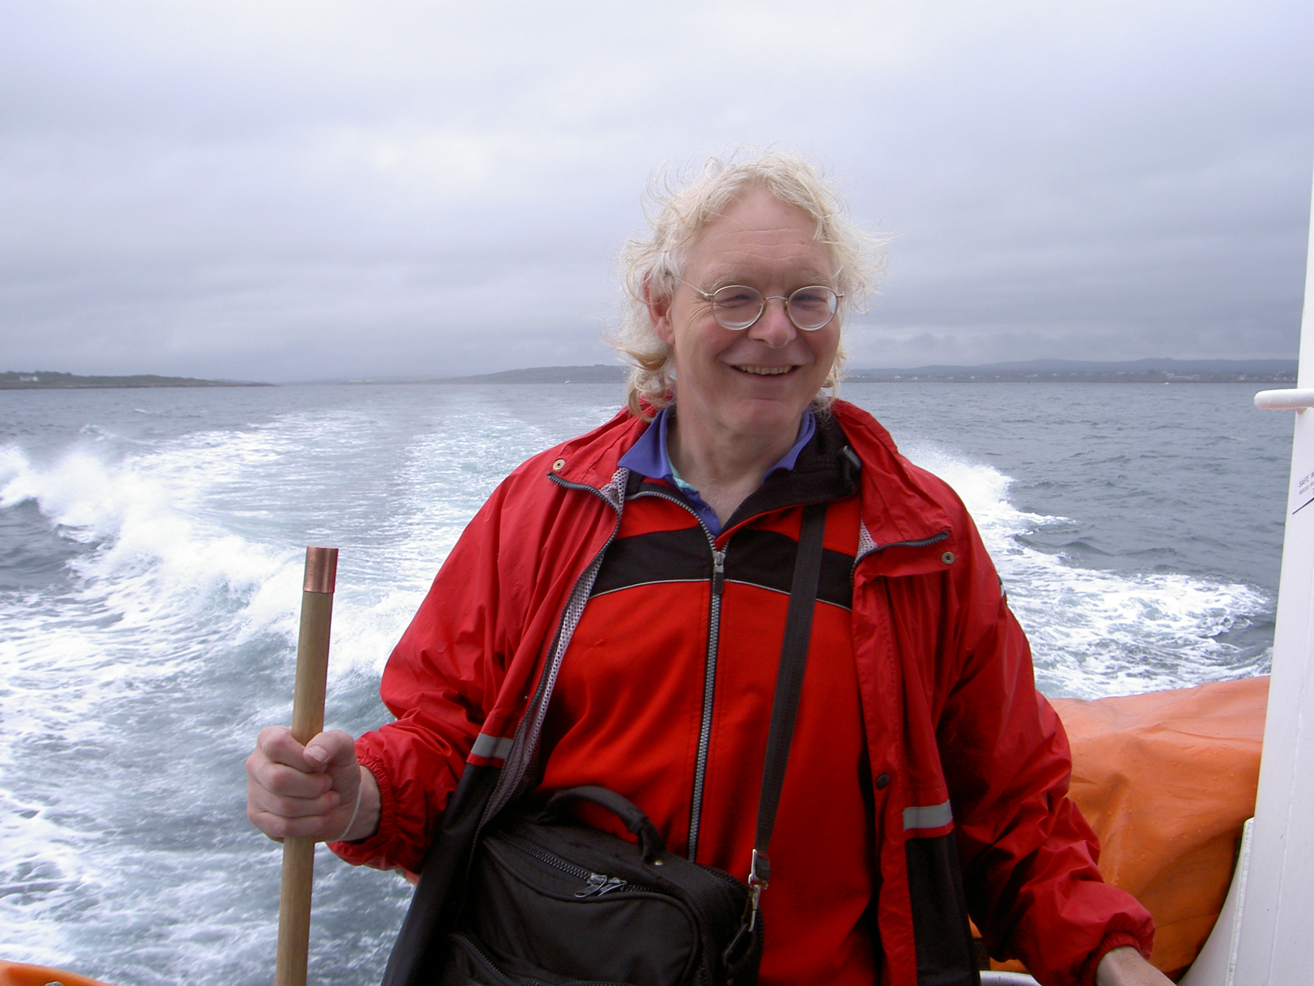
Wisdom and Virtue in Context
Wisdom cannot be understood outside of the personal, cultural and religious contexts that frame judgments about wisdom and virtue.
Notes:
Unpack these ideas (self-trtanscendence) connecting wisdom to virtue etc.
What do we mean by wisdom? What is it and why is it relevant: Broadly Aristotelian approach that has been adopted by the scientific approach to the empirical study of wisdom.
Less text—skeleton and put text in notes.
Interesting
2 motivations: halt temptation, improve self (prevent vs. promote)
Why different ages? Generativity; life tasks (Eriksonian idea of wisdom asa task of old age (But baltes says no difference): Why important?
Good to nominate people: Not psychologists, just nominated as wise (ask people in study 1 to nominate wiser peoplethey know.

Slide 7

Wisdom Connects Self to Others
Wisdom involves different understandings of how self relates to others, due to
  National differences
  Religious differences
  Life stage differences
Notes:
Wisdom involves different understandings of how self relates to others, due to
1. National differences in self-understanding, for example:
Asian may see self as more Interdependent, while North Americans see it as more independent
2. Religious differences might result from seeing self as
an expression of a Christian or Muslim soul
vs. the Buddhist view that there is ‘no essential self’
3. Life stage differences
—allow us to test Erikson’s view that wisdom and self-transcendence are more characteristic of later adulthood

Slide 8
Methodology

Slide 9
Design
Two Convergent Parallel Mixed Methods studies:
  4 faith conditions
  3 nations
  2 stages of adulthood
Site Managers for each country will manage recruitment and data analysis in collaboration with the team.

Slide 10
Working Hypotheses
National culture and religious faith will inform individual life experiences through implicit and explicit narratives about virtue.
Both will interact across the life span to develop the moral self and wise motivation to virtue.

Slide 11
4 Faith Conditions

Slide 12
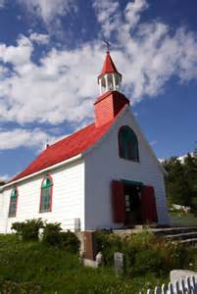
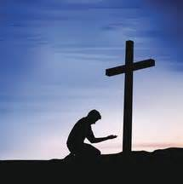
Christian

Slide 13
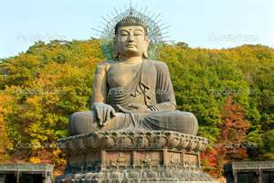
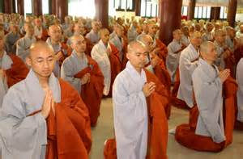
Buddhist

Slide 14
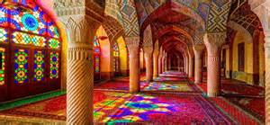
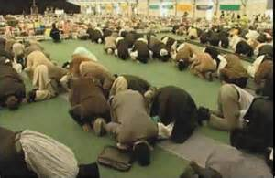
Muslim

Slide 15
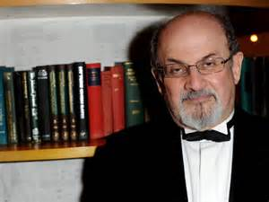
Agnostic

Slide 16
3 Nations

Slide 17
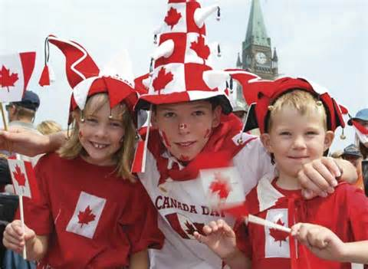
Canada

Slide 18
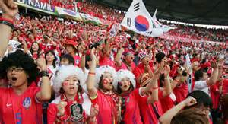
Korea

Slide 19
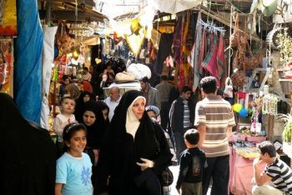
Iran

Slide 20
2 Stages of Adulthood

Slide 21

Young Adult

Slide 22

Older Adult

Slide 23
General Procedure
Self-Report Questionnaires on
  Level of Religiosity, Wisdom, Self-Construal, Self-Transcendence, Locus of Control, ‘Quality of Life’
Wisdom Simulation Game
  6 rounds of decision-making aiming to benefit a fictitious country, allowing performance of a virtuous self
Notes:
1. We will give people a battery of Self-Report Questionnaires on
Level of Religiosity, Wisdom, Self-Construal, Self-Transcendence, Locus of Control, ‘Quality of Life.’
We will use these to orient our interpretation of performance on
2. A Wisdom Simulation Game. A 2-person game that involves
6 rounds of decision-making aiming to benefit a fictitious country, allowing performance of a virtuous self

Slide 24
General Procedure
Two Interviews
  First interview
    (1) React to Classic stories of Christian, Muslim, and Buddhist wise motivation to virtue.
    (2) wise motivation to virtue in a personal acquaintance
      (1) immediate motivation (e.g. resisting temptation), and
      (2) lifespan motivation to personal development, through, e.g., daily mindfulness mediation or social and public interaction
    (3) The role of community in creating and sustaining wise motivation to virtue.
  Second Interview
    (1) Discuss their simulation performance
    (2) Follow up on themes from 1st interview.
Notes:
Two studies of 3 nations and 4 religious traditions
Two Interviews
The First interview has 3 parts:
(1) Discuss 3 culturally significant stories of wisdom and virtue from different religious traditions.
(2) Describe two kinds of motivation to virtue in someone personally known to be living a virtuous life:
(1) proximal motivation (e.g. resisting temptation), and
(2) lifespan developmental motivation to personal development, through, e.g., daily mindfulness mediation or prayer
(3) Describe the role of virtuous communities
Second Interview
(1) Discuss simulation performance
(2) Follow up on themes from 1st interview.
Classic stories of wise Christian, Muslim, and Buddhist motivation to virtue
Proximal and distal motivation to virtue in a personal acquaintance
The role of community in creating and sustaining wise motivation to virtue

Slide 25
Buddhist Example of a Motivation to Virtue Story
(Samyutta Nikaya Vol. 1, ch.3:25 (5) <224-29>)
King Pasenadi of Kosala approached the Buddha, who asked him where he was coming from. The King replied that he had been engaged in issues of state.
The Buddha then asked, “What do you think, great king? If a reliable man came from the east and said “I saw a great mountain high as the clouds coming this way, crushing all living beings. And suppose other reliable people, with the same message, came from the north, south, and west? …what should be done?”
King Pasenadi answered, “if such a great peril should arise, what else should be done but to live by the Dharma [eternal law], to live righteously, and to do wholesome and meritorious deeds?” To which the Buddha replied, “Great king, aging and death are rolling in on you and no armies can defeat them; what else should you do but live by the Dharma, live righteously, and do wholesome and meritorious deeds?”
Notes:
The story goes that one day King Pasenadi of Kosala approached the Buddha and greeted him. The Buddha asked him where he was coming from in the middle of the day. King Pasenadi replied that he had been engaged in issues of state needed to keep stable control over a large kingdom.
The Buddha then asked, “What do you think, great king? Here, a man would come to you from the east, one who is trustworthy and reliable, having approached, he would tell you: ‘For sure, great king, you should know this: I am coming from the east, and there I saw a great mountain high as the clouds coming this way, crushing all living beings. [And suppose other reliable people, with the same message, came from the north, south, and west?] Do whatever you think should be done, great king.’ If, great king,…such a great peril should arise…what should be done?”
King Pasenadi answered, “If, venerable sir, such a great peril should arise, such a terrible destruction of human life, the human state being so difficult to obtain, what else should be done but to live by the Dhamma [eternal law], to live righteously, and to do wholesome and meritorious deeds?”
To which the Buddha replied, “I announce to you, great king: aging and death are rolling in on you”, adding that, while great armies can often defeat an enemy, no armies can defeat aging and death; while crafty councilors can sometimes divide enemies or buy them off, not so when aging and death roll in. “So it is, great king! As aging and death are rolling in on you, what else should you do but live by the Dhamma, live righteously, and do wholesome and meritorious deeds?”

Slide 26
Study 1
Participants
  2 age groups at opposite ends of adulthood:
    10 emerging adults (age 18-25)
    10 older adults (age 60-80)
  In 4 faith conditions
    Christian, Muslim, Buddhist, Agnostic
  in 3 nations (chosen to illuminate debates on self)
    Canada, Iran, Korea
Total participants: 240
Notes:
Participants
2 age groups at opposite ends of adulthood
(testing Erikson’):
10 emerging adults (age 18-25)
10 older adults (age 60-80)
In 4 faith conditions
Christian, Muslim, Buddhist, Agnostic
in 3 nations (chosen to illuminate debates on self)
Canada, Iran, Korea
Total participants: 240
Each participant interviewed twice
1. Self-report questionnaires and initial interview
2. Simulation and follow-up interview

Slide 27
Study 2
Replicates Study 1 with authorities nominated as wise
  In the same 4 faith conditions
    10 Christian, Muslim, and Buddhist authorities
    10 agnostic wisdom nominees
    In the same 3 countries (Canada, Iran, and Korea)
Purposive sampling
  collect as wide a diversity of views as possible of wise motivation to virtue.
Total participants: 120
2 Interviews
  Interview 1 will be the same as in study 1
  Interview 2 asks participants to reflect on
    (i) Simulation performance
    (ii) Their own first interview
    (iii) The results of study 1 on everyday understanding of wise self-motivation to virtue
Notes:
Replicates Study 1 with participants who have made a careful study of motivation to virtue and are nominated as wise
In 4 faith conditions
10 Christian, Muslim, and Buddhist religious authorities
10 agnostic wisdom nominees
In 3 countries
Canada, Iran, and Korea
Purposive sampling will aim to collect as wide a diversity of views as possible of wise motivation to virtue within each faith tradition in different countries.
Total participants: 120
Each participant interviewed twice
1. Self-report questionnaires and initial interview
2. Simulation and follow-up interview

Slide 28
Deep Integration
Notes:
Explain how you will meet the requirements of Deep Integration.

Slide 29
Achieving Deep Integration
Team Integration by Monthly team meetings
  Continue interdisciplinary conversation on wisdom begun in 2011 with most of our team
    Now oriented to data from our empirical research.
Methodological Integration: Converge/orchestrate data from
  self-report questionnaires (Ardelt, Bang, Ferrari, team),
  computer simulation performance (Connell, team).
  Interviews (including dispositional exploration)
    Theological analysis (Mongeau)
    Thematic/hermeneutic analysis (Ardelt, Ferrari, team)
    Narrative analysis (Edmondson, team)
Notes:
Monthly team meetings will continue ongoing interdisciplinary discussion of wisdom begun in 2011
This discussion can now be grounded in/oriented to data from our empirical research.
Converging/orchestrating data from a wide range of quantitative and qualitative methods will provide deep integration
self-report questionnaires (Ardelt, Bang, Ferrari, team),
Interviews (including dispositional exploration)
thematic/hermeneutic analysis (Ardelt, Ferrari, team)
narrative analysis (Edmondson, team)
computer simulations (Connell, team).

Slide 30
Achieving Deep Integration
Coordination will mitigate weaknesses of particular methods.
  Interview analyses informed through questionnaire data by identifying
    different levels of wisdom and self-transcendence
    different types of self-construal and locus of control
  Extreme cases in questionnaire results and simulation data will let us explore patterns in the qualitative interviews
Theoretical Integration:
  Dis/Confirm existing factors within questionnaire measures
  Discover new understandings of self, motivation, wisdom and virtue via foreign-language interviews
  Convergence will create an expanded typology of motivations of self to virtue
    in different nations
    in different faiths
    at different ages
Notes:
Coordinating methods will provide a more comprehensive account of how self, motivation and virtue are understood at different ages, in different faiths and nations
Triangulation between methods will mitigate weaknesses of particular methods.
We will enhance qualitative findings through quantitative analysis of questionnaire data by identifying
different types of self-construal, locus of control
different levels of wisdom and self-transcendence
We expect to:
Confirm existing factors within questionnaire measures (e.g., interdependent and independent self-construal)
discover new understandings of self, motivation, wisdom and virtue, via qualitative interviews and the simulation, so as to create a typology of motivations of self to virtue
in different nations and faiths,
perhaps also at different ages

Slide 31
Anticipated Challenges

Slide 32
Interdisciplinary challenges
  Different disciplinary languages
  Different disciplinary cultures of reasoning
  Different core conceptual concerns
  Different fundamental models of the human being
Methodological challenges associated with interdisciplinarity:
  Selecting our sample: Purposive vs. quota sampling
  Conceptualizing and analyzing data: Contextualized cases vs. universal patterns
Pragmatic challenges with conceptual implications:
  Analyzing data in foreign languages
    Translation problems between languages and worldviews
    Training (and checking) native-language interviewers
Notes:
Interdisciplinary challenges
Learning each others’ disciplinary languages
Appreciating each others’ core conceptual concerns
Addressing each others’ fundamental models of the human being
Methodological challenges associated with interdisciplinarity:
Selecting our sample
Purposive sampling needed for an in-depth qualitative understanding of motivating the self to virtue
Quota sampling needed for quantitative measures
Data analysis
Situated contextualized understanding of particular motivations and how they are wise, sought by qualitative analysis
Larger-scale patterns within nations or faiths, sought by quantitative analysis
Pragmatic challenges with conceptual implications:
Analyzing data in foreign languages
Translation problems between languages and worldviews
Training (and checking) native-language coders/interpreters

Slide 33
Strategies for Response

Slide 34
Interdisciplinary challenges
  Ongoing team discussions
    monthly meetings using Skype for members outside Canada
    at least 2 in-person whole team meetings
  Writing together to induce shared understanding.
    an ongoing project journal about challenges that we hope to eventually publish
    Circulate manuscript drafts
Methodological challenges
  Aim for consensus, with a spirit of friendship in dissent;
  Key analyses done by members with specific disciplinary expertise,
    but debated within the team to enhance mutual learning.

Slide 35
Pragmatic challenges
  Build on past team experience;
    Including pilot interviews and questionnaires on wisdom and well-being collected in Canada, Iran and Korea
  One team member is a native speaker/national from each of our participating nations;
    Will liaise with site managers and interviewers and bring concerns back to the whole team.
  Key interviews will be translated for documented discussion/interpretation by the whole team.
Notes:
Pragmatic challenges
Build on past team experience dealing with large international samples;
Including pilot data we already have on how wisdom is understood in Canada, Iran and Korea
Explore patterns and extreme cases found in quantitative questionnaire and simulation data in greater depth through qualitative interviews;
One team member is a native speaker/national from each of our participating nations;
Will liaise with site managers and coders and bring concerns back to the whole team; on-going input by team will accentuate ‘process’;
Key passages and key qualitative interviews will be translated for documented discussion/interpretation by the whole team.

Slide 36
Summary
Research Goal:
  Explore
    conceptions of wise virtue
    Immediate and long-term wise self-motivations to achieve virtue.
  Compare
    early and late adulthood,
    4 faith traditions (Christian, Muslim, Buddhist, Agnostic)
    3 nations (Canada, Iran, Korea)
Methodological Innovation:
  Coordinate between social sciences, philosophy and theology.
  Converge findings from quantitative, qualitative, and simulation data.
Theoretical Innovation:
  Explore dispositions to behavior through narrative and simulation performance.
  Problematize scientific discourse about the moral self and its development in different faiths and nations.
    Create a more comprehensive typology of self-motivation to virtue

Slide 37
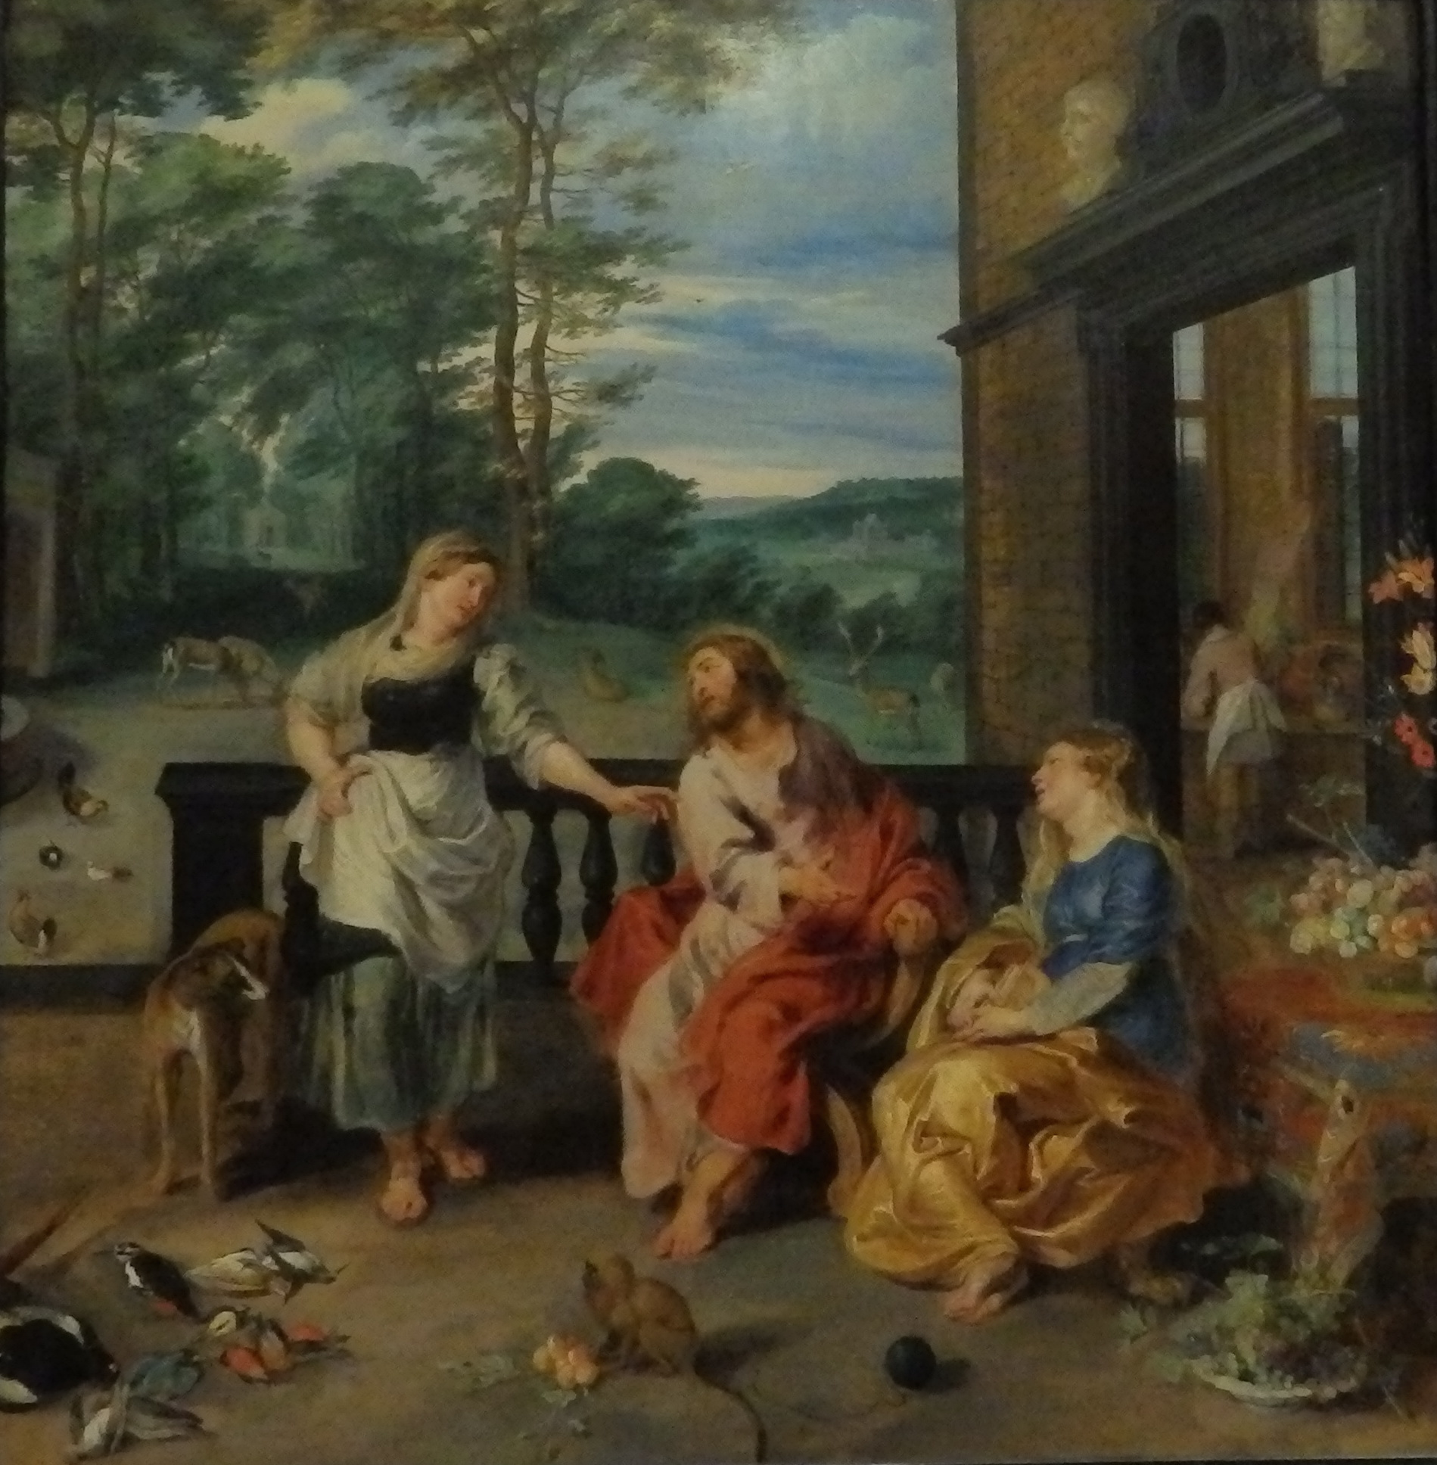
  Our aim: Synergy in co-operation
  as exemplified by Breughel and Rubens (1628)
Notes:
Collaborated to paint (1628) Martha and Mary who had two very different approaches to virtue

Slide 38
Appendix (for questions)
Self-Report Questionnaires (Quantitative Method)
Self-Report Questionnaires exploring
  Level of Religiosity, Wisdom, Self-Construal, Self-Transcendence, Locus of Control, Quality of Life
MODEL (to be Dis/Confirmed and its components elaborated)
  Level of Religiosity: A threshold will be used to select participants for each faith condition.
  Hypotheses
    Wisdom will be associated with (i) interdependent self-construal, (ii) high self-transcendence, (iii) internal locus of control, and (iv) higher quality of life.
    Older adulthood will be associated with higher self-transcendence and greater wisdom.
    Asian nations will view the self as more interdependent, Canadians will view the self as more independent
    Christians and Muslims will view the self as more Independent; Buddhists will view the self as more interdependent.
Methodological Innovation:
  Questionnaires will be read aloud to participants in their native language, and they will be invited to query any items that seem unclear or confusing to them and this will be recorded as data.

Slide 39
Self-Report Questionnaires: Specific Measures
Level of Religiosity: Dimensions of Religiosity Scale (Joseph & DiDuca, 2007)
    20-item self-report measure of religious preoccupation, guidance, conviction, and emotional involvement
Wisdom: Three Dimensional Wisdom Scale (Ardelt, 2003)
    39 item self-report measure of Cognition, Reflection and Compassion
Self-Transcendence: The Adult Self-transcendence Scale (Levenson et al., 2005).
    35 Item self-report measure: 10 Alienation items; 25 Self-transcendence with 3 dimensions (equanimity, social concern, cosmic perspective)
Self-Construal: Self-Construal Scale (Singelis, 1994)
    A 24 item self-report measure of independent and interdependent self-construal
Locus of Control: Reid-Ware 3-factor Internal-External Scale (1974)
    45 item self-report measure of Social System Control, Fatalism and Self-Control
Quality of Life: Quality of Life Inventory (Frisch, 1988)
  A 32 item self-report measure of quality of life measuring
    16 dimensions of quality of life (Health, Self-Esteem, Goals and Values, Money, Work, Play, Learning, Creativity, Helping, Love, Friends, Children, Relatives, Home, Neighborhood, Community)
    And satisfaction with each of these dimensions
Notes:
The Dimensions of Religiosity Scale: 20-item self-report measure of religious preoccupation, guidance, conviction, and emotional involvement
Authors
Stephen Joseph
Deborah DiDuca
Source Information
November 2007, Volume10(Issue6) Page p.603To-608

Slide 40
Simulation Data
Simulation Performance
  6 rounds of simulated decision-making (taking about one hour)
  Quantitative Analysis
    Social Behavior during the simulation (Connell)
  Qualitative Analysis
    Conversations between participants during the simulation (Edmondson)
    Rationale for performance choices and definition of wisdom (Ferrari, Bang)
Methodological Innovation:
  provides a performance measure of the moral self in action
  quantitative and qualitative measures of e.g. sociability can be triangulated with questionnaire and interview data.

Slide 41
Qualitative Interview Data
Semi-Structured interviews in 3 parts:
  Reactions to Classic stories of wise Christian, Muslim, and Buddhist motivation to virtue
  Immediate and long-term motivation to virtue in a personal acquaintance
  The role of community in creating and sustaining wise motivation to virtue
Analysis of interview data on self, motivation, virtue:
  Conceptual analysis (Vervaeke, philosopher; Edmondson)
    Key Concepts: self, motivation, virtue, & wisdom
  Theological analysis of the sacred (Mongeau, theologian)
  Thematic / hermeneutic analysis
    Context and community (Edmondson)
    Extreme case analysis (Ardelt)
Methodological Innovation:
  Coordination between philosophical, theological, and social science methods of interpreting discourse.

Slide 42
Narrative Analysis
Charles Taylor (1989) ‘we must inescapably understand our lives in narrative form’, within ‘webs of interlocution’ we gain from the cultures we live in.
Narrative
  Gives a sense of time and process
  Responds to fluidity and development of meanings
  Is eloquent about both sociality and practice or style of life.
A hermeneutic approach to language and behavior responds to how they fit into, derive from, impact on or are interpreted within their cultural and temporal contexts.
  It sees these relationships as interactive, so that meaning is contributed in part by recipients of language or conduct.
  It also acknowledges that understanding them is itself likely to be incomplete, to develop over time, and to impact upon the person who is trying to understand.

Slide 43
Classic Wisdom Story: Buddhist Example
(Samyutta Nikaya Vol. 1, ch.3:25 (5) <224-29> passim)
The story goes that one day King Pasenadi of Kosala approached the Buddha and greeted him. The Buddha asked him where he was coming from in the middle of the day. King Pasenadi replied that he had been engaged in issues of state needed to keep stable control over a large kingdom.
The Buddha then asked, “What do you think, great king? Here, a man would come to you from the east, one who is trustworthy and reliable, having approached, he would tell you: ‘For sure, great king, you should know this: I am coming from the east, and there I saw a great mountain high as the clouds coming this way, crushing all living beings. [And suppose other reliable people, with the same message, came from the north, south, and west?] Do whatever you think should be done, great king.’ If, great king,…such a great peril should arise…what should be done?”
King Pasenadi answered, “If, venerable sir, such a great peril should arise, such a terrible destruction of human life, the human state being so difficult to obtain, what else should be done but to live by the Dhamma [eternal law], to live righteously, and to do wholesome and meritorious deeds?”
To which the Buddha replied, “I announce to you, great king: aging and death are rolling in on you”, adding that, while great armies can often defeat an enemy, no armies can defeat aging and death; while crafty councilors can sometimes divide enemies or buy them off, not so when aging and death roll in. “So it is, great king! As aging and death are rolling in on you, what else should you do but live by the Dhamma, live righteously, and do wholesome and meritorious deeds?”

Slide 44
Innovation and Relevance
Research Goal:
  Compare stages of adulthood, faith traditions and nations on:
    conceptions of wise virtue
    Immediate and long-term wise self-motivations to virtue.
Methodological Innovation:
  Coordinate between social sciences, philosophy and theology,
  Converge findings from quantitative, qualitative, and simulation data.
Theoretical Innovation:
  Explore dispositions to behavior through narrative and simulation performance.
  Problematize scientific discourse about the moral self and its development in different faiths and nations.
    Create a comprehensive typology of self-motivation to virtue.
Notes:
Goal:
Compare stages of adulthood, faith traditions and nations regarding:
conceptions of wise virtue
distal and proximal self-motivations to wise virtue.
Methodological Innovation:
Triangulate between social sciences, philosophy and theology,
Converge findings from quantitative, qualitative, and simulation data.
Theoretical Innovation:
Foreign language discussion of wisdom and self-motivation to virtue will broaden the horizon of scientific discourse about the moral self and its development.
Create a comprehensive typology of wise motivation to virtue
Our project will explore dispositions and behaviour, not just self-reports.

