Slide 1
Eudaimonic Growth:
How Virtues and Motives Shape the Narrative Self and Its Development within a Social Ecology
Jack J. Bauer
Peggy DesAutels
University of Dayton

Slide 2
Main Questions
How do eudaimonic values and virtues serve as motives that shape the development of the narrative self?
How do families and social institutions both foster and constrain that development?
How should they?
Notes:
Virtues as both motives and outcomes
Narrative self as both vehicle and content of (broader) character development
Method: Qualitative & quantitative analysis of life stories and family stories

Slide 3
Deep Integration: People
Jack Bauer, Ph.D., psychology, P. I.
  Psychology: Narrative self-identity development, eudaimonic growth, motivation, moral psychology
  Philosophy: Eudaimonia, East and West
Peggy DesAutels, Ph.D., philosophy, co-P. I.
  Philosophy: Virtue ethics, feminist ethics, philosophy of mind
  Psychology: Cognitive science and moral psychology

Slide 4
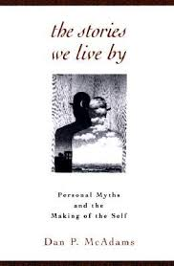
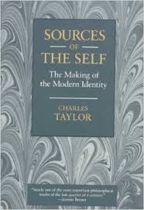
Why the Narrative Self?
  Narrative self (McAdams, 1993, 2006)
  How people construct subjectively meaningful
  construals of themselves and their lives
Narrative self is a moral self (Taylor, 1989)
  Life stories position self and others via themes of motivating values and virtues, endowing persons
  and actions with meaning (Hermans, 2001)
Narrative self development (McLean et al., 2007)
  Meanings of self & life reinterpreted over time
  Capacity to construct meaning develops
Notes:
• Life stories let researchers observe how people construct subjectively meaningful construals of themselves as persons and of their lives
• To highlight the deep integration of psychology and philosophy, citations of psychologists are in light blue, and citations of philosophers are in light orange. Although the citations just scratch the surface.
• Self as subjective construal…: Personality as construals of person by either other people or oneself. Self as the subjective construal of one’s person over time. (We’re focusing in this study on the narrative construction of self, but not exclusively so.)
• Life stories: Like any story, life stories use narrative elements of
• cultural master narratives: We can study the life story in terms of intrapersonal meaning, interpersonal meaning, or as reflecting culture and social history (LHA)
• Moral self: life stories position the self in terms of others along lines of human values and virtues
But according to varied principles, so be careful
• Abstract virtues: One problem of talking about a person as virtuous is that that person is in any given situation not virtuous. The problem with the situationist perspective is that it actually decontextualizes the situation as if it functioned outside the context of actual persons, who bring developmentally formed intentions and mental frameworks to bear on the doing of the virtuous acts.
• Life stories often feature conflict of virtues, where valued virtues are not being lived out, and how the person struggles with that. with simpler measures, there’s a tendency to say Person X has X virtue.
Stories contextualize the virtues in people’s lives, but without decontextualizing the situation
CUT:
Virtues serve as themes in narrative self that:
(1) give meaning to interpreted actions
(2) motivate subsequent action
Virtues serve as thematic motives for character development

Slide 5
Why Eudaimonic Growth?
Eudaimonia is multifaceted, like personhood
  Person: Traits, motives, stories (McAdams, 2013)
  Eudaimonia: Many virtues—at each level of person
  Eudaimonic growth: Capacities for virtues develop over time
  Plus culture and evolution (Flanagan, 2011; Narvaez, 2008)
Whether a mess or a rich tapestry, this all comes together in the methodologically pluralistic study of the narrative self and eudaimonic growth
Notes:
• Most of us are probably familiar with the notion of eudaimonia (either pronunciation). In a nutshell, eudaimonia was Aristotle’s answer to the question, What makes a good life? Eudaimonic theories, taken together, East and West, give us a very wide range of virtues.
• What has always drawn me to models of eudaimonia is that eudaimonia, like the person, is multifaceted.
• Eudaimonia…at each level: Virtues cut across McAdams’ levels, but virtues as personality phenomena are studied perhaps most commonly at the level of motives, or what McAdams calls characteristic adaptations, the level of the person as agent. Yet an unbroken if marginalized line of research studies virtues in life narratives, at the level of the person as author.
• Eudaimoinc growth…”: Varied priniciples. Kohlberg’s model of moral development has different principles than, say,.a dialogical narrative model (Mark Tappan). So they’re different, but they’re all part of the person’s character development, so they need to be studied together, under the same roof.

Slide 6
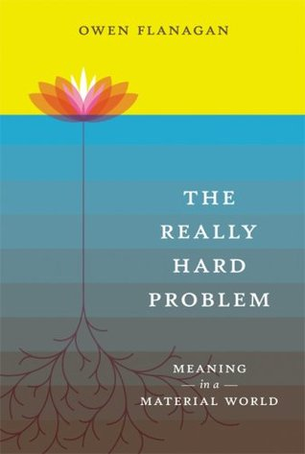
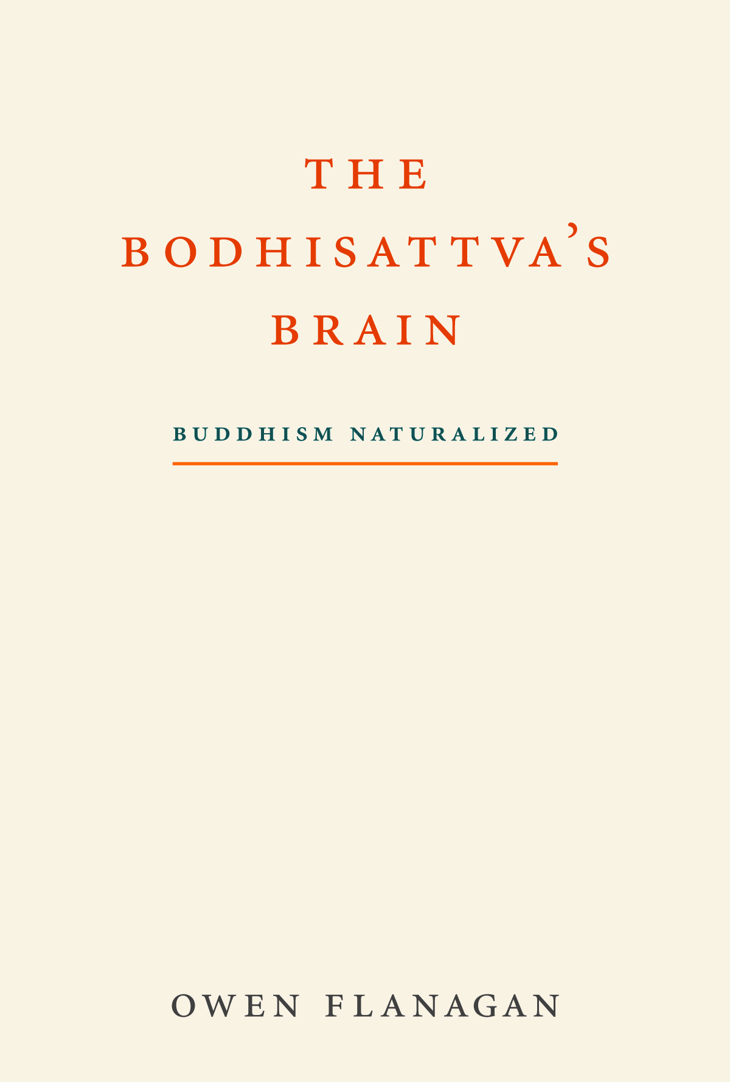
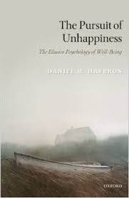

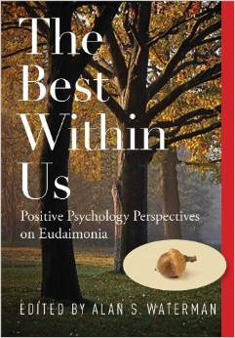
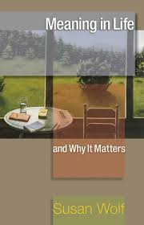
The Umbrella of Eudaimonia
(Philosophy and Psychology, East and West)
Wisdom: practical reason, psychosocial maturity, authenticity, self-actualizing, mindfulness, etc.
Happiness: satisfaction, fulfillment, meaningfulness
Love: compassion, generativity, etc.;
harmonious passion, vital engagement, etc.
Growth: development of wisdom, happiness, love

Slide 7

Narrative Self & Eudaimonic Growth
The Transformative Self (Bauer, 2016)
Experiential Growth Themes
Reflective Growth Themes
• Deepened or strengthened life experience
• “This [time away together] really strengthened our marriage, as my feelings for him became deeper and more caring.”
• Learning, insight; heightened conceptual understanding
• “My wedding…I saw an imagined future, I saw an accumulated past…it all integrated into a profound order.”
Happiness/Well-Being
Wisdom/Maturity
(Bauer & McAdams, 2004, 2010; Bauer, McAdams, & Sakaeda, 2004, 2005)
Notes:
The transformative self: Life stories featuring growth themes
But there are several varieties of each, at the core of which are a wide range of eudaimonic values and canonical virtues.

Slide 8
The Social Ecology of the Person
(Bronfenbrenner, 1979)
Macrosystem
Exosystem
Mesosystem
Cultural master narratives
Political system
Religion
Cultural norms
Microsystem
Activities
of work,
church,
school
Family
Individual
Peers
Community
services
Mass media
Education system
Cultural ideologies
Cultural attitudes
Chronosystem
Time: Social history and individual development

Slide 9

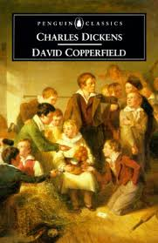
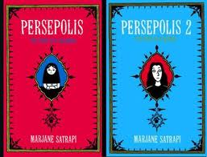

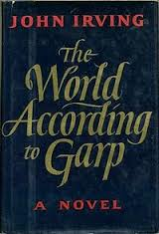
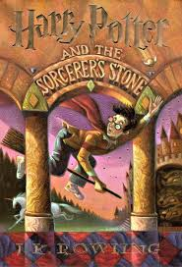

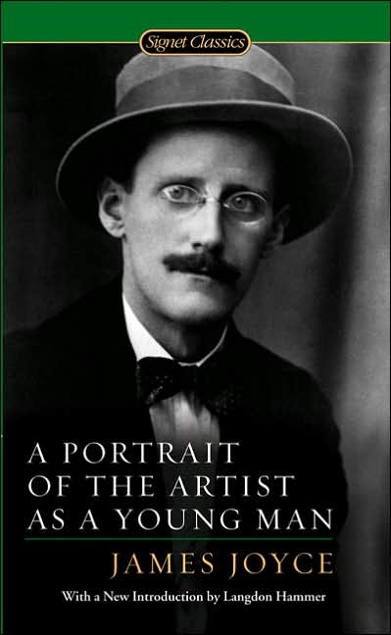

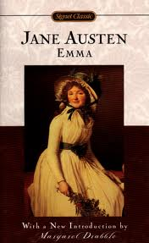
Cultural Master Narratives of Eudaimonic Growth: Bildungsroman
(Bauer, 2016)
Notes:
• [New slide] That contrast serves as a segue to the story of personal growth, which is about humanistic and experiential progress, where a good life is defined as a meaningful life, focused on personally meaningful relationships and doing personally meaningful activities in work and play
• In contrast to the story of upward mobility, the story of personal growth features the transformation of the person—the person’s characteristics, interest, abilities, etc.
• Concerns of increases in social status and material wealth are of secondary concern
• [Click] We see the story of personal growth idealized in the popular bildungsroman genre of literature and film. The bildungsroman is a story of character development and personal growth
• Literature professor Thomas Jeffers describes the bildungsroman as focusing “on an individual’s development, each stage having its own specific value and serving as ‘the ground for a higher stage,’ an upward and onward vision of human growth.” (2005, p. 49)
• The general plot goes like this: The youth on the cusp of adulthood feels called to express and pursue personal values that are at odds with a life of keeping up with appearances and upward mobility
• The general storyline is one of self-exploration, self-discovery, self-invention, and self-actualization, all set against the conventions of society
• It might involve a life of the mind, a quest for wisdom
• Or perhaps the artistic path, as with Joyce’s Stephen Dedalus, or some kind of spiritual development
• It might be a life of the heart, toward meaningful relationship, family, contributing to society
• It might be life struggling with the cultural and political and racial and ethnic margins of society
• We see examples of all these on the screen here
• There are so many examples of bildungsroman, especially in popular film, because people love the idea of personal growth
• As mentioned earlier, the idea of progress runs deep in Western culture
• In the U.S., self-help books represent up to 60% of non-fiction best-selling books

Slide 10
Growth in the Margins of the Social Ecology
Macrosystem: Cultural master narratives of a good life (McAdams, 2006)
  Aristotle: Eudaimonia requires leisure and luck
  Depend on luxury, power, cosmopolitanism (DesAutels, 2009; Hammack, 2008)
Exosystem: Social institutions foster or inhibit capabilities for eudaimonic growth (Nussbaum, 1998)
  Systematic oppression (via gender, SES, ethnicity, etc.) makes eudaimonic growth difficult or impossible (DesAutels & Walker, 2004; DesAutels & Whisnant, 2007; Tessman, 2001)
Notes:
• Cultural master narratives require relatively ideal circumstances of leisure and luck, even if not to the degree of Aristotle
• Safety concerns: An ethic of security (Narvaez, in press)
• What does eudaimonic growth sounds like in narratives of non-idealized contexts?

Slide 11
Family Master Narratives
(Microsystem)
(Fivush et al., 2010; McLean, in press)
Shape life stories, as do cultural master narratives
Conduit of cultural values, but contextualized for the family’s specific microsystem
Family narratives can both counter and contribute to cultural oppression
Understudied in both philosophy and psychology
Notes:
Family master narratives have not been studied in the specific context of character development

Slide 12
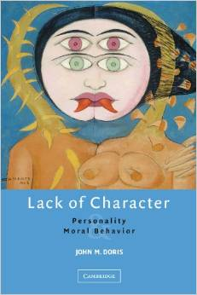
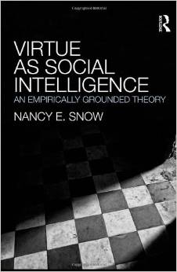

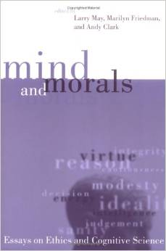


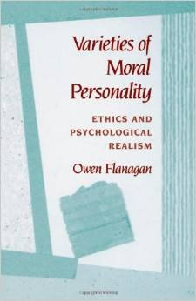
Contributions to Virtue Ethics
Non-idealized developmental approach
Focus on situations of unequal power relationships, abuse of power, institutional hierarchies, and so on.
Identify virtues and moral projects needed to resist oppression and abusive power (Tessman Burdened Virtues, DesAutels “Resisting Organizational Power”)
Expand the contexts and situations in which virtues are embedded both diachronically and synchronically

Slide 13
Hypotheses & Questions
Transformative self → eudaimonic growth
  Hypotheses for specific paths
Family stories shape narrative self & development
  Concordance v. discordance → eudaimonic growth
Social institutions shape life stories & family stories
  Concordance v. discordance → eudaimonic growth
Structure of eudaimonic growth? Non-idealized?
Notes:
• Eudaimoinc growth, or character development
• Specific paths, including coherence/integration varies by virtue themes & age
• Coherence…: But different kinds of narrative coherence for different paths of eudaimonic growth. Structural complexity and wisdom. Social integration and love. But not crossover, so focusing on reflective wisdom might not breed social cohesion, and focusing on communal themes might not breed reflective wisdom.
• Discordance x growth…: wisdom, particularly as perspective-taking
• Age: generative concern breeds well-being in midlife, but not in youth.

Slide 14
Methodology: Interviews
Longitudinal study of adult character development
  Allows for 2-yr stand-alone study + longer-term analyses
Year 1: Life story interviews
  100 participants, ages 18–80s
  Virtues in key life memories, virtue conflicts, virtue projects
  2 hours each, plus 1-hour online survey
Year 2: Family story interviews
  50 (of the 125) with 3-4 family members
  Virtues in key family memories, virtue conflicts & projects
  2 hours each, plus 1-hour online survey of family members
  Also Year 2: Life story follow-up interviews & surveys
Notes:
Interviews conducted by P.I.s and trained students
• Key life memories, like key life decisions
• Virtue conflicts: internally, interpersonally, and within social insttitutions
• Virtue projects: Wolf (2008)

Slide 15
Methodology: Narrative Analysis
Transdisciplinary, mixed-methods inquiry into the varieties and degrees of themes of eudaimonic virtues and growth in the narrative self
  By interdisciplinary team of professors and students
Quantitative
  Coded with established & adapted protocols
  Coded by multiple researchers for inter-rater reliability
Qualitative
  Critical inquiry: Deductive
  Grounded theory: Inductive

Slide 16
Methodology:
Examples of Non-Narrative Measures
  Wisdom: 3-dimensional wisdom (Ardelt, 2003); subject-object interview (Kegan, 1982) or ego development (Loevinger, 1976); perspective-taking (Davis, 1980); mindfulness (Brown & Ryan, 2003); authenticity (Wood et al., 2008)
  Happiness: PWB (Ryff & Keyes, 1995); SWB (Diener et al., 2006)
  Love: compassion (Hwang et al., 2008); generativity (McAdams & de St. Aubin, 1992); self-compassion (Neff, 2003); harmonious & obsessive passion (Vallerand, 2008)
  Growth: growth motivation (Bauer et al., 2015); comparisons over time
  Also: values (Schwartz, 1990); moral foundations (Graham, Haidt, et al., 2011); quiet ego (Wayment, Bauer, & Sylaska, 2014)

Slide 17
Deep Integration: People
Matt Montoya, Ph.D., social psychology, consultant
  Interpersonal and intergroup relations, evolutionary psychology, moral psychology
  Sociology and biological psychology
Jana Bennett, Ph.D., religious studies, consultant
  Theological ethics, marriage and family ethics, feminism
  Developmental moral psychology

Slide 18
Deep Integration: People
Lucas Keefer, Ph.D., psychology postdoctoral fellow
  Social/personality psychology of relationships, cultural metaphors in self-identity
Lars Bauger, M.A., psychology predoctoral fellow
  Telemark University, Norway; at UD fall 2015 semester
  Self & character development, aging, life transitions
2-3 graduate assistants in psychology
10-15 undergrad assistants in psychology & philosophy

Slide 19
Challenges
Revising and integrating models of eudaimonia, virtues, and their development
  Bridging ideal and non-ideal contexts for flourishing
  Descriptive and normative categorization of virtues
  Objectivist and subjectivist approaches to the good
Links among individual, family, society
  Counter-narratives to oppressive master narratives
  Degrees of convergence and conflict in self and family stories
Disciplinary frameworks and purposes
Notes:
• Bridging…: I tend to have my eyes on the stratosphere, at the heights of eudaimonic growth. Peggy has her eudaimonic eyes in the dirt, on the ground on which eudaimonia could possibly stands. We’re looking for a model that blends earth and sky.

Slide 20
Approach to Challenges
Ongoing discussion of our aims and approaches
Method: Collaborative narrative analysis
Results: Directly compare and contrast quantitative and qualitative assessments
Transdisciplinary publications and presentations
  Book on this study
  Articles, chapters (e.g., Bauer & DesAutels, 2015)
Notes:
Lots of experience analyzing narratives and the varied perspectives that different people bring to them.
• Method: Team meetings: profs; profs & students; students
• Results:
Data can sharpen normative questions
Normative questions can sharpen scientific questions

Slide 21

Thank You

Slide 22
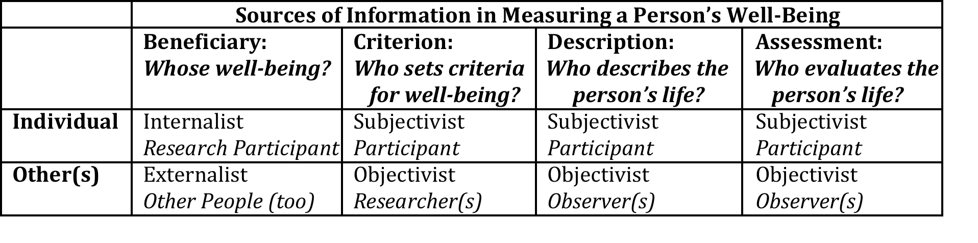
Subjective & Objective
Measures of the good
(Bauer, 2016)

Slide 23
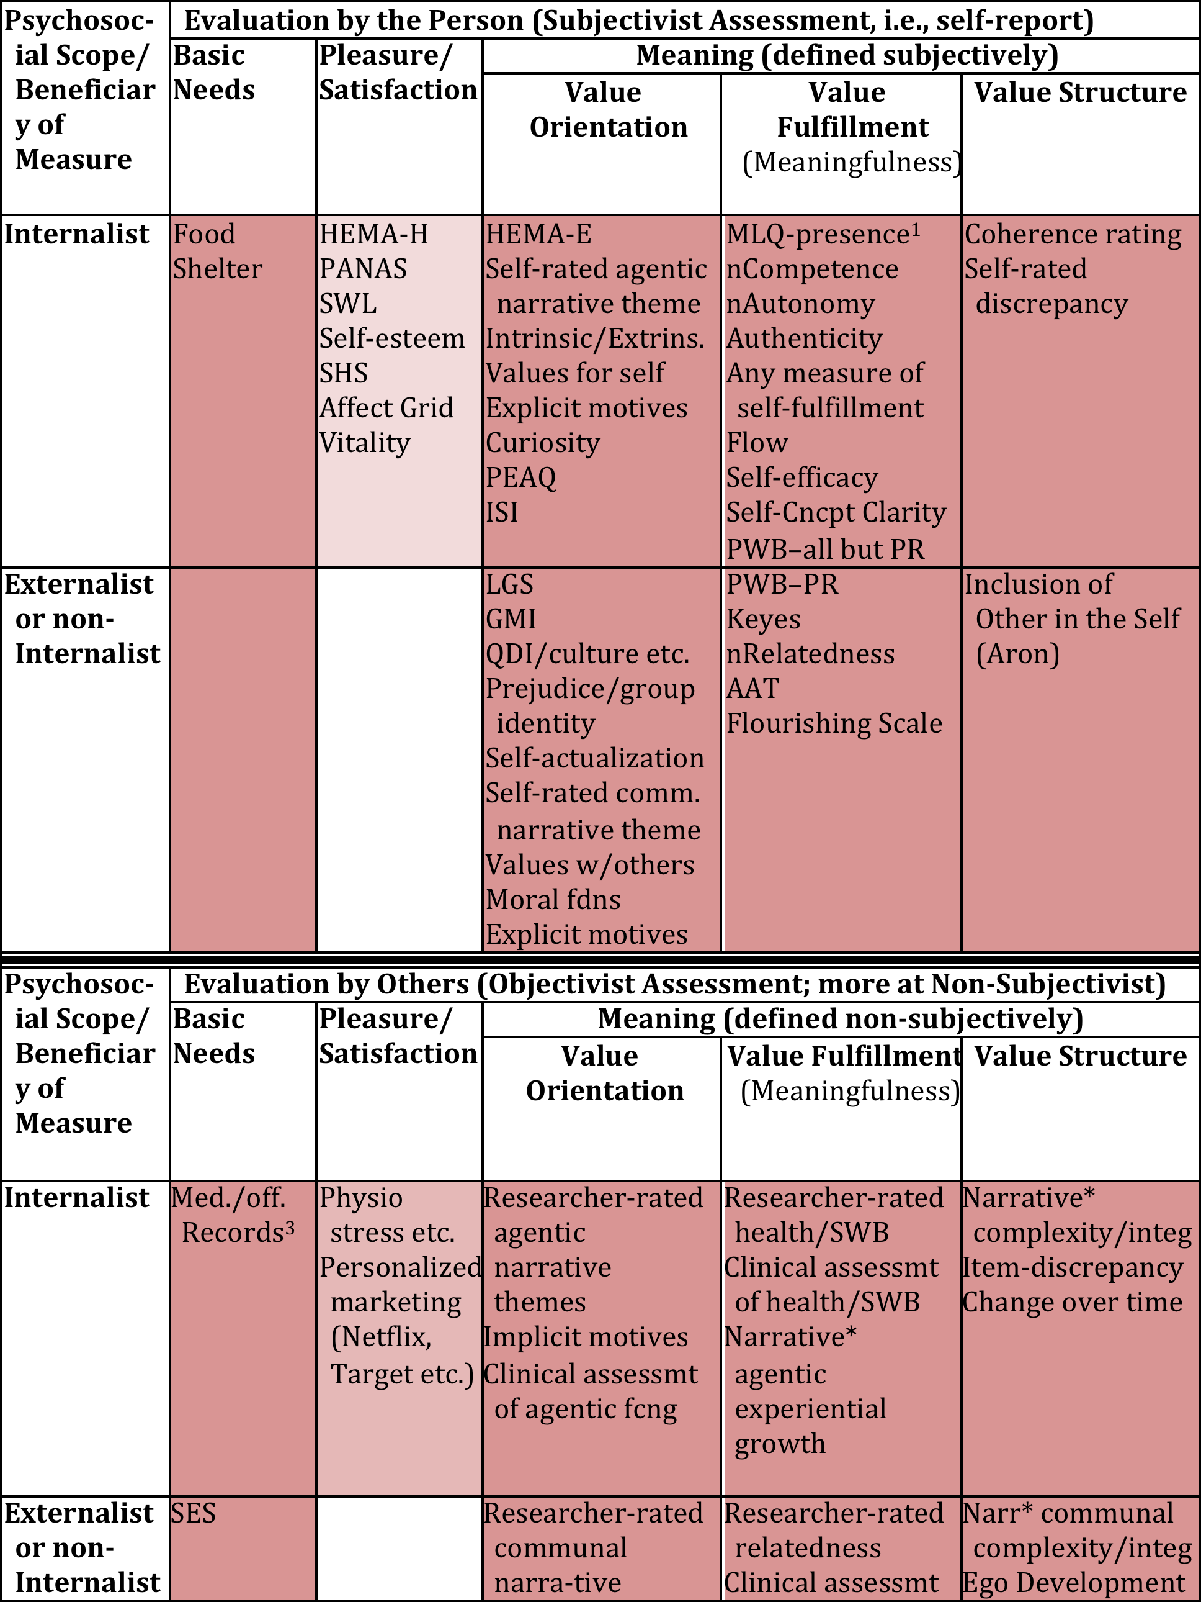
(Bauer, 2016)

