Slide 1
Existential Feelings in Virtue:
A Philosophical-Psychological Investigation
Co-PIs: Daniel Sullivan, Dept. of Psychology, University of Arizona
Achim Stephan, Institute for Cognitive Science, University of Osnabrück
Interdisciplinary Moral Forum
Self, Motivation, and Virtue Project
Marquette University, 14 March 2015

Slide 2




Project Team
Daniel Sullivan, Department of Psychology University of Arizona
Achim Stephan, Institute for Cognitive Science University of Osnabrück
Roman Palitsky, Deptartment of Psychology University of Arizona
Matthew Ratcliffe, Professor of Theoretical Philosophy, University of Vienna
Asbjørn Grønstad, Information Science and Media Studies, University of Bergen

Slide 3
Affective Processes and Virtue
Standard: cognitive, developmental
  Encourages classification, typology
Our project:
  Phenomenological experience
Virtue involves a sense of connectedness
Existential feelings

Slide 4
Specific Aims
Identify the role of existential feelings in virtuous character and behavior
Investigate changes in existential feelings across the lifespan to understand the role of development and life experience in virtue

Slide 5
Existential Feelings
“Background” states against which specific emotional episodes arise
Ways of experiencing possibilities for engagement with the world and others
Ratcliffe (2008; 2015); Stephan (2012)

Slide 6


Existential Feelings
Positively-valenced existential feelings (PEF)
  “Feeling welcome, a part of a group, much needed and important”
Negatively-valenced existential feelings (NEF)
  “Feeling rejected, isolated, dispensable, uninvited”
Stephan (2012)

Slide 7
Virtue
Tillich, The Courage to Be (1952)
Those with a core sense of acceptance have the courage for transcendence and humanity
Peterson & Seligman (2004)

Slide 8
Specific Aims
Aim 1: Identify the role of existential feelings in virtuous character and behavior
Guiding Hypothesis: Dispositionally and situationally, PEF will increase, and NEF will decrease, the capacity for virtues of courage, humanity, and transcendence

Slide 9
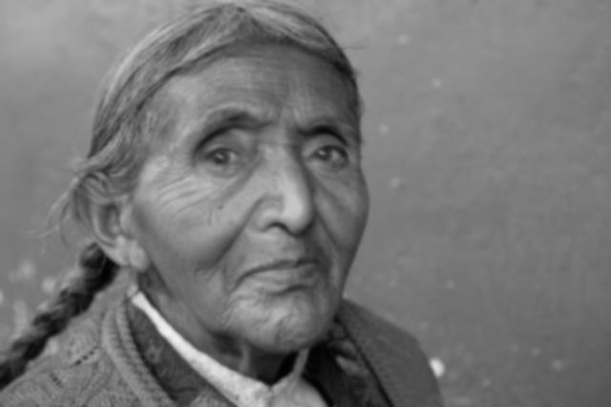
Existential Feelings and Virtue across the Lifespan
Older adults experience many life changes that might induce NEF
  Reduced agency or familiarity with the environment
Also potentially acquire certain resources for virtue
Bryant, Jackson, & Ames (2008); Roberts, Walton, & Viechtbauer (2006)

Slide 10
Specific Aims
Aim 2: Investigate changes in existential feelings across the lifespan to understand the role of development and life experience in virtue
Life Circumstances
Temporary PEF
+
-
AGE
NEF
Virtue

Slide 11
Study | Goal | Method | Population
1 | Develop account of EF and virtue across life periods and situations | Qualitative phenomenological survey | Community members & university students, Germany & USA
2 | Examine relationship between personal EF and virtue | Quantitative survey | U.S. Internet users
3 | Assess the effect of primed EF on virtue | Experiment using novel film inductions | U.S. university students
4 | Examine relationship between personal EF and virtue | Combined qualitative & quantitative survey | Older community members, Germany & USA
5 | Assess the effect of primed EF on virtue | Experiment using autophotography | Members of a retirement community, USA

Slide 12
Deep Integration
Studies 1, 2, & 4: Dialogue between qual. & quant. data
Qualitative:
  Describe your emotions and moods during the last five years. In what ways are they different from when you were young?
  How would you describe a virtuous person?
Quantitative:
  I never really feel “at home” in the world.
    1 = Strongly disagree, 7 = Strongly agree

Slide 13


Deep Integration
Study 3 – Novel film clips to induce PEF and NEF
  Produced through the University of Arizona
Consulting by Asbjørn Grønstad, film scholar

Slide 14

Unique Method: Autophotography
Participants document “who they are” (Ziller, 1990)
  Images convey varying levels of interpersonal connectedness
Study 5: In a Tucson retirement community, autophotographies from high-PEF and NEF participants
Dollinger & Clancy (1993); Ziller (1990)

Slide 15

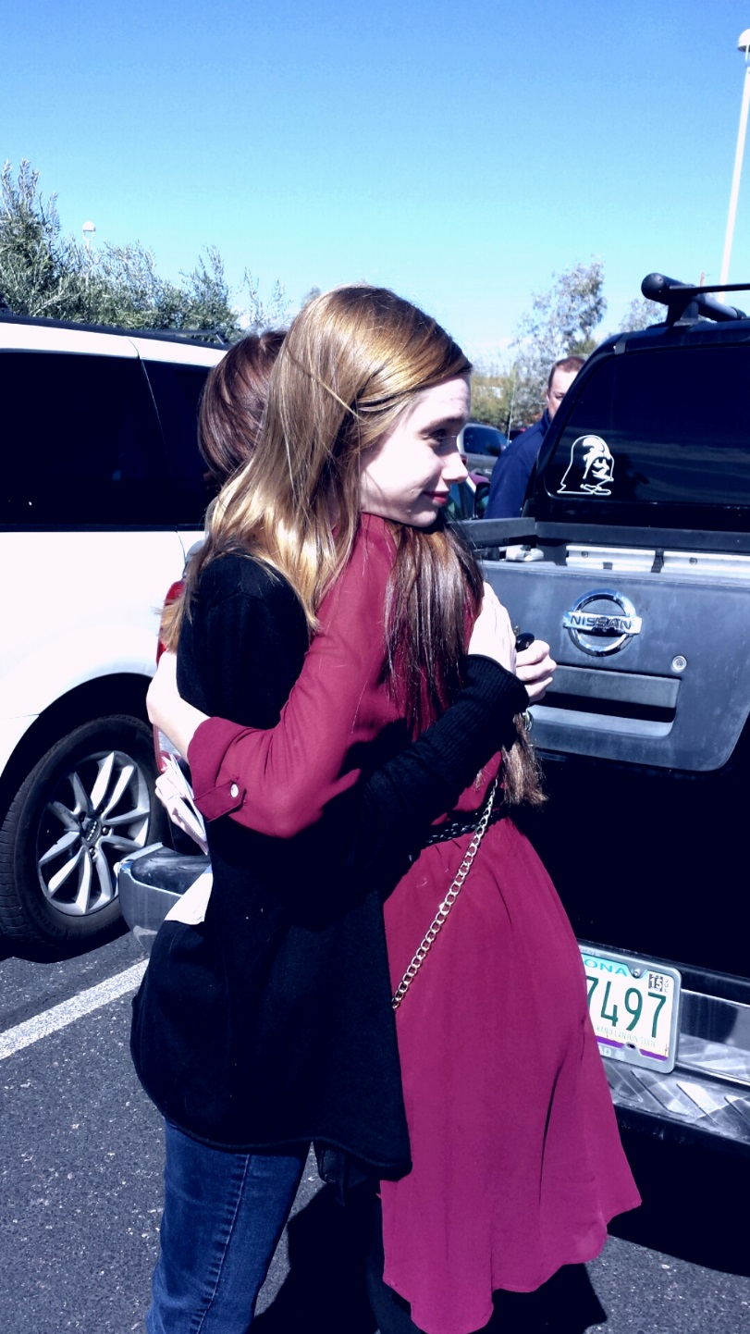
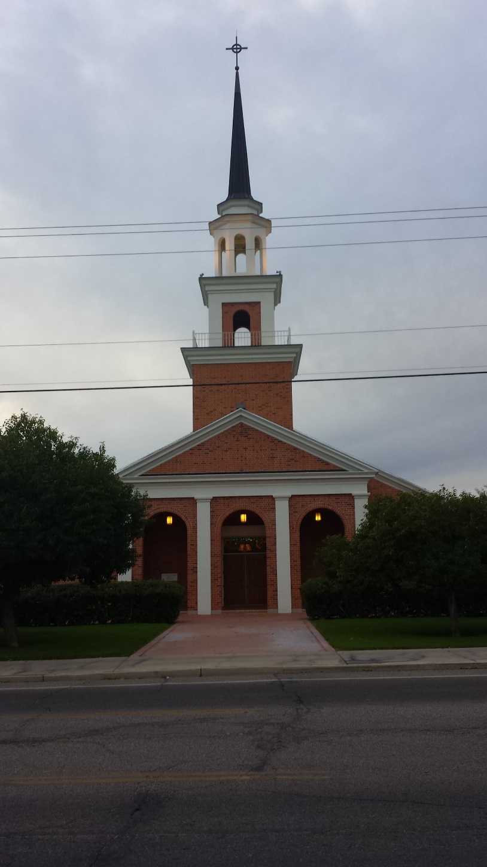
Images from a high PEF participant

Slide 16

Image from a high NEF participant

Slide 17
Virtue Assessments
Previously validated
  Hope Scale, Subjective Vitality Scale
Behaviors
  Local charities, volunteering
Open-ended questions
Novel concepts and measures

Slide 18
Challenges
Integration of qualitative and quantitative data
RESPONSE: Ongoing dialogue
Can “temporary” EF changes truly affect virtue?
RESPONSE: The power of minor situational forces

Slide 19
Impacts
Deeper understanding of the role of affect in selfhood and virtue
Illumination of changes in the capacity for virtue across the lifespan
Positive change in the lives of older adults

Slide 20
Thank you!
Daniel Sullivan, University of Arizona swolf22@email.arizona.edu
Achim Stephan, University of Osnabrück achim.stephan@uni-onsabrueck.de

