Slide 1
Troubleshooting Electronic Resources
Kirsten davis, application administrator
University of Central Oklahoma
Notes:
First Nations acknowledgement: This event is taking place on Osage, Caddo, Chickasaw, and Muscogee land.
Show of hands: Where’s your primary responsibility? (serials, cataloging, acquisitions, R&I, circulation, systems, administration)
Mine: Currently systems (app admin for Alma and Primo; config file for EZProxy; Help email primary contact). Former Serials & E-Res; acquisitions before that. Have dealt with a lot of systems.

Slide 2
Some systems:
Aggregator database
Journal package subscription
Link resolver
Proxy server
The places where systems touch is where the highest likelihood of error occurs.
Notes:
[NTS: Check that everyone know what the latter two are.]
These (plus others) are all individual systems with which we/our patrons interact. The points at which they touch are where we find errors. You do NOT have to be intimately familiar with all the systems in order to recognize and communicate errors.
Let me repeat that: You do NOT have to be intimately familiar with All The Systems in order to recognize and communicate errors.

Slide 3
If you can’t fix it, report it.
Know your limits (access, expertise, time)
Notes:
Some of you (like me) will need to be concerned with fixing errors sometimes, but most of us, most of the time, will be best served if we can accurately and thoroughly convey what we’ve found to the person/s responsible for error-fixing.
If you don’t have access to the right systems to fix the problem, or the right expertise, or enough time to get the expertise, then leave it to someone else. Especially if you’re paying them!

Slide 4
Some errors:
Straightforward
Complex
Mix
Is it borked or is it broken?
Notes:
1. Straight-forward errors: Borked. Usually single system. Relatively simple to test/report (tho not necessarily to fix).
Internet outage (building/campus, OneNet)
System outage (404-type errors)
URL change (http→https; proxy needs updated)
2. Complex errors: Broken in this case. Multiple systems; more time to test/write up.
Mis-matches (a single abstract w/in conference proceeding; wrong citation)
Erroneous data (incorrect indexing; issue 2 digitized as issue 3)
Data structure (pkg we paid for [Gale] isn’t in link resolver)

Slide 5
Diagnosis:
Down for everyone?
Whose error is it?
What does it tell you?
Is it consistent?
Test, retest, use the test against itself
Notes:
How do you diagnose an error?
Down for everyone? (or just you)—is it repeatable? [how big/urgent]
Whose error is it (your proxy vs. the journal vendor’s website) [who you’ll report it to]
If there’s an error message, what does it say? (like using the test against itself) [documenting]
What happens when you try variations? (different browser, for ex.) [documenting]
Match against known-to-you situations (refer to other cases specifically, if possible) [reporting]
Especially if using a ticketing system. Saying “looks similar to X which is being handled by Suzie” can help greatly.
Note that these steps aren’t necessarily linear! And can most definitely be recursive if the error is big/widespread.

Slide 6
Tips:
Start somewhere
Document everything
Let go of what you can’t fix
Know how to report and to whom
Be thorough but not obsessive
Notes:
Pick a thread and start. You’ll learn by doing, and there’s very little that you’ll be able to irreversably break.
Fix what’s in your purview, but don’t spend a lot of time and energy on what you can’t fix. Know when to let go.
Document everything (screenshots within narrative/description). This document will be your friend when you need to revisit the case. Especially if the vendor’s response doesn’t include your original communication (EBSCO).
Generally speaking, it’s better to report to one vendor at a time if you’re unsure which vendor is causing an error. (sometimes the process of troubleshooting can cause more errors)
If you need to track your error reports, BE CONSISTENT and put them all in one place. If you’ve got a ticketing system, great. If not, use any means that will work for you (Excel spreadsheet; Kanban board; notebook)

Slide 7
Questions so far?
Yes, I’m getting to the practical stuff
Notes:
From here on out, it’s a discussion. The slides are just to give us examples.

Slide 8
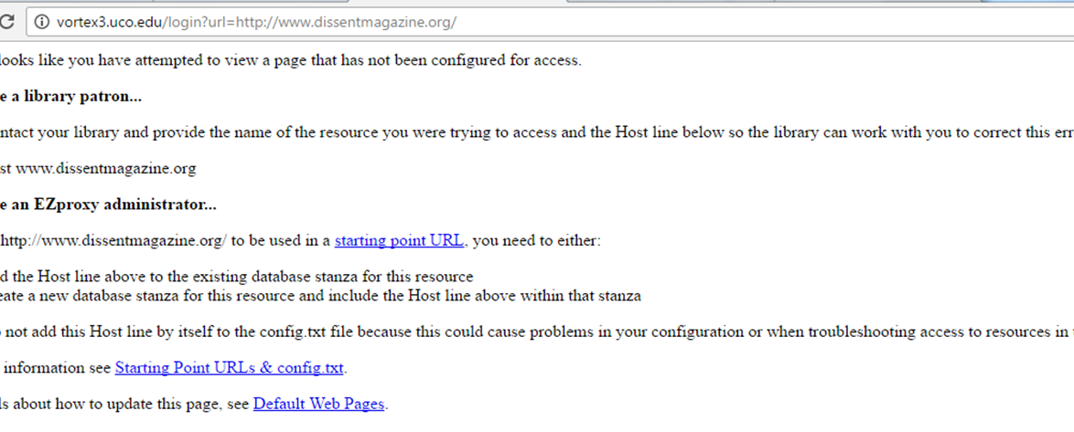
Proxy problems
Notes:
Down for everyone?
Whose error is it?
What does it tell you?
Is it consistent?
Fix: Report to whoever handles the proxy config file for your library.
Other proxy errors you’ve seen?

Slide 9
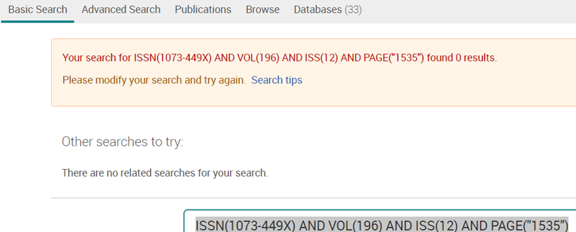
How would you approach this?
Notes:
[looking for: ways they would determine why the citation got no result from the database]
Actual situation: Student-reported error. Citation: A Multicenter Randomized Controlled Trial of Zephyr Endobronchial Valve Treatment in Heterogeneous Emphysema (TRANSFORM). Kemp et. al. American journal of respiratory and critical care medicine, 15 December 2017, Vol.196(12), pp.1535-1543
Going into database via Journal Lookup, get a list of vol/issues available. December 15, 2017 was missing. Checked journal publisher’s website, and citation was correct (issue existed, and the article within it). Reported to database vendor (they had rest of issues through 1 Feb 2018, so that one was just skipped somehow).

Slide 10
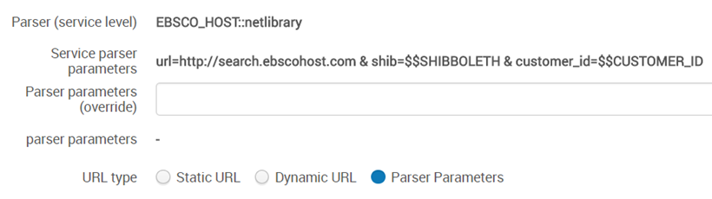
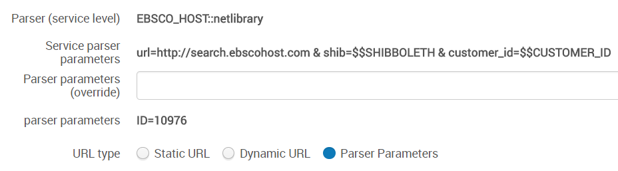
Which one works? Why?
Notes:
Situation: A perpetual purchase ebook has two portfolios, both linking to the same place. One works as expected, the other gets an (unhelpful) error on the ebook vendor’s page.
[wait for them to see it]
Answer: When there are two links but one’s broken, look for differences. In this case, the missing parser parameter in the left-hand picture is what’s causing the link to fail. Needs a unique ID (in EBSCO’s case, the ebook parser parameters are the same as EBSCO’s accession number, so it’s fairly simple to find a missing one and fix/report.)

Slide 11

The problem with supplements
THE PRECISION OF VIRTUAL PELVISES DERIVED FROM CLINICAL CT-IMAGES FOR FORENSIC ANTHROPOLOGY
Colman, Kl ; Dobbe, Jgg ; Stull, Ke ; Ruijter, Jm ; Oostra, Rj ; Van Rijn, Rr ; Van Der Merwe, AE ; de Boer, Hh ; Streekstra, Gj
Forensic Science International, 2017 Aug, Vol.277 Suppl 1, pp.92-93
Notes:
Does anyone know what’s going on here?
Situation: Web of Science has indexed presentation/poster abstracts as individual articles. However, the publisher sees them as a single publication—indexing at the issue level. One single PDF (p1-257) so the citation’s linking URL will break because of pp92-93 (if nothing else).

Slide 12

Here’s a fun one
Notes:
Looks pretty normal, but when you click over to Sage…
(source is Web of Science, BTW, though not related to previous)

Slide 13
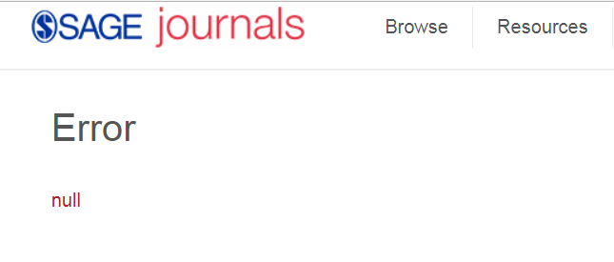
Ooops
http://journals.sagepub.com/openurl?rft.issn=0033-2941&rft.volume=105&rft.spage=1283&rft.atitle=The+theoretical+foundations+of+principal+factor+analysis%2C+canonical+factor+analysis+and+alpha+factor+analysis+(vol+23%2C+pg+1%2C+1970)&rft.genre=article&rft.date=2009&url_ver=Z39.88-2004&rft.issue=3
Notes:
But wait. Why are there two years in that URL?
If you go in via the citation, you find…

Slide 14
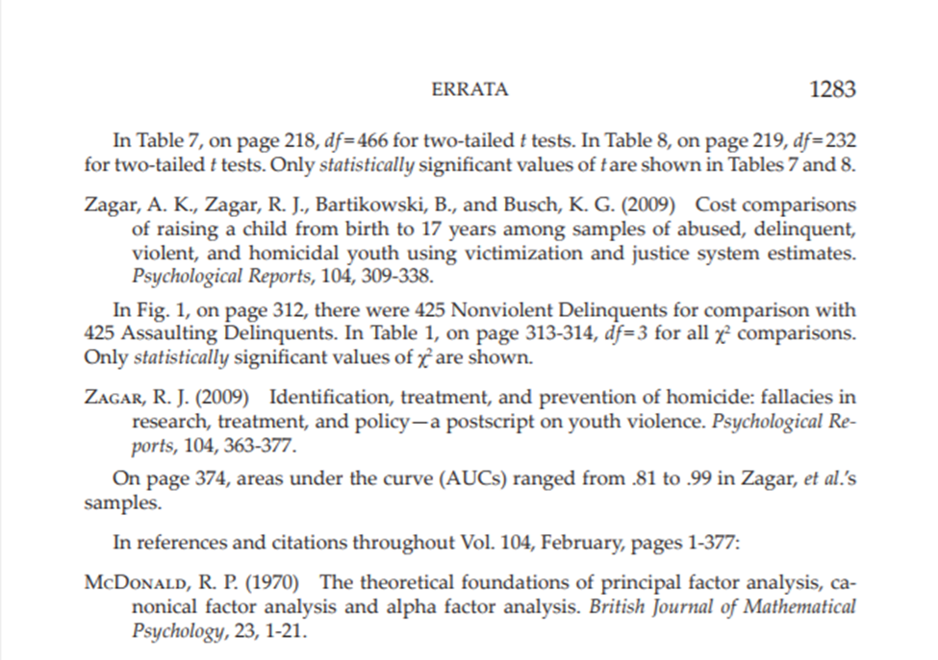
Errors all the way down
Issue is incorrect (not #3, but #3S)
The page number gets you to the errata page, which includes →
Notes:
Not only did someone index a citation as if it were an article, but they did so out of a list of errata.
Also, the page number on the original citation was the give-away that the issue number was wrong (#3 stops at p994).
Not going to get World of Science (or any vendor) to change how they index—not that that keeps me from complaining about it when I have the chance! But I do usually report incorrect metadata like the issue number being off.

Slide 15
IP issues
Q: How can you tell when an IP range is registered to the wrong institution? Or not at all?
A: Branding is a good clue.
Notes:
A few easy ones…

Slide 16
Knowledge Base woes
Problems:
Coverage dates
Package titles
Changed URLs
Solution:
Report to Vendor
Notes:
Most of the time, it’s better to report KB problems to the KB vendor. This way it gets fixed for everyone.

Slide 17
Questions?

Slide 18
Thank you!
Contact Kirsten: sdavis63@uco.edu

