Slide 1
“Big Storage, Little Budget”
Kyle Hutson
Adam Tygart
Dan Andresen

Slide 2
Background
Previously using glusterfs
Running out of disk space
Used Ceph for ~1.5 years for backup space
Notes:
Describe Glusterfs array

Slide 3
About Ceph
Primarily Object Storage
Grown from Sage Weil’s PhD thesis on storage systems
Baseline:
  RADOS (“reliable, autonomous, distributed object store”)
  CRUSH maps (“controlled replication under scalable hashing”)

Slide 4
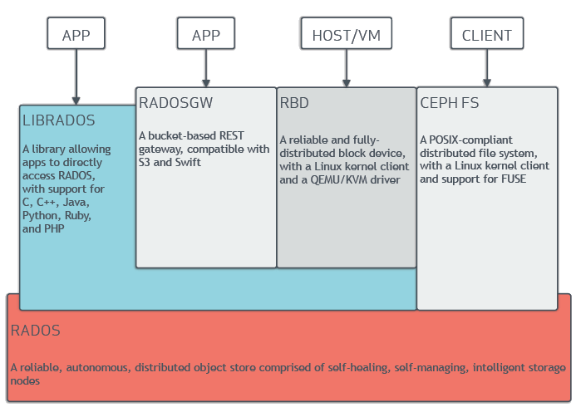
About Ceph (continued)

Slide 5
Ceph Daemons
OSD (“object storage device”) – usually an entire disk, but can use a partition. Where the data is saved. It is also a daemon which client computers can talk to.
Monitor – a daemon that talks to clients and keeps track of the CRUSH map and where data is located
MDS – Metadata server – a daemon which keeps track of CephFS metadata

Slide 6
Our Hardware
(24) Dell R730xd servers, each with
  (2) E5-2650L (12-core) CPUs
  (12) 6 TB HDDs
  (4) 4 TB HDDs
  (Total of 88 TB HDDs/server)
  (2) 480 GB SSDs
  128 GB RAM
Cost: $300,000
Raw Storage: 2.1 PB

Slide 7
Cool Concepts
Erasure Coded Pools
Cache Tiering
CephFS
Scalability
Very fast metadata – active/passive currently with active/active promised
CRUSH hierarchy
Notes:
As always, the devil is in the details

Slide 8
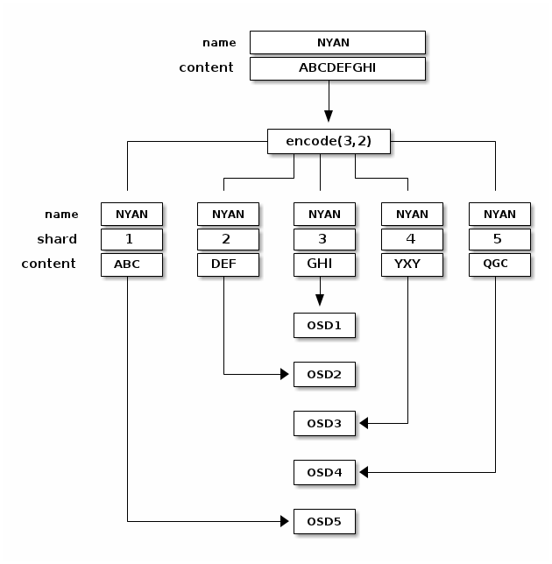
Cool Concepts – Erasure coding

Slide 9
Timeline
January: Hardware arrives, we begin playing
  Erasure coding with cache tiers
May: First attempt to cutover
July: Actual cutover
Present: Still fighting performance issues

Slide 10
Final configuration
Erasure coding with m=8, k=4
~1.3 PB usable disk space
Journals on OSD (HDDs)
Metadata on SSDs
Cache on HDDs

Slide 11
Future plans
Multi-site archive
Hadoop

Slide 12
Advice for the reader
Get guidance on your proposed hardware
  ‘ceph-users’ mailing list or on IRC
Don’t skimp on quality of SSDs
Cache tier sizing
Testing, testing, testing

