Slide 1





Oklahoma Science, Technology, Engineering, and Mathematics (STEM) Mentorship Program

Slide 2
What is the OITMP?
The Oklahoma STEM Mentorship Program is an educational outreach connecting networking professionals from OU, OneNet, and other institutions with students in the technology field.
It is part of an NSF grant to enhance Oklahoma’s educational and research capability through network improvements.
http://www.oscer.ou.edu/ostemmp.php
2

Slide 3
Job Shadowing
The goal:
IDENTIFY, DEVELOP and RECRUIT Talent
Activities include:
  Presentations to students throughout OK
  Job shadowing opportunities (on-site & virtual)
http://www.oscer.ou.edu/ostemmp.php
3

Slide 4
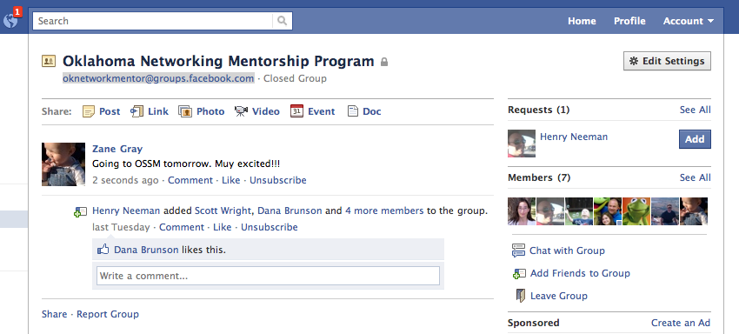
Job Shadowing
On-Site
  Schedule a time with us to see what we do!
Virtual
  e-mail us at network@ou.edu (OU IT Network Team)
  Facebook: oknetworkmentor@groups.facebook.com
http://www.oscer.ou.edu/ostemmp.php
4

Slide 5
Other Opportunities/Resources
Jobs at OU
  http://jobs.ou.edu
Jobs at OneNet
  http://www.okhighered.org/job-opportunities/
http://www.oscer.ou.edu/ostemmp.php
5

Slide 6
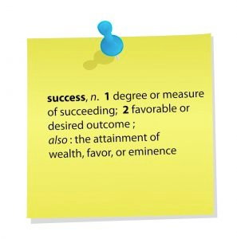
About This Presentation
What do I do in the IT field?
Lessons learned for getting this job.
Recommendations for keeping the job.
Being successful in this field.
http://www.oscer.ou.edu/ostemmp.php
6

Slide 7

About This Presentation (cont.)
(But not this time…)
[Cyber Security]
Things that keep
Me awake at night…
http://www.oscer.ou.edu/ostemmp.php
7

Slide 8

Number 5…
The Users…
http://www.oscer.ou.edu/ostemmp.php

Slide 9

Number 5…
The Users…
http://www.oscer.ou.edu/ostemmp.php

Slide 10
Number 5…
The Users…
Only has a computer because a grandchild gave it to him
Assumes all e-mails are legitimate
Typically a member of several botnets
Too intimidated
to ask questions
http://www.oscer.ou.edu/ostemmp.php

Slide 11
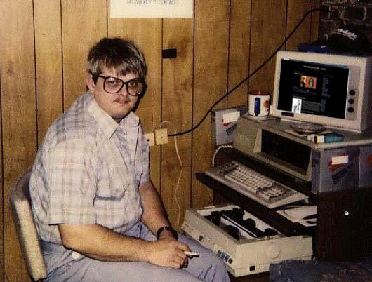
Number 5…
The Users…
Too intimidated
to ask questions
http://www.oscer.ou.edu/ostemmp.php

Slide 12
Number 5…
The Users…
Extremes
Fluent in at least three languages, including Klingon, Gallifreyan, and the binary language of moisture vaporators.
Devorkian keyboard layout.
Member of a local Cyber Security club.
Calls Help Desks to let them know what is wrong.
http://www.oscer.ou.edu/ostemmp.php

Slide 13
Number 5…
The Users…
Too intimidated
to ask questions
Calls Help Desks
to let them know
what is wrong
http://www.oscer.ou.edu/ostemmp.php

Slide 14
Number 5…
The Users…
Too intimidated
to ask questions
Calls Help Desks
to let them know
what is wrong
The rest of us…
http://www.oscer.ou.edu/ostemmp.php

Slide 15
Number 5…
The Users…
Too intimidated
to ask questions
Calls Help Desks
to let them know
what is wrong
The rest of us…
AKA:
“ID10T”
“Loose nut between keyboard and chair”
http://www.oscer.ou.edu/ostemmp.php

Slide 16
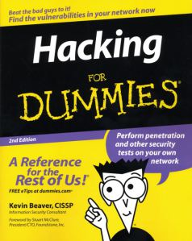
Number 5…
User education is important!!!
http://www.oscer.ou.edu/ostemmp.php

Slide 17
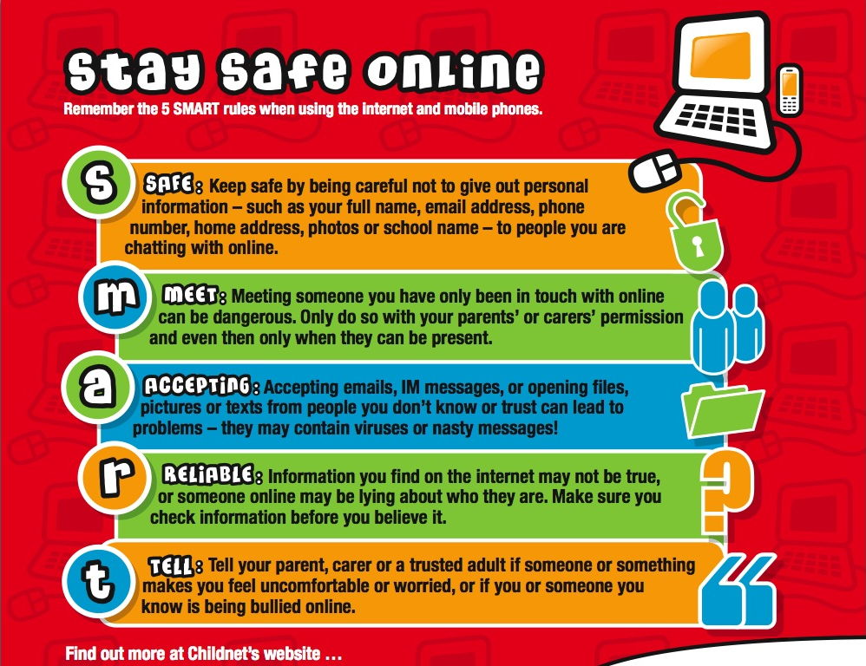
Number 5…
User education is important!!!
http://www.oscer.ou.edu/ostemmp.php

Slide 18

Number 4…
“Expectation” vs. “Reality”
Example: The “firewall”…
http://www.oscer.ou.edu/ostemmp.php

Slide 19

Number 4…
The “Firewall”… (or: “User Expectations”)
Internet
Users assume that there is a “firewall” between them and the Internet.
http://www.oscer.ou.edu/ostemmp.php

Slide 20
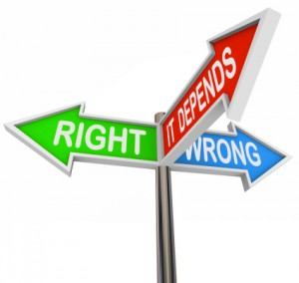


Number 4…
The “Firewall”… (or: “User Expectations”)
Internet
EXPECTATION: This “firewall” is a “morality filter” that separates the “good” from the “bad”.
http://www.oscer.ou.edu/ostemmp.php

Slide 21
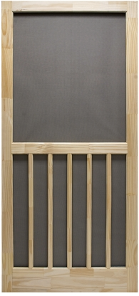
Number 4…
The “Firewall”… (or: “User Expectations”)
Internet
REALITY: IT knows that firewalls are just a “screen door”.
http://www.oscer.ou.edu/ostemmp.php

Slide 22
Number 4…
“Expectation” vs. “Reality”
Firewall is just one example…
IT is watching everything that I do…
Wireless is available everywhere for free…
My antivirus software can clean up anything…
What works at home should work in the corporation…
http://www.oscer.ou.edu/ostemmp.php

Slide 23
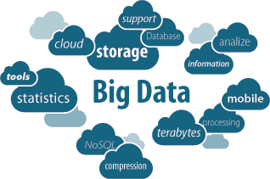
Number 3…
Governance and “Big Data”
http://www.oscer.ou.edu/ostemmp.php

Slide 24
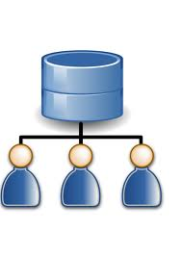
Number 3…
Governance and “Big Data”
Active Directory
http://www.oscer.ou.edu/ostemmp.php

Slide 25
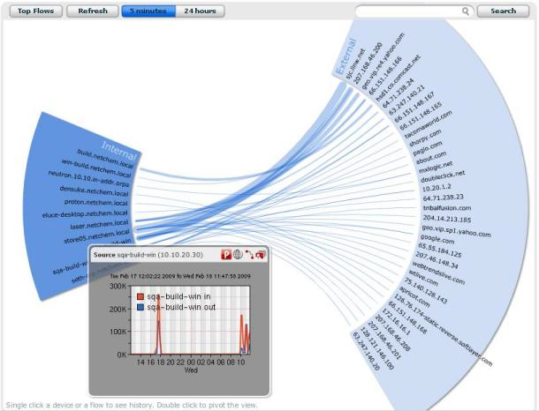
Number 3…
Governance and “Big Data”
Active Directory
NetFlow Data
http://www.oscer.ou.edu/ostemmp.php

Slide 26

Number 3…
Governance and “Big Data”
Active Directory
MAC Address
Database
NetFlow Data
http://www.oscer.ou.edu/ostemmp.php

Slide 27
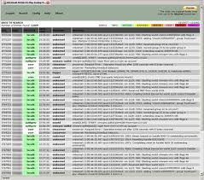
Number 3…
Governance and “Big Data”
Active Directory
MAC Address
Database
Syslog Data
NetFlow Data
http://www.oscer.ou.edu/ostemmp.php

Slide 28
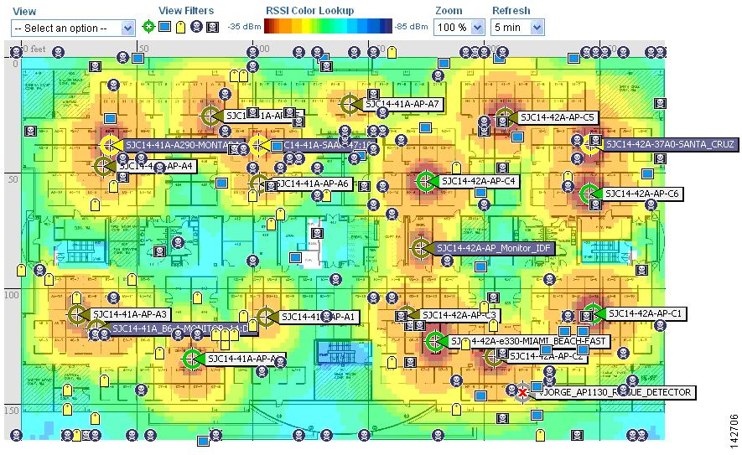
Number 3…
Governance and “Big Data”
Active Directory
MAC Address
Database
Wireless Location
Syslog Data
NetFlow Data
http://www.oscer.ou.edu/ostemmp.php

Slide 29
Number 3…
Governance and “Big Data”
Independently, these are “benign”.
Tie them together, and you may create privacy concerns!
Worse yet, who watches the watchmen?
http://www.oscer.ou.edu/ostemmp.php

Slide 30

Number 2…
Next Generation Networking
http://www.oscer.ou.edu/ostemmp.php

Slide 31

Number 2…
Next Generation Networking
http://www.oscer.ou.edu/ostemmp.php

Slide 32
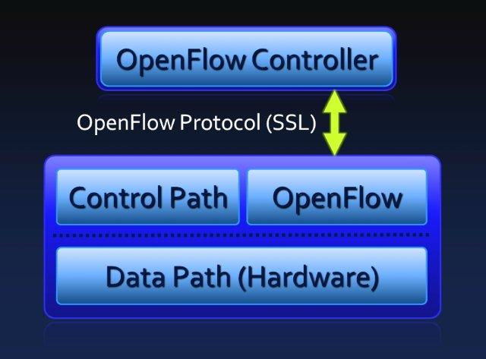
Number 2…
Next Generation Networking
SDN
http://www.oscer.ou.edu/ostemmp.php

Slide 33

Number 2…
Next Generation Networking
Cloud Computing
SDN
http://www.oscer.ou.edu/ostemmp.php

Slide 34
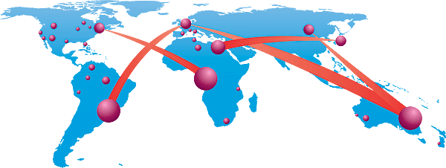
Number 2…
Next Generation Networking
Circuit-Based Networking
Cloud Computing
SDN
http://www.oscer.ou.edu/ostemmp.php

Slide 35
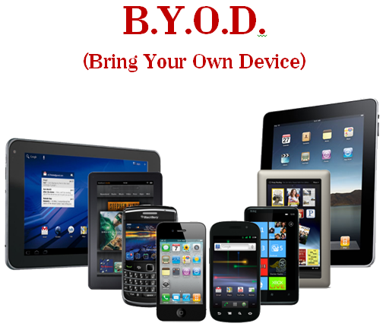
Number 2…
Next Generation Networking
Circuit-Based Networking
Cloud Computing
SDN
http://www.oscer.ou.edu/ostemmp.php

Slide 36

Number 2…
Next Generation Networking
Security Policies have yet to be developed!
http://www.oscer.ou.edu/ostemmp.php

Slide 37
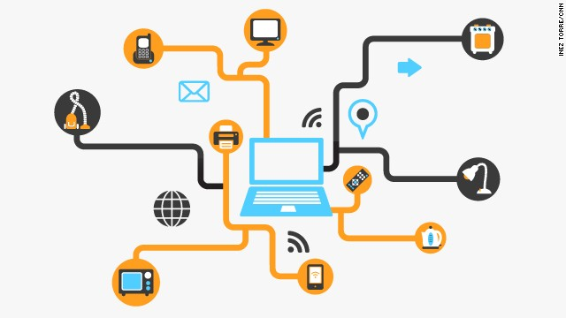
Number 1…
Internet of “things”…
http://www.oscer.ou.edu/ostemmp.php

Slide 38
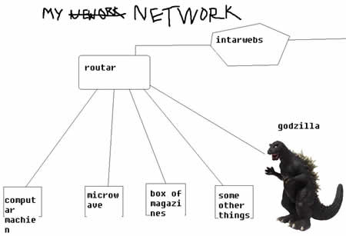
Number 1…
Networks used to be simple:
http://www.oscer.ou.edu/ostemmp.php

Slide 39
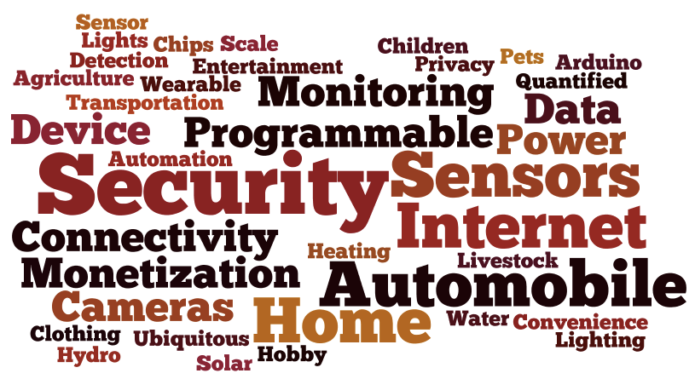
Number 1…
Now everything is network attached:
http://www.oscer.ou.edu/ostemmp.php

Slide 40

Number 1…
But what about the “protocols” used?
http://www.oscer.ou.edu/ostemmp.php

Slide 41

Number 1…
But what about the “protocols” used?
http://www.oscer.ou.edu/ostemmp.php
Location

Slide 42

Number 1…
But what about the “protocols” used?
Over-the-air
transmission
http://www.oscer.ou.edu/ostemmp.php
Location

Slide 43
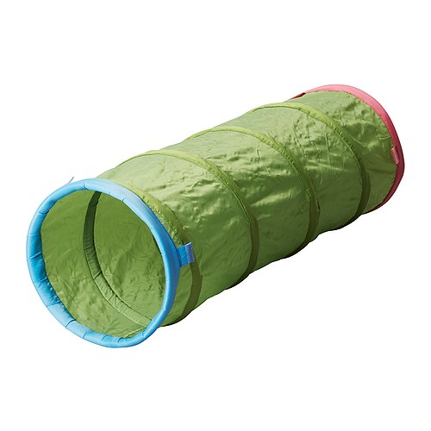
Number 1…
But what about the “protocols” used?
Tunneling
Over-the-air
transmission
http://www.oscer.ou.edu/ostemmp.php
Location

Slide 44

Number 1…
But what about the “protocols” used?
Tunneling
Over-the-air
transmission
Firewall Traversal
http://www.oscer.ou.edu/ostemmp.php
Location

Slide 45
Number 1…
But what about the “protocols” used?
Users assume that the devices that they
connect to are both KNOWN and TRUSTWORTHY!
http://www.oscer.ou.edu/ostemmp.php

Slide 46

If you got ‘em, ask ‘em!

Slide 47
Evaluation Time!
Please take a moment to fill out the evaluations…
or NOT! The evaluations are completely optional!
No personal or personally identifiable data is collected.
Data is used by the grant providers to gauge success.

Slide 48

The End (about time too…)
(and now for Chris Mallow…)

