Slide 1
Self-Control
The Linking of Self, Motivation, and Virtue
Jen Cole Wright, Psychology
Thomas Nadelhoffer, Philosophy
Daniela Goya-Tocchetto, Philosophy & Economics
Amy Langville, Mathematics
College of Charleston
Noel Struchiner, Law
Pontifical Catholic University of Rio de Janeiro, Brazil

Slide 2
What the project is and why it matters.

Slide 3
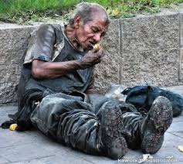
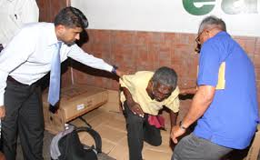
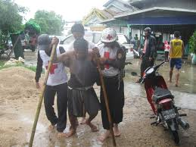
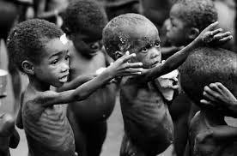
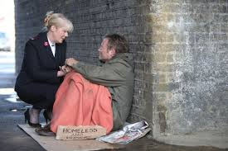
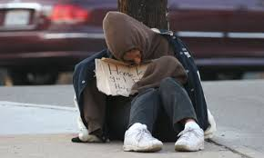
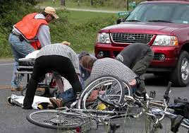
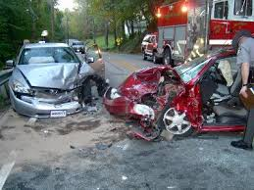
What the project is and why it matters.
Everywhere, we are surrounded by virtue-relevant stimuli
What leads to
virtue-appropriate responses?
Notes:
The details may differ for different virtues (compassion, bravery, honesty, generosity) but the problem is the same.

Slide 4
What the project is and why it matters.
virtue-relevant stimuli
cognitive states
virtue-appropriate responses
motivational states
affective states
  Creates normative pressure for internal “integrity”
Increase cross-situational consistency of responses
Increase salience of VRS
Determine whether response are virtuous
Notes:
In response to VRS, people have a variety of relevant beliefs, hopes, emotions – some inclining them towards virtuous responses, others not. In order to make those responses typical and consistent, they must be linked together and aligned with virtue-relevant motivational states.

Slide 5
What the project is and why it matters.
virtue-oriented
self identity
commitments
virtue-relevant stimuli
virtue-appropriate responses
goals
values
desires
narrative structure
Notes:
These motivational states come in many different forms – at the most basic level, our specific desires, which become values, goals, and then at the highest level, generalized commitments to being certain kinds of people – people who do the right thing in the right way for the right reason. These motivational states become incorporated into people’s self-identities and even more broadly, their life narratives.

Slide 6
What the project is and why it matters.
virtue-oriented
Everywhere, we are surrounded by virtue-relevant stimuli
What leads to
virtue-appropriate responses?
We will identify and understand the motivational structure that
links perception of VRS with VAR.
Dispositional structure of moral character
Notes:
The integration of different levels of motivational states, linked with a person’s cognitive and affective states, form the dispositional structure of moral character.

Slide 7
Methodology and deep integration.

Slide 8
Methodology and deep integration.
Objective 1: Develop measures that provide insight into the underlying motivational structure involved in the development and expression of virtue and the cultivation of virtuous character.
  Existing self-regulatory measures
    self-control, delayed gratification, impulse control, will-power, executive function, locus of control, intentional self-regulation, etc.
  Virtue-oriented values/goals and self-identity
    * explicit vs. implicit * abstract vs. concrete
    * short-term vs. long-term * essential (core) vs. tangential
    * intrinsic vs. instrumental * actual vs. ideal
    * effortful vs. automatic * self vs. other oriented
Notes:
Here we will use of mixture of self-report and other-report methodologies, daily diaries and ESM.

Slide 9
Methodology and deep integration.
Objective 1: Develop measures that provide insight into the underlying motivational structure involved in the development and expression of virtue and the cultivation of virtuous character.
  Existing self-regulatory measures
    self-control, delayed gratification, impulse control, will-power, executive function, locus of control, intentional self-regulation, etc.
  Virtue-oriented values/goals and self-identity
    * explicit vs. implicit * abstract vs. concrete
    * short-term vs. long-term * essential (core) vs. tangential
    * intrinsic vs. instrumental * actual vs. ideal
    * effortful vs. automatic * self vs. other oriented
Notes:
Here we will use of mixture of self-report and other-report methodologies to examine what they say vs. what they actually spend their time doing

Slide 10
Methodology and deep integration.
Objective 1: Develop measures that provide insight into the underlying motivational structure involved in the development and expression of virtue and the cultivation of virtuous character.
  Existing self-regulatory measures
    self-control, delayed gratification, impulse control, will-power, executive function, locus of control, intentional self-regulation, etc.
  Virtue-oriented values/goals and self-identity
    * explicit vs. implicit * abstract vs. concrete
    * short-term vs. long-term * essential (core) vs. tangential
    * intrinsic vs. instrumental * actual vs. ideal
    * effortful vs. automatic * self vs. other oriented
Notes:
Chronic accessibility, measured in terms of order and speed.

Slide 11
Methodology and deep integration.
Objective 1: Develop measures that provide insight into the underlying motivational structure involved in the development and expression of virtue and the cultivation of virtuous character.
  Existing self-regulatory measures
    self-control, delayed gratification, impulse control, will-power, executive function, locus of control, intentional self-regulation, etc.
  Virtue-oriented values/goals and self-identity
    * explicit vs. implicit * abstract vs. concrete
    * short-term vs. long-term * essential (core) vs. tangential
    * intrinsic vs. instrumental * actual vs. ideal
    * effortful vs. automatic * self vs. other oriented
Notes:
Inspired by Strominger & Nichols “essential moral self”

Slide 12
Methodology and deep integration.
Objective 1: Develop measures that provide insight into the underlying motivational structure involved in the development and expression of virtue and the cultivation of virtuous character.
  Existing self-regulatory measures
    self-control, delayed gratification, impulse control, will-power, executive function, locus of control, intentional self-regulation, etc.
  Virtue-oriented values/goals and self-identity
    * explicit vs. implicit * abstract vs. concrete
    * short-term vs. long-term * essential (core) vs. tangential
    * intrinsic vs. instrumental * actual vs. ideal
    * effortful vs. automatic * self vs. other oriented
  The connection between general and virtue-oriented self-regulation

Slide 13
Methodology and deep integration.
virtue-relevant stimuli
general
self-regulation
virtue- appropriate responses
virtue-oriented
regulation
VARs become less effortful and more robust and automatic because the regulatory mechanisms become embedded in virtue-oriented values/goals and identity.

Slide 14
Methodology and deep integration.
Objective 2: Examine the role of personal narratives in generating motivational structures that advance virtue expression and development.
narrative
structure
Attitudes* about Others
Attitudes* about World
Attitudes* about Self
Provides:
  organization
  meaning
  reasons
*range of cognitive, affective, motivational states

Slide 15
Methodology and deep integration.
Objective 2: Examine the role of personal narratives in generating motivational structures that advance virtue expression and development.
  We will explore the role of narratives in virtuous activity
    Perception of virtue-relevant stimuli
    Engagement in virtue-appropriate responses
  Are there different roles for different narratives?
    actual vs. fictional
    self vs. other oriented
    past vs. future anchored
  Usefulness of different methodologies?
    controlled experimental design vs. naturalistic observations
    computational textual analysis
      Uncover narrative features of hi/low virtue-oriented regulation
Notes:
Using daily diaries and other, shorter writing prompts, we will explore the relationship between people’s personal narratives – how they think about themselves, other people in their lives, the larger world around them – and their scores on the virtue-oriented values/goals and identity measures. We could also introduce measurements of virtue-oriented responses (through ESM). These narratives can be past, present, and future oriented.
Narratives could be coded for a variety of characteristics: level of virtue-orientedness, but also redemptive vs. contaminative, optimistic vs. pessimistic, self vs. other focused.

Slide 16
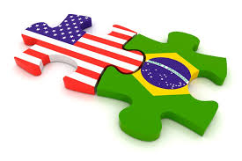
Methodology and deep integration.
Objective 3: Examine these relationships cross-culturally between the US and Brazil.
In a recent World Value Survey (2005-2009) people were asked how much control over, and choice in, their lives they possessed.
1% of Brazilians and 17% of Americans stated that they have “a great deal of choice” over how their lives turned out
75% of Brazilians and 30% of Americans stated that luck determines income
21% of Brazilians and 39% of Americans stated that poor people are lazy

Slide 17
Methodology and deep integration.
Objective 3: Examine these relationships cross-culturally between the US and Brazil.
Previous research revealed that Brazilians tend to be more collectivist than Americans and tend to prefer less egocentric forms of negotiation and conflict resolution (e.g., Pearson & Stephan 1998)
Haidt and colleagues’ early work on the Moral Foundations was informed by comparative data from Americans and Brazilians.
This collectively suggests that Brazil will be a fruitful place for cross-cultural studies in moral psychology.
In addition, we also have good practical grounds:
  We have collaborators in place who have access to a wide variety of sub-populations in Brazil (e.g., college students vs. residents in favelas).
  We also have collaborators willing to help us translate (and back translate) our materials.

Slide 18
Methodology and deep integration.
Objective 3: Examine these relationships cross-culturally between the US and Brazil.
  We will explore cultural differences at two levels:
    Different self-regulatory mechanisms/capacities may be emphasized/encouraged
    Different kinds of narratives may be generated
  This could lead to different motivational structures
    Different virtues might be more/less likely to develop
    Different constellations of character might result

Slide 19

Methodology and deep integration.
Objective 4: Develop therapeutic narrative exercises to enhance virtue development in applied settings, e.g., local programs (Be-A-Mentor, WINGS) that serve at-risk youth.
Writing Your Way to Happiness (well.blogs.nytimes.com)
  Generating personal narratives can lead to behavioral changes and improve happiness
    Pennebaker, Writing to Heal (2004)
    White & Epston, Narrative Means to
    Therapeutic Ends (1990)
    White, Maps of Narrative Practice (2007)
Explore whether narratives can promote virtue/character development
  College students
  Local “at-risk” youth groups – e.g., WINGS, Be a Mentor
Notes:
Michael White and David Epston

Slide 20
Methodology and deep integration.
Our team includes researchers with backgrounds in economics, law, mathematics, philosophy, and psychology, with proven track records of working across disciplinary boundaries.
  It is an international team, including members from both the US and Brazil.
Members of our team have previously received Templeton funding
  Grants to study humility and free will
  Visiting scholar with the Character Project
Part of a larger project on virtue and character
  Developing a theoretically rigorous, philosophically respectable account
  Able to be empirically operationalized and measured
We are fully committed to working closely together and are well positioned to work productively and openly as an interdisciplinary group.

Slide 21
Anticipated challenges and strategies for response.

Slide 22
Anticipated challenges and strategies for response.
Theoretical
Methodological
Practical

Slide 23
Anticipated challenges and strategies for response.
develop an adequate account of the motivational structure of virtue/character
Methodological
Practical
Notes:
There are a number of theoretical challenges: the first is having a clear theoretical/empirical account of virtue and character (which I’ve been working on with Nancy), which involves a hypothesis about how cognitive/affective/motivational states “hang together”, where the virtue-orientation “seeps in”
getting clear on the different types of self-control/regulation and how they are related

Slide 24
Anticipated challenges and strategies for response.
Theoretical
develop/utilize a range of measurement tools, experimental/naturalistic
Practical
Notes:
Here, there are a number of questions we’ll need to address: how best to “operationalize” and measure virtue/character and all of its underlying components,
We’ve decided against focusing on particular isolated virtues (helping) and so we’ll need strategies for measuring the presence of multiple virtues in values/goals and self-identity
best strategies for measuring self-regulation
balancing the pros/cons of the different methodological strategies – self vs. other report, introspective vs. observational data, one-time vs. longitudinal data, controlled lab vs. naturalistic observation
Ensuring symmetry between US and Brazil sample (translation of measurements, etc.)

Slide 25
Anticipated challenges and strategies for response.
Theoretical
Methodological
develop creative ways to attract participants from various locations/age groups
Notes:
I cannot emphasize enough how much this piece matters for good research. Time and time again, a perfectly well designed study goes to hell because of bad equipment or problems recruiting participants, etc.
We will have a demanding protocol, we will need to come up with reasonably inexpensive and creative ways to implement them, maintain participant integrity, insure high quality data collection, etc.

Slide 26
Self Virtue
How do I become virtuous?
motivational structure
(the link that ties them all together)
← Motivation →
virtue-relevant stimuli
cognitive/affective
states
Questions?
virtue-
appropriate responses

