Slide 1


Personal Projects and the Development of Virtue: How Characteristic Adaptations Enact and Encourage Virtue
Valerie Tiberius, Philosophy
Colin DeYoung and Moin Syed, Psychology
University of Minnesota
Notes:
Mention the fields.

Slide 2
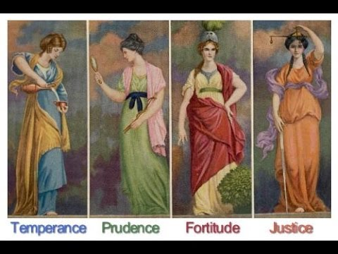
Overview: Well-being, virtue and change
  How are Virtue and Well-Being Related?
  One approach: Does virtue cause subjective well-being?

Slide 3
Overview: Well-being, virtue and change
  How are Virtue and Well-Being Related?
  One approach: Does virtue cause subjective well-being?
  Problem: narrow conception of well-being.

Slide 4
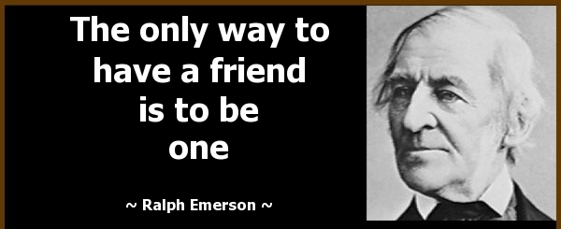
Overview: Well-being, virtue and change
How do the pursuit of personal projects and the cultivation of virtues work together?
  Well-Being: Successful pursuit of certain personal projects is an important component of well-being.
  Virtues: traits or characteristic adaptations; good for the self or others
Notes:
Personal projects such as friendship require virtue to succeed.

Slide 5
Self-Report
Peer-Report
Traits
Virtues
Well-being
CAs
Personal Project Analysis (PPA)
Wave 1
200 Incoming college students
Notes:
Here is what we are doing

Slide 6
Self-Report
Peer-Report
Traits
Virtues
Well-being
CAs
Personal Project Analysis (PPA)
Wave 1
200 Incoming college students
Wave 2
End of
College Year 1
Wave 3
Beginning of College Year 2
Wave 4
End of
College Year 2
Notes:
But we are doing it over time!

Slide 7
Self-Report
Peer-Report
Traits
Virtues
Well-being
CAs
Personal Project Analysis (PPA)
Evidence of Virtue
Wave 1
200 Incoming college students
Wave 2
End of
College Year 1
Wave 3
Beginning of College Year 2
Wave 4
End of
College Year 2
Notes:
We expect normative increases in evidence for virtue mediated by various characteristics of personal projects.

Slide 8
Self-Report
Peer-Report
Traits
Virtues
Well-being
CAs
Personal Project Analysis (PPA)
Future-Authoring Intervention
Evidence of Virtue
Wave 1
200 Incoming college students
Wave 2
End of
College Year 1
Wave 3
Beginning of College Year 2
Wave 4
End of
College Year 2
Notes:
But an intervention!

Slide 9
Self-Report
Peer-Report
Traits
Virtues
Well-being
CAs
Personal Project Analysis (PPA)
Future-Authoring Intervention
Intervention Group
Evidence of Virtue
Control Group
Wave 1
200 Incoming college students
Wave 2
End of
College Year 1
Wave 3
Beginning of College Year 2
Wave 4
End of
College Year 2
Notes:
Probably will facilitate even more

Slide 10
Methodology
How do students’ goals affect how their character develops?
  What are their goals?
  How do they see their goals?
  What makes them more or less successful in the pursuit of these goals?
Notes:
PPA is the right method for answering these questions. It is a method with a lot of virtues; for our purposes the most important are that it’s systemic, personally salient, evocative and temporally sensitive,

Slide 11
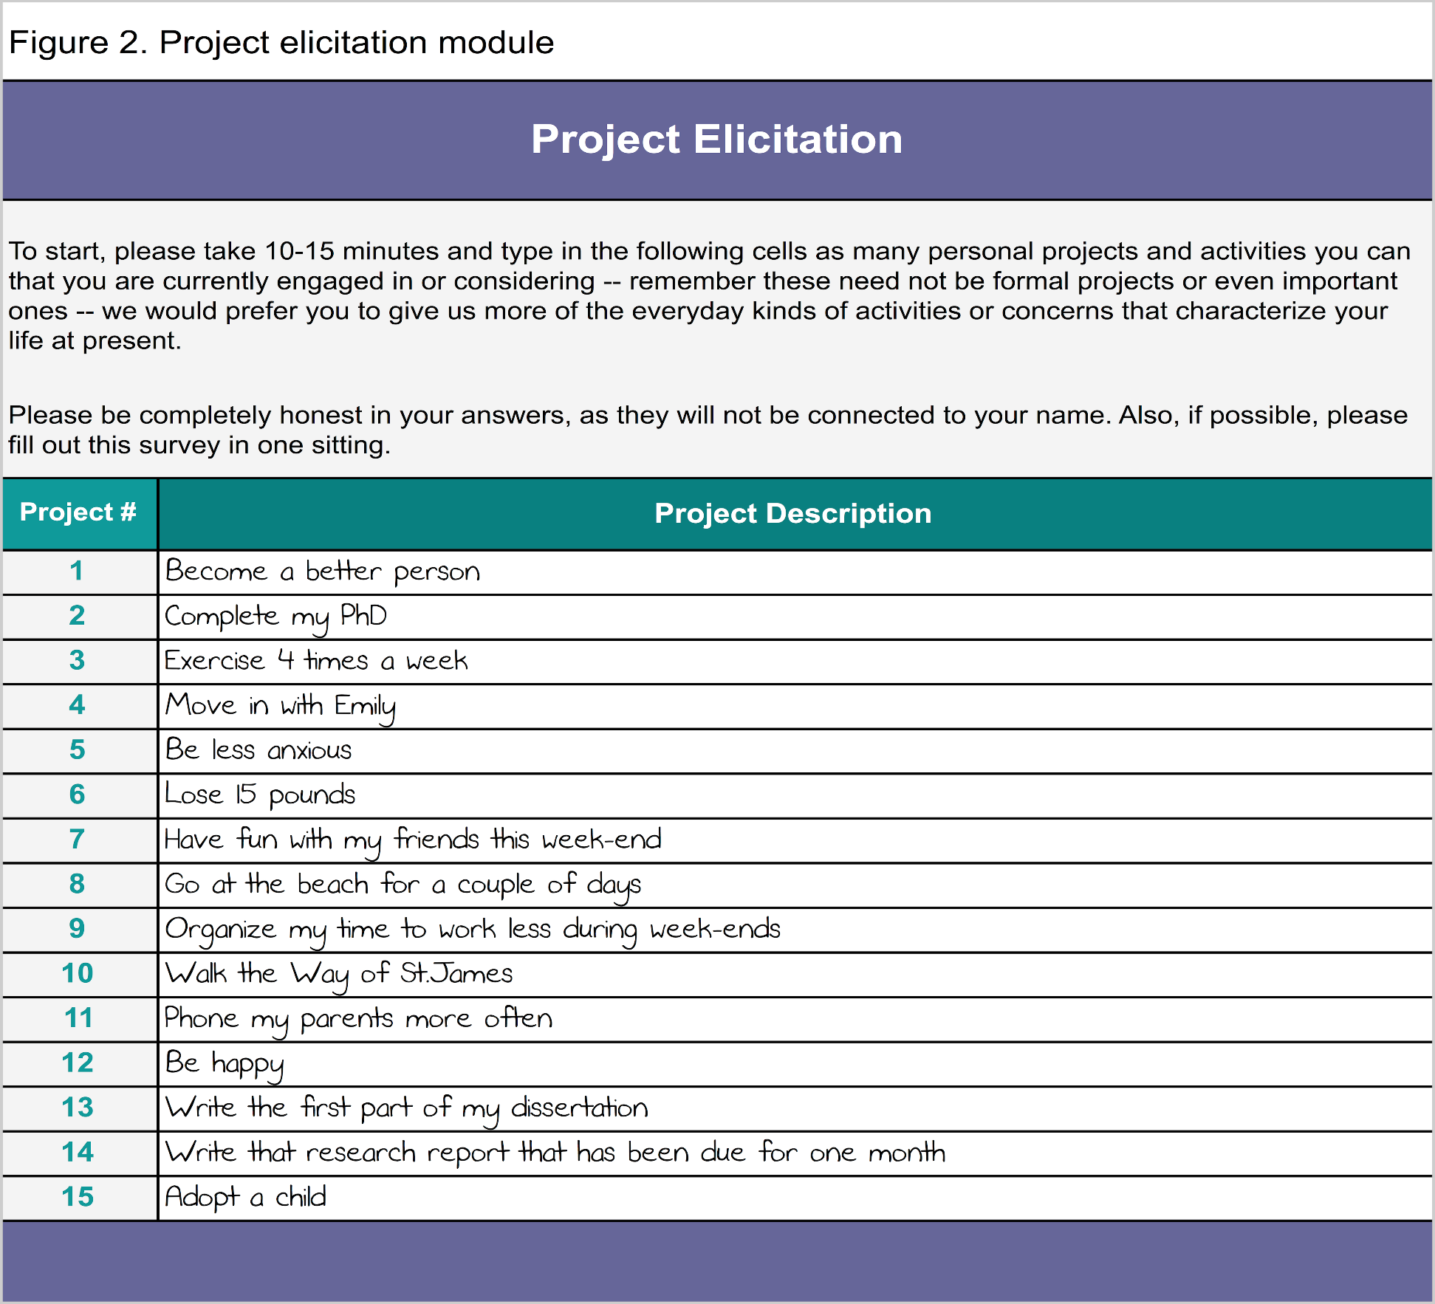
Personal Project Analysis
Stage 1: Project Elicitation
Notes:
PPA is a method that has been designed and tested by Brian Little. It has three major components.
First, project elicitation. What that means is participants are asked to list projects, based on a description of personal projects… These can be fairly specific (like “have fun with my friends this weekend”), or quite grand and subsuming of other projects (like “become a better person”).

Slide 12
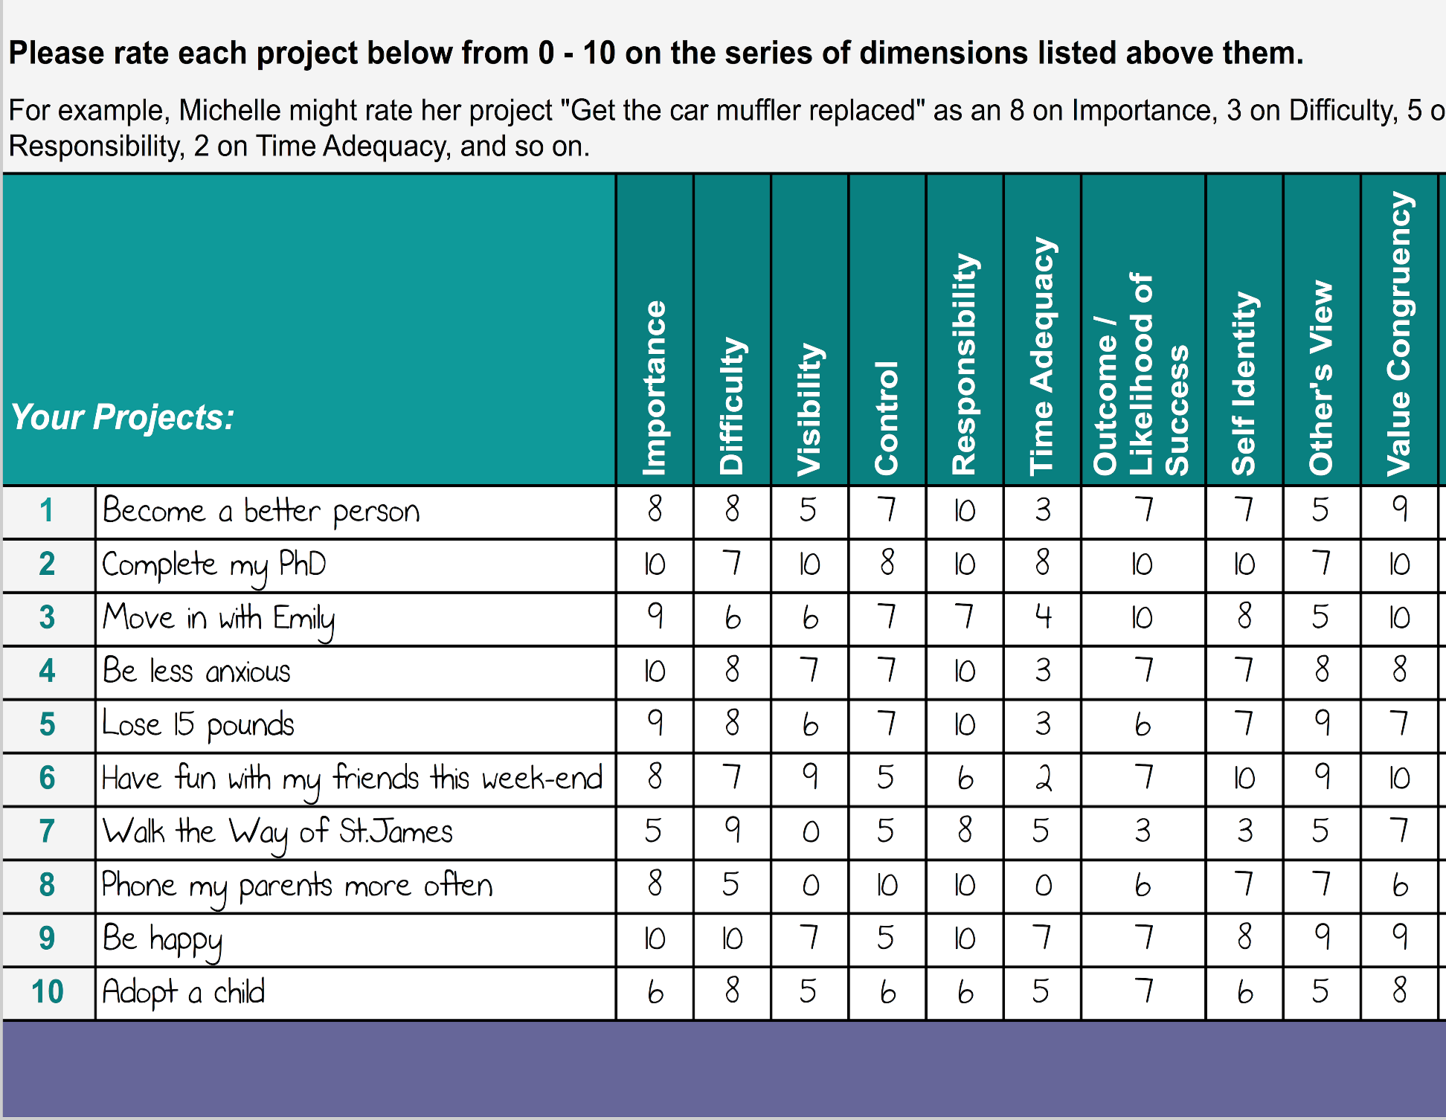
Personal Project Analysis
Project Appraisal Matrix (Cognitive Dimensions)
Stage 2: Project Appraisal
Notes:
Second, project appraisal. Here participants are asked to score their projects on various dimensions, which helps tell a more complete story about each project. We’ll use some of the standard set of questions developed by Little, given here: importance, self-identity, value congruence.
We also plan to add questions tailored to our projects. E.g., how much will pursuing this project make you a better person?

Slide 13
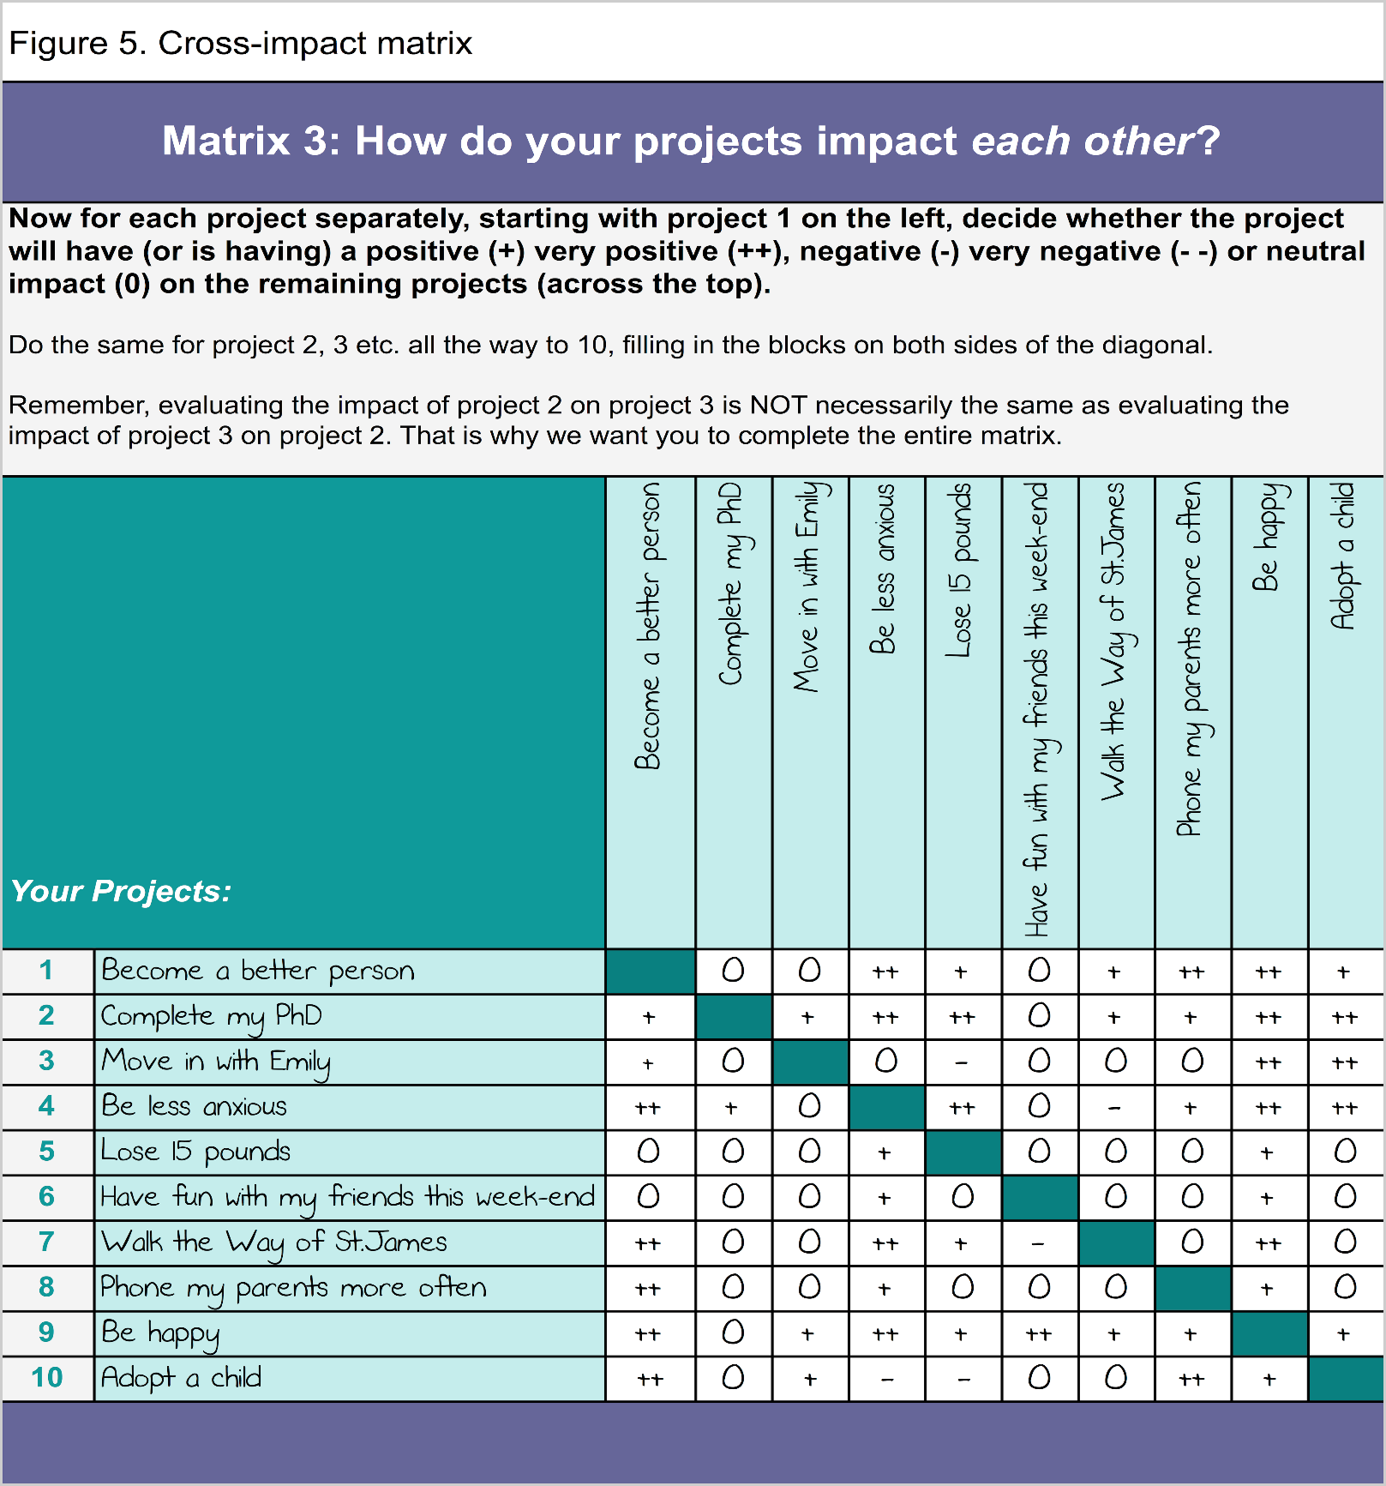
Personal Project Analysis
Stages 3 & 4: Cross Impact and Hierarchical Analysis
Notes:
Third, Cross Impact. Here, participants are asked to think about how their goals affect each other.
At stage 4, Hierarchical Analysis they are asked why they have the goals that they have until they arrive at a terminal value and how they will achieve those goals until they arrive at a specific plan.

Slide 14
Methodology
We predict we’ll find that virtue develops naturally in people in ways that are shaped by their goals and strategies.
But can we encourage the development of virtue?
Self-Authoring Intervention
  Free imagination
  Then, structured guide (ours will include instructions to think about character-related goals: what kind of person will you be in your ideal future?)
  Exploratory part of study
Notes:
The goal setting protocol begins with a period of free imagination of one’s ideal future, but then provides a structured guide to extracting and listing a set of goals, identifying strategies and obstacles to achieving them.
Goal-setting or future-authoring has good effects.
2 ½ hours of narrative writing has been shown to improve GPA and retention rates in college students (Morisano et al. JAP 2010).

Slide 15
Challenges
Methodological Challenges
Epistemological (Integration) Challenges
  How will we define virtues and will we have the same thresholds?
  Preserving relevance to the big questions through the increasing specificity needed for empirical work.
    Recall the question: How are Virtue and Well-Being Related?
Notes:
Coding narrative responses on open-ended narrative answers in PPA or self-authoring. Moin has a lot of experience developing coding systems for free form data, via group consensus.
There are lots of other methodological challenges, which will be obvious from the previous slides, but I want to focus on the challenges of integration.
Answering the big question: philosophical expertise useful here to determine what the findings support → virtue is part of well-being, virtue causes well-being, virtue is a by-product of well-being….

Slide 16



Deep Integration
A synthetic model for interdisciplinary research on normative topics:
  Identify shared key features of normative notions
  Operationalize with attention to the underlying theories
  Gather and analyze data
  Draw out implications for various evaluative and theoretical perspectives.
Notes:
Explain how our project came to be.
There is a way to merge empirical and philosophical research in ethics, but it’s not going to be a top down method of “applying a theory”.

Slide 17



Thanks!

