Slide 1
Power BI Configurations for Citizen Analysts
Presenters:
Elizabeth Jones, PhD, IT Manager Data Analytics & BI, ejones42@uco.edu
Melissa Wood, Data Analyst, mwood23@uco.edu

Slide 2

Overview
Scope of Presentation:
  How to configure Power BI for use by citizen analysts.
  Citizen analysts are data users across campus that have access to data to fulfill job functions.
  Use Ellucian Insights as a sample case.
  Securing user access.
Outside Scope of Presentation:
  Power BI sensitivity labels.
  Power BI gateway configuration.
  Ellucian Insights setup and configuration.

Slide 3

Overview Cont...
Background
Challenges
Solutions
Power BI Pro Limits
Dataflow Configuration & Steps
Demo
Today
Tomorrow & Beyond

Slide 4
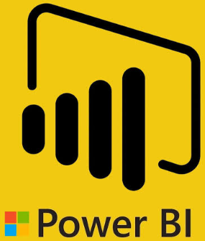




Background
2 Data Warehouses on Campus.
  Blackboard Analytics
  Ellucian ODS
Moving to 1 Data Warehouse, Ellucian Insights.
Multiple Reporting Tools on Campus.
Citizen Analysts exist across campus in various departments using ODBC connections to data.

Slide 5

Background Cont…
Insights access and technical support managed by IT.
Business Intelligence Reporting & Data Solutions (BIRDS) – New team.
Moving to Banner Cloud.
Trying to move ODBC access from Banner to ODS.
Citizen analysts hardcoding credentials in Excel and Access and sharing those files.

Slide 6
Challenges
One username and password to connect to external reporting tools.
Password can only be changed by vendor.
Power BI is the main reporting tool with Pro License for Campus on a shared capacity.
How do we allow citizen analysts to access data without sharing the password?
How do we continue to let citizen analysts use preferred tools such as Excel & Access?

Slide 7

Solution
Power BI dataflows.
Utilizes the Office 365 authentication.
Utilizes Power BI Workspaces access.
One Power BI source connection using the one Insights user account.
Citizen Analysts can create dataflows using their Office 365 credentials and connect to the Power BI source connection.
Excel & Access can connect to dataflows without embedding credentials.

Slide 8

Power BI Pro Limits
10 Dataflows with scheduled refreshes.
8 scheduled refreshes/24 Hours.
Each Refresh is a full refresh.
Needed to upgrade to Power BI Premium Capacity.

Slide 9

Dataflow Configuration & Steps
Create Power BI connection for Insights and grant access to citizen analyst.
Create Power Automate connection for Insights and grant access to citizen analyst.
  Make sure to use your Power BI gateways for this connection.
Create a dataflow in the appropriate workspaces.
  The dataflow uses the Power Automate connection during creation.
  The scheduled data refreshes uses the Power BI connection.

Slide 10
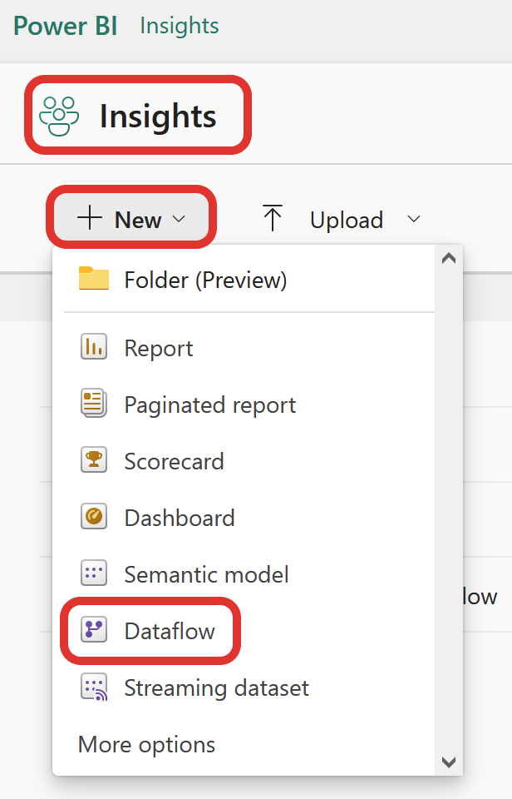
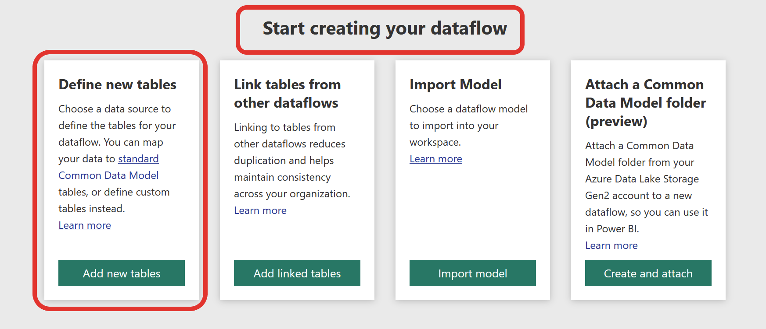
Demo
Step 1: Workspace -> New-> Dataflow
Step 2: Define New Tables -> Add new tables

Slide 11
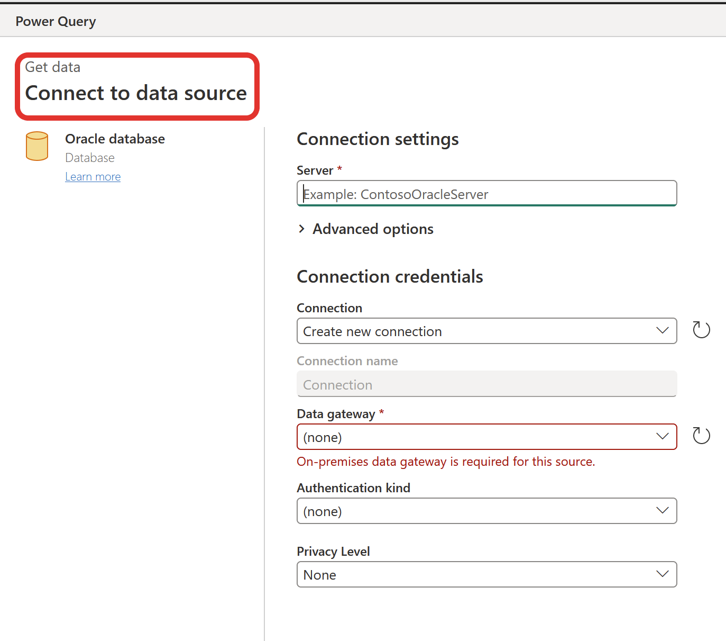
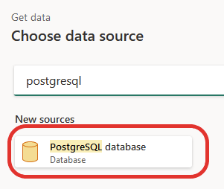
Demo Cont...
Step 4: Connect to Data Source
Step 3: Choose Data Source

Slide 12
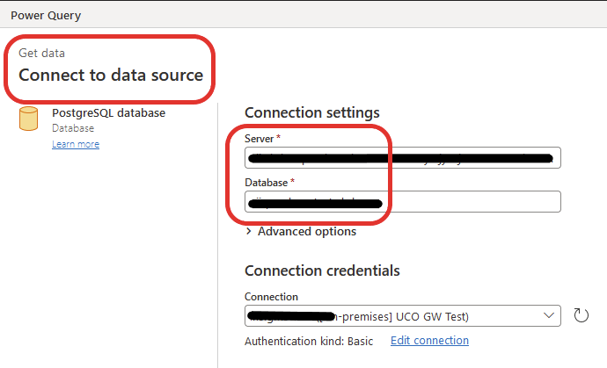
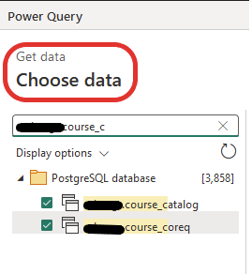
Demo Cont...
Step 4 (Option 1): Connect to a Data Source and Navigate to a Table

Slide 13
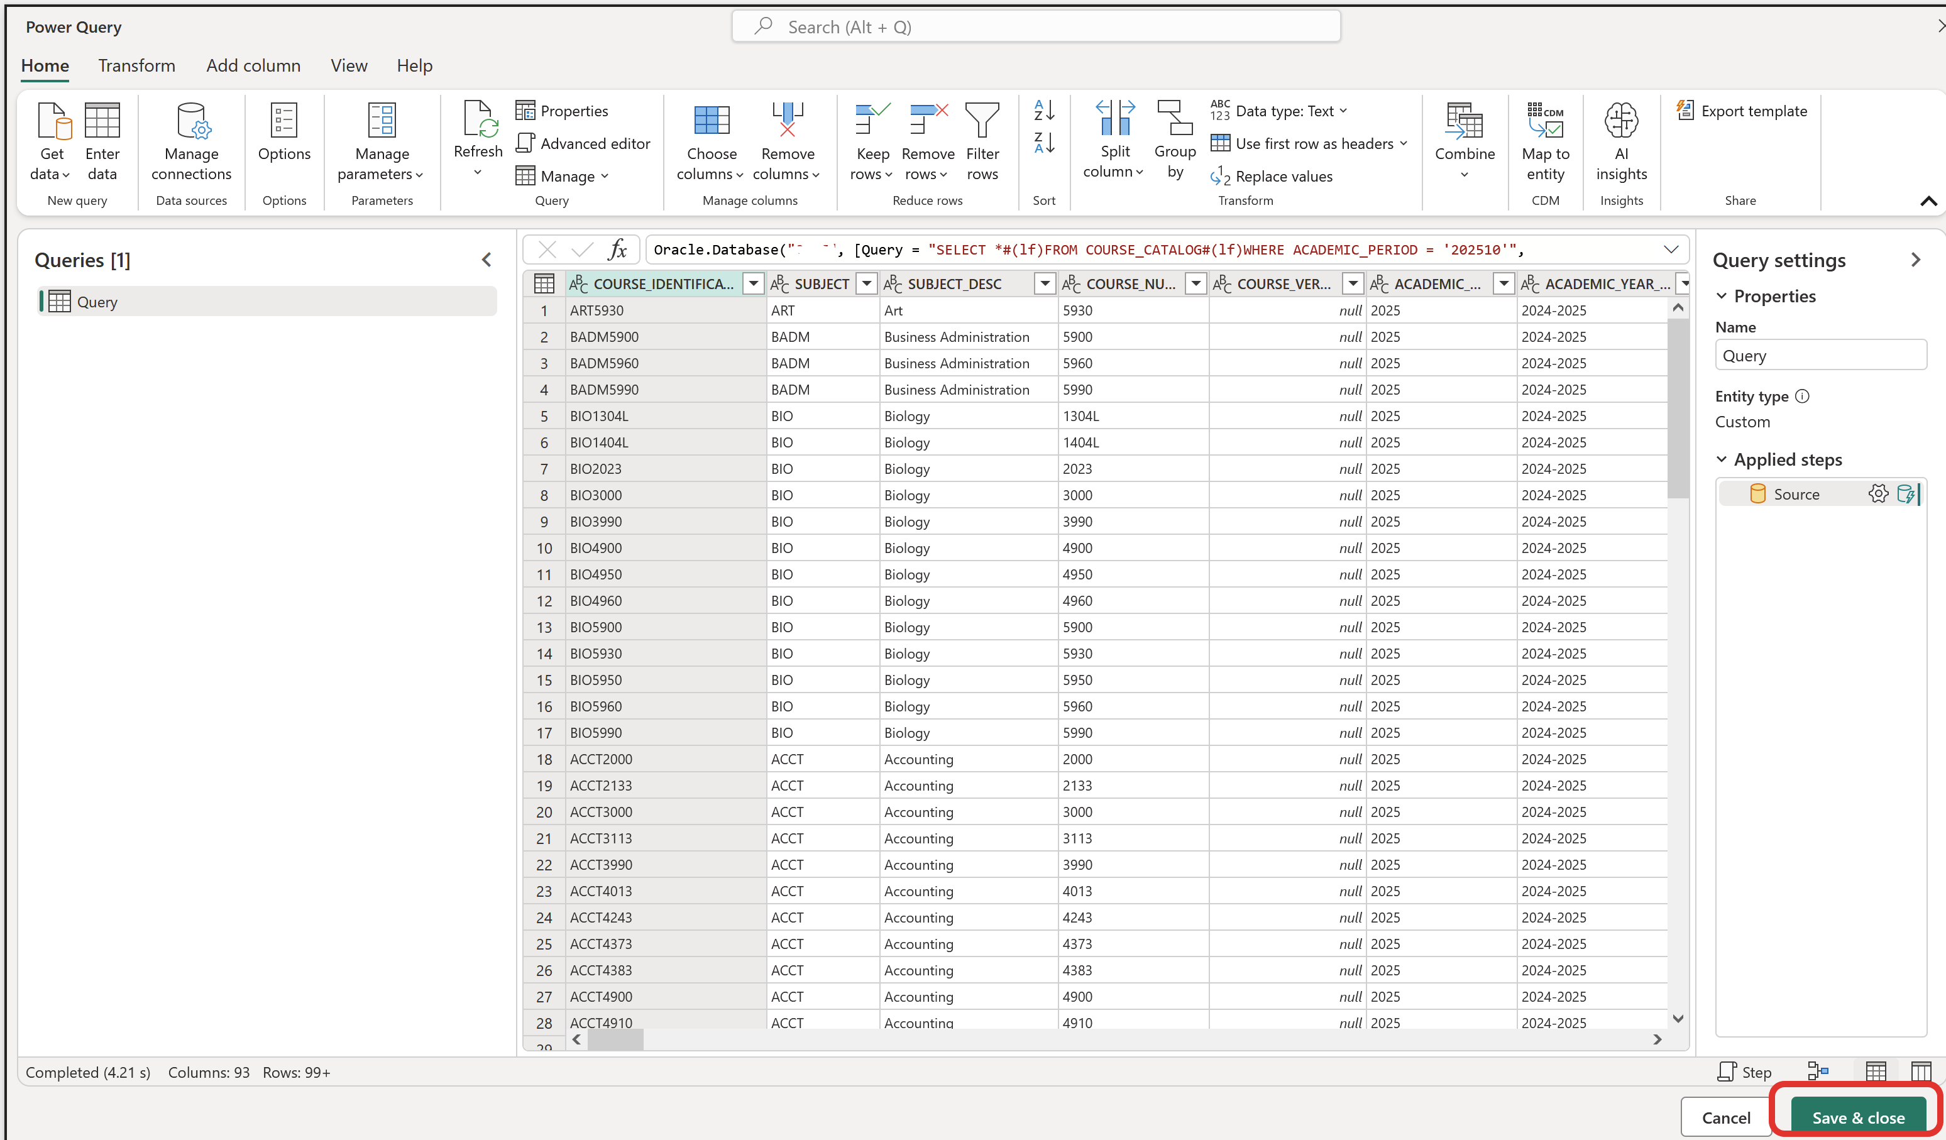
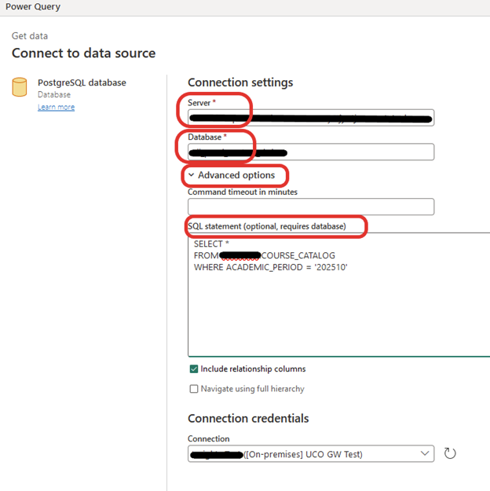
Demo Cont...
Step 4 (Option 2): Connect to Data Source with a SQL Statement
Step 5: Make Transformations and Save

Slide 14
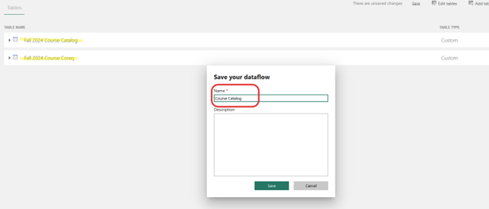
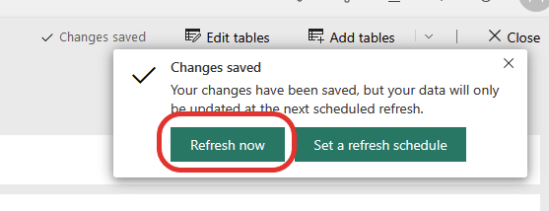
Demo Cont...
Step 6: Save Dataflow
Step 7: Refresh Data

Slide 15
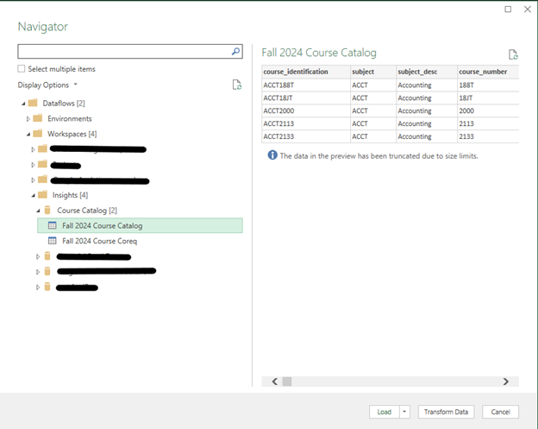
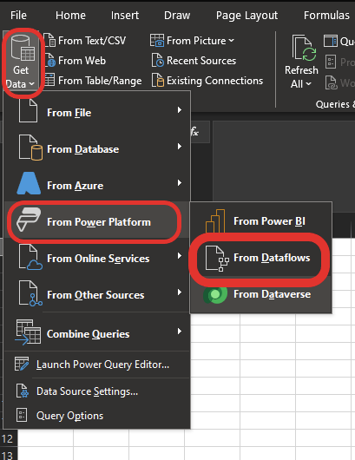
Demo Cont...
Access Dataflow from Excel

Slide 16
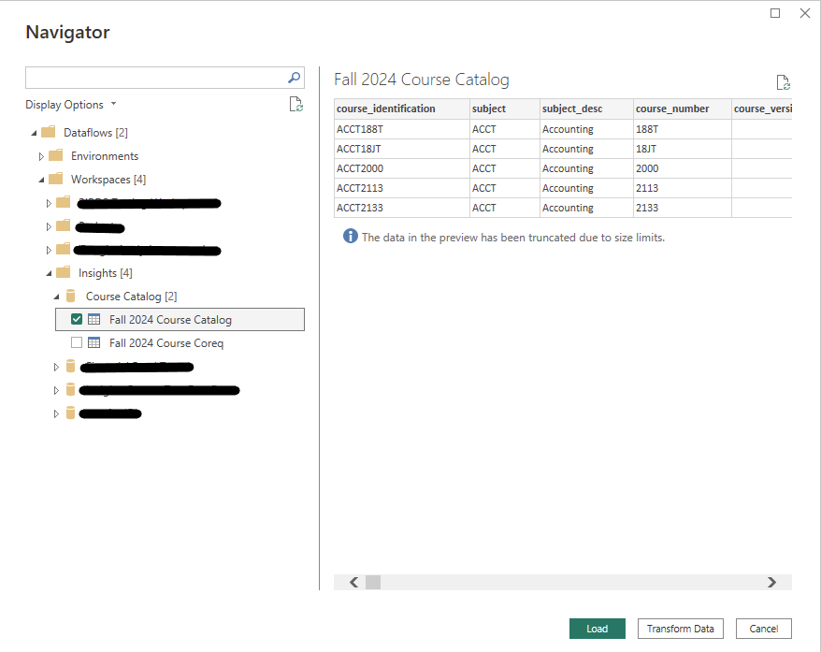
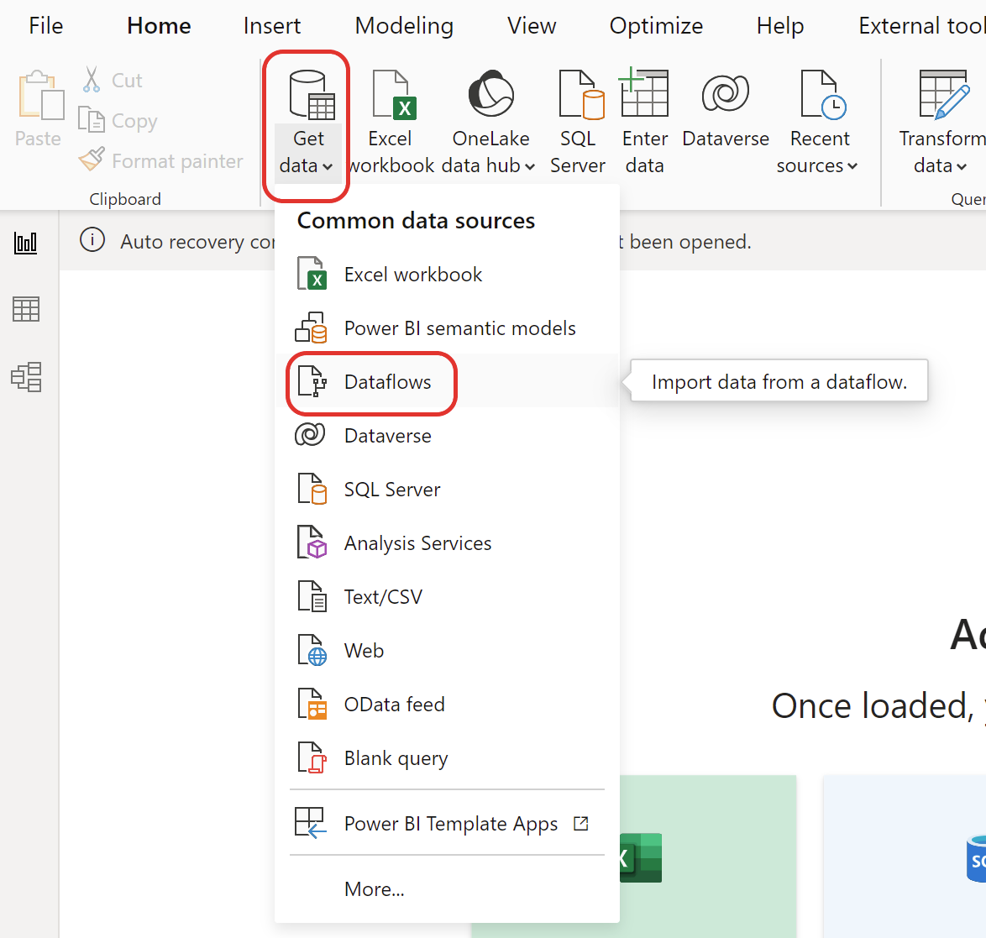
Demo Cont...
Access Dataflow from Power BI

Slide 17
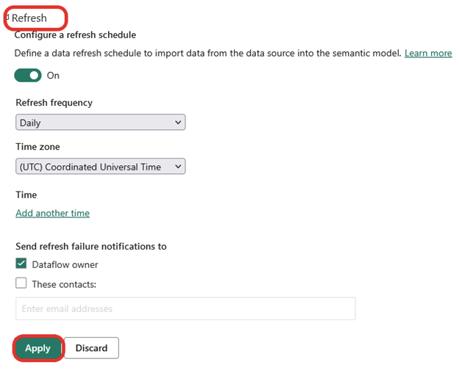
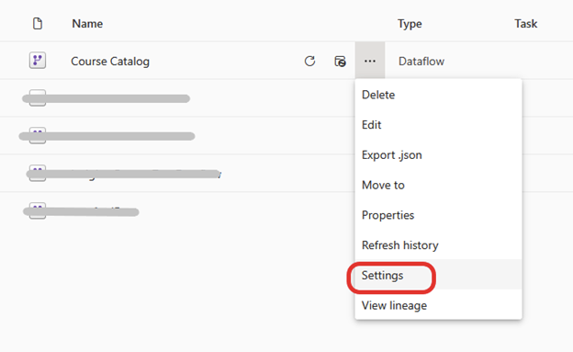
Demo Cont...
Scheduled Refresh

Slide 18
Today
In the process of upgrading to Power BI Premium Capacity.
In the process of bringing up the production environment for Ellucian Insights.
Testing Dataflows.
Using Semantic Models to get people using Excel to limit their connections directly to Banner. (Will be migrated to Insights).
Insights Go Live June 2024.
Decommission ODS end of 2024.
Decommission BbA end of 2025.

Slide 19
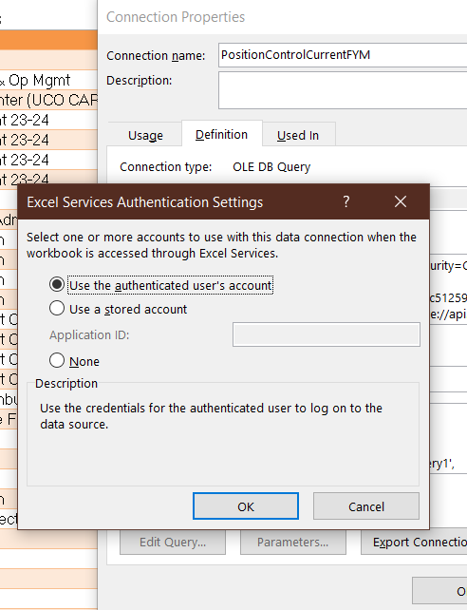
Tomorrow & Beyond
Continue developing dataflows as best practices.
  Develop standard models based on the dataflows.
Configuring Tableau for the equivalent of dataflows.
Restricting Excel Constant Login.
Testing dataflows with Access.

