Slide 1
Building an Exotic HPC Ecosystem at The University of Tulsa
John Hale
Peter Hawrylak
Andrew Kongs

Slide 2
Changing Our CS Culture
Platforms
  Desktop, workstations, mobile
Programming
  Java, python
  Serial

Slide 3
Changing Our CS Culture
Platforms
  Desktop, workstations, mobile += Big iron and HPC
Programming
  Java, python += C, etc.
  Serial += parallel and multi-threaded

Slide 4

Changing Our CS Culture
Platforms
  Desktop, workstations, mobile += Big iron and HPC
Programming
  Java, python += C and HPC toolchains/APIs.
  Serial += parallel and multi-threaded

Slide 5
Friends in HPC Places
OU – Oklahoma Supercomputing Center for Education and Research (OSCER)
  Wisdom, guidance and models
OneOklahoma Cyberinfrastructure Initiative (ONEOCII)
  Community and relationships
Tandy SuperComputing Center
  Resources, access and expertise
Researchers at TU and OU-Tulsa
  Problem spaces and commiseration

Slide 6
TU HPC Ecosystem Overview
Facilities
  Anvi1, Hamm3r, Furn4ce
Classes
  High Performance Computing
  HPC Competition
Research
  Security analytics, Bioinformatics, Geosciences
Philosophy
  Leverage resources; add value; be different

Slide 7
Bootstrapping
Re: Friends in HPC Places
  Sage advice
  Generous donations of equipment and service
Instrumentation grants
  DoD DURIP
  NSF MRI
Finding a niche
  Be different; add value...Heterogeneous computing

Slide 8
Heterogeneous Computing
Definition: systems using more than one kind of processor, exploiting specialized capabilities in problem solving
Common heterogeneous compute elements
  CPU, GPU, MiC, FPGA
Problem Domains
  Systems biology, computer vision, image processing

Slide 9
Our First Cluster - Anvil
Two Alums of our research group went to work at Wikipedia
Wikimedia/Wikipedia was retiring a large number of servers and giving them to another non profit made the paperwork easy
We thought we were going to get about five servers, we ended up with forty-five.
I drove a U-Haul full of servers from Tampa, Florida back to Tulsa, OK
We decided to build a cluster with the majority of the machines

Slide 10
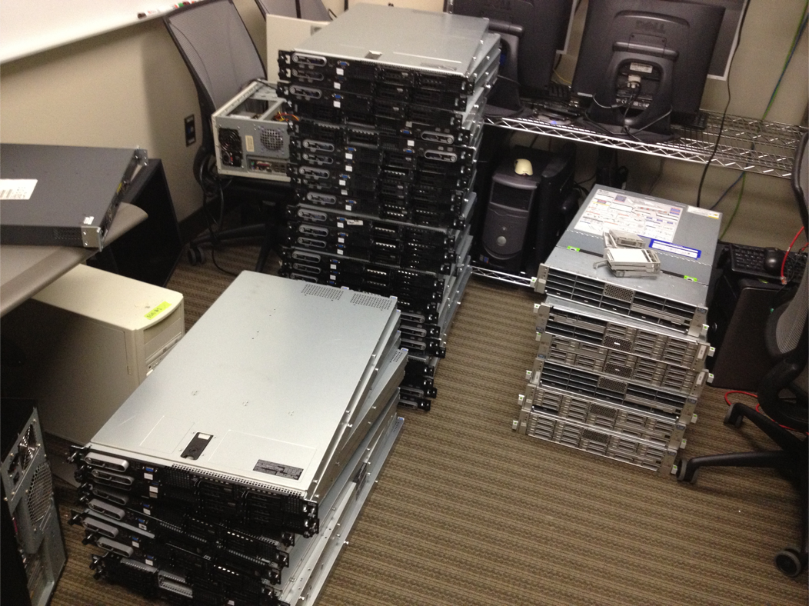

Slide 11
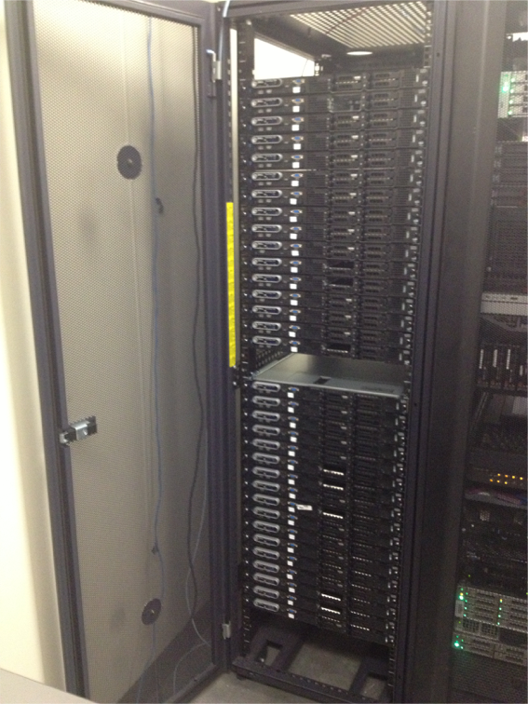
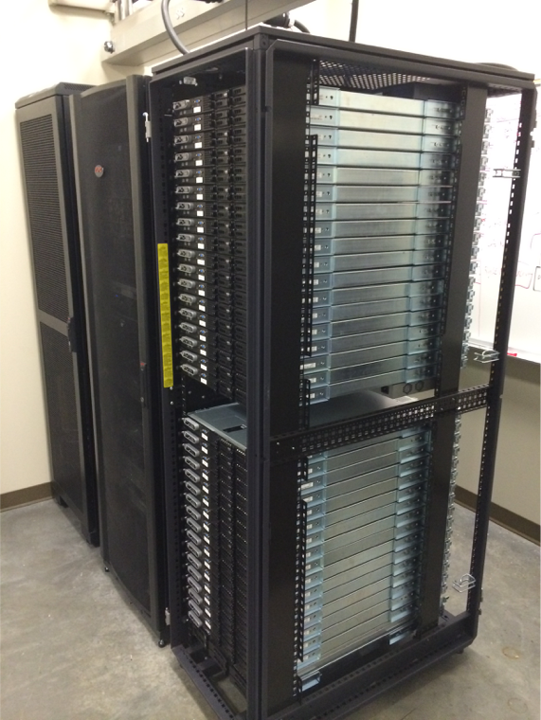

Slide 12
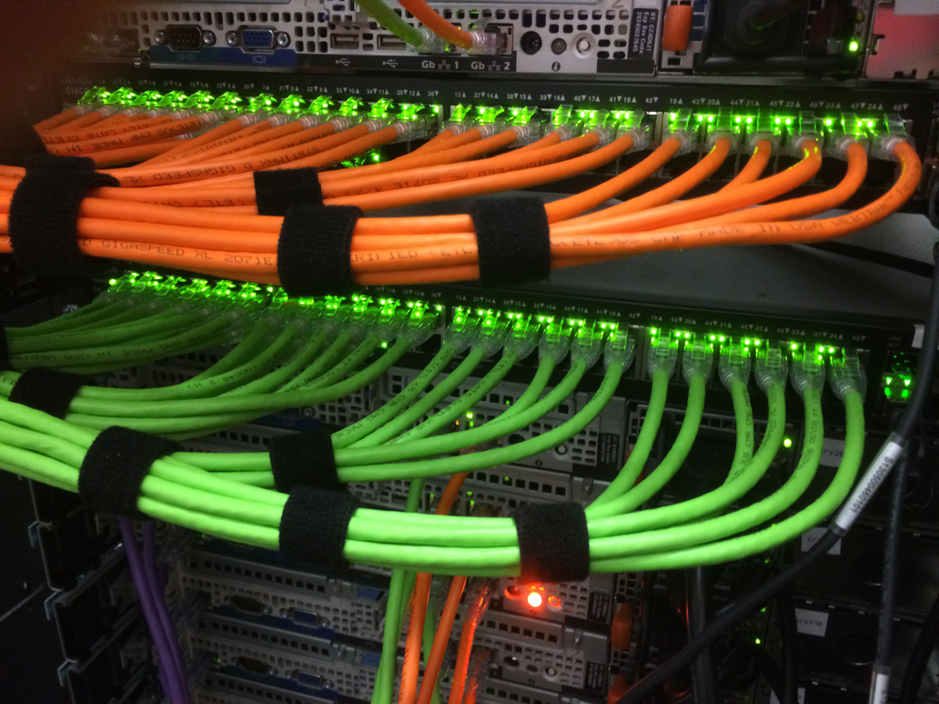

Slide 13
Anvil – Duct Tape and Bailing Wire
32 compute node CPU-only Linux cluster using Dell PowerEdge 1950 III servers
Dual Xeon L5420 (Quad-Core each), 2.5GHz “Harpertown” CPUs
32GB (Upgraded from 8GB) of Fully Buffered DDR2
Each machine has three Ethernet networks – Compute/Management, Storage, and Lights out management
Cluster-wide shared storage (3TB), VMware machine for management and services, Dedicated Login and Head node

Slide 14
Software
Nodes run CentOS 6 for RHEL compatibility (for “science” software)
Runs SLURM scheduler, single job queue
Simple shared storage using NFS from NAS
Machines are configured using puppet and pxe boot using razor
Paths and environment variables are managed with lmod (lua)

Slide 15
New Machines - HAMM3R and FURN4CE
12/16 Nodes, each with Dual Xeon E5-2630 v3 “Haswell” CPUs @ 2.4GHz
Each node has 64GB of RAM, 240GB SSD, 56Gb/s FDR Infiniband
HAMM3R -Dual Xeon Phi 31S1P w/ 57 cores @ 1.1GHz, 8GB RAM
FURN4CE – Single AMD FirePro S9050 GPU, 12GB RAM, 1792 SPs
Each node will have a Nallatech OpenCL accelerator with either Altera Stratix-V (HAMM3R) FPGA or Arria-10 FPGA (FURN4CE)
Built using SuperMicro servers assembled by Colfax

Slide 16
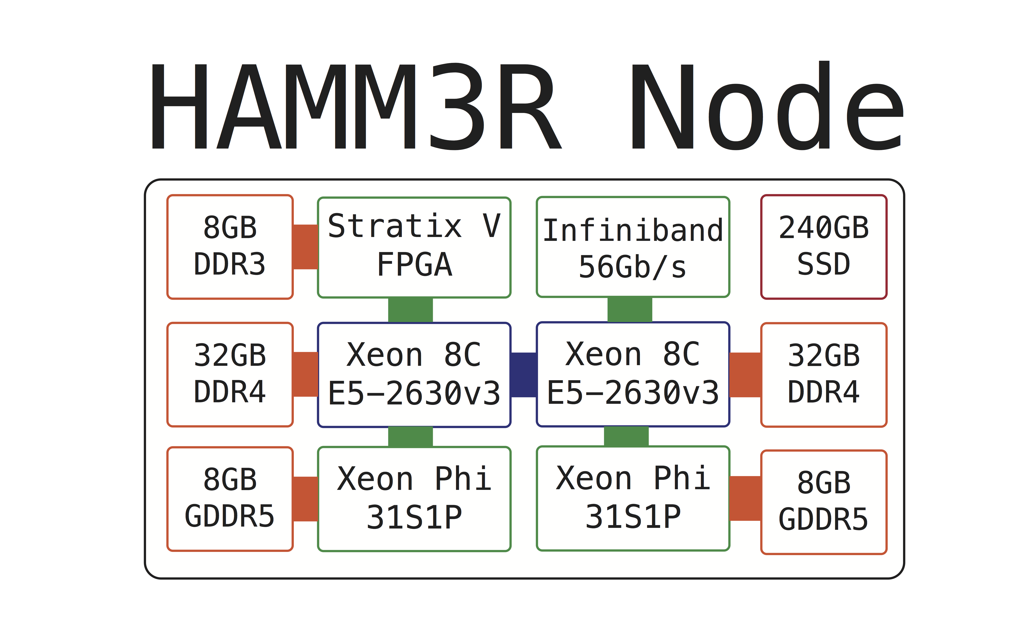
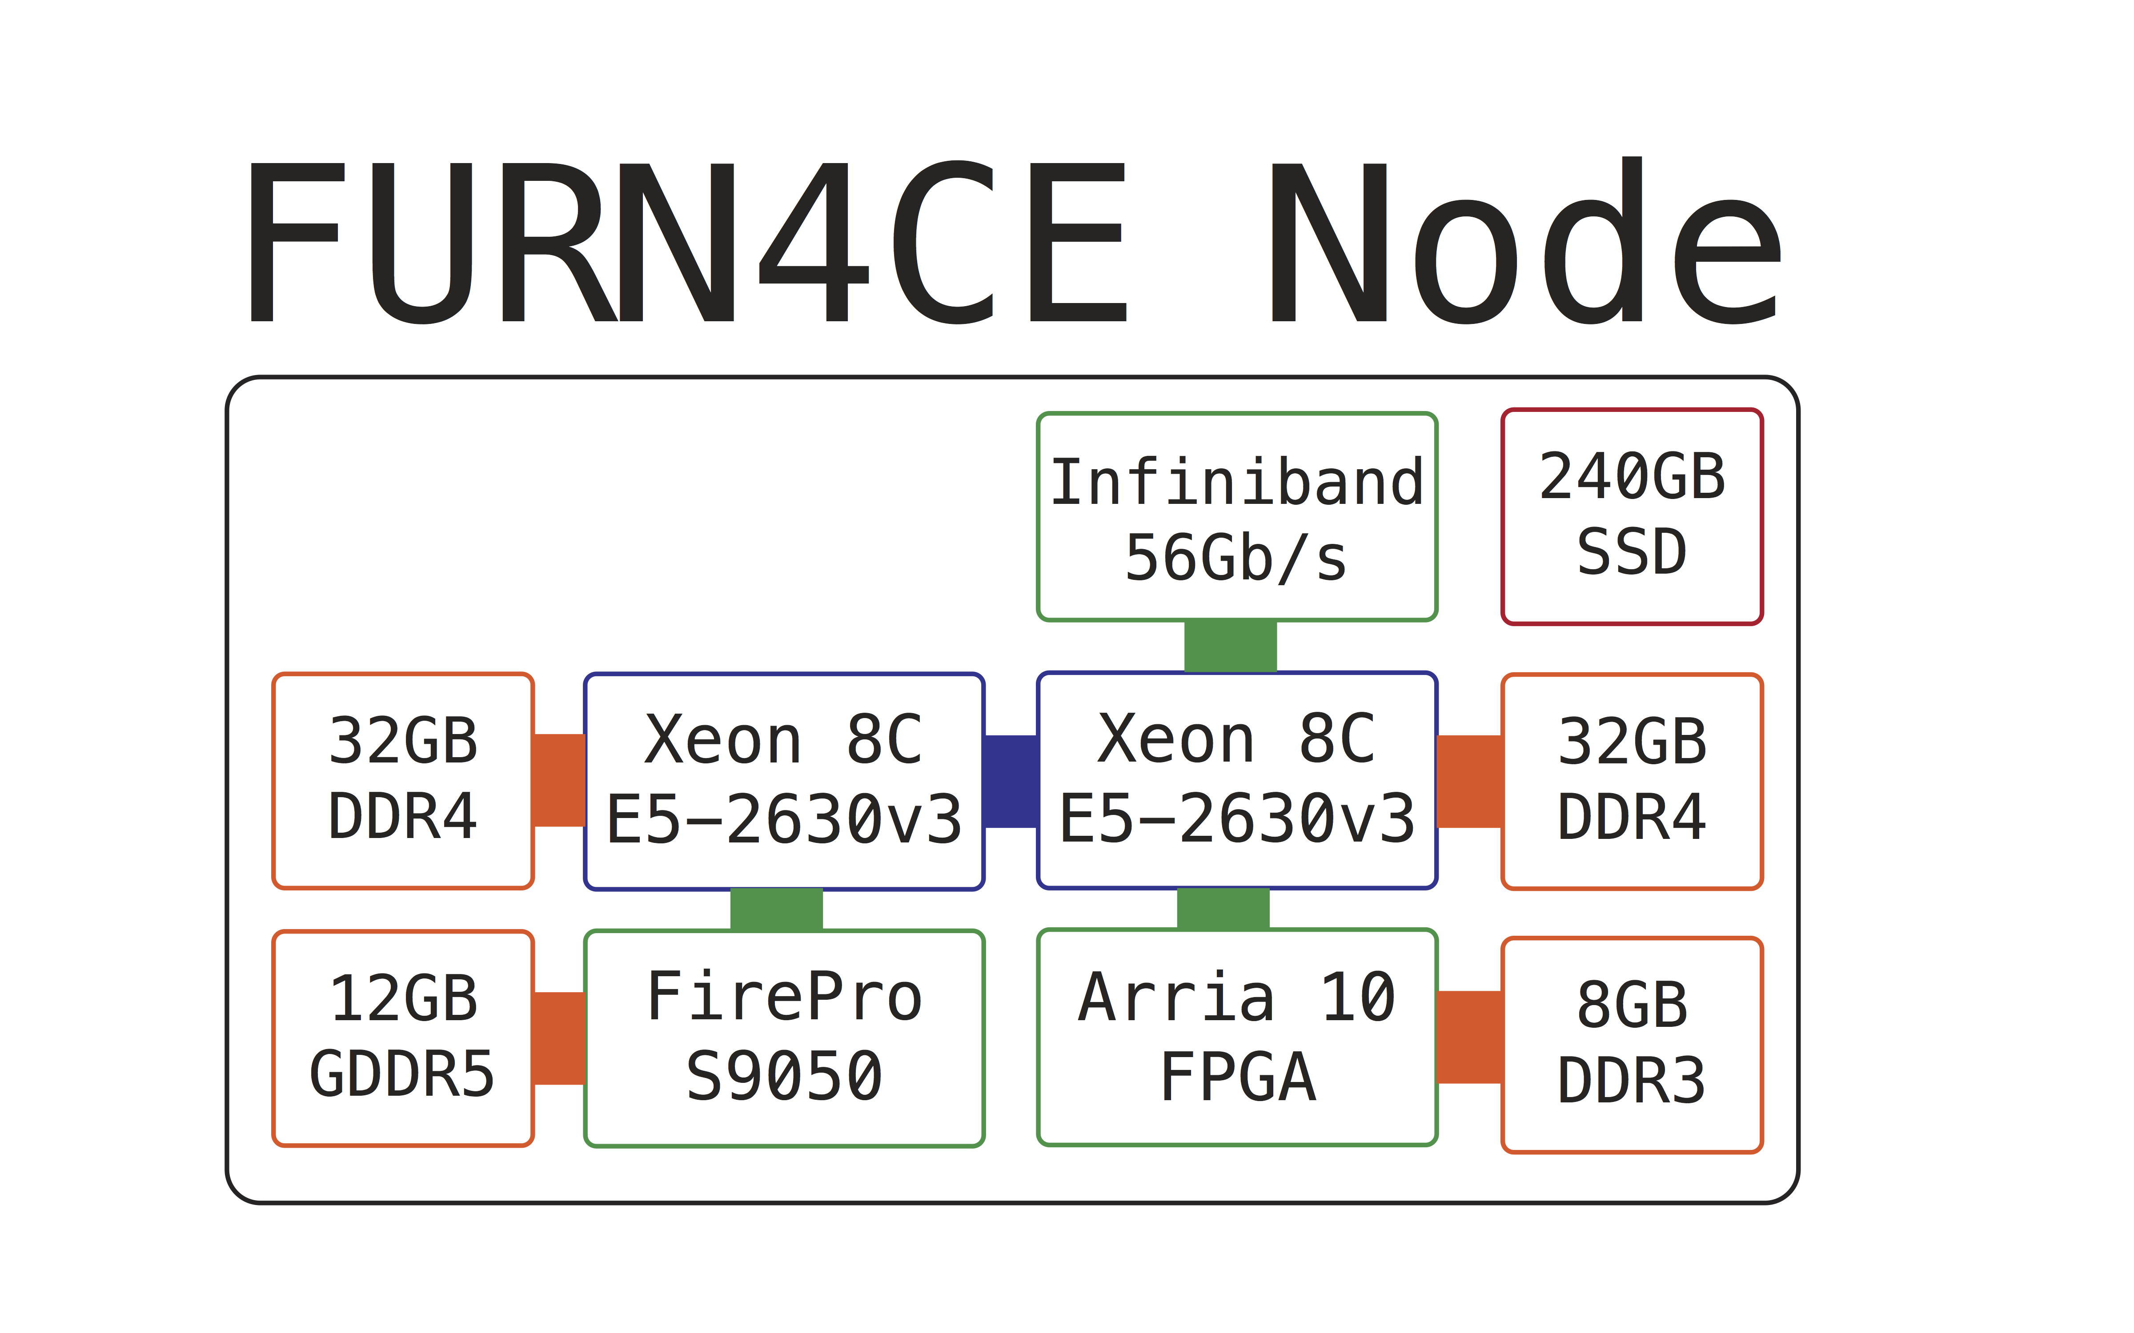

Slide 17
Command and Control Interface
Called – “Blacksmith”
Web interface for monitoring and managing the cluster
Tightly integrated with SLURM, Puppet, and Razor
Planned to visual and and simplify the using the machine greatly
VAPORWARE

Slide 18
Computing Environment
1
Node
CPU
MiC
FPGA
Fixed Purpose Units
User-Defined Hardware
2
Node
CPU
GPU
FPGA
Fixed Purpose Units
User-Defined Hardware

Slide 19
FPGA Benefits
Customizable
  “Blank Slate” for hardware
  Custom pipelines
  New architectures
Reconfigurable between jobs
  Optimally balance resources
Soft-Core Processor
  More control over internal components

Slide 20
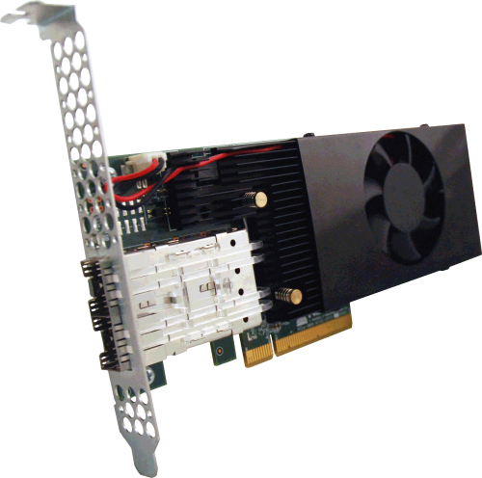
FPGA Hardware
Altera Stratix V
  General purpose logic
Customizable
Connectivity
  InfiniBand
  Ethernet
Notes:
8 GB (giga-byte) of DDR3 SDRAM

Slide 21
OpenCL Toolchain
Traditional
VHDL/Verilog
Flow

Slide 22
Education and Outreach
New 1-credit course
  Basic HPC knowledge
  Train to participate in HPC competition
  Freshman to Senior Undergraduates
HPC Competition
  ISC 2016 Student Cluster Competition
  Build a local HPC Competition?

Slide 23
Conclusions
New Research Capabilities
  HPC
  Novel HPC Architecture
  Software/Hardware Co-Development
  HPC and Software/Hardware Tool Development
New Education Capabilities
  HPC Courses
New Outreach Capabilities
  HPC Competition – Internal and External

