Slide 1

Self-Transcendence, Virtue and Happiness:
A Psychological Investigation of Buddhist Perspectives on the Self and Well-Being
P e l i n K e s e b i r
C o r t l a n d D a h l
R i c h a r d J. D a v i d s o n
R o b i n G o l d m a n
CENTER FOR INVESTIGATING HEALTHY MINDS
University of Wisconsin-Madison

Slide 2
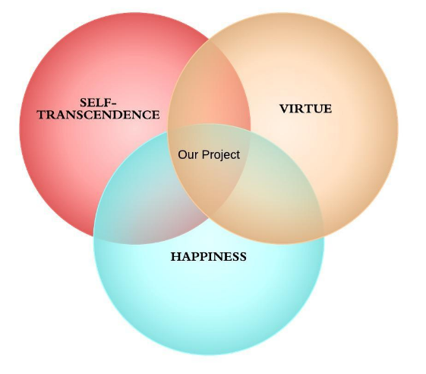
Our Project
We propose to study a family of Buddhist-inspired self-transcendent virtues that we expect to be closely related to happiness.
Specifically, we want to:
develop non-self report measures for these virtues,
establish their relation to happiness,
create simple interventions to cultivate these virtues.

Slide 3
Our Project: The “Why”
Few things are more relevant to personal and societal well-being than a healthy relationship to one’s self.
Self-related processes play a central role in determining our happiness.
  “The Curse of the Self” (Leary, 2004)
We need healthy ways of relating to our selves, especially today…
  The last couple of decades witnessed a shift toward radical individualism and the glorification of a self-oriented worldview in the West (e.g., Myers, 2000; Twenge & Campbell, 2009).

Slide 4

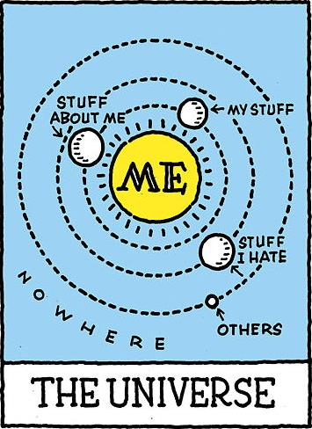




Slide 5
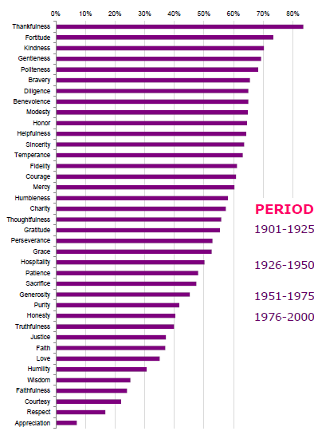
Our Project: The “Why”
  Self-transcendent virtues represent ideal ways of relating to our selves.
Happiness and virtue are bi-directionally related—with virtue leading to happiness and happiness leading to virtue, in a “virtuous cycle” (Kesebir & Diener, 2014).
Most robustly linked to life satisfaction are the virtues of love, gratitude, hope, curiosity, zest, and perspective/wisdom (Park, Peterson, & Seligman, 2004).
Percentage Drop in the Appearance Frequency of Virtue Words
(1901-2000)
(Kesebir & Kesebir, 2012)

Slide 6

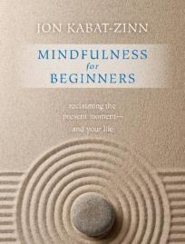
Our Project: The “Why”
At the center of Buddha’s teachings is the notion that suffering is rooted in confusion about the nature of the self (Bodhi, 2005).
Buddhism offers a comprehensive account of how one should relate to the self to reduce suffering and achieve well-being.
  It emphasizes self-transcendence and moving beyond an isolated sense of self, by recognizing the impermanent and interdependent nature of the self.

Slide 7

Our Project
We propose to study Buddhist-inspired self-transcendent virtues that we regard as supremely important to achieving lasting well-being.

Slide 8
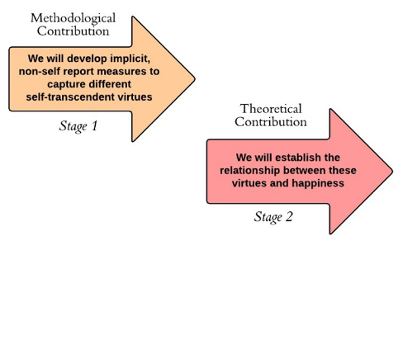
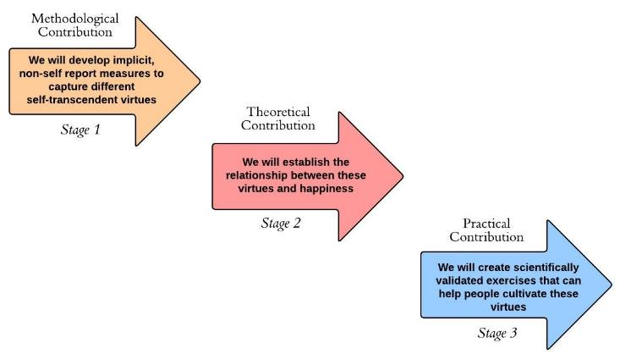
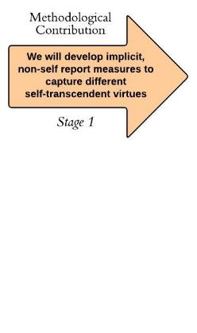
Our Project: The “How”
We plan a three-stage project with distinct contributions at every stage:

Slide 9
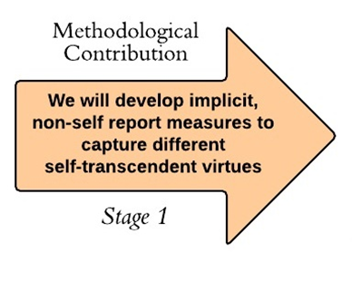
The First Stage
Our first goal will be to develop measures to assess self-transcendent virtues, particularly implicit and behavioral measures.
Self-report measures have their strengths, but also their weaknesses.
  People are not always able or willing to report on their true states.

Slide 10
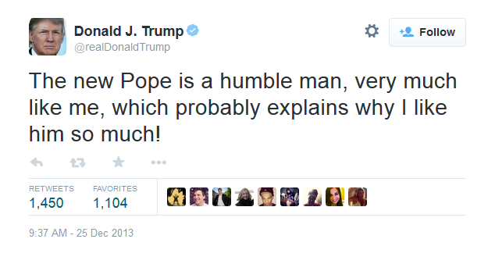
The Trouble with Self-Reports

Slide 11
The First Stage
Our first goal will be to develop measures to assess self-transcendent virtues, particularly implicit and behavioral measures.
Self-report measures have their strengths, but also their weaknesses.
  People are not always able or willing to report on their true states.
We aim to develop measures that are less susceptible to self-serving biases or impression management attempts.

Slide 12
The First Stage: Virtues to Study
  A sense of the fundamental sameness of the human family
  Humility, or a quiet ego
  Perspective, or the ability to get out of oneself and see things in true perspective

Slide 13
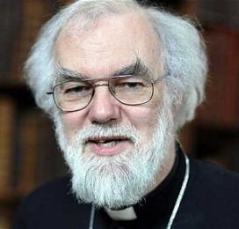



Sample Research Idea
To measure participants’ proneness to perceive the fundamental sameness of the human family:
Briefly expose participants to combinations of pictures of people from different backgrounds
And then ask them how similar the people in the pictures were to each other

Slide 14
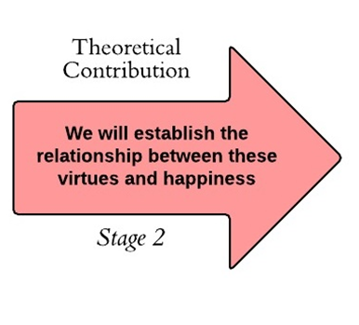
The Second Stage
This stage will employ correlational and experimental design.
Sample research hypotheses would be:
  People who score high in proneness to perceive the fundamental sameness of the human family will report higher happiness.
  When experimentally manipulated to think about the fundamental sameness of the human family, participants will display higher prosociality and lower unethical behavior.

Slide 15
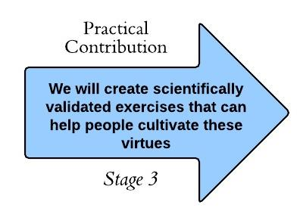

The Third Stage
We aspire to translate the conceptual findings from our research program into practical exercises.
We will come up with and test the effectiveness of practices that can cultivate different self-transcendent virtues.
What exercises can make people appreciate the fundamental sameness of the human family?

Slide 16
Our Project: The “How”

Slide 17

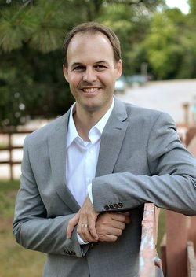


Deep Integration: Our Team
Pelin Kesebir
Cortland Dahl
Richard J. Davidson
Robin Goldman

Slide 18
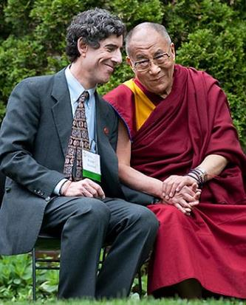
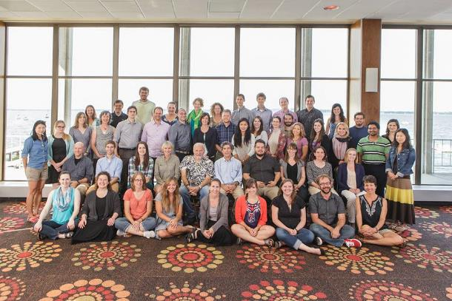

Deep Integration: Our Center
Mission: To cultivate well-being and relieve suffering through a scientific understanding of the mind.
Vision: A kinder, more compassionate world
http://www.investigatinghealthyminds.org/

Slide 19

Anticipated Challenges and Strategies for Response
Our proposed project is quite ambitious.
We plan to achieve our goals despite the large scope of our project by engaging in the following strategies:
  Focusing only on a limited number of virtues.
  Using Amazon’s Mechanical Turk (www.mturk.com) to collect data online fast and inexpensively.
  Taking advantage of the fact that several virtues can be studied simultaneously as dependent or independent variables.

Slide 20

Anticipated Challenges and Strategies for Response
Quantifying virtues is hard; developing measures is hard; and developing implicit measures is harder.
The issues of operationalization and construct validity will be a challenge.
We will try to deal with the inherent difficulties of operationalization by relying on our team’s expertise.
We plan to plan to deal with the construct validity challenge by validating our implicit measures using:
  Self-reports
  Informant reports
  Behavioral tasks

Slide 21


