Slide 1










On Fostering a Culture of Research Cyberinfrastructure Grant Proposals within a Community of Service Providers in an EPSCoR State
Henry Neeman, University of Oklahoma
Kate Adams, Great Plains Network
Joshua Alexander, University of Oklahoma
Dana Brunson, Oklahoma State University
S. Patrick Calhoun, University of Oklahoma
James Deaton, OneNet
Franklin Fondjo Fotou, Langston University
Karl Frinkle, Southeastern Oklahoma State University
Zane Gray, University of Oklahoma
Evan Lemley, University of Central Oklahoma
George Louthan, Oklahoma Innovation Institute
Greg Monaco, Great Plains Network
Mike Morris, Southeastern Oklahoma State University
Joel Snow, Langston University
Brett Zimmerman, University of Oklahoma

Slide 2
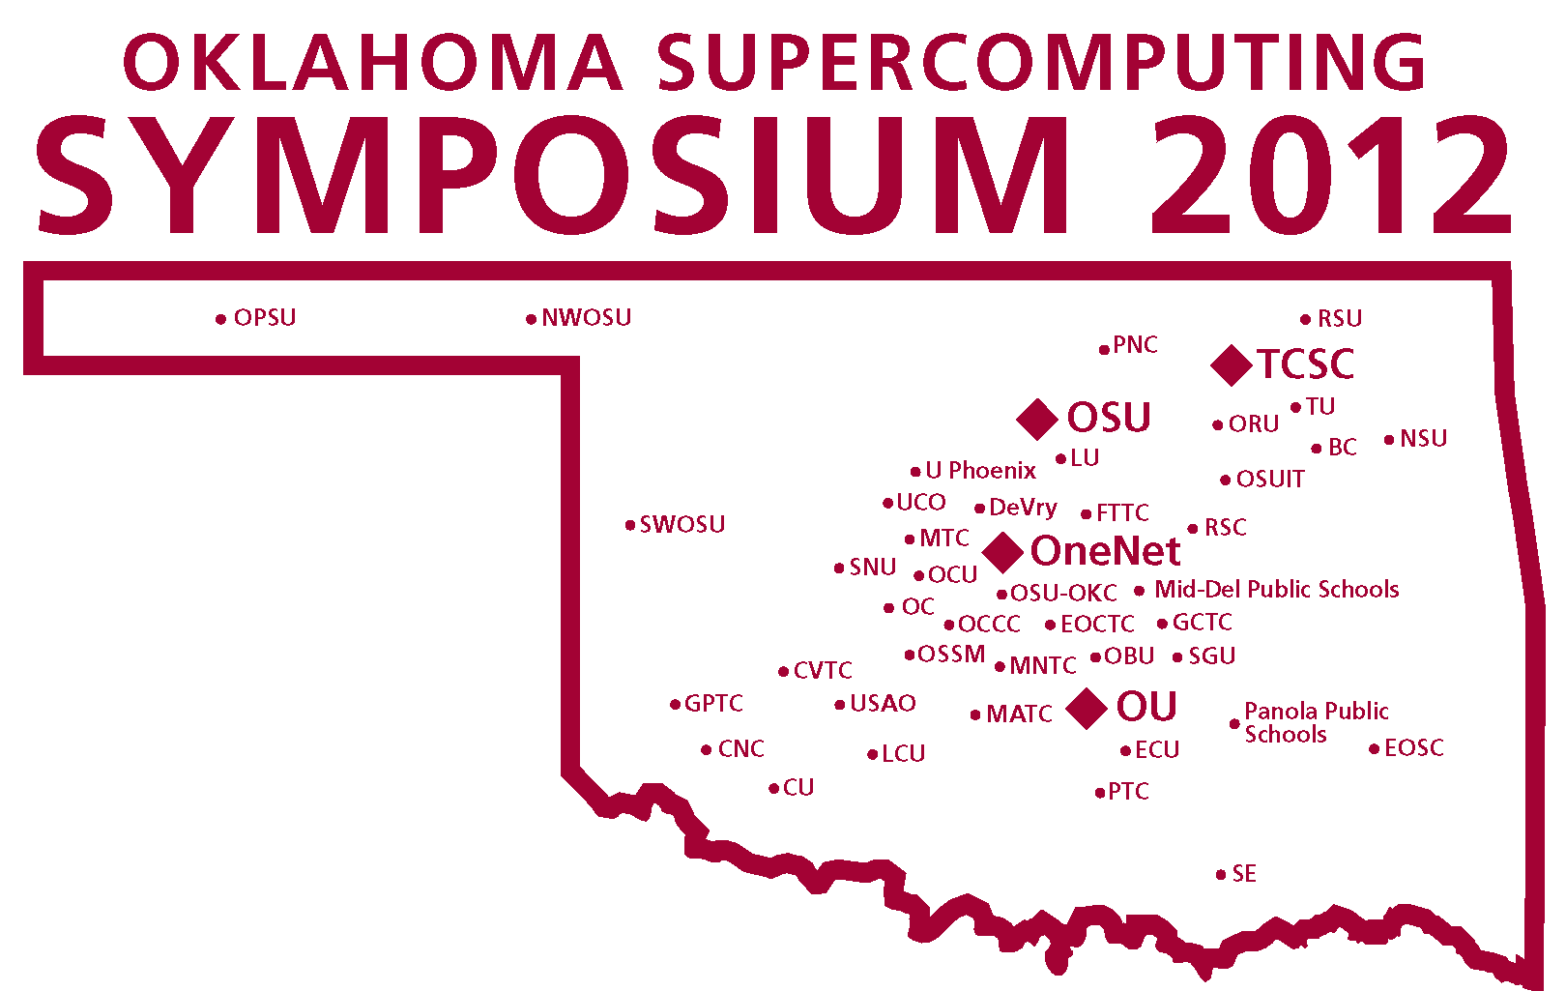
OneOklahoma Cyberinfrastructure Initiative
TSC
LU
UCO
So far:
SE
55 OK academic
48 OK non-academic

Slide 3
CI Proposal Summary
2001-2014 CI
  2001: Minimal CI Resources
  2014 - 200 teraflops and emerging shared DMZ
    Expansion in 2015: OU’s new cluster arriving now
  2008-present: 14 CI proposals
    NSF MRI: OU, OSU, Langston U, UCO: 6 submits, 4 awards
    NSF EPSCoR RII Track-2 (CI focus) with KS: 1 submit, 1 award
    NSF EPSCoR RII C2: 1 submit, 1 award
    NSF CC-NIE: 1 submit, 1 award
    NSF CC*IIE: 3 submits, 2 awards
    NSF CC*DNI: 2 submits (both pending)
    12 reviewed, 10 awarded (83%) / 2 declined
      OK FY 2014 NS average - 20%

Slide 4
CI Capacity
2002: 1.2 TFLOPs statewide, 1 Service Provider
2005: 6.5 TFLOPs statewide, 1 Service Provider
2008: 40 TFLOPs statewide, 2 Service Providers
2012: 200+ TFLOPs statewide, 4 Service Providers
2015: 400+ TFLOPs statewide, 5 Service Providers

Slide 5
OneOklahoma
Cyberinfrastructure
Initiative

Slide 6
OCII vs OneOCII
Originally OCII, established under Oklahoma’s 2008-13 NSF EPSCoR Research Infrastructure Improvement (RII) Track-1 grant.
Became OneOCII under Oklahoma’s 2013-18 RII Track-1.
  State Science & Technology plan, a required proposal component for RII Track-1, was the OneOklahoma Science & Technology Plan.

Slide 7
OneOCII Goals
Reach institutions outside the mainstream of advanced computing.
Serve every higher education institution in Oklahoma that has relevant curricula.
Educate Oklahomans about advanced computing.
Attract underrepresented populations and institution types into advanced computing.

Slide 8
OneOCII Service Methodologies Part 1
Access: to supercomputers and related technologies (20 OK academic institutions to date).
Dissemination: Oklahoma Supercomputing Symposium – annual advanced computing conference has reached 112 academic institutions, 143 commercial, 36 government, 20 nongovernmental (25 OK academic institutions to date).
Education: “Supercomputing in Plain English” (SiPE) workshop series: 11 talks about advanced computing, taught with stories, analogies and play rather than deep technical jargon. Have reached 362 institutions (academic, government, industry, nonprofit) in 51 US states and territories and 17 other countries (16 OK academic institutions to date).

Slide 9
OneOCII Service Methodologies Part 2
Faculty/Staff Development: Workshops held at OU and OSU on advanced computing and computational science topics, sponsored by the National Computational Science Institute, the SC supercomputing conference series, the Linux Clusters Institute, the Virtual School for Computational Science & Engineering. Oklahoma is the only state to have hosted multiple events sponsored by each of these (18 OK academic to date).
Informatics: research facilitators embedded in specific research projects (and largely funded by them)
Outreach: “Supercomputing in Plain English” (SiPE) overview talk (25 OK academic to date).

Slide 10
OneOCII Service Methodologies Part 3
Proposal Support: Letters of commitment for access to OneOCII resources; collaborations with OneOCII lead institutions (4 OK academic, 1 nongovernmental).
Stewardship: Research data stewardship initiative, led by Libraries.
Technology: Got or helped get technology (e.g., network upgrade, mini-supercomputer, hi def video camera for telepresence) for that institution (14 OK academic to date).

Slide 11
OneOCII Service Methodologies Part 4
Workforce Development – (39 OK academic)
  Oklahoma Information Technology Mentorship Program (OITMP)
  “A Day in the Life of an IT Professional” presentations to courses across the full spectrum of higher education.
  Job shadowing opportunities and direct mentoring of individual students.
  Institution Types: high schools, career techs, community colleges, regional universities, PhD-granting universities.
Special effort to reach underrepresented populations:
underrepresented minorities, non-PhD-granting, rural

Slide 12
OneOCII Institution Profile
To date, OneOCII has served 103 Oklahoma institutions, agencies and organizations:
55 OK academic
48 OK non-academic

Slide 13
OneOCII Institution Profile
To date, OneOCII has served 103 Oklahoma institutions, agencies and organizations:
55 OK academic
  Universities & Colleges
    3 comprehensive PhD-granting
    20 regional non-PhD-granting
  Community Colleges: 10
  Career techs: 14
  Secondary schools: 4
  Public school systems: 4
48 OK non-academic

Slide 14
OneOCII Institution Profile
So far, OneOCII has served:
55 OK academic
  10 Minority Serving Institutions
  16 other institutions with above state average and national average for one or more underrepresented minorities
48 OK non-academic
Minority Serving Institutions
Oklahoma’s only Historically Black College or University
  Langston U (Langston)
Native American Serving Non-tribal Institutions
  East Central U (Ada)
  Northeastern Oklahoma A&M College (Miami)
  Northeastern State U (Tahlequah)
  Southeastern Oklahoma State U (Durant)
Tribal Institutions
  College of the Muscogee Nation (Okmulgee)
  Comanche Nation College (Lawton)
  Pawnee Nation College (Pawnee)
  Sequoyah High School
Other Minority Serving Insitution
  Bacone College (Muskogee)

Slide 15
OneOCII Institution Profile
To date, OneOCII has served 103 Oklahoma institutions, agencies and organizations:
55 OK academic institutions
48 OK non-academic organizations
  16 commercial
  19 government
  2 military
  11 non-governmental

Slide 16
OneOCII Outcomes: Research
External research funding to OK institutions facilitated by OneOCII lead institutions (Fall 2001- Summer 2013): $165M+
Funded projects facilitated: over 200
OK faculty and staff: over 100 in ~20 academic disciplines
Specifically needed OneOCII just to be funded: over $42M
(necessary but far from sufficient)
  NSF EPSCoR RII Track-1 (2008-13): $15M to OK
  NSF EPSCoR RII Track-1 (2013-18): $20M to OK (+$4M State Regents)
  NSF EPSCoR RII Track-2: $3M to OK
  NSF EPSCoR RII C2: $1.17M to OK
  NSF MRI (OU): $793K
  NSF MRI (OSU): $908K
  NSF MRI (Langston U): $250K
  NSF MRI (UCO): $304K
  NSF CC-NIE (OU/OSU/LU/TSC): $500K
  NSF CC*IIE (OU): $400K
  NSF CC*IIE (OneNet+GPN): $350K
Publications facilitated: over 1500

Slide 17
OneOCII Outcomes: Education
Teaching: 9 institutions including 3 MSIs
Taught parallel computing using OneOCII resources:
  Cameron U – multiple times
  East Central U (NASNI)
  Oklahoma City U – multiple times
Taught parallel computing via LittleFe baby supercomputer and OneOCII resources:
  Southeastern Oklahoma State U (NASNI) – 3 semester sequence, multiple times
Taught computational chemistry using OneOCII resources:
  Northeastern State U (NASNI) – multiple times
  Southern Nazarene U
  Rogers State U – multiple times
Taught Bioinformatics using OneOCII resources:
  U Tulsa – 2 semester sequence

Slide 18
OneOCII Outcomes: Resources
6 institutions including 2 MSIs, plus C2 institutions
NSF Major Research Instrumentation grants: $1.95M
  OU: Oklahoma PetaStore, $793K (in production)
  Oklahoma State U: Cowboy cluster, $909K (in production)
  Langston U: cluster, $250K (in production)
  U Central Oklahoma: cluster, $304K (being deployed)
LittleFe baby supercomputer grants ($2520 each)
  OU: Ron Barnes
  Oklahoma City U: Larry Sells & John Goulden
  Southeastern Oklahoma State U: Mike Morris & Karl Frinkle
Networking
  NSF EPSCoR RII C2 grant: $1.17M
  NSF CC-NIE grant: $500K
  NSF CC*IIE grant: $400K

Slide 19
University of Oklahoma

Slide 20
University of Oklahoma
NSF MRI 2003-6 (OU, LU): Itanium2 cluster ($340K)
DOE EPSCoR 2004-11 (OU, OSU, LU): Established Oklahoma Center for High Energy Physics ($2.6M)
NSF EPSCoR RII Track-1 2008-13 (OU, OSU, Samuel Roberts Noble Foundation): Established OCII, co-led by OU and OSU ($15M).
NSF EPSCoR RII Track-2 2009-13 (OU, OSU, KU, KSU): Established Informatics team, created software CI ($6M).
NSF EPSCoR RII Cyber Connectivity (OU, OSU, LU, OneNet, Noble, U Tulsa): Statewide research ring network and institutional CI had network upgrades.

Slide 21
University of Oklahoma
NSF Major Research Instrumentation 2010-14 (OU): Oklahoma PetaStore.
NSF EPSCoR RII Track-1 2013-18 (OU, OSU, Noble): solidified Informatics, added Data Stewardship, transitioned OCII to OneOCII, led to weekly OneOCII conference calls.
NSF CC-NIE 2013-15 (OU, OSU, LU, OneNet, Oklahoma Innovation Institute/Tandy Supercomputing Center; adding U Central Oklahoma): OneOklahoma Friction Free Network.
NSF CC*IIE 2014-16 (OU): ACI-REF (including ACI-REF Virtual Residency program).

Slide 22
Oklahoma
State University

Slide 23
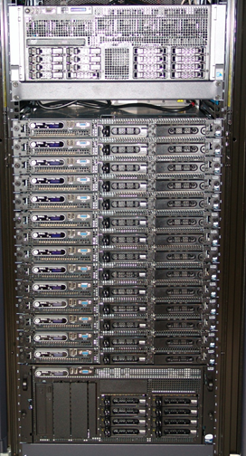
Oklahoma State U
November, 2007
  19 users
  Hired yours truly.
  Met Henry Neeman, formed OCII
By 2010,
  Had over 150 users
  Modestly more resources
and needed
  More resources
  More staff

Slide 24
Oklahoma State U
Community ideas to the rescue?
  Campus researchers
  Oklahoma Cyberinfrastructure Initiative
  Great Plains Network
  XSEDE Campus Champions
NSF MRI proposal (first time as PI; Henry talked me into writing it!)
Mentorship from Henry – especially in articulating the vision to stakeholders and proposal writing.

Slide 25
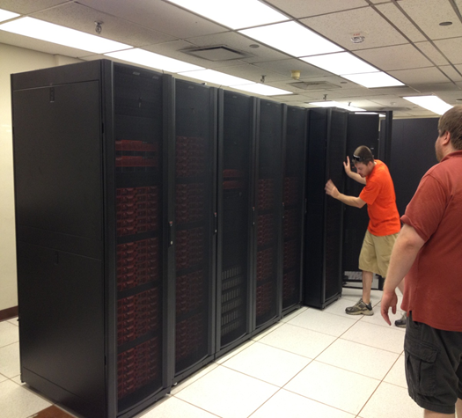
Oklahoma State U
Cowboy is funded by an NSF grant for $908,812.
Cost share funded new full-time position.
Cowboy is the largest externally funded supercomputer in state history!
9x the capacity of the previous cluster.

Slide 26
Oklahoma State U
TODAY:
New Cloud resource (helped by OneOCII expertise)
New “Research Cyberinfrastructure Analyst”
Another new FTE for Program Coordination
And another FTE Bioinformatics Specialist
Summer Graduate Research Assistant
From one FTE to 5.5 FTEs in 3.5 years.
Submitted NSF MRI in 2015 for new cluster.

Slide 27
Langston University

Slide 28

Langston U
Langston University (LU) is a land grant institution founded in 1897.
LU is Oklahoma's only Historically Black College/University (HBCU).
  LU has a more diverse student body than at its founding.
LU is a Primarily Undergraduate Institution (with few advanced degrees conferred).
Faculty engage in research activities in physics, biology, chemistry, agriculture, and applied mathematics.

Slide 29
Langston MRI
LU's NSF MRI project (“Acquisition of a High Performance Computing Cluster for Research and Education,” NSF ACI-1229107, $250K, 2013-2016, PI Joel Snow, Co-PI Franklin Fondjo Fotou).
This funding was critical in deploying “Lucille” at the Langston University Computing Center for Research and Education (LUCCRE) and have enable large scale HPC and HTC on campus.

Slide 30
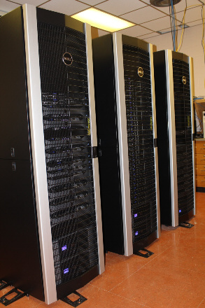
Lucille
Lucille is a Dell Cluster with 8 TFLOPs CPU, 18.72 TFLOPs GPU power by Rocks/Centos 6 OS.

Slide 31
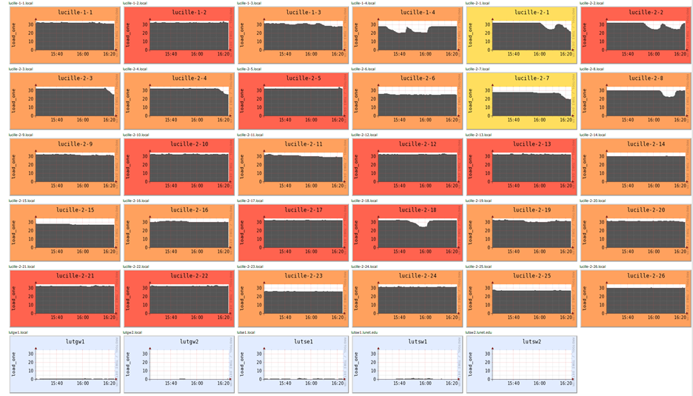
Lucille Ganglia
Lucille Ganglia Load July 28, 2015

Slide 32
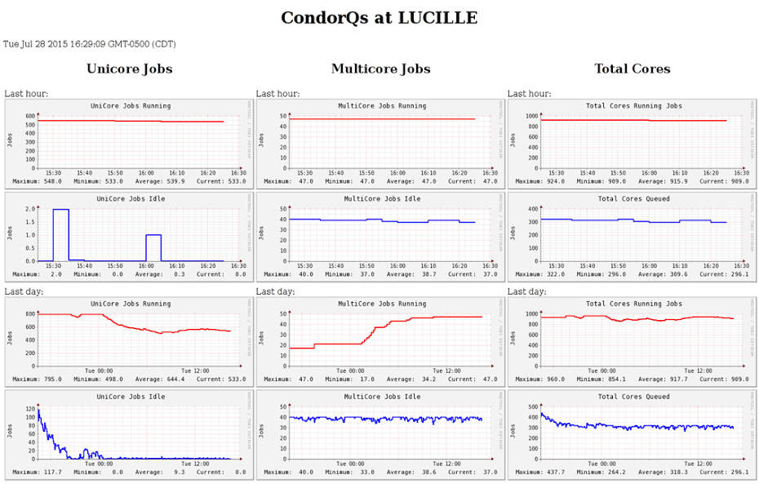
Langston U
Plots of the data above can be found at: http://lutgw1.lunet.edu/prod/proddata.html
Links to other Lucille metrics can be found at: http://lutgw1.lunet.edu/atwork.html

Slide 33
Lucille’s Constituency
Lucille serves local and distributed users doing computing intensive research, as well as providing educational opportunities for students and faculty.
The award is directly responsible for LU’s participation in the distributed computing system of the ATLAS High Energy Physics experiment taking place at the Large Hadron Collider at CERN in Geneva, Switzerland.

Slide 34
Main Success Drivers
A major factor in the award was the availability of 10 Gbps Ethernet (10GE) connectivity for the MRI HPC cluster, Lucille, through Oklahoma’s 2010-13 NSF EPSCoR RII C2 grant.
Thus, OneOCII formed the nucleus of an informal collaborative body of research CI service providers, serving as an informal and ad-hoc incubator of research CI projects.
Notes:
Main Driver

Slide 35
Motivators
SC11 conferences, which were attended by three LU faculty, including MRI Co-PI F. Fondjo Fotou.
Conversations with other Oklahoma CI leads about the intricacies of developing successful CI MRI projects.
OneOCII and Oklahoma EPSCoR leadership encouraged one of LU’s CI leads to attend an NSF EPSCoR CI meeting in the Washington DC area in 2010.
A related experience was PI Snow’s participation in OU’s 2003 CI MRI.
Notes:
Main Driver

Slide 36
Key Factors
LU would not only have been underprepared to submit such a proposal without these influences drivers and motivations.
This was LU’s first, and first successful, CI MRI, and it was fully funded at the requested amount ($250,000).
This MRI funding was the precursor to founding the LU Computing Center for Research and Education (LUCCRE).
LU intends to submit a follow-up MRI proposal for the next generation system in 2016 or 2017.
Notes:
Main Driver

Slide 37
Oklahoma
Innovation Institute/
Tandy Supercomputing Center

Slide 38

OK Innovation Institute
Oklahoma Innovation Institute
  501(c)(3) not-for-profit corporation supporting economic development in Tulsa and Oklahoma
  Board of Directors includes venture capital professionals and presidents of OU-Tulsa, OSU-Tulsa, U. Tulsa, and Tulsa Community College
  Promotes research collaboration and technology transfer among Tulsa higher education institutions
Tulsa Regional STEM Alliance
  60+ STEM workforce and education stakeholders: K-12, afterschool, employers, higher education, professional societies, tribal governments

Slide 39
OII: Tandy Supercomp Ctr
Tandy Supercomputing Center
Shared supercomputing center to broadly serve the Tulsa community
  Primarily academic; commercial access available
Provide and support education, workforce development, and a “Community Supercomputer” resource
Funding
  Lead gift from the A.R. & Marylouise Tandy Foundation
  EDA #080104715, “Tulsa Community Supercomputer”

Slide 40
OII and OneOCII
OII is not a traditional academic institution:
  As a not-for-profit: OFFN would not have been possible without an academic institution as the lead.
  As a higher education collaboration, OneOCII provides valuable points of contact to OU and OSU’s main campuses.
Tandy Supercomputing Center
  Valuable assistance in system design and general support contributed to the success of OII’s Economic Development Administration matching grant.

Slide 41
OII and OneOCII
Tulsa Regional STEM Alliance
  OneOCII provided a powerful joint letter of support from multiple institutions for OII’s US2020 City Competition (STEM mentorship).
  Tulsa was among 13 finalists from a field of 52 and ultimately designated “US2020 City Network Founding Partner” -- in-kind support and 2 AmeriCorps VISTAs.

Slide 42
University of Central Oklahoma

Slide 43
U Central Oklahoma
PUI & Metropolitan Univ. (OKC Metro)
  17,000 total students
National Undergraduate Research Model (CUR)
  Hosting 2018 NCUR Conference!!
Centers - CURE-STEM, CIBER, CREIC
  Internal (RCSA+Faculty) & External Grants (NIH/INBRE+NSF)
UCO needs for HPC resources
  Former Dean Barthell - support for first HPC center
  2012 established UCO’s Center for Research and Education in Interdisciplinary Computation (CREIC)

Slide 44
OneOCII Participation
2004 - NCSI Parallel Computing Workshop at OU (2 faculty)
2004 - now Oklahoma SC Symposium (multiple faculty)
Oklahoma Supercomputing Symposium presentations: 2006, 2008, 2009, 2010, 2014
SC 2011, 2012, 2014: one or more faculty
Virtual School for Computational Science & Engineering: Scientific Visualization workshop remote site at OSU
OU National Computational Science Institute Parallel Computing workshops
  2004: 2 faculty
  2012 2 faculty

Slide 45
OneOCII Contribution
Participation in OneOCII
  From June 2013
  NSF-MRI support
    Weekly calls
    Comments/suggestions on proposal
    HW on computing needs
    Three other OK institutions with NSF MRI CI recently
  “Acquisition of a High Performance Computing Cluster for Research at a Predominantly Undergraduate Institution,” NSF ACI-1429702, $304,375, 2015-17, PI E. Lemley
  4 Attempts! UCO’s first cluster. (OneOCII only on last)

Slide 46

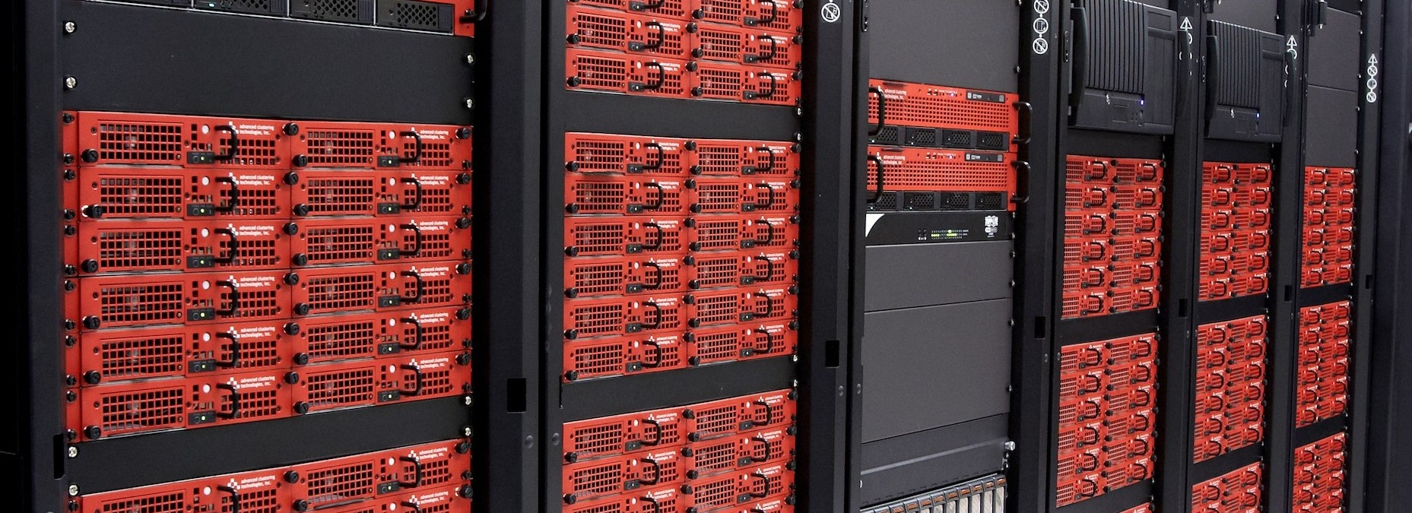
Buddy!
Helping computational research get done
NSF - MRI funded recently!
Buddy Supercomputing Cluster Delivered in June!!
~30 TFLOPs! ---- bioinformatics, biomechanics, biomedical imaging, microfluidics, phylogenetics, statistics, computational biology, liquid crystals, mathematical biology, intelligent systems, aerodynamics, bioheat transfer, operations research

Slide 47
Great Plains Network and
OneNet

Slide 48
Great Plains Network
Regional CI & Networking Consortium (4 Oklahoma university members)
Supercomputing Symposium Academic Sponsor since 2003
OneOCII Participant
  Interested in seeing the model propagated across the region
OneOCII shared GPN SC14 exhibit space along with 3 universities
GPN ENCITE Project (ENabling CyberInfrastructure via Training & Engagement)
  Funded by NSF Award to Kansas State University
  Co-PIs include OneNet
  Cooperative arrangement with OneOCII for facilitating infrastructure deployment, education and training

Slide 49
Southeastern Oklahoma State University

Slide 50
Southeastern OK State U
Regional Liberal Arts University in Durant, OK
Primarily Undergraduate, with a few Masters Programs
30% of students are Native American
Approximately 3900 enrolled students Fall 2014
235 Faculty (104 have PhDs)

Slide 51
SE Players
Mike Morris
  CS Faculty
  Started attending OU Supercomputing Symposiums in 2005
  Started building compute clusters with students early on
  Applied for LittleFE in 2011
Karl Frinkle
  Math Faculty
  Recruited by Mike Morris in 2011
  Helped build and install LittleFE on SE campus 2011

Slide 52
Integrating into OK HPC
Teaching Course
  LittleFE instrumental in teaching courses starting in 2011
  One HPC course taught each semester since 2011
  Small cluster build in 2014
Involvement in the state’s HPC community
  Getting in on OneOCII calls
  Attending, presenting at annual OU Supercomputing Symposium
  Booths at Women in Science conference with other OneOCII members

Slide 53
Grant Opportunity
GPN ENCITE/Internet2 Broadening the Reach workshop at OU, February 2015
  Discussion about CC-DNI program
  Suggested that SE should write a grant proposal
  Quick deadline, no grant writing experience on SE players
  Mike and Karl agreed, hesitantly

Slide 54
Proposal Writing
Very few proposal writing personnel on SE campus
No NSF grant proposals had been written for 5 years
Coordinated with our grant coordinator
Attended ENCITE/Internet2 grant writing seminar at OU tailored specifically for this grant
Teleconferenced with multiple OneOCII members
Many OneOCII members offered guidance on what information needed to be on each part of the grant, and templates were shared with us
Charlie Peck of Earlham College, current awardee, did teleconference to discuss successful strategy

Slide 55
Proposal Writing
Google Docs was used to help share our work with the proposal with other OneOCII members
Submission was done on time, one day before deadline
Would not have been possible without the help of the OneOCII network
Should know within the month if our grant proposal was accepted

Slide 56
Recent Papers
H. Neeman, K. Adams, J. Alexander, D. Brunson, S. P. Calhoun, J. Deaton, F. Fondjo Fotou, K. Frinkle, Z. Gray, E. Lemley, G. Louthan, G. Monaco, M. Morris, J. Snow and B. Zimmerman, “On Fostering a Culture of Research Cyberinfrastructure Grant Proposals within a Community of Service Providers in an EPSCoR State.” Proc. XSEDE2015.
H. Neeman, D. Akin, J. Alexander, D. Brunson, S. P. Calhoun, J. Deaton, F. Fondjo Fotou, B. George, D. Gentis, Z. Gray, E. Huebsch, G. Louthan, M. Runion, J. Snow and B. Zimmerman, 2014: “The Fostering CI Proposals Culture: Towards a Multi-Institutional Science DMZ in an EPSCoR State.” Proc. XSEDE2014.
S. P. Calhoun, D. Akin, J. Alexander, B. Zimmerman, F. Keller, B. George and H. Neeman, 2014: “The Oklahoma PetaStore: A Business Model for Big Data on a Small Budget.” Proc. XSEDE2014.
C. Carley, B. McKinney, L. Sells, C. Zhao and H. Neeman, 2013: “Using a Shared, Remote Cluster for Teaching HPC.” Proc. IEEE Cluster 2013.
H. Neeman, D. Brunson, J. Deaton, Z. Gray, E. Huebsch, D. Gentis and D. Horton, 2013: “The Oklahoma Cyberinfrastructure Initiative.” Proc. XSEDE 2013.

Slide 57
Acknowledgements
Portions of this material are based upon work supported by the National Science Foundation under the following grants:
  Grant No. EPS-0814361, “Building Oklahoma's Leadership Role in Cellulosic Bioenergy”
  Grant No. EPS-0919466, “A cyberCommons for Ecological Forecasting”
  Grant No. EPS-1006919, “Oklahoma Optical Initiative”
  Grant No. OCI-10310029, “MRI: Acquisition of Extensible Petascale Storage for Data Intensive Research”
  Grant No. OCI-1126330, “Acquisition of a High Performance Compute Cluster for Multidisciplinary Research”
  Grant No. ACI- 1229107, “Acquisition of a High Performance Computing Cluster for Research and Education”
  Grant No. EPS-1301789, “Adapting Socio-ecological Systems to Increased Climate Variability”
  Grant No. ACI-1341028, “OneOklahoma Friction Free Network”
  Grant No. ACI-1440783, “A Model for Advanced Cyberinfrastructure Research and Education Facilitators”
  Grant No. ACI-1440774, “ENabling CyberInfrastructure via Training and Engagement”
Dell provided seed systems for the OU Research Cloud (“OURcloud”) and the OU Science DMZ.

Slide 58
Thanks for your attention!
QUESTIONS?

