Slide 1
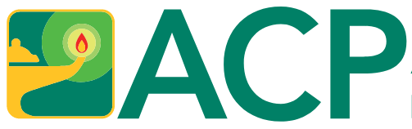
Improving Registration for Internal Medicine Clinic Patient Portal:
A Quality Improvement Initiative
Mark Street MD, Stuart Jack MD, Kory Drake DO, Ryan Yarnall MD, Amritanshu Singh DO, Kaleb Vaughn DO, Lindsey Gusman RN, Gina Mullins RN, Vicki Minton RN, Brent Beasley MD, Audrey Corbett MD

Slide 2
Background
Effective utilization of Electronic Medical Records to help with the Triple Aim of Healthcare
Patient Experience
(Better Care)
Health of Populations
(Better Health)
Reducing Per Capita Cost
(Better Value)
Notes:
reducing costs, enhancing patient experience, and improving health.
increase use of portal secure messaging to clinical staff and decrease the patient call-to-visit ratio.

Slide 3
Background (cont.)
Prior initiative improved patient portal enrollment and utilization
Goal to increase the use of secure portal messaging and decrease the patient call-to-visit ratio
Notes:
reducing costs, enhancing patient experience, and improving health.
increase use of portal secure messaging to clinical staff and decrease the patient call-to-visit ratio.

Slide 4
Background (cont.)
Why is this important?
  ~1,800 visits per month
  ~3.3 calls per visit
  ~10 minutes per call
  ~990 hours per month are spent communicating via telephone
Notes:
reducing costs, enhancing patient experience, and improving health.
increase use of portal secure messaging to clinical staff and decrease the patient call-to-visit ratio.

Slide 5
Goals
Increase portal secure messaging by 10%
Decrease patient call-to-visit ratio by 10%
Notes:
reducing costs, enhancing patient experience, and improving health.
increase use of portal secure messaging to clinical staff and decrease the patient call-to-visit ratio.

Slide 6
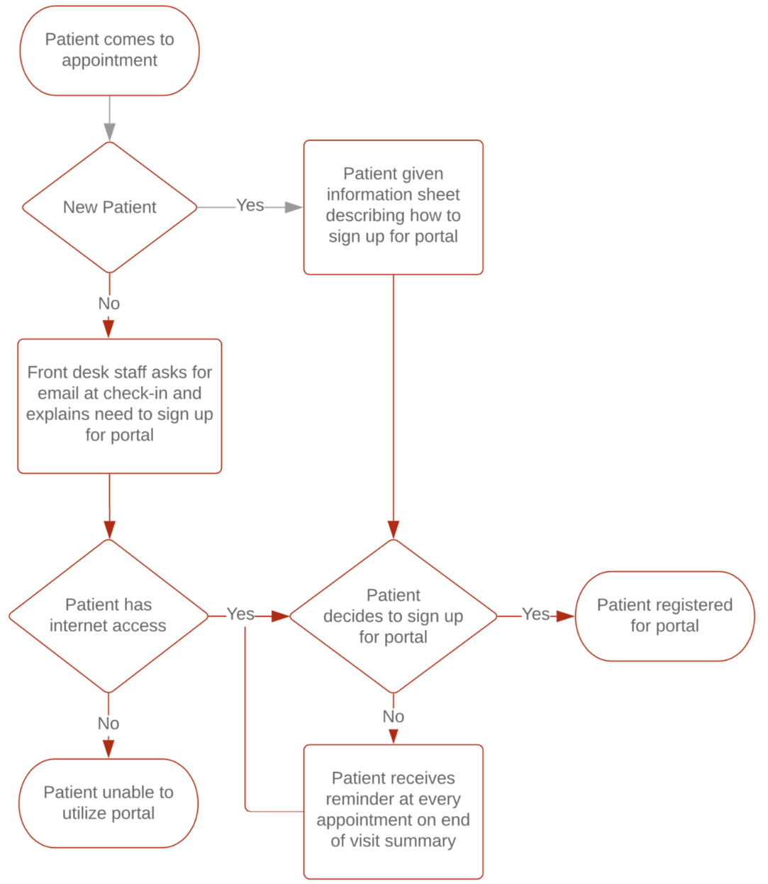
Methods
Patient Portal Enrollment Process Map
Notes:
PDSA #1: Laminated flyers containing instructions for portal registration were placed at the check-in desk.
PDSA #2: The resident physicians were instructed in communication through the portal and encouraged to use it with their patients.
PDSA #3: Instructions for portal registration were placed at the top of the clinical visit summary document given to patients at the end of their office visit.
PDSA #4: COVID
Data was collected which included the monthly number of secure portal messages from patients to clinic staff and patient call to visit ratios. The ratios were calculated by comparing the total number of calls to the clinic to the number of visits over a month-long period. These data points were plotted on XmR charts to determine significant trends and averages.

Slide 7
Methods
Act
Plan
Plan-Do-Study-Act Model for Quality Improvement
Study
Do
Notes:
PDSA #1: Laminated flyers containing instructions for portal registration were placed at the check-in desk.
PDSA #2: The resident physicians were instructed in communication through the portal and encouraged to use it with their patients.
PDSA #3: Instructions for portal registration were placed at the top of the clinical visit summary document given to patients at the end of their office visit.
PDSA #4: COVID
Data was collected which included the monthly number of secure portal messages from patients to clinic staff and patient call to visit ratios. The ratios were calculated by comparing the total number of calls to the clinic to the number of visits over a month-long period. These data points were plotted on XmR charts to determine significant trends and averages.

Slide 8
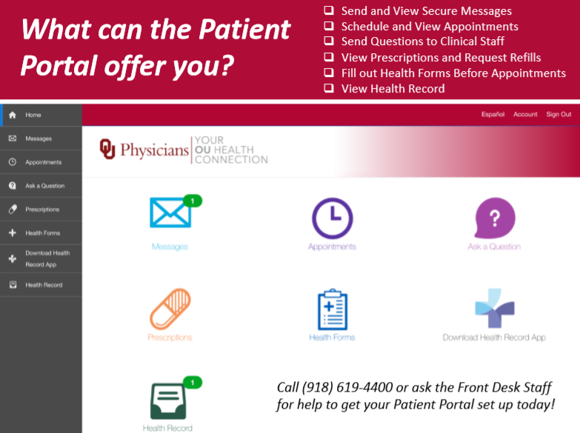
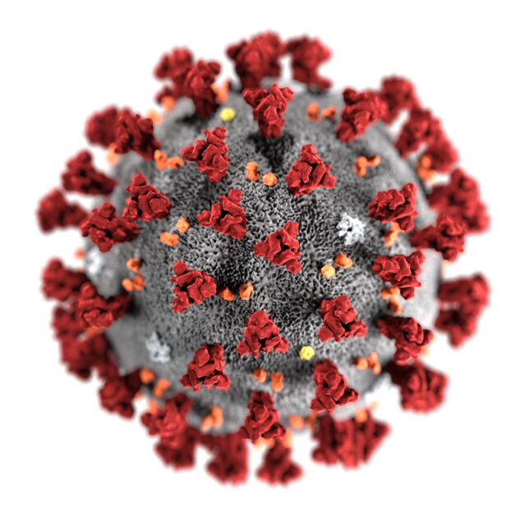
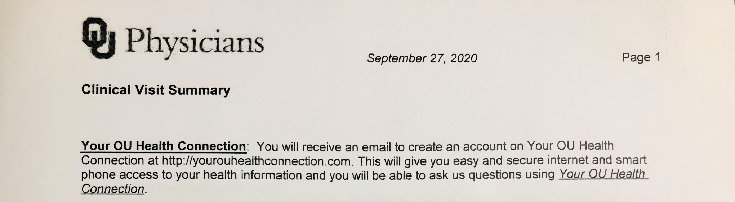
Methods (cont.)
PDSA #1: Flyer at Front Desk
PDSA #2: Instruct Residents About Portal
PDSA #3: Including Portal Information on Clinical Visit Summaries
PDSA #4: COVID-19

Slide 9
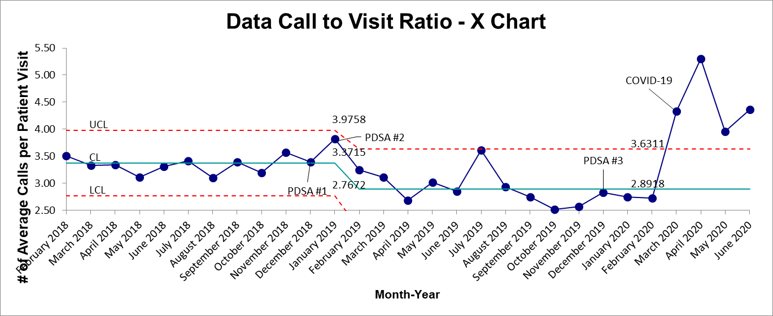
Results
Decreased 14% (from 3.37 to 2.89)
Notes:
Call-to-visit ratio decreased 14% (from 3.37 to 2.89)

Slide 10
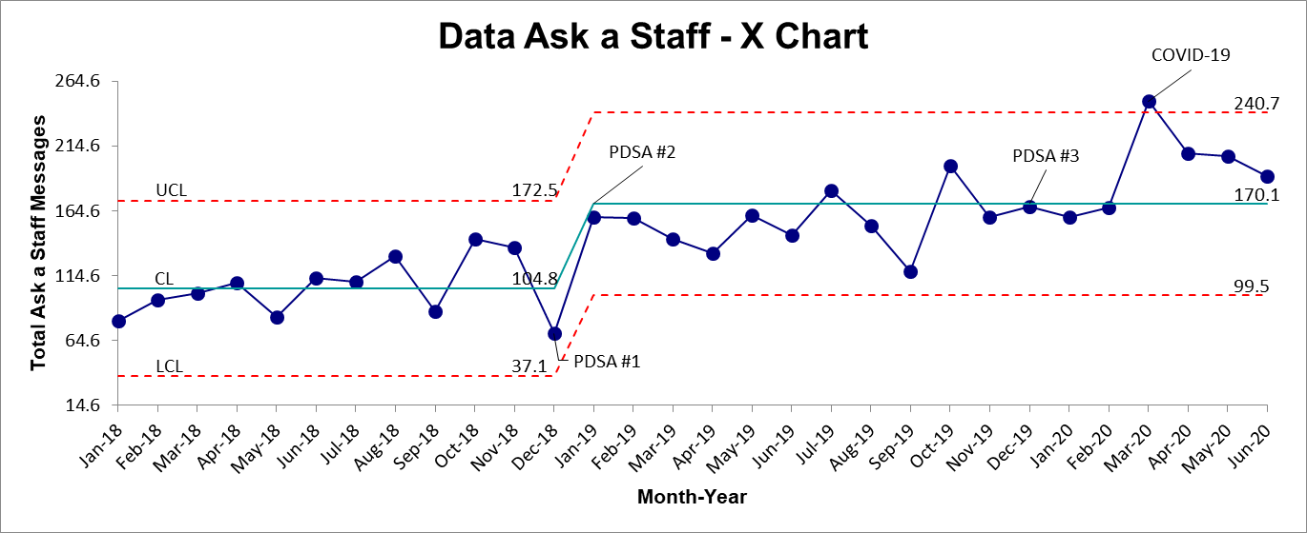
Results (cont.)
Increased by 38% (from 104.8 to 170.1)
Notes:
Patient-to-clinic messaging increased by 38% (from 104.8 to 170.1)

Slide 11
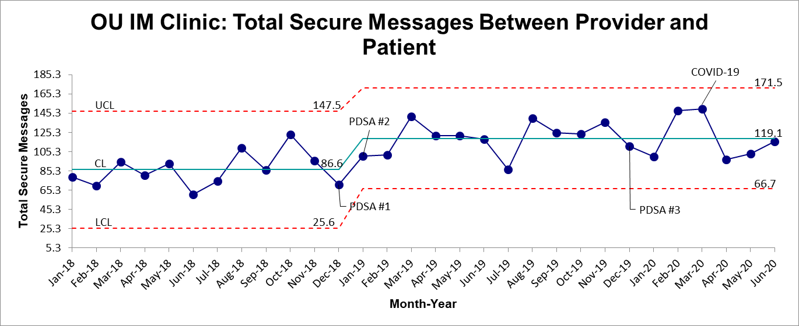
Results (cont.)
Increased 27.3% (from 86.6 to 119)
Notes:
Patient-to-provider messaging increased 27.3% (from 86.6 to 119 messages/month)

Slide 12
Results (cont.)
Initially met goals for both call-to-visit ratio and secure messaging
Reduction of the call-to-visit ratio from 3.37 to 2.89 resulted in 144 hours less of call time
Advertising with flyers appeared to have the greatest change
COVID-19 resulted in a significant increase in the call-to-visit ratio as well as secure messaging
Notes:
With 1800 visits on average, this reduced the number of calls by 864, which equaled 8640 minutes or 144 hours of reduction of call time
COVID-19 resulted in increased messages to clinical staff and a significant increase in the call-to-visit ratio--likely from the drastic decrease of in-person clinic appointments and increased calls to the clinic.

Slide 13
Conclusion
Initial data showed decreased call-to-visit ratio and increased secure messaging prior with basic marketing approaches incorporated in clinical workflow
COVID-19 was an industry disruptor that both demonstrated the need for enhanced clinical communication and need for new communication strategies
Notes:
korysdrake@gmail.com
stuartjack329@gmail.com

Slide 14
Conclusion (cont.)
Need additional data regarding the time and effectiveness of secure messaging
Increased portal utilization can continue to help with the Triple Aim of Health Care
Need new strategies to effectively communicate with patients during this unprecedented time
Notes:
korysdrake@gmail.com
stuartjack329@gmail.com

