Slide 1

When Lightning Strikes Twice in the Case of Anemia
Matthew Reddick, MSIV & Dr. Vishal Mundra, M.D.

Slide 2
Incidence of different causes of anemia
B12 anemia present in 1.4% of the general population
Folate deficiency anemia present in 0.5% of the general population
Warm autoimmune hemolytic anemia present in only 0.017% of the general population

Slide 3
Case Report: Presenting Illness
65 year old female
Symptoms of fatigue and dyspnea on exertion with insidious onset
Denied bleeding from any orifice
Denied dietary restriction or deficiencies
Admitted to a remote history of anemia that had never been fully worked up

Slide 4
History and Physical Exam
Past medical history of insulin dependent type two diabetes as well as hypothyroidism
Social History: Denied smoking, drinking or illicit drug use. Worked at an assisted living facility as a caretaker
Medications included 10 units of long acting insulin daily and Tresiba
Physical exam was benign. Vitals signs were stable. No noticeable pallor. No glossitis. No tachycardia. No murmurs. No hepatosplenomegaly.

Slide 5
Initial Workup
Preliminary labs showed a pancytopenia with a macrocytosis.
This prompted B12 and methylmalonic acid studies that revealed a B12 deficiency anemia
Pernicious anemia (PA) became less likely with immunoassay
WBC | Hgb | Hematocrit | Platelets
2,900/mm³ | 4.8 g/dL | 13.3% | 101 x10⁹/L
MCV | B12 | Methylmal-onic acid | Intrinsic Factor Immunoassay
110.4 fL/cell | 146 pg/mL | 18.72 nmol/L | negative

Slide 6
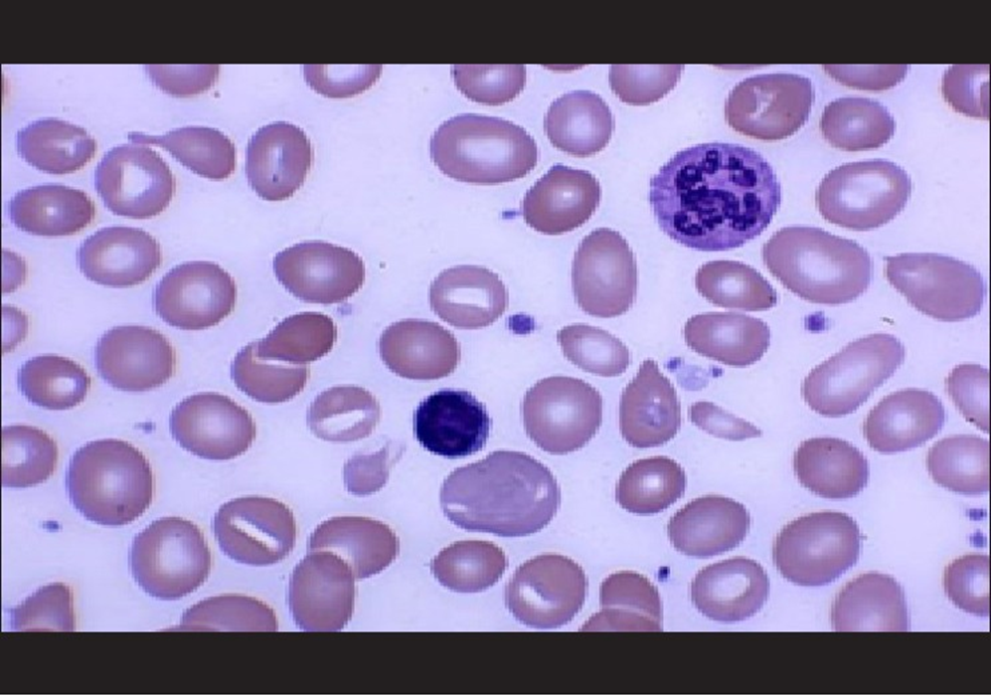
Secondary Workup
Patient was admitted and treated with two units of pRBC’s.
Etiology of B12 anemia was investigated further
  Peripheral smear ordered
  EGD scheduled
  Hemolysis labs suggested
(Not actual peripheral smear image)

Slide 7
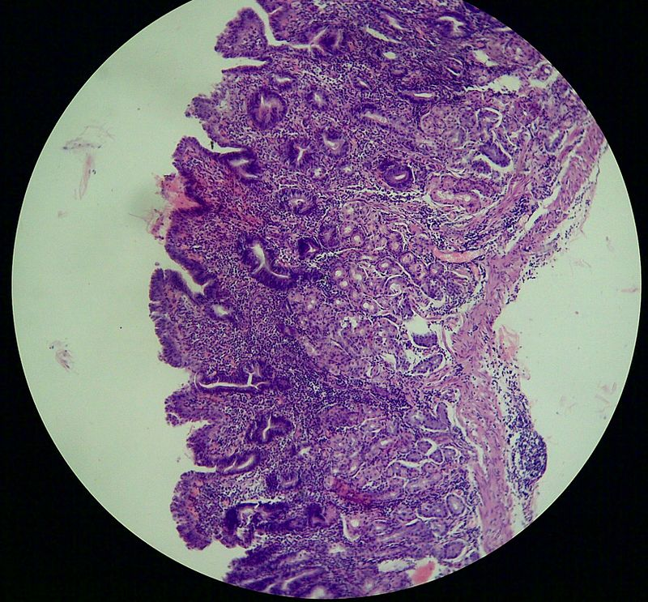
EGD Results
Chronic atrophic gastritis was present with metaplasia in the stomach
No evidence of H. pylori
Lack of parietal cells was likely the cause of B12 malabsorption and deficiency
(Not actual histologic slide)

Slide 8
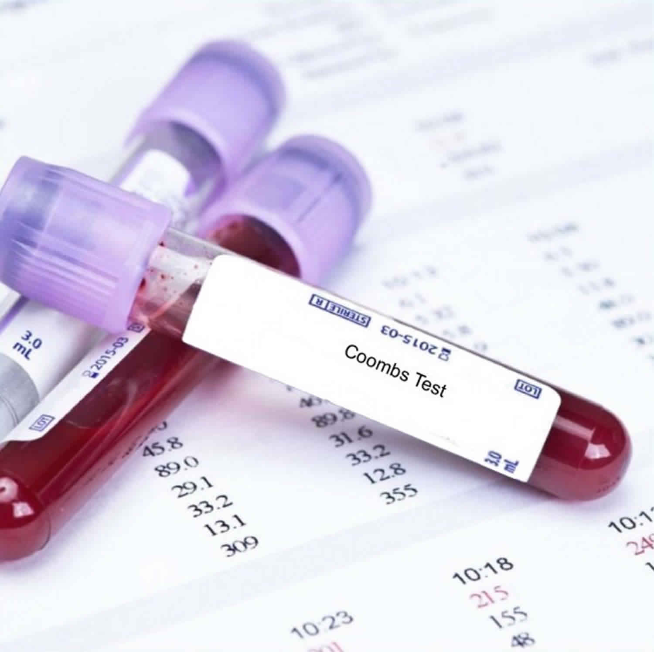
Hemolysis labs
Low haptoglobin of 8.0 mg/dL
Elevated LDH at 5,561 U/L.
Absolute reticulocyte count was low at 0.13%
This prompted a direct combs test and direct antigen test that both revealed the presence of AIHA to with IgG.
i.e. warm AIHA

Slide 9
Conclusion
Each of these two separate causes of anemia occurring independently and simultaneously in the general population would happen only once in every 420,000 people.
Episodes of PA are autoimmune related as are cases of AIHA, and there are a few case reports in the literature of these occurring together. While the sensitivity of IF immunoassay leaves ample room for speculation, our case may represent a novel situation where a non-autoimmune B12 deficiency anemia went hand in hand with AIHA.
A true instance of lightning striking twice in the case of anemia

Slide 10
References
PubMed
TI
  Clinical heterogeneity and predictors of outcome in primary autoimmune hemolytic anemia: a GIMEMA study of 308 patients.
AU
  Barcellini W, Fattizzo B, Zaninoni A, Radice T, Nichele I, Di Bona E, Lunghi M, Tassinari C, Alfinito F, Ferrari A, Leporace AP, Niscola P, Carpenedo M, Boschetti C, Revelli N, Villa MA, Consonni D, Scaramucci L, De Fabritiis P, Tagariello G, Gaidano G, Rodeghiero F, Cortelezzi A, Zanella A
SO
  Blood. 2014;124(19):2930. Epub 2014 Sep 16.
[1] PubMed TI Prevalence of potential underlying aetiology of macrocytic anaemia in Dutch general practice.
AU Stouten K, Riedl JA, Droogendijk J, Castel R, van Rosmalen J, van Houten RJ, Berendes P, Sonneveld P, Levin MD
SOBMC Fam Pract. 2016;17(1):113. Epub 2016 Aug 19.
[2] PubMed TI Clinical heterogeneity and predictors of outcome in primary autoimmune hemolytic anemia: a GIMEMA study of 308 patients.
AU Barcellini W, Fattizzo B, Zaninoni A, Radice T, Nichele I, Di Bona E, Lunghi M, Tassinari C, Alfinito F, Ferrari A, Leporace AP, Niscola P, Carpenedo M, Boschetti C, Revelli N, Villa MA, Consonni D, Scaramucci L, De Fabritiis P, Tagariello G, Gaidano G, Rodeghiero F, Cortelezzi A, Zanella A
SO Blood. 2014;124(19):2930. Epub 2014 Sep 16.
By Dr. DY Patil Vidyapeeth peripheral smear https://www.mjdrdypu.org/article.asp?issn=0975-2870;year=2014;volume=7;issue=1;spage=25;epage=28;aulast=Manzoor;type=3
By Radioxoma - Own work, CC BY-SA 3.0, https://commons.wikimedia.org/w/index.php?curid=18156433

