Slide 1



So You Want to Write a Cyberinfrastructure Proposal
Henry Neeman, University of Oklahoma
Director, OU Supercomputing Center for Education & Research (OSCER)
Assistant Vice President, Information Technology - Research Strategy Advisor
Associate Professor, College of Engineering
Adjunct Faculty, School of Computer Science
ACI-REF Virtual Residency Workshop 2015
Thursday June 4 2015

Slide 2
Outline
Instrument Location and Type (MRI/CRI)
Vision
Research Activities to be Enabled
  Includes Results from Prior NSF Support
Description of the Instrument and Needs
Impact on Research and Training Infrastructure
Management Plan
Cost Share & Institutional Commitment

Slide 3
Major Research Instrumentation

Slide 4
Vision
Describe the overall project.
Give your instrument a name. Use it often.
  It’s great if the name obviously relates to your institution.
Justify: In your first paragraph, quote a report from a national body (e.g., NSF, national academies, etc) saying that this sort of project is important.
What will be the outcome if the proposal isn’t funded?
Give a quick list of research projects.
Give a quick description of the instrument.
Provide a table of all projects, including how much of the resource they need, their funding and headcounts.
If the proposal has no unifying science theme, provide a list of themeless funded MRI grants.

Slide 5
Research Projects
Each research project to be served by the instrument should have anywhere from a page to a few sentences of description, along with the answers to the questions on the next few slides.
  Prove that it’ll be full all the time, ideally oversubscribed.
Hero projects should get the most proposal real estate and should come first; gradually reduce the length of later, less shiny projects.
For a Cyberinfrastructure proposal, the biggest consumers of the resource should be early, but you don’t have to go in order of consumption -- go from most compelling to least.

Slide 6
Equipment Proposal Questions #1
How much funding does your research currently have? How much is pending? Planned? From what sources?
How many faculty, staff, postdocs, grad students and undergrads on your team will be served by this equipment?
What makes your research transformational?
What are the broader impacts?
  Not just in the STEM research sense
    Underrepresented populations
    Integration of education and research
    Dissemination
    Societal impact
    etc

Slide 7
Equipment Proposal Questions #2
How much of the proposed resource (CPU hours, storage, bandwidth, whatever) do you expect to need over the next N years?
How did you calculate this amount?
Please give me a one page summary of your research that incorporates these issues.
  This is typically straightforward, because faculty often have either a 1 page summary from a grant proposal or a more broad research statement.

Slide 8
MRI/CRI for HPC Cluster Questions #1
How many CPU core hours or node hours will you need over the next N years?
How did you determine that?
Have you benchmarked your code?
  On what platform?
  What is the expected performance improvement on the proposed instrument, compared to the platform you benchmarked on?
  Do you plan to optimize the software? If so, what performance improvement do you anticipate?
  http://www.nsf.gov/pubs/2011/nsf11011/nsf11011.jsp

Slide 9
MRI/CRI for HPC Cluster Questions #2
If the proposal is for a new type of platform (for example, accelerators such as GPUs or Intel Xeon Phi/MIC):
  Who will be responsible for porting the code to the new platform?
    If this is either a community code or a commercial code, the porting may already have been done by the developers. Say that.
  Have they committed to do so? How reliable is that commitment? How is that being funded?
  What speedup is expected on the new platform?

Slide 10
MRI/CRI for Storage Questions
How much storage will be needed for this project?
  If this is a live storage MRI/CRI: What is the maximum amount of storage at a time that will be needed for this project?
  If this is an archival storage MRI/CRI: What is the total amount of storage needed over the lifetime of the instrument?
How was that calculated?

Slide 11
CC*DNI Questions #1
What is the expected typical size of each dataset being transferred?
(It would be helpful to know expected growth rate: Are you expecting it to stay roughly the same over the next several years, or to double every two years, or what?)

Slide 12
CC*DNI Questions #2
Where are such datasets originating, and where are they being transferred to?
Why do such datasets need to be transferred between these endpoints?
(That is, what requirement do these data transfers address for your team’s research?)

Slide 13
CC*DNI Questions #3
What is the time window for transferring each such dataset?
Why does each such dataset need to be transferred during that specific time window?
That is, what's the negative impact of the transfer taking
(a) marginally longer and (b) much longer?
How often do you expect to have such a data transfer need?

Slide 14
Prior Results
Every NSF proposal has to have a section on “Results from Prior NSF Support.”
If your team has lots of that, you can’t fit it all. The solicitation and the NSF’s Grant Proposal Guide provide useful guidelines on that.
  The PI and each Co-PI should each provide the one most relevant grant.
For an MRI, preference should be given to instrument grants, especially other MRIs.
If you don’t have anything relevant, say that.
If you do, is there a way that you can fit this proposal into a more coherent story about how your institution does CI?

Slide 15
Instrument Description
Give a rationale for the instrument. This reinforces your vision statement.
Describe the purchase process.
Describe current similar instruments at your institution or otherwise available to your researchers.
  Just because there’s another one nearby doesn’t mean your proposal isn’t fundable.
  Just because there are national centers with bigger resources doesn’t mean your proposal isn’t fundable.
Describe the role of the instrument.

Slide 16
Instrument Description
Describe the instrument in detail. You can express lots of technical information in a modest number of paragraphs.
Describe how the instrument will be accessed.
Give the expected performance.
Describe delivery, installation and operations training.

Slide 17
Impact
Describe how the instrument will attract researchers. Will it be used to attract new faculty and/or new students?
Refer back to the research section to describe the impact on your team’s research.

Slide 18
Broader Impacts
Describe the broader impacts.
  Impact on STEM research
  Integration of research and education
  Underrepresented populations
    minorities, women, disabled
    non-PhD-granting institutions
    rural vs urban
  Technology transfer
  Dissemination
Refer back to the individual research projects’ broader impacts.
You don’t need to have all of these items, but have some.
Your broader impacts are judged on what you’ve already done.

Slide 19
Management Plan
Describe the facility where the instrument will reside, in detail.
Operations labor: who, what credentials, who will manage them.
  You can make them or their boss Senior Personnel.
Apportioning: Who will get how much?
Decision making: Describe the procedure.
Advisory committee(s)
  External: one CI, one researcher, one broader impacts.
  You can also have an Internal Advisory Committee.
Timeline and milestones
Sustainability plan: What happens when the grant ends?

Slide 20
Management Plan: Facility
Where will the instrument reside? (e.g., data center)
What capabilities does that location have?
  Space
  Power
    UPS? Generator?
  Cooling
  Fire suppression?
  Network
  Security
  Accessibility: Describe the path from loading dock to data center floor.

Slide 21
Cost Share
Mandatory according to the program solicitation.
Can only be done at exactly the level required.
There is NO SUCH THING as voluntary cost share: if they don’t ask for it, you can’t include it.
  Your proposal may be returned without review.
For MRI, cost share is required of PhD-granting institutions and non-degree-granting, but NOT of non-PhD-granting degree-granting institutions.
  30% of total project budget (NSF pays 70%)

Slide 22
Institutional Commitment
Not the same as cost share.
Not required nor prohibited.
Strange rules:
  CANNOT mention any dollar figures (or anything that can be straightforwardly translated into dollar figures).
  MUST appear in the Facilities section (preference for at the end).
  SHOULD be confirmed in a letter of commitment from someone who has the authority to commit.
  MAY appear in the project description.

Slide 23
CC: Cyberinfrastructure Plan
Description of campus network: detail is good!
Description of statewide network, if appropriate
Relevant networking grants, if any
IPv6
perfSonar
InCommon
BCP 38 (or uRPF)
Connection to Internet2, AL2S, ESnet, etc
Other relevant services (e.g., Globus Online, Cilogon)
Be concise and specific ….

Slide 24


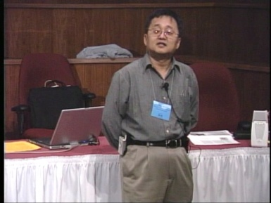
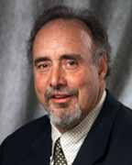
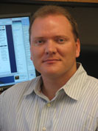
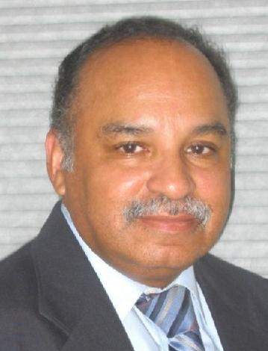

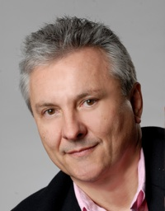
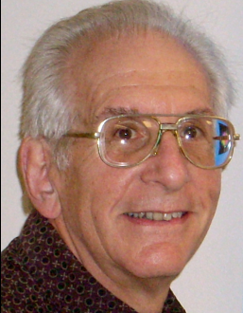


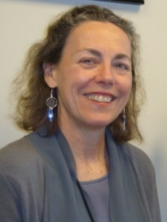
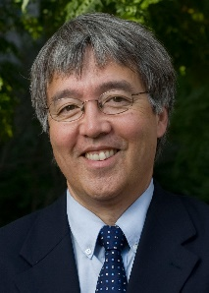
OK Supercomputing Symposium 2015
2003 Keynote:
Peter Freeman
NSF
Computer & Information
Science & Engineering
Assistant Director
2004 Keynote:
Sangtae Kim
NSF Shared
Cyberinfrastructure
Division Director
2005 Keynote:
Walt Brooks
NASA Advanced
Supercomputing
Division Director
2006 Keynote:
Dan Atkins
Head of NSF’s
Office of
Cyberinfrastructure
2007 Keynote:
Jay Boisseau
Director
Texas Advanced
Computing Center
U. Texas Austin
2008 Keynote: José Munoz Deputy Office Director/Senior Scientific Advisor NSF Office of Cyberinfrastructure
2009 Keynote: Douglass Post Chief Scientist US Dept of Defense HPC Modernization Program
FREE!
Wed Sep 23 2015
@ OU
Over 235 registra2ons already!
Over 150 in the f dy, over 200 in the first week, ver 225 in the firstmonth.
Reception/Poster Session
Tue Sep 22 2015 @ OU
Symposium
Wed Sep 23 2015 @ OU
2010 Keynote: Horst Simon Deputy Director Lawrence Berkeley National Laboratory
2011 Keynote: Barry Schneider Program Manager National Science Foundation
2012 Keynote: Thom Dunning Director National Center for Supercomputing Applications
2013 Keynote: John Shalf Dept Head CS Lawrence Berkeley Lab CTO, NERSC
2014 Keynote: Irene Qualters Division Director Advanced Cyberinfarstructure Division, NSF
2015 Keynote:
Jim Kurose
NSF
Computer & Information
Science & Engineering
Assistant Director

Slide 25
Thanks for your attention!
Questions? hneeman@ou.edu

