Slide 1
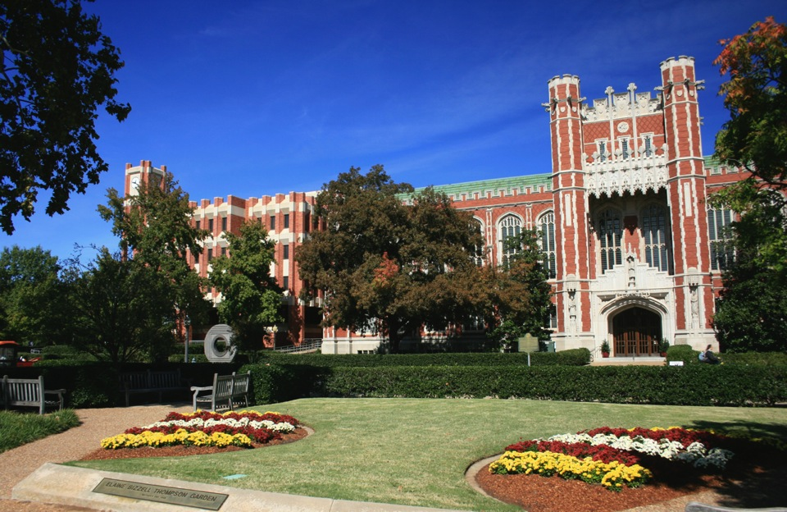

Galileo’s World: Driving Library Exhibitions to New Heights with State-of-the-art Technology
Carl Grant
Associate Dean, Knowledge Services and Chief Technology Officer

Slide 2
Agenda
Introduction - University of Oklahoma Libraries
Creating an exhibition without walls
  Physical
    Bridging locations to underscore “Intellectual Crossroads”
    Building an attractive exhibition space
  Virtual
    Digitization
    Repository
    Website
    Virtual Reality / Timeline / Semantic Web
    NavApp
    Tablet Displays
    E-books
    Hackathons
Lessons learned?

Slide 3
Agenda
Introduction - University of Oklahoma Libraries
Creating an exhibition without walls
  Physical
    Bridging locations to underscore “Intellectual Crossroads”
    Building an attractive exhibition space
  Virtual
    Digitization
    Repository
    Website
    Virtual Reality / Timeline / Semantic Web
    NavApp
    Tablet Displays
    E-books
    Hackathons
Lessons learned?

Slide 4


Notes:
OU is celebrating its 125 anniversary. It has been centered on Galileo’s World and of course, a fund raising drive.
We called our exhibition Galileo’s World and the word World is important. It is not about pure history of science exhibit, nor is it strictly about Galileo. It’s about our world and all the ways Galileo provided us with the foundations upon which today’s knowledge is built. It’s about knowledge building on knowledge. It’s about the importance of science.
You probably don’t realize that the OU is one of only two libraries on earth that have all 12 of Galileo’s first edition works. (The other library is the Vatican). Four of ours have Galileo’s handwriting in them.

Slide 5
University Goals
Library Strategic Plan
Library experience: virtual & physical
Special Collections
Research & data stewardship
External
forces
21st C. Library
Scholarly Communications
Workforce
Collections
Staff
Services
Facilities
Technology
Financial Resources
Notes:
At the highest level, are the goals of the university.
The library strategic plan is written to support those goals.
As resources, we have our collections, consisting of physical and digital content, both owned and licensed. Then we have our faculty and staff. Services are produced. All of this is housed in our facilities and all of this is leveraged and extended through technology.
The focus of our strategic plan are these five things that we see as moving us towards becoming a 21st century library.
Go over 5 pillars above.

Slide 6
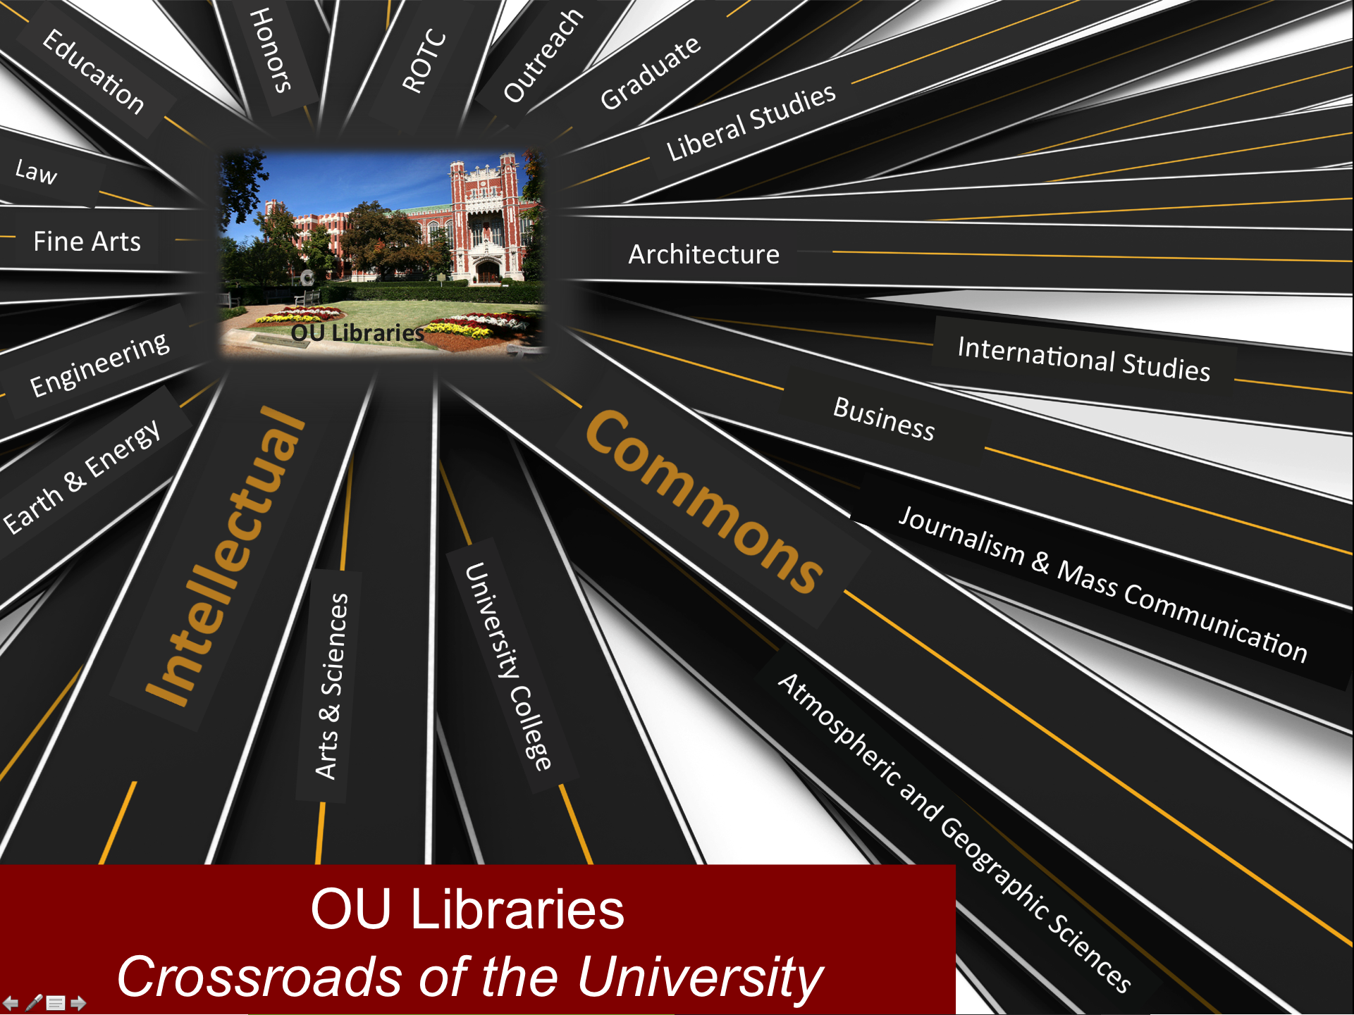
Notes:
We ARE the intellection commons, the crossroads of the community we serve.

Slide 7
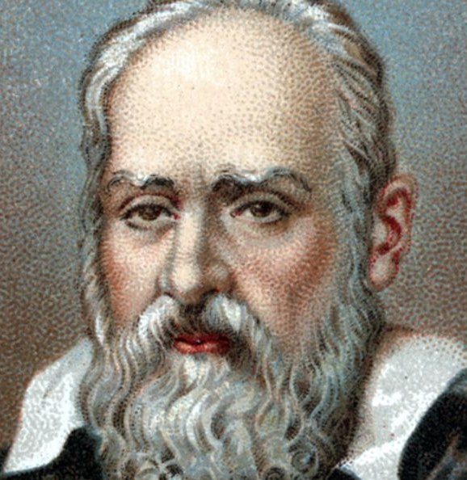
Galileo? Why do I care?
Born: Feb 15, 1564, in Pisa, Italy, Galileo Galilei was a mathematics professor who made pioneering observations of nature with long-lasting implications for the study of physics. He also constructed a telescope and supported the Copernican theory, which supports a sun-centered solar system. Galileo was accused twice of heresy by the church for his beliefs, and wrote books on his ideas. He died in Italy, on January 8, 1642.
http://www.biography.com/people/galileo-9305220

Slide 8
Major goals of G.W. Exhibition:
Celebrate the 125 anniversary of the University.
Emphasize the library as the intellectual crossroad, bring the University together around the exhibit
All should be able to go and see it (physically or virtually)
Make it appealing to scholars, public & youth
Show the importance of science and that knowledge builds on knowledge

Slide 9
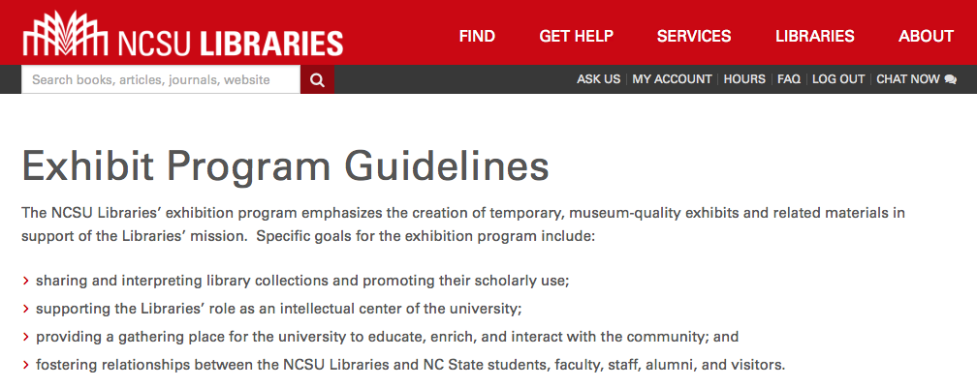
Why are Libraries, like OU, engaging in exhibitions?

Slide 10
Major Special Collections @ OU
Bizzell Bible Collection
Harry W. Bass Business History Collection
History of Science Collection
Johan and Mary Nichols Rare Books and Special Collections
Western History Collections
Daniel and Ruth Boorstin Collection

Slide 11
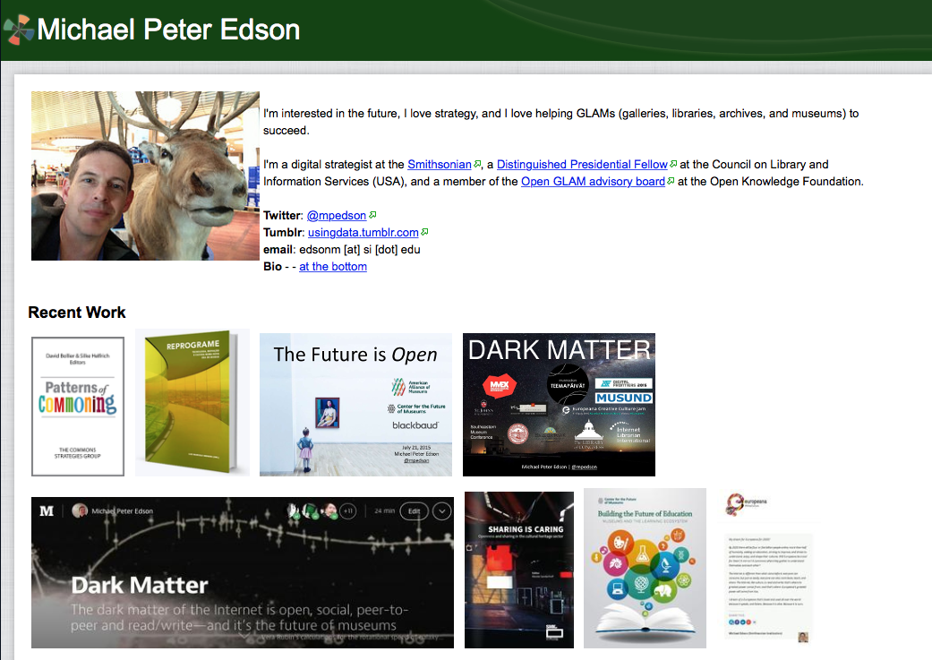
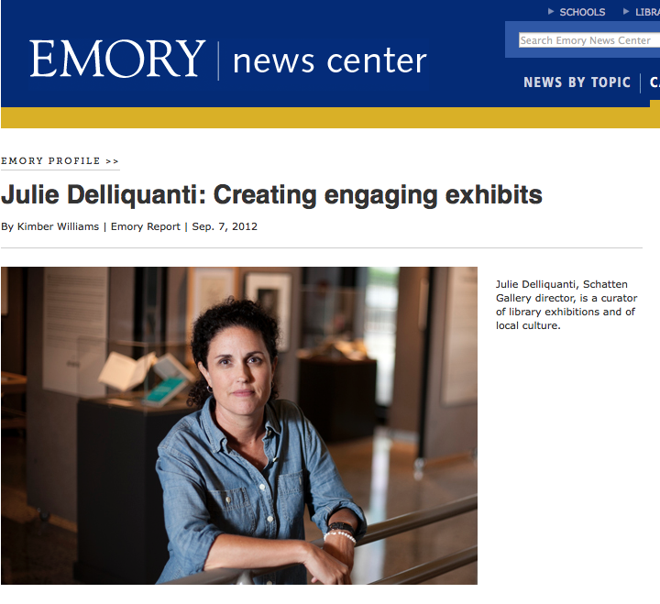
Consulted with:
http://michaelpeteredson.wikispaces.com

Slide 12
Agenda
Introduction - University of Oklahoma Libraries
Creating an exhibition without walls
  Physical
    Bridging locations to underscore “Intellectual Crossroads”
    Building an attractive exhibition space
  Virtual
    Digitization
    Repository
    Website
    Virtual Reality / Timeline / Semantic Web
    NavApp
    Tablet Displays
    E-books
    Hackathons
Lessons learned?

Slide 13
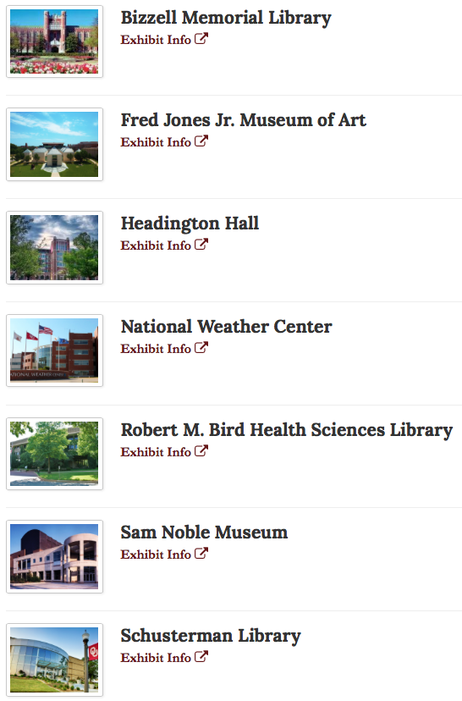
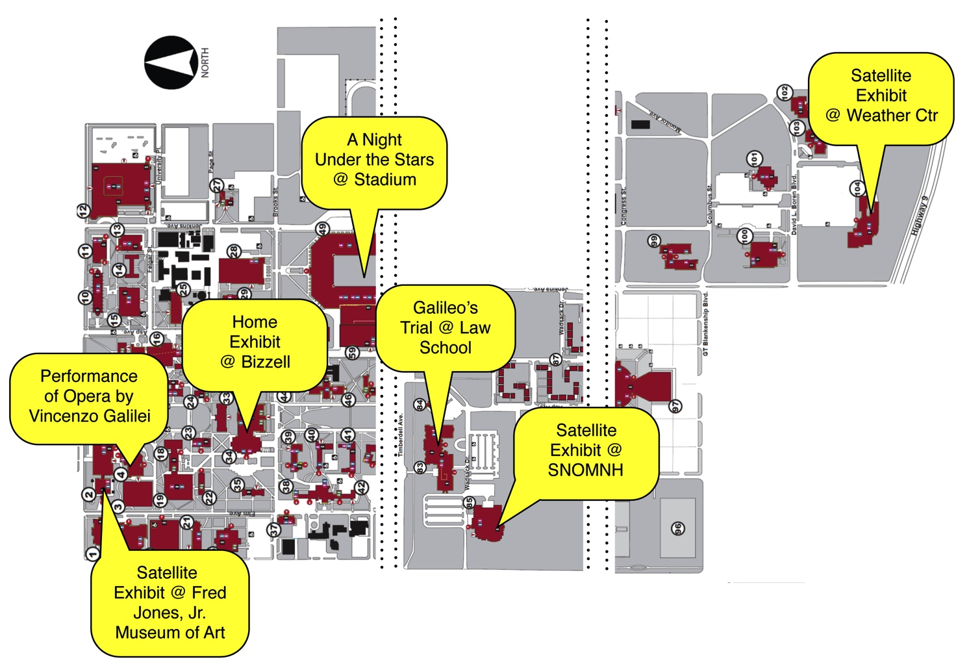

Slide 14
G.W. Exhibition brings together a total of:
3 Campuses
7 Different Locations
All linked together and supported by technology, programs, website and resources
Supporting the theme:
“Crossroads of the University”

Slide 15
Agenda
Introduction - University of Oklahoma Libraries
Creating an exhibition without walls
  Physical
    Bridging locations to underscore “Intellectual Crossroads”
    Building an attractive exhibition space
  Virtual
    Digitization
    Repository
    Website
    Virtual Reality / Timeline / Semantic Web
    NavApp
    Tablet Displays
    E-books
    Hackathons
Lessons learned?

Slide 16
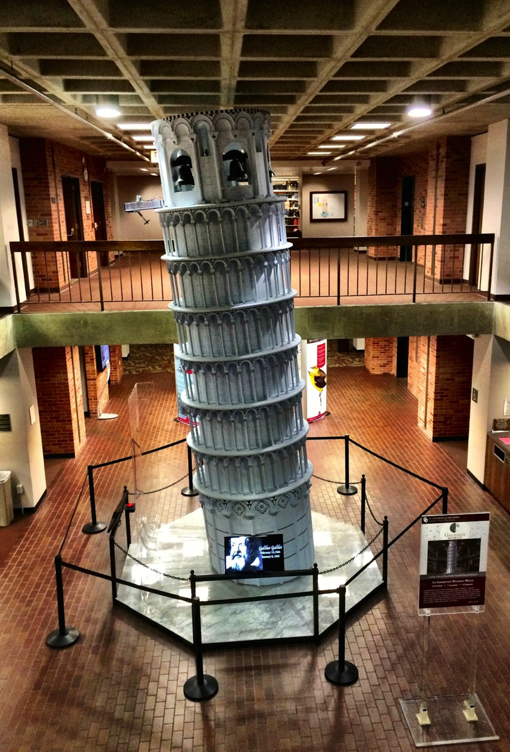
Featured in main lobby of Library:
20 foot replica of Tower of Pisa
  Built by College of Engineering
  Operating ball drop simulating Galileo’s reported test
  Speeds calculated and reported to user

Slide 17
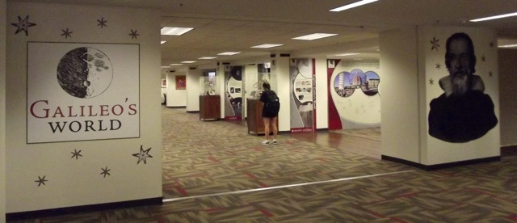
Digital Tech Square, Main Floor – Bizzell Memorial Library
Notes:
This floor explores the impact of Galileo’s work on today’s world.

Slide 18
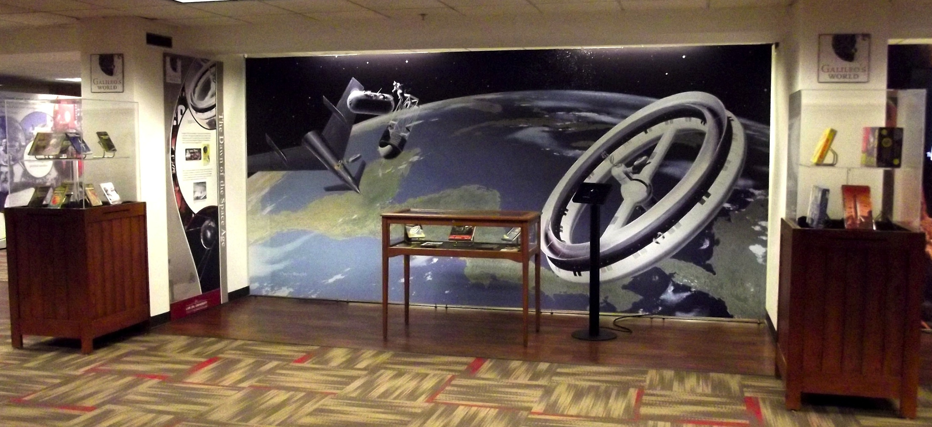
Digital Tech Square, Main Floor – Bizzell Memorial Library

Slide 19
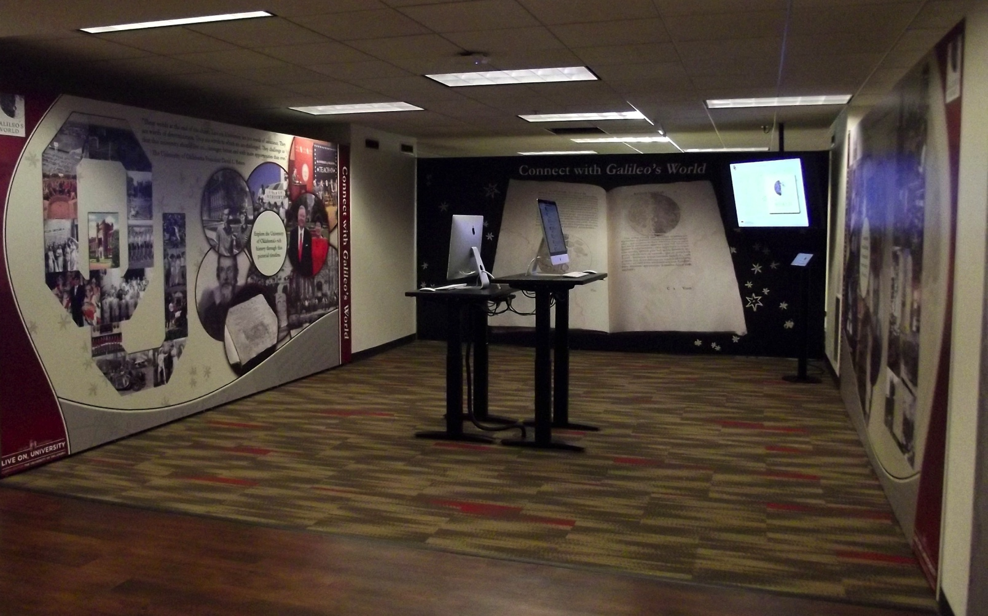
Digital Tech Square, Main Floor – Bizzell Memorial Library

Slide 20
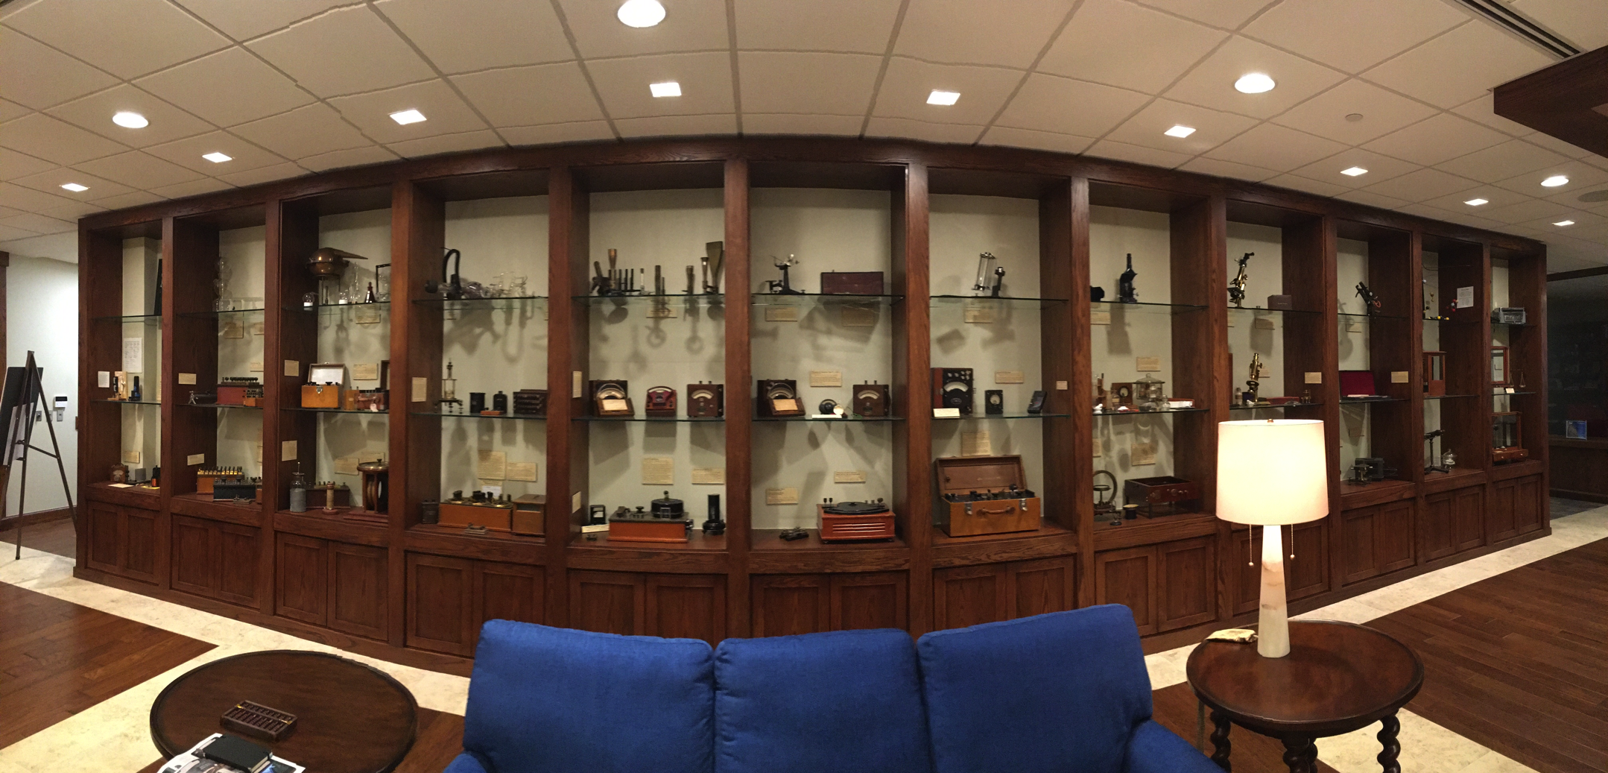
5th Floor – Special Collections – Bizzell Memorial Library

Slide 21
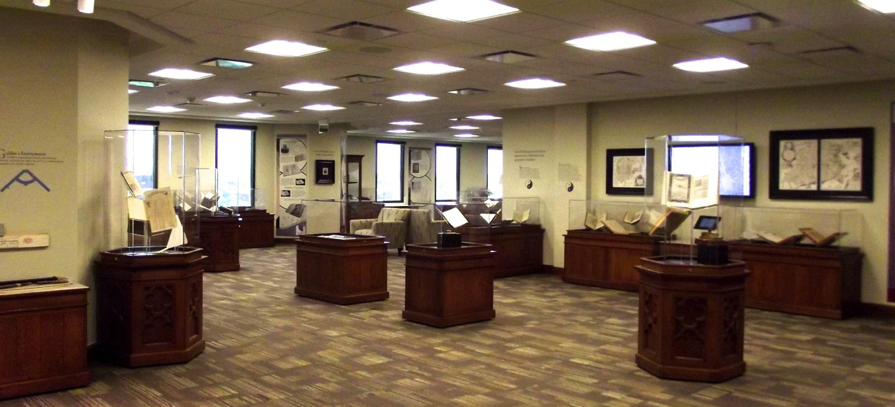
5th Floor – Special Collections – Bizzell Memorial Library

Slide 22
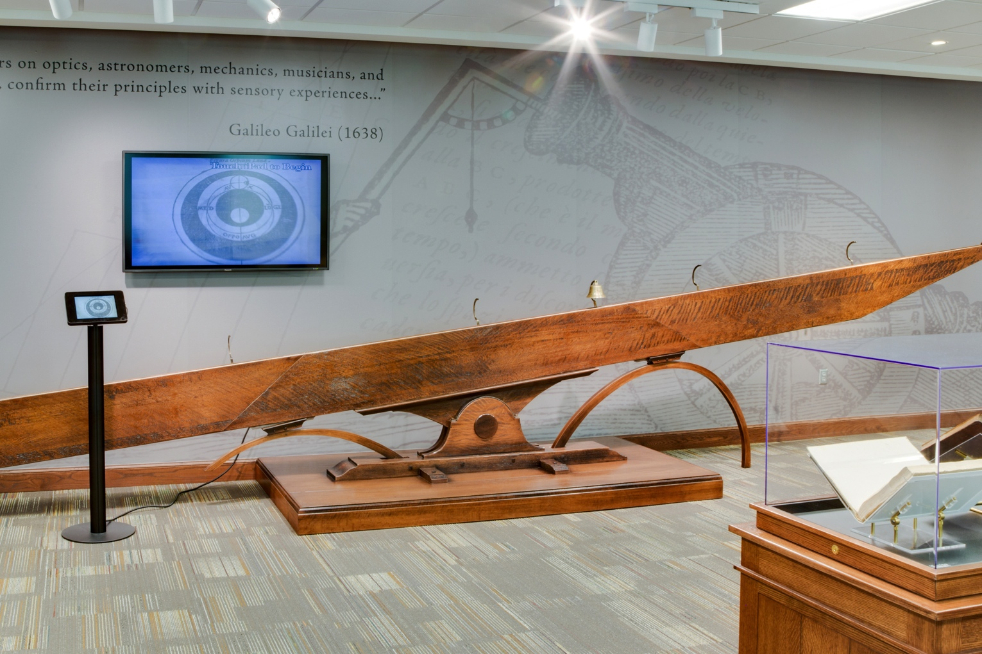
5th Floor – Special Collections – Bizzell Memorial Library
Notes:
Galileo’s incline plane

Slide 23
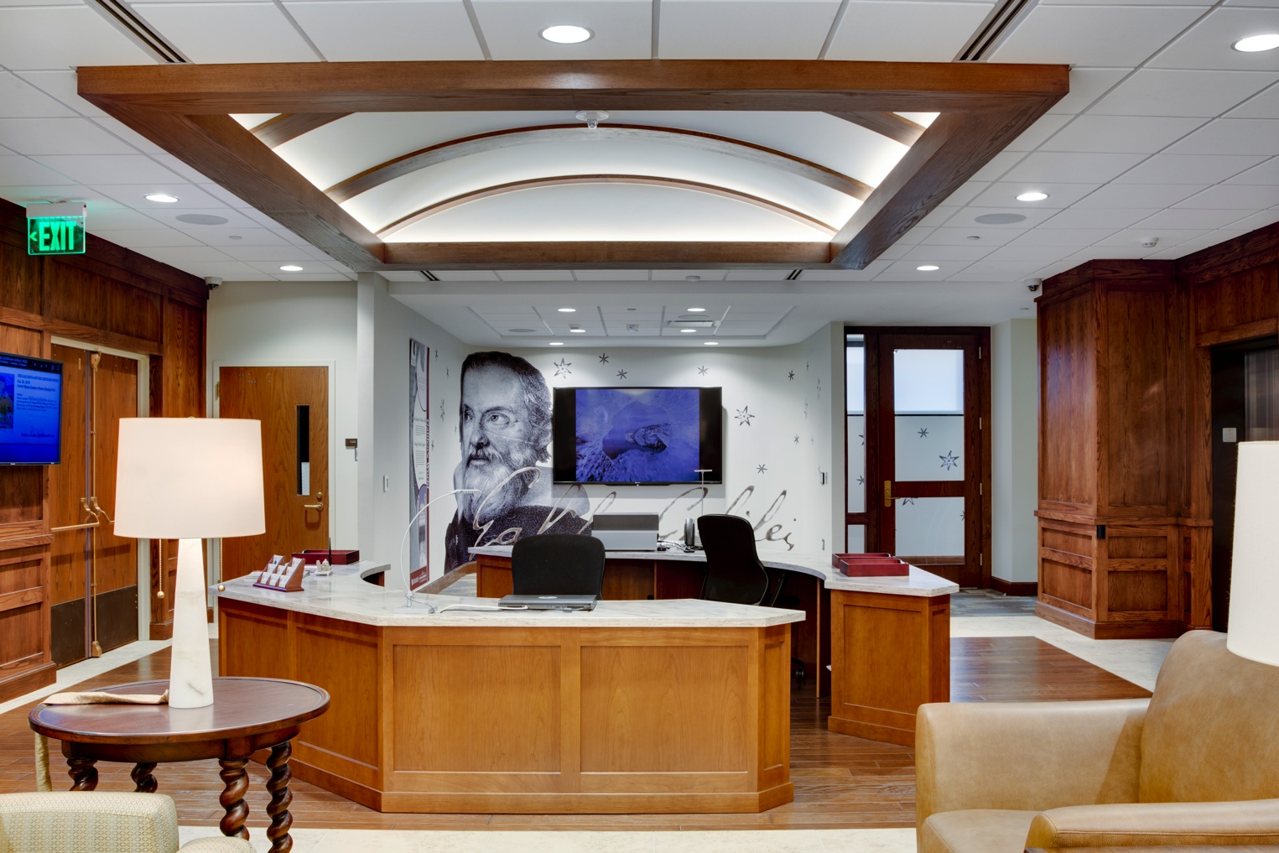
5th Floor – Special Collections – Bizzell Memorial Library

Slide 24
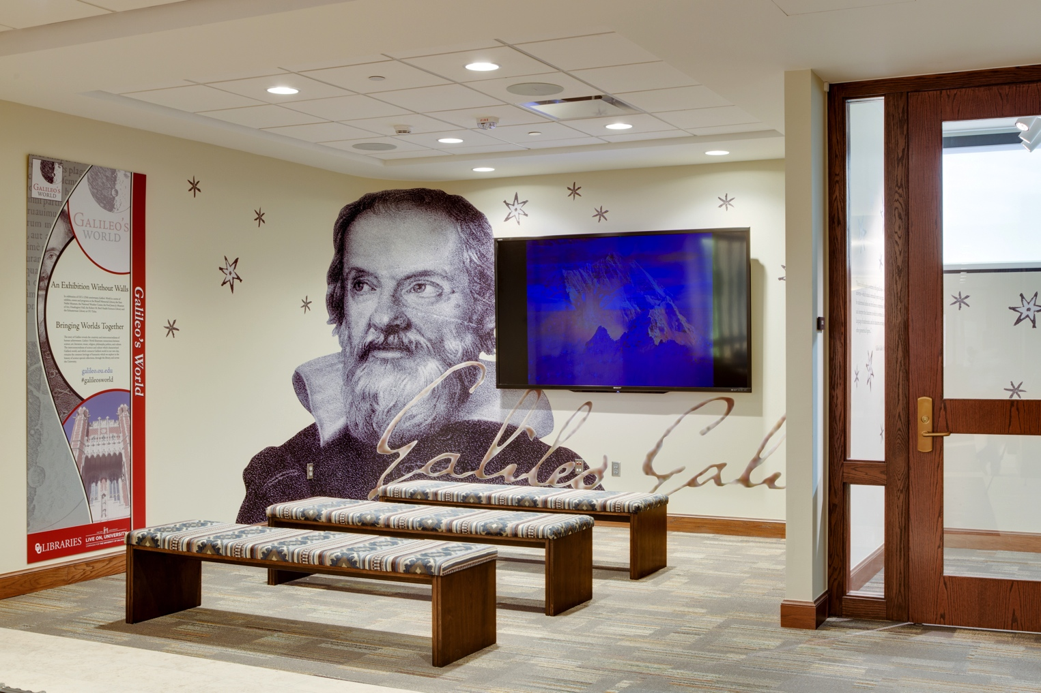
5th Floor – Special Collections – Bizzell Memorial Library
Notes:
Main lobby theatre

Slide 25
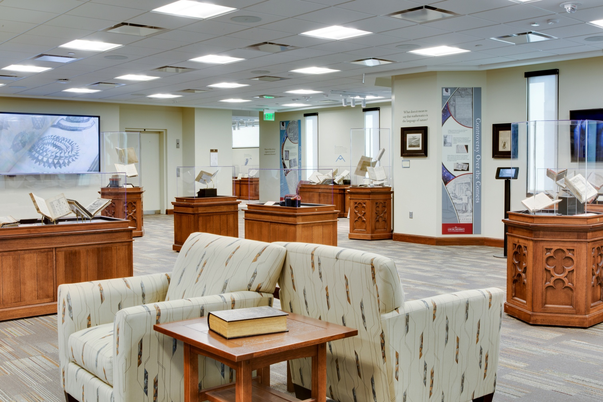
5th Floor – Special Collections – Bizzell Memorial Library

Slide 26
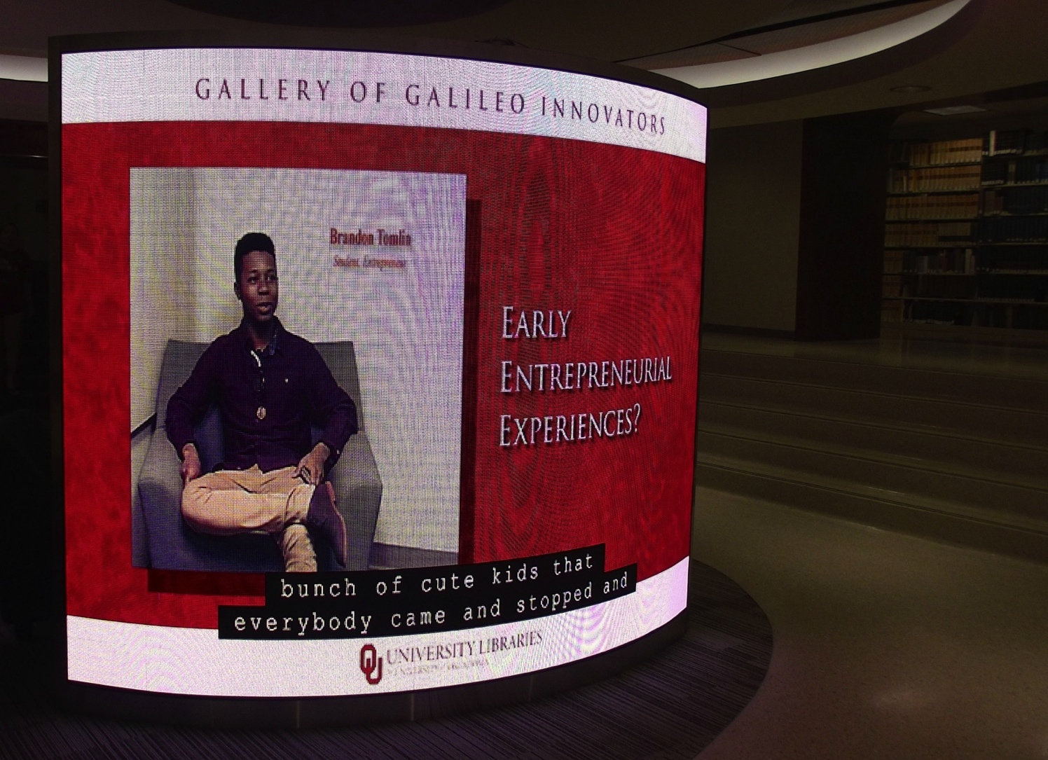
Lower Level 1 – HCLC – Bizzell Memorial Library

Slide 27
Total Physical Exhibition Visitors
August - 433
September – 1,468
October – 1,633
November – 1,521

Slide 28
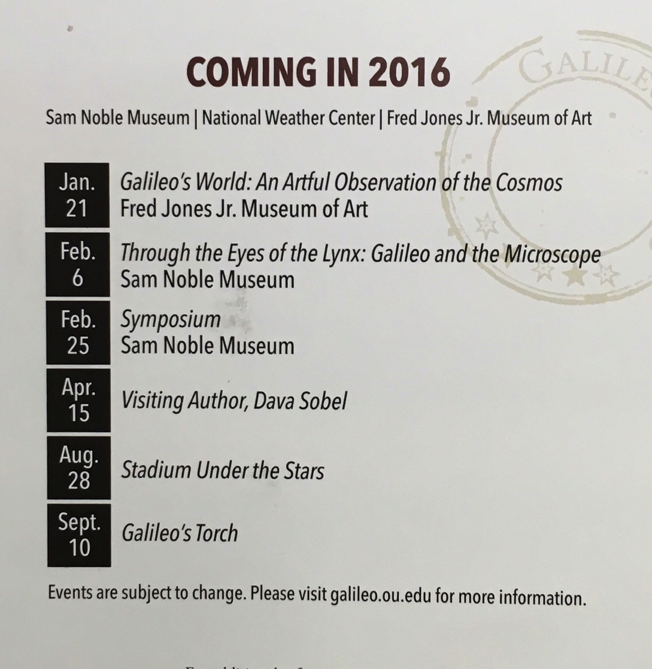

Slide 29
Agenda
Introduction - University of Oklahoma Libraries
Creating an exhibition without walls
  Physical
    Bridging locations to underscore “Intellectual Crossroads”
    Building an attractive exhibition space
  Virtual
    Digitization
    Repository
    Website
    Virtual Reality / Timeline / Semantic Web
    NavApp
    Tablet Displays
    E-books
    Hackathons
Lessons learned?

Slide 30
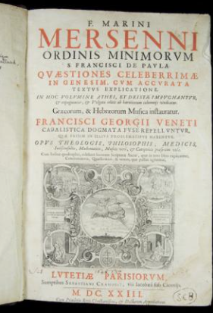
Digitization
Over 250 books & maps (~108,000 pages) were digitized in their entirety to support exhibition.

Slide 31
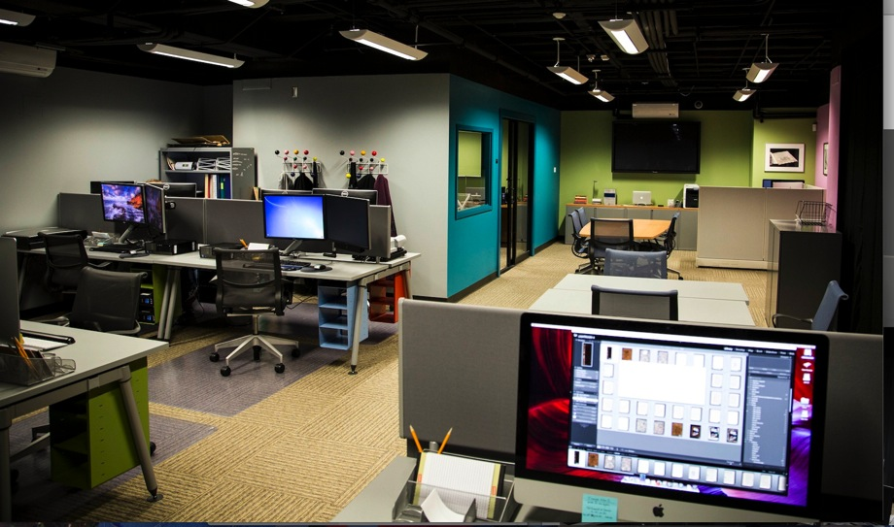
DigiLab @ University of Oklahoma Libraries
Notes:
We digitize at very high resolutions to capture details of or beyond the ability of the naked eye to see. The images can be resized in order to examine very fine details, including the evenness of the printer’s ink, texture of the paper and the structure of the binding.
Lab has two full time staff and about 40 undergrad and grad students that worked on Galileo’s World.

Slide 32
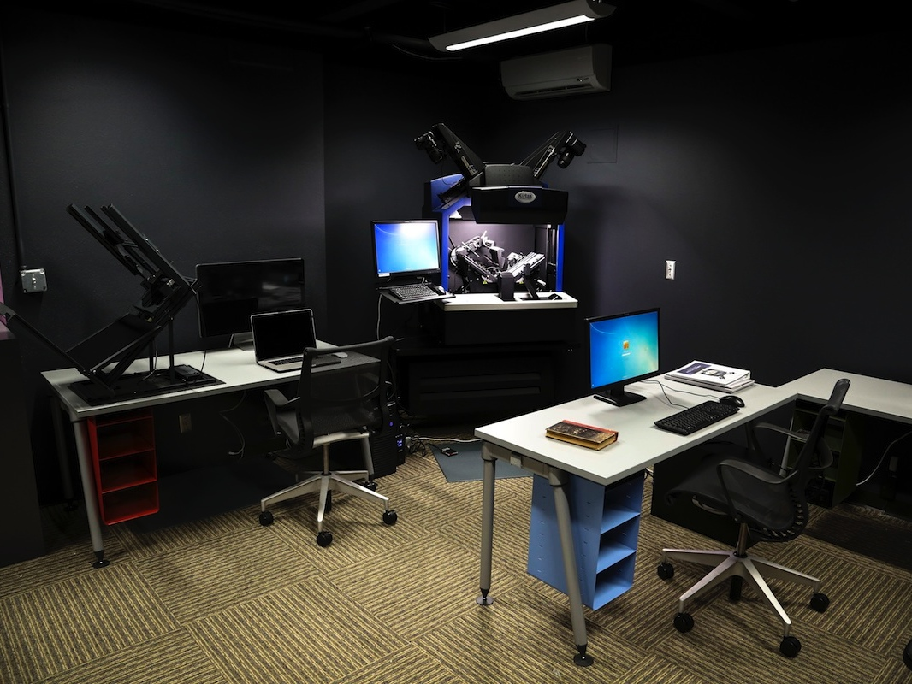
DigiLab @ University of Oklahoma Libraries

Slide 33
Agenda
Introduction - University of Oklahoma Libraries
Creating an exhibition without walls
  Physical
    Bridging locations to underscore “Intellectual Crossroads”
    Building an attractive exhibition space
  Virtual
    Digitization
    Repository
    Website
    Virtual Reality / Timeline / Semantic Web
    NavApp
    Tablet Displays
    E-books
    Hackathons
Lessons learned?

Slide 34
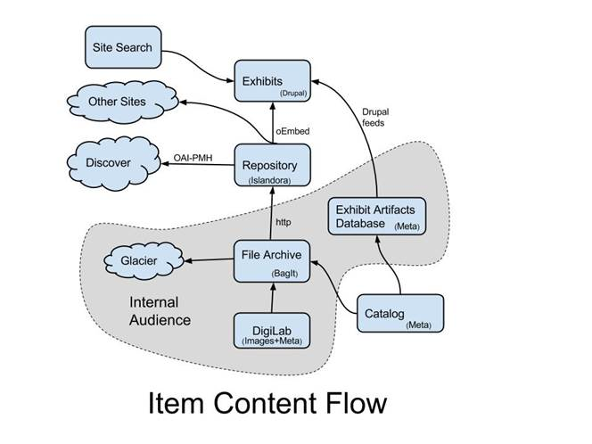
Repository
Installed Fedora repository with an Islandora interface and launched it, with content, for opening of Galileo’s World.

Slide 35
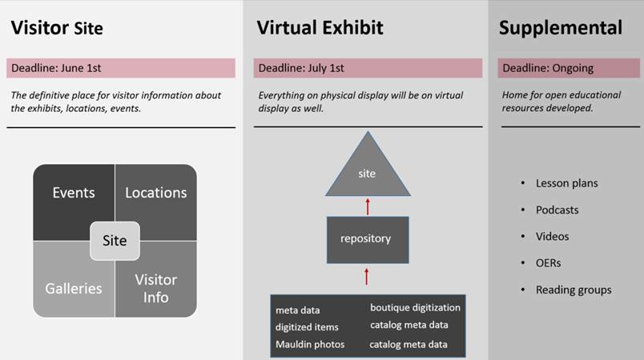

Slide 36
Agenda
Introduction - University of Oklahoma Libraries
Creating an exhibition without walls
  Physical
    Bridging locations to underscore “Intellectual Crossroads”
    Building an attractive exhibition space
  Virtual
    Digitization
    Repository
    Website
    Virtual Reality / Timeline / Semantic Web
    NavApp
    Tablet Displays
    E-books
    Hackathons
Lessons learned?

Slide 37
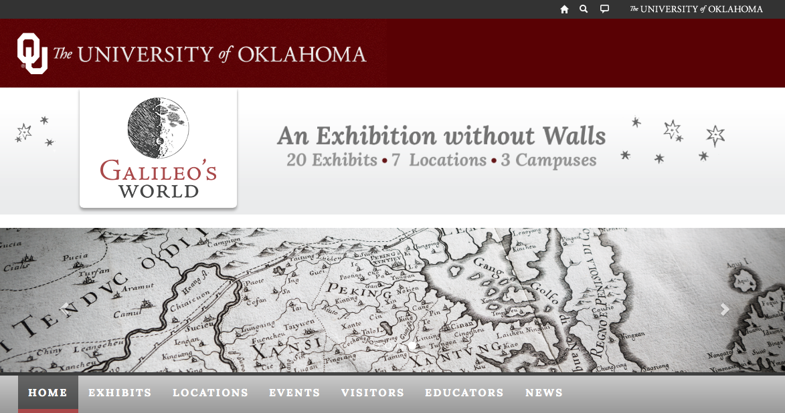
Website
http://galileo.ou.edu
Drupal based website developed
Descriptions from the Curator
Images of every item in exhibit
Embedded book viewer for most works
Information on all exhibits, events, programs, educational resources.
Links to social media.

Slide 38
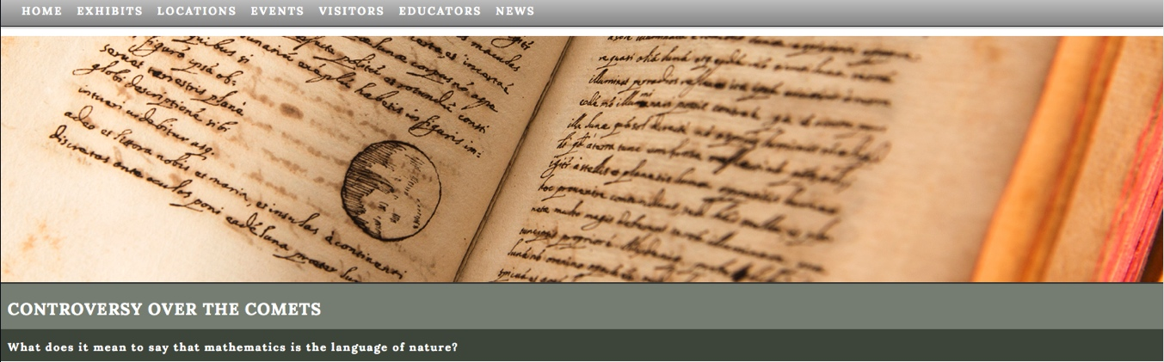
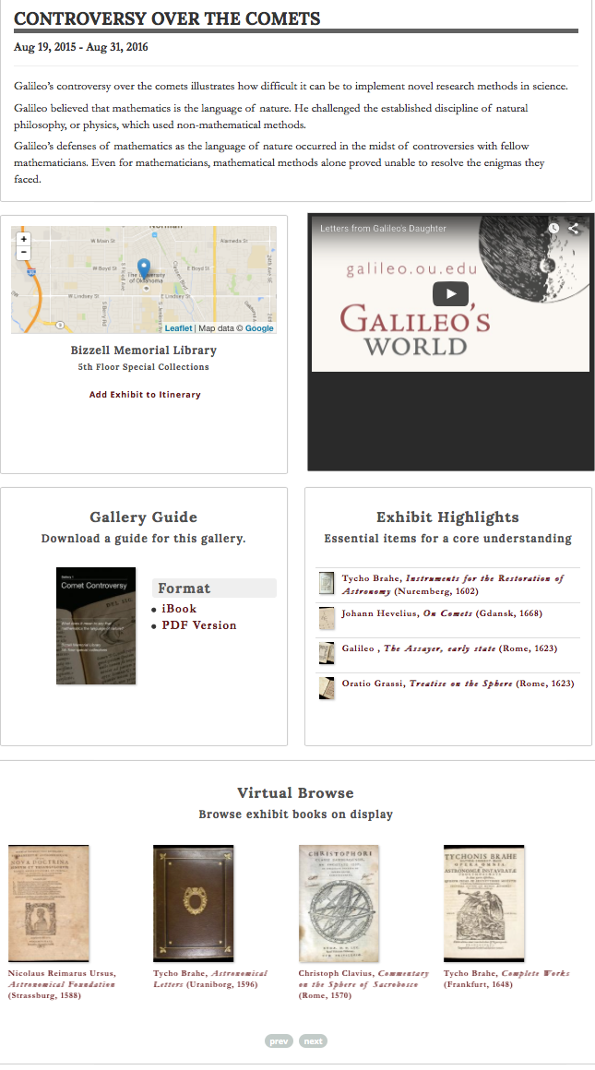
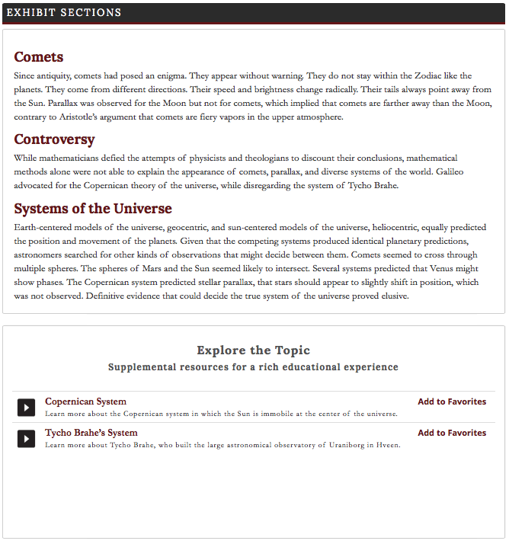
Sample Webpage

Slide 39
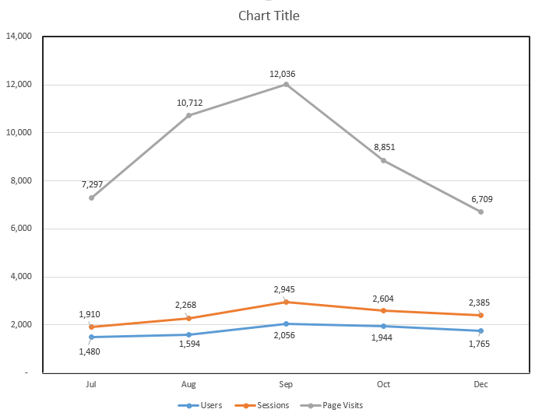
Total Website (w/o Walls) Exhibition Visitors

Slide 40
Agenda
Introduction - University of Oklahoma Libraries
Creating an exhibition without walls
  Physical
    Bridging locations to underscore “Intellectual Crossroads”
    Building an attractive exhibition space
  Virtual
    Digitization
    Repository
    Website
    Virtual Reality / Timeline / Semantic Web
    NavApp
    Tablet Displays
    E-books
    Hackathons
Lessons learned?

Slide 41
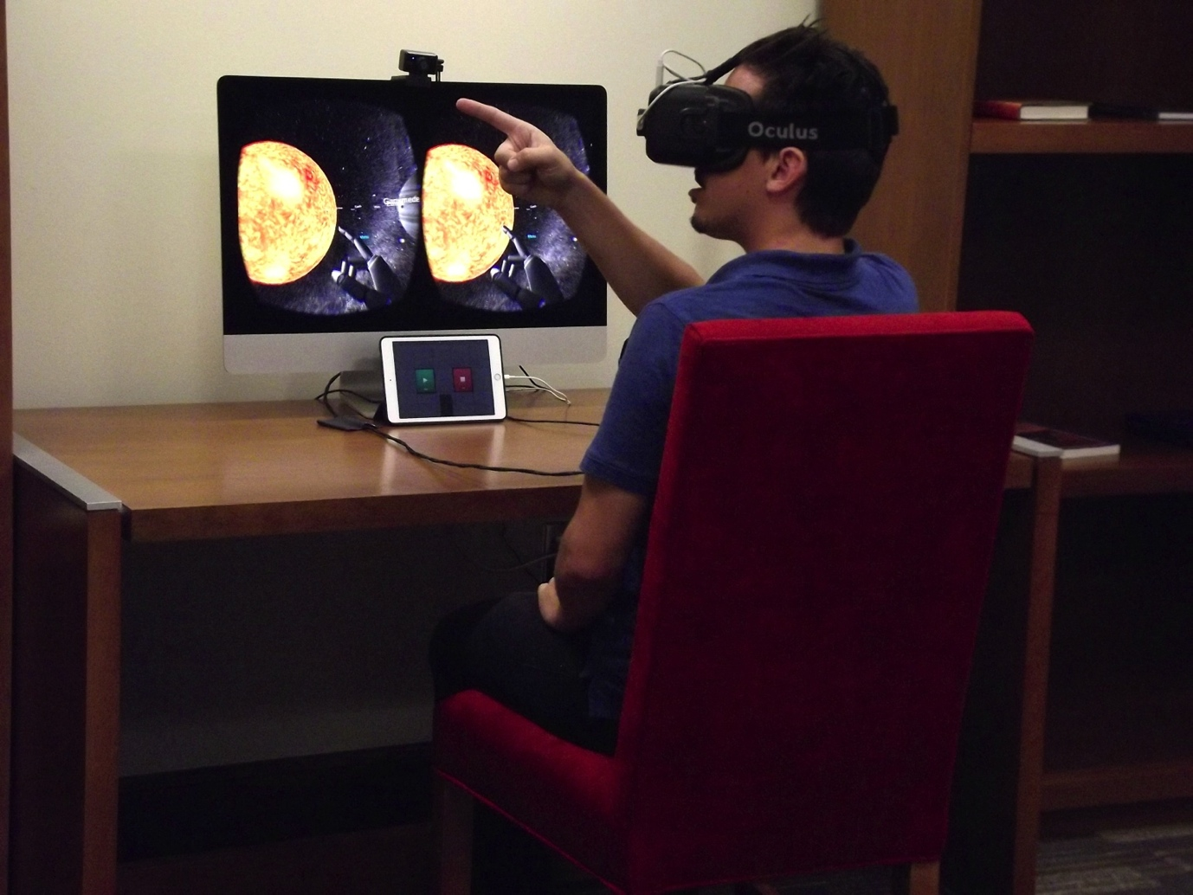
Virtual Reality

Slide 42
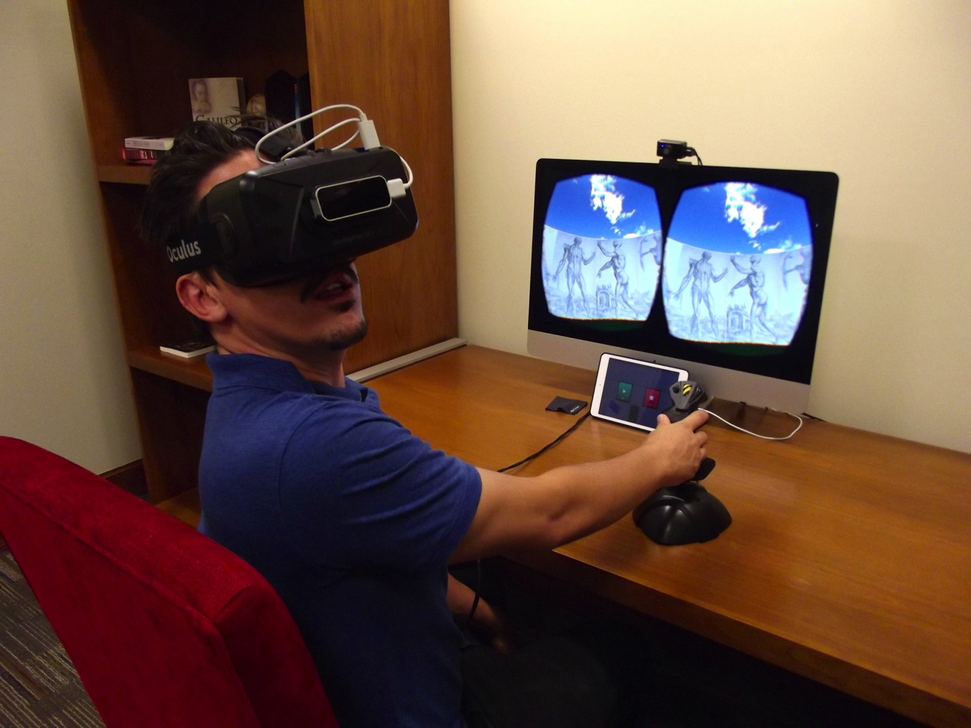
Virtual Reality
Notes:
Map GORES

Slide 43
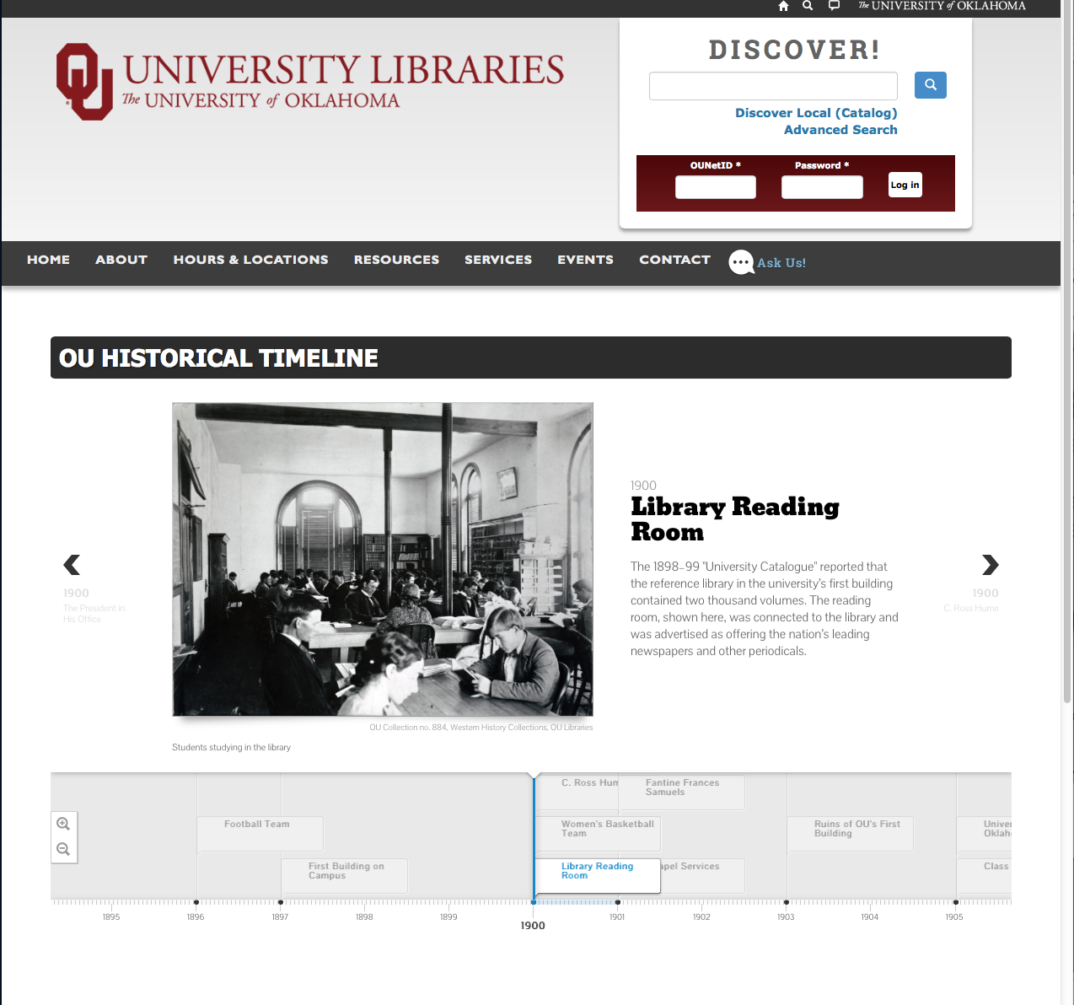
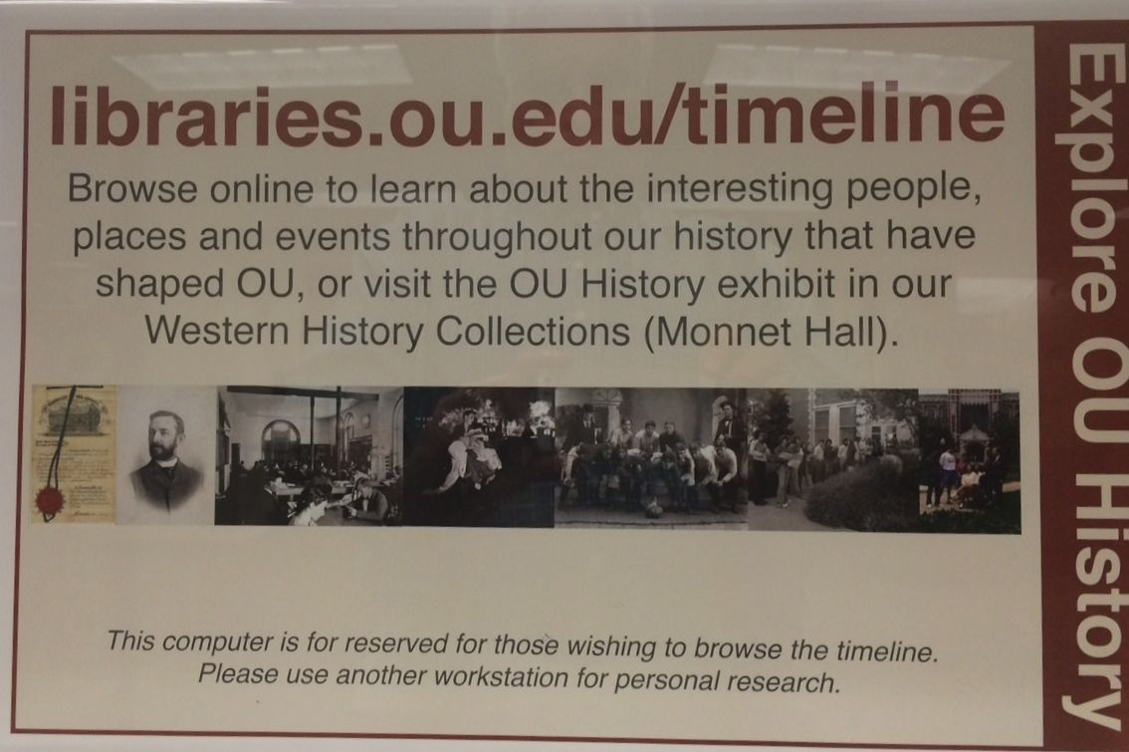

Slide 44
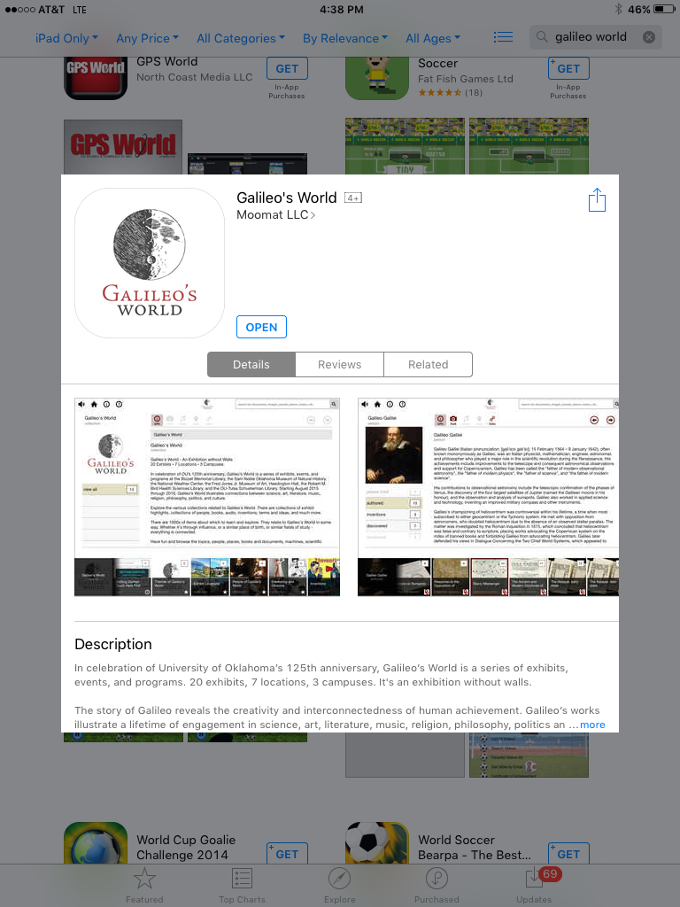
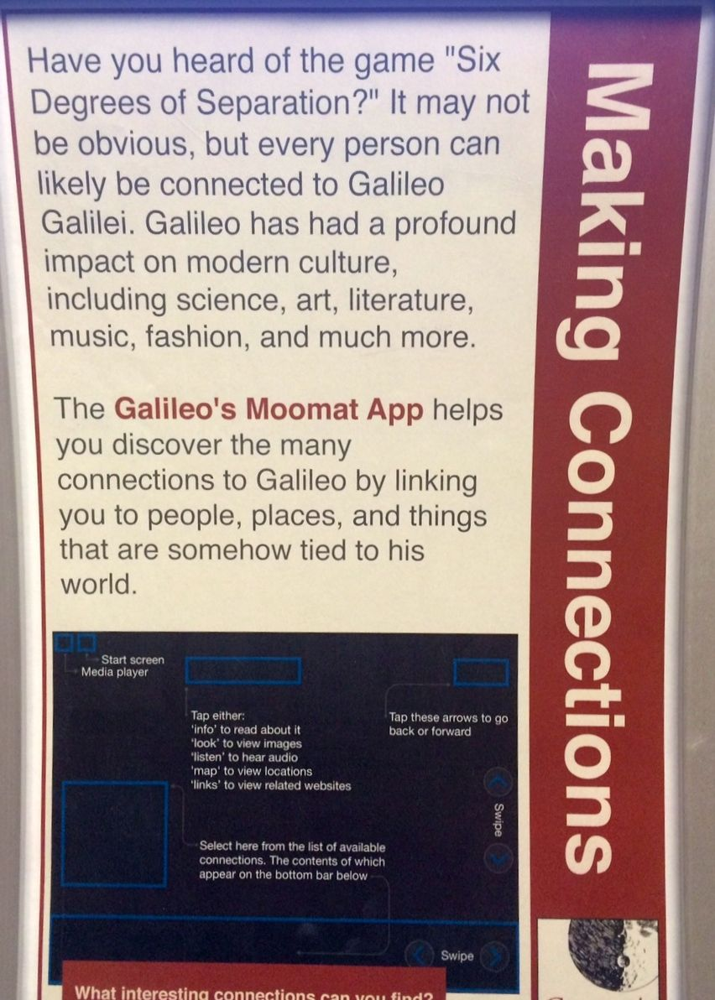
MooMat’s CultureScout implementation of Galileo’s World is downloadable from the App Store

Slide 45
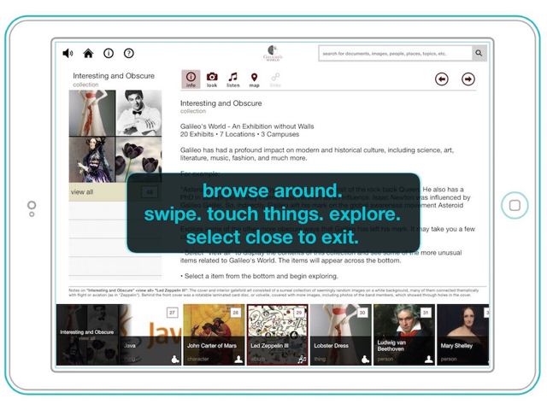

Slide 46
Agenda
Introduction - University of Oklahoma Libraries
Creating an exhibition without walls
  Physical
    Bridging locations to underscore “Intellectual Crossroads”
    Building an attractive exhibition space
  Virtual
    Digitization
    Repository
    Website
    Virtual Reality / Timeline / Semantic Web
    NavApp
    Tablet Displays
    E-books
    Hackathons
Lessons learned?

Slide 47
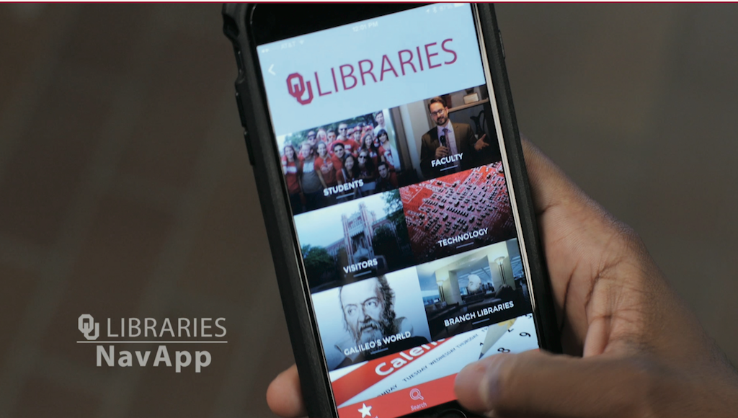
OU Libraries developed its first mobile app, OU Libraries NavApp
For iOS and Android
Provides Bluetooth-beacon-based indoor navigation in OU’s main library (Bizzell), exhibit case-specific content and,
GPS-based outdoor navigation across the OU Norman campus

Slide 48
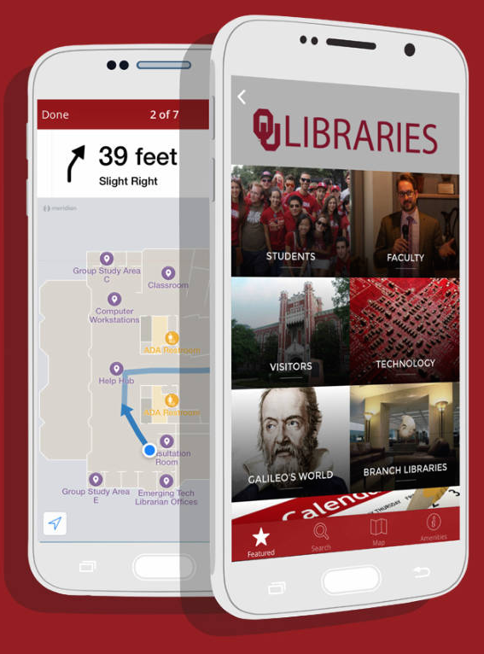
Goals of NavApp?
Unify digital/physical campus resources
Simplify complex indoor (and outdoor) environments
Support Galileo’s World exhibition across campus
Generate campus-wide interest in innovative tool
Feed useful content based on location and user type
Provide analytics for gauging resource usage throughout campus

Slide 49
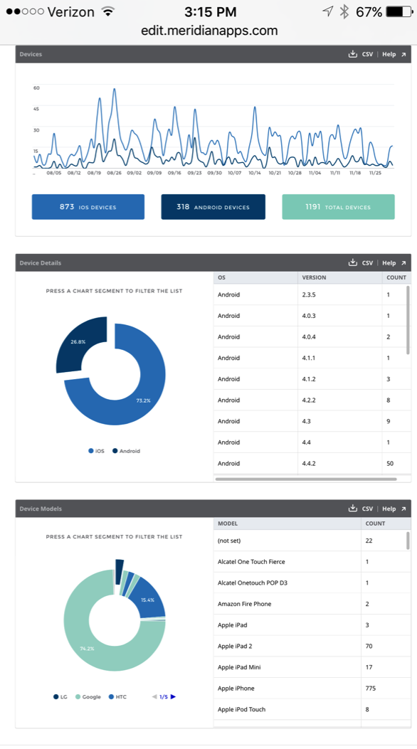
Usage of NavApp (2 Months)
Unique Users: 1,200
  ~900 iOS
    775 iPhones alone
  ~300 Android
Screen Views: 19,673
  Per visitor: 16.5*
Buildings Covered: 4 + Campus
  Beacons Deployed: 400
  Outdoor, campus map includes all major campus buildings + collections

Slide 50
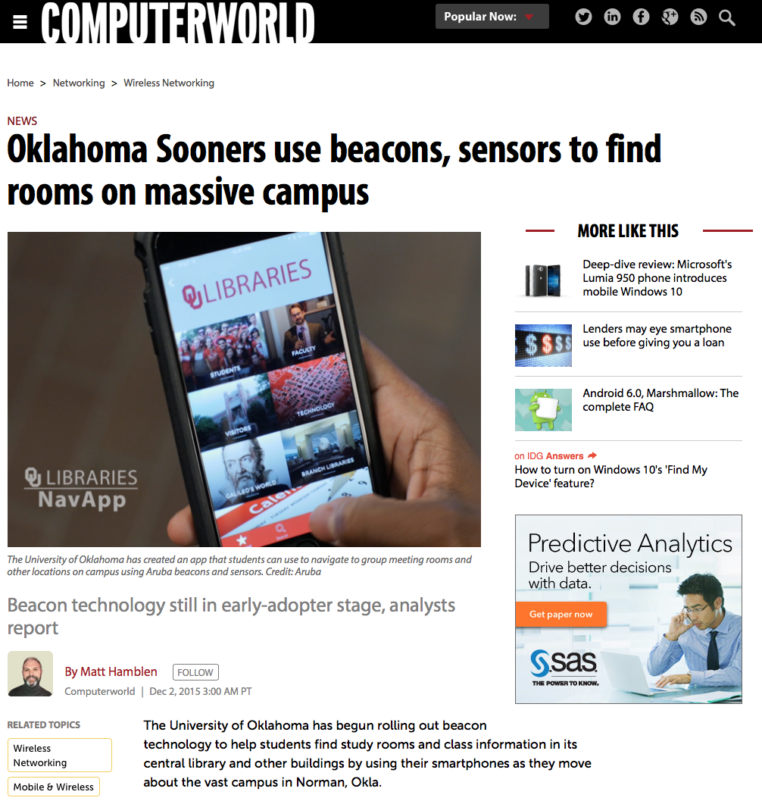
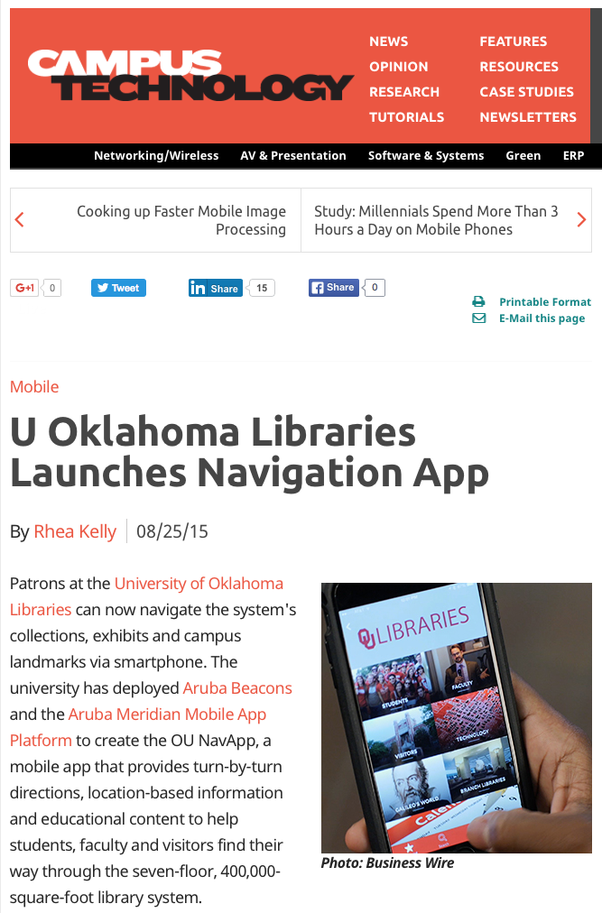

Slide 51
Agenda
Introduction - University of Oklahoma Libraries
Creating an exhibition without walls
  Physical
    Bridging locations to underscore “Intellectual Crossroads”
    Building an attractive exhibition space
  Virtual
    Digitization
    Repository
    Website
    Virtual Reality / Timeline / Semantic Web
    NavApp
    Tablet Displays
    E-books
    Hackathons
Lessons learned?

Slide 52
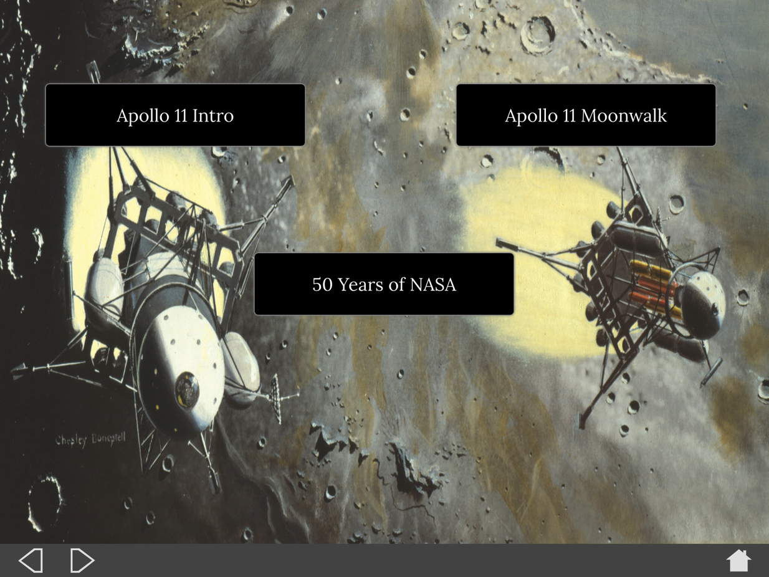
Tablet Displays
Developed a separate app for each nook in Digital Technology Square, including:
Dawn of Space Age
Mars and the Imagination
Quest of Other Worlds

Slide 53
Agenda
Introduction - University of Oklahoma Libraries
Creating an exhibition without walls
  Physical
    Bridging locations to underscore “Intellectual Crossroads”
    Building an attractive exhibition space
  Virtual
    Digitization
    Repository
    Website
    Virtual Reality / Timeline / Semantic Web
    NavApp
    Tablet Displays
    E-books
    Hackathons
Lessons learned?

Slide 54
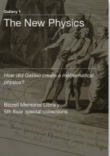
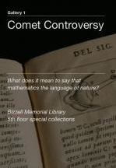
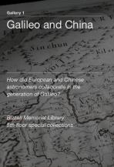
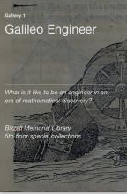
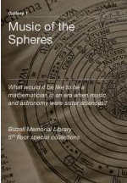
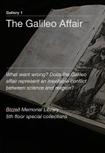
E-Books
Created “Gallery Guides” using iBook Author
Done for the 5th floor exhibits only
Offered 2 versions:
  PDF for people w/o iPads
  iBook version (fully interactive)

Slide 55
Agenda
Introduction - University of Oklahoma Libraries
Creating an exhibition without walls
  Physical
    Bridging locations to underscore “Intellectual Crossroads”
    Building an attractive exhibition space
  Virtual
    Digitization
    Repository
    Website
    Virtual Reality / Timeline / Semantic Web
    NavApp
    Tablet Displays
    E-books
    Hackathons
Lessons learned?

Slide 56
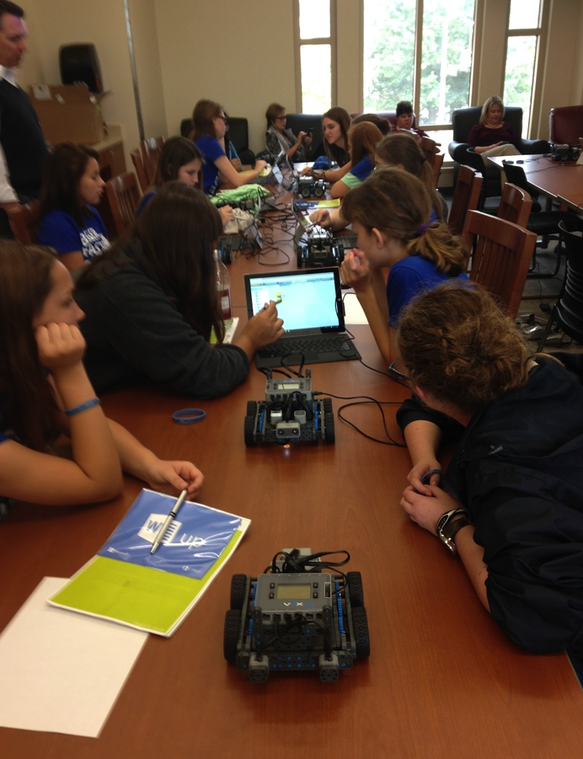

Hackathons
One U Cup - working on a Galileo's World VR session with Verizon
Digirlz session, - working on a session with Microsoft

Slide 57
Agenda
Introduction - University of Oklahoma Libraries
Creating an exhibition without walls
  Physical
    Bridging locations to underscore “Intellectual Crossroads”
    Building an attractive exhibition space
  Virtual
    Digitization
    Repository
    Website
    Virtual Reality / Timeline / Semantic Web
    NavApp
    Tablet Displays
    E-books
    Hackathons
Lessons learned?

Slide 58
Lessons Learned?
Know, and share widely, the vision/objectives of the exhibit
  Do they support the larger organizational objectives?
  What should the end-user experience be? Develop user stories
Define the scope of the exhibit
  Document and define in an MOU w/all parties. Signed!
  Include counts, timelines, milestones, desired impacts & measures
“ADBD” – Always Digitize Before Display
  Ensure legal permissions are in place

Slide 59
Lessons Learned?
Apply project management techniques
  Ensure all parties are present at all stages of creation of the plan
  Develop and share critical paths also Plans “B” & “C”
  Know order lead and delivery times on technology components. Is this in the project plan?
  What are the quality checks? By who? When? How often?
Use agile techniques and break down silos that might exist between the teams
Plan the promotion/marketing well ahead
  Don’t forget social media promotion plan!

Slide 60
Future Plans?
Implement support of IIIF
Support more hack-a-thons & events, i.e. “Stadium under the Stars” event in the OU Football stadium
Moving to a “DevOps” approach to future exhibitions
Implement website ideas described in this book…

Slide 61

Recommendation
Read and use this book’s ideas in your exhibition websites

Slide 62
Q & A
Carl Grant
Associate Dean for Knowledge Services
Chief Technology Officer
M: +1-540-449-2418
E: carl.grant@ou.edu
Twitter: http://www.twitter.com/carl_grant
Personal Blog: http://thoughts.care-affiliates.com

