Slide 1
SELFISH LUNG SYNDROME
Xu Jackie Zhang, OMS-IV; Vishal Mundra, MD Oklahoma State University College of Osteopathic Medicine

Slide 2
What is Congenital lobe emphysema (CLE)?
Rare congenital developmental anomaly characterized by hyperinflation of one or more pulmonary lobes.
Prevalence: 1 out of 20000/30000. Higher incidence in males.
Etiology is unknown.
Most frequently identified cause is obstruction of developing airway, occurs in 25%.
Obstruction can be intrinsic or extrinsic.
Intrinsic causes: bronchomalacia or absent cartilage, causing alveolar distention.
  This creates compression atelectasis → ventilation perfusion mismatch
  Air trapping on expiration due to a ball-valve effect.
Extrinsic compression can be caused by vascular anomalies or intrathoracic masses.
Left upper lobe affected most often, 40-50% of the cases.

Slide 3
Case report
Patient is a 55 year old male, with a hx of CLE and tobacco abuse, who comes to the ED with dyspnea and cough. He was in mild distress, tachypneic, and oxygen saturations were in the 70s. He had a barrel-shaped chest wall and some expiratory wheezes were noted as well. He was not on oxygen at home and did not follow up with a pulmonologist. Pt denied having any surgical intervention for his congenital malformation other than bronchoscopy as a child.

Slide 4
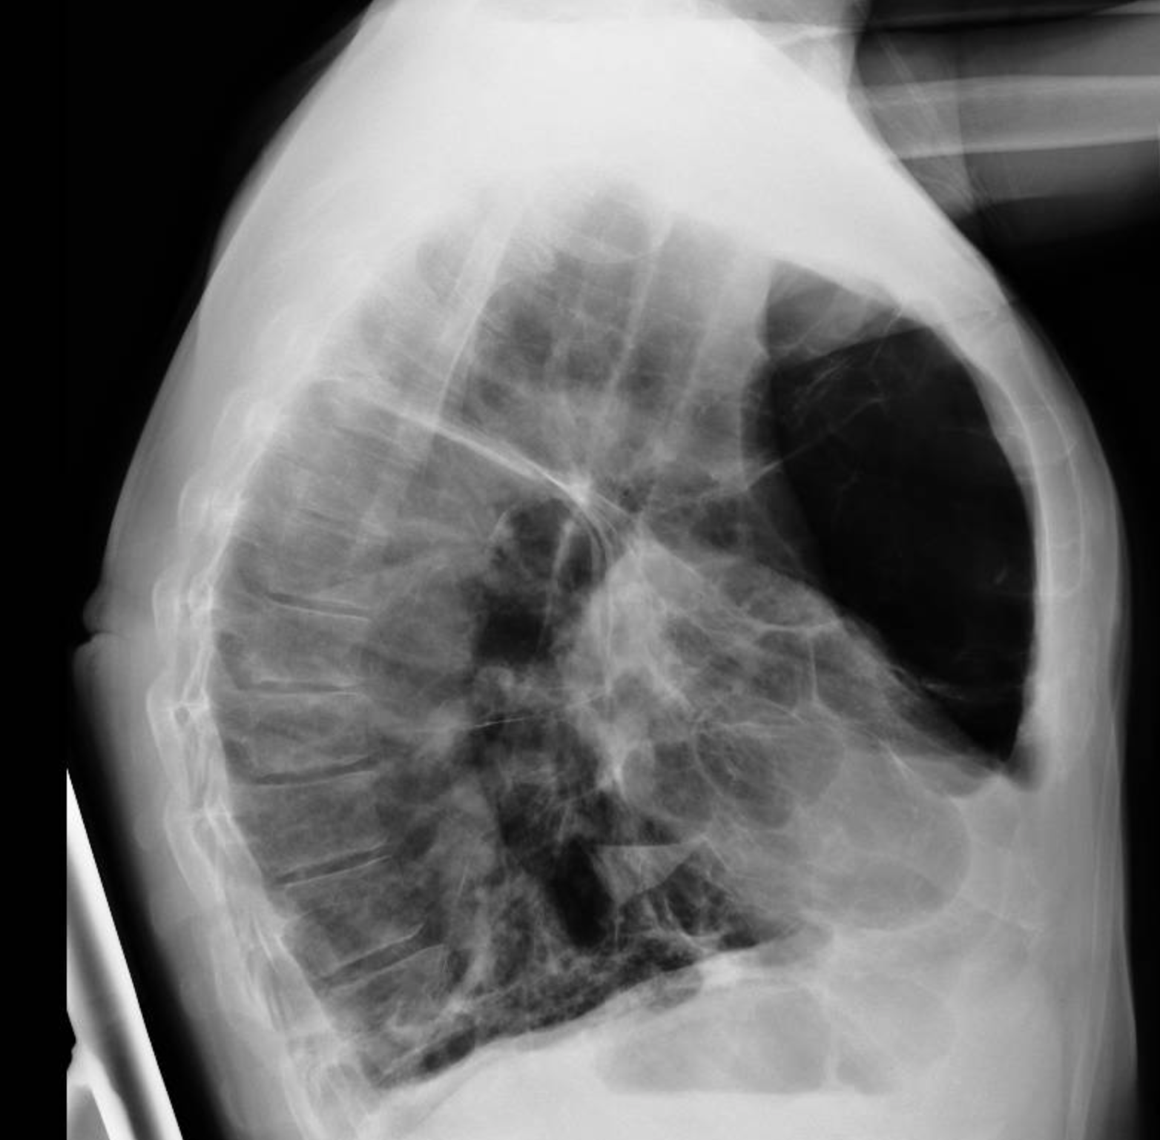
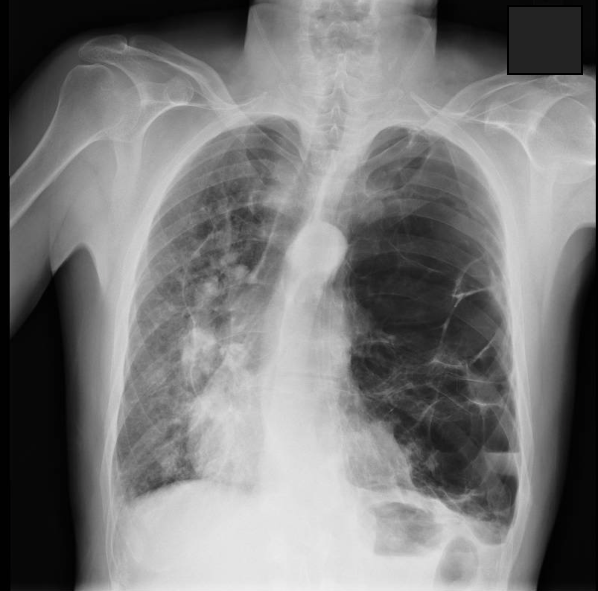
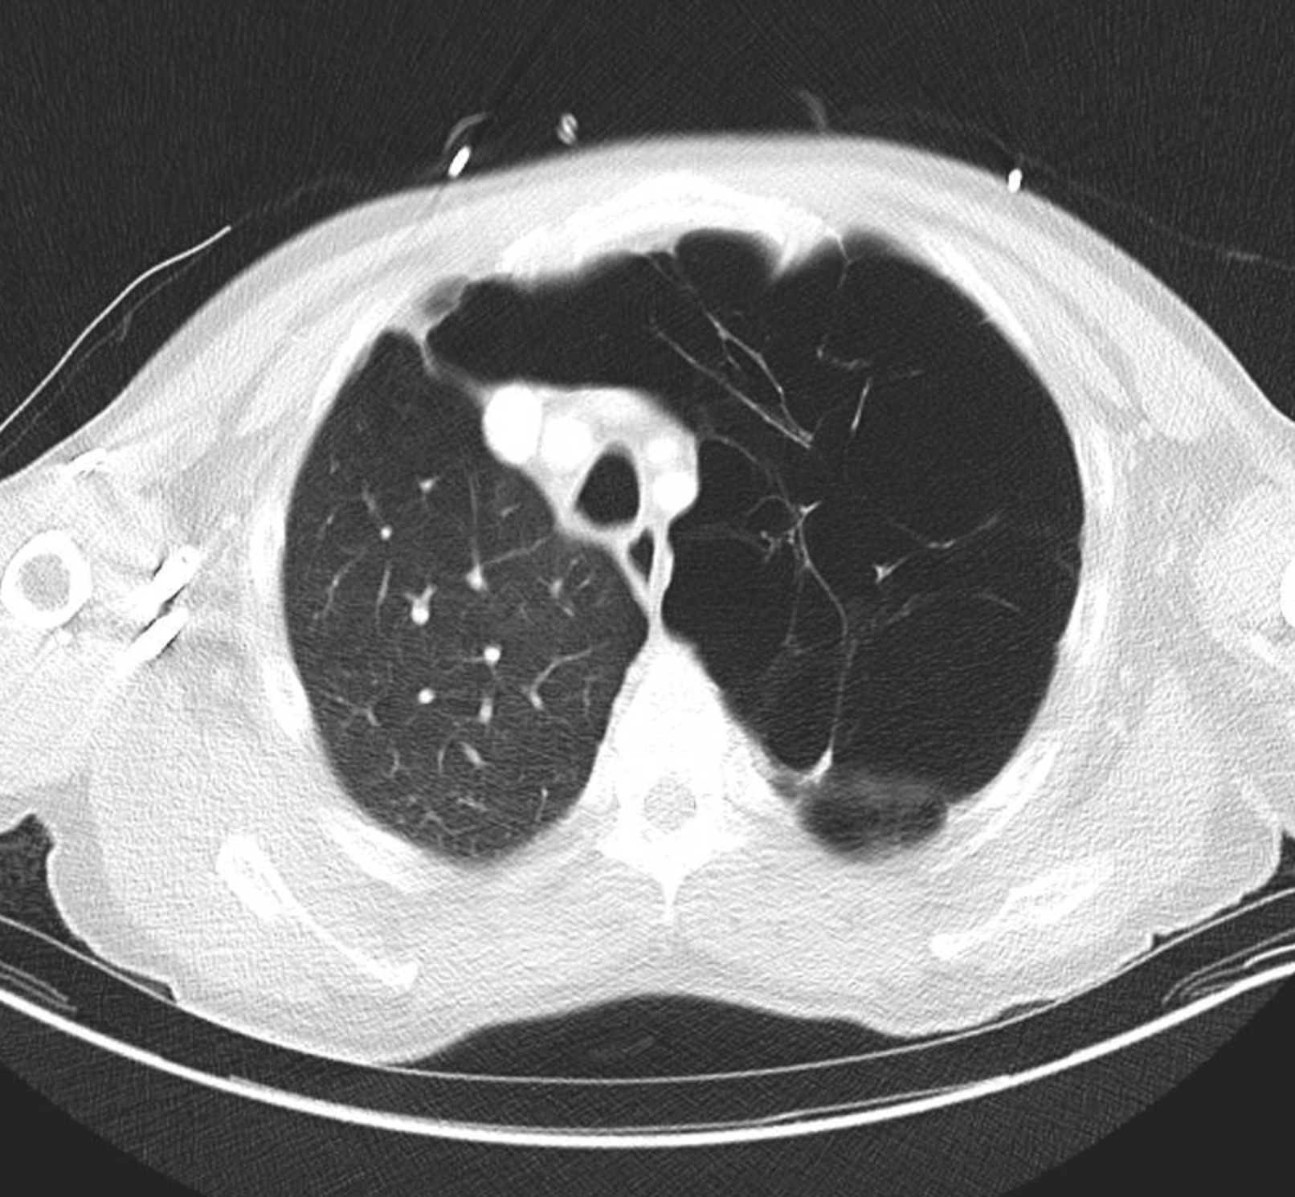
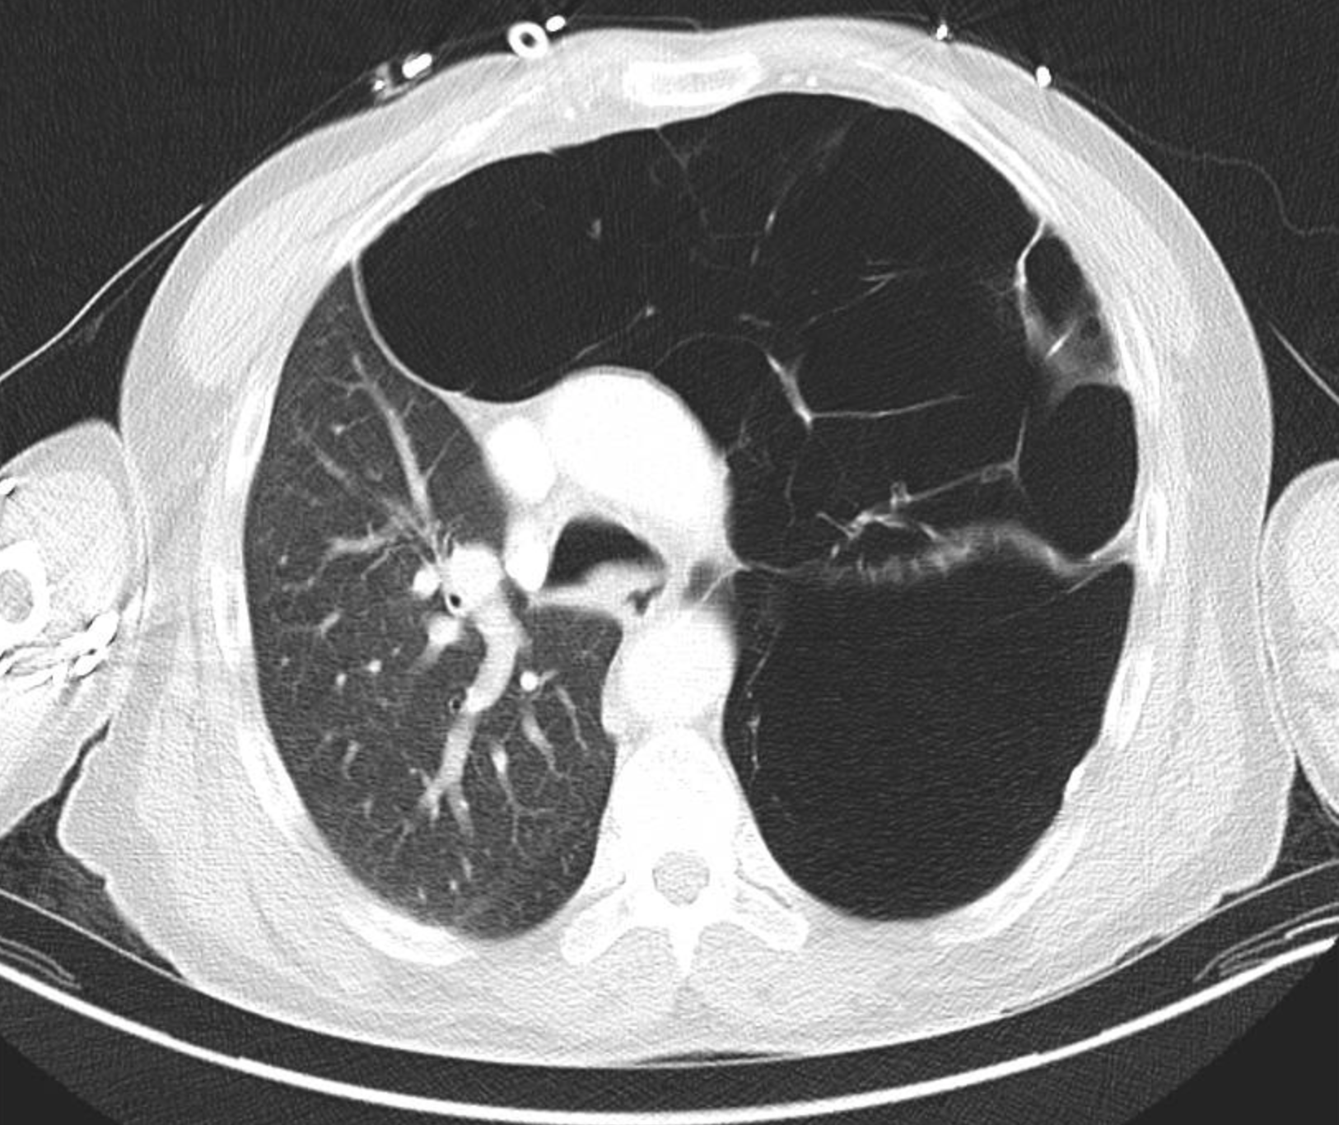
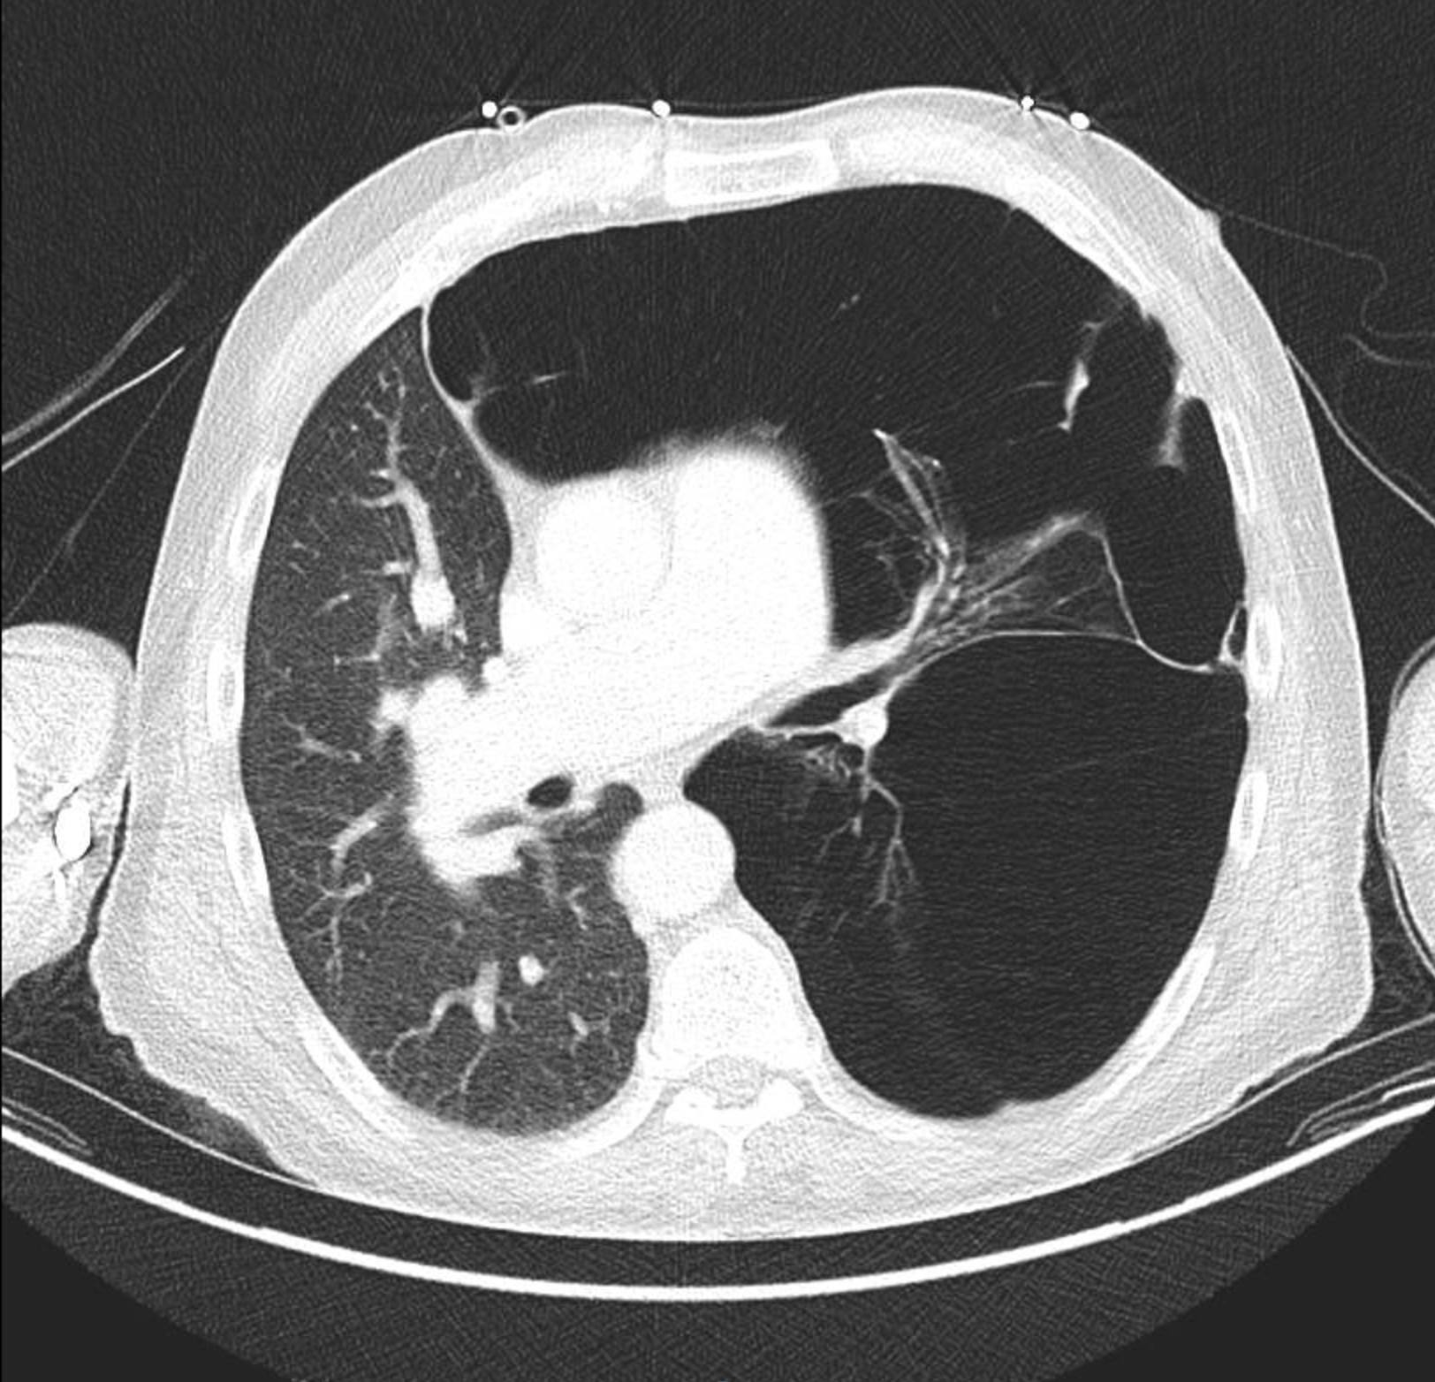
imaging

Slide 5
imaging
CT chest with contrast:
  Massive congenital lobar overinflation/emphysema involving the entirety of the left lung with mass effect on the right lung and deviation of the anterior junction line by approximately 8 cm to the right.
  Additional airspace opacities within the left lower lobe with fluid/fluid level within some of the left-sided bullae, raising the possibility of pneumonia.

Slide 6
Case report
Pulmonology consulted.
Cardiothoracic surgical team consulted
  Recommended left pneumonectomy
Patient chose to pursue outpatient surgery.
At the time of discharge: hemodynamically stable, saturating above 90%, at baseline.
Unfortunately, patient was lost to follow up.

Slide 7
Conclusion
Patient was mostly asymptomatic throughout his life.
Lungs continue to deteriorate.
Perhaps if he had regular follow up with a pulmonologist, the damages to his lung could have been limited.
Early surgical intervention has been found to significantly improve the patient’s condition. However, number of lobes affected can also determine the outcome of surgery.
Remind patients the importance of monitoring and follow up regardless of symptom status.

Slide 8
References
Cataneo, Daniele Cristina, Rodrigues, Olavo Ribeiro, Hasimoto, Erica Nishida, Schmidt Jr, Aurelino Fernandes, & Cataneo, Antonio Jose Maria. (2013). Congenital lobar emphysema: 30-year case series in two university hospitals. Jornal Brasileiro de Pneumologia, 39(4), 418-426. https://doi.org/10.1590/S1806-37132013000400004
Chandran-Mahaldar D, Kumar S, Balamurugan K, Raghuram AR, Krishnan R, Kannan. Congenital lobar emphysema. Indian J Anaesth. 2009;53(4):482-485.
Chinya A, Pandey PR, Sinha SK, Sarin YK. Congenital lobar emphysema: Pitfalls in diagnosis. Lung India. 2016;33(3):317-319. doi:10.4103/0970-2113.180883

