Slide 1


Cluster Analysis as a More Precise Burnout Measure among Healthcare Providers
Auston Stiefer, MS3, Krista Kezbers, PhD, DipACLM, Tessa Austin, MS2, Amy Nguyen, BS, Heather McIntosh, MS, CRA, Bryan Touchet, MD

Slide 2
Background
Occupational Burnout (MBI)
→ 16- or 22- item survey
Emotional Exhaustion
Cynicism
Professional Inefficacy
1. Shanafelt TD, Boone S, Tan L, et al. Burnout and Satisfaction With Work-Life Balance Among US Physicians Relative to the General US Population. Arch Intern Med. 2012;172(18):1377–1385.
2. Leiter, Michael P, and Maslach, Christina. "Latent Burnout Profiles: A New Approach to Understanding the Burnout Experience." Burnout Research 3.4 (2016): 89-100.
Notes:
Studying physician burnout has become growingly important in recent years due to its implications for poor pt outcomes, medical errors, and physician health.
Maslach Burnout Inventory (MBI) is the validated, gold-standard measurement of occupational burnout¹
However, the 22- or 16-item survey generating multivariate psychometric data is often abbreviated when assessing physician burnout -- reducing burnout to a monolithic concept

Slide 3
Background
Abbreviated 1- or 2- item burnout measures lack multidimensional subscores & reduce burnout to a homogenous, discrete variable.
Maslach et al. have published findings demonstrating how this approach is non-validated
  Latent profile analysis & cluster analysis of subscores proposed as more robust approaches.³
Previous studies have already begun using this method for studying occupational burnout in other professions.
3. Berjot, Sophie, Altintas, Emin, Grebot, Elisabeth, and Lesage, François-Xavier. "Burnout Risk Profiles among French Psychologists." Burnout Research 7 (2017): 10-20

Slide 4
Methods
Secondary data analysis from 2019 OUSCM annual well-being survey
  16-item MBI with subscores alongside other social constructs
Additional TwoStep Cluster Analysis used via SPSS, method being validated.³
TwoStep Cluster Analysis = algorithm using distance models to identify non-random, repeating combinations of data from multivariate sets⁴
  In this study = repeating patterns of similar MBI subscores
3. Berjot, Sophie, Altintas, Emin, Grebot, Elisabeth, and Lesage, François-Xavier. "Burnout Risk Profiles among French Psychologists." Burnout Research 7 (2017): 10-20.
4. Conry, Mary C, Morgan, Karen, Curry, Philip, McGee, Hannah, Harrington, Janas, Ward, Mark, and Shelley, Emer. "The Clustering of Health Behaviours in Ireland and Their Relationship with Mental Health, Self-rated Health and Quality of Life." BMC Public Health 11.1 (2011): 692

Slide 5
Results
Total of 272 burnout subscores were included in TwoStep Cluster Analysis
Sample demographics (n=272):
  Mean age = 39.4 years
  78% female
  75.1% white
  57.2% staff

Slide 6
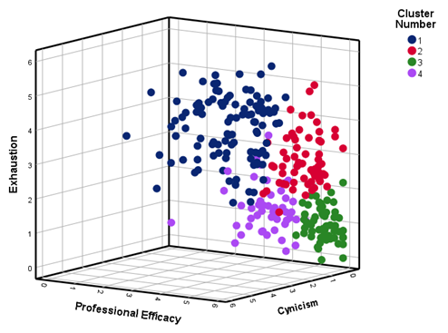
Results
“Fair” cluster quality, based on silhouette measure of cohesion and separation [0.2,0.5]
  Larger sample (>300) needed to reach “Good” [0.5,1]
This was secondary analysis, thus no a priori power analysis
  Included in next study
Notes:
-The silhouette measure of cohesion and separation was “Fair” and could be improved in the future by having larger sample sizes or fewer clusters. The 2 cluster result was the only one that provided a “Good” cluster rating but we did not feel this provided enough distinction for our exploratory analysis. Due to the exploratory nature of this study, we felt comfortable with the 4 clusters and “Fair” rating as it pertained to understanding how the different burnout subscores could be clustered together.
-For sample size, as a secondary data analysis, we had to use what data we had. An a priori power analysis can be conducted for the next study that aims to dig deeper into how clustering would work as a better evaluation method of the MBI.

Slide 7
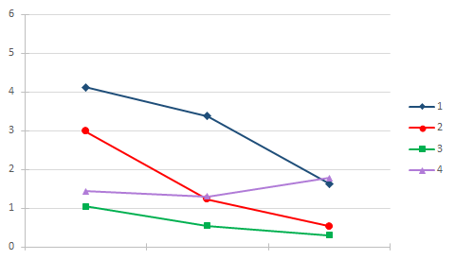
Results
Plot of Means from TwoStep Cluster Analysis
Cluster Number
Cluster Number | n | Mean Exhaustion | Mean Cynicism | Mean Inefficacy
1 | 105 | 4.12 | 3.3752 | 1.6302
2 | 62 | 2.9871 | 1.2258 | 0.5323
3 | 58 | 1.0414 | 0.5379 | 0.3046
4 | 47 | 1.4383 | 1.2979 | 1.7695
Exhaustion
Cynicism
Inefficacy
Notes:
1) respondents with high subscores in cynicism only alongside those with high subscores in all areas, 105 (38.6%);
2) respondents with high scores of exhaustion only, 62 (22.8%);
3) individuals with low scores in all areas, 58 (21.3%);
4) those with high scores of inefficacy only, 47 (17.3%).

Slide 8
Discussion
The emergent 4-cluster pattern in our population’s MBI data is consistent with results using the same methods in a sample of French psychologists.³
This method highlights the multidimensional, non-universal experience of burnout among academic medical professionals and trainees.
Expansion of cluster analysis in academic medical institutions will assist in developing more precise interventions to mediate burnout.
3. Berjot, Sophie, Altintas, Emin, Grebot, Elisabeth, and Lesage, François-Xavier. "Burnout Risk Profiles among French Psychologists." Burnout Research 7 (2017): 10-20.

Slide 9
Limitations
Less than 300 participants prevented our 4-cluster model from achieving “Good” cluster quality.
Sample was obtained from multidisciplinary population within healthcare.
Cross-sectional survey represents only one snapshot in time, does not reveal meaningful insight on burnout clusters over time.⁵
5. Gabbe S, Vetter M, Nguyen M, Moffatt-Bruce S, Fowler J. Changes in Burnout Profile of Chairs in Academic Departments of Obstetrics and Gynecology Over the Past 15 Years. 2018 American Journal of Obstetrics and Gynecology. 219(3):303-309.
.

Slide 10
References
Shanafelt TD, Boone S, Tan L, et al. Burnout and Satisfaction With Work-Life Balance Among US
Physicians Relative to the General US Population. Arch Intern Med. 2012;172(18):1377–1385.
Leiter, Michael P, and Maslach, Christina. "Latent Burnout Profiles: A New Approach to Understanding the
Burnout Experience." Burnout Research 3.4 (2016): 89-100.
Berjot, Sophie, Altintas, Emin, Grebot, Elisabeth, and Lesage, François-Xavier. "Burnout Risk Profiles
among French Psychologists." Burnout Research 7 (2017): 10-20.
Conry, Mary C, Morgan, Karen, Curry, Philip, McGee, Hannah, Harrington, Janas, Ward, Mark, and Shelley, Emer. "The Clustering of Health Behaviours in Ireland and Their Relationship with Mental Health, Self-rated Health and Quality of Life." BMC Public Health 11.1 (2011): 692.
Gabbe S, Vetter M, Nguyen M, Moffatt-Bruce S, Fowler J. Changes in Burnout Profile of Chairs in Academic Departments of Obstetrics and Gynecology Over the Past 15 Years. 2018 American Journal of Obstetrics and Gynecology. 219(3):303-309.

