Slide 1

Parallel Programming in the Classroom
Analysis of Genome Data
Karl Frinkle - Mike Morris
Parallel Programming Seminar CS4973
Spring 2015

Slide 2
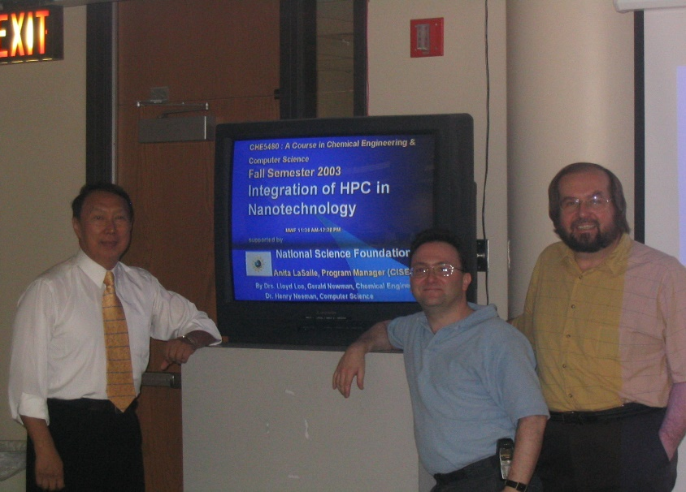
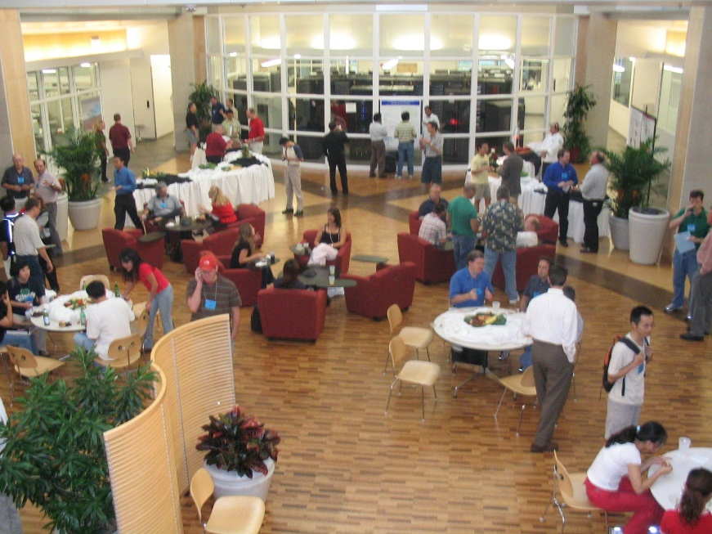
We Started Here . . .
Notes:
I thought it might be appropriate to translate the title of our paper and explain what the whole exercise is about.
1. That’s why we’re here!
2. We researched the latest ACM accreditation guidelines and found that parallel computing is suggested in multiple areas of the CS curricula.
3. That is what we meant by interdisciplinary.
4. Small liberal arts colleges are notorious for not showering money on the sciences.

Slide 3
We Started Here . . .
Early Henry!
Notes:
I thought it might be appropriate to translate the title of our paper and explain what the whole exercise is about.
1. That’s why we’re here!
2. We researched the latest ACM accreditation guidelines and found that parallel computing is suggested in multiple areas of the CS curricula.
3. That is what we meant by interdisciplinary.
4. Small liberal arts colleges are notorious for not showering money on the sciences.

Slide 4
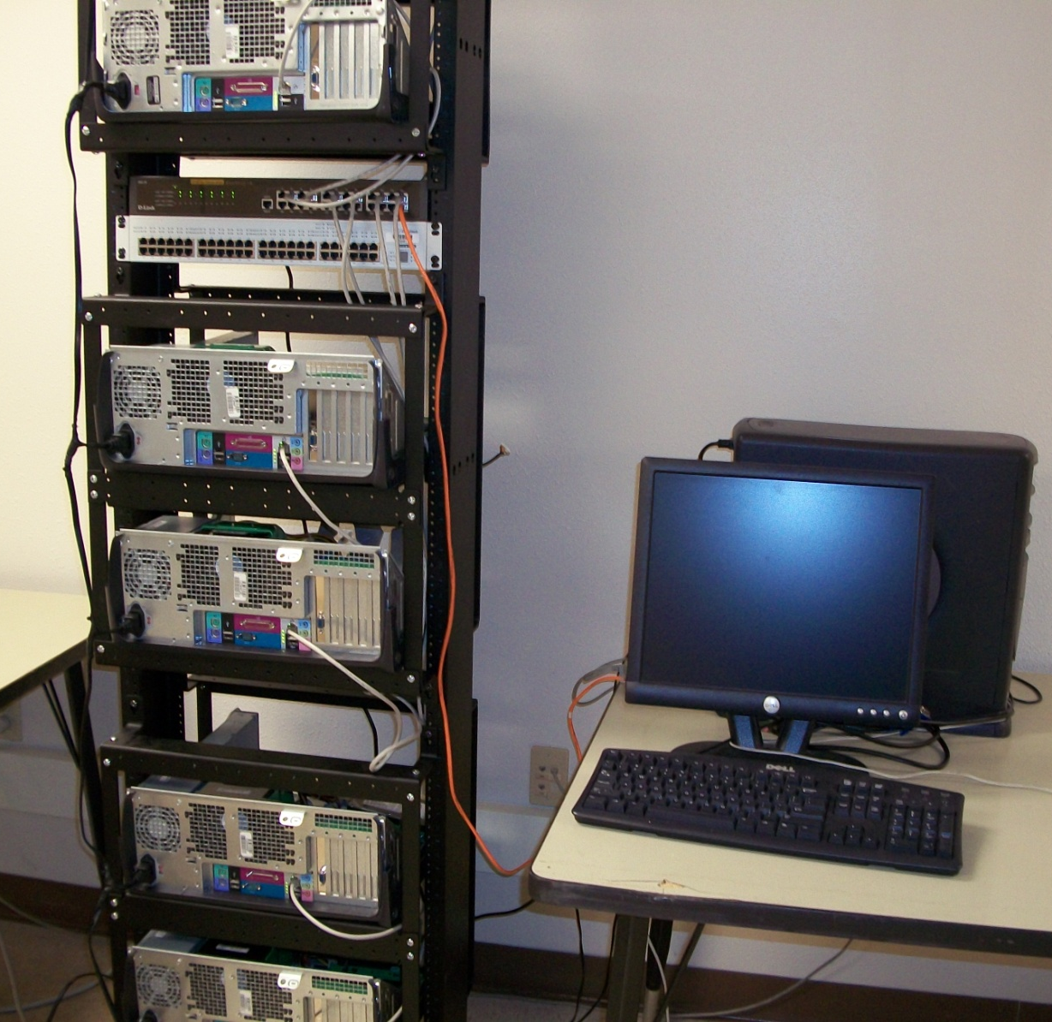
We Progressed To . . .
Our first cluster – made from junk – but it worked!
Notes:
This is where the 3-semester part came in.
Course 1: We needed a crash course in C that was tailored to parallel thinking, so we tweaked a standard introductory C course.
Course 2: After some MPI success it seemed like a good idea to introduce CUDA.
Course 3: After a year of fairly intense programming, we felt like students could use some validation as to why we do this in the first place. We just happened to have a real research-level math problem at hand.

Slide 5
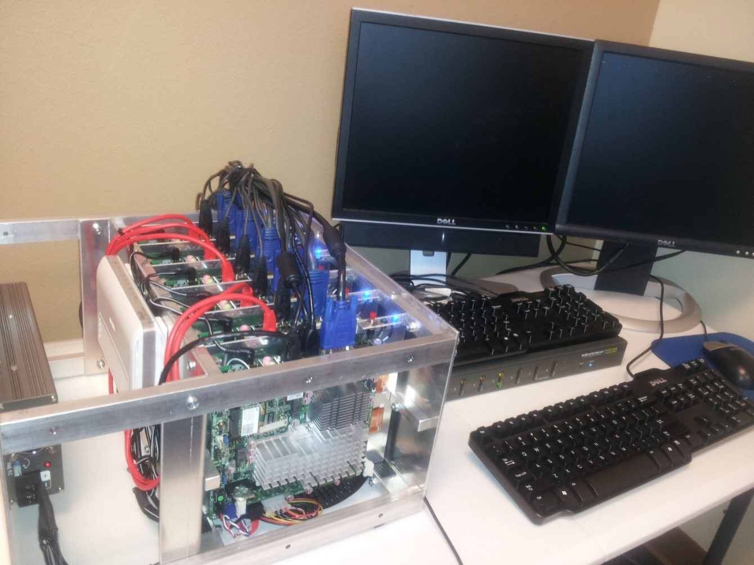
Then Found LittleFe . . .

Slide 6
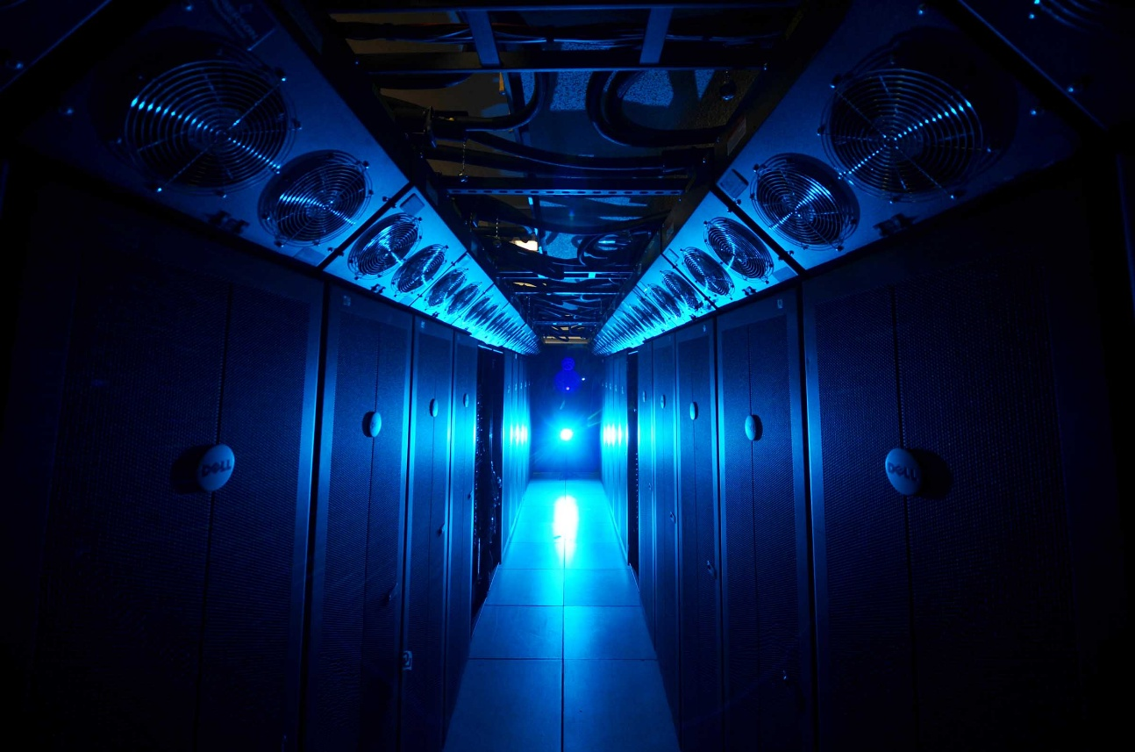
Next We Used Sooner . . .
Notes:
This is the Oklahoma Supercomputing Center for Research and Education’s old supercomputer, Sooner. It’s been replaced by Boomer . . .

Slide 7
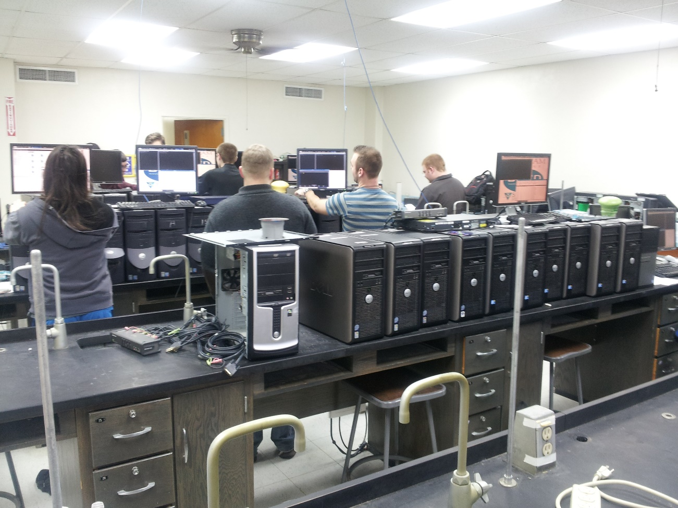
Now We Have . . .
Notes:
This is the Oklahoma Supercomputing Center for Research and Education’s old supercomputer, Sooner. It’s been replaced by Boomer . . .

Slide 8
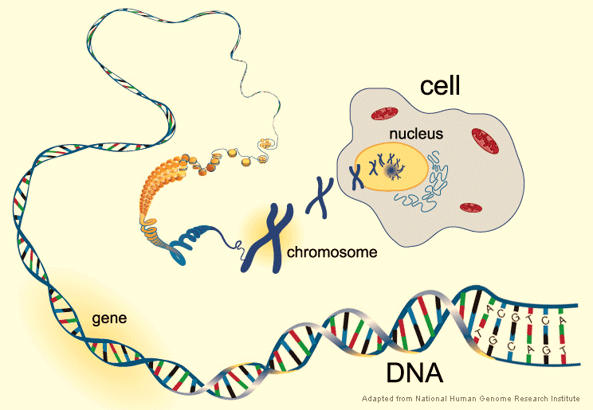
Analyzing Genome Data

Slide 9
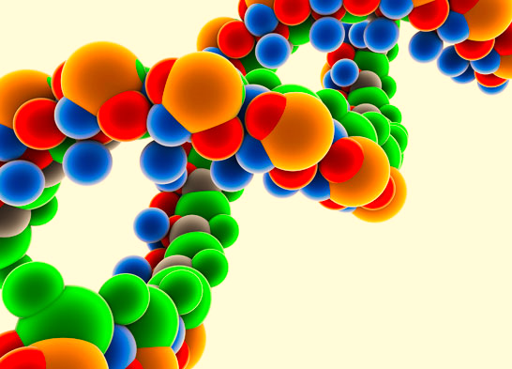
PHASE 1 – Write Code

Slide 10

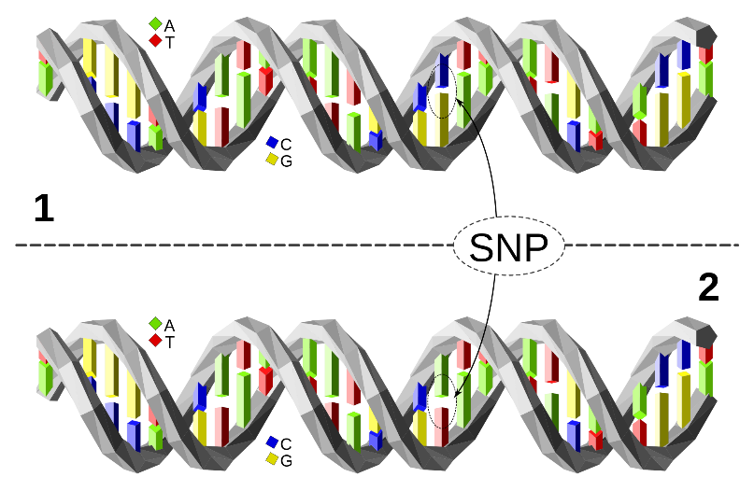
PHASE 1 – Write Code
Definitions:
SNP: single-nucleotide polymorphism
pronounced “snip” is a DNA sequence commonly varying within a population

Slide 11
PHASE 1 – Write Code
Definitions:
SNP: single-nucleotide polymorphism
pronounced “snip” is a DNA sequence commonly varying within a population
rsid: Reference SNP cluster ID
access number used to refer
to specific SNPs

Slide 12
PHASE 1 – Write Code
Harvard PGP* Database
23andME
# rsid chromosome position genotype
. . .
rs12564807 1 734462 AA
rs3131972 1 752721 GG
rs148828841 1 760998 CC
rs12124819 1 776546 AA . . .
* PGP - Personal Genome Project

Slide 13
PHASE 1 – Write Code
Harvard PGP Database
Per person, there were about 1,000,000 snips.
# rsid chromosome position genotype
. . .
rs12564807 1 734462 AA
rs3131972 1 752721 GG
rs148828841 1 760998 CC
rs12124819 1 776546 AA . . .

Slide 14
PHASE 1 – Write Code
We started with 200 profiles
Then gave ‘em names
That was about 5G of data
# rsid chromosome position genotype
. . .
rs12564807 1 734462 AA
rs3131972 1 752721 GG
rs148828841 1 760998 CC
rs12124819 1 776546 AA . . .
Per person, there were about 1,000,000 snips.

Slide 15

!! Important Info for HPC Instructors !!
5G of data isn’t necessarily “big”
Our clusters are significantly small

Slide 16
!! Important Info for HPC Instructors !!
5G of data isn’t necessarily “big”
Our clusters are significantly small
We’re teaching concept and techniques
We can easily scale up to Boomer

Slide 17
PHASE 1 – Write Code
Several programs begged to be written, and
all were great candidates for parallelization.
Search for a particular rsid for a given person
Ditto for many persons
Both of the above for a collection of rsids
Compare 2 persons’ makeup
  we used a sliding window algorithm
Compare many persons’ makeup

Slide 18
Sliding Window Technique . . .
PENELOPE KARDASHIAN
i6019305 1 891343 GG
rs13303106 1 891945 AG
i6019306 1 894379 GG
rs13303010 1 894573 AG
i6019308 1 897792 CC
i6019309 1 898082 AA
rs6696281 1 903104 CT
i6019310 1 905681 CC
i6019311 1 906114 CC
i6019312 1 907666 AA
i6060381 1 909238 CG
rs2340592 1 910935 --
rs13303118 1 918384 GT
rs78164078 1 921071 GG
rs6665000 1 924898 AC
rs2341362 1 927309 CC
rs9777703 1 928836 CT
STONEY BURKE
i6019305 1 891343 GG
rs13303106 1 891945 AG
i6019306 1 894379 GG
rs13303010 1 894573 AA
i6019308 1 897792 CC
i6019309 1 898082 AA
rs6696281 1 903104 CT
i6019310 1 905681 CC
i6019311 1 906114 CC
i6019312 1 907666 AA
i6060381 1 909238 CG
rs2340592 1 910935 GG
rs13303118 1 918384 GT
rs78164078 1 921071 GG
rs6665000 1 924898 AC
rs2341362 1 927309 CC
rs9777703 1 928836 TT

Slide 19
Sliding Window Technique . . .
PENELOPE KARDASHIAN
i6019305 1 891343 GG
rs13303106 1 891945 AG
i6019306 1 894379 GG
rs13303010 1 894573 AG
i6019308 1 897792 CC
i6019309 1 898082 AA
rs6696281 1 903104 CT
i6019310 1 905681 CC
i6019311 1 906114 CC
i6019312 1 907666 AA
i6060381 1 909238 CG
rs2340592 1 910935 --
rs13303118 1 918384 GT
rs78164078 1 921071 GG
rs6665000 1 924898 AC
rs2341362 1 927309 CC
rs9777703 1 928836 CT
STONEY BURKE
i6019305 1 891343 GG
rs13303106 1 891945 AG
i6019306 1 894379 GG
rs13303010 1 894573 AA
i6019308 1 897792 CC
i6019309 1 898082 AA
rs6696281 1 903104 CT
i6019310 1 905681 CC
i6019311 1 906114 CC
i6019312 1 907666 AA
i6060381 1 909238 CG
rs2340592 1 910935 GG
rs13303118 1 918384 GT
rs78164078 1 921071 GG
rs6665000 1 924898 AC
rs2341362 1 927309 CC
rs9777703 1 928836 TT
If one person’s rsid was unrecorded, both were tossed out.

Slide 20
Sliding Window Technique . . .
PENELOPE KARDASHIAN
i6019305 1 891343 GG
rs13303106 1 891945 AG
i6019306 1 894379 GG
rs13303010 1 894573 AG
i6019308 1 897792 CC
i6019309 1 898082 AA
rs6696281 1 903104 CT
i6019310 1 905681 CC
i6019311 1 906114 CC
i6019312 1 907666 AA
i6060381 1 909238 CG
rs13303118 1 918384 GT
rs78164078 1 921071 GG
rs6665000 1 924898 AC
rs2341362 1 927309 CC
rs9777703 1 928836 CT
STONEY BURKE
i6019305 1 891343 GG
rs13303106 1 891945 AG
i6019306 1 894379 GG
rs13303010 1 894573 AA
i6019308 1 897792 CC
i6019309 1 898082 AA
rs6696281 1 903104 CT
i6019310 1 905681 CC
i6019311 1 906114 CC
i6019312 1 907666 AA
i6060381 1 909238 CG
rs13303118 1 918384 GT
rs78164078 1 921071 GG
rs6665000 1 924898 AC
rs2341362 1 927309 CC
rs9777703 1 928836 TT
FIRST
VARIANCE

Slide 21
Sliding Window Technique . . .
PENELOPE KARDASHIAN
i6019305 1 891343 GG
rs13303106 1 891945 AG
i6019306 1 894379 GG
rs13303010 1 894573 AG
i6019308 1 897792 CC
i6019309 1 898082 AA
rs6696281 1 903104 CT
i6019310 1 905681 CC
i6019311 1 906114 CC
i6019312 1 907666 AA
i6060381 1 909238 CG
rs13303118 1 918384 GT
rs78164078 1 921071 GG
rs6665000 1 924898 AC
rs2341362 1 927309 CC
rs9777703 1 928836 CT
STONEY BURKE
i6019305 1 891343 GG
rs13303106 1 891945 AG
i6019306 1 894379 GG
rs13303010 1 894573 AA
i6019308 1 897792 CC
i6019309 1 898082 AA
rs6696281 1 903104 CT
i6019310 1 905681 CC
i6019311 1 906114 CC
i6019312 1 907666 AA
i6060381 1 909238 CG
rs13303118 1 918384 GT
rs78164078 1 921071 GG
rs6665000 1 924898 AC
rs2341362 1 927309 CC
rs9777703 1 928836 TT
VARIANCES

Slide 22
Sliding Window Technique . . .
PENELOPE KARDASHIAN
i6019305 1 891343 GG
rs13303106 1 891945 AG
i6019306 1 894379 GG
rs13303010 1 894573 AG
i6019308 1 897792 CC
i6019309 1 898082 AA
rs6696281 1 903104 CT
i6019310 1 905681 CC
i6019311 1 906114 CC
i6019312 1 907666 AA
i6060381 1 909238 CG
rs13303118 1 918384 GT
rs78164078 1 921071 GG
rs6665000 1 924898 AC
rs2341362 1 927309 CC
rs9777703 1 928836 CT
STONEY BURKE
i6019305 1 891343 GG
rs13303106 1 891945 AG
i6019306 1 894379 GG
rs13303010 1 894573 AA
i6019308 1 897792 CC
i6019309 1 898082 AA
rs6696281 1 903104 CT
i6019310 1 905681 CC
i6019311 1 906114 CC
i6019312 1 907666 AA
i6060381 1 909238 CG
rs13303118 1 918384 GT
rs78164078 1 921071 GG
rs6665000 1 924898 AC
rs2341362 1 927309 CC
rs9777703 1 928836 TT
A set number of variances were allowed in a given “block” size w/o causing a “difference”.
VARIANCES

Slide 23
Sliding Window Technique . . .
--
--
--
@@
--
--
--
--
--
--
--
--
--
@@
--
@@
--
--
@@
--@@
--
--
--
--
--
--

Slide 24
Sliding Window Technique . . .
--
--
--
@@
--
--
--
--
--
--
--
--
--
@@
--
@@
--
--
@@
--@@
--
--
--
--
--
--
This represents rsid locations. “@@” means difference. “—” means agreement.

Slide 25
Sliding Window Technique . . .
--
--
--
@@
--
--
--
--
--
--
--
--
--
@@
--
@@
--
--
@@
--@@
--
--
--
--
--
--
This represents rsid locations. “@@” means difference. “—” means agreement.
For this example, if 2 or more do not agree in a group of 8, then record a difference. Otherwise it is recorded as a match.

Slide 26
Sliding Window Technique . . .
--
--
--
@@
--
--
--
--
--
--
--
--
--
@@
--
@@
--
--
@@
--@@
--
--
--
--
--
--
This represents rsid locations. “@@” means difference. “—” means agreement.
For this example, if 2 or more do not agree in a group of 8, then record a difference. Otherwise it is recorded as a match.
It’s a “best case” algorithm. If an rsid is ever in a match box of 8, then it is forever a match.

Slide 27
Sliding Window Technique . . .
--
--
--
@@
--
--
--
--
--
--
--
--
--
@@
--
@@
--
--
@@
--@@
--
--
--
--
--
--
For this example, if 2 or more do not agree in a group of 8, then record a difference. Otherwise it is recorded as a match.

Slide 28
Sliding Window Technique . . .
--
--
--
@@
--
--
--
--
--
--
--
--
--
@@
--
@@
--
--
@@
--@@
--
--
--
--
--
--
For this example, if 2 or more do not agree in a group of 8, then record a difference. Otherwise it is recorded as a match.
Green = Match
Red = Difference

Slide 29
Sliding Window Technique . . .
--
--
--
@@
--
--
--
--
--
--
--
--
--
@@
--
@@
--
--
@@
--@@
--
--
--
--
--
--
For this example, if 2 or more do not agree in a group of 8, then record a difference. Otherwise it is recorded as a match.
Green = Match
Red = Difference

Slide 30
Sliding Window Technique . . .
--
--
--
@@
--
--
--
--
--
--
--
--
--
@@
--
@@
--
--
@@
--@@
--
--
--
--
--
--
For this example, if 2 or more do not agree in a group of 8, then record a difference. Otherwise it is recorded as a match.
Green = Match
Red = Difference

Slide 31
Sliding Window Technique . . .
--
--
--
@@
--
--
--
--
--
--
--
--
--
@@
--
@@
--
--
@@
--@@
--
--
--
--
--
--
For this example, if 2 or more do not agree in a group of 8, then record a difference. Otherwise it is recorded as a match.
Green = Match
Red = Difference

Slide 32
Sliding Window Technique . . .
--
--
--
@@
--
--
--
--
--
--
--
--
--
@@
--
@@
--
--
@@
--@@
--
--
--
--
--
--
For this example, if 2 or more do not agree in a group of 8, then record a difference. Otherwise it is recorded as a match.
Green = Match
Red = Difference

Slide 33
Sliding Window Technique . . .
--
--
--
@@
--
--
--
--
--
--
--
--
--
@@
--
@@
--
--
@@
--@@
--
--
--
--
--
--
For this example, if 2 or more do not agree in a group of 8, then record a difference. Otherwise it is recorded as a match.
Green = Match
Red = Difference

Slide 34
Sliding Window Technique . . .
--
--
--
@@
--
--
--
--
--
--
--
--
--
@@
--
@@
--
--
@@
--@@
--
--
--
--
--
--
For this example, if 2 or more do not agree in a group of 8, then record a difference. Otherwise it is recorded as a match.
Green = Match
Red = Difference

Slide 35
Sliding Window Technique . . .
--
--
--
@@
--
--
--
--
--
--
--
--
--
@@
--
@@
--
--
@@
--@@
--
--
--
--
--
--
For this example, if 2 or more do not agree in a group of 8, then record a difference. Otherwise it is recorded as a match.
Green = Match
Red = Difference

Slide 36
Sliding Window Technique . . .
--
--
--
@@
--
--
--
--
--
--
--
--
--
@@
--
@@
--
--
@@
--@@
--
--
--
--
--
--
For this example, if 2 or more do not agree in a group of 8, then record a difference. Otherwise it is recorded as a match.
Green = Match
Red = Difference
It’s a “best case” algorithm. If an rsid is ever in a match box of 8, then it is forever a match.

Slide 37
Sliding Window Technique . . .
--
--
--
@@
--
--
--
--
--
--
--
--
--
@@
--
@@
--
--
@@
--@@
--
--
--
--
--
--
For this example, if 2 or more do not agree in a group of 8, then record a difference. Otherwise it is recorded as a match.
Green = Match
Red = Difference
It’s a “best case” algorithm. If an rsid is ever in a match box of 8, then it is forever a match.

Slide 38
Sliding Window Technique . . .
--
--
--
@@
--
--
--
--
--
--
--
--
--
@@
--
@@
--
--
@@
--@@
--
--
--
--
--
--
For this example, if 2 or more do not agree in a group of 8, then record a difference. Otherwise it is recorded as a match.
Green = Match
Red = Difference

Slide 39
Sliding Window Technique . . .
--
--
--
@@
--
--
--
--
--
--
--
--
--
@@
--
@@
--
--
@@
--@@
--
--
--
--
--
--
For this example, if 2 or more do not agree in a group of 8, then record a difference. Otherwise it is recorded as a match.
Green = Match
Red = Difference

Slide 40
Sliding Window Technique . . .
--
--
--
@@
--
--
--
--
--
--
--
--
--
@@
--
@@
--
--
@@
--@@
--
--
--
--
--
--
For this example, if 2 or more do not agree in a group of 8, then record a difference. Otherwise it is recorded as a match.
Green = Match
Red = Difference

Slide 41
Sliding Window Technique . . .
--
--
--
@@
--
--
--
--
--
--
--
--
--
@@
--
@@
--
--
@@
--@@
--
--
--
--
--
--
For this example, if 2 or more do not agree in a group of 8, then record a difference. Otherwise it is recorded as a match.
Green = Match
Red = Difference

Slide 42
Sliding Window Technique . . .
--
--
--
@@
--
--
--
--
--
--
--
--
--
@@
--
@@
--
--
@@
--@@
--
--
--
--
--
--
For this example, if 2 or more do not agree in a group of 8, then record a difference. Otherwise it is recorded as a match.
Green = Match
Red = Difference

Slide 43
Sliding Window Technique . . .
--
--
--
@@
--
--
--
--
--
--
--
--
--
@@
--
@@
--
--
@@
--@@
--
--
--
--
--
--
For this example, if 2 or more do not agree in a group of 8, then record a difference. Otherwise it is recorded as a match.
Green = Match
Red = Difference

Slide 44
Sliding Window Technique . . .
--
--
--
@@
--
--
--
--
--
--
--
--
--
@@
--
@@
--
--
@@
--@@
--
--
--
--
--
--
For this example, if 2 or more do not agree in a group of 8, then record a difference. Otherwise it is recorded as a match.
Green = Match
Red = Difference

Slide 45
Sliding Window Technique . . .
--
--
--
@@
--
--
--
--
--
--
--
--
--
@@
--
@@
--
--
@@
--@@
--
--
--
--
--
--
For this example, if 2 or more do not agree in a group of 8, then record a difference. Otherwise it is recorded as a match.
Green = Match
Red = Difference

Slide 46
Sliding Window Technique . . .
--
--
--
@@
--
--
--
--
--
--
--
--
--
@@
--
@@
--
--
@@
--@@
--
--
--
--
--
--
--
For this example, if 2 or more do not agree in a group of 8, then record a difference. Otherwise it is recorded as a match.
Green = Match
Red = Difference

Slide 47
Sliding Window Technique . . .
--
--
--
@@
--
--
--
--
--
--
--
--
--
@@
--
@@
--
--
@@
--@@
--
--
--
--
--
--
--
For this example, if 2 or more do not agree in a group of 8, then record a difference. Otherwise it is recorded as a match.
Green = Match
Red = Difference

Slide 48
Sliding Window Technique . . .
--
--
--
@@
--
--
--
--
--
--
--
--
--
@@
--
@@
--
--
@@
--@@
--
--
--
--
--
--
--
For this example, if 2 or more do not agree in a group of 8, then record a difference. Otherwise it is recorded as a match.
Green = Match
Red = Difference

Slide 49
Sliding Window Technique . . .
--
--
--
@@
--
--
--
--
--
--
--
--
--
@@
--
@@
--
--
@@
--@@
--
--
--
--
--
--
--
For this example, if 2 or more do not agree in a group of 8, then record a difference. Otherwise it is recorded as a match.
Green = Match
Red = Difference

Slide 50
PHASE 2 – Web GUI

Slide 51
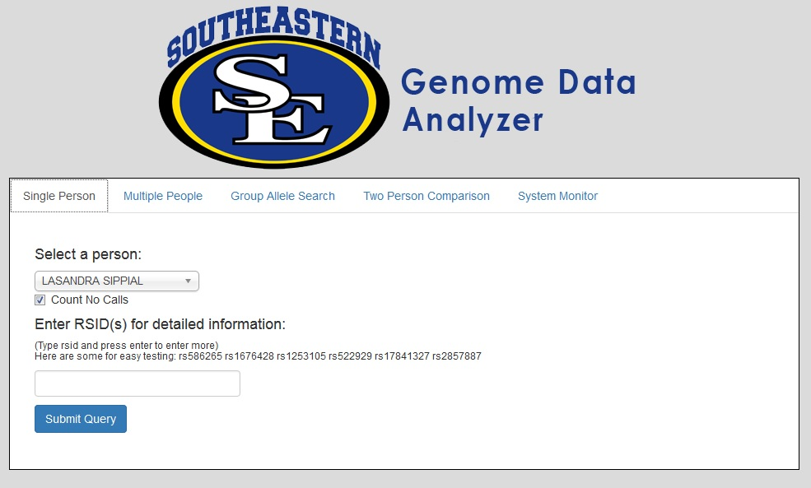
PHASE 2 – Web GUI

Slide 52
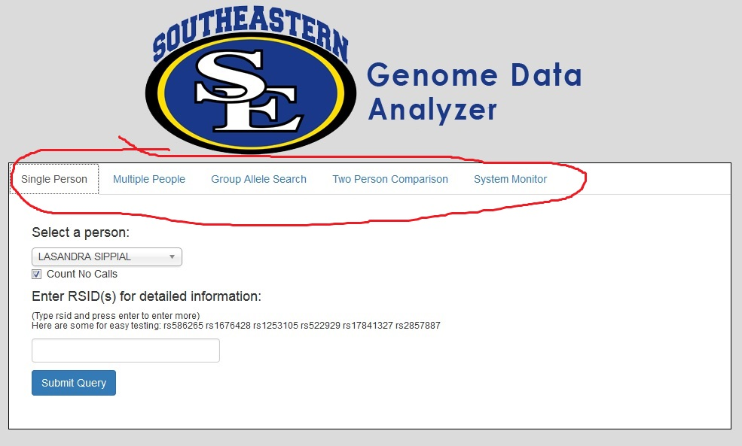
PHASE 2 – Web GUI
Currently we have 5 options.

Slide 53
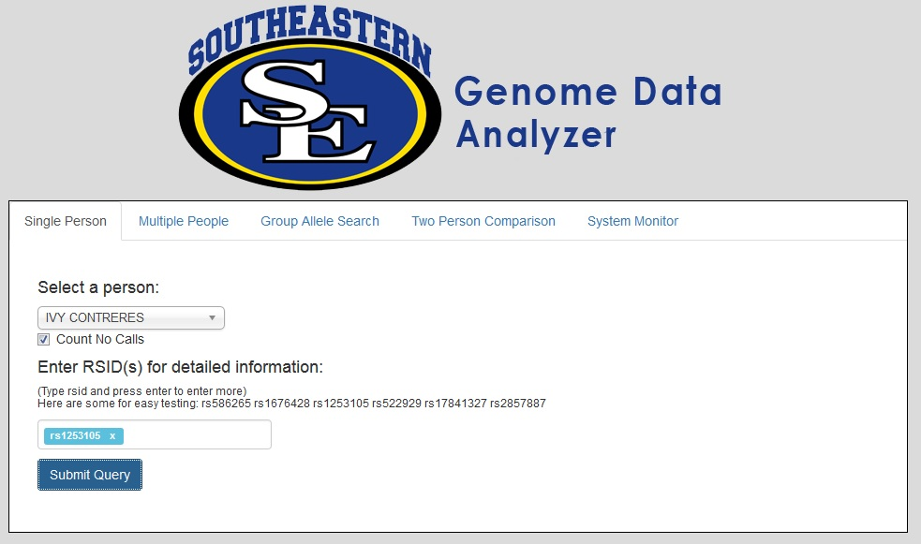
Web GUI – Single Person

Slide 54
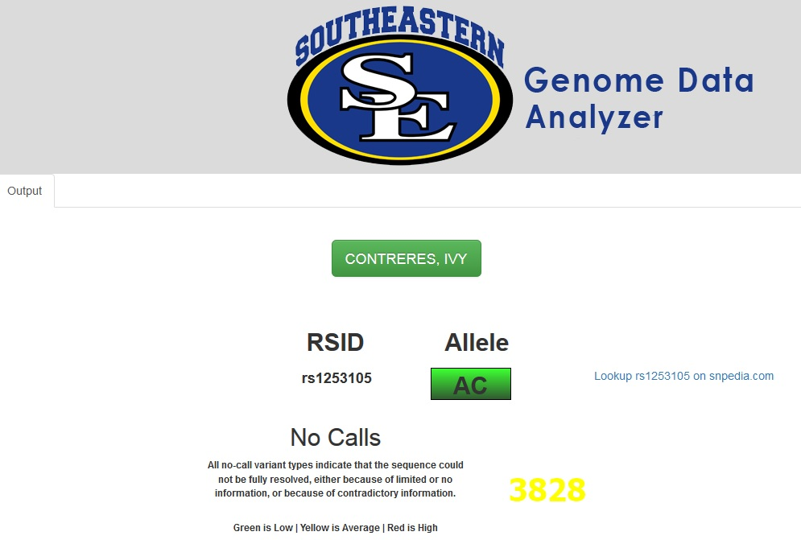
Web GUI – Single Person

Slide 55
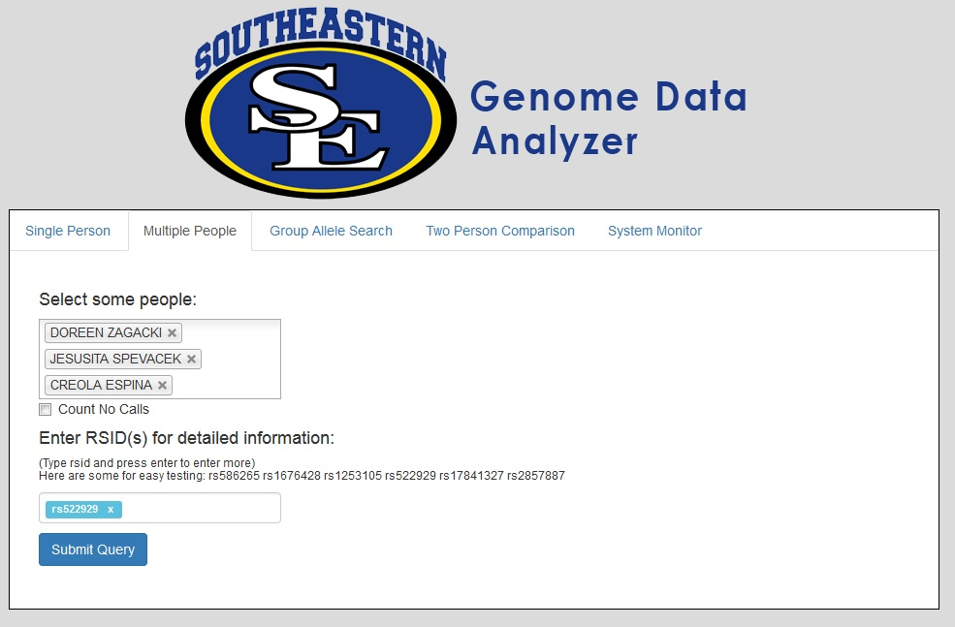
Web GUI – Multiple Person

Slide 56
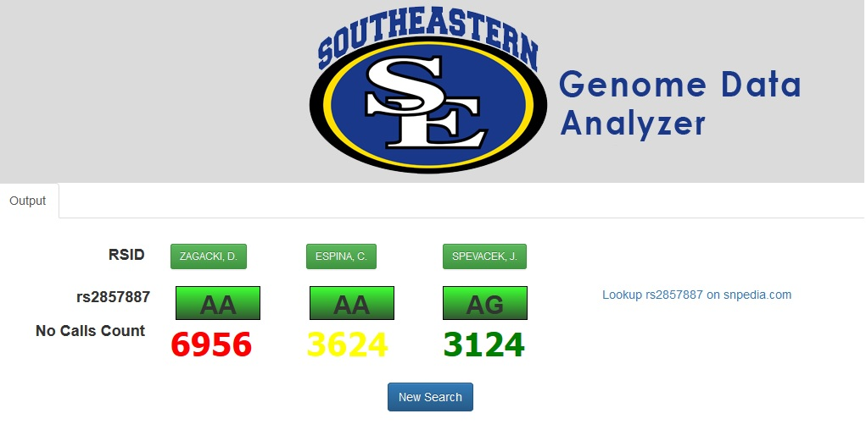
Web GUI – Multiple Person

Slide 57
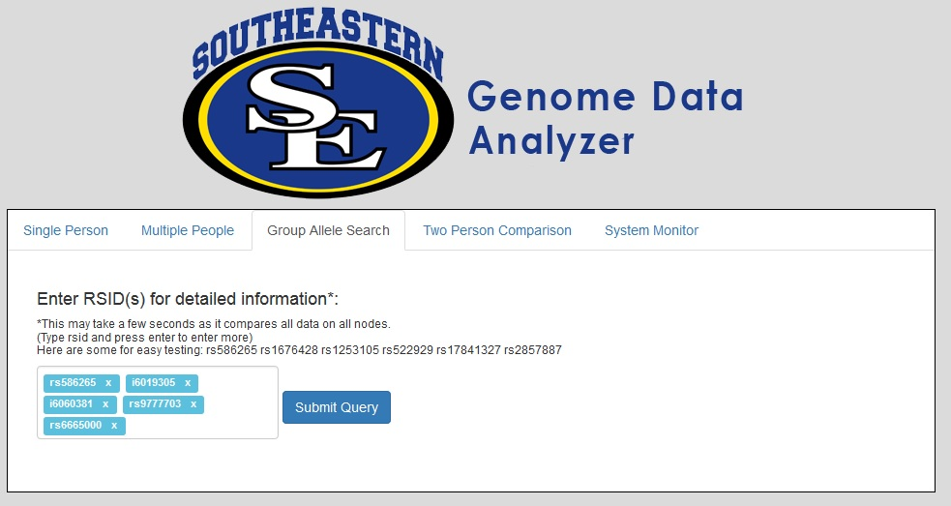
Web GUI – Group Allele

Slide 58
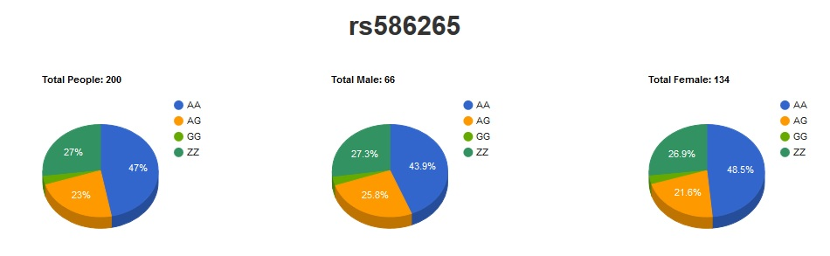
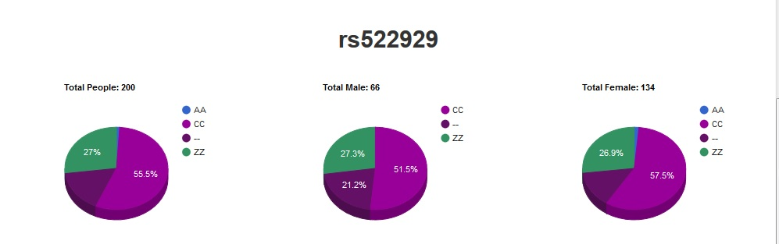
Web GUI – Group Allele

Slide 59
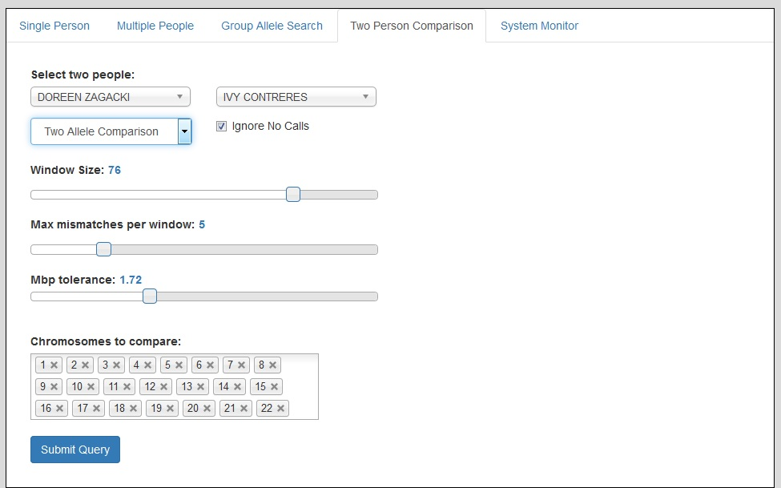
Web GUI – Two Person Compare

Slide 60
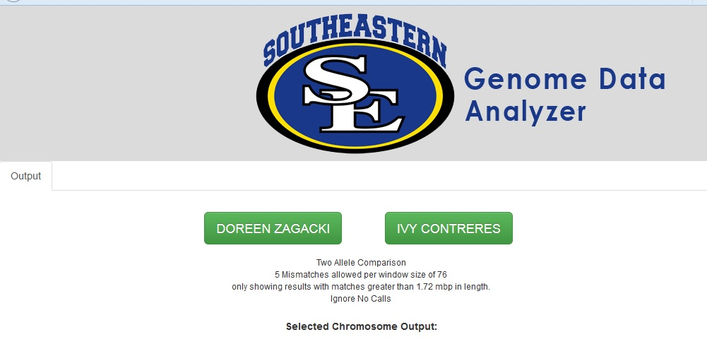
Web GUI – Two Person Compare

Slide 61
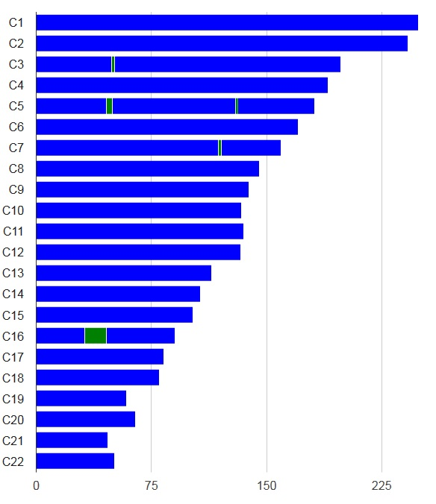
Web GUI – Two Person Compare
Very different –
no connection.
(Blue is no match.)

Slide 62
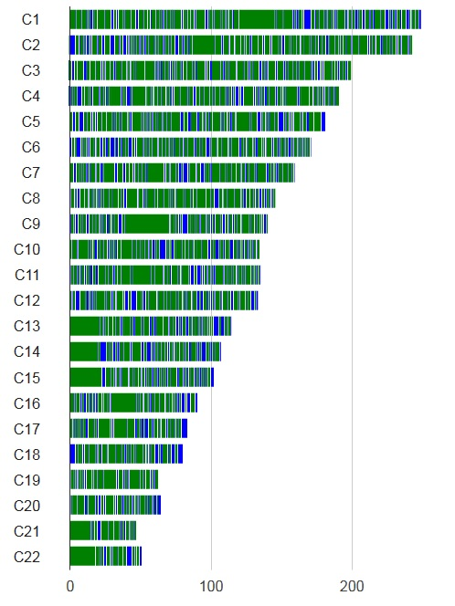
Web GUI – Two Person Compare
One-allele search.
Blue is no match,
green is match.

Slide 63
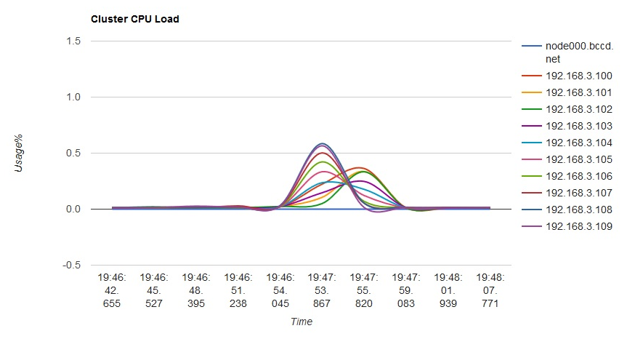
Web GUI – System Monitor

Slide 64
Web GUI – System Monitor
Group allele – accesses all files on all nodes.
Seeking 2 alleles.

Slide 65
Web GUI – System Monitor
Group allele – accesses all files on all nodes.
Seeking 2 alleles.
Head node doing traffic only – not relatively busy.

Slide 66
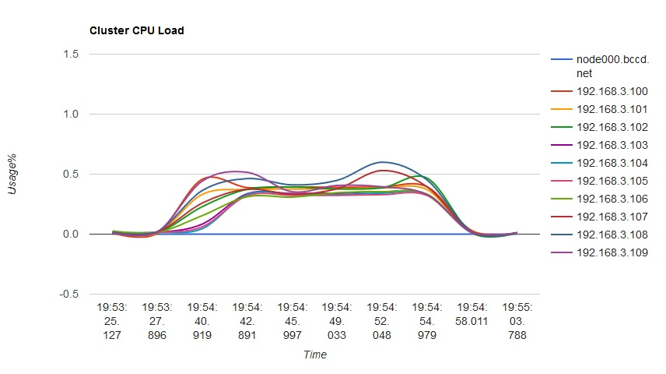
Web GUI – System Monitor
Group allele – accesses all files on all nodes.
Seeking 6 alleles.
Head node doing traffic only – not relatively busy.

Slide 67
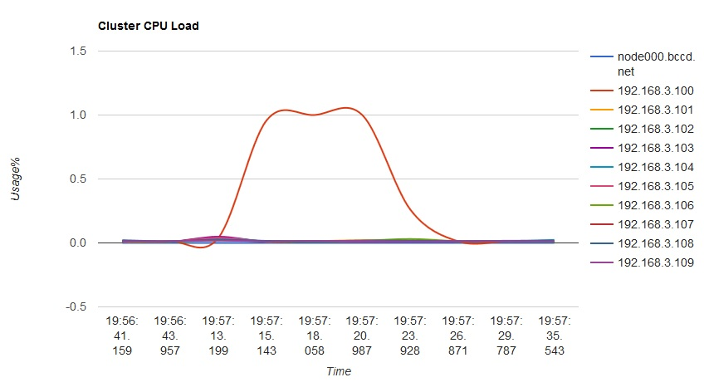
Web GUI – System Monitor
Two-person compare,
files on same node.

Slide 68
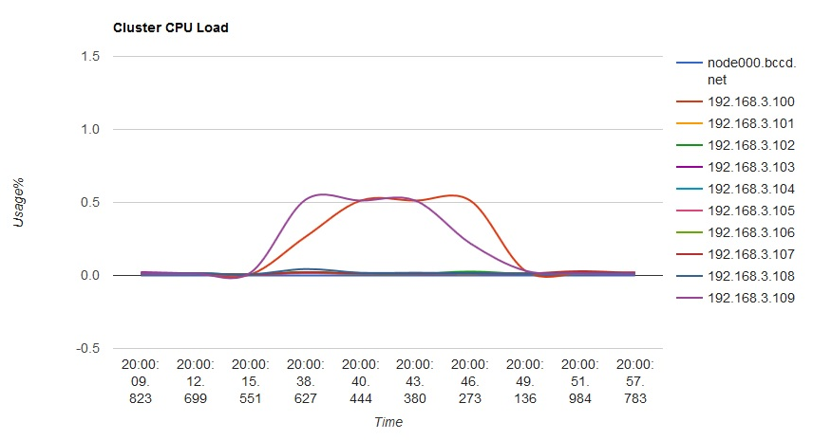
Web GUI – System Monitor
Two-person compare,
files on different nodes.

Slide 69
Thank You!
We especially thank Henry Neeman, Charlie Peck, Tom Murphy, and everyone else associated with OU IT, the LittleFe project, the SOSU IT guys and all of our colleagues and friends in the educational community involved with HPC, for all the help we have received.
Karl Frinkle
Mike Morris

