Slide 1







Finding the Key
Unlocking Engagement & Alleviating Anxiety Through Escape Rooms
Notes:
Welcome everyone!

Slide 2

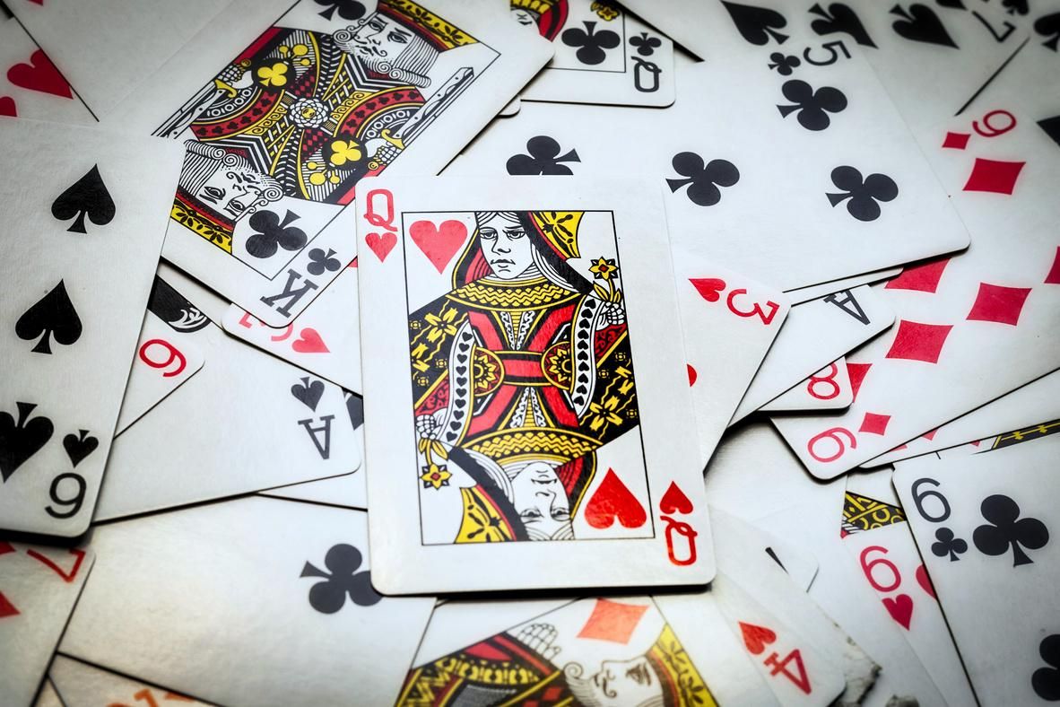
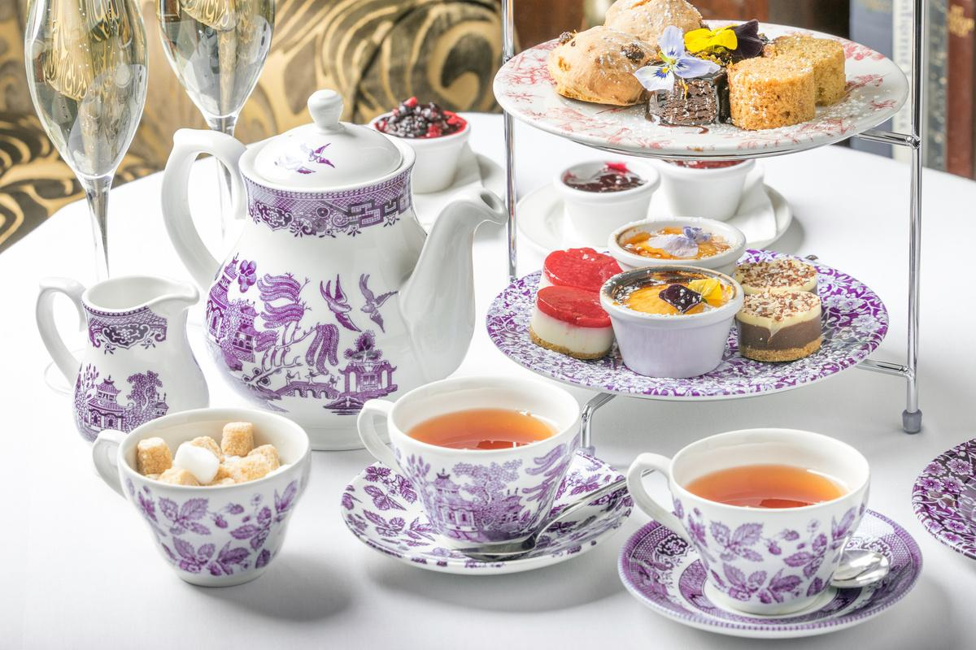

Meet the team
Ashley Bean
Audrey Baker
Kaitlin Crotty
Notes:
(Self introductions)
Audrey Baker
Ashley Bean
Kaitlin Crotty

Slide 3


02
01
Timeline, Registration, & Promotion
Development & Implementation
Table of Contents
04
03
Results, Tips, & Resources
Questions
Notes:
Here is an overview of our presentation today.
First, we'll go over the Timeline, Registration, and Promotion of the escape room.
Next, we'll talk about the Development and Implementation of the event.
Then we'll share the Results, Tips, and Resources to help you create your own escape room.
Finally, we'll open the floor to questions.

Slide 4




Inspiration
  Quarterly game nights
    Board games
    Card games
    TTRPGs
  Attendance pre and post COVID
  Change in plans: Create a custom escape room!
Notes:
Since 2018, RSU Libraries has hosted quarterly game nights where students, faculty, staff, and community members are invited into the library to play our collection of board, card, and TTRPG games.
While very popular, attendance has dropped significantly since COVID.
We decided to try something new to draw more folks in: create a custom escape room!

Slide 5



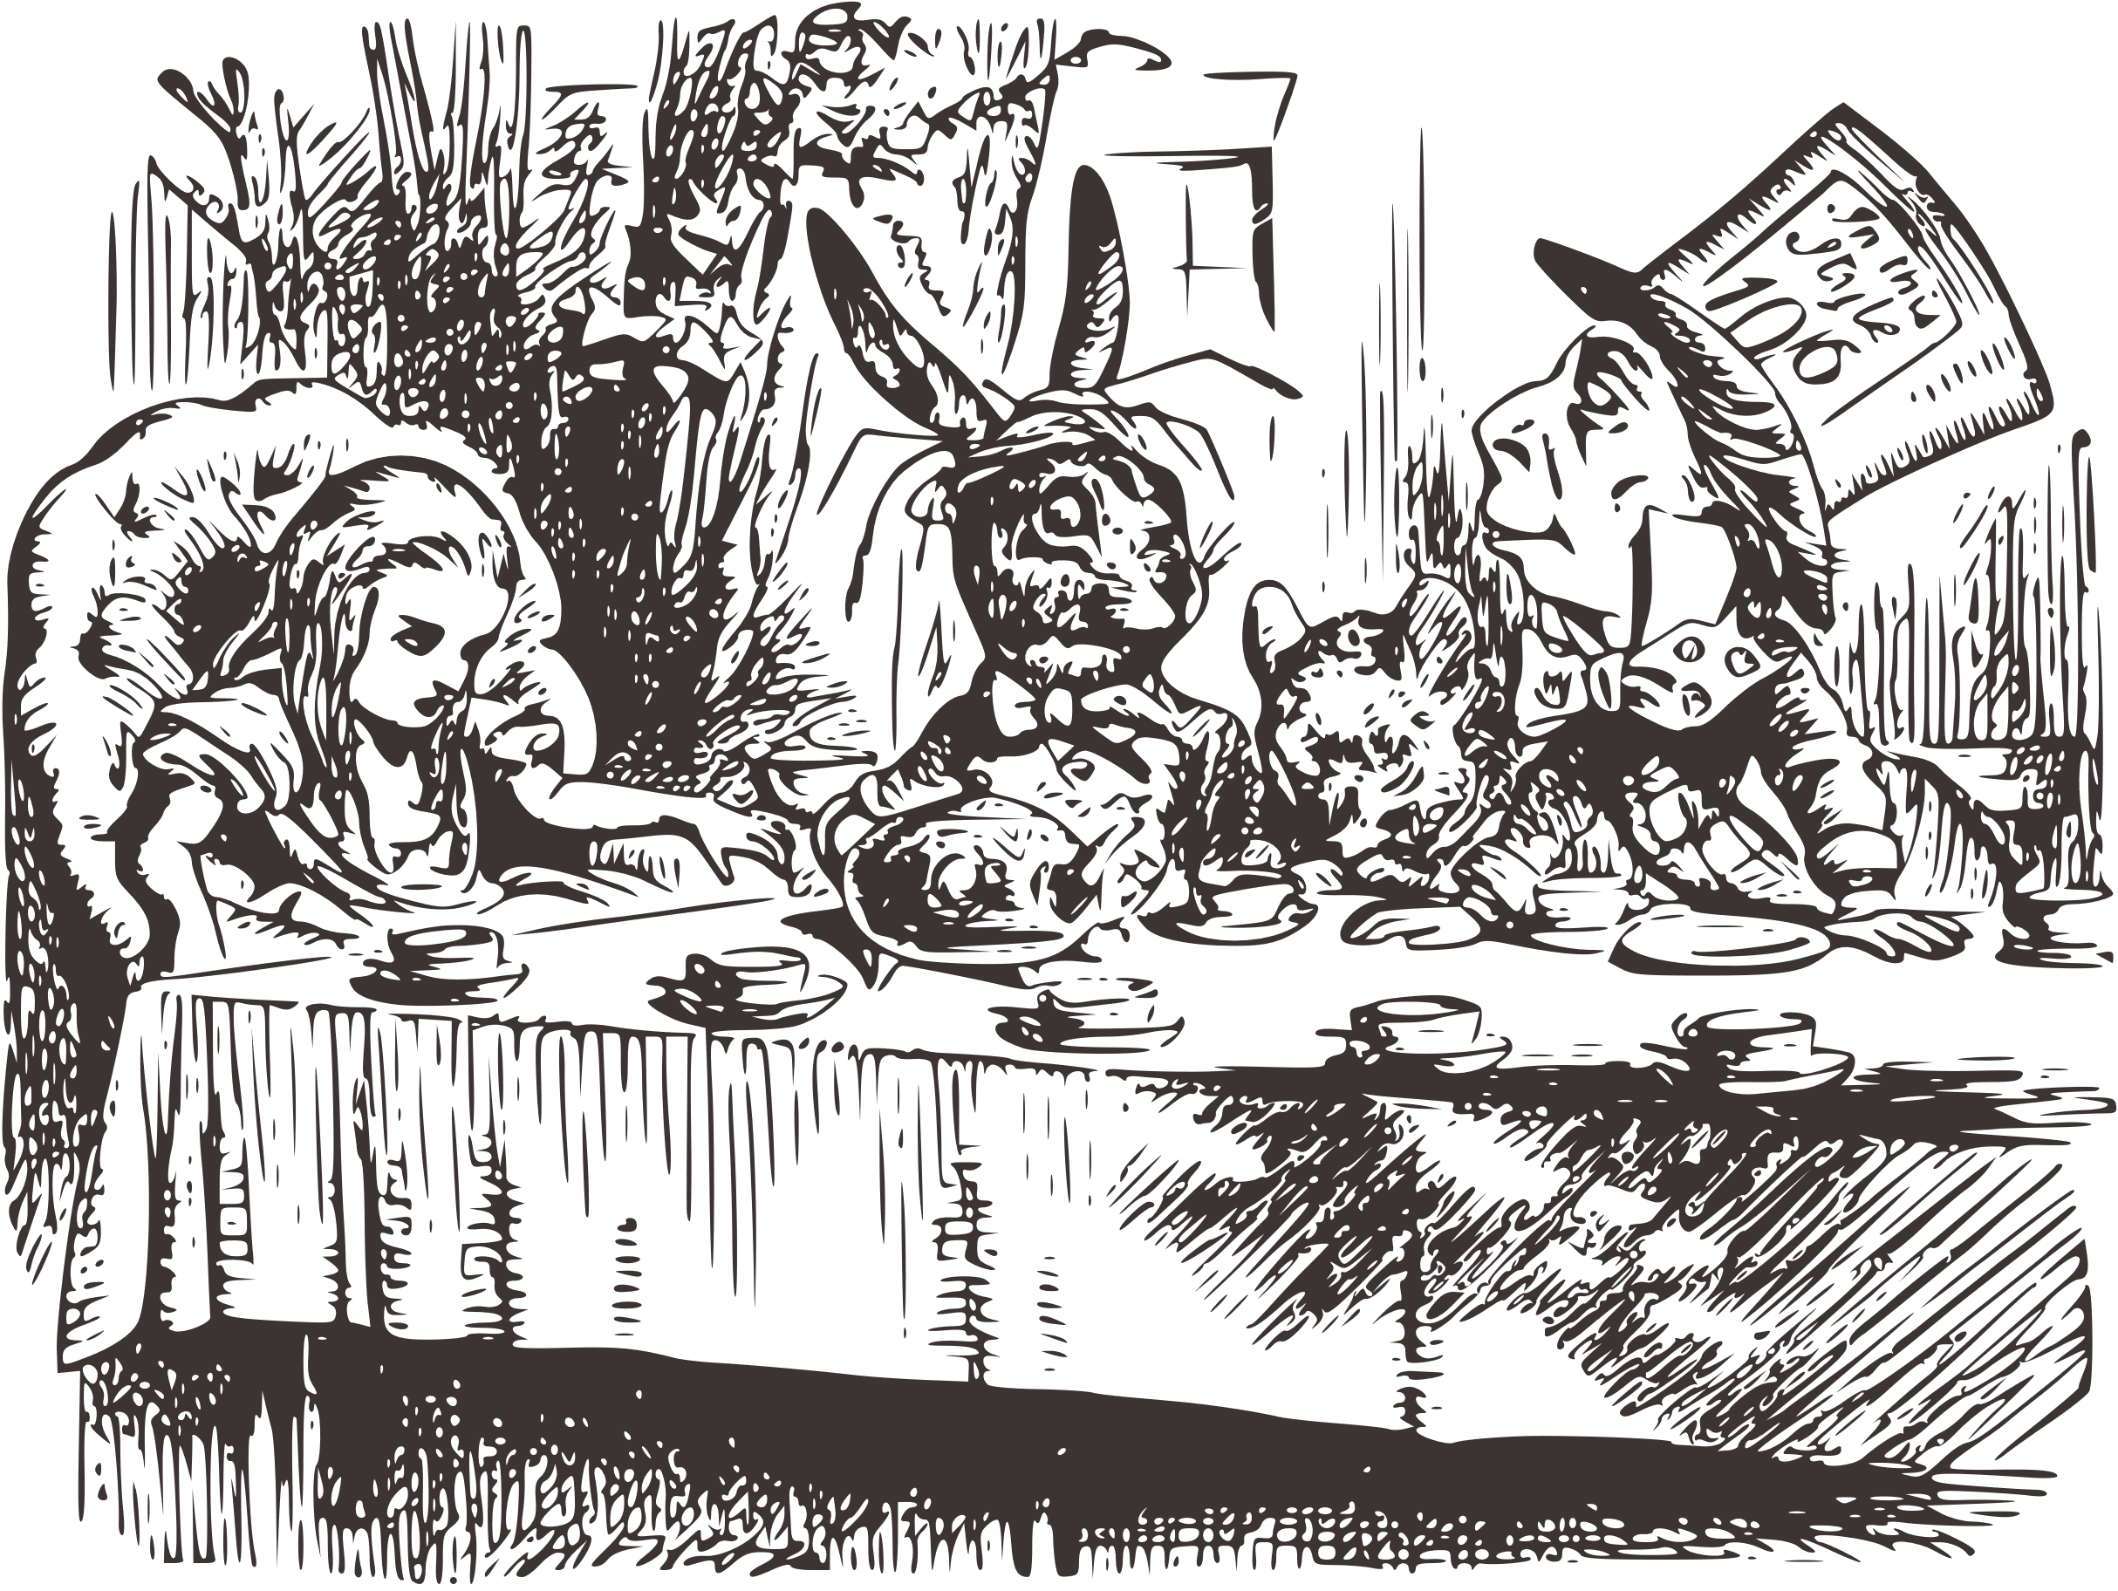
Timeline
January 2023: Decide to host the event in NLW
January - March: Background research
March: Establish group and begin weekly meetings
  Decide upon theme, storyline, and scope
April
  Registration & promotion
  Development
  Purchase supplies
  Test run
  Revise
  Test run #2
  Revise
Event Day 4/25
Survey Analysis & Debrief
A cautionary tale...
Notes:
This timeline is a little scary and is a tale of caution. This is what NOT to do, although we proved it to be possible! I will run through our timeline here, and then go into more detail in the following slides.
In January we met to determine what events we would host during the spring semester. We knew we wanted to do something special for game night events, and we thought National Library Week would be the perfect time to try something new and celebrate the library. We decided then to create our own custom escape room from scratch.
Over the next couple of months, Ashley conducted background research to learn about escape rooms in general and see what other libraries had done. There is a lot of literature out there! To help you dive in, we have include a large list of references at the end of the presentation.
However, time got away from us! In March, we finally established an official group to plan and develop the escape room. The initial group consisted of us (three library staff members) and one library student worker.
In our first meeting, we got to work and quickly picked our storyline and theme since everything revolves around those two details. We also discussed the scope: how many participants we expected, which contributed to how many rooms we wanted to run, how long participants have to escape, and how many time slots to have. More details on scheduling and running the event later.
We also discussed how difficult we wanted our room to be. Did we want EVERYONE to succeed? Did we want it to be challenging? As library workers, we always want everyone to succeed, but we wanted to give our participants a challenge as well. So we tried to take a Goldilocks approach, not too difficult, but not too easy.
Once we decided upon theme and timing, we immediately started promoting the event and registration. We were unsure how much demand there would be for an event like this, so it was important to start early and gauge interest.
Then it was time to truly begin diving in and developing the clues and puzzles. We continued to meet weekly and check in with each other's progress and offer support when needed.
During the clue path development, we took stock of supplies we already had and determined what we would need to buy.
The week before the event, we had two test runs with the rest of the library staff and student workers. We took notes and revised things each time.
Finally, it was the day of the event! We'll get into details soon. After the event, we analyzed the feedback surveys and had a meeting to debrief.

Slide 6


Registration
Notes:
So, something like this is going to require a lot of organization on our part right? Once we had the gist of a plan, we had to figure out where to begin. What better place to start than with Registration.

Slide 7
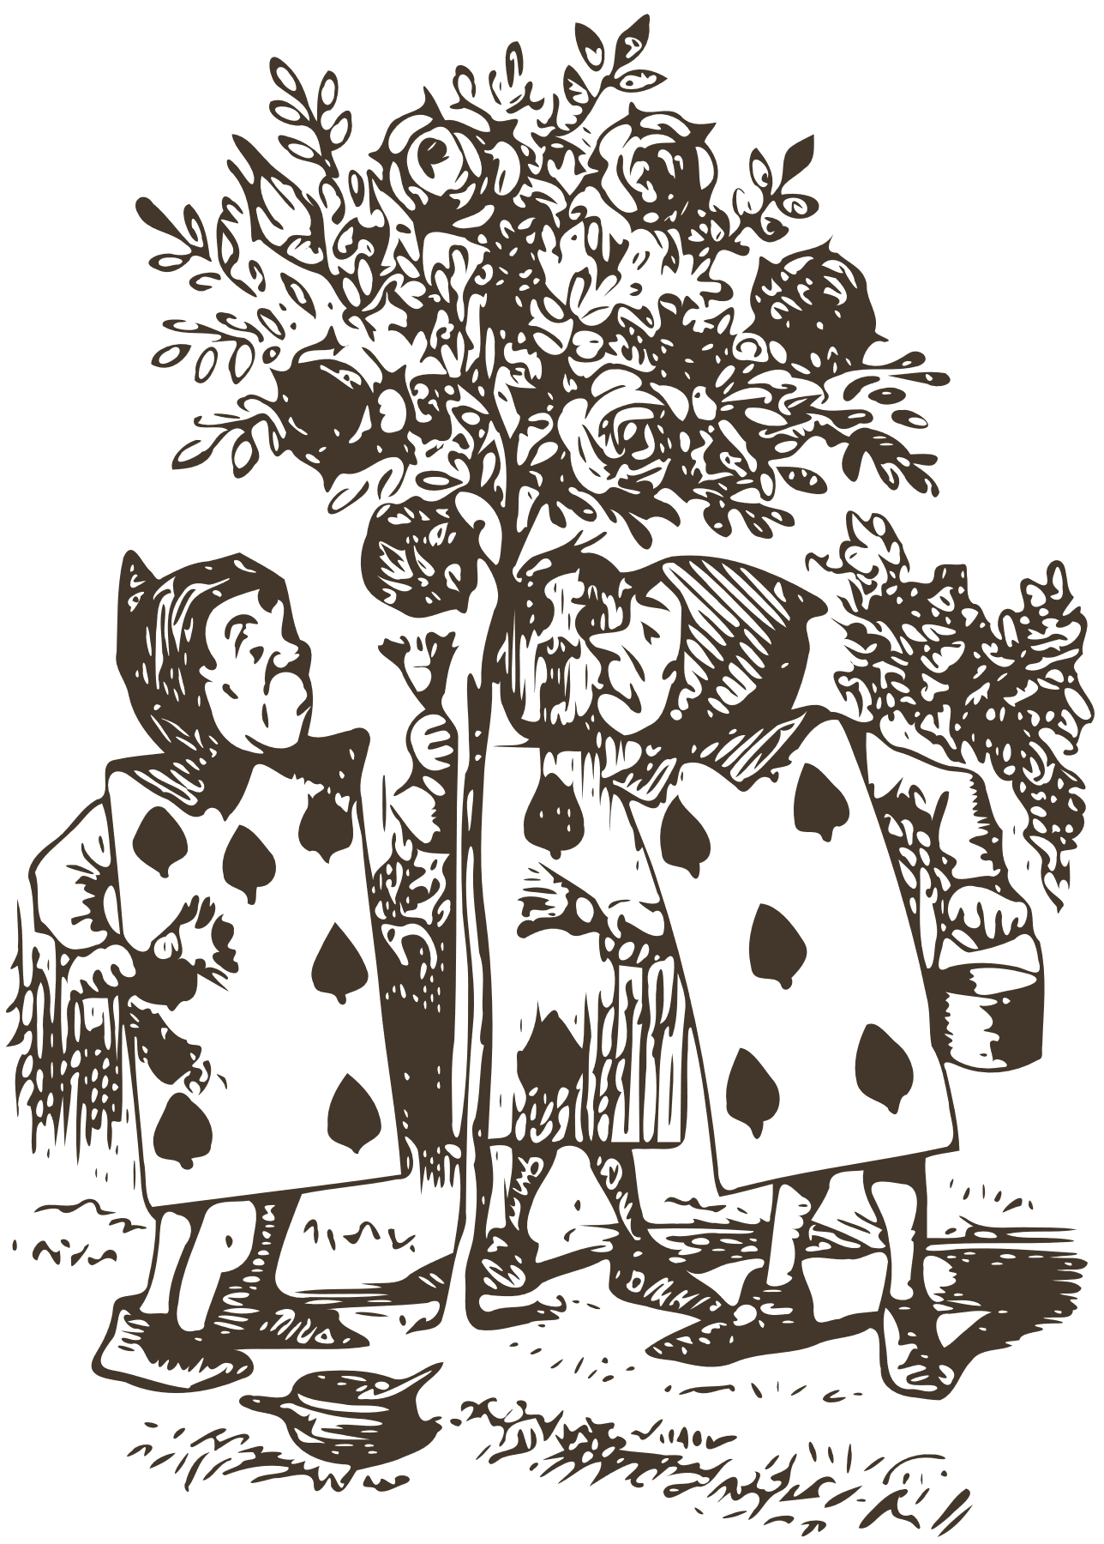

Registration
  Determine necessary information
    Full Name
    Contact Information
    University Affiliation
    Individual/Group
    Timeslot(s)
    Accommodations
    Agreement Statement
  Create registration form
    LibWizard
    Google Forms
    SurveyMonkey
Notes:
So what do you ask during registration, and where do you ask it?
First, determine the information you absolutely need to have. For us, at the most rudimentary level, we needed:
Full name, contact information, timeslots, and agreement statement.
Next, we asked ourselves what would make our lives easier in addition to the most basic information necessary. We knew people would likely want to participate with others from their social circles, so we added an option for individual or group registration. If 'Group' was selected, then a box to list group members would appear.
We leave the majority of our events open to public participation as well, so we also needed a way to prioritize student registrations if the response was unexpectedly overwhelming. We didn't anticipate needing this, but instead of searching each registrant's name in our system, we decided to add a question asking registrants to self-identify as either Student, Faculty, Staff, Alumni, or Other (i.e. community.)
Once we had our question fields, we threw a form together in LibWizard, but this could also be easily completed using a free service such as Google Forms or probably even SurveyMonkey.

Slide 8
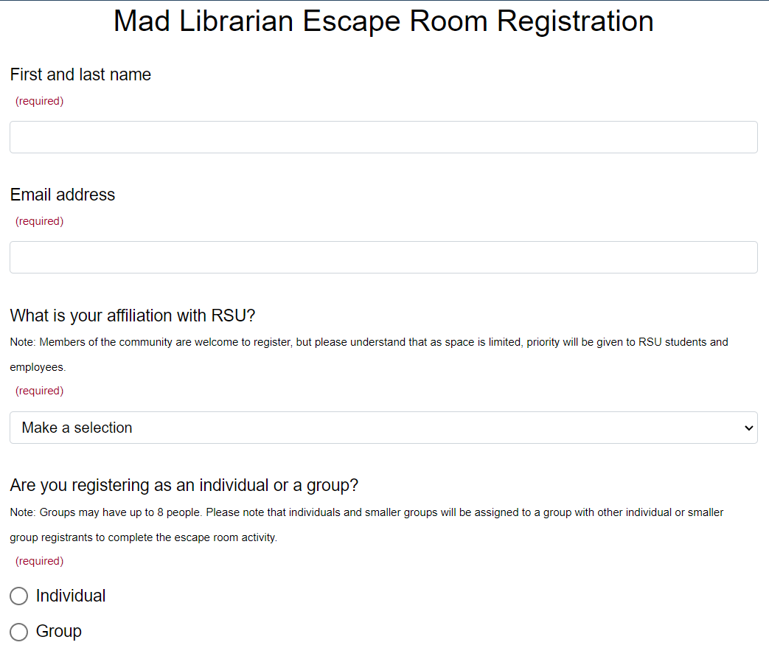

Registration
Notes:
Whatever system you use, make sure you mark the most essential fields as Required.

Slide 9
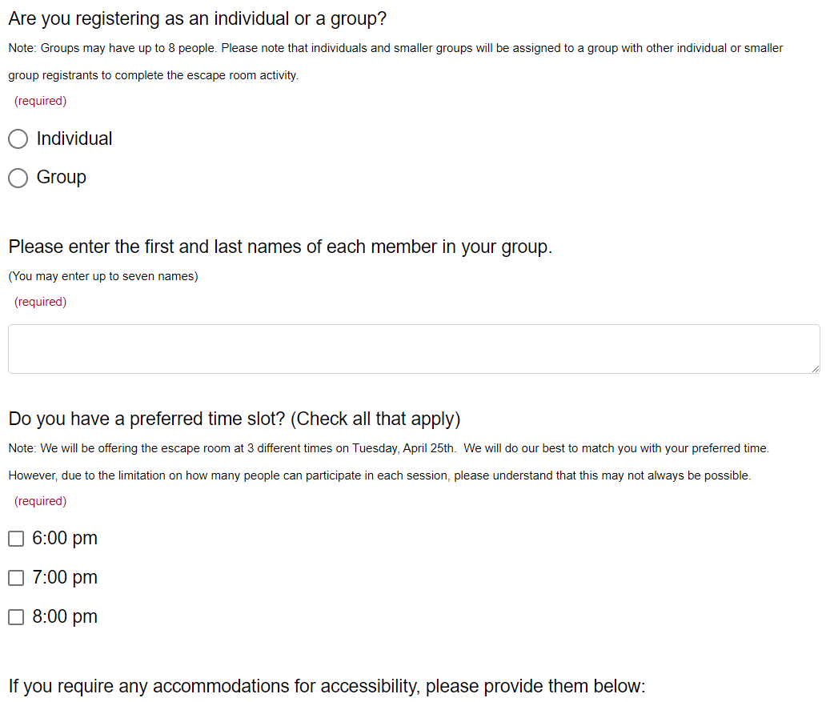
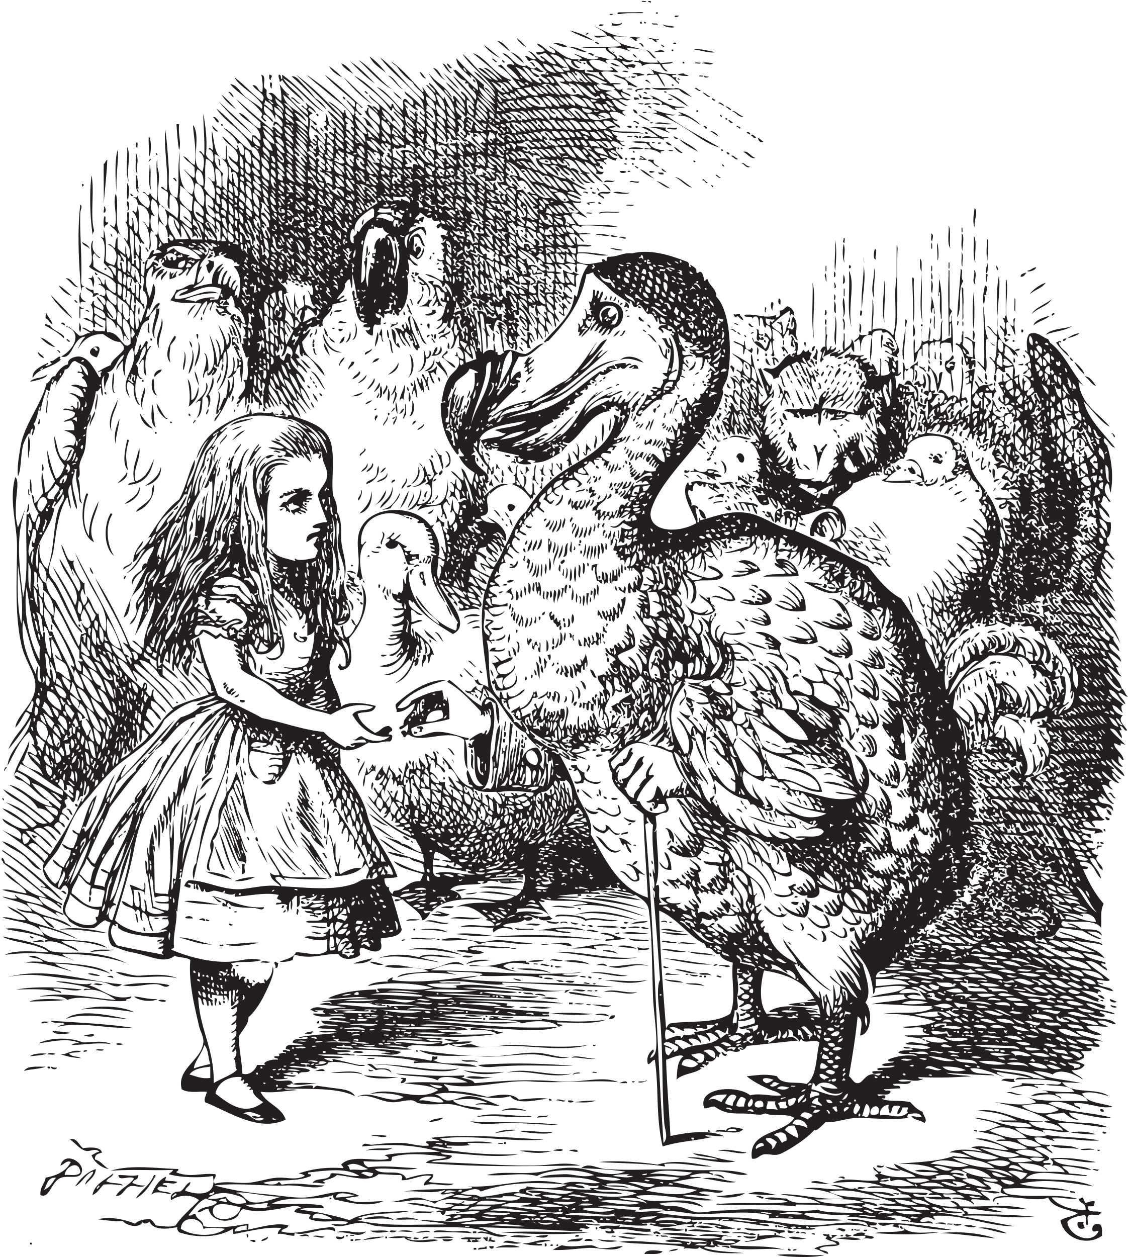
Registration

Slide 10
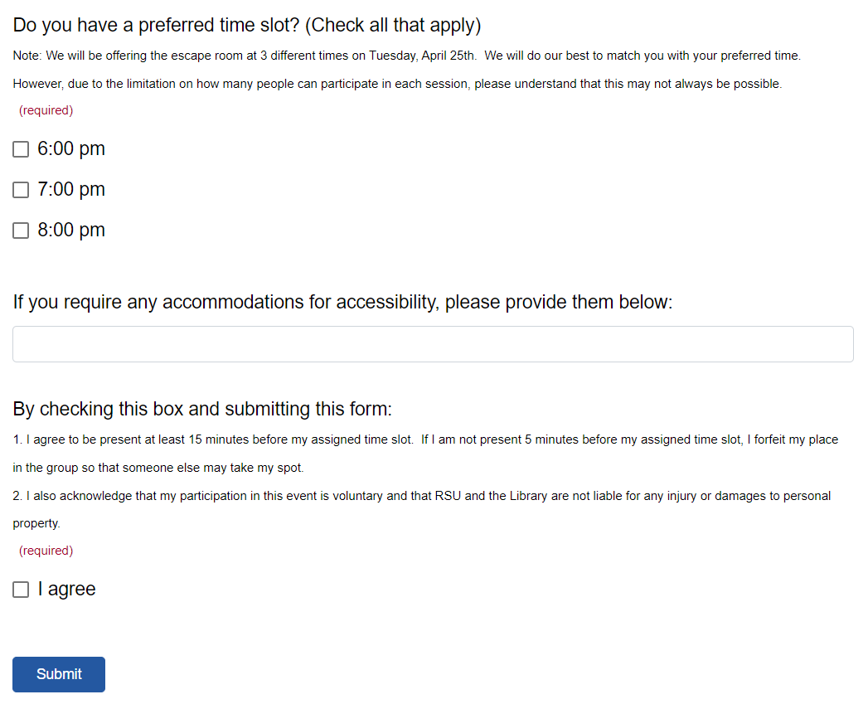
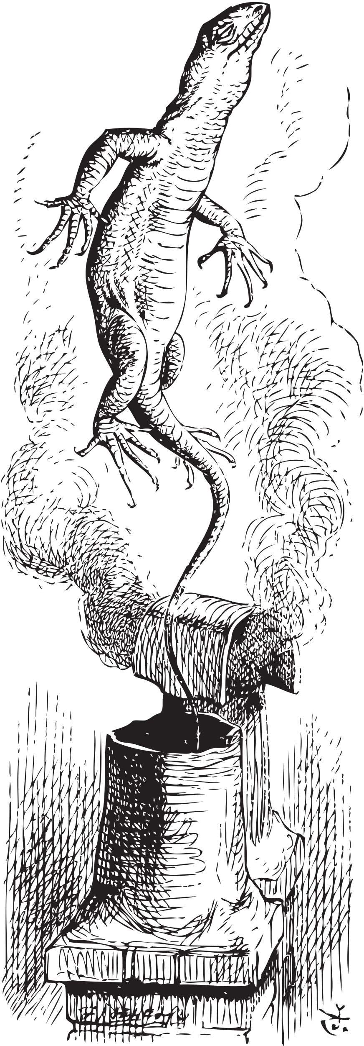
Registration
Notes:
One thing I do want to point out here is the singular optional question we included in our form. We strive to be as conscious as possible about accessibility, and we wanted to know if anyone wished to request any sort of accommodations for the escape room. This would enable us to prepare in advance instead of scramble the moment of. At least that was the goal. I will say no one requested any accommodations, but we did have someone end up arriving on crutches, likely injured between registration and the event. It was easy to work around since we have two elevators. More on that later though.

Slide 11


Promotion
Notes:
Okay, so we have our form. Now what?
Promotion. We needed to get the word out quickly. For our events, we do our best to cast a wide net.
Posters around campus, graphics on Facebook and Instagram, adding the event to the university calendar and to the landing page students see when accessing their university information. We also submit the events for inclusion in the weekly "what's going on" emails that go out to students and to faculty and staff. Lastly, we also send our own email to all students, specifically just about our event.
With the digital promotion, it's easy to include the registration link either in the post/event info or in a LinkTree for Instagram. For the physical promotion, we opted to include a QR code on the posters.
Now, if you haven't figured it out by now, the theme we chose was...

Slide 12

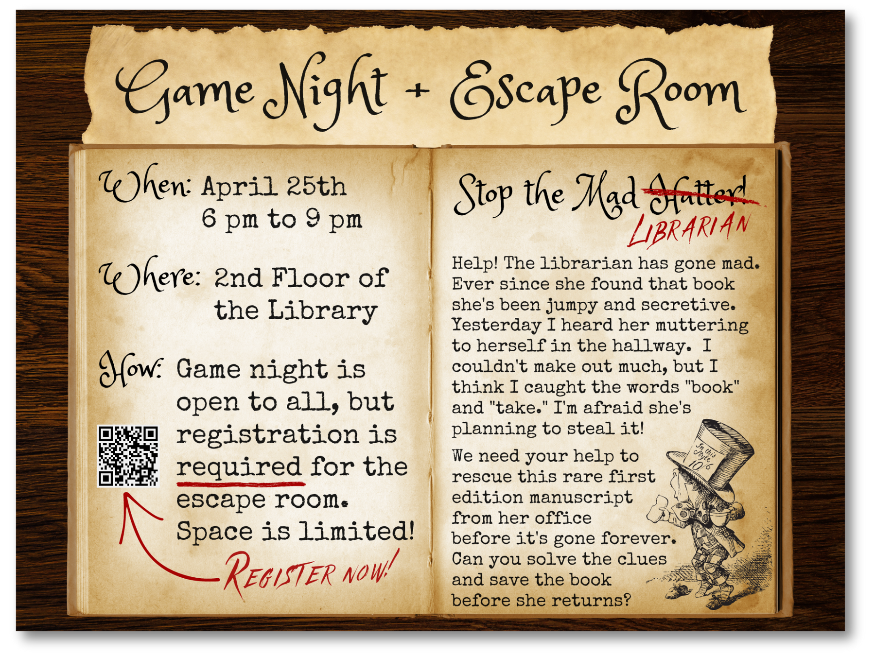
Notes:
Alice's Adventures in Wonderland.
I wanted the promotion to look a bit like it was a story in an aged book, so this is one of those situations where "once you know the rules, you're free to break them."
Typically you do not want this much text on anything. Promotion hinges on being brief but memorable. I did my best to blend the two styles here. Key information on the left with the registration QR, and then the 'story' on the right. I used the red for emphasis in a font that looked like someone had written into the book in a slightly unhinged way.

Slide 13
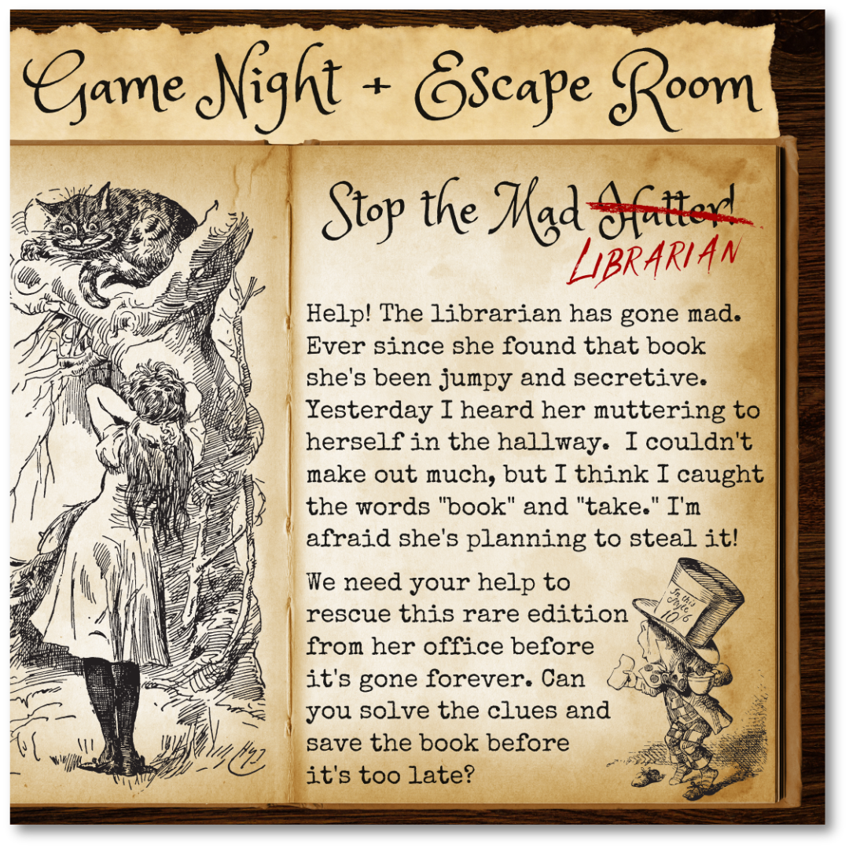
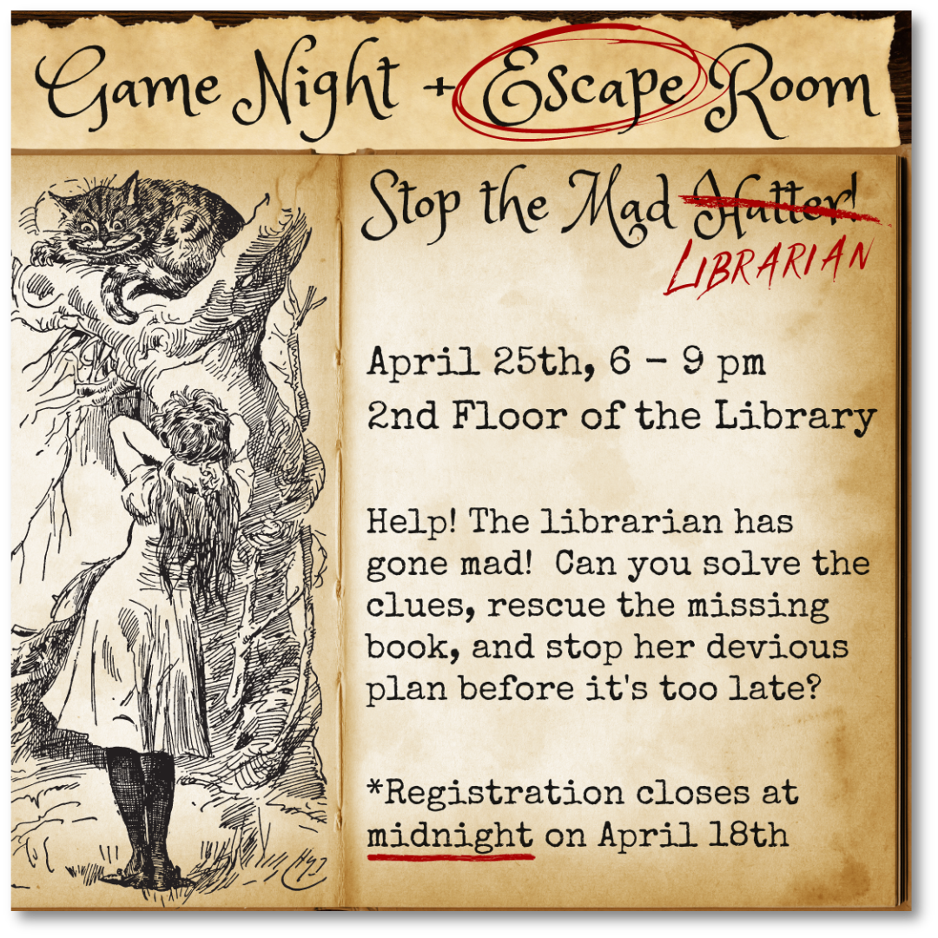

Notes:
Social media posts looked a little different, and promotion on those platforms went up a few times. Here's an example of two versions from Instagram. The one on the left was the initial post, registration link in a LinkTree. The image on the right was published closer to the registration deadline, simpler on the text, more emphasis on Escape and the registration deadline itself.
In my experience there's not really a one-size fits all when it comes to promotion. Just find what works for you.

Slide 14

Notes:
I want to pause here and say that as of about 36 hours before registration was set to close, we had 28 people signed up (counting listed group members).
We were THRILLED. But there was still a little time left, and I sent a reminder email out to all students just to let them know registration would be closing at midnight the next evening.
This turned out to be both one of the best and worst decisions made throughout this process.
It was great because interest and registrations skyrocketed. It was bad because, by the time I checked back in with the form results that same evening, the number of registrants had increased by 41.
Why was that bad? We had planned three timeslots, with two experience rooms to be run simultaneously, with a group cap of 8 people.
We thought we were overestimating by quite a bit when we planned for the possibility of 48 people. But now, still more than 24 hours before registration was meant to close, we were sitting at 69 people in total.
I admit I panicked a little. I messaged Ashley about the issue, and as soon as I made it home, I modified the registration form to announce that registration had closed early due to "overwhelming interest" and offered the option for people to sign up for a waitlist.
An additional 8 people signed up for the waitlist. We now had 77 people who wanted to experience this adventure we had created, and in true library fashion, we did not want to disappoint any of them.
Thankfully, our timeline was to close registration a week prior to the event to allow ourselves time to figure out each registrant’s assigned time slot.
We met immediately the next day and discussed our options. Did we deny 37% of our registrants by sticking with the initial 48 person plan? Did we add a second night? A third room, that we didn’t really have available or have the supplies for?
We eventually settled on adding a fourth timeslot and increasing the group cap to 10 instead of 8 to allow up to 80 people to participate.

Slide 15


Scheduling
Notes:
So, with the logistics revised, it was time to sort the registrants and their groups out into teams and set the schedule.

Slide 16

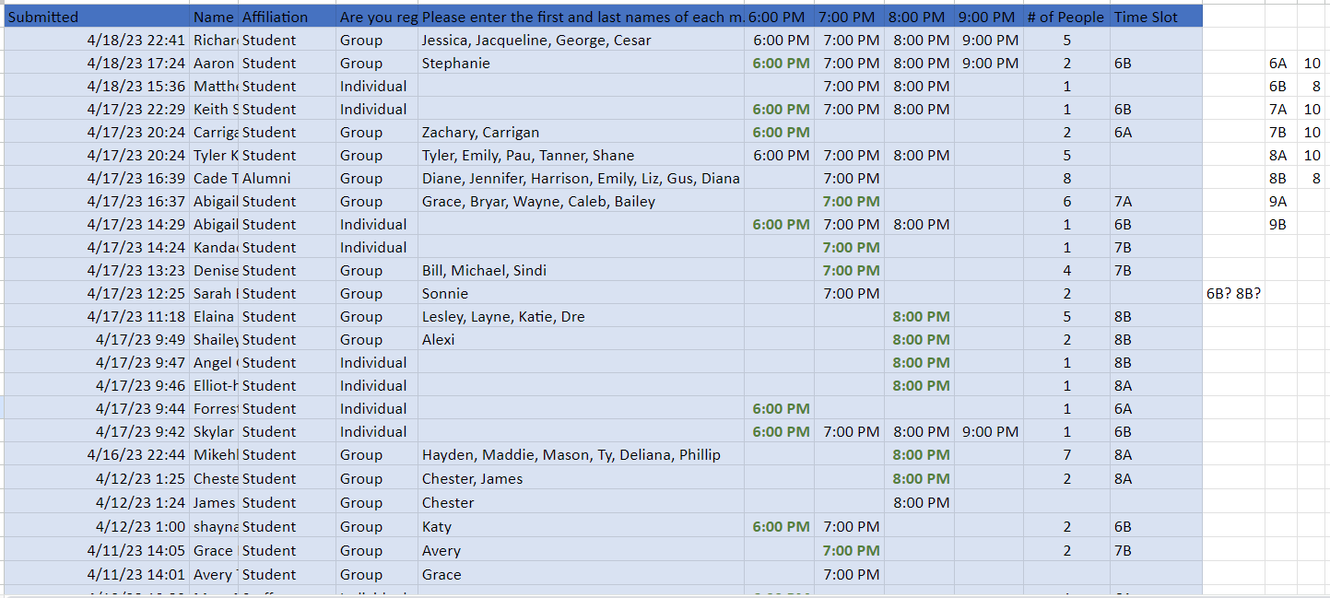
Scheduling
Notes:
The registration form had noted that groups could have up to 8 people, and also noted that individuals would be assigned to groups with other individual registrants or smaller group registrants.
Essentially I exported the registration results to a spreadsheet, filtered it down to just what was necessary for scheduling, and started doing my best to match up registrations to complete teams.
However, we had added a time slot, so I needed to email registrants (focusing mostly on those who registered for 8pm since it was a popular timeslot) asking if anyone would be available to come in earlier or later. I received enough responses that I was able to fit everyone in, and the schedule looked something like this.

Slide 17

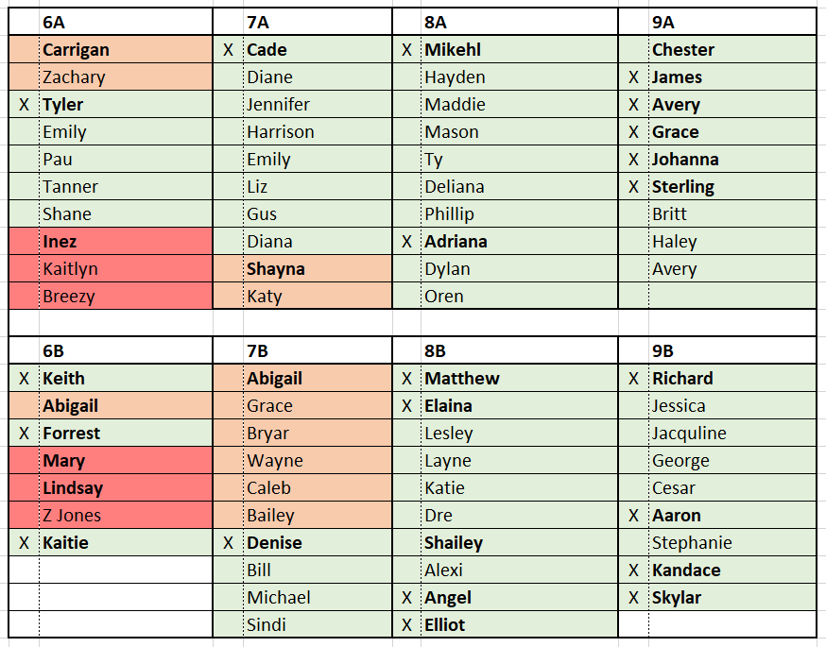
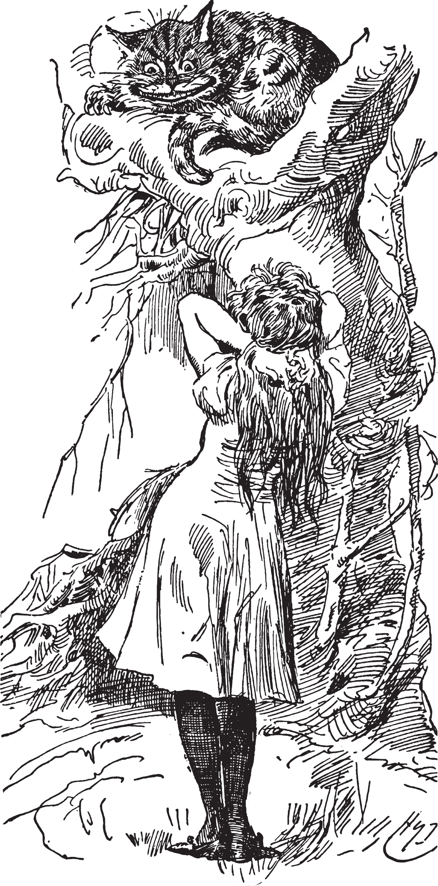

Scheduling
Notes:
This was not color coded initially. Once I had this schedule created, I emailed each group to let them know their time slot and ask them to confirm their attendance at our event.
Based on responses, I started color coding. Green had confirmed. Orange didn't respond. Red had to cancel for various reasons.
You'll also notice certain names in bold. These are the names of the primary registrant. We found it helpful to emphasize this because the printed version that would be held at the desk later on needed to be dynamic and easily changed on the fly. We knew some of the unconfirmed people might not show, and we also knew we might have people show who didn't register. Bolding these names allowed us to know who was part of what group in case we needed to shift things around.
Another thing I did is send an email around the day of the event, once I had an idea of the cancellations, and let students know that due to a cancellation, we had a small number of spaces available at 6pm for the escape room. Whoever replied to me first would get first chance at the slots. I did get a response for a group and those spots mostly filled back up.
None of this was going to matter, though, unless we figured out the rooms themselves.

Slide 18

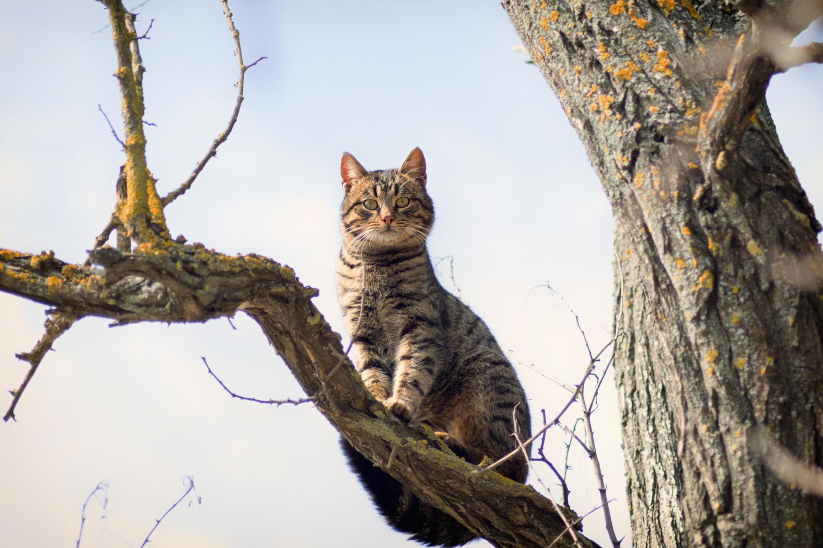
Development
Notes:
So, where do you even begin to develop something as intricate as an escape room? Creating one from scratch can be intimidating, especially if you have little to no experience.

Slide 19

Development:
Story & Scope
Story:
  Supplies you already have
  Supplies you can purchase
  End goal
Scope:
  Timing
  Number of participants
  Space
  Difficulty
Notes:
We started by picking our story and theme. There are a few ways to go about deciding on a theme. One is to see what supplies and themed decor you already have on hand that would fit a theme. Do you happen to have a million rabbit plushies and tea sets lying around? Then maybe Alice in Wonderland would work for you! This is not the route we took, although we did consider what we had and how easy and expensive it would be to purchase supplies that fit.
While reading over several articles and chapters detailing other libraries' experiences creating an escape room, we decided to adapt the basic storyline from Susan Hansen's "Stop the Mad Librarian: A Library Orientation Escape Room" and create a mad librarian of our own! While searching for rare, expensive books around the world, a group member (Kaitlin, I think??) saw a story about an edition of "Alice's Adventures in Wonderland" being worth between 2-3 million dollars (original printing had illustration errors and were pulled, maybe around 22 copies in existence). And just like that, we had our Mad Hatter, I mean, librarian!
Part of deciding on a story is to determine the end goal of the room. The goal does not actually HAVE to be "escape the room." You can choose a goal that fits your theme, like diffusing a bomb in a city or piecing together a message to stop the bad guy; the sky is the limit!
Our end goal was that participants would search the librarian's office to find a way to rescue the book from a locked book vault before she came back and escaped with it.
Next, we considered the scope of the event. How long would the event run for? How much time would we give participants to succeed? How many rooms did we want to run? How difficult do you want it to be? Some of the nitty gritty details won't be ironed out at this stage, but it is important to set some parameters. After our registration skyrocketed, we decided the event would run for one evening from 6pm - 10pm, which would allow for four one-hour time slots. We then decided we would run two identical rooms simultaneously to allow for more participants. We gave them 40 minutes to complete the room and around 15 minutes to reset the room between groups. After registration exploded, we decided to add one additional time slot to allow for two more groups.
Next, consider your space. Do you have a space or spaces you can reserve for the event? Are they large enough to accommodate all game materials and groups of people walking around? Do they contain any cool or breakable equipment or props? We used our library classroom and a large group study room.
Finally, think about the difficulty. Do you want everyone to succeed? Do you want it to be challenging and leave some folks stumped? This is a fine balance, and we opted for a Goldilocks approach: not too difficult, but we did want to give our participants a challenge.

Slide 20


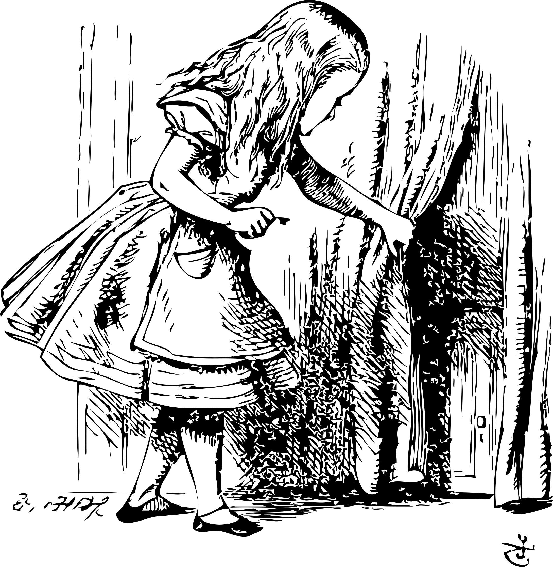
Development:
Backwards Design
W
1
A
8
Unlock the book vault
M
3
H
2
Notes:
Once you have your story, the next step is to incorporate some backwards design and figure out how participants will reach the end goal. It's much easier to work backwards and create clue paths with the end goal in mind. Many escape rooms use a final lock and it works very well. We decided to use a four character alphabet lock, with the correct code being WAMH (We're All Mad Here).
Here is a lesson learned: if you choose to use alphabet locks, make sure the lock has the characters needed on each dial! We could not find a lock that contained our letters, so we ultimately had to change to a four digit lock instead, using the birth year of the author Charles Dodgson, aka Lewis Carroll, which is 1832.
Four or five digit codes work well for the final obstacle, because each digit can be split among the clue paths. We would have 4 main clue paths, and each led the participants through clues, puzzles, and games to finally reach a digit of the code.

Slide 21

Development:
Divide & Conquer
Divide the task
Multiply your success
Conquer the thing
Notes:
With your end goal in mind, it was time to start fleshing out the clue paths leading to the final code digits. We opted to take a divide and conquer approach. Each group member developed a clue path leading to a final digit. We would check in with each other and provide feedback and support at our weekly meetings.
This worked well for us, but it can be a risk if your clue paths don't mesh together well since they were developed by different people. Therefore, it's very important that you keep communicating and working together to create a cohesive experience. A shared document or flowchart and regular meetings are all good ways to divide and conquer together.

Slide 22
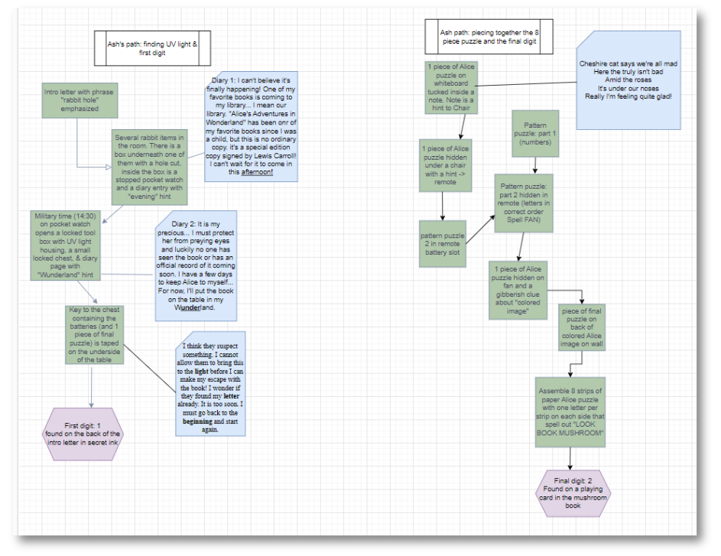
Notes:
With our rushed timeline, we didn't have a complete flowchart with every clue path listed. But I did want to show everyone an example of a flow chart with two clue paths detailed. I know you probably can't read the small text, but I will walk you through one of the paths so you have an idea of the flow.
The path on the left is the first clue path, and the final clue path is on the right. Green boxes are the actual clue path; blue boxes are diary pages with bolded clues; purple hexagons are the final digits.
The first path works as an introductory path. The clues and puzzles are simple and should help build confidence in the participants. It also is the path that unlocks a necessary tool: the UV flashlight.
The first green box is the introduction letter. The letter was "from" the library director asking the players to please help them track down the code to the book vault before the librarian returns in 40 minutes to escape with the book. The director states that they left a few clues to help the players start, but they would be on their own after. Letters are bolded in the text and spell out "rabbit hole," and when players look underneath the plush rabbits in the room they will find one of them sitting on a box with a hole cut, revealing a stopped pocket watch. The time would open a locked toolbox in the room, but they had to read the diary entry to realize it uses military time 14:30 instead of 2:30.
Inside the toolbox was a smaller locked wooden chest, a diary page, and the UV flashlight, but the batteries were missing! Another diary page with bolded text hinted at something underneath a table. When the players looked carefully, they would find a small key taped on the underside of a table. The key opened the small chest with the flashlight batteries and another diary page with the bolded words "light," "letter," and "beginning," steering them to examine the introduction letter with the flashlight, finding their first digit of the final code!

Slide 23
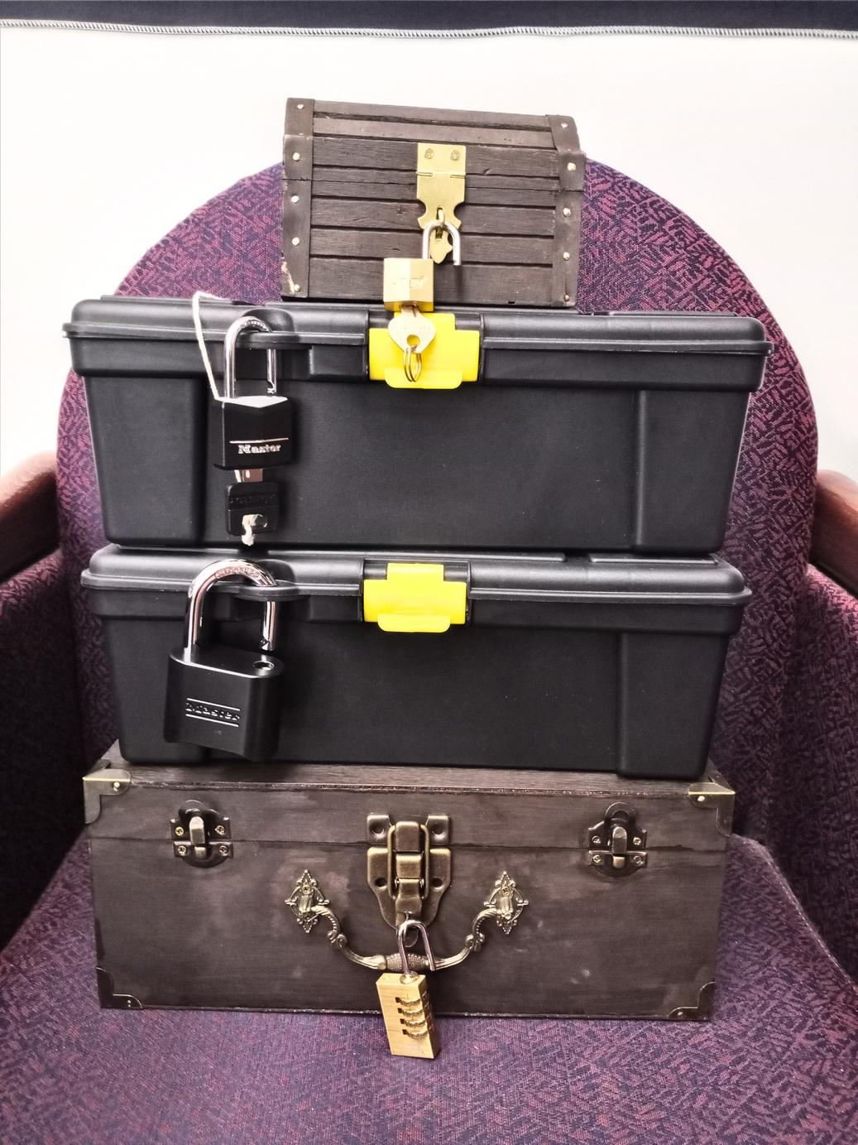

Development:
Sourcing Materials
What do you need?
  Lockable items
  Padlocks
  Clue items
  Tools (i.e. blacklight)
  Decor
  Optional: Prizes
Notes:
So what kind of "stuff" do you need for an escape room, and where do you get it? This is one of the hardest parts because every escape room is entirely unique and will utilize very different clues, puzzles, and decor. We'll tell you about what we used and include suggestions.
Again, start with what you already have to make this event as affordable as possible. Do you have old padlocks lying around in the junk drawer? Anything that can serve as a lockable object? Out of season decor that matches your theme? Without decor, the room will appear bare. Don't skip it, but you don't have to over do it.
After taking stock of what you have, make a list of what else you need. We needed a lot of additional items from locks to decor, so we supplemented with items from Dollar Tree, thrift stores, craft stores, and Amazon. There is a lot of creative space for DIYers and crafters here! Our lovely wooden chests were stained by Kaitlin and they were perfect!
Generally, you want a few lockable items. We had 4 in each room, including the book vault (stained chest on the bottom). These can be toolboxes, chests with hasps, zipper bags, and so on. There are TONS of lock styles available too. Look around at tool shops and Amazon for inspiration and to see what will work best for your room. However, pay attention to dimensions and measurements!! The hasp of your lockable item must be able to fit the lock shackle: we learned this the hard way! We found these cheap toolboxes from Dollar Tree, but our lock shackles were too thick to fit in the hasp space. So, we got out our power drill and widened it to fit.
Most of our clues were paper based, for time and simplicity's sake, but we also had pictures in frames hung by command strips, playing cards, plush rabbits, nesting boxes, flowers, tea sets, ceramic mushrooms, and more.
Finally, consider offering prizes. This is totally optional, but without spoiling too much, offering prizes ensured we had a great response rate on our survey. More on this later.
One final note: have backups. If something breaks in the middle of a session, you want to have a backup on hand. If you're using UV flashlights, have an extra and batteries on hand. We are lucky our cheap toolboxes didn't break because we had no plan for that.

Slide 24
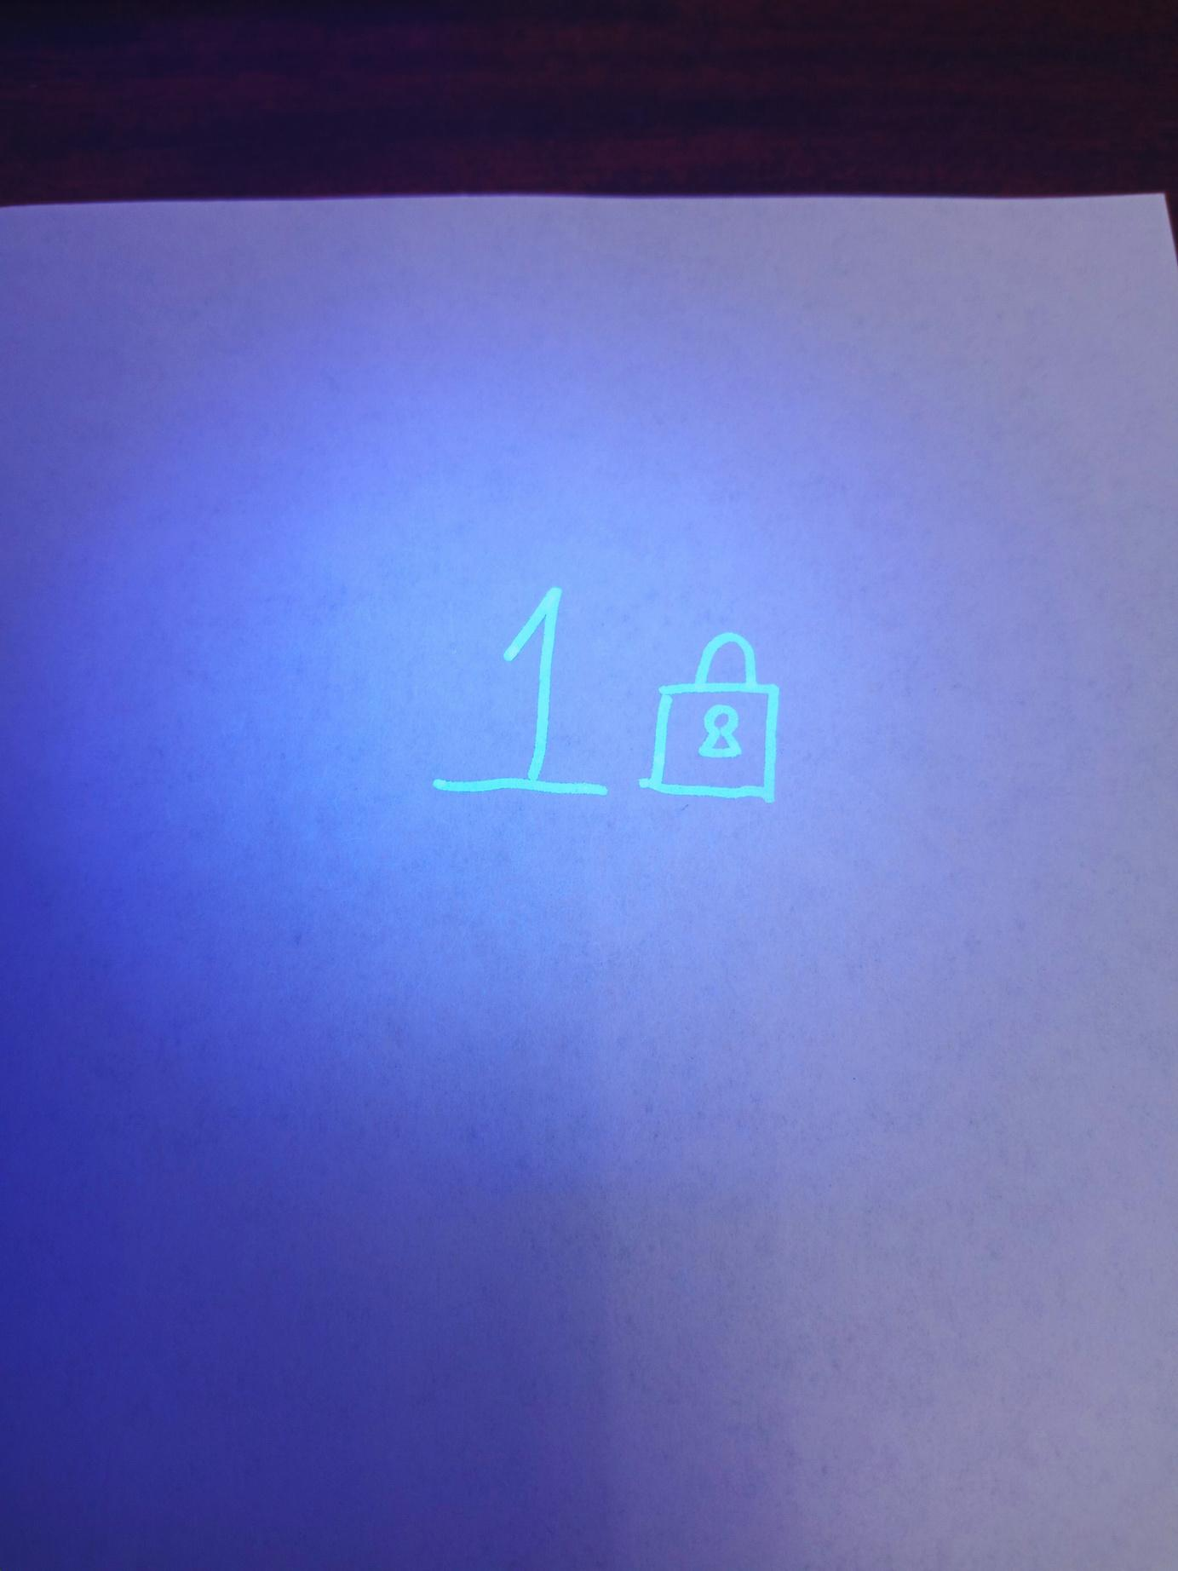
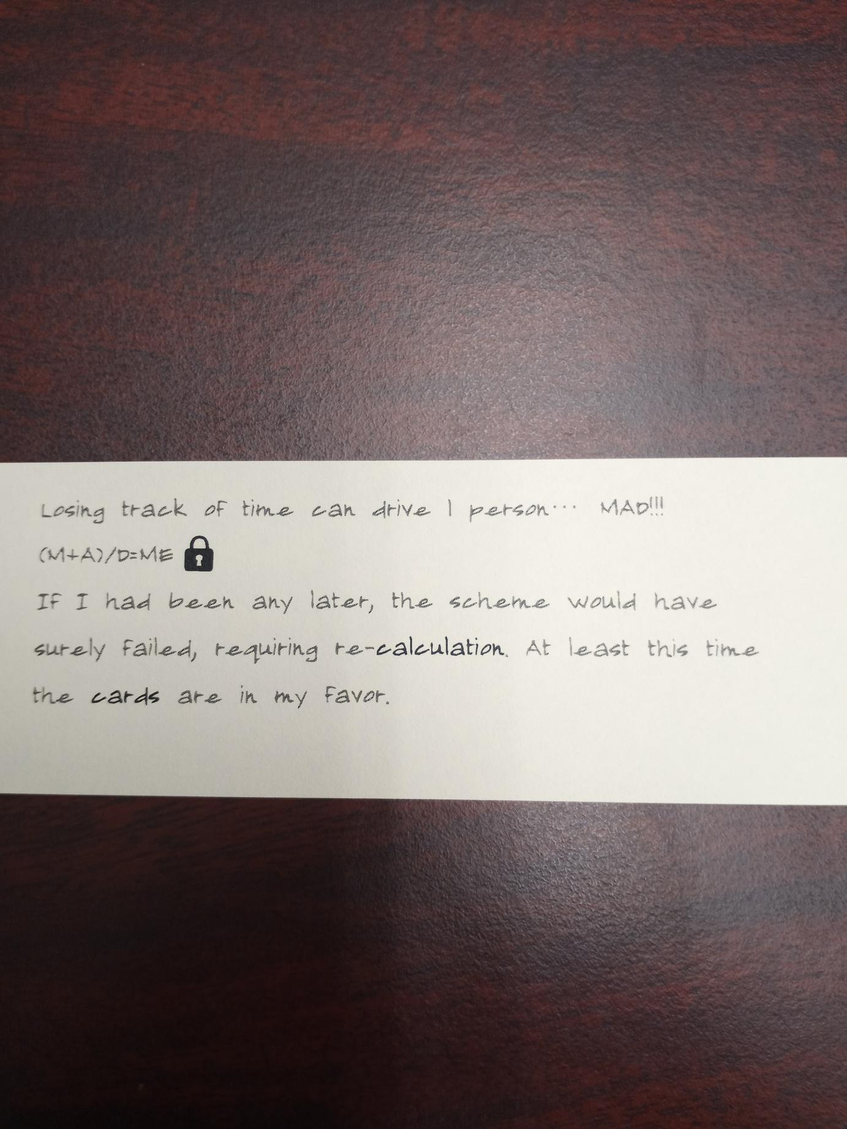
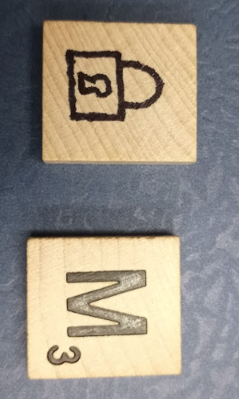
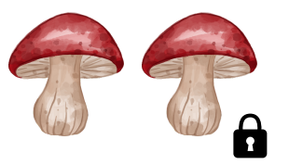
Development:
Testing & Revising
Notes:
The final and arguably most important step is to TEST, TEST, TEST! Do not overlook this step. Much like proofreading and editing, testing your escape room is vital to its success. Your clues and puzzles are going to seem obvious to you, but that will probably not be the case with your participants.
We held two small testing sessions with the remainder of the library staff and student workers. In hindsight, it might have been a good idea to invite students and employees outside of the library to participate in a testing session, because we only had three people per testing session. We still received valuable feedback which helped us revise our paths.
Our biggest change was that even when the testing groups had found one of the final code digits, they didn't realize that's what it was. It was just a random number. To clarify that, we added a small lock image beside the number to indicate to participants that the number was a part of the final code.

Slide 25
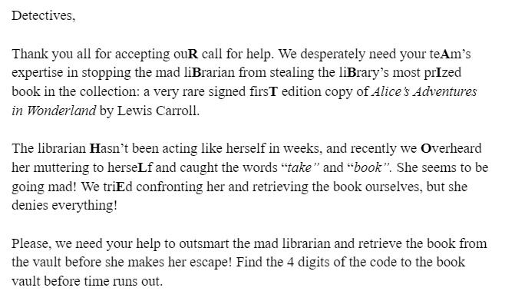

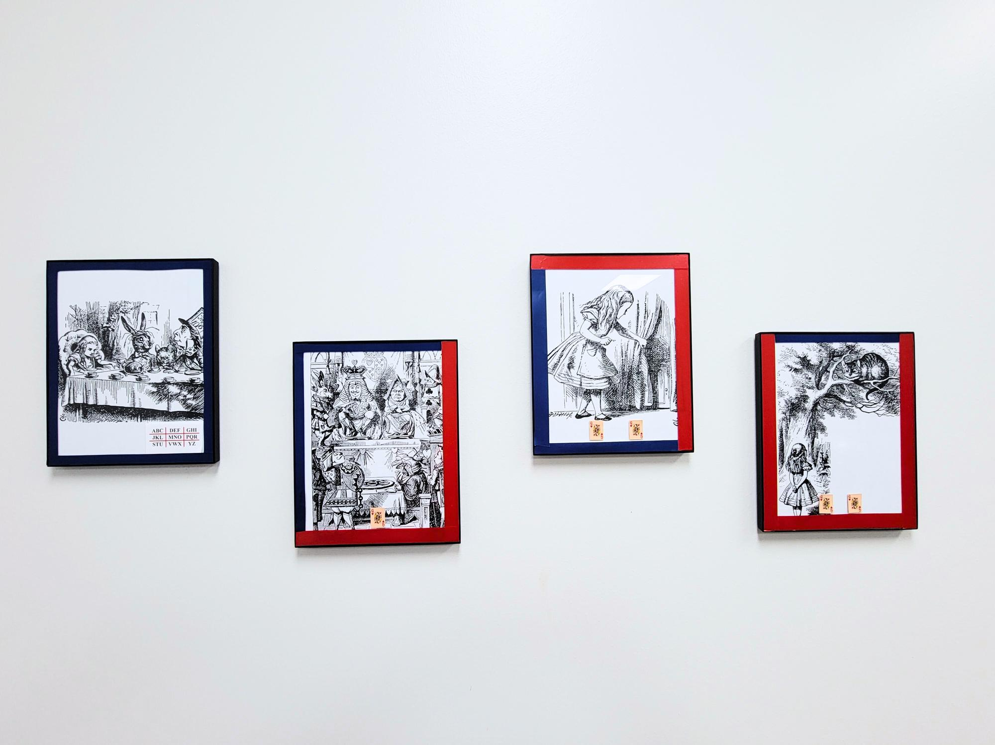


Introduction letter / first clue
Red light anaglyph
ABC DEF GHI
JKL MNO PQR
STU VWX YZ
Notes:
Here are some of our clues and puzzles. It’s always a good idea to mix it up and include a variety of clues, puzzles, games, and coded messages that fit your theme.
The introduction letter gave the participants a clear place to begin and gave them their first clue! Little did they know, the first digit of the final code was on the back of the letter in UV ink.
Next, we have our quadrant cipher puzzle. Each frame with red tape signifies a letter, and the three frames spell out a three letter word. To solve it, participants had to use the red tape to identify which quadrant the letter would be located, and the amount of small cards on the frame told the player which space the letter was located within the quadrant. (i.e. the first frame’s letter is the first letter in the first quadrant: A). This puzzle would spell out the word “ate,” meaning the number 8.
Then we have our anaglyph with a hidden message if you look through a red filter. Kaitlin found a red tinted plate that worked perfectly to display the message! When viewed through a red filter or lens, a message becomes visible that says "you're late for tea!" which then directs participants to inspect all of the tea sets scattered through out the room. 4 tea items had tiny, seemingly blank scraps of paper hidden in them. When viewed under the UV flashlight, the scraps say "the keys are board," leading them to a scrabble tile taped under the keyboard with a final digit.
A note here on creating redundancies. With our red light anaglyph, we realize that it wouldn't be accessible to some folks. Since we didn't receive any accessibility notifications during registration, we didn't think too much of it. But, it would have been a good idea to create an alternate way to proceed in this clue path. Incidentally, we kind of did anyways, because participants could skip this part entirely by simply finding the tea clues through exploration, or just finding the scrabble tile under the keyboard.

Slide 26
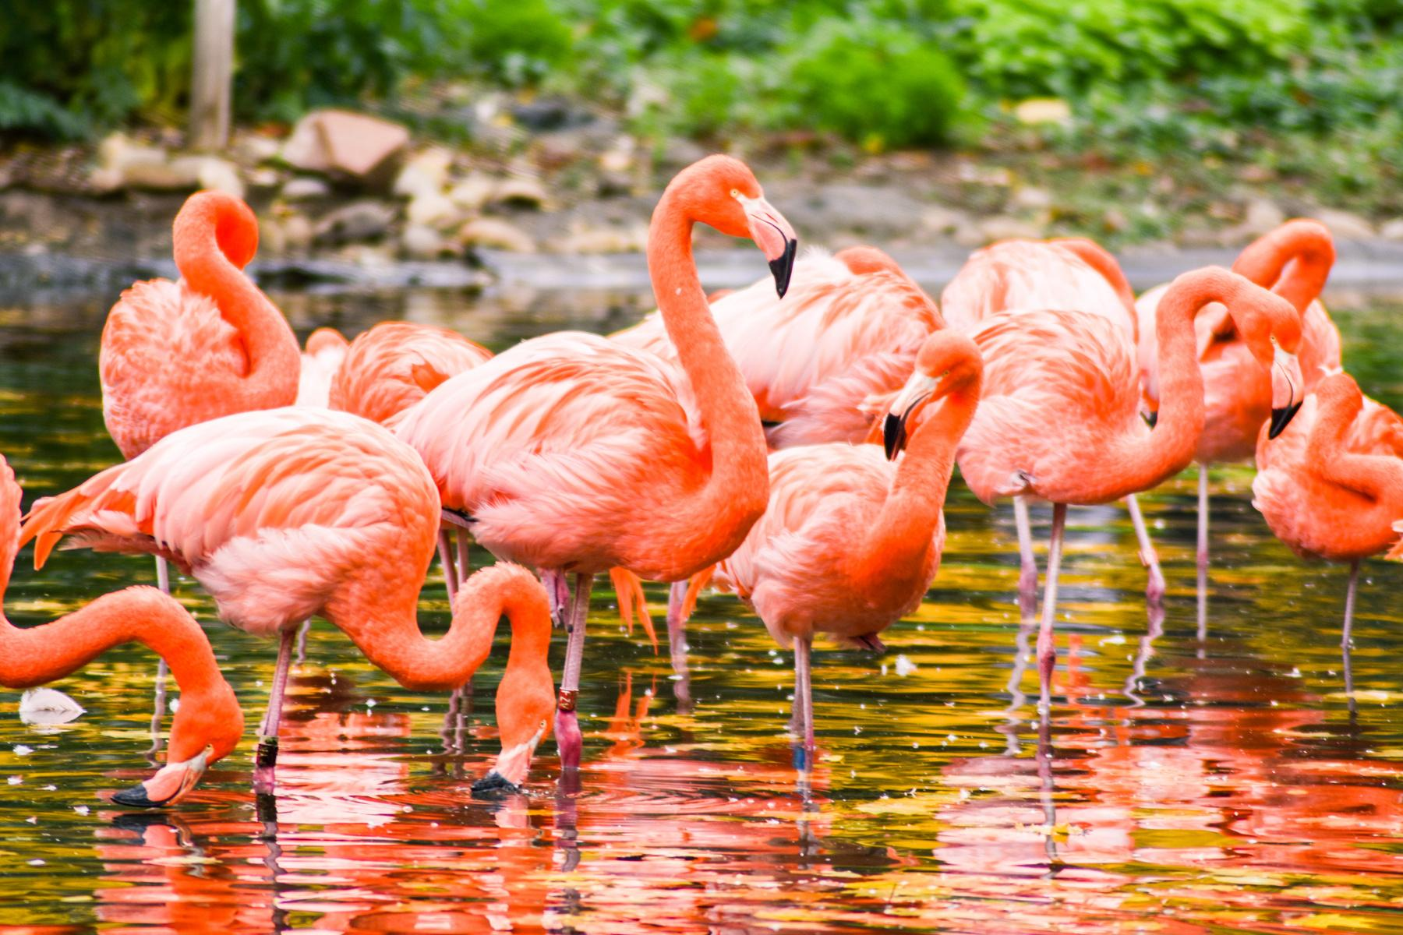
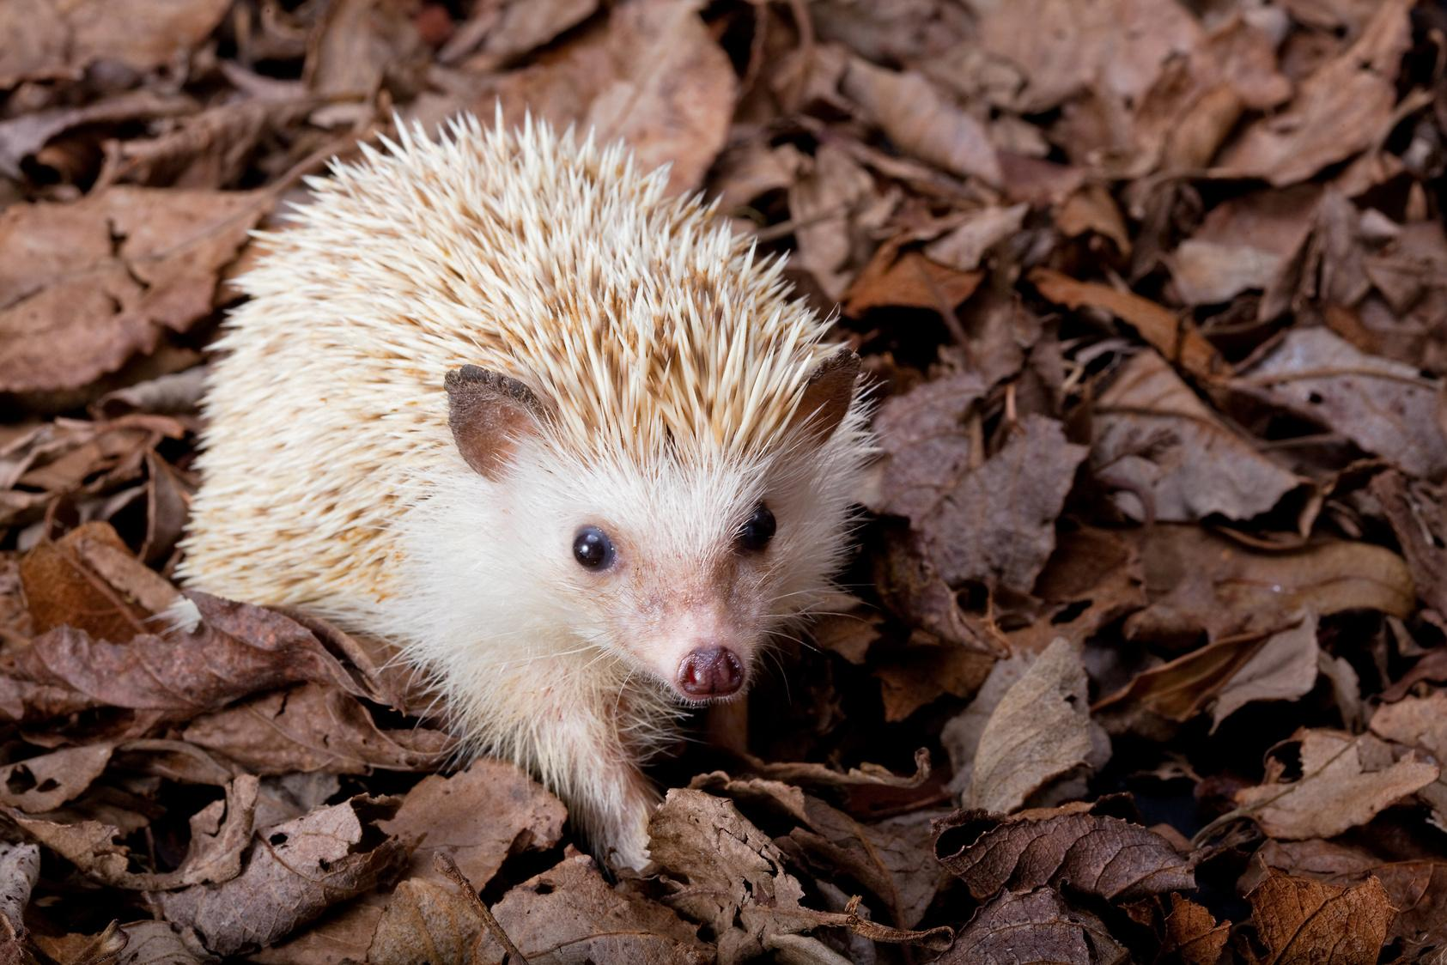
Implementation
Notes:
After an INCREDIBLY busy month, it was time for the event.

Slide 27




Implementation:
Staff Roles & Duties
Staff Roles: 4 total
  1 Event Host
  2 Room Hosts
  1 Floating Staff Member
Honorable Mentions:
  All full-time staff
  All student workers
Notes:
Depending on institution size, it is possible that all staff members will be involved in the creation, testing, or implementation of the escape room. For our event, 4 staff members were required to ensure success.
1 Event Host - the event host is responsible for participant sign-in, reading the rules, and providing an overall introduction of the theme and purpose of the game. They were also responsible for making adjustments to the schedule on the fly if registrants didn’t show up and another patron was interested in joining the event.
1 Room Host per room (in our case 2 staff members - number subject to change depending on the number of rooms being ran) who coordinate the activities within the room, provide hints as needed, and reset the room in between games.
1 floating staff member who coordinates groups before and after the escape room experience - This staff member's responsibilities are the most flexible as they can be used for fill in at most of the other positions if need be. In our case, this staff member facilitated the movement of the groups, with unexpected accessibility challenges, assisted with sign-in and collected surveys, while monitoring game night.
Honorable Mentions
All full-time library staff and all library student workers were involved in planning and/or testing.

Slide 28
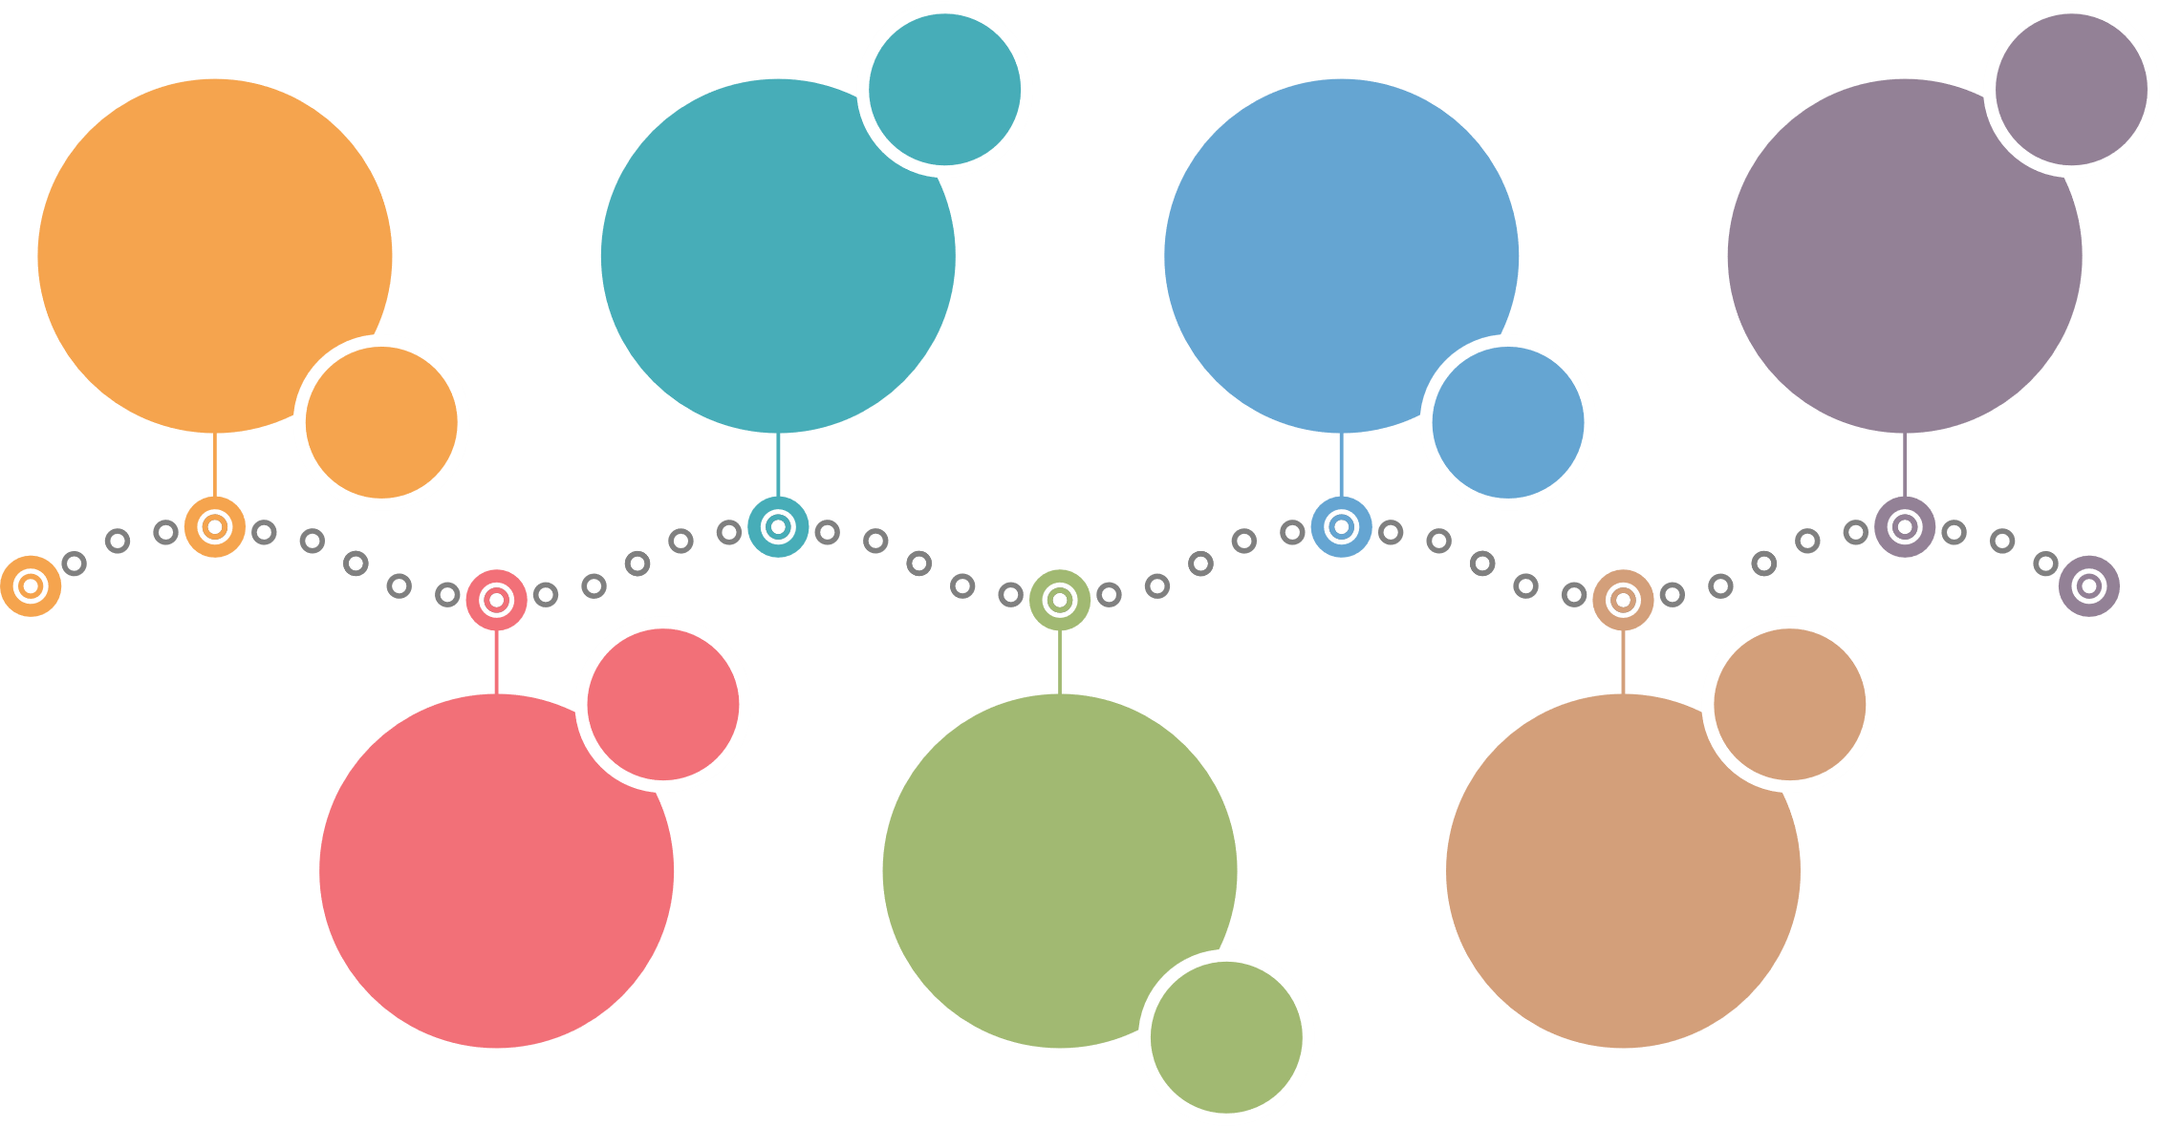
Implementation:
Flow of the Event
03
07
Enter Room
Survey
& Prize
Check-in
Review
01
05
02
06
Intro.
& Rules
Game On
Reset
04
Notes:
The night of the event we had 77 individuals registered, of which 65 participants actually attended.
To begin their escape room experience: The primary registrant, and all members of their registered group checked in at the front desk. Upon check-in, participants receive a ticket that lists the time slot and room (ex. 6A, 6 pm, room A) they have been assigned. They are instructed to hold on to the ticket to gain access to the room and that the end of the event they will be asked to complete the survey on the back of the ticket for a prize.
If you recall from our promotional materials, our board game night began 6pm, at the beginning of the first time slot for the escape room. Participants that arrived early were encouraged to play a board game and enjoy refreshments while waiting. Some groups were delighted to have something to do while they waited. Additionally, two groups purposely came before their slotted registration time to play board games, and many remained after they completed the escape room to talk about their experience while playing a board game. Overall attendance for game night increased by 43%!
Next, about 10 minutes before each time slot, the groups from both rooms are called to gather around the front desk and listen to the rules (which provide guidance on how to play the game and what items within the rooms are not part of the experience) and story introduction. After which, the group is divided based on room A or B and each group is led to their respective room. This is done in order to make sure that the entire group reaches their destination in a timely manner and that a staff member is always there to assist with any seen or unforseen accessibility challenges. Additionally, this allows time for a bit of stage performance and/or clarification of any of the rules the participants have received.
Once in the rooms, the room hosts provide any additional small details (additions or modifications due to unforseen circumstances) about the task at hand and participants are allowed to begin. Game on! Players have 40 mins, and 3 hints, to solve all of the riddles. Room hosts are also able to steer players away from activities that may damage items that are, or are not, part of the game.
After time is called, the room hosts provide the players with a review and breakdown of any clues they may have missed and answer any questions posed to them.
At the 45 min mark, the same staff member that led the groups to their rooms meets the groups and directs/assists them back to the front desk area so that they could complete the surveys on the back of the tickets and receive a prize. During this time, the room hosts reset the games and puzzles for the next group.

Slide 29

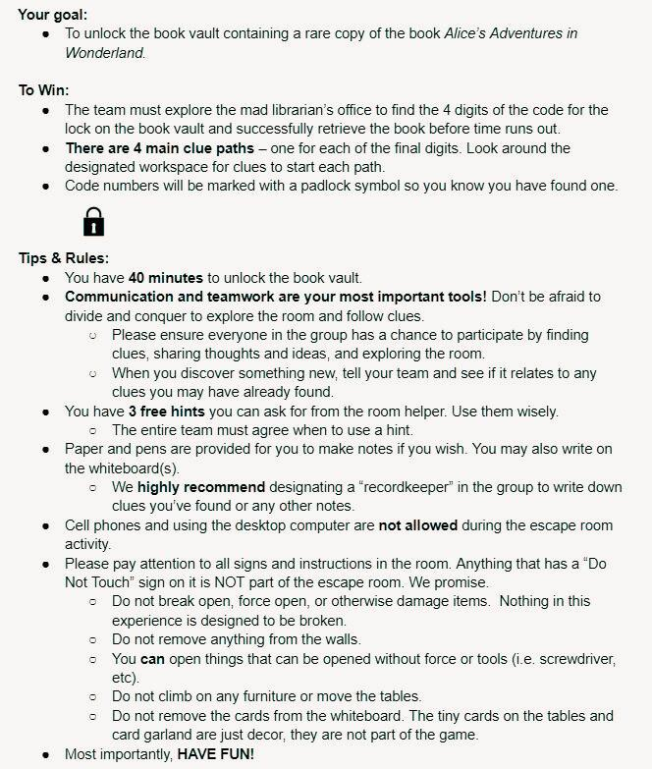
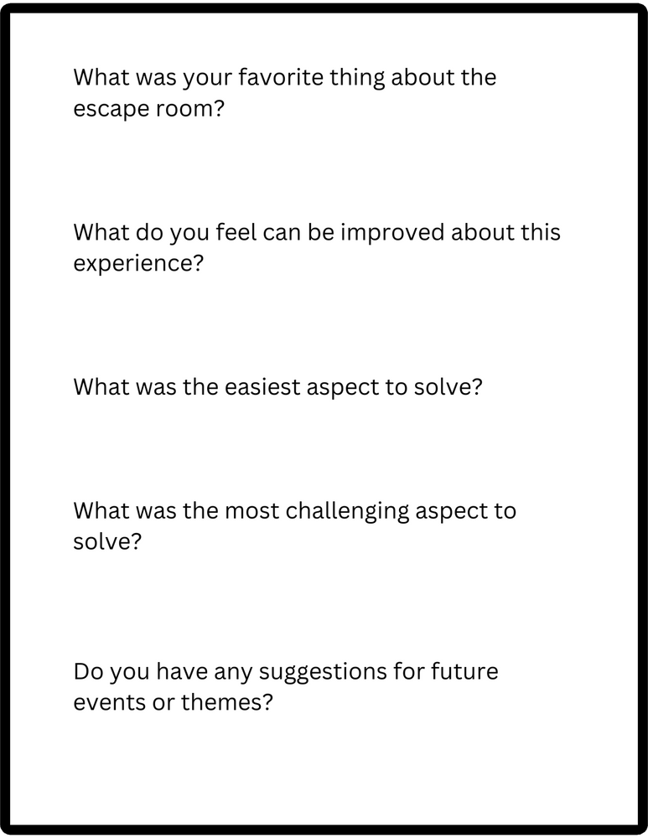
Implementation:
Rules & Ticket
Notes:
Here is what our rules sheet and tickets looked like. It may be a little hard to see, but these rules provide clear instructions on winning the game and include helpful guidelines to complete the puzzles and determine if an item is part of the game or not. This is where we defined the time limit, number of hints, and how items within the room should be treated. It is best to outline expectations as clearly as possible to keep participants on track and prevent damage to the space. Therefore, if none of your paths involve removing items from the wall or turning over chairs, mention that in this step and reiterate it again once they are in the room. This document also outlined how much time players had and how many hints. We gave them 3 hints.
By linking the ticket with the survey and adding a prize for returning them, we received 94% of the surveys distributed.

Slide 30
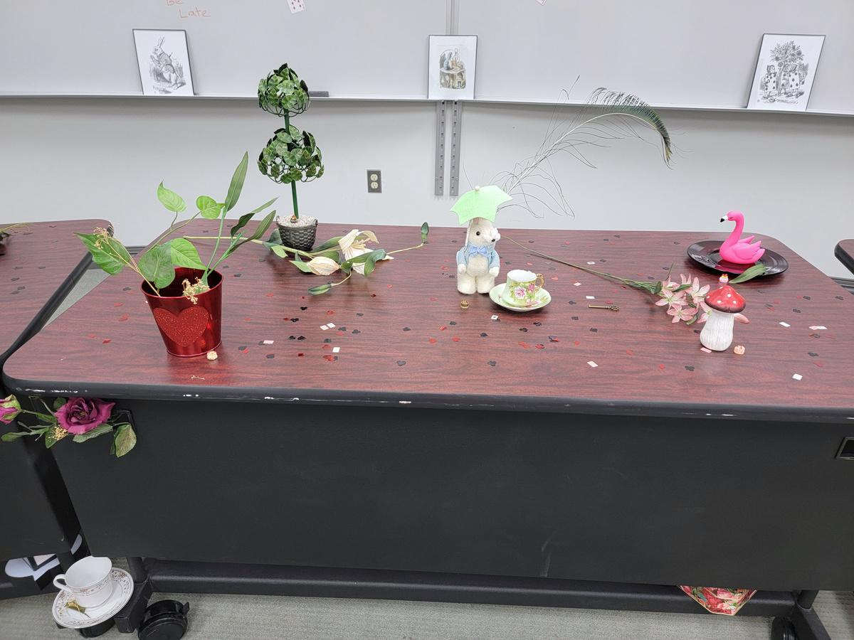
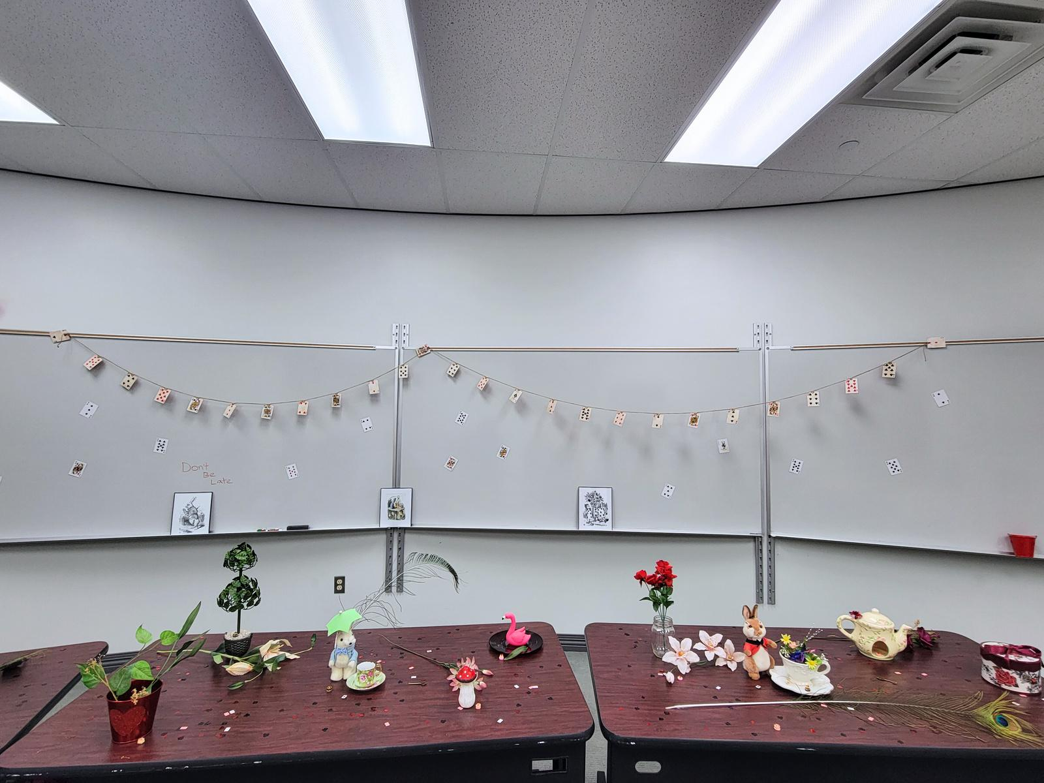
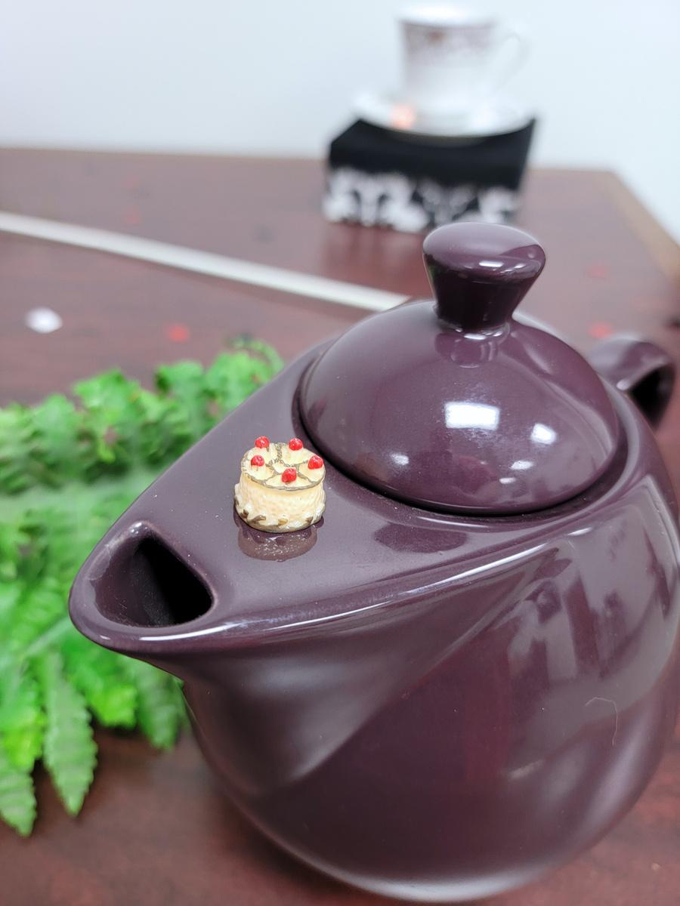
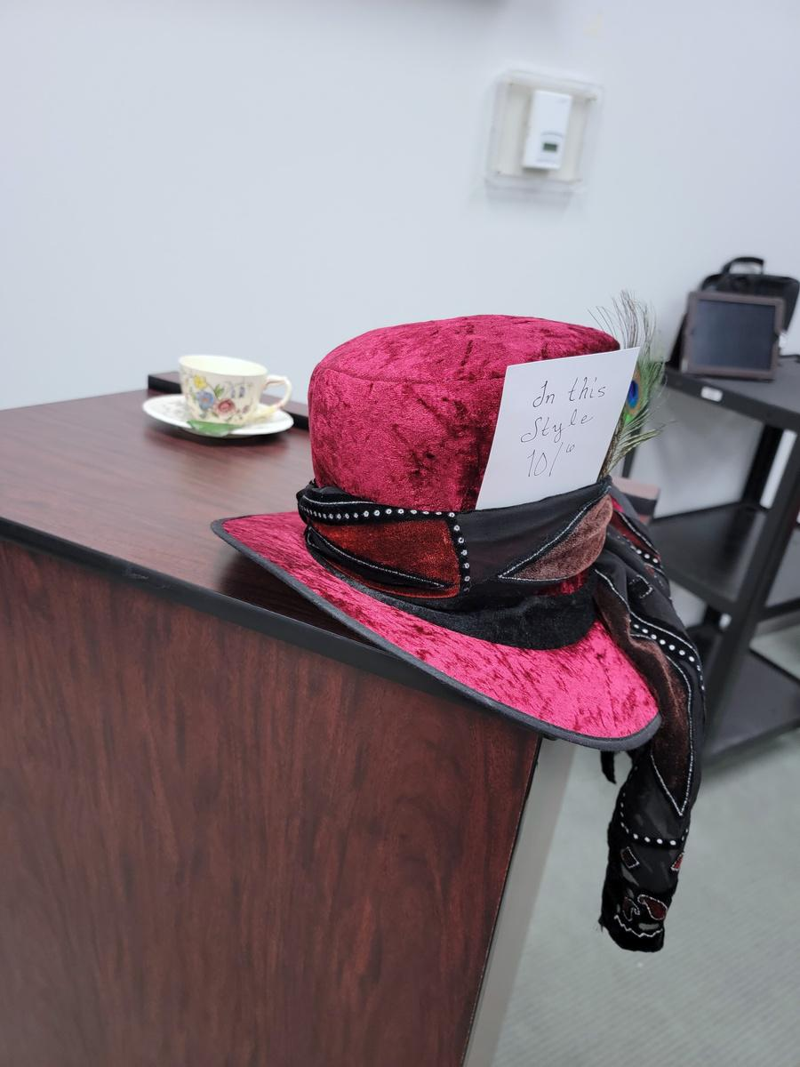
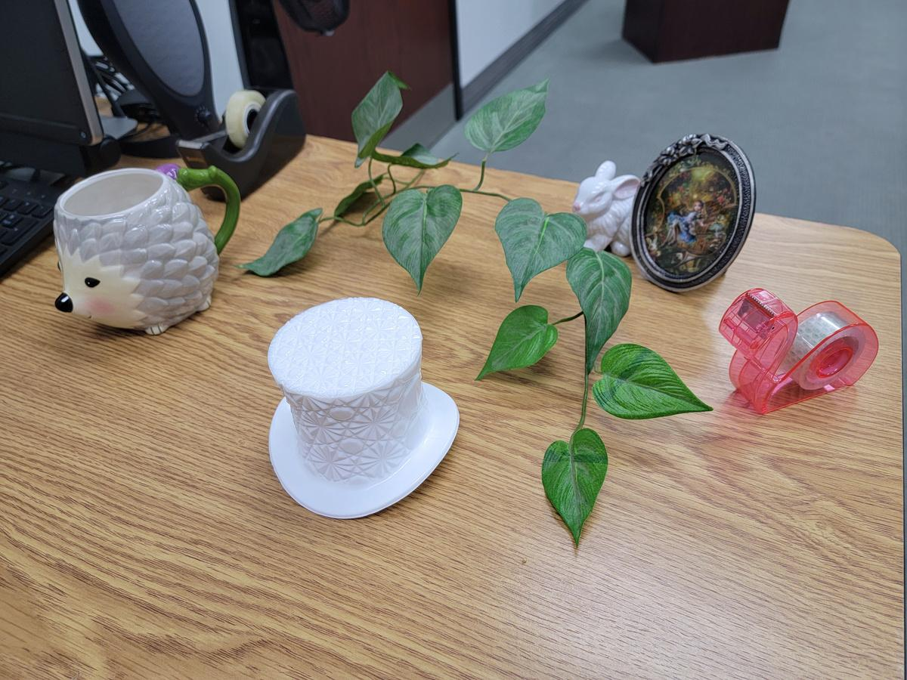
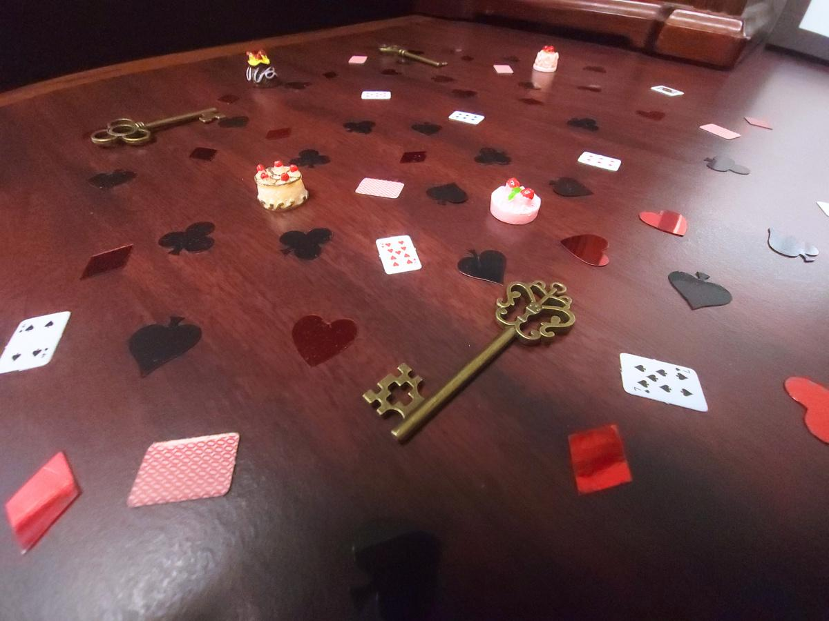
The Rooms
Notes:
Next we have several photos of our two identical escape rooms. They both had the exact same puzzles and clues, and the decor may have varied some, but we made sure we had similar items in each room. Both had several different tea sets and plush rabbits scattered throughout the room, various Alice themed knickknacks, a Mad Hatter hat, a card garland, fake flowers and greenery, framed Alice illustrations, teeny tiny playing cards, cakes, and card suit confetti.
We also made a simple "do not touch" sign to put on anything that we didn't want players to mess with, such as framed paintings, electronics, thermostats, etc. We clearly stated on the sign that the item is not part of the escape room.

Slide 31
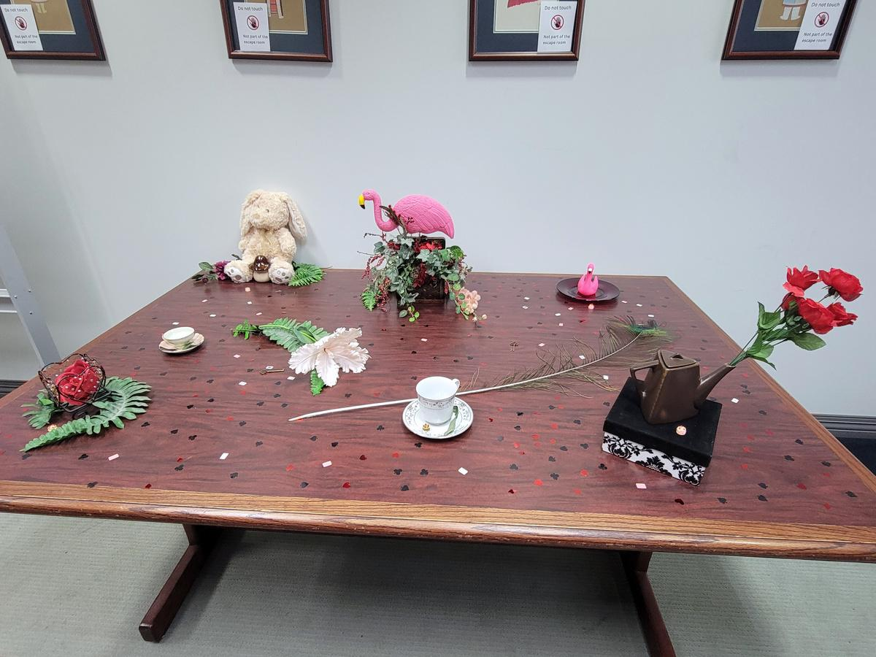
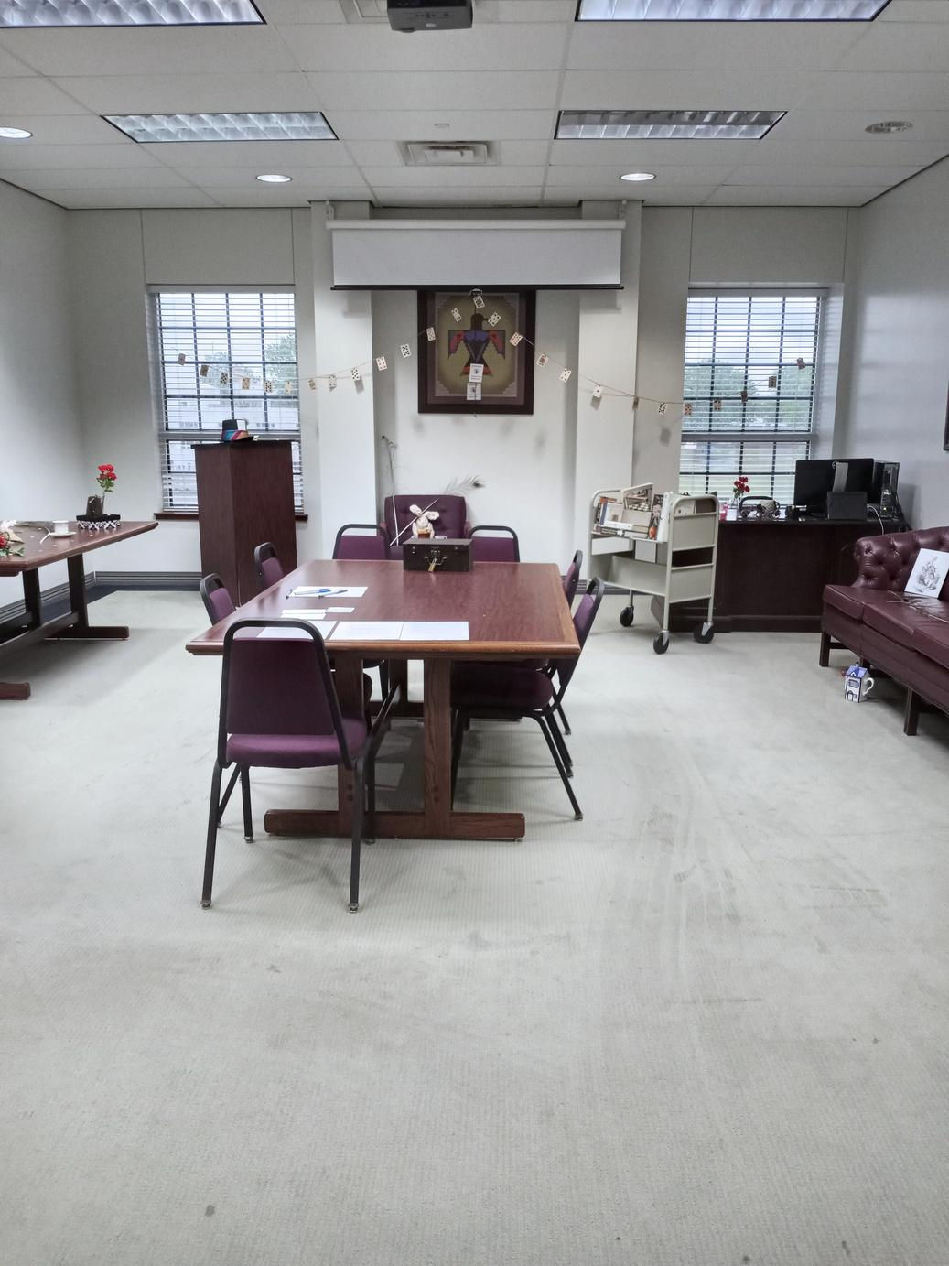
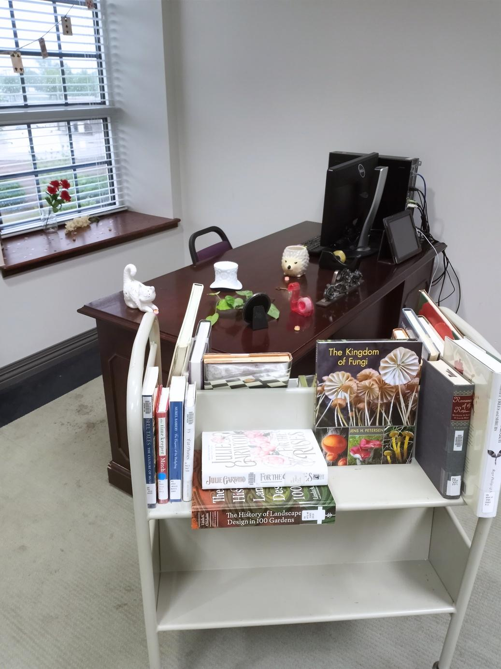
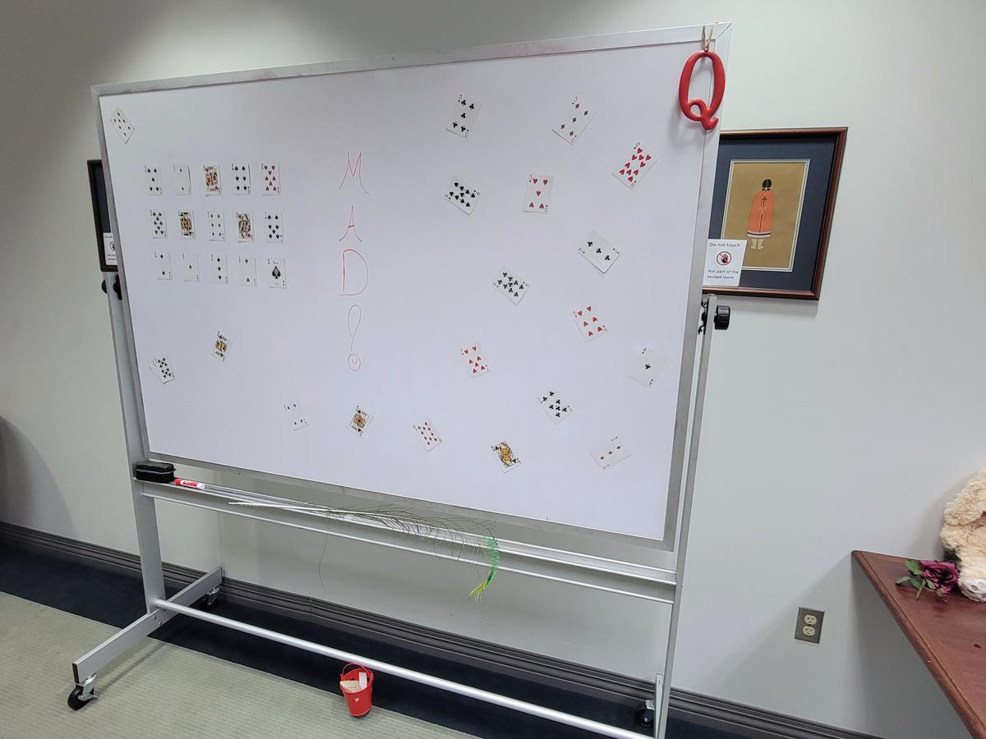
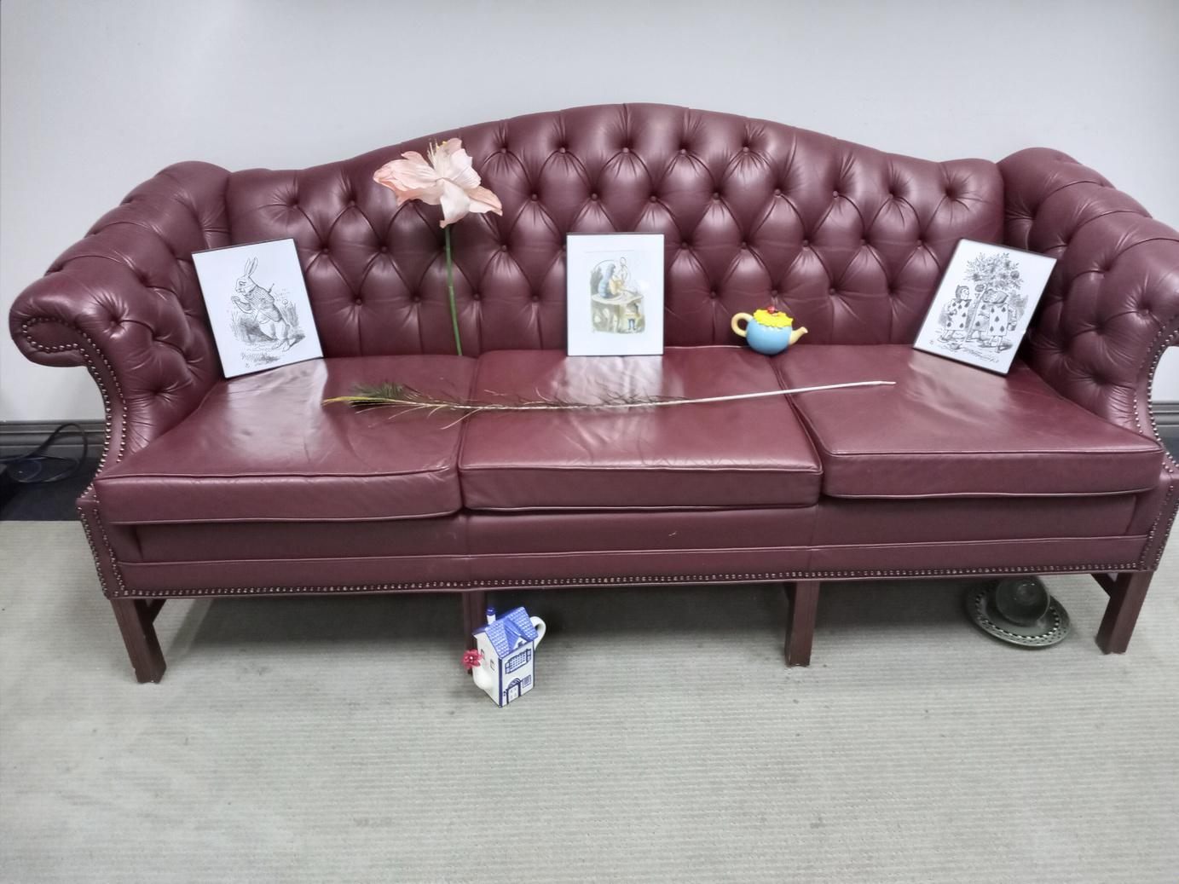
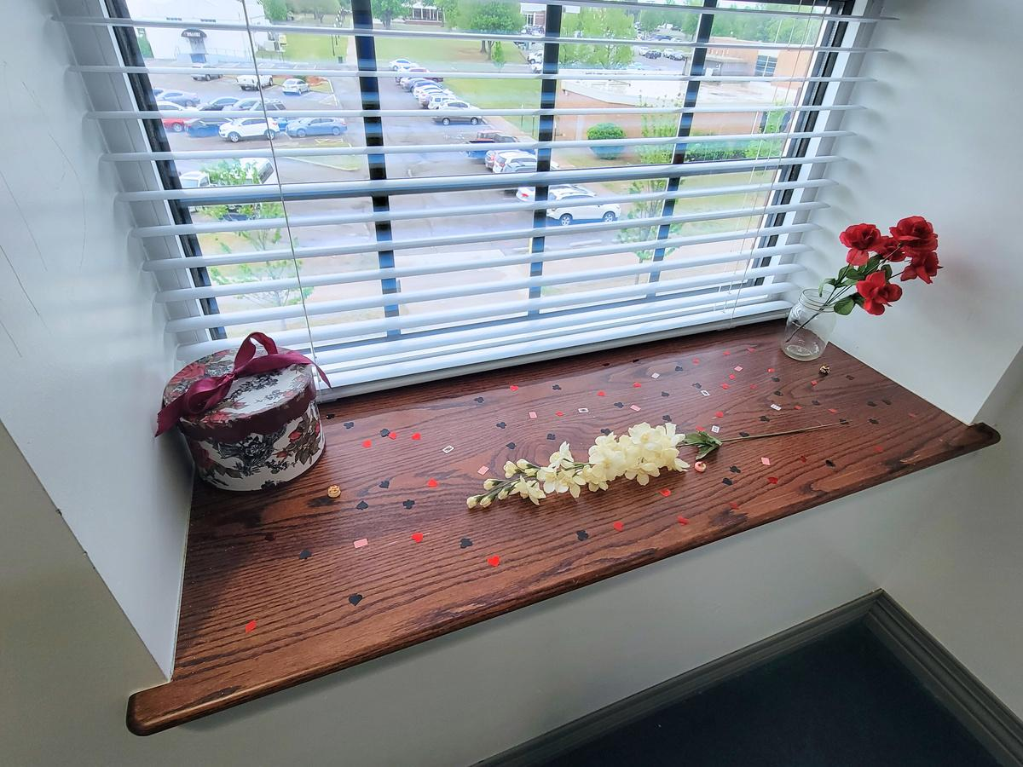
The Rooms

Slide 32
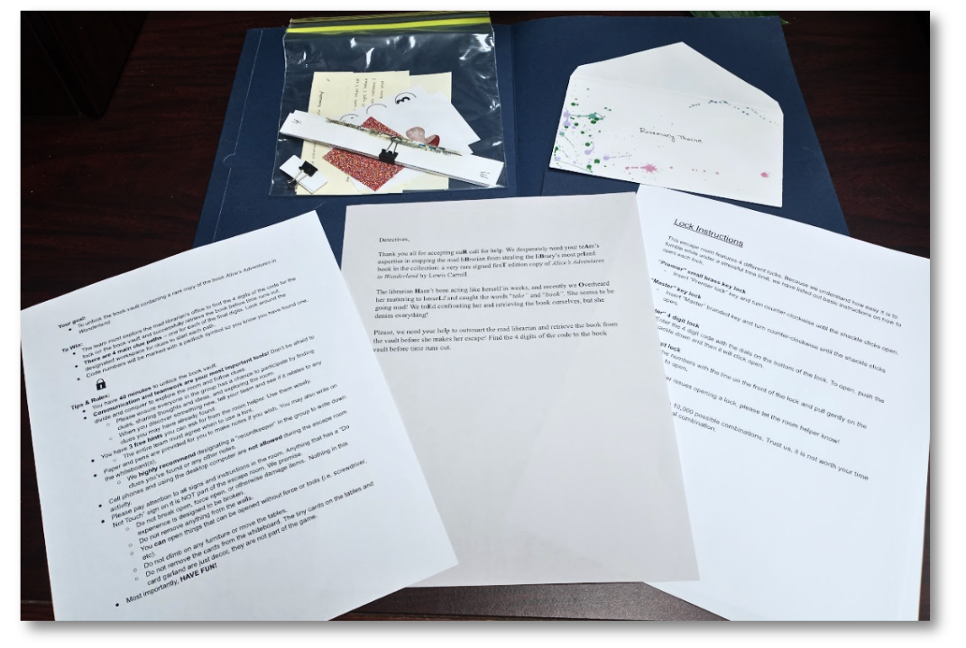
Implementation:
Room Resets
Room Reset Packets:
  Introduction letter
  Room reset list
  Rules & Guidelines
  Lock Instructions
  Diary pages
  Puzzle pieces
  Anaglyph picture
  Tiny tea clues
  Paper slip with two mushrooms
  Blank papers for note taking
Notes:
Since we only gave ourselves 10-15 minutes to reset the rooms between groups, we needed a way to streamline the process. We decided to create these room reset packets which contained a fresh copy of all letters, rule sheets, lock instructions, paper clues, and scratch paper for participants to take notes on.
There was one folder for each time slot. This way we could trash all paper clues and start with a fresh set, and not mix them up. This used a lot of paper, and with more time we might have laminated our paper clues and saved some trees. But we were extremely thankful for these packets because...

Slide 33
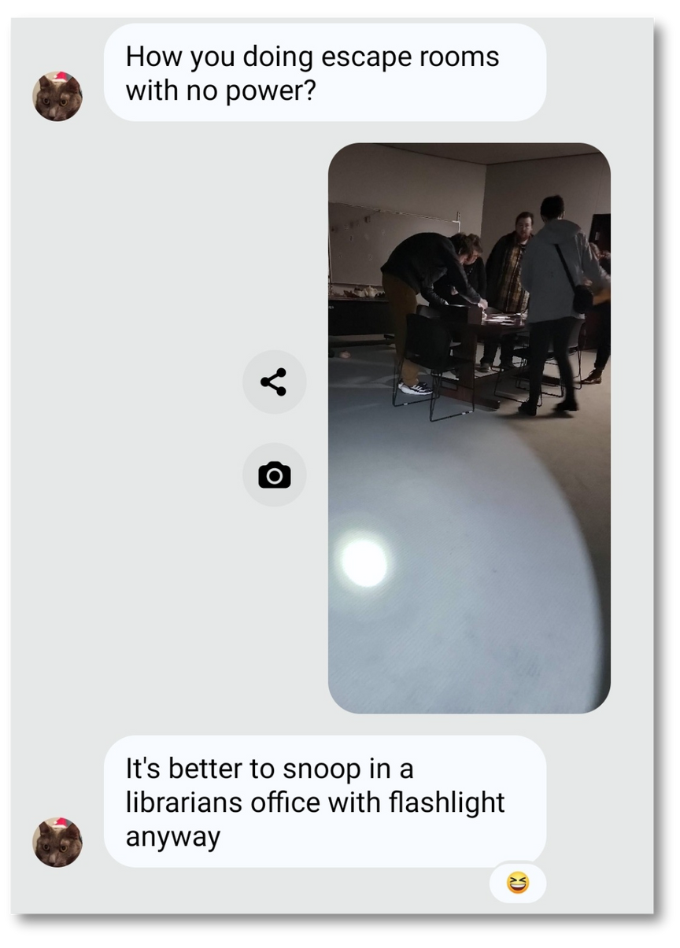
Things Go Wrong
  Electricity
  Accessibility
  Flexibility
Notes:
Things go wrong.
It was a nice, clear night, most of the participants showed up, no staff were sick, and we had all of our ducks in a row! So what could possibly go wrong??
Unfortunately, there are some things outside of our control no matter how well we prepare. In this case, our entire campus lost power towards the end of the first time slot and stayed off or blinking for the majority of the second time slot. One of our rooms had an emergency light towards the back which helped, and the other room had a window that helped while there was still daylight. Other than that, we frantically pulled out our regular flashlights from an emergency kit and allowed participants to use their phones' flashlight. Some participants actually liked and preferred the lights out challenge, while others were understandably a bit frustrated.
With no electricity, this also meant that our elevators were not functioning. Our building has 3 floors, with the library occupying the 2nd and 3rd floors. We had one participant with crutches who had to traverse the stairs since there were no elevators.
Additionally, a patron who wasn't an escape room participant was in the elevator when the power went out. The elevator was stuck between floors and wouldn't open, and the patron had to work with the fire department and ultimately use their own athletic abilities to escape. This patron had the true "escape" room experience, but we would not recommend it!
Moral of the story: you have to remain flexible, because you simply can't know when things will go wrong. Thankfully, we had flashlights available in an emergency kit, so the room helpers used those to help illuminate the dark rooms for the participants. We originally told participants that they could not pull out their cell phones during the escape room, but we changed this rule to allow them to use the flashlight function.
Ultimately, 6 out of 8 groups successfully completed the escape room!

Slide 34
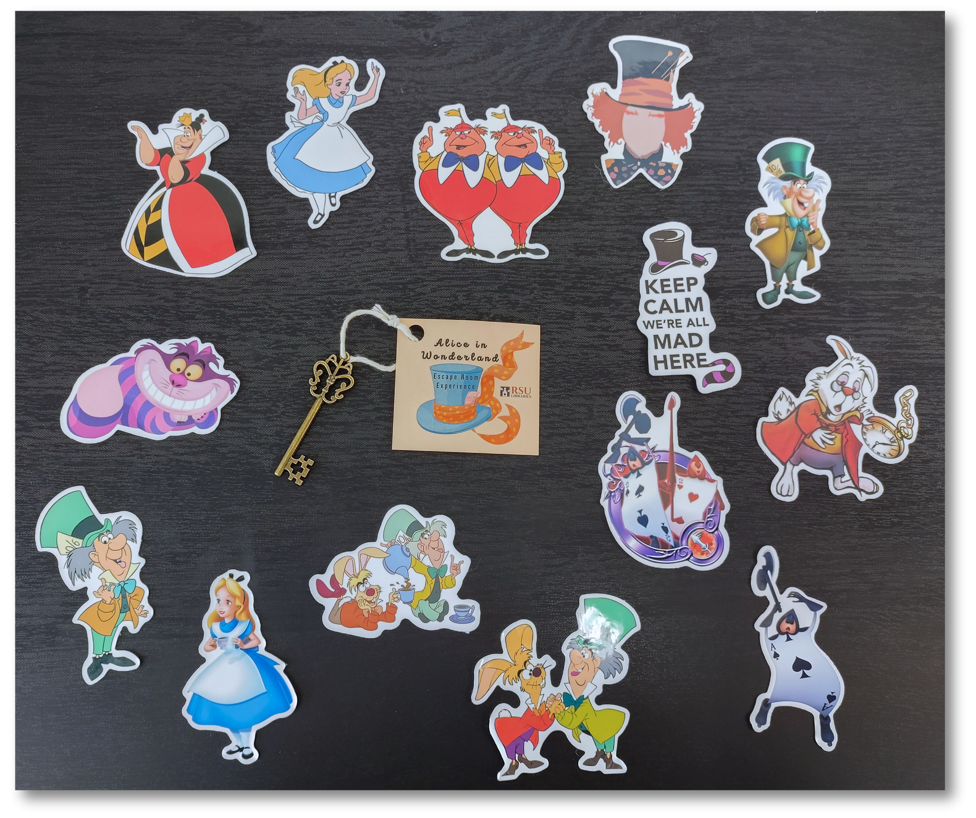
Survey & Prizes
  5 open-ended questions
  Trade a completed survey for prizes (incentive)
  High response rate (94%)
Notes:
Despite the unexpected issues, the power came back on in time for the 3rd time slot and stayed on for the remainder of the night, and the event went smoothly from there.
Remember the ticket players were given at check in? We told them to hold onto it, complete the survey after their experience, and trade it for a prize at the front desk. We didn't tell them what the prize would be, but everyone was intrigued no matter their age. We wanted our participants to have something to remember the event by, so we allowed them to pick an Alice in Wonderland themed sticker and take a key with a tag on it, as seen in the photo.
The prizes were well received and ensured a very high response rate! Only 4 people out of 65 didn't return their survey.

Slide 35
What was your favorite thing about the escape room?
61 responses / 65 participants
  Challenge - 15
  Puzzles & Clues - 13
  Social - 11
  Theme & Decor - 10
Theme
& Decor
20.4%
Challenge
30.6%
Social
22.4%
*Honorable Mention:
A couple of folks also mentioned that it was a fun break from studying
Puzzles
& Clues
26.5%
Notes:
After the event, Ashley created a spreadsheet and entered all of the survey feedback. Since this was all qualitative data, she found common themes for each question and began to code answers that fit into certain themes. This was time intensive, but definitely worth it!
This first question asked what their favorite thing was, and the most common answer was about the challenge of the escape room, closely followed by the puzzles and clues themselves. 11 people mentioned the social aspect, such as meeting new people, playing with friends, and so on. Finally, 10 people mentioned the theme and/or decor was their favorite thing.
Also an honorable mention: at least two people mentioned that the escape room event was a great break from homework and studying!

Slide 36
What do you feel can be improved about this experience?
61 responses / 65 participants
  Nothing or Other - 26
  More Time - 11
  More Space - 5
More Time
26.2%
Nothing
or Other
61.9%
More Space
11.9%
Notes:
Next, we asked what could be improved. This wasn't a very successful question, because folks often have trouble offering fair criticism, especially with an open-ended question. Most people put nothing or that they enjoyed it as is, while some mentioned the power situation noting that it was out of our control.
However, 11 people mentioned wanting more time in the escape room. Many commercial escape rooms give participants a full hour to solve, and 40 minutes did go by quickly.
Finally, 5 people mentioned wanting larger rooms with more space. One of our rooms was significantly smaller than other, and it was pretty packed when a full group of 10 were working. This might not have been an issue if we had kept our group cap to 8, but something to consider. Players need enough room to look around the room from every angle, gather clues, and work together.

Slide 37
What was the easiest aspect to solve?
61 responses / 65 participants
  Discovery - 10
  Bolded Letters - 10
  Key Game - 8
Key Game
28.6%
Discovery
35.7%
Bolded Letters
35.7%
Notes:
Next, we wanted to know what players thought the easiest thing to solve was. The most common answers were discovery (looking around and finding things or opening things) and bolded letter clues.
We knew we put too many clues that could be found without going in the intended path order, and that ended up overwhelming a lot of players, so we expected that feedback. Exploration and discovery are important parts of any escape room, but we need to be more intentional about sequencing and how or when items can be found. Some clue paths were almost entirely missed or skipped because players found the end goal or next clue without realizing it.
10 people also mentioned the bolded letter clues, like the diary pages and the introduction letter. We used a lot of these, and sometimes they were pretty straightforward. They are a great way to slowly introduce players into the game and build player confidence, but don't overuse them.
Finally, 8 people mentioned the key game, which we also expected. The key game was a fun brain break we used to give players a more active element in the escape room. Some players would take the time to grab each individual string and try the key in the lock, but a few would just pull all of the keys out at once and look for the key with the correct brand and solve it instantly. We didn't mind either way - this was their escape room experience.

Slide 38
What was the most challenging aspect to solve?
61 responses / 65 participants
  Math Puzzle - 14
  Finding the Final Code - 10
  Order of Final Code - 6
Order of
Final Code
20%
Math Puzzle
46.7%
Finding the
Final Code
33.3%
Notes:
The final question we'll discuss is what was the most challenging aspect to solve. Funny enough, the top answer was the card math puzzle, which most groups avoided like the plague. They would take one look at the simple equation in the diary entry and go "NOPE!" and wouldn't attempt it or look at it again. Note: people are intimidated with math, period. However, the few who did attempt it solved it very quickly and were very satisfied!
10 people mentioned finding the final code, which kind of confused us because the entire escape room is finding the code, not just one puzzle.
Finally, 6 people answered that the order of the final code was the most challenging part. We knew this would be a challenge for our players, even though we did add a hint in secret ink on the book vault to show players what the order was, most groups did not find it because it was on the bottom of the book vault.

Slide 39

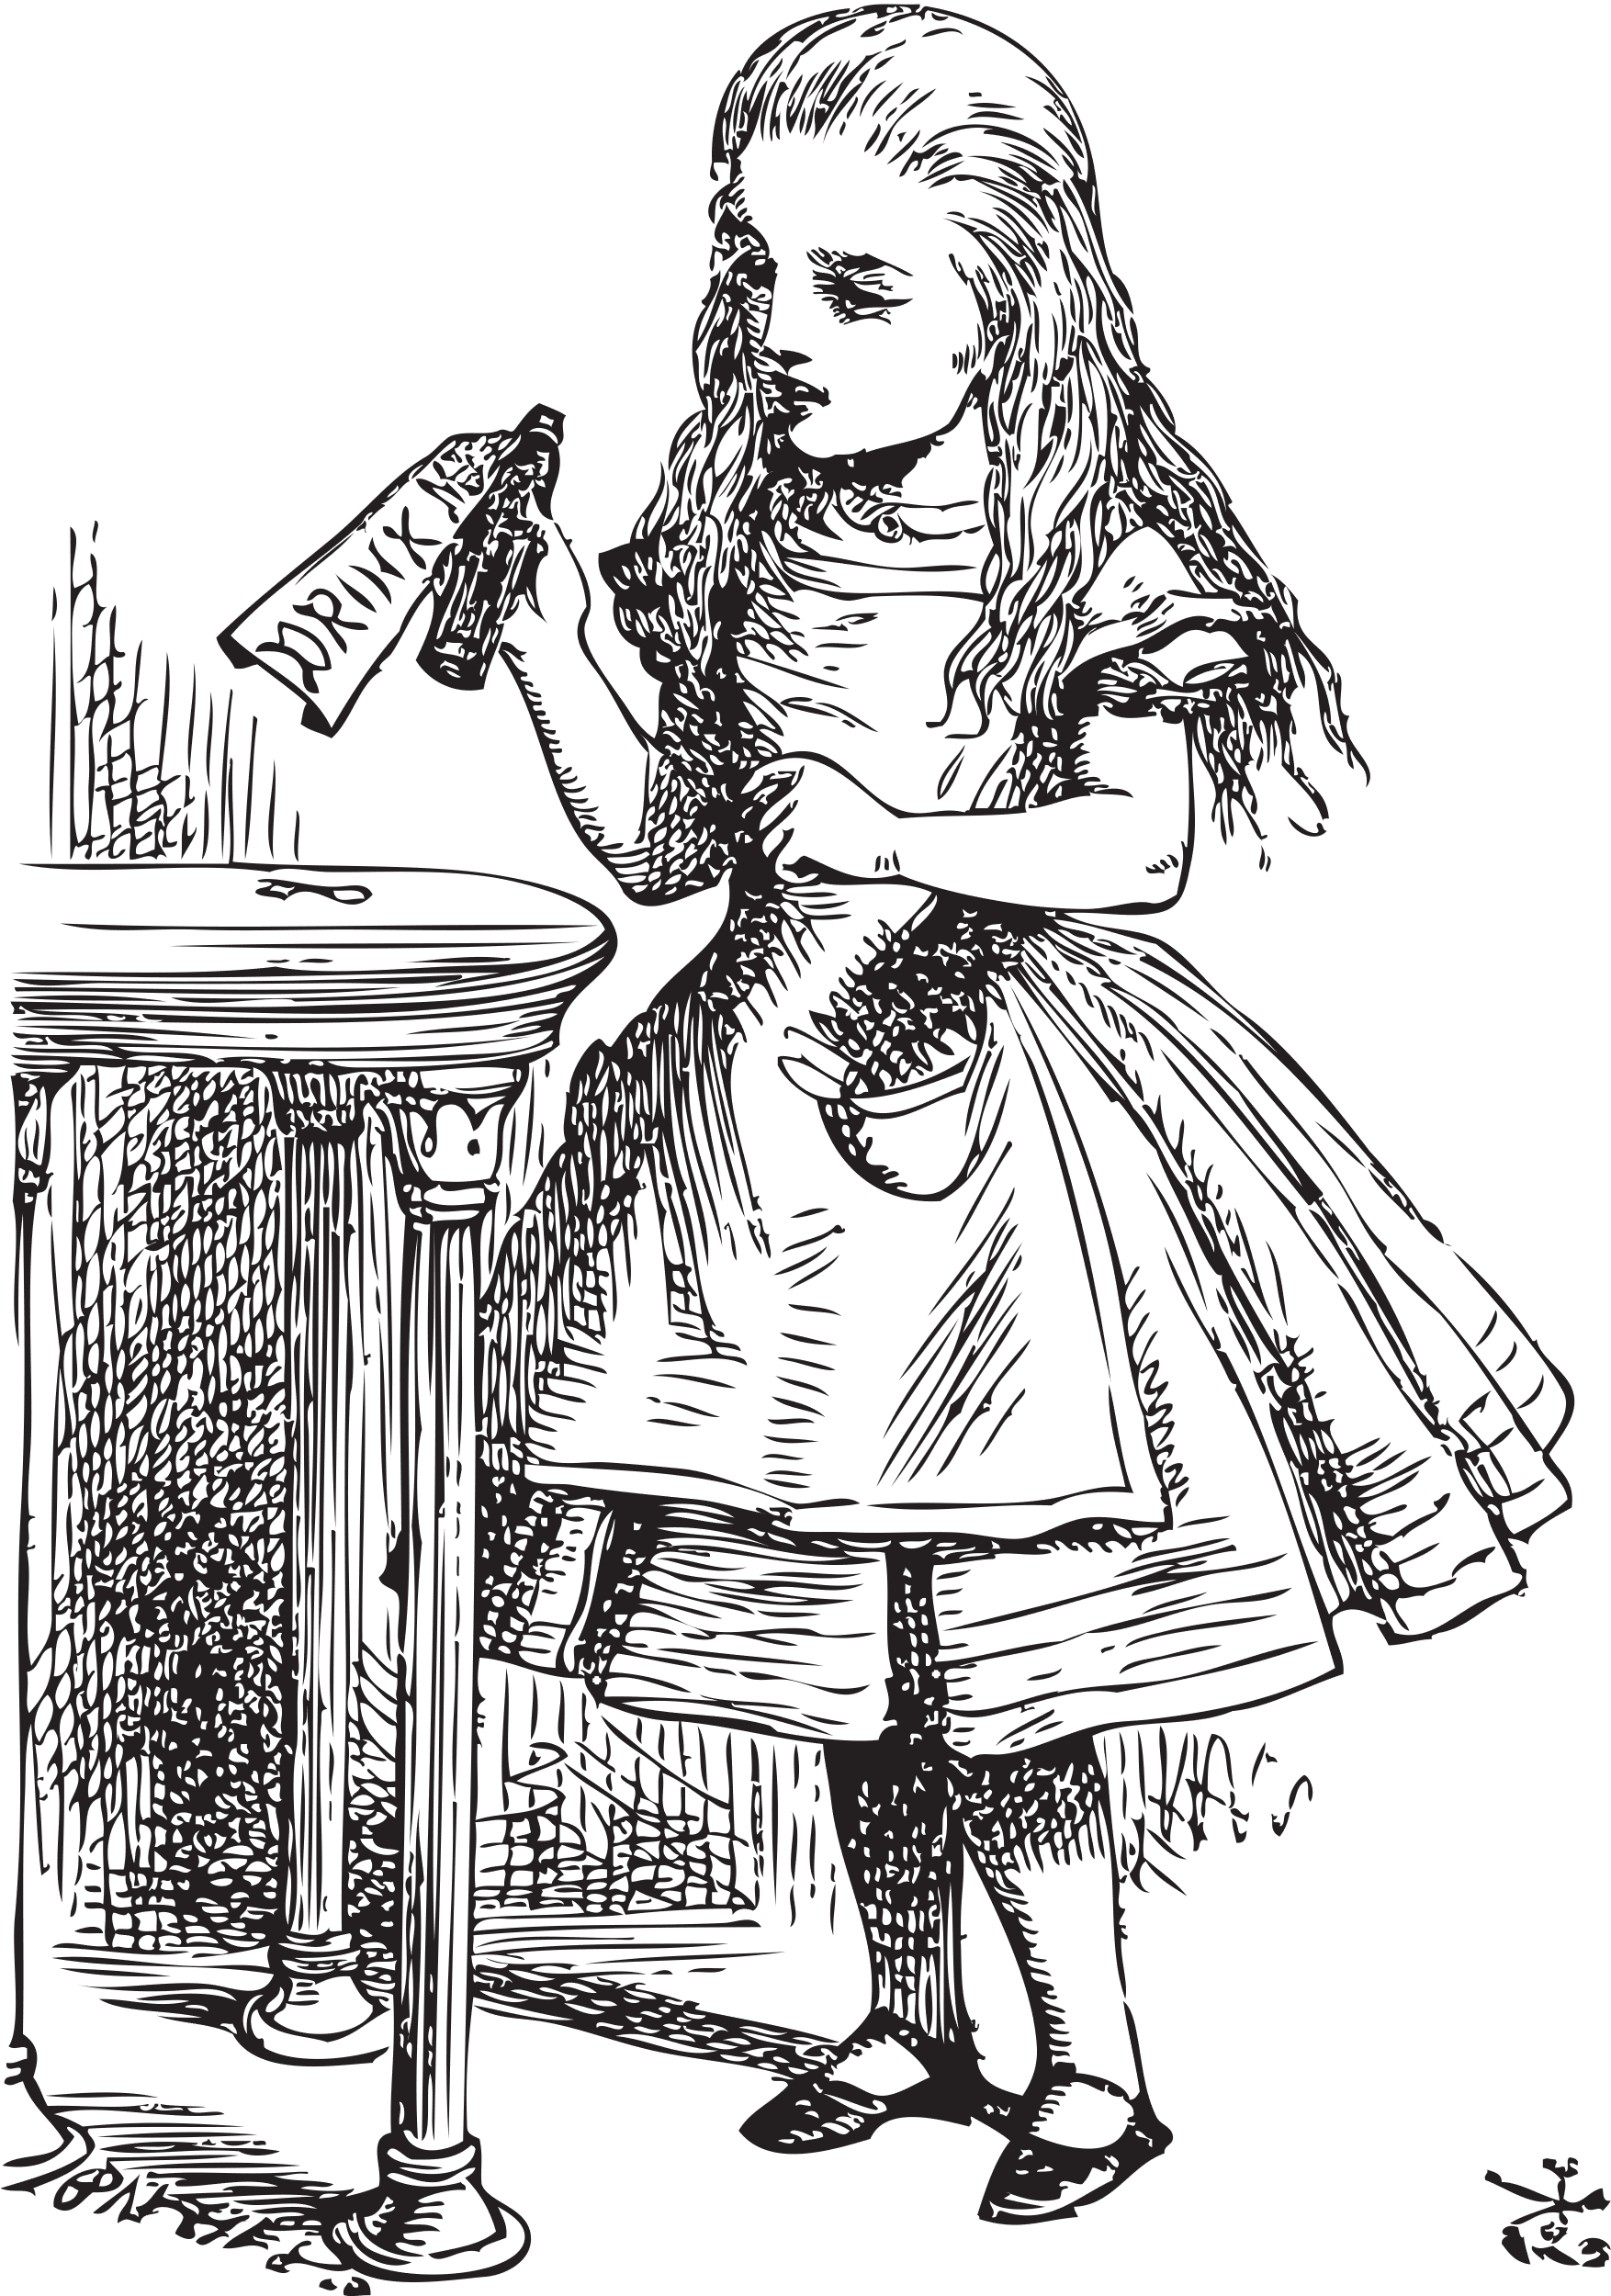
Reflection:
What would we change?
  Development Timeline
  Hidden Clues
  Longer Escape Room
  Survey
Notes:
So, what would we change or do differently?
First and foremost, we would not wait as long to start developing. This is a time intensive process, and it needed much more time than a single month. Not impossible, but not recommended. Give yourself a few months for developing the clues and puzzles, acquiring the supplies, testing, and revising.
With our short timeline, we relied on paper and "finding" clues a lot. Many of our clues pointed to a specific place in the room to look for the next clue, but many things were found early on by accident. Exploring every nook and cranny is part of the escape room experience, so don't trust that your clues will remain hidden until a pointer clue is found. Having so many clues early on overwhelmed and confused some participants and made teamwork and communication difficult.
Based on the feedback we received in the survey, we might also lengthen the time of the escape room. However that would force us to expand the 1 hour per group time slot, meaning less people could participate. Or, we could expand the event to multiple days. Timing is a fine balance!
Some participants, probably the ones who had previous escape room experience, wanted a multi-room escape room. Meaning, you start in one smaller space and eventually open a way to an additional room to continue. We don't really have the space capabilities for that, but something to think about if we can get creative.
We also wish we had asked about their experience level with escape rooms. This seemed to influence what they would expect from our escape room and how they enjoyed it.

Slide 40

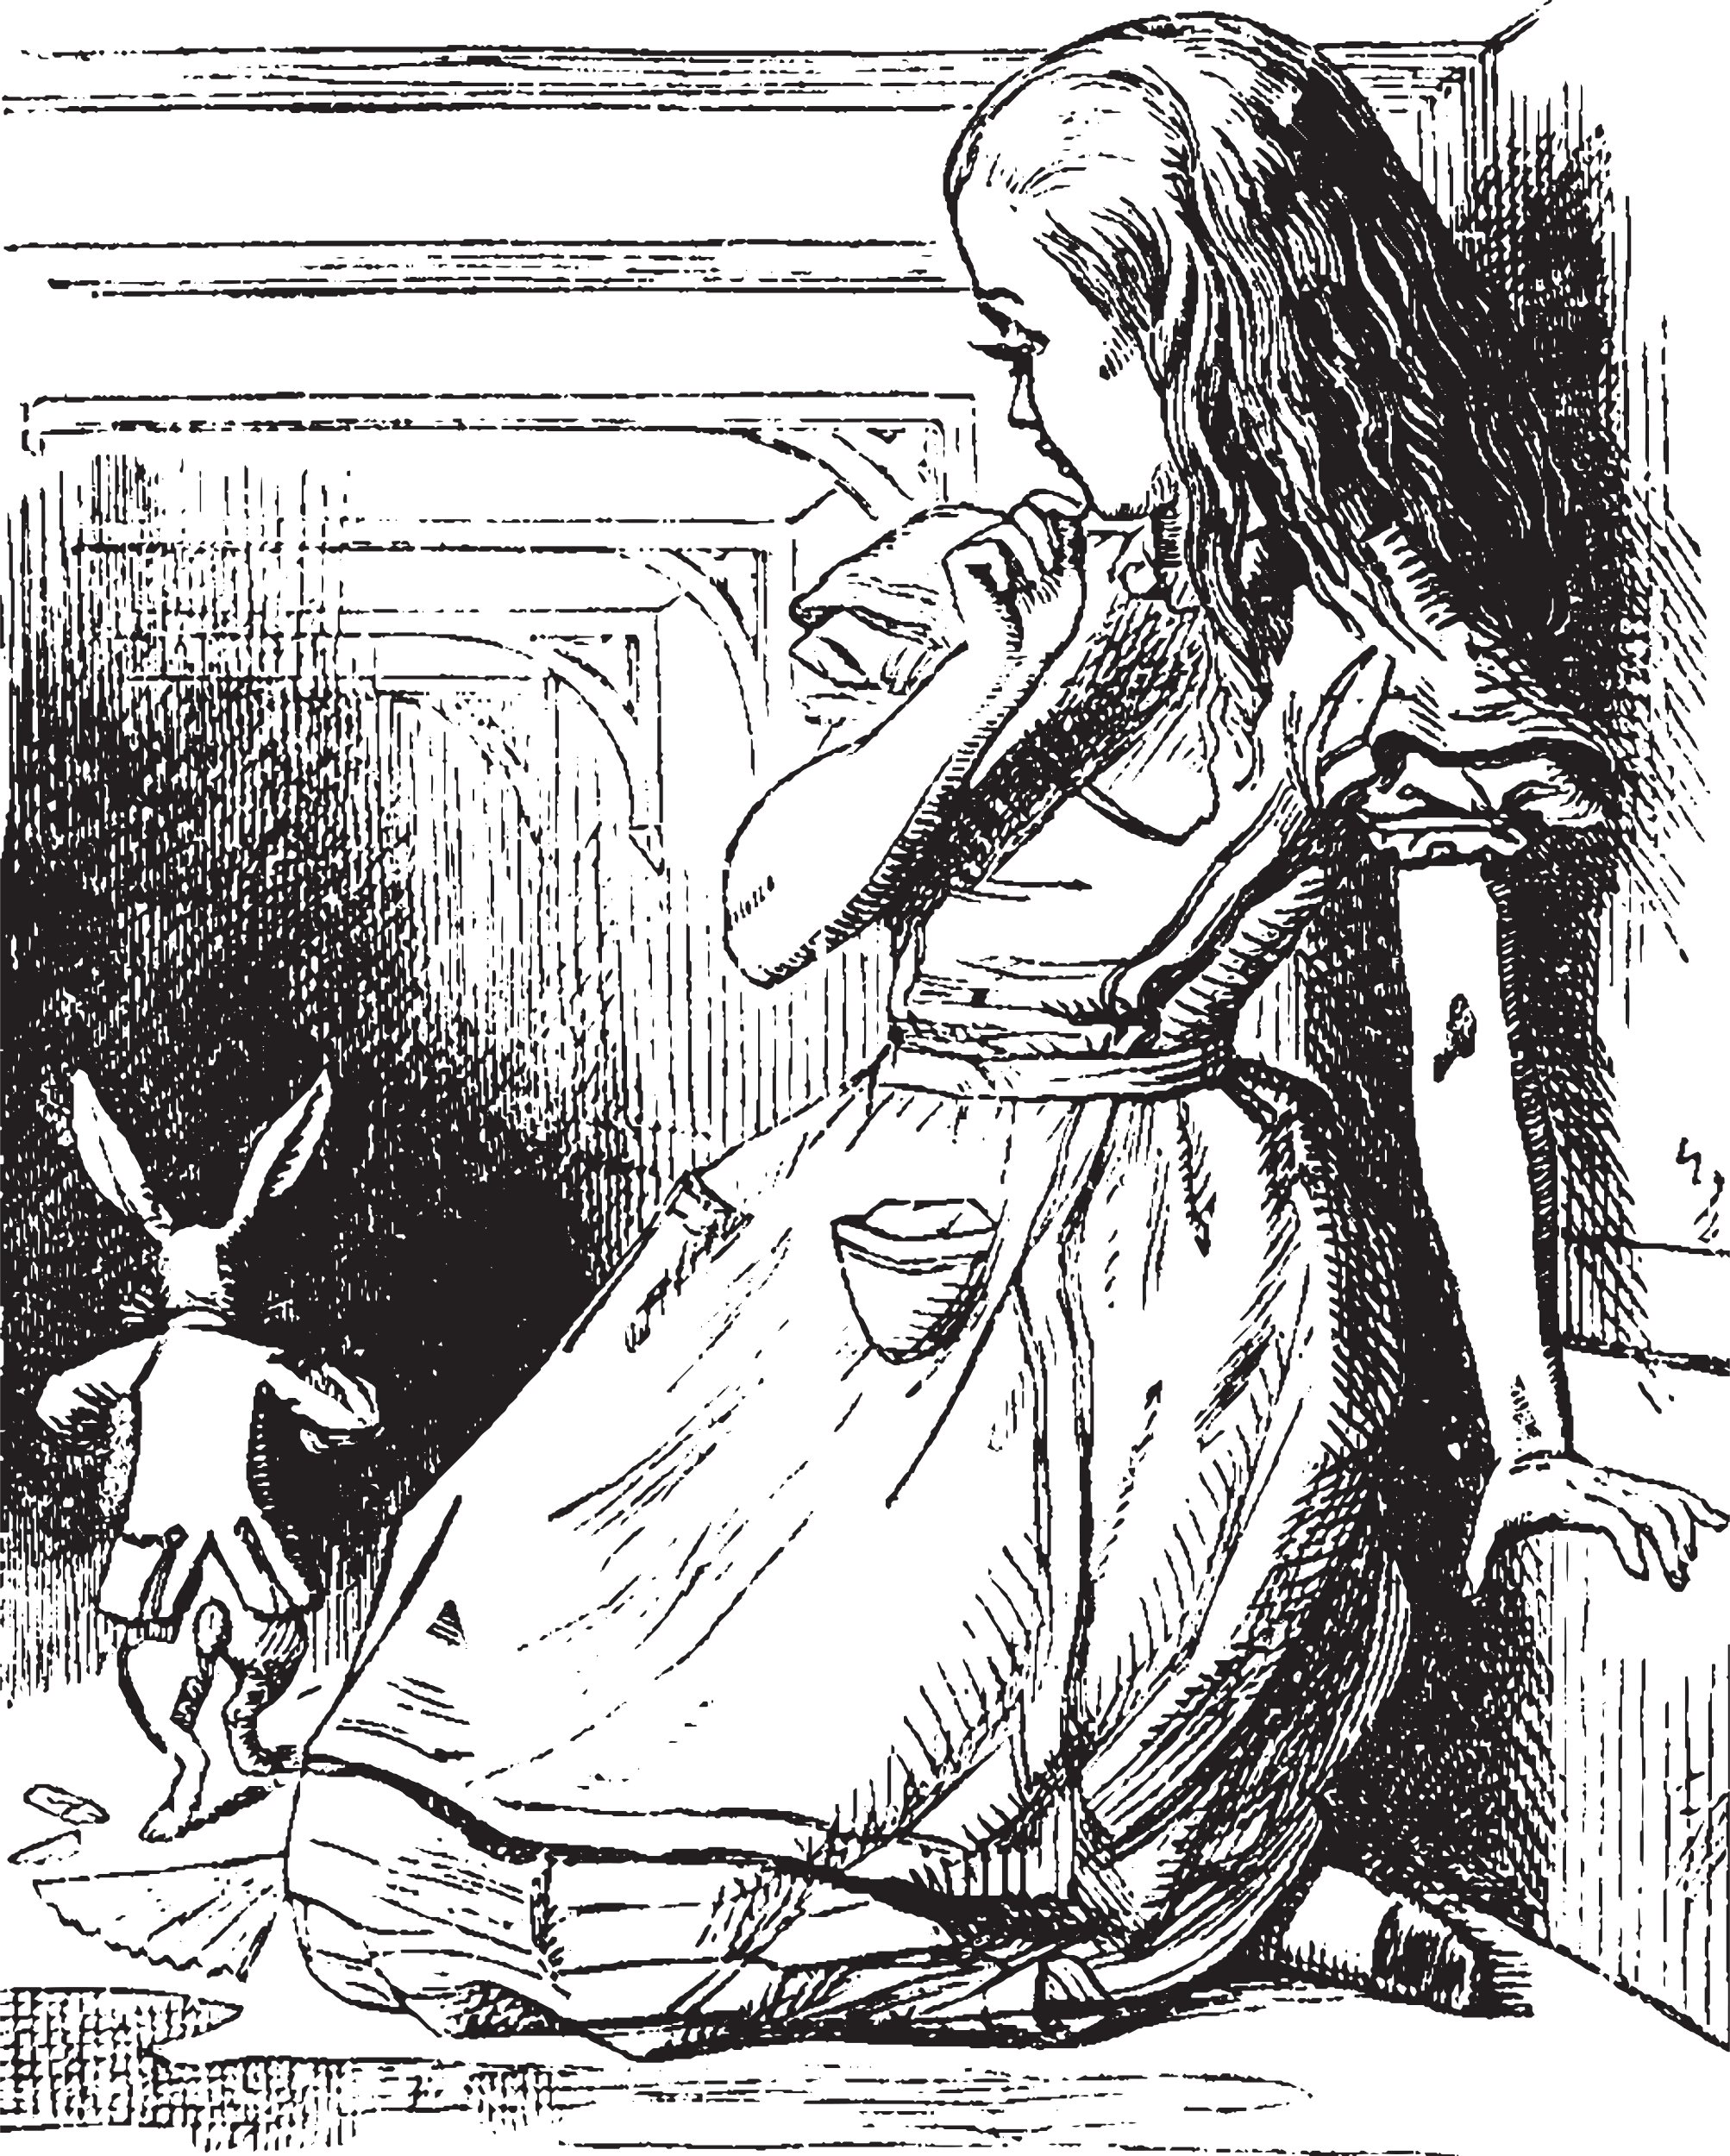
Reflection:
What worked?
  Promotion
  Registration
  Scheduling
  Staff Roles
  Theme
  Survey & Prizes
Notes:
So, what worked?
There's a lot to improve on, but we also did really well on some things. Promotion, registration and scheduling worked very well, except for our surprise outburst of registrations right before the form closed. The QR code worked well for our physical posters, and everyone absolutely loved the theme and look of the rooms as well as the promotional materials.
Our staff roles worked well for the flow of our event. We could have used one additional person, especially when things went wrong. But the way we ran things worked well.
Our theme was extremely well received! Part of our success is due to the popularity of Alice in Wonderland drawing people in.
Finally, offering prizes in exchange for a completed survey was brilliant. Everyone knows how difficult it can be to get patrons to contribute meaningful feedback for anything! The prizes were simple and affordable, and very well received. Hint: people LOVE stickers no matter what age they are!

Slide 41
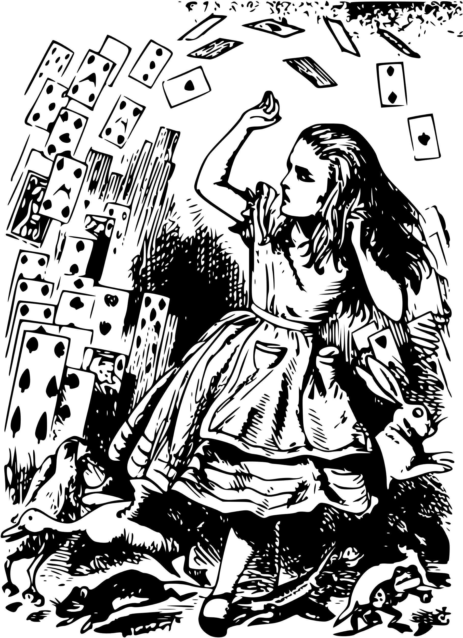
Reflection:
Tips for the future
  Manage expectations
  Read the literature
  Learn from others
  Time
  Participate in an
  escape room
Notes:
What tips do we have?
First, manage expectations. This event was a lot of work and is not a quick and easy passive event to just put on the calendar. Manage your own expectations as librarians and designers. But also, try to manage the expectations of your players. Regardless of how clear you make your event in your promotion, people are still going to come into the event with their own ideas of what an escape room is. A few of our players thought it would be more like a commercial escape room experience, where there are multiple rooms, high tech puzzles and clues, and they would actually have to "escape." Be aware of the wide variety of player experience!
Next, read the literature. All the literature. There is a surprising amount written on designing escape rooms for a variety of settings: educational, orientation, in schools, in libraries, and so on.
Along the same lines, look at what others are doing. There is no need to reinvent the wheel. Learn all you can so you can know what to expect and what steps to take, and get tons of inspiration for themes, puzzles, and clues.
Give yourself plenty of time. You have seen the whirlwind of chaos that was our timeline, so please learn from us! Give yourself lots of time to think through your clue paths and how they relate to your story. Also, testing. Lots of testing!
Finally, if you haven't already, please go find a local commercial escape room and participate in it! This will help you get into the mindset of a player and learn more about how escape rooms work.

Slide 42

Resources: Books, Articles, & More
Cerri Mirasol, Jessica, and Lizzy Walker. "Transforming Tangible Materials to Intangible Experiences: A Case Study of Two Escape Rooms at Wichita State University." The New Review of Academic Librarianship, vol. 26, no. 2-4, 2020, pp. 322-337.
Cho, Ruth. “Save Lewis the Librarian! An Information Literacy Escape Room.” 52 Ready-to-use Gaming Programs for Libraries. ALA Editions, Chicago, 2020.
Davis, Robin C. "Introducing First-Year and Transfer Students to a College Library with a Historical Mystery from the Special Collections." College & Undergraduate Libraries, vol. 26, no. 4, 2019, pp. 278-300.
Escape Room Manual. Librarylady nicole. https://libraryladynicole.com/programs/escape-room/. Accessed 6 June 2023.
"Escape This: Creating DIY Escape Rooms for Your Library", American Library Association, September 7, 2018.
http://www.ala.org/tools/escape-creating-diy-escape-rooms-your-library (Accessed July 7, 2023)
Hansen, Susan M. “Stop the Mad Librarian: A Library Orientation Escape Room.” 52 Ready-to-Use Gaming Programs for Libraries. Chicago, 2020.
Humphrey, Kimberley. "The Application of a Serious, Non-Digital Escape Game Learning Experience in Higher Education." Sport & Exercise Psychology Review, vol. 13, no. 2, 2017, pp. 48-54.
Koelling, Glenn, and Alyssa Russo. "The Mystery Room: Discovering the Flexibility of an Information Literacy-Based Educational Escape Room." Public Services Quarterly, vol. 16, no. 1, 2020, pp. 1-11.

Slide 43
Resources: Books, Articles, & More
Kroski, Ellyssa. Escape Rooms and Other Immersive Experiences in the Library. American Library Association, Chicago, 2018.
Nicholson, Scott. (2016). Ask Why: Creating a Better Player Experience Through Environmental Storytelling and Consistency in Escape Room Design. Paper presented at Meaningful Play 2016, Lansing, Michigan. Available online at http://scottnicholson.com/pubs/askwhy.pdf
Nicholson, S. (2015). Peeking behind the locked door: A survey of escape room facilities. White Paper available at http://scottnicholson.com/pubs/erfacwhite.pdf
Pun, Raymond. "Hacking the Research Library: Wikipedia, Trump, and Information Literacy in the Escape Room at Fresno State." The Library Quarterly (Chicago), vol. 87, no. 4, 2017, pp. 330-336.
Rouse, Wendy. "Lessons Learned while Escaping from a Zombie: Designing a Breakout EDU Game." The History Teacher (Long Beach, Calif.), vol. 50, no. 4, 2017, pp. 553-564.
Thoegersen, Jennifer L. and Thoegersen, Rasmus. “Lab of Dr. Morton McBrains Playbook.” 2016. Faculty Publications, UNL Libraries. 348. https://digitalcommons.unl.edu/libraryscience/348
Wise, Hannah, et al. "Escape the Welcome Cliché: Designing Educational Escape Rooms to Enhance Students’ Learning Experience." Journal of Information Literacy, vol. 12, no. 1, 2018, pp. 86.

Slide 44
Resources: Puzzle Ideas
Escape Room Geeks - https://escaperoomgeeks.com/diy-puzzles/
Lock Paper Scissors - https://lockpaperscissors.co/escape-room-puzzle-ideas#start-puzzles
Escape Room Tips - https://escaperoomtips.com/design/escape-room-puzzle-ideas
Homeschool of 1 - https://www.homeschoolof1.com/escape-room-puzzle/
Anaglyph Secret Message Generator - https://www.khanacademy.org/computer-programming/secret-anaglyph-message/5395038998921216
Flowchart creator - https://app.diagrams.net/

Slide 45
Resources: Pre-Made Rooms
Lock Paper Scissors - https://lockpaperscissors.co/
BreakoutEDU - https://www.breakoutedu.com/
Escape Empire Designs - https://escapeempire.com/

Slide 46
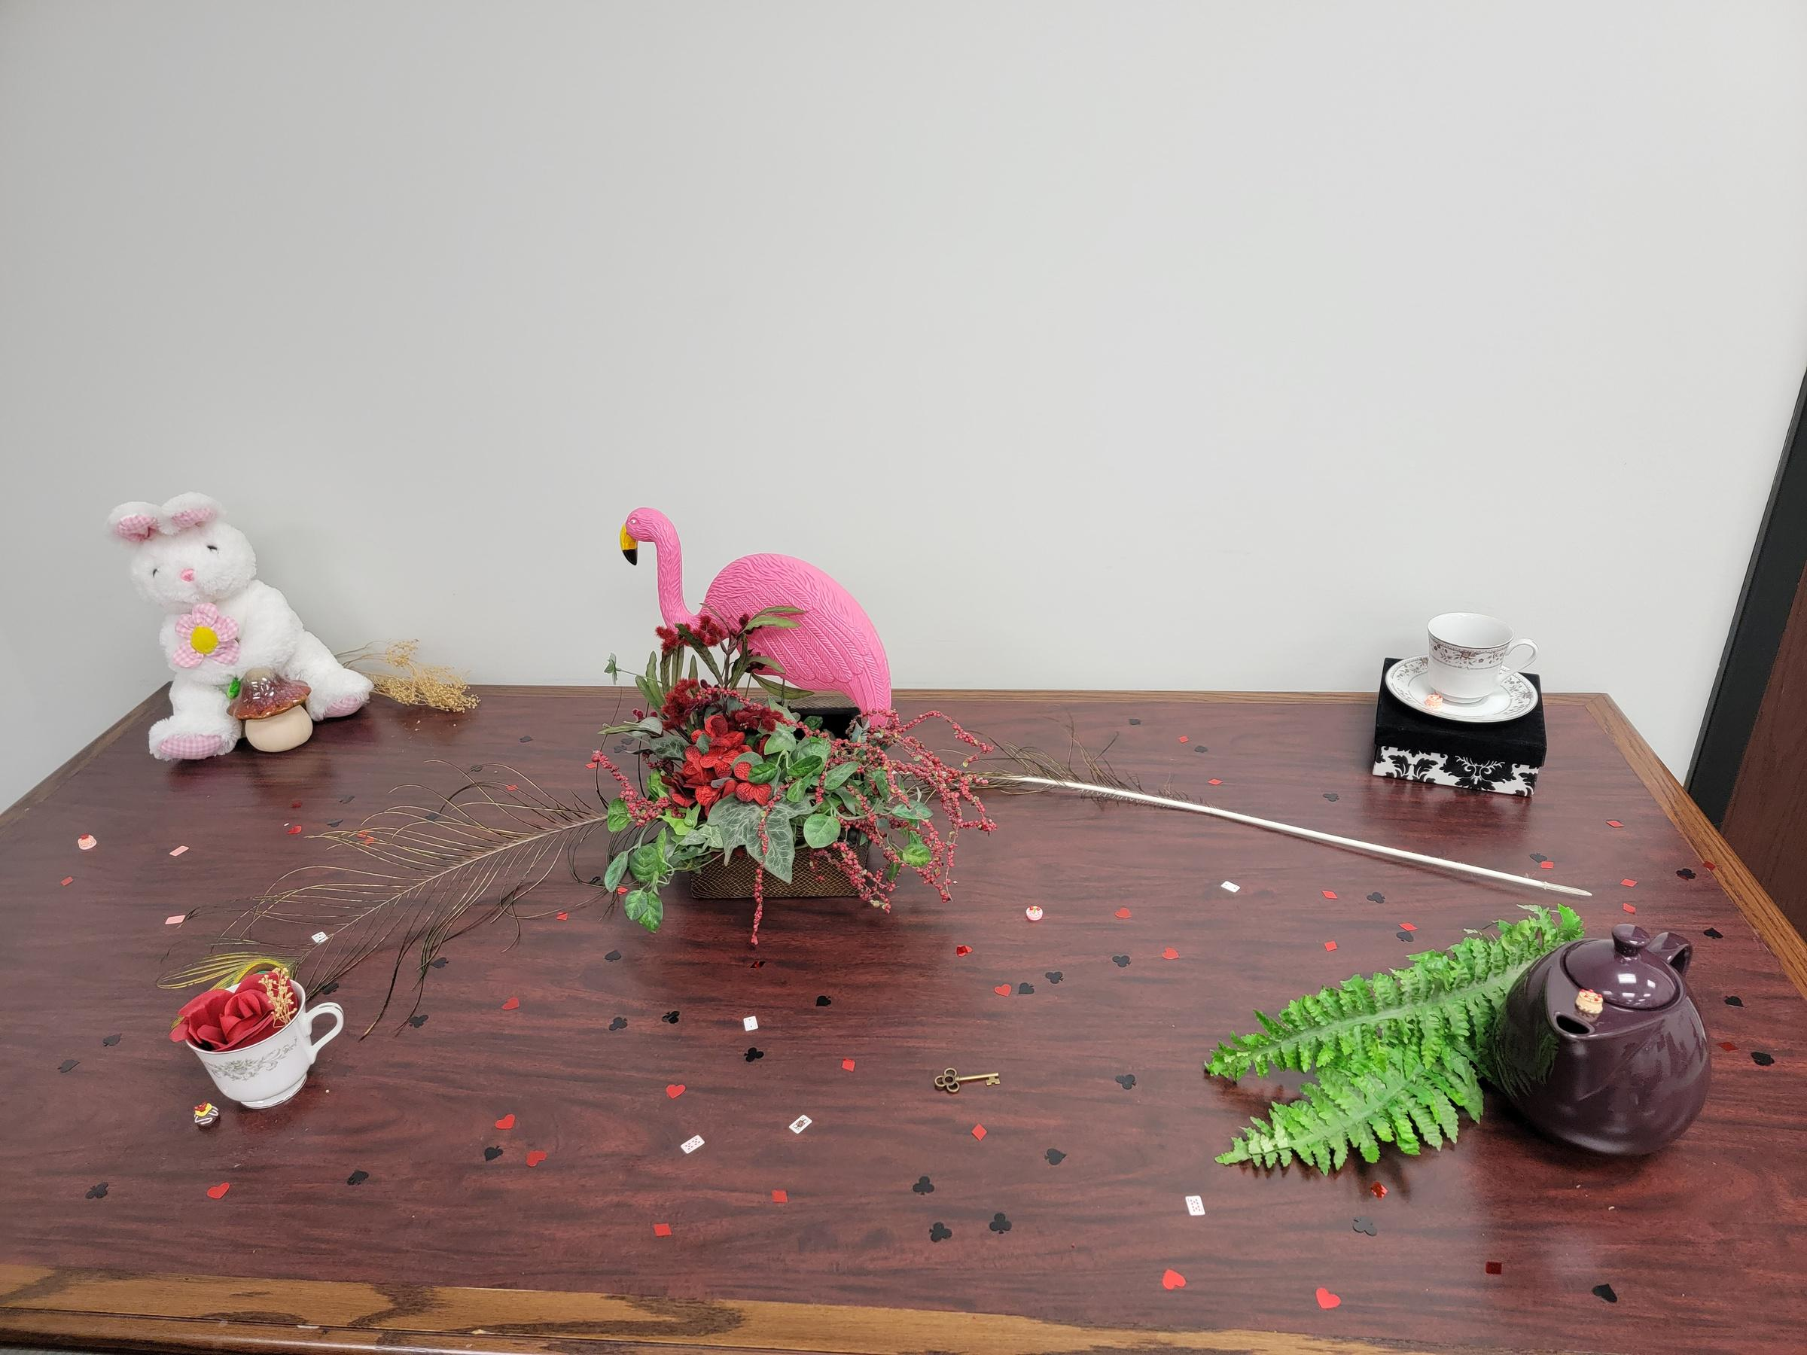
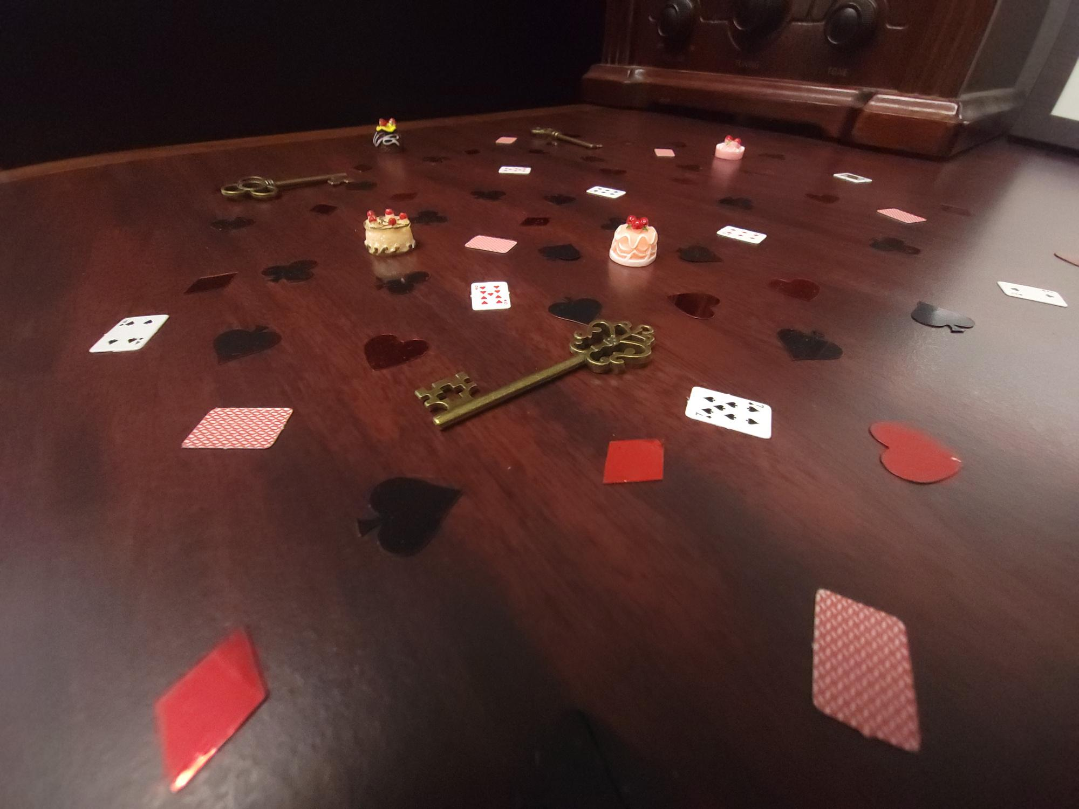



Thank You
Ashley Bean: abean@rsu.edu
Audrey Baker: abaker@rsu.edu
Kaitlin Crotty: kcrotty@rsu.edu
Notes:
Here is our contact info.
And now we'll open the floor to questions.

Slide 47
Questions?
Ashley Bean: abean@rsu.edu
Audrey Baker: abaker@rsu.edu
Kaitlin Crotty: kcrotty@rsu.edu

