Slide 1


Increasing Colon Cancer Screening in the OU –Tulsa Internal Medicine Outpatient Clinic
Audrey Harris, DO; Eugene Quaye, DO; Elizabeth Tran, DO; Tristan Smith, DO; Mohammed Eslam, MD; Dru Albin, DO; Audrey Corbett, MD; Lindy Sullins, BSN
Department of Internal Medicine
University of Oklahoma, Tulsa, OK

Slide 2
Introduction
Colorectal cancer is the fourth most common cancer in North America
Second leading cause of cancer death in North America
Annually, approximately 53,000 people die of colorectal cancer
It is largely preventable through screening.

Slide 3
Aim statement
Our aim was to increase the amount of colon cancer screening in the OU internal Medicine clinic by 10% by April, 2020.
Project was initiated in September of 2019 – 7 months to reach goal

Slide 4
Methods
All patients seen in the OU Internal Medicine clinic were screened for eligibility for colon cancer screening using the USPSTF criteria.
If the patients were eligible they were offered several screening possibilities to include colonoscopy, FIT testing, and Cologuard screening.
The necessary means to undergo testing was then arranged for eligible patients.

Slide 5
Methods
First PDSA cycle: consisted of drafting a standardized letter which was added to the clinic EMR.
Allowed patients to bring a guest with them via SoonerRide to their colonoscopy appointments
Providers and nurses were educated
Unfortunately with the onset of the SARS- CoV2 pandemic only one PDSA cycle was implemented

Slide 6
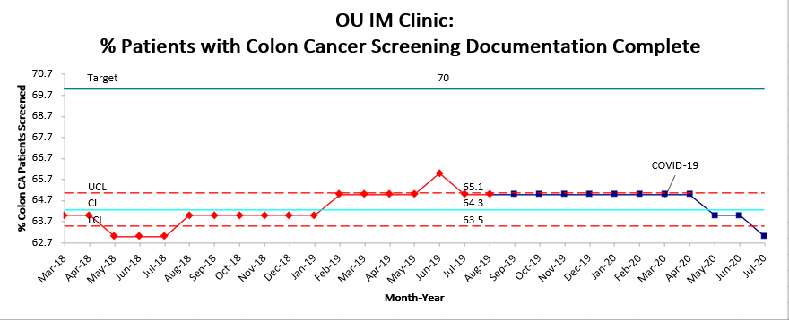
Data collection
Graph 1: The percentage of patients out of total qualifying patients in the OU IM clinic who have documented colon cancer screening done or reason why deferred. The goal for meaningful use is 70%.

Slide 7
Results
Following the implementation of the first PDSA cycle the percentage of patients out of total qualifying patients in the OU IM clinic who have documented colon cancer screening done or had reason why deferred remained at 65.1%.
There were no significant increases or decreases in the total percentage.
Following the onset of the COVID-19 pandemic, the percentage decreased to as low as 62.7%.

Slide 8
Conclusion
There was neither a significant increase or decrease in colon cancer screening in the five months following implementation of the first PDSA cycle.
A dramatic decrease following the onset of COVID-19 pandemic was observed due to lack of office visits, and elective procedures

Slide 9
Discussion
In March 2020 the American Cancer society recommended that all routine (nondiagnostic) cancer screenings be suspended in the wake of the COVID-19 pandemic.
As a result, screening rates decreased by 86% relative to the average before January 2020.
A focus on FIT like testing may be beneficial moving forward to reduce rates of missed cancers.

Slide 10
Questions

Slide 11
Bibliography
Shaukat A, Church T. Colorectal cancer screening in the USA in the wake of COVID-19. Lancet Gastroenterol Hepatol. 2020;5(8):726-727. doi:10.1016/S2468-1253(20)30191-6

