Slide 1
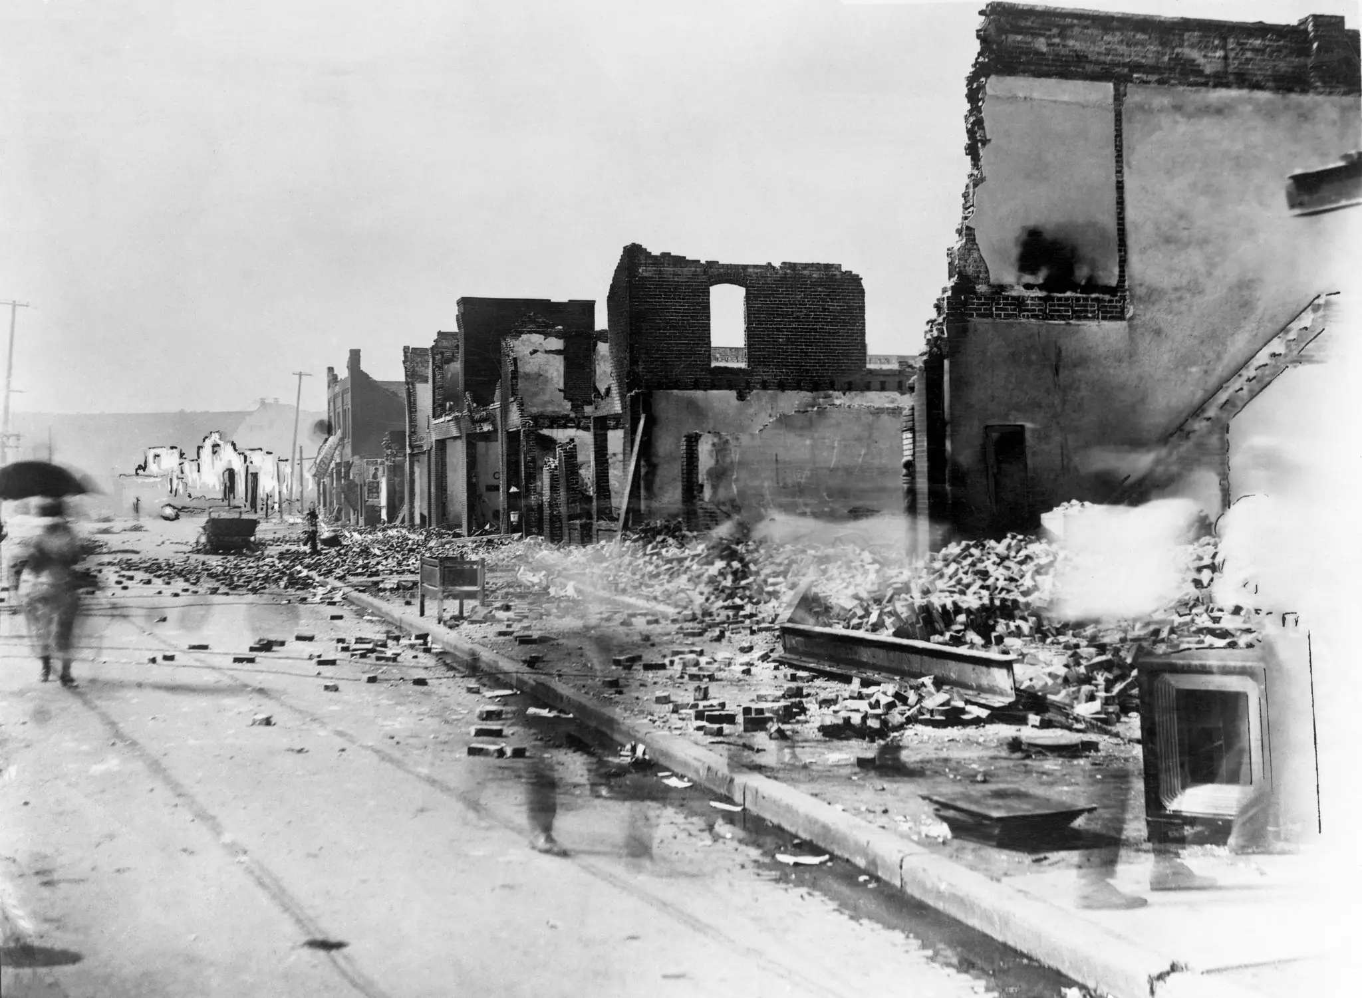
From “Riot” to “Massacre”—
LC Subject Headings and Metadata Justice
University of Oklahoma Libraries
Learning & Working Group on Metadata Justice
Jay Shorten, Cataloger
Karie Antell, Public Services Librarian
Notes:
Hi! I’m Karie Antell from the University of Oklahoma Libraries, joined by my colleague Jay Shorten. We are members of our library’s Learning & Working Group on Metadata Justice. We’re here to talk about our recent successful proposal to Library of Congress to change the subject heading “Tulsa Race Riot” to “Tulsa Race Massacre.”
In case you’re not very familiar with this event, it happened in 1921 when a vigilante mob of white people attacked Black residents and destroyed 35 square blocks of homes and businesses in Tulsa Oklahoma’s Greenwood district, one of the nation’s wealthiest Black communities at the time.
But before going into changing the LC Subject Heading, I’ll talk a little bit about the concept of Metadata Justice and why we wanted to make this change.

Slide 2

What is metadata justice?
The subject terms we use to describe information should be . . .
  Accurate
  Commonly used
  Unbiased
Yes
 Dogs.
 Dog breeds.
 Dogs -- Health.
No
 Canines.
 Canis familiaris.
 Man’s best friend.
Notes:
So, how is metadata related to JUSTICE?
The subject terms we use to describe information should be accurate and appropriate.
For instance, one principle of good cataloging is that we should choose words that accurately reflect the natural language that people commonly use. As an example, for books about dogs, it’s better to use “dogs” than “canines” or “canis familiaris.” Most people know and use the word “dogs.”
But we can get it wrong. Sometimes we might use words that are inaccurate or inappropriate. We might even use words that are biased or harmful. And often, concepts of accuracy, appropriateness, bias, and harmfulness change over time. So a word or phrase that was appropriate and correct at one time might be incorrect or inappropriate later.
When library catalogs -- and other metadata systems -- describe people, places, events, and concepts using words that are inaccurate, inappropriate, biased, or harmful, this constitutes metadata injustice.

Slide 3
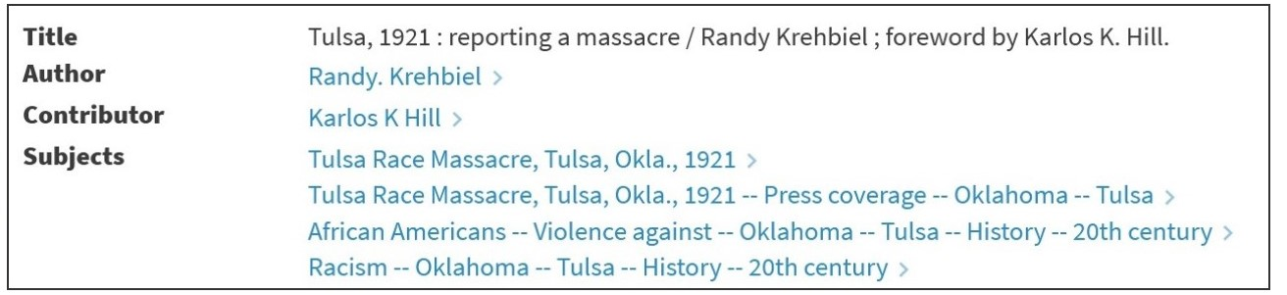

Metadata justice: From “riot” to “massacre”
Notes:
For example -- This catalog record shows the subject term “Tulsa Race Massacre.” That’s currently the most commonly used, appropriate, accurate, unbiased, and respectful way to refer to the event that was once called the Tulsa Race Riot.
But “Tulsa Race Massacre” was just added to the Library Of Congress Subject Headings this year. The previous term was “Tulsa Race RIOT.”
“Tulsa Race RIOT” is problematic for several reasons.
First, the word “riot” suggests that the Black community in Greenwood, Tulsa, were the perpetrators of violence -- when in fact, the violence was initiated by a violent mob of white people.
Second, because the event was characterized as a “riot,” Black property owners could not file insurance claims to recoup damages -- most insurance policies excluded “riots” because “riots” implied that people were destroying THEIR OWN community and THEIR OWN property.
Third, the phrase “Tulsa Race Riot” is not the term used by the people most affected by the massacre, the Black people of Greenwood. It’s a phrase that was imposed on the event by others, such as the mainstream media, political leaders, insurance companies, and so forth.
Metadata systems can evolve, just as language evolves, and just as culture evolves. But metadata systems are “conservative by nature.” I do not mean that they are conservative in a political way. I simply mean that they tend to stay the same over time, or to change only slowly – and that’s because they RESPOND to changes in language and culture. They do not change FIRST. And that’s because their point is to help people find information. “Tulsa Race Riot” might not be the most accurate, appropriate, or respectful way to refer to the event that happened in 1921. But if it’s the phrase that most people actually use, the Library of Congress is more or less obliged to keep using it, on the assumption that people who need information about the topic will look it up using the phrase “Tulsa Race Riot,” not “Tulsa Race Massacre.”

Slide 4
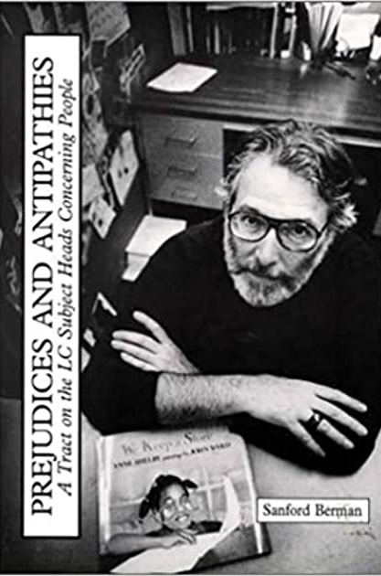
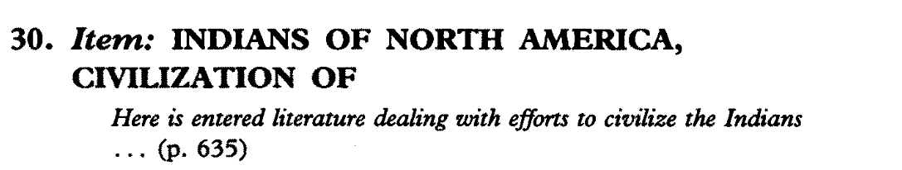
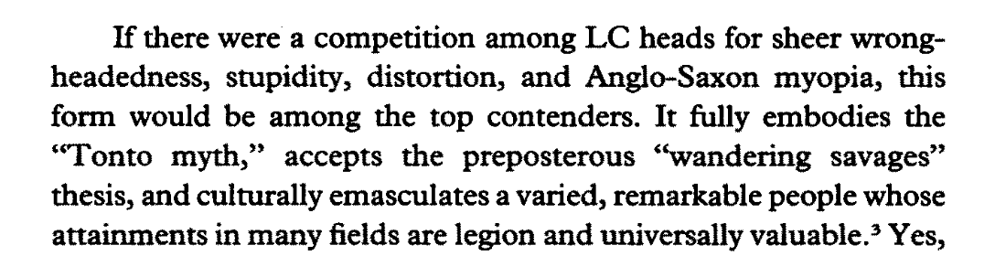
“Humanizing the catalog”
Sanford Berman, 1971. Prejudices & Antipathies: A Tract on the LC Subject Heads Concerning People.
Notes:
It’s important for me to mention that the notion of metadata justice owes a great deal to the work of Sanford Berman and other pioneering catalogers. 50 years ago, Sandy Berman first published Prejudices & Antipathies: A Tract on the LC Subject Heads Concerning People. One of his stated goals was to “humanize the library catalog.”
What did he mean by this? He was working to prevent library catalogs from perpetuating false and harmful stereotypes about people and groups.
For instance, he discusses the term “Indians of North America --- Civilization of,” which applied to “literature dealing with efforts to civilize the Indians.” Berman rightly points out that Native peoples have never “needed civilizing” and have had their own diverse civilizations since long before Europeans came to North America. He suggests replacing this term with new subject headings such as “Indians of North America – deculturation” and “Indians of North America – relations with missionaries & settlers.”

Slide 5
Sources of metadata injustice in LC subject headings
Terms that have become outdated or offensive over time.
“Idiocy” → “Mental retardation” → “Intellectual disabilities”
Notes:
So let’s look some of the ways that metadata injustice creeps into LC subject headings. First – some terms that were once commonly used simply become outdated or offensive over time. You can probably think of some examples of offensive terms that were once used to describe people or groups.
As just one small example, books about cognitive disabilities were once catalogued using the subject term “idiocy” and “idiots.” These terms used to be more “clinical,” used by doctors to diagnose a condition of cognitive disability, but they came to have more pejorative meanings over time. The subject heading “Idiocy” was changed to “mental retardation” and later “intellectual disabilities,” when the word “retardation” also picked up negative connotations.

Slide 6
Sources of metadata injustice in LC subject headings
Terms that have become outdated or offensive over time.
“Idiocy” → “Mental retardation” → “Intellectual disabilities”
Terms whose categorization is inaccurate or offensive.
Categorizing sexual orientations & gender identities other than cis-straight as “sexual perversions”
Notes:
Another way that metadata injustice enters the catalog is through terms whose categorization is inaccurate or offensive.
One example is the subject headings used for LGBTQ people over the years. Books about LGBTQ topics were once catalogued under the heading “sexual perversions” at a time when most people considered any deviation from the cis-straight norm to be a biological or psychological illness. The profession of psychology no longer classifies people’s sexual orientations or gender identities as “disorders,” so it’s simply inaccurate to classify these materials under “Sexual perversions.”

Slide 7
Sources of metadata injustice in LC subject headings
Terms that have become outdated or offensive over time.
“Idiocy” → “Mental retardation” → “Intellectual disabilities”
Terms whose categorization is inaccurate or offensive.
Categorizing sexual orientations & gender identities other than cis-straight as “sexual perversions”
Terms that assume a “normal user” who is . . .
White
Male
Christian
Straight
Middle-class
Cisgender
A citizen of the U.S.
Nondisabled
Notes:
Metadata injustice can also stem from LC subject headings that “assume a normal user.”
What do I mean by this?
Many terms suggest that the “normal” person is a white straight cis middle-class Christian male non-disabled U.S. citizen.

Slide 8


“Men” as normal
Women astronauts
(formerly: Women as astronauts)
Astronauts
Notes:
Let’s look at a few examples of the assumed “normal user.”
A book about astronauts will be assigned the subject term “astronauts,” unless the astronauts in the book are mainly women. In that case, the book is given the term “women astronauts.” This implies that the “default astronaut” is a man. The former term, “women as astronauts,” made this implication even more strongly – it seemed to suggest that a woman astronaut was ESSENTIALLY a woman, but “playing a role” as an astronaut.
Many other subject terms describing professions work the same way. There are “lawyers” and “women lawyers,” and “scientists” and “women scientists.” In fact, a search of the LCSH subject headers shows about 4500 results for the word “women” and less than 1000 for the word “men.”
This also works the other way around for professions are considered to be women by default. At one time, there was no subject header for “female prostitutes”, while there was one for “male prostitutes” and one for “prostitutes.” And we still have “nurses” and “male nurses.”

Slide 9


“White” as normal
African American
executives
Executives
Notes:
The “normal user” is white as well as male.

Slide 10

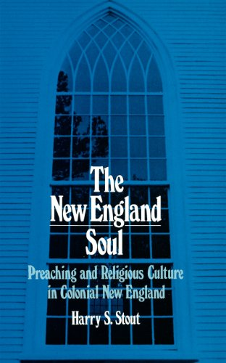
“Christian” as normal
Buddhist sermons
Sermons
Notes:
Christianity is also embedded as “the norm” in the catalog. For instance, we find “sermons” and “Buddhist sermons,” but not “Christian sermons.” By default, “sermons” are Christian.

Slide 11

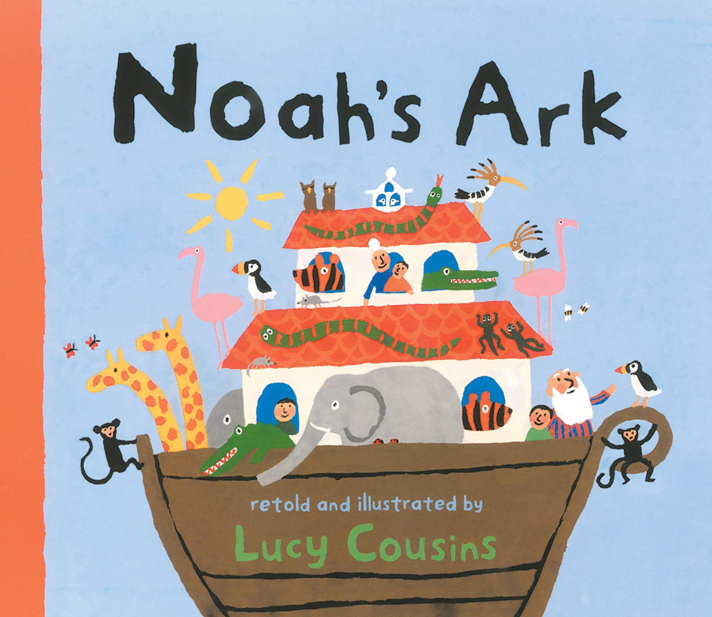
“Christian” as normal
Mythology -- Maori
Bible stories
Notes:
And let’s consider the words “mythology” and “bible.”
In the LC subject headings, “the Bible” refers to the Christian Bible by default, even though there are other religions that have collections of texts referred to as “the Bible,” such as Judaism and Rastafarianism.
The term “mythology,” on the other hand, is applied to dozens of the world’s belief systems, but not to Christian stories.

Slide 12
From “riot” to “massacre” –
Harnessing the evidence
Google search results
for the phrases
“Tulsa Race Riot” and
“Tulsa Race Massacre,”
August 2019 and August 2020
Notes:
Our group, the Learning & Working Group on Metadata Justice, wanted to get LC to change “Tulsa Race Riot” to “Tulsa Race Massacre.” But I’d like to point out that the Library of Congress Subject Headings do not exist to promote metadata justice. They exist to help users find information. And users are most easily able to find information when the most accurate and the most commonly used words in our natural language are aligned with the catalog’s subject terms.
So, our job was to harness evidence showing that “Tulsa Race Massacre” is CURRENTLY the most accurate and most commonly used term to refer to the event.
Luckily, we started working on this in 2020, just as an immense shift was occurring in how people talked and wrote about the massacre. As an example, in August 2019, a Google search on the phrase “Tulsa Race Riot” retrieved 107,000 results, whereas “Tulsa Race Massacre” retrieved only 28,400 – only about one-fourth as many. But just a year later, “Tulsa Race Massacre” had more than 10 times as many Google results as it had in 2019 – 299,000 results! The Google results for “Tulsa Race Riot” had increased a bit, from 107,000 to 125,000, but it was now clearly the less-used term.

Slide 13
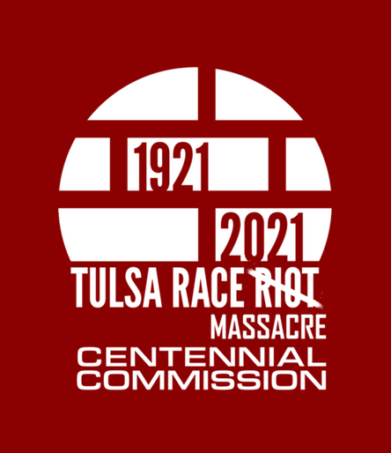
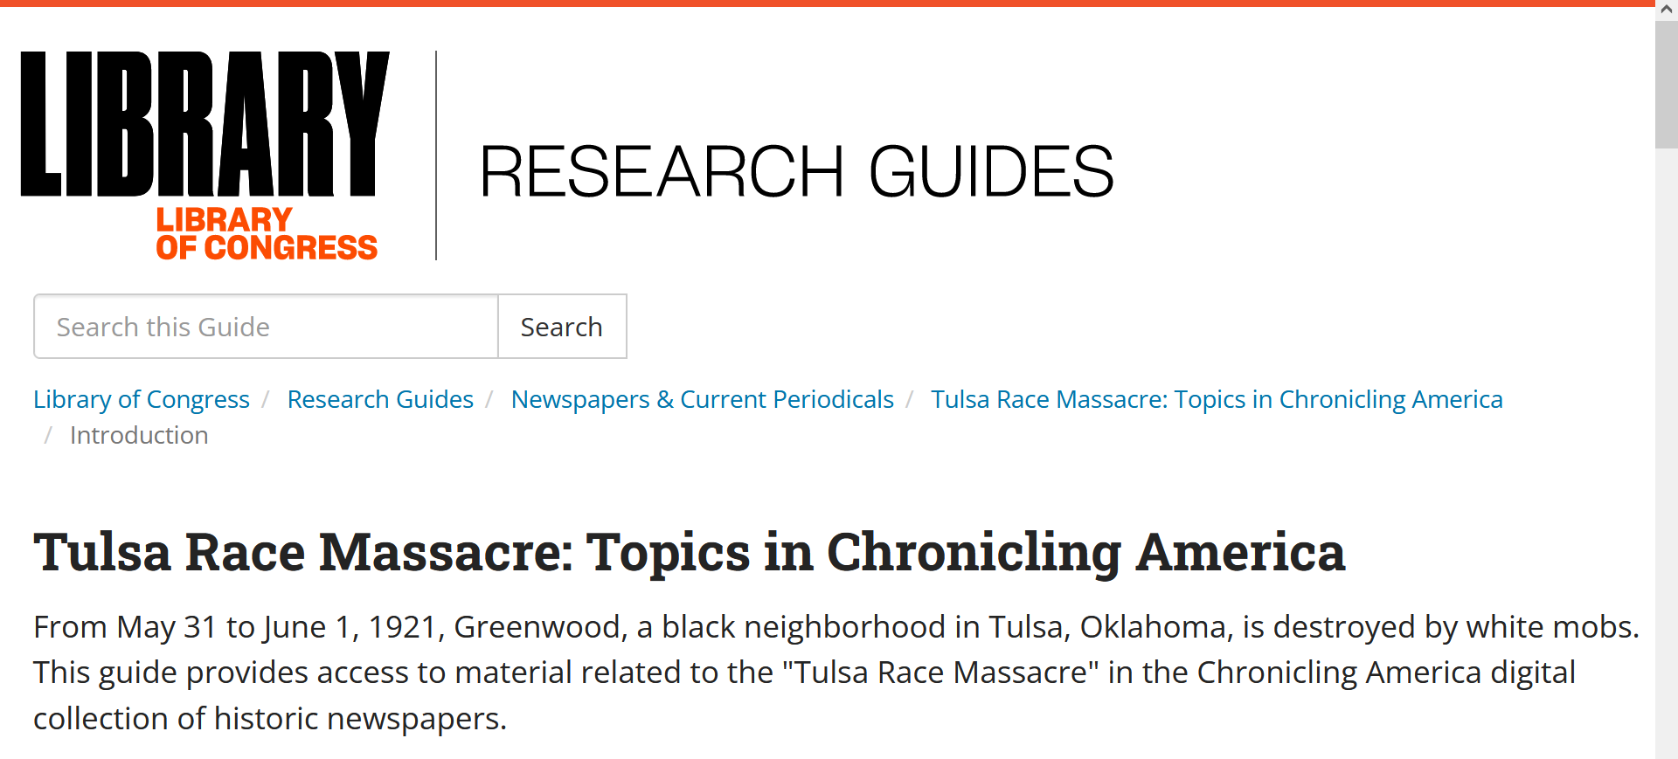
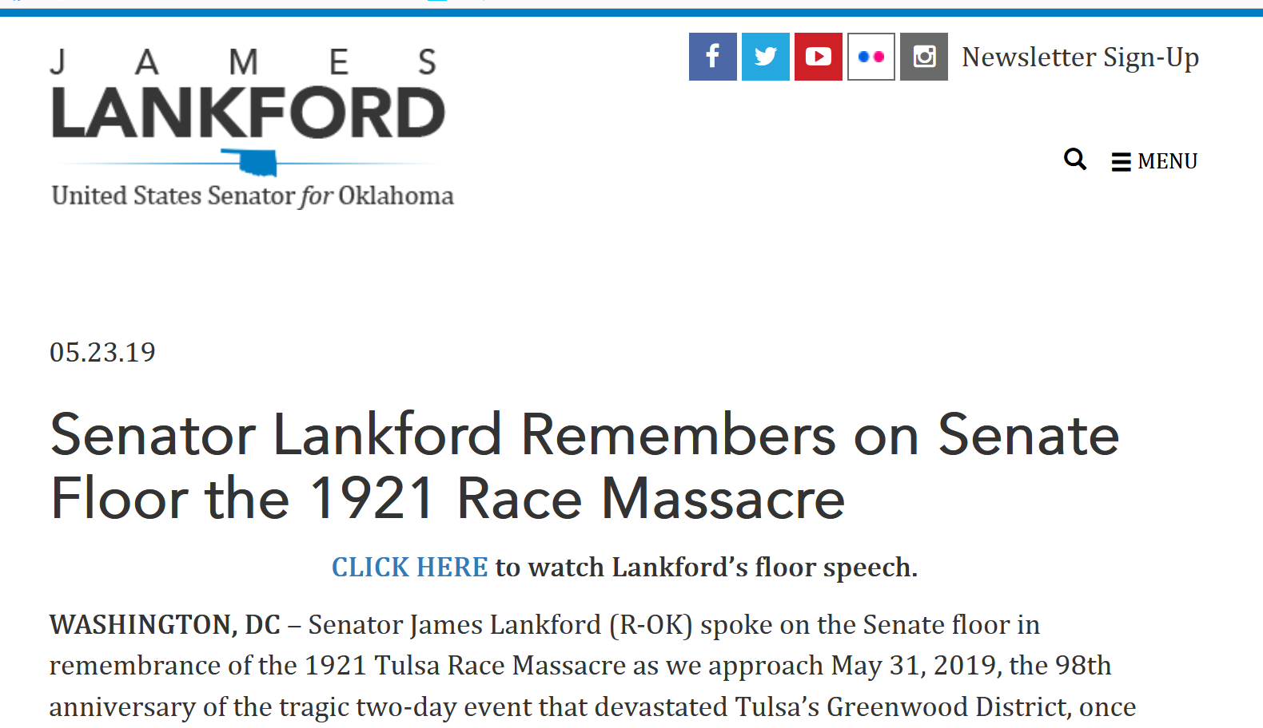

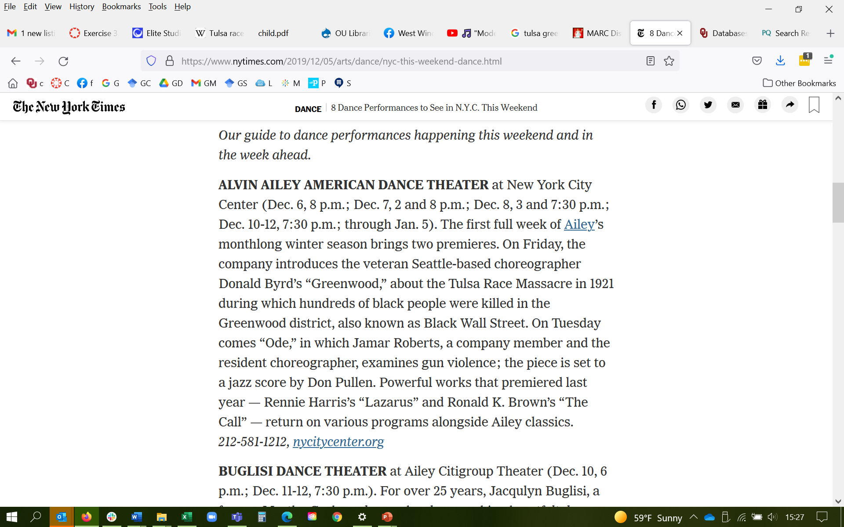
Notes:
But of course, a Google count is not the only evidence we needed. We also showed that the term “Tulsa Race Massacre” was more commonly used than “Tulsa Race Riot” in . . .
Recently published books on the topic
Newspaper articles about the planned 100-year commemoration events
Documents produced by the 1921 Tulsa Race Massacre Centennial Commission, which is the official organization devoted to the history of the Greenwood community
The Congressional Record, reporting Senator James Lankford’s proclamation to the Senate about the 100th anniversary of the massacre
And even a research guide published by the Library of Congress itself!

Slide 14
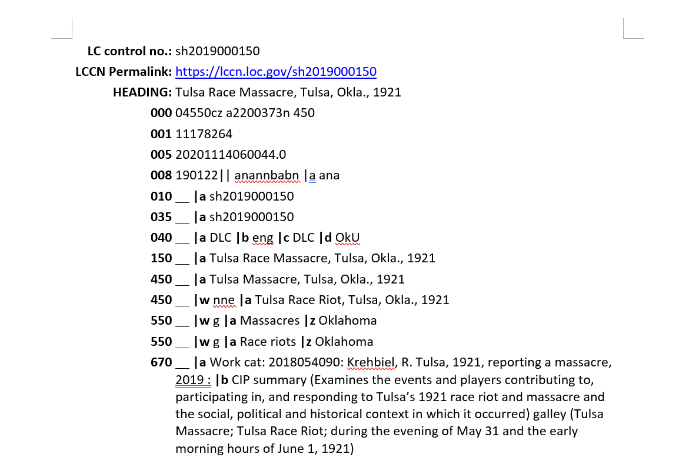
MARC format for Tulsa Race Massacre heading
Notes:
This is what the Tulsa Race Massacre heading looks like today in machine-readable format, though actually this is the machine-readable format parsed for human cataloguer eyes. The heading has the official heading in the 150 and variants in 450s. Notice one variant has a $w nne. That shows it was the old version of the heading. But we still need to retain it for the benefit of people looking this up under this old heading. The 550s are broader subjects this heading goes under. And then we have a long list of 670s, which are citations for the heading in various sources, starting with the book the Library of Congress catalogued that was the justification to make the heading. Library of Congress subject headings can’t be made for things that might theoretically exist; they must reflect a topic of some actual item that is being catalogued.

Slide 15
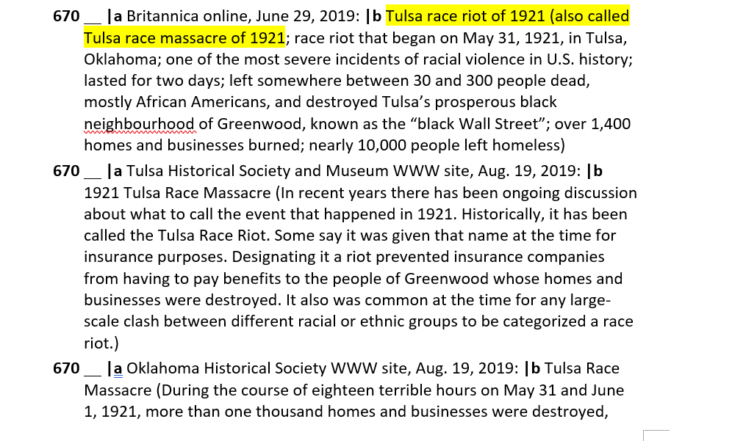
Notes:
More sources the Library of Congress used to cite what the Tulsa Race Massacre was and what were the various terms people called that event. These justify the 150 and 450s.

Slide 16
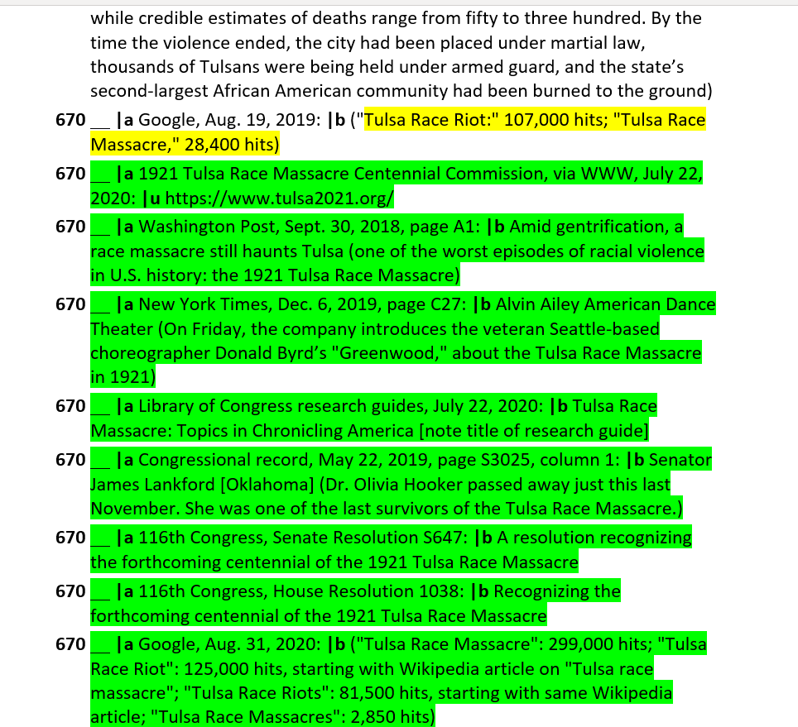
Notes:
The yellow 670 is LC’s proof. Notice they went with what most people called it on Google on August 19, 2019. The green 670s are the citations we added to the subject heading to prove the change in terminology. Notice we even added a newspaper citation from before LC’s Google search result.

Slide 17
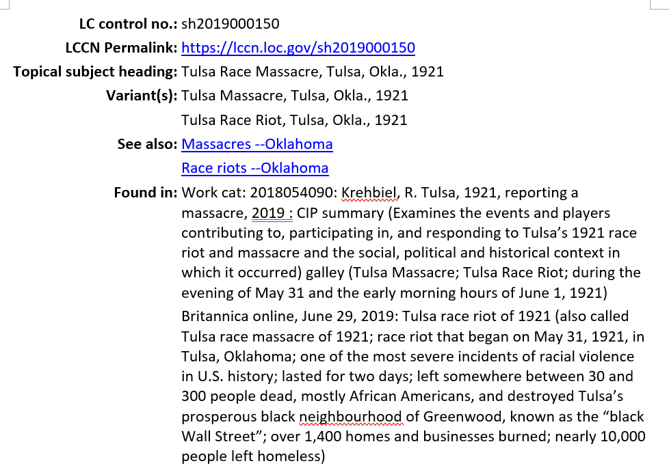
Human-readable format for Tulsa Race Massacre heading
Notes:
This is what you see when you click on the permalink above, which is in a form most people can read.

Slide 18
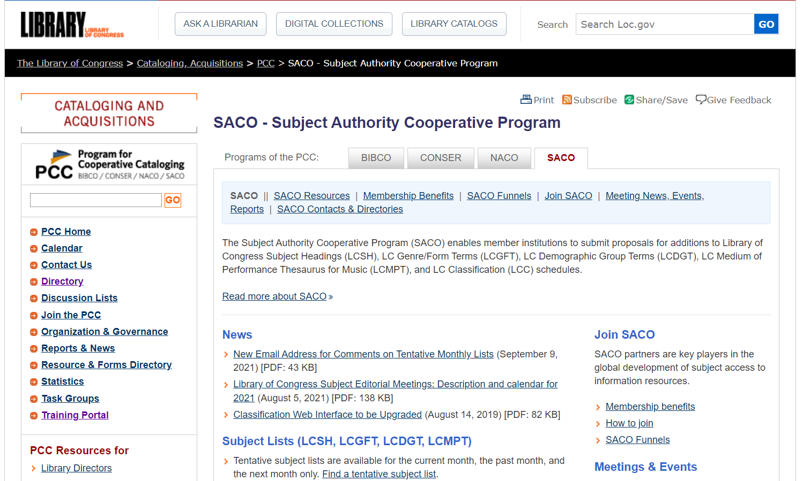
Notes:
But not just anyone can make or propose changes to the Library of Congress subject headings. Their institutions must belong to a program called SACO, the Subject Authority Cooperative Program which as you see “enables member institutions…” They need to get thoroughly trained on how LCSH works and what makes a good proposal.

Slide 19
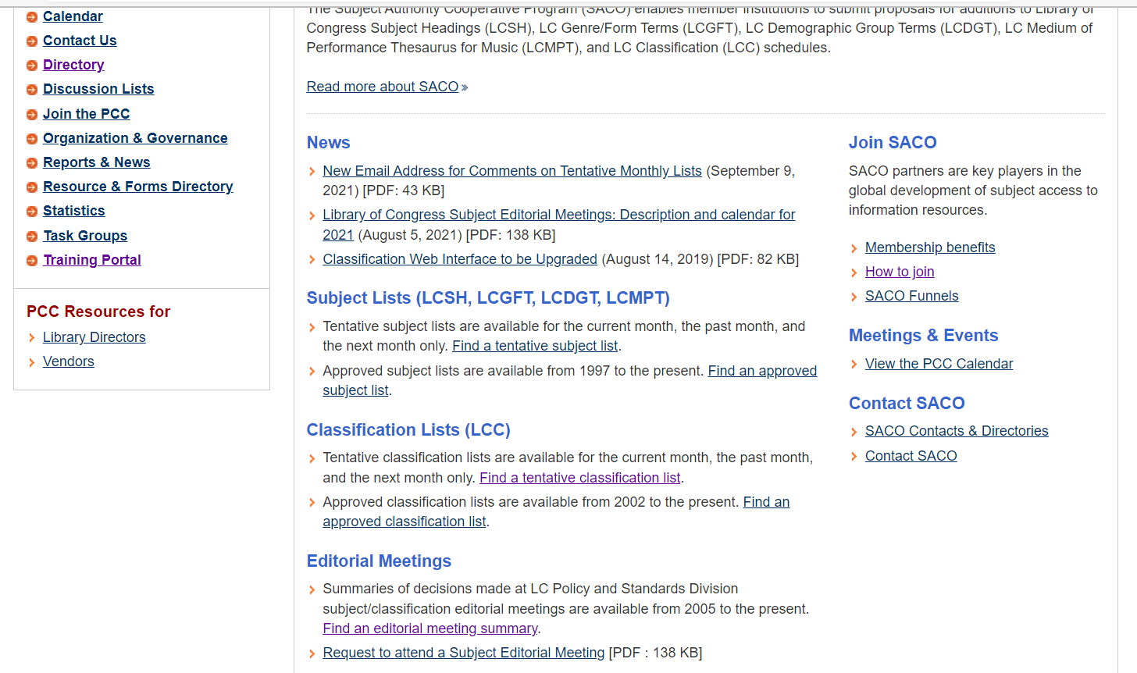
Notes:
Members must keep an eye on the subject lists and editorial meeting summaries. More later.

Slide 20
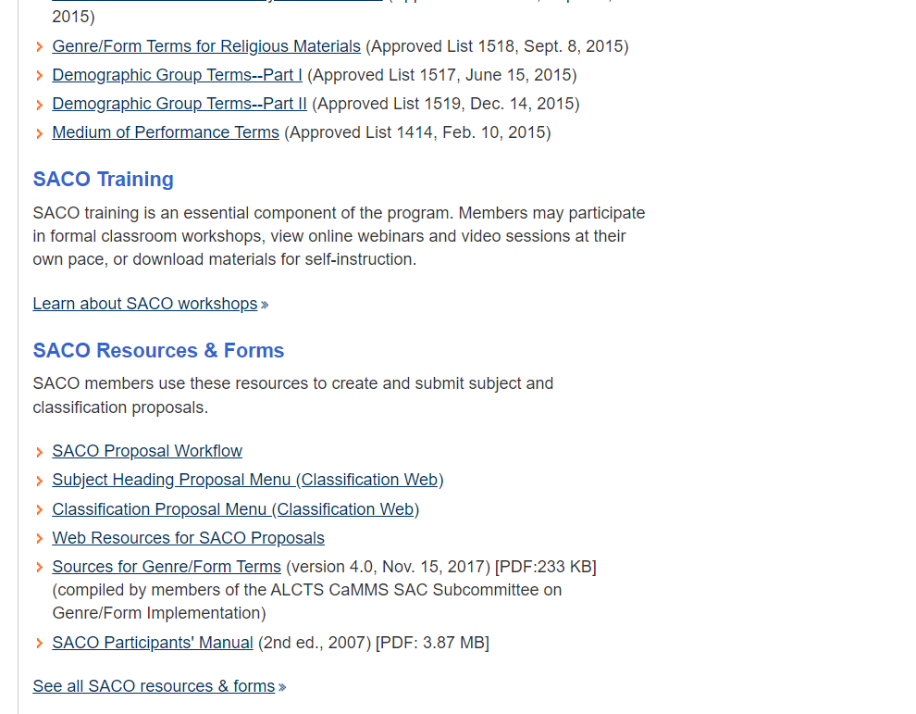
Notes:
After that, they get to use the subject heading proposal menu in ClassWeb.

Slide 21
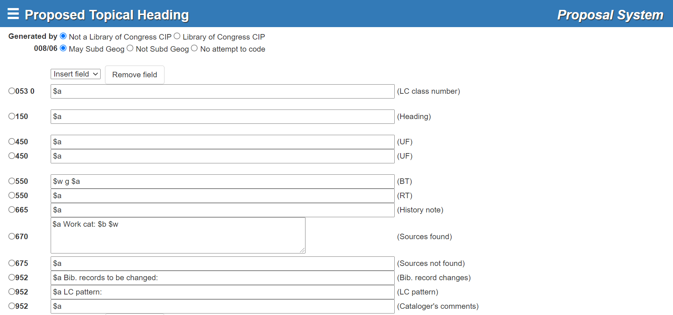
Notes:
This is what a new proposal looks like. We are trained in what to fill in and how to fill it in.

Slide 22
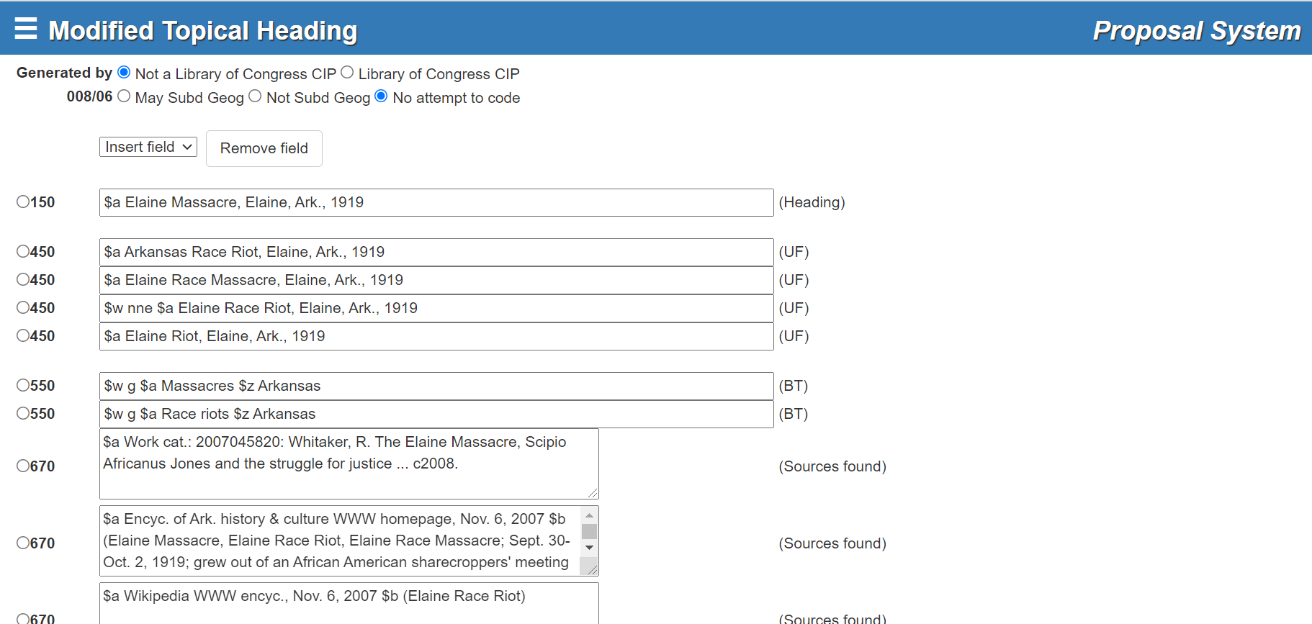
Notes:
If we were editing a current heading, we would add new lines to a subject heading like this one.

Slide 23
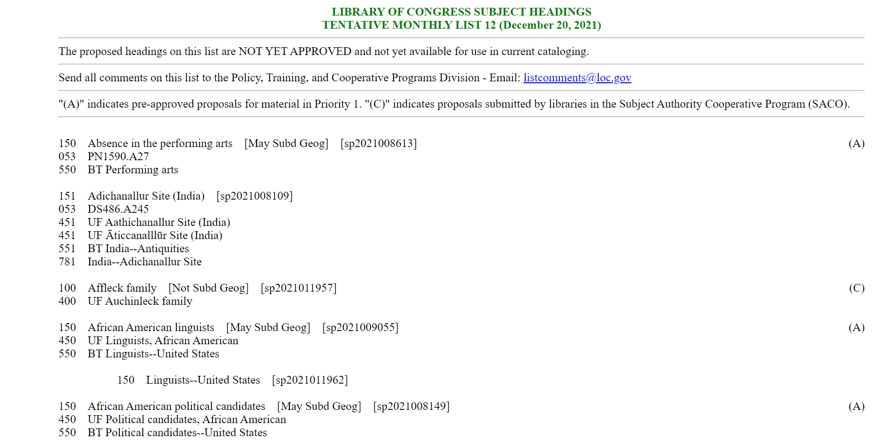
Notes:
When people propose a heading, it goes on the monthly tentative list. Proposals marked C are from SACO libraries. Notice the capital letters that these proposals are NOT YET APPROVED… LC may have to edit the proposals, or even reject them, and so you won’t find these in the LCSH yet as listed in the regular ClassWeb or OCLC.
Our proposal appeared on the Tentative list for August 2020, but that’s gone now.

Slide 24
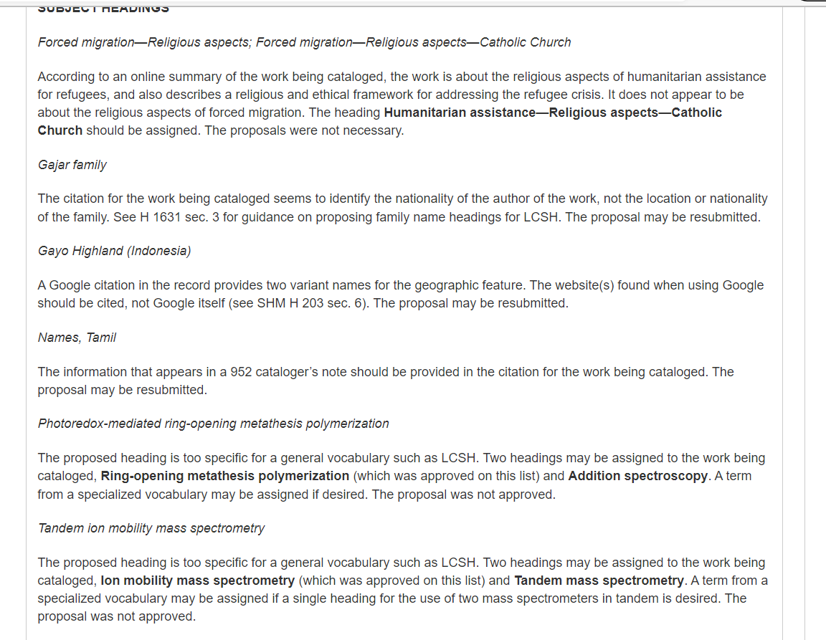
Notes:
We must also keep an eye on the monthly Summary of Decisions. If the LC has a problem with a proposal, this is the format they use to tell the institution what the problem is, what needs to be corrected, or why the proposal has been rejected. It’s posted like this so that other libraries can learn from the corrections.
But if the proposal is acceptable to LC, they just send you an e-mail to say the proposal was accepted and will appear on Monthly List #.
It takes two months for a proposal to work its way through the system.

Slide 25
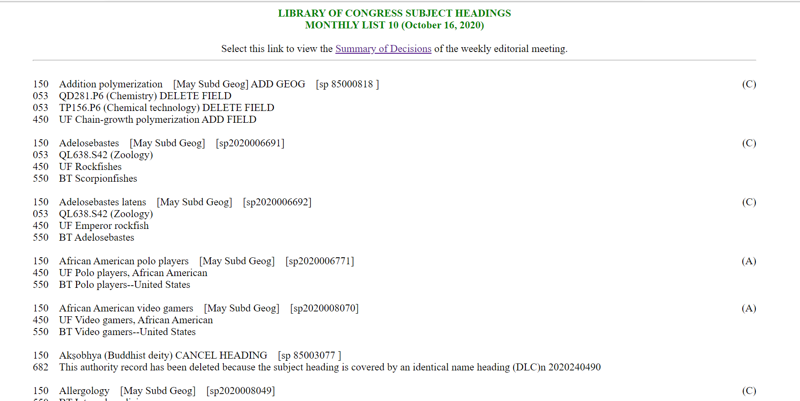
Our proposal appeared on this list
Notes:
LC had no problems with our proposal.

Slide 26
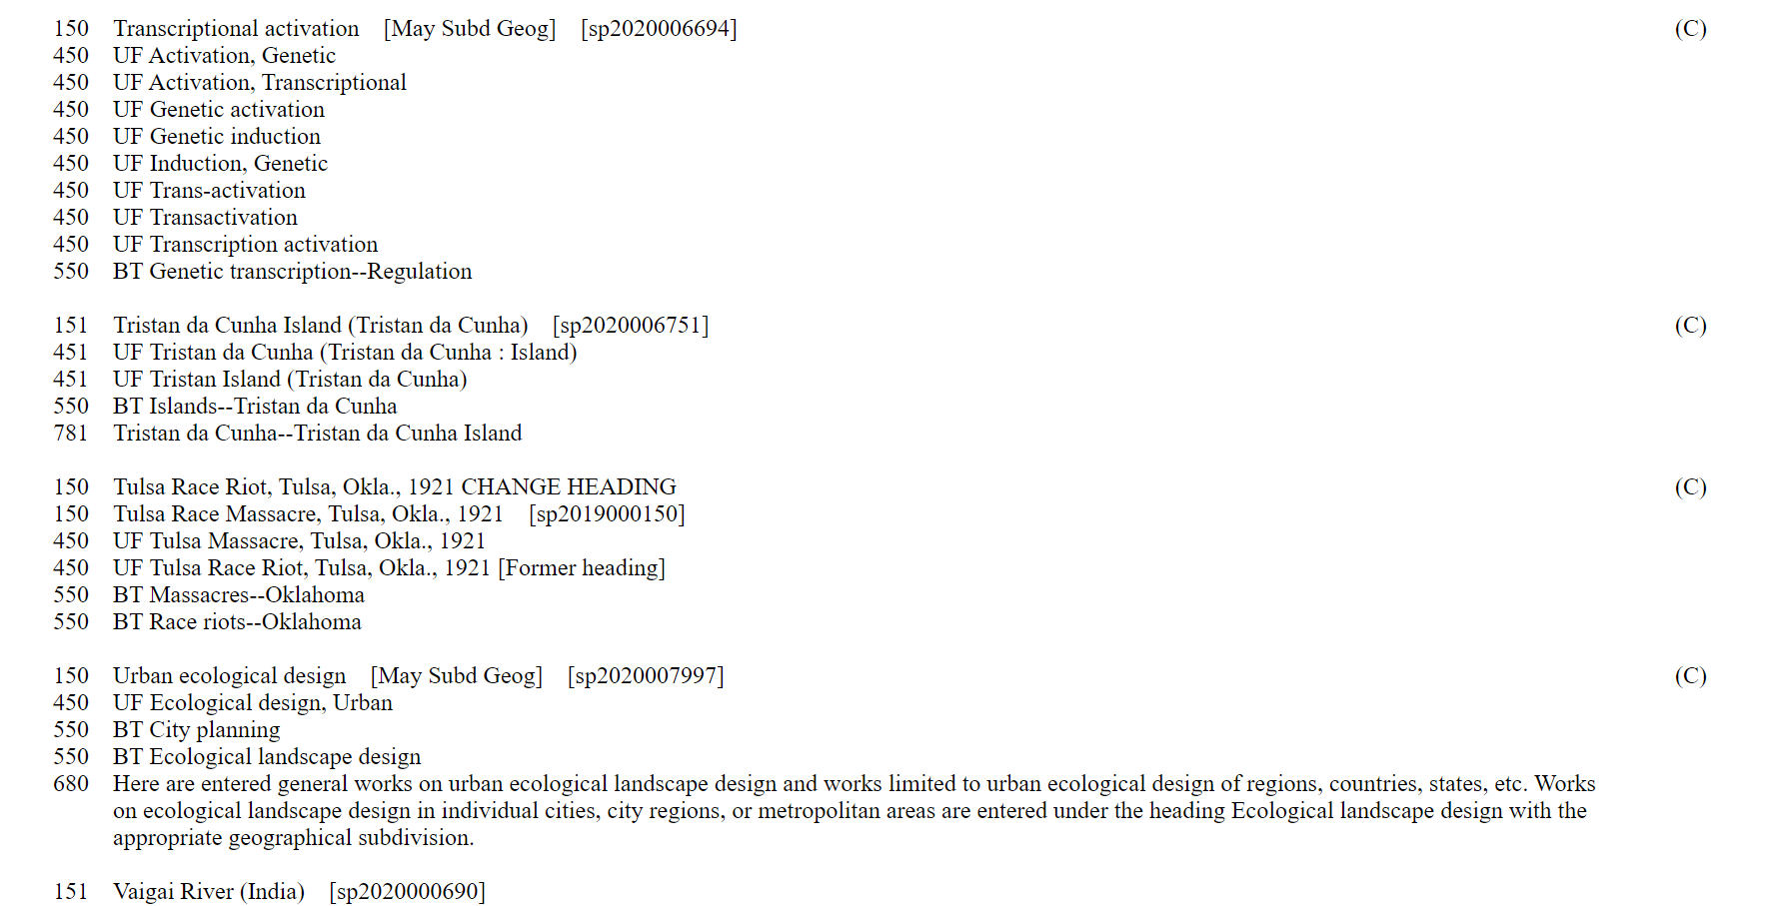
Notes:
And here it is. (LC may add things to it, and of course that is their right because it’s their subject headings after all.)

