Slide 1

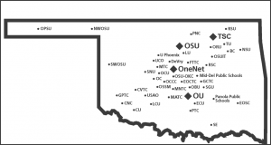

OneOklahoma Friction Free Network (OFFN)
Dr. Henry Neeman, Dr. Veronica McGowan, and Matt Younkins University of Oklahoma
Dr. Dana Brunson, Oklahoma State University
(complete list of members\contributors at presentation conclusion)

Slide 2
Abstract
This session presents a stage model that describes the ongoing deployment of a Science DMZ known as the OneOklahoma Friction Free Network (OFFN) in order to guide multi-campus collaborations on their journey to a robust cyberinfrastructure model. This session defines implementation stages and describes the deliverables, benefits, challenges, best practices, and metrics for each stage. The results of the initial implementations are expected to show that metrics including speed, stack size, context switching, signal deliveries, and socket message traffic is improved and latency and errors including page faults are reduced. It is hoped that this model will serve as a sustainable model for EPSCoR states hoping to maximize research efficiency and minimize risk in their engagement of statewide research interests.

Slide 3
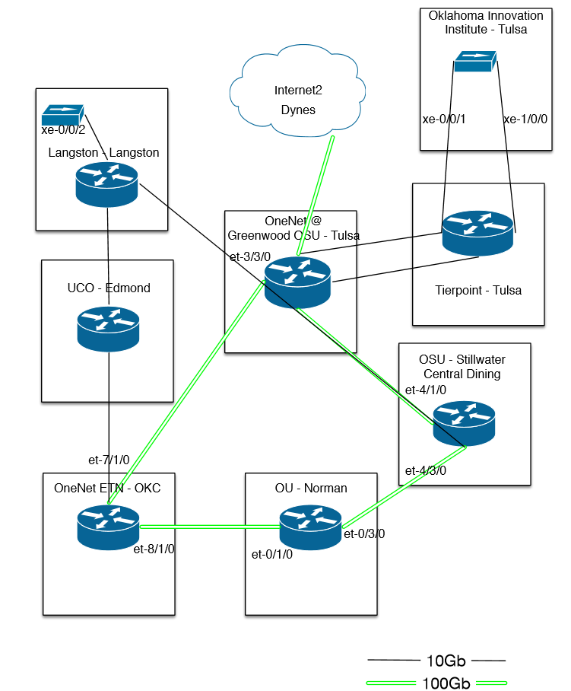
Introduction
Shared amongst the University of Oklahoma, Oklahoma State University, Langston University, University of Central Oklahoma, and the Tandy Supercomputing Center (TSC), as the Oklahoma Innovation Institute (OII), the ring and spur implementation of a NSF Cyber Connectivity - Networking Integration and Engineering (CC-NIE) grant, known as the OneOklahoma Friction Free Network (OFFN), is discussed in terms of its deployment as a multi-institutional Science DMZ for friction free and Software Defined Networking (SDN)[1].
University of Central Oklahoma and University of Tulsa are in the approval process for membership in OFFN.
Drawing by David Brockus

Slide 4
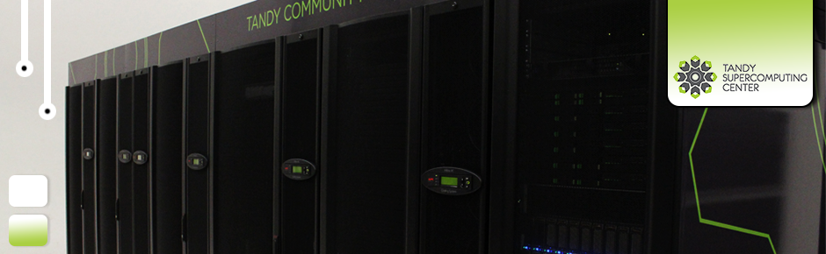
What is a Science DMZ?
Moving a 1 Terabyte file[3]:
Science DMZs enable high speed file transfers to/from off-campus locations.
In 2011, the Campus Bridging task force of the National Science Foundation (NSF) Advisory Committee on Cyberinfrastructure (ACCI) recommended[2]:
“The NSF should create a new program funding high-speed (currently 10 Gbps) connections from campuses to the nearest landing point for a national network backbone. The design of these connections must include support for dynamic network provisioning services and must be engineered to support rapid movement of large scientific data sets”.
10 Mbps network | 10 Mbps network | USB 2.0 portable disk | 1 Gbps network | 10 Gbps network
300 hours | 30 hours | 20-30 hours | 3 hours | 20 minutes
Photo courtesy of the Oklahoma Innovation Institute

Slide 5
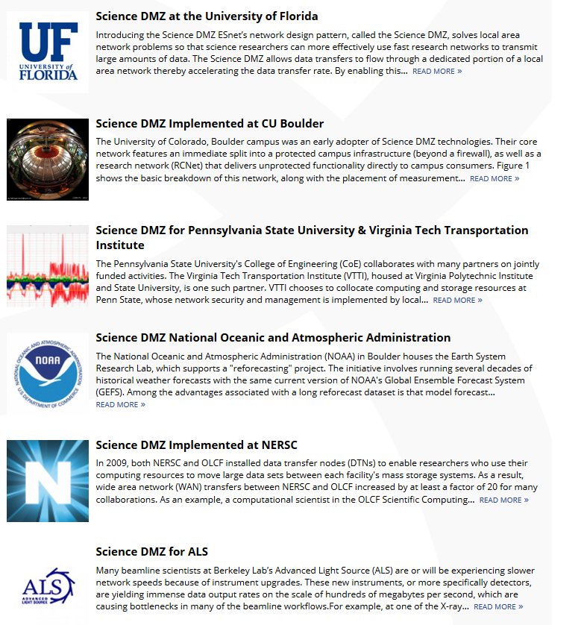
What is the Science DMZ architecture?
As specified by Esnet[4a], three key components:
1. “Friction Free” network path -Allows scientists to perform research and send and receive data without constraints, such as firewalls, associated traditional enterprise networks.
  Highly capable network devices
  Virtual circuit connectivity option
  Security policy and enforcement specific to science workflows
  Located at or near site perimeter
2. Dedicated, high-performance Data Transfer Nodes (DTNs)
  Hardware, operating system, libraries optimized for transfer
  Optimized data transfer tools
3. Performance measurement/test node
  perfSONAR (next slide)
ESnet-recognized case studies of best practice [4b]
Notes:
Located at or near site perimeter - Since data transfer most directly influences performance in data-intensive applications, such as representational state transfer (REST) commands, a dedicated portion of a network, located close to the network perimeter, has been shown to best utilize bandwidth R. K. L. Ko, M. Kirchberg, S. L. Bu and E. Chew, 2012:” Overcoming Large Data Transfer Bottlenecks in RESTful Service Orchestrations”. 2012 IEEE 19th International Conference on Web Services (ICWS), 654-656. DOI: 10.1109/ICWS.2012.107.
E. Dart, L. Rotman, B. Tierney, M. Hester, and J. Zurawski, 2013: “The Science DMZ: A Network Design Pattern for Data-Intensive Science.” Proceedings of SC13. DOI: 10.1145/2503210.2503245.
Includes optimized data transfer tools such as Globus
Online and GridFTP

Slide 6
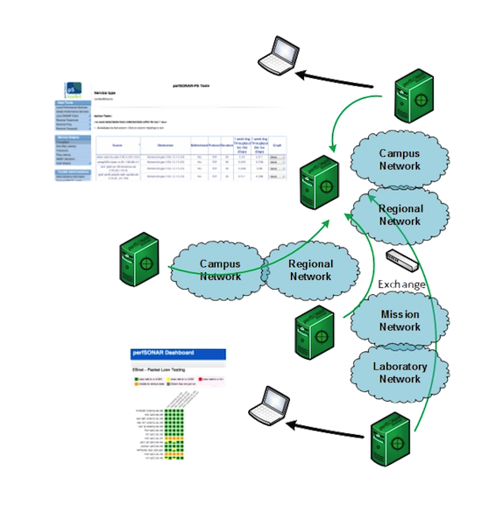
perfSONAR nodes
Internet2 recommended hardware configuration[4c]:
Dell R720 Chassis, DC enabled PDU
8 GB of RAM
2 x Intel E5-2609 CPU @ 2.4 Ghz clock speed; 4 cores per CPU; HyperThreading disabled.
Dell motherboard, Intel C600 Chipset
146GB RAID-1 disk
Dual port 10GBASE-SR Broadcom NetXtreme II BCM57800 (x8 PCIe 2.0) NIC directly connected to the AL2S networking components
Used with permission from the perfSONAR Project [3a]
Notes:
About the image; The basic use case for perfSONAR is to make the node available for others to use. This is referred to as the "beacon" use case. By setting up the node, keeping it"open" (e.g. not imparting policy that would prevent the average user from initiating a test), and ensuring that it remains operational, networks can allow others the ability to learn what their end-to-end performance characteristics look like.

Slide 7
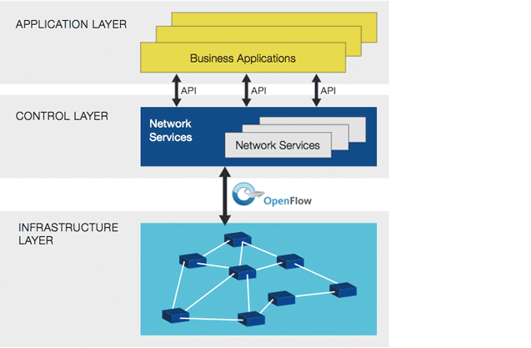
What is Software-Defined Networking (SDN)?
The OpenNetworking Foundation defines SDN as “The physical separation of the network control plane from the forwarding plane, and where a control plane controls several devices”[4].
The OpenFlow® protocol separates the data and control paths from operating on the same device and prevents exposure of the internal workings of network devices[5].
Graphic used with permission from OpenNetworking.org
Notes:
Emphasize that Software-Defined Networking (SDN) is an emerging architecture (so supporting literature ranges from theoretical support to early case studies and implementation). Network control is directly programmable (hence, this is a cost-effective and easy way to manage the entire system-yes, time and expertise investment is needed, particularly in terms of applications support, HOWEVER, the point is that administrators can dynamically adjust to meet needs with a centralized controller.
The defining attribute of SDN is the separation of the data and control planes. This separation was not invented recently by SDN academics -since the 1980s all well-­‐designed communications systems
have enforced logical separation of 3 planes :
•
data plane (forwarding)
•
control plane (e.g., routng )
•
management plane (e.g., policy, commissioning, billing)
What SDN really does is to:
1) insist on physical separation of data and control
2) erase the difference between control and management planes

Slide 8
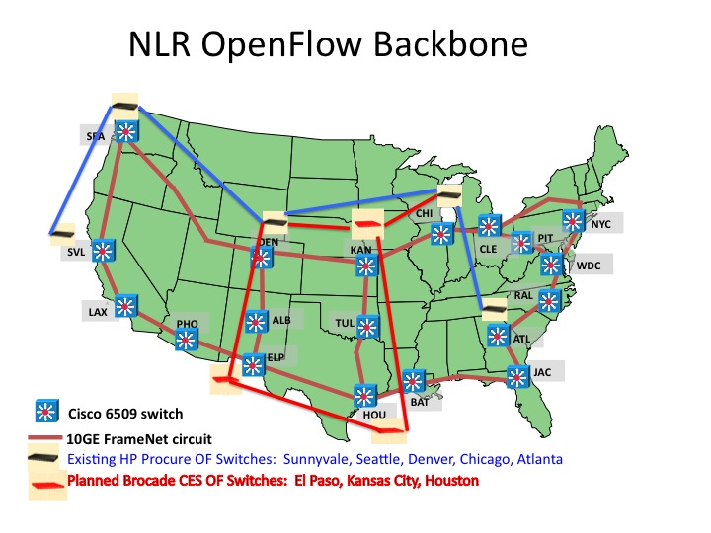
The bigger picture

Slide 9

How will we use OFFN?
The initial domain Science, Technology, Engineering & Mathematics (STEM) research projects include numerical weather prediction, high energy physics, bioinformatics and weather radar, and research slated for OFFN has already begun expanding to other research disciplines.
ATLAS Tier 2 and DØ High Energy Physics: One of the largest physical science collaborations ever, with 2000+ physicists (including ~800 students) from 150+ universities and laboratories in 34 nations, ATLAS is a High Energy Physics (HEP) experiment at the Large Hadron Collider (LHC) at the European Organization for Nuclear Research (CERN) that explores the fundamental nature of matter and the basic forces that shape our universe, by examining head-on collisions of protons of enormously high energy. OUHEP personnel have contributed significantly to network monitoring research to quickly pinpoint network-related problems [8].
Real-time Numerical Weather Prediction: Located at OU’s National Weather Center (NWC), CAPS is a leader in storm scale Numerical Weather Prediction (NWP) and Data Assimilation (DA) research. Since 2007, CAPS has led a Spring Real-time Storm Forecast Experiment using systems both on XSEDE/TeraGrid and at OSCER, as part of an ongoing collaboration with other academic researchers and research and operational centers in the National Oceanic and Atmospheric Administration (NOAA), e.g., the Storm Prediction Center. Forecast suites have included 25-50 member ensembles, using multiple NWP models (WRF-NMM, WRF-ARW, ARPS, COAMPS) at 4 km resolution over the Continental US (CONUS); hourly 2D fields and images are generated at NICS and sent back to OU for real time use and evaluation by meteorologists from research and operations communities in the Hazardous Weather Testbed (HWT)., Experimental forecasts of convection initiation and severe thunderstorms are created from the ensemble forecasts, to evaluate their utility [9,10, 12, 13].
Weather Radar: The societal impact of weather-related hazards such as tornadoes, high winds, snow, and flash floods is substantial, but can be mitigated by timely, accurate prediction via adequate observations and advanced scientific understanding. Weather radar is one of the most crucial instruments to improve the lead time for hazardous weather, benefitting operational and research communities. Weather radar advancements such as polarimetric capability and phased array technology provide valuable information to transform our understanding of radar meteorology [9, 12].
Eco-informatics and Geo-Informatics: EOMF leads efforts in mapping land use and land cover change at various spatial scales, modeling terrestrial ecosystem gross and net primary production, and predicting risk of highly pathogenic avian influenza (subtype H5N1) in Asia, using optical sensors (e.g., Landsat, SPOT-VEGETATION, MODIS, IKONOS, WorldView), synthetic aperture radar images (e.g., PALSAR), and LiDAR images across spatial domains from sites worldwide. Datasets from the US Geological Survey EDC data portal, including MODIS and Landsat require ~320 GB/day for surface reflectance products, and ~80 GB/day for surface temperature products [13-15].
Data Networks Research: Remote visualization with interactive steering needs real-time multicasting, to ensure that (a) data reaches all destination nodes at roughly the same time, and (b) at any given time, only one host can control the visualization, to avoid visualization or data inconsistency. Floor control is the problem of providing exclusive access in a communication session; control mechanism is to use a circulating token: at any given time, a controller holds the token so any node requesting the floor needs the controller for the token. Once the requesting node gets the token, all other requests for the token are queued or processed according to application demands and features. The node relinquishing the floor releases the token to the controller, and the process continues. This project has proposed distributed floor control protocols that are effective on overlay networks.,, and plans include extending floor control protocols to enable them to work in OpenFlow networks, with testing on a real-time simulation and visualization experiment [16-17].
Photo courtesy of Oklahoma State University

Slide 10
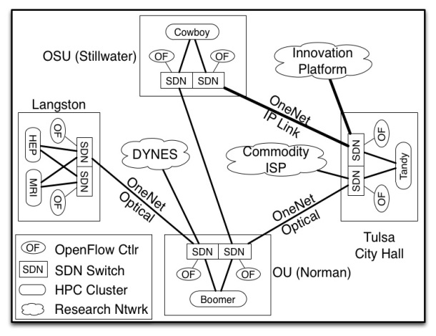
OFFN Goals
Provide a proven, commercial off-the-shelf hardware platform backed with vendor support.
Realize the Science DMZ goals through the use of a truly independent network at each campus site. The network deployment will consist of dedicated optical pathways to the optical transport provider (OneNet), as well as to the local campus backbone where desired.
Deploy a fully virtualized infrastructure, to be used simultaneously by multiple research entities, presented to each entity as a dedicated “slice” of the overall resource.
Leverage federation to provide oversight and visibility into the operations of the virtualized platform.
Realize the full potential of OFFN through awareness, training, site-specific hand-off, and communities of support for OFFN adopters.

Slide 11
OFFN implementation
Each of OFFN’s client site deployments will consist of the following resources, two of each component per institution for redundancy and failover:
SDN switches (Dell Force10 S4810, each 1U, 14.39 lbs, 1194 BTU/hr, 350 W)
Platform support switches (Dell PowerConnect 7024, each 1U, 14 lb, 300.5 BTU/hr, 88 W)
Servers (Dell PowerEdge R720xd, each 2U, 64.9 lbs for 2.5” drives, 4100 BTU/hr, 485 W)
Total physical requirements per institution are 8U rack space, 187 lbs, 11,189 BTUs/hr and 1846 W of power.
Collectively, these institutional assets provide a hybridized foundation both for production data and for multiple instances of SDN with associated OpenFlow control, allowing OFFN to be both flexible for rapid deployment needs and stable for always-on requirements.
Software (all Open Source and/or free): the OS virtualization platform, Linux host and guest OS, SDN controller, performance testing, as well as monitoring.
As part of the toolset for statistics gathering, performance monitoring, and health checking, perfSonar is provided via physical devices at each site, already deployed by OneNet (ps.onenet.net), connecting to other perfSonar instances at all OFFN sites, to provide a true end-to-end analysis of network performance.
Notes:
SDN switches (Dell Force10 S4810, each 1U, 14.39 lbs, 1194 BTU/hr, 350 W) provide a virtualized data plane resource, to effectively and efficiently forward Ethernet traffic based on rules configured on the SDN controller. (Note that TSC will use a 24-port SDN-capable Brocade linecard instead.)
Platform support switches (Dell PowerConnect 7024, each 1U, 14 lb, 300.5 BTU/hr, 88 W) provide the connectivity required for out-of-band management functions, including server lights-out management, SDN switch component management, and Virtual Machine (VM) host management.
Servers (Dell PowerEdge R720xd, each 2U, 64.9 lbs for 2.5” drives, 4100 BTU/hr, 485 W) provide multiple virtualized SDN controller resources, plus a virtualized platform for providing performance toolsets, management and monitoring utilities, and data transfer tools.
In concert with the deployment, each controlling organization has committed rack space (8U in total), AC power (diverse power sources if possible, 6 110VAC/220VAC receptacles per source, 1846 W of maximum overall power draw), cooling (11,189 BTU/hr or 0.93 tons maximum), physical security, public IP address space allocation (/25), as well as necessary inter-building fiber connectivity (two each single mode fiber optic cable pairs) to achieve connectivity to the Internet Service Provider (ISP) when ISP colocation is not feasible.
Software (all Open Source and/or free): the OS virtualization platform (Xen, VirtualBox or Qemu), Linux host and guest OS (Fedora or CentOS), SDN controller (Beacon or Floodlight), performance testing (iPerf and the PSPerformance Toolkit), as well as monitoring (Cacti or Nagios).

Slide 12
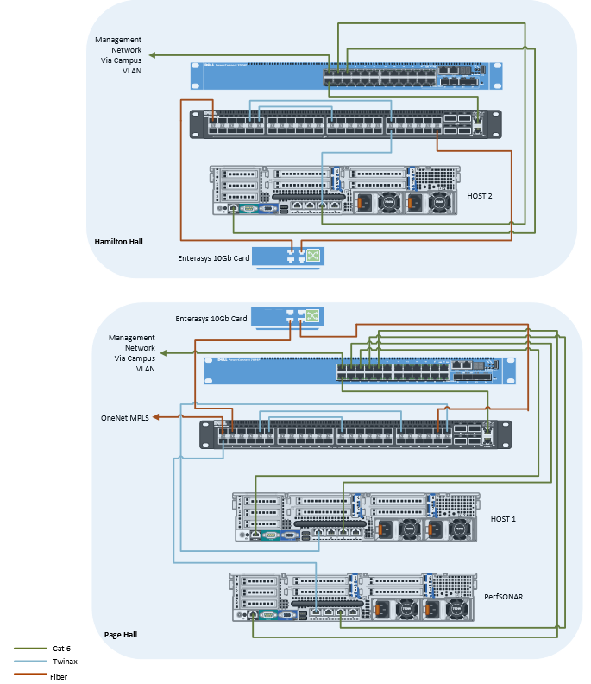
Example site implementation-Langston University
Additional Equipment needs:
-4ea 3m jumpers SC to LC (Single mode)
-2ea Single Mode SR Optics for S4810
-4ea Multi Mode SR Optics for S4810
-2ea 4 port 10Gb Cards for Enterasys K6
-8ea 3m Multi Mode SR Optics for Enterasys K6
-8ea 1m TwinAx cables
-2ea C13 power cable for 7024
-2ea R720 power cables (standard plug)
-2ea 7024 power cables (standard plug)
-10ea 3M Cat6 network cables
-2ea Single Mode SR Optics for OneNet equipment
-Copper ports for OFFN Management Network
-Copper Ethernet ports for OFFN Management Network
-Interconnecting Fiber

Slide 13
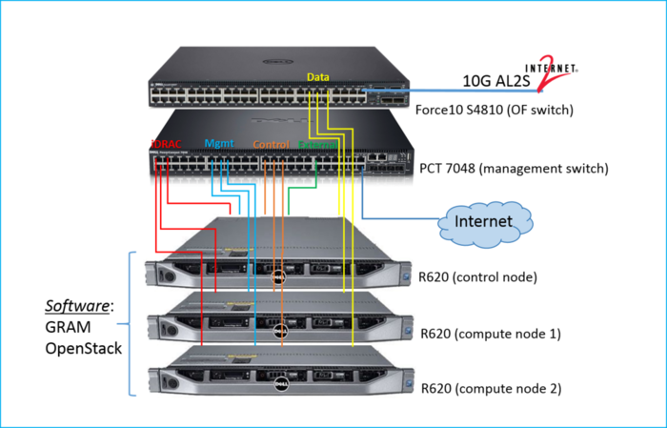
Example GENI implementation –OSU site
GENI racks are being implemented to meet the goals specified by rack requirements developed by GENI [7] which include requirements for: software, integration, monitoring, production aggregate, local aggregate owner, and experimenter.
http://groups.geni.net/geni/wiki/GeniRacks
Matt will send citation or use correct Rack Config diagram

Slide 14
Our checklist for deploying an OpenGENI site?
Does the connection between OpenFlow switches appear as a layer 1 connection?
  using dedicated fiber, existing pseudo-wire technologies, OF switches to pass traffic, or applying special configurations to traditional layer 2 VLANs such as disabling mac learning and STP.
Additional hardware for preparing OSU’s network environment for hosting a GENI rack?
Identification of transceiver connecting the GENI rack to the 10Gb uplink connection?
Post-Purchase **Important: If the following information is not or cannot be provided prior to the rack being sent to your site, you will receive the hardware with only a bare OS installed on all servers and the switch un-configured. In order to have your rack delivered as a ready to be deployed product, you MUST provide the following:
Identification of Hostname, GENI identifier, and external plane VLAN number
How do we check conflicts?
DNS server
GRAM software Range and subnet of public IP addresses for virtual machines:
Define a range of contiguous IP addresses to be assigned to the Virtual Machines.
External network configuration on control nodes and compute nodes
Assign the following for the control node attached to the system. (DHCP is not recommended as a change in IP address can disrupt the software utilized by GENI)
Static IP address:
Subnet:
Gateway:
DNS Server:
Will the following ports be allowed through your campus/network firewall, to the entire rack subnet:
22 - SSH
25 - SMTP (outbound connections only, from control node)
80 - HTTP (must also allow outbound connections from control node)
443 - HTTPS (must also allow outbound connections from control node)
843 - Flash Policy Server
3000-3300 - SSH access for experimenter resources
5001 - GRAM AM API V3
5002 - GRAM AM API V2
9000 - VMOC Controller
30000-65535 - General application traffic such as connections to OpenFlow controllers.
ICMP - ping
iDRAC network configuration Static IP address Subnet
Gateway
Force10 switch network configuration Assign the following:
Static IP address
Subnet
Gateway
PT7048 switch network configuration Assign the following:
Static IP address
Subnet
Gateway

Slide 15
Expected OFFN Metrics
Specifically:
Triangulation of the below as a measurement of signal delivery:
Bitstream reliability
Payload
Overhead calculations will be captured as a
Switch reliability, capacity, and availability metrics
Increased bandwidth, traffic metrics including:
Last mile metrics
  OneNet
  local campus backbone
Server and switch hardware performance metrics
Metrics related to software-defined networking
Metrics related to specific research
  presumably increase in: storage capacity, processing, search time, etc.,
  user satisfaction with hardware and software resources
  Information on statewide collaborations (research teams, IT teams) (presumably an increase in research collaboration)
In general, metrics describing effectiveness at sites, at deployment connections, from the OFFN commercial provider and within specific research projects will be used to evaluate the project as a whole as well as a sum of its parts.
Notes:
Since bitstream reliability is a major component in connectivity speed, that, was well as payload and overhead calculations will be captured as a triangulated measurement of signal delivery.
Switch reliability, capacity, and availability metrics
Increased bandwidth metrics Last mile metrics (dedicated optical pathways to the optical transport provider (OneNet), as well as to the local campus backbone) Server and switch hardware performance metrics Metrics related to software-defined networking (presumably a reduction in conflicts) Metrics related to specific research (presumably increase in storage capacity, processing, search time, etc., especially for weather prediction, high energy physics, weather radar and bioinformatics Any data on user satisfaction with hardware and software resources Info on statewide collaborations (research teams, IT teams) (presumably an increase in research collaboration) Policies developed due to OFFN

Slide 16
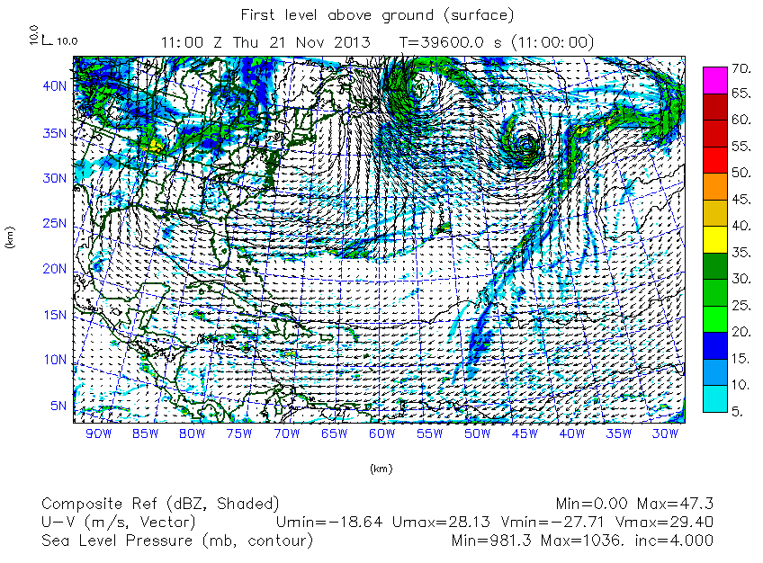
How will we gather effectiveness data?
A representative, test case for benchmarking activity is an interacting Spring Storms simulation
  A next-generation mesoscale numerical weather prediction system of two dynamical cores, a data assimilation system, and a software architecture facilitating parallel computation and system extensibility
  Typical problem sizes are in the range of [60 raw timesteps on disk at a time, with allotments of 2 TB for the raw data and 2 TB for the metadata].
The scaling behavior of selected applications will averaged across multiple runs (5 executions) performed at different times.
For sequential performance compare each unit (Schooner, Cowboy, Lucille, Buddy, Tandy, etc.) in terms of processor performance
Microbenchmarking may reveal that network performance related to the 100G OneNet connection is a dominant factor
Investigation of failure to reach performance benchmarks
Possible performance limitations:
  short ssh sessions
  data transfer node underperformace
  multiple cores
  virtual instances\communication
  variability in execution time across runs
  shared resource performance
Notes:
The scaling behavior of selected applications (list out:MathLab, etc.) were
For sequential performance compare each unit (Schooner, Cowboy, Lucille, Buddy, Tandy, etc.) in terms of processor performance (use a graph in which the slope of the curve shows how the applications scale on different platforms). Private and public cloud (for some\all apps) and core usage to indicate linear scalable parallel performance.
Improved scalability tested using application profiling, performance tools and microbenchmarking (such as CPU affinity settings on different types of enviroments) the platforms and found that network performance related to the 100G OneNet connection is a dominant factor (can we track fall-off-would tie to need for 100G Native drop on OU and OSU campuses.
A representative, test case for benchmarking activity is an interacting Spring Storms simulation, a real-time high-resolution weather forecasting model produced by the Center of Analysis and Prediction of Storms at the University of Oklahoma. In this next-generation mesoscale numerical weather prediction system, two dynamical cores, a data assimilation system, and a software architecture facilitating parallel computation and system extensibility produce Storm-Scale Ensemble Forecasts (SSEF) for the full continental U.S. domain, assimilating radial velocity and reflectivity data and other available background, surface multi-level sounding and profiler data as well as radar data as observations into a cost function model (Du, Xue, Zhao, & Min, 2012). Typical problem sizes are in the range of [60 raw timesteps on disk at a time, with allotments of 2 TB for the raw data and 2 TB for the metadata].
If any sites have any apps with poor performance: While all applications scale well on [Boomer, Schooner and Cowboy], some applications, especially [XX] fail to reach performance benchmarks with evidence [name] indicating [i/o (such as unrelated i/o like short ssh sessions checking on job progress), data transfer node underperformace]. Also need to explain any: platform performance up to [#] of cores and any issues with virtual instances\communication; variability in execution time across runs (by calculating the coefficient of variation for execution time across 5 executions. Shared resource performance, Network performance (are we using a ping-pong benchmark?) in order to find latencies and bandwidth (with the implication on real-time intensive applications (reason could be network\device virtualization?). Idle time (including iterative apps) and error handling

Slide 17




How do researchers work on a Science DMZ?
Emerging paradigms in the field include:
Data Center: RN aggregation switches at 10­Gb/s, providing direct connections
Lab-based: A researcher, department, or other entity could purchase additional Brocade switches to expand the network in a manner similar to an edge connection.
Ethernet Fabric: 10­Gb/s Ethernet Fabric Switch. This option provides one (1), 10­Gb/s connection, an additional 10­Gb/s fiber edge port, and either 24 or 48 1­Gb/s connections to individual research workstations.
Compliance Port: An individual “research or compliance port” on an existing ITS managed, converged network switch, Such as a virtualized wall jack network connection.
Notes:
Data center-perhaps most popular. NOTE: no known study of Science DMZ implementations-so this is my analysis of the field-there may be other paradigms. Researchers with equipment already in a Data Center (either the Computer Building Data Center or the forthcoming Data Center on Tower Road) are encouraged to connect to the Penn State Research Network via the RN aggregation switches in those Data Centers at 10­Gb/s.

Slide 18
Learn More
http://fasterdata.es.net/science-dmz/

Slide 19
References
1. H. Neeman, D. Akin, J. Alexander, D. Brunson, S. P. Calhoun, J. Deaton, F. Fondjo Fotou, B. George, D. Gentis, Z. Gray, E. Huebsch, G. Louthan, M. Runion, J. Snow, B. Zimmerman, 2014: “The OneOklahoma Friction Free Network: Towards a Multi-Institutional Science DMZ in an EPSCoR State”. XSEDE '14: Proceedings of the 2014 Annual Conference on Extreme Science and Engineering Discovery Environment, 49. DOI:10.1145/2616498.2616542.
2. National Science Foundation Advisory Committee for Cyberinfrastructure Task Force on Campus Bridging Final Report, March 2011, p.78. http://www.nsf.gov/od/oci/taskforces/TaskForceReport_Cam pusBridging.pdf
3. D. Smith, 2014:“Campus Network Design Science DMZ”. Retrieved from http://www.interlab.ait.ac.th/training/2014/PPT/Friday/01.1.1_Science_DMZ.pdf.
3a. The perfSONAR project. “Performance Beacon Deployment Use Case” graphic. Retrieved from https://www.perfsonar.net/deploy/deployment-use-cases/
4. https://www.opennetworking.org/sdn-resources/sdn-definition
4a. https://fasterdata.es.net/science-dmz/
4b http://www.es.net/science-engagement/case-studies/science-dmz-case-studies/
4c. https://www.perfsonar.net/deploy/hardware-selection/deployment-examples/
5. http://archive.openflow.org/wp/learnmore/
6a. H. Dempsey, “NLR Open Flow1” graphic file NLR OpenFlow1.jpeg. Retrieved from http://groups.geni.net/geni/wiki/NLROverview
7. GENI, 2016: “GENI Rack Requirements”. Retrieved from http://groups.geni.net/geni/wiki/GeniRacks
8. S. McKee, A. Lake, P. Laurens, H. Severini, T. Wlodek, S. Wolff and J. Zurawski, 2012: “Monitoring the US ATLAS Network Infrastructure with perfSONAR-PS.” Journal of Physics: Conference Series, 396 042038. DOI:10.1088/1742-6596/396/4/042038.
9. F. Kong, M. Xue, K. W. Thomas, Y. Wang, K. Brewster, A. J. Clark, M. C. Coniglio, J. Correia Jr., J. S. Kain, and S. J. Weiss, 2014: “CAPS Storm-Scale Ensemble Forecasting System: Impact of IC and LBC perturbations”. Extended Abstracts, 26th Conf. on Weather Analysis and Forecasting / 22nd Conference on Numerical Weather Prediction, American Meteorological Society, Paper 119. Retrieved from http://ams.confex.com/ams/94Annual/webprogram/Manuscript/Paper234762/Kong_26WAF22NWP-extendedAbstract.pdf.
10. A. J. Clark, S. J. Weiss, J. S. Kain, I. L. Jirak, M. Coniglio, C. J. Melick, C.Siewert, R. A. Sobash, P. T. Marsh, A. R. Dean, M. Xue, F. Kong, K. W. Thomas, Y. Wang, K. Brewster, J. Gao, X. Wang, J. Du, D. R. Novak, F. E. Barthold, M. J. Bodner, J. J. Levit, C. B. Entwistle, T. L. Jensen and J. Correia Jr., 2012: “An Overview of the 2010 Hazardous Weather Testbed Experimental Forecast Program Spring Experiment.” Bulletin of the American Meteorological Society, 93, 55-74. DOI: 10.1175/BAMS-D-11-00040.1.
11. J. S. Kain, M. Xue, M. C. Coniglio, S. J. Weiss, F. Kong, T. L. Jensen, B. G. Brown, J. Gao, K. Brewster, K. W. Thomas, Y. Wang, C. S. Schwartz and J. J. Levit, 2010: “Assessing advances in the assimilation of radar data within a collaborative forecasting-research environment.” Weather Forecasting, 25, 1510-1521. DOI: 10.1175/2010WAF2222405.1.
12. D. R. Stratman, M. C. Coniglio and M. Xue, 2011: “Using Traditional and Spatial Verification Methods to Evaluate Real-Time Model Forecasts of Convection.” Proceedings of the. 24th Conference on Weather Forecasting/20th Conference on Numerical Weather Prediction of the American Meteorological Society, Paper 11B.2.
13. National Research Council, Committee on Progress and Priorities of U.S. Weather Research and Research-to-Operations Activities, 2010: “When Weather Matters: Science and Service to Meet Critical Societal Needs.” Washington, DC: National Academy Press. DOI: 10.17226/12888.
14. R. J. Serafin and J. W. Wilson, 2000: “Operational weather radar in the United States: Progress and opportunity.” Bulletin of the American Meteorological Society, 81, 501–518. DOI: 10.1175/1520-0477.
15. J. W. Dong, X. M. Xiao, B. Q. Chen, N. Torbick C. Jin, G. L. Zhang and C. Biradar, 2013: “Mapping deciduous rubber plantations through integration of PALSAR and multi-temporal Landsat imagery.” Remote Sensing of Environment, 134, 11. DOI: 10.1016/j.rse.2013.03.014.
16. C. Jin, X. M. Xiao, L. Merbold, A. Ameth, E. Veenendaal and W. Kutsch, 2013: “Phenology and gross primary production of two dominant savanna woodland ecosystems in South Africa.” Remote Sensing of Environment, 135, 12. DOI: 10/1016/j.rse.2013.03.033.
17. V. Martin, D. U. Pfeiffer, X. Y. Zhou, X. M. Xiao, D. J. Prosser, F. S. Guo and M. Gilbert, 2011: “Spatial Distribution and Risk Factors of Highly Pathogenic Avian Influenza (HPAI) H5N1 in China.” Plos Pathogens, 7. DOI: 10.1371/journal.ppat.1001308.
18. S. M. Banik, S. Radhakrishnan, and C. N. Sekharan, 2007: “Multicast routing with delay and delay variation constraints for collaborative applications on overlay networks.” IEEE Transactions on Parallel and Distributed Systems, 18(3), 421-431. Retrieved from http://ieeexplore.ieee.org/stamp/stamp.jsp?arnumber=4079539.
19. S. M. Banik, S. Radhakrishnan, V. Sarangan and C. N. Sekharan, 2008: “Implementation of distributed floor control protocols on overlay networks.” IEEE Transactions on Parallel and Distributed Systems, 19 (8), 1057-1070. DOI: 10.1109/TPDS.2007.70807.

Slide 20
Additional Contributors
David Akin, University of Oklahoma
david.akin@ou.edu
Joshua Alexander, University of Oklahoma
jalexander@ou.edu
S. Patrick Calhoun, University of Oklahoma
phineas@ou.edu
David Brockus, University of Oklahoma
dbrockus@ou.edu
James Deaton, OneNet
jed@onenet.net
Franklin Fondjo Fotou, Langston University
ffondjo@langston.edu
Debi Gentis, University of Oklahoma
dgentis@ou.edu
Brandon George, University of Oklahoma
bcg@ou.edu
Zane Gray, University of Oklahoma
zgray@ou.edu
John Hale, University of Tulsa
john-hale@utulsa.edu
Peter Hawrylak, University of Tulsa
peter-hawrylak@utulsa.edu
Eddie Huebsch, University of Oklahoma
ehuebsch@ou.edu
Evan Lemley, University of Central Oklahoma
elemley@uco.edu
George Louthan, Oklahoma Innovation Institute
george.louthan@tulsahpc.org
Matt Runion, University of Oklahoma
mrunion@ou.edu
Joel Snow, Langston University
jmsnow@lunet.edu
Brett Zimmerman, University of Oklahoma
zim@ou.edu

