Slide 1
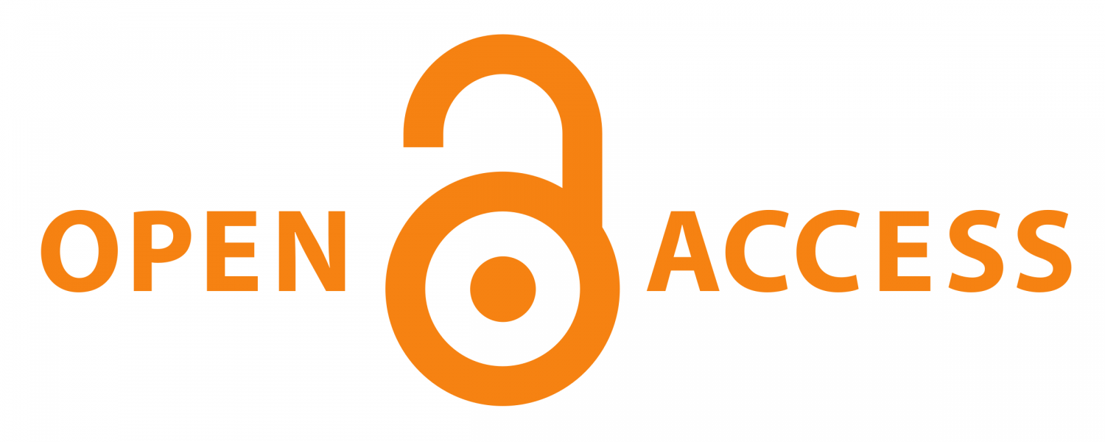
FINDING THE BALANCE:
Creating an Open, Sustainable Future for OU
Notes:
Darren Purcell
This presentation summarizes key points from the report Finding the Balance: Creating an Open, Sustainable Future for OU. The report is a product of the Scholarly Communication Task Force, appointed by the University Libraries Committee. Our presentation communicates key actions and best practices OU scholars can take to have the most positive impact upon the creation of an open and sustainable system of scholarly communication.

Slide 2
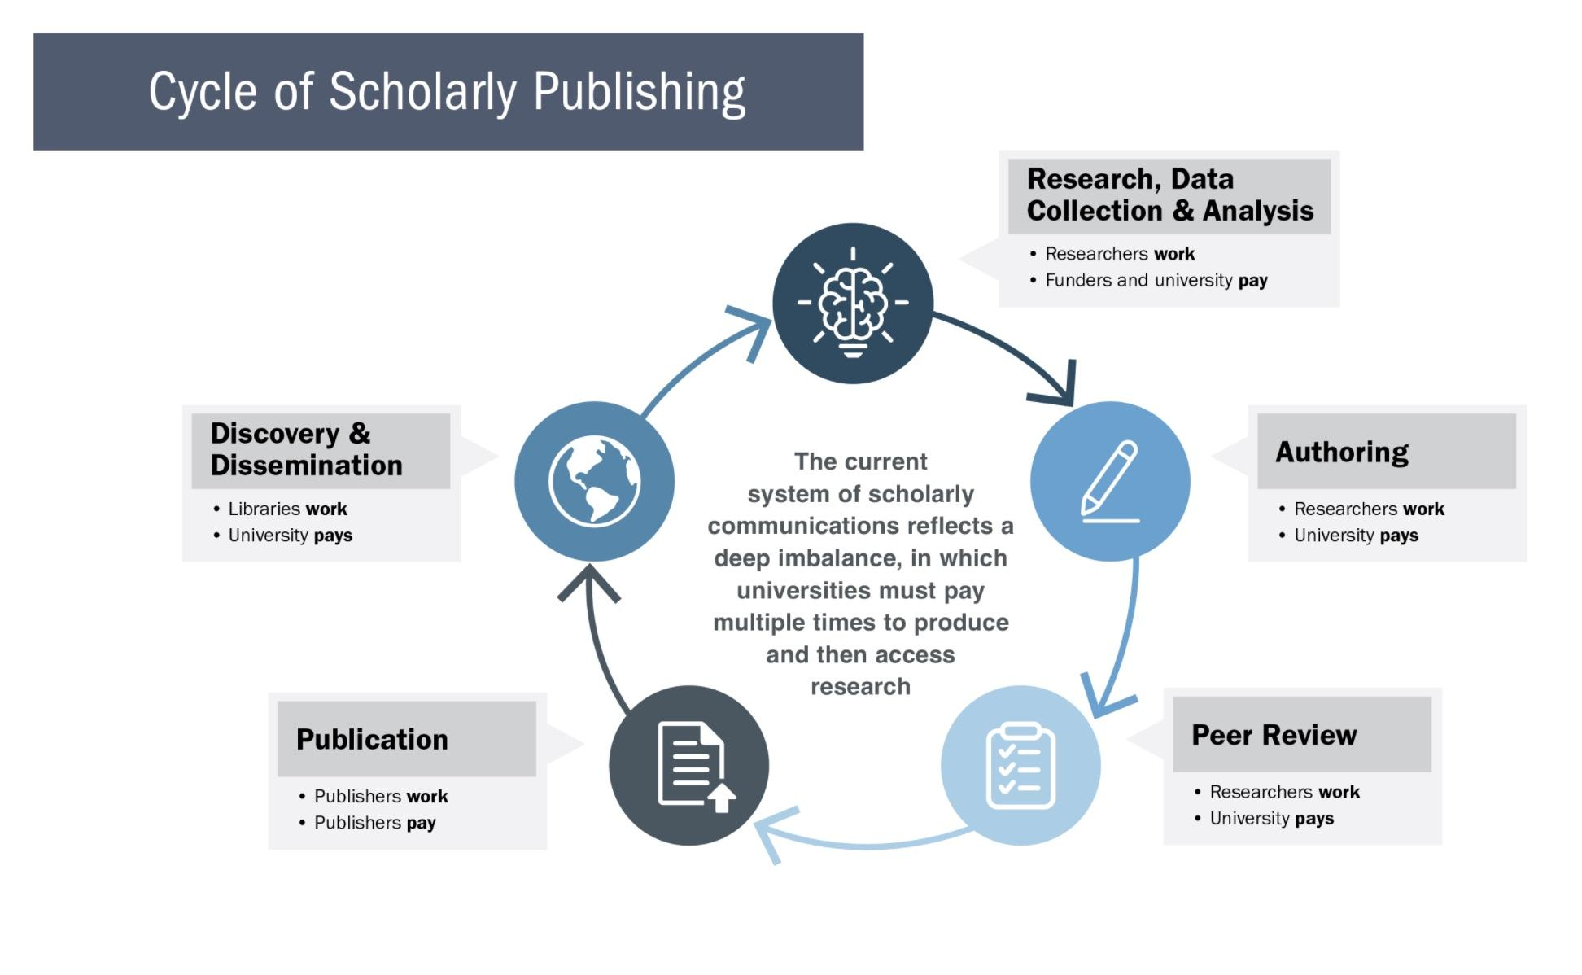
Source: Toler, L. (2020) Scholarly publishing at the tipping point. UNC Libraries. DOI: https://library.unc.edu/2020/02/scholarly-publishing-at-the-tipping-point/
Notes:
Darren Purcell
We’re starting out by illustrating and reminding you of what you already know – the cycle of scholarly publishing – which involves funders, researchers and authors, peer reviewers, publishers, editors, and universities – including university libraries.
But this doesn’t simply illustrate the cycle in which we all participate. It also illustrates the imbalance in the system. If you take a closer look, you’ll see that the system is heavily supported by individual authors, funders, institutions, and libraries who either pay or provide their labor – often more than once – so that the publishers can do their work.

Slide 3
Stakeholder Interests in Scholarly Publishing
Disciplinary Communities & Funding Agencies
Universities & University Libraries
Traditional Publishers
Scholars
Maximize dissemination of work
Maximize discovery of work
Maximize recognition/impact of work
Maximize access to scholarly content
Enhance institutional reputation
Responsibility to serve state and national stakeholders
Maximize public access to work
Maximize recognition/impact of work
Enhance visibility for justifying future budgets
Maximize profit margin
Control accessibility to work
Control copyright
Notes:
Darren Purcell
We’ve highlighted these various interests here with different detail. Scholars are interested in disseminating their work so that it can be discovered, read, and cited. Ultimately, they want maximum recognition or impact for their work.
Universities and libraries want to provide the most access to their researchers’ outputs in order to enhance their institutional reputation and to serve the public.
Scholarly societies and funding agencies have similar goals – they also want to maximize public access, and they often want this so that they can justify future budgets.
Again, we can see that the motivations and interests for traditional publishers are different from those of the other stakeholders. Traditional publishers want to maximize their profits, and often have an imperative to do so, since they answer to their shareholders. Publishers, therefore, control accessibility to works via subscriptions and ownership of copyright.

Slide 4
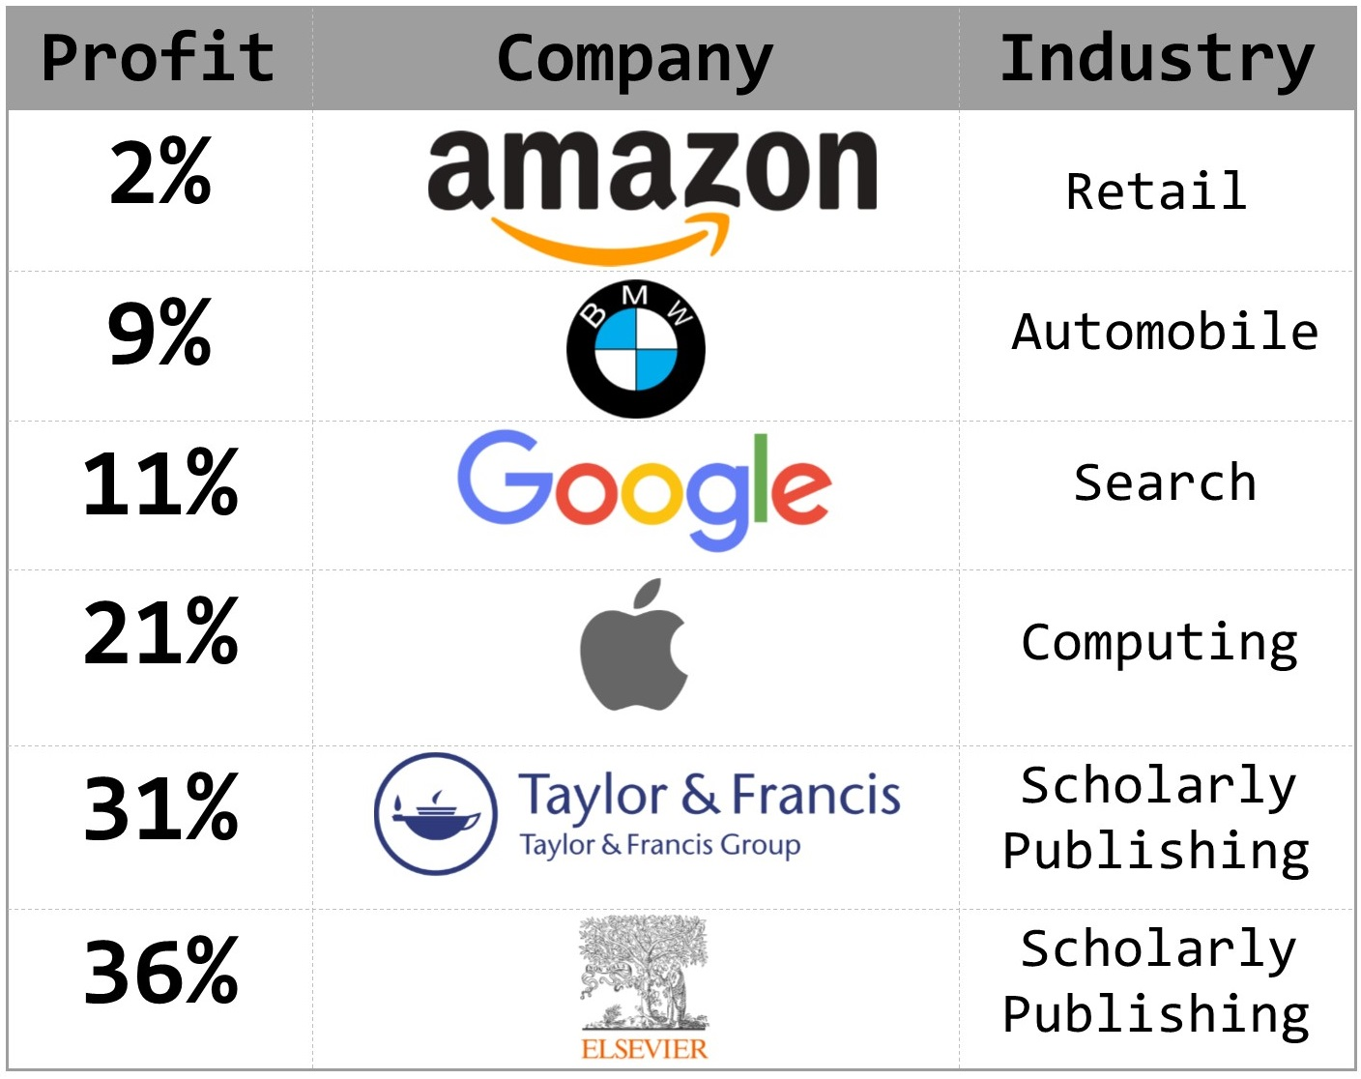
ECONOMICS OF PUBLISHING
Source: Duke University Libraries, Library 101 Toolkit, Scale of Scholarly Publishing
DOI: https://sites.duke.edu/library101_instructors/2018/08/28/scale-of-scholarly-publishing/
Notes:
Darren Purcell
And we can see that some of these publishers are making profits that rival the most successful tech companies. A 2018 presentation from the University of Virginia Library put commercial publisher profits in line with or higher than those of tech companies, banks, and pharmaceutical firms.
By way of contrast, according to the NYU Stern database of more than 7,000 US companies, the average profit margin across all firms in 2019 was 7.9%.

Slide 5
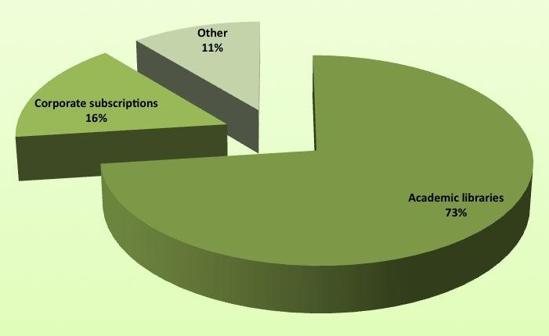
SOURCES OF THE ~$8 BILLION SCHOLARLY JOURNAL REVENUE
Source: Morrison, H. (2013) Economics of scholarly communication in transition. First Monday. Volume 18, Number 6 – 3. DOI: https://doi.org/10.5210/fm.v18i6.4370
Notes:
Darren Purcell
Universities employing the authors and editors of journal content then buy it back through their own libraries, at a considerable markup, so that faculty and graduate students can have access to their own work. Overwhelmingly, academic libraries are the major purchasers of scholarly journal content.

Slide 6
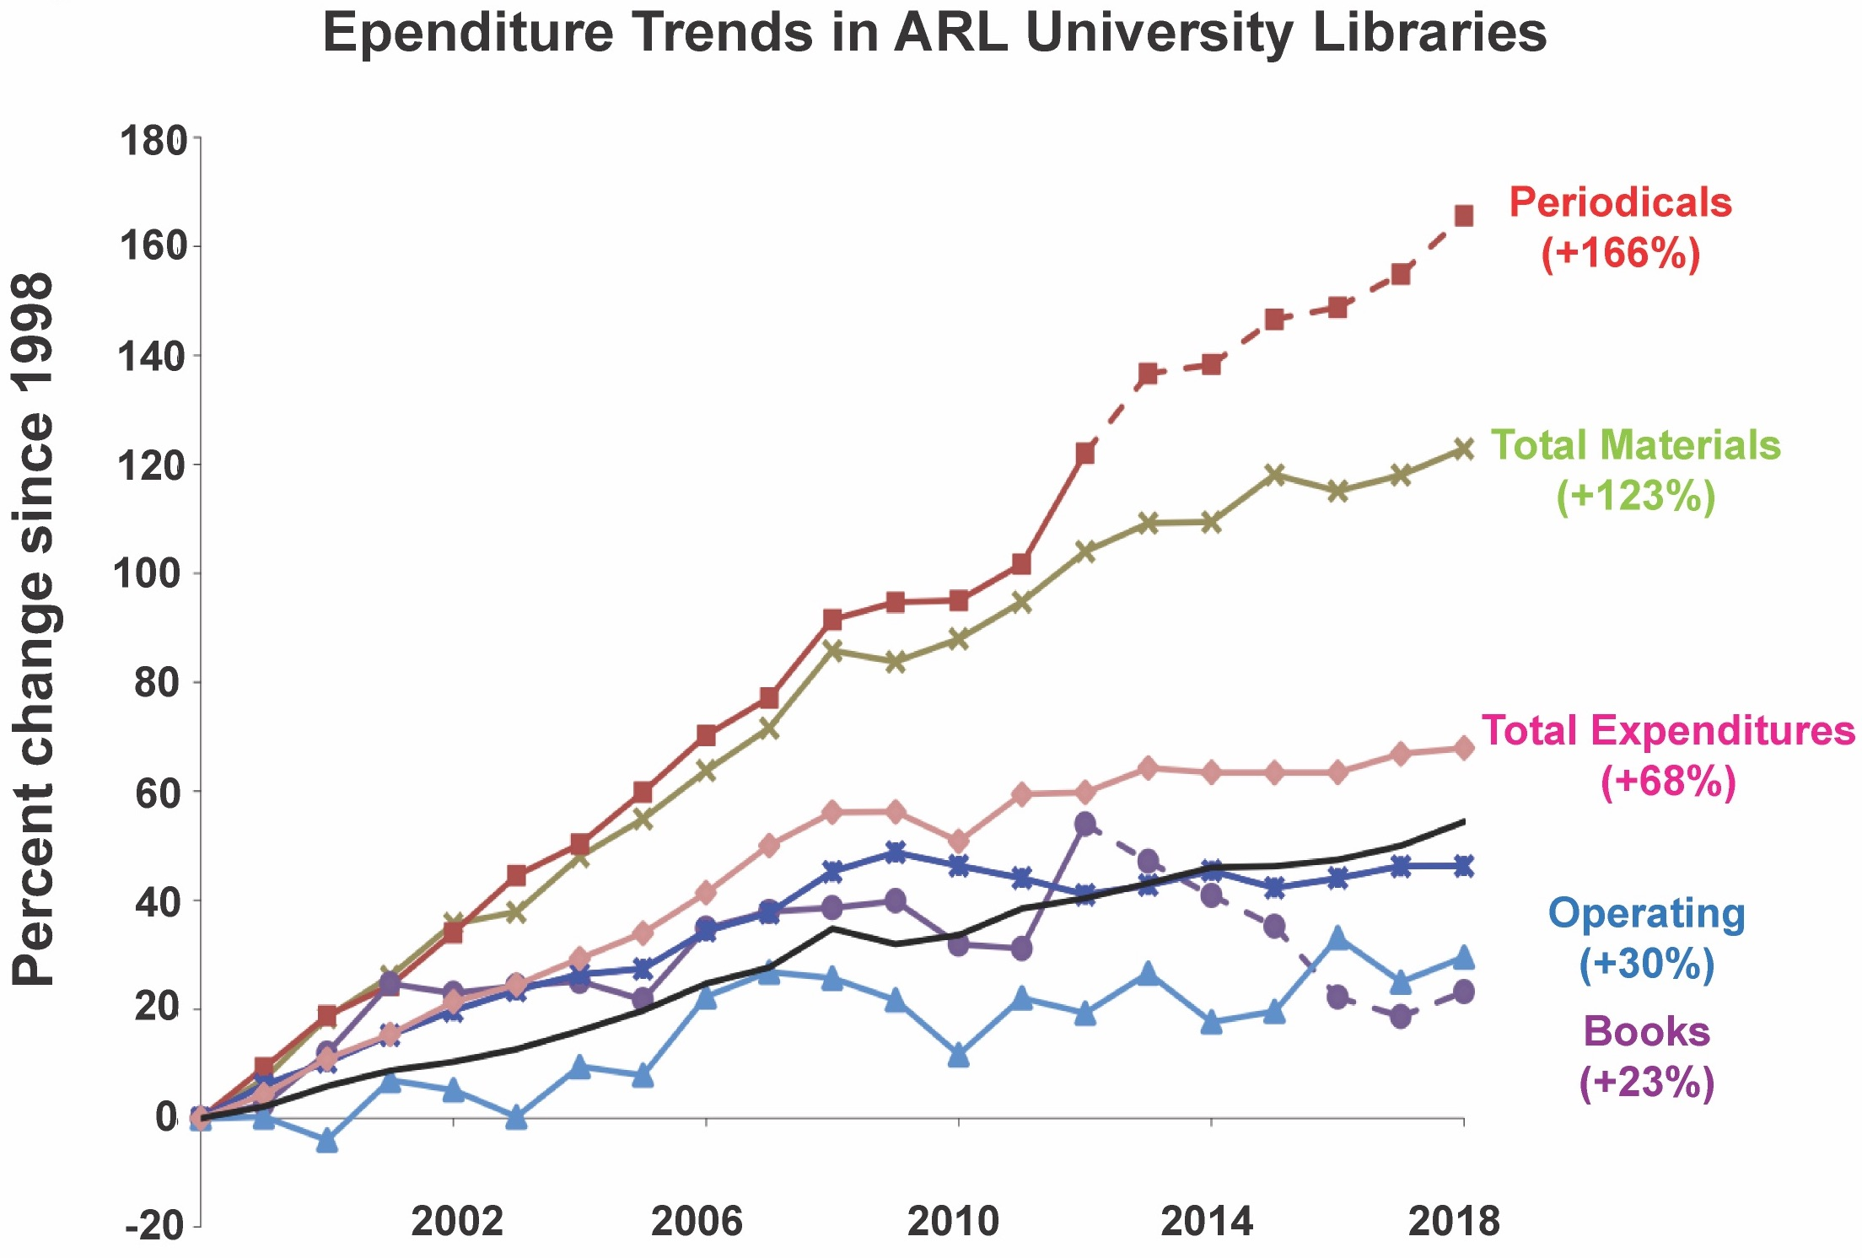
Expenditure Trends in Association of Research Libraries (ARL) Libraries
ECONOMICS OF PUBLISHING
Source: ARL Statistics 2017-18 Association of Research Libraries, Washington, D.C.
Notes:
Lee Fithian
Academic libraries being the major purchasers of scholarly journal content is problematic for a number of reasons. The first reason is library’ budgets.
This chart from the Association of Research Libraries demonstrates that in a twenty-year period there have been increases across the board in academic library costs, but none so marked as periodicals, a.k.a. journal subscriptions. These increased 166% over the 1998 costs. Monograph purchases are up 23% over the same period, but have declined from a peak in 2012.
OU’s data displays a clear increase in the proportion devoted to serials from 2010-2018, and a concomitant decline in monograph purchases. The costs of database access increased slightly.

Slide 7
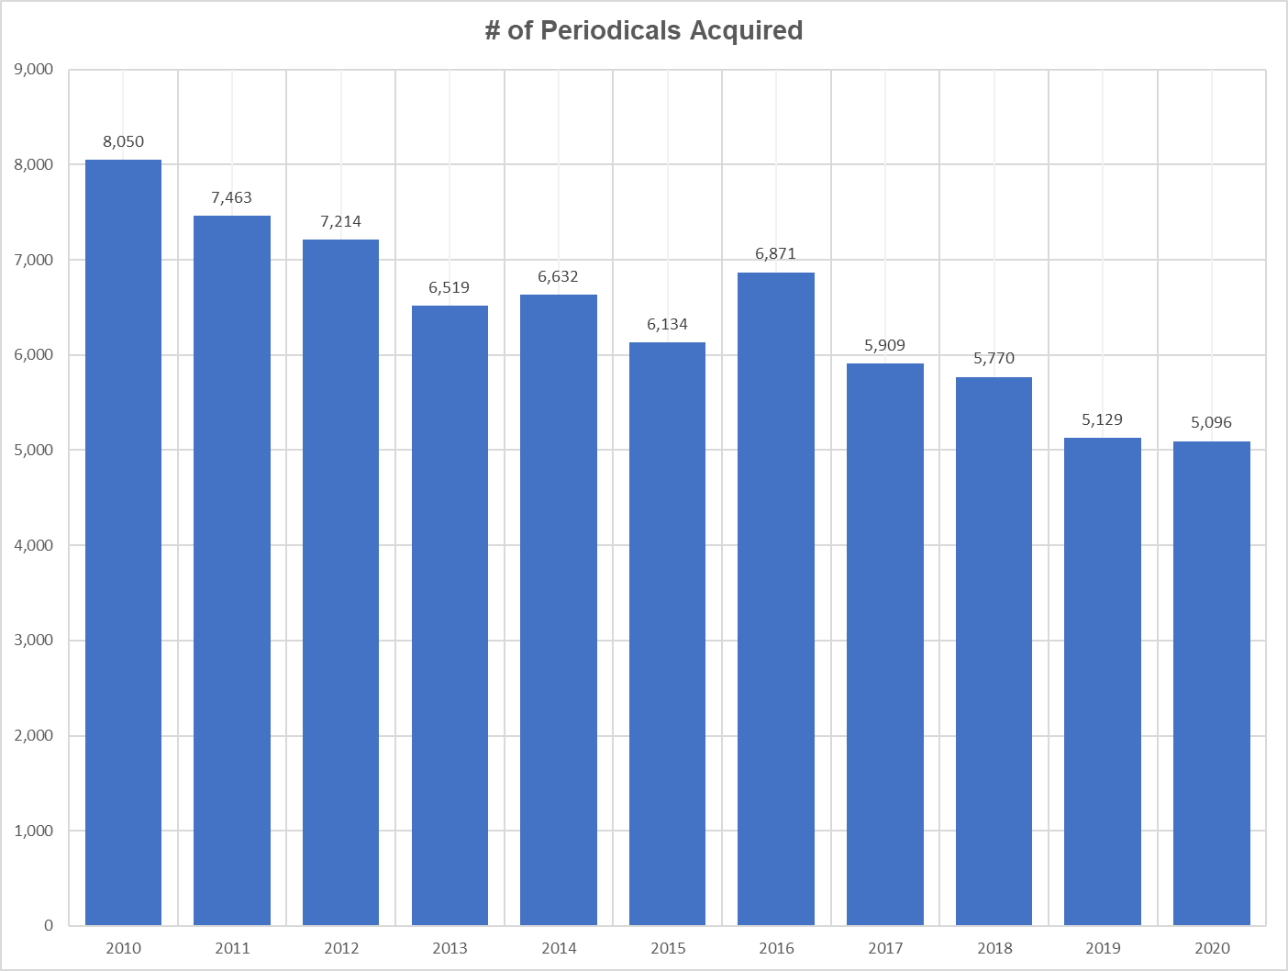
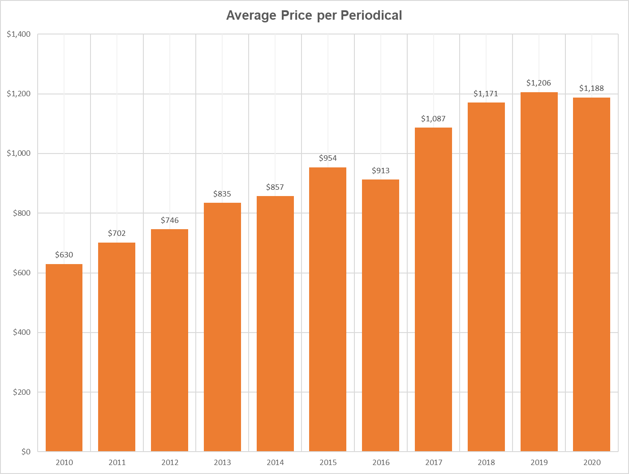
Escalating Costs at OU - Periodicals
Notes:
Lee Fithian
Despite withdrawing from several comprehensive subscription packages, the larger issue is that OU’s library budget has remained largely flat or has seen declines. This included a one-million-dollar permanent reduction across FY19 and FY20. As you’re all aware, the impacts of these costs include hard choices about what resources OU is able to subscribe to. And cuts to resources negatively impact the access to information that you and and your students need to remain competitive.
These graphs clearly show that as the average price per journal has increased, the number of journals OU Libraries are able to subscribe to has decreased.

Slide 8
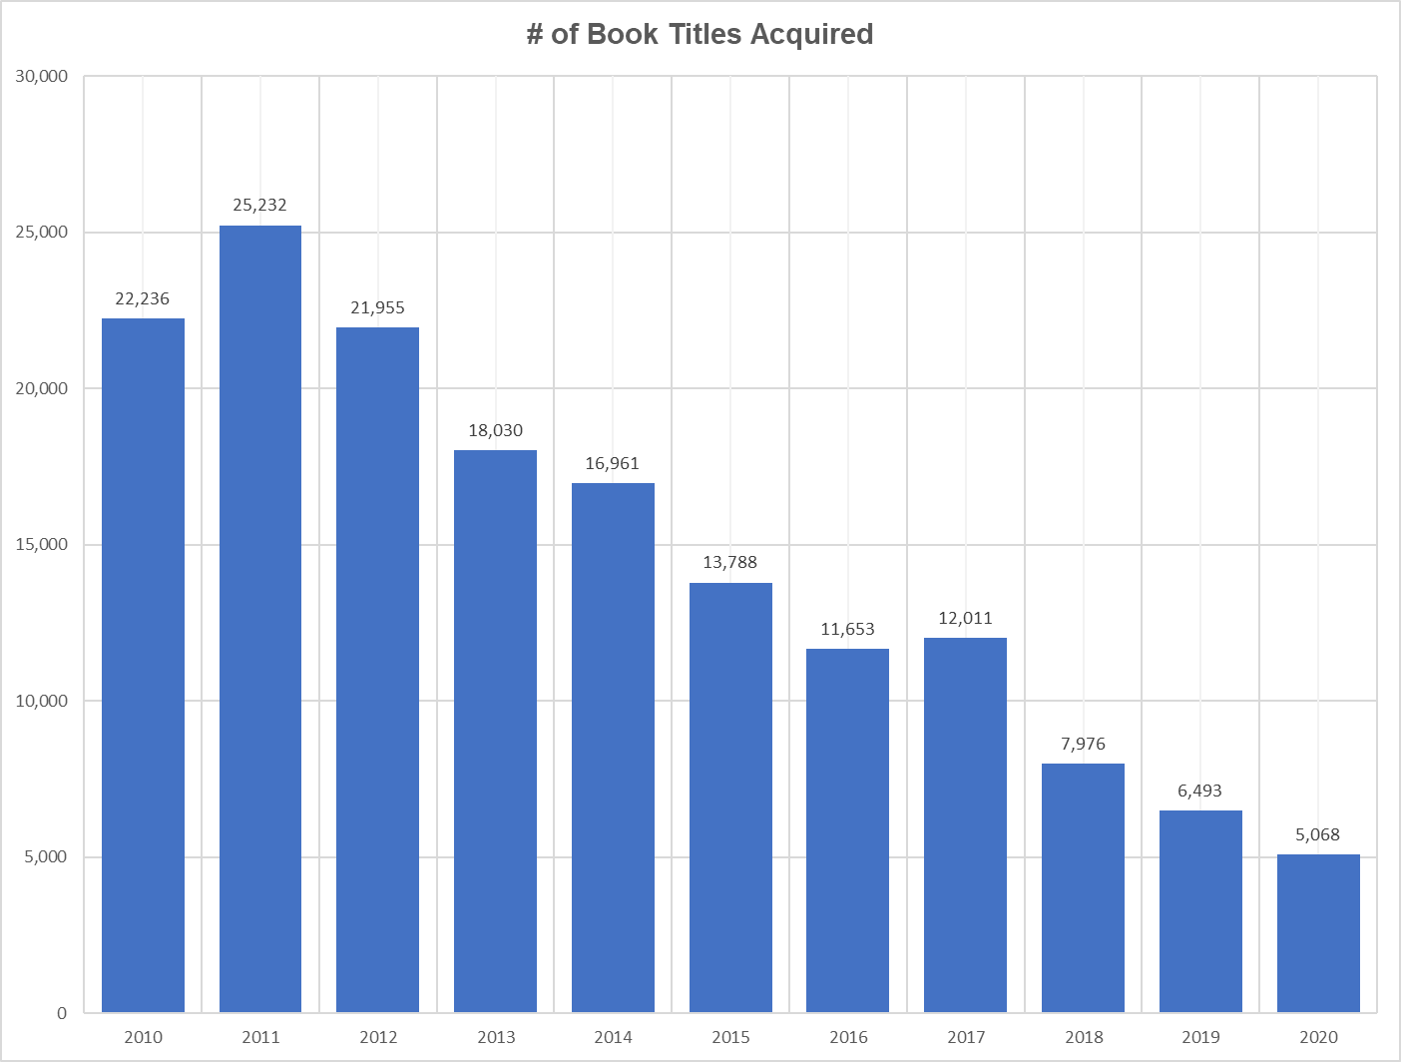
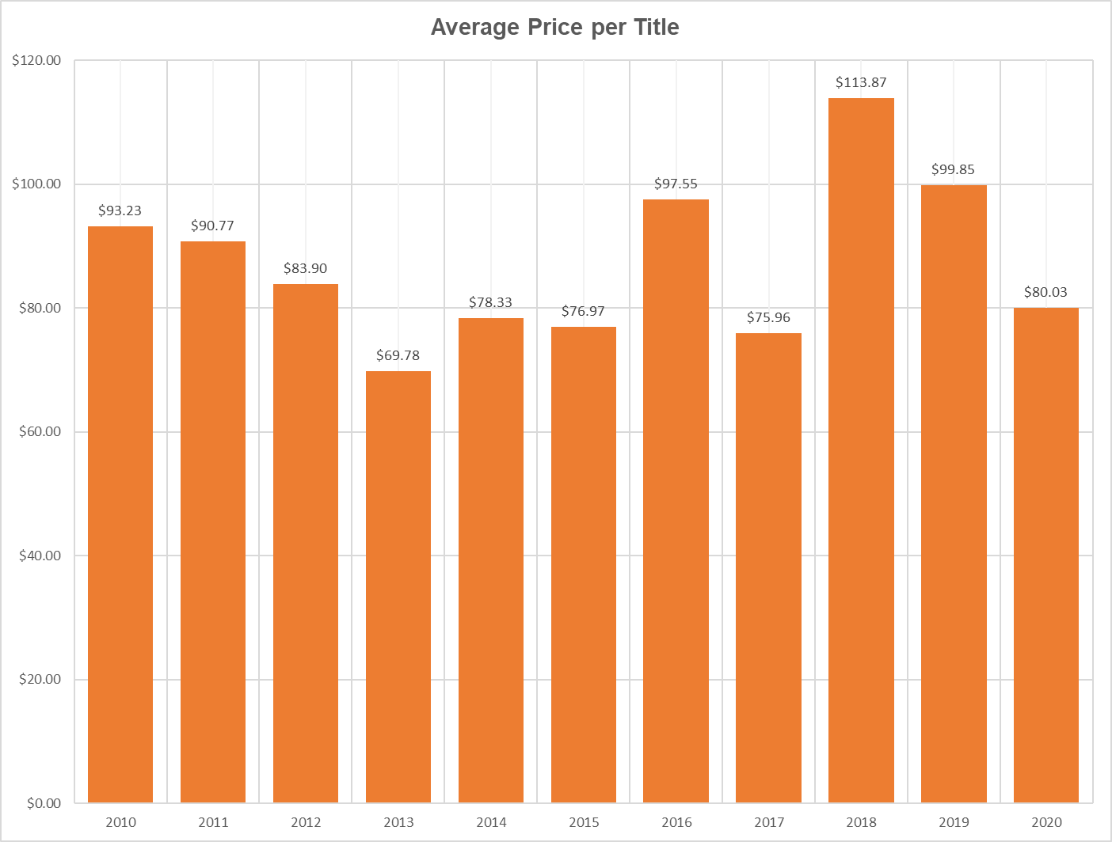
Escalating Costs at OU - Books
Notes:
Lee Fithian
To a lesser extent, this has occurred with book purchases as well. But in this case, book purchases have primarily declined as a result of the increase in journal subscription costs.

Slide 9
OPEN ACCESS
Open Access is the free, immediate, online availability of research articles coupled with the rights to use those articles fully in a digital environment.
Notes:
Caroline Schroeder
The Scholarly Communication Taskforce report makes ten recommendations, but the taskforce believes that understanding and taking action on our open access options is one of the most valuable actions the OU community can take.
Open access is the free, immediate, online availability of research articles coupled with the rights to use those articles fully in a digital environment. Over the past decade, open access has become central to advancing the interests of researchers, scholars, students, businesses, and the public.

Slide 10
FACILITATING OA
Managing your rights as an author
Notes:
Caroline Schroeder
There are four primary ways to facilitate Open Access, and we will cover all of them in the next several slides.
The first way to facilitate open access is to manage your rights as an author.

Slide 11
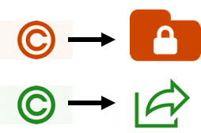
MANAGEMENT OF AUTHOR RIGHTS
Traditional journals require authors to transfer their copyrights to the publisher, which can limit dissemination and impact of a scholar’s work.
Negotiating your rights or publishing in OA journals allows authors to retain their copyrights.
When authors retain their copyrights they have more control over where and how their work gets disseminated.
Notes:
Caroline Schroeder
Traditional journals require authors to transfer their copyrights to the publisher, which limits dissemination and impact of a scholar’s work. When authors retain their copyright, they have maximum freedom and flexibility to share their work in any way they choose.
OU Libraries offers services to ensure that authors understand publishing agreements, which is where these copyright transfers take place. The Office of Open Initiatives and Scholarly Communication assists OU authors in publishing with modified contracts that maximize the retention of copyright, as many journals are willing to license back to authors the right to share their own work.
Publishing in open access journals generally allows authors to retain their copyrights.

Slide 12
FACILITATING OA
Managing your rights as an author
Choosing open access publishing
Notes:
Mike Bemben
The second mechanism to facilitate open access is via open access publishing.

Slide 13
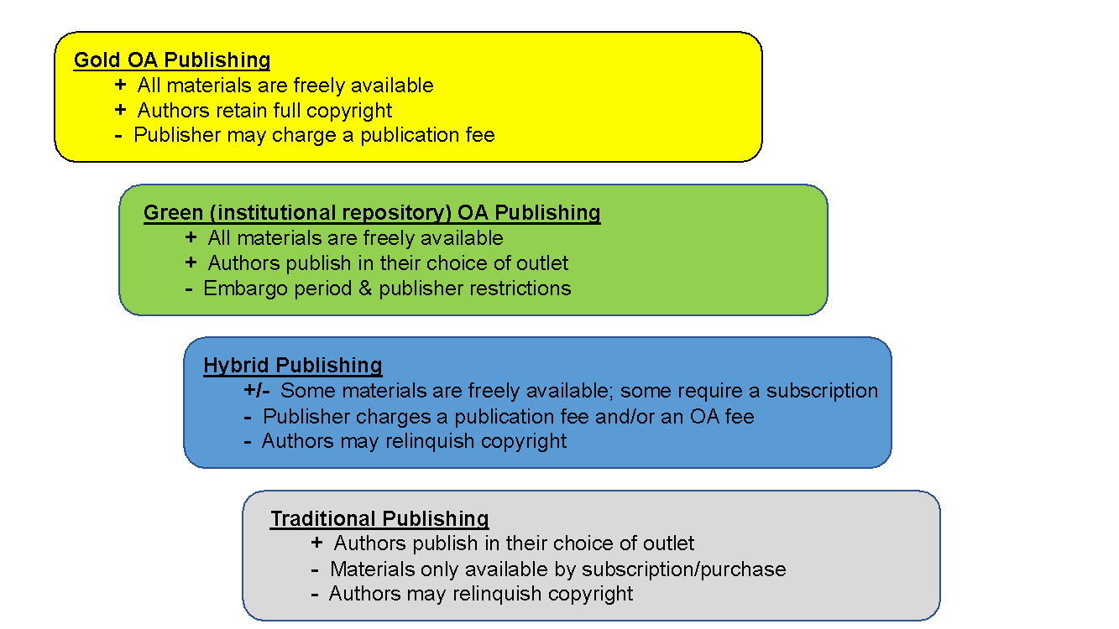
OPEN ACCESS PUBLISHING
Notes:
Mike Bemben
In traditional publishing you publish in your choice of journal, you transfer your copyright, and the articles in the journal are only available to those with a subscription. In addition to subscription fees, authors or their institutions often pay page charges or figure charges to publish in these journals. This is not an open access publishing option, and it is shown here in the gray box only as a departure point with which you are all familiar.
Traditional publishers have begun offering a hybrid publishing model in which, in any given journal issue, some of the articles are freely available, and some articles require a subscription. In order to make individual articles available, publishers levy an article processing charge or “APC” on individual authors. There are still problems with hybrid publishing, as the cost of APCs are rising at triple the rate of inflation, and universities find themselves paying for content twice – once in the form of the APC and then again for the journal subscription itself. So while individual articles can be made open access, this is not a sustainable model for existing library or institutional budgets.
In Green Open Access, authors publish in their choice of outlet and also deposit a version of their article in an institutional or disciplinary repository, which we will cover in a moment.
Finally, complete access to all journal content is considered “gold” open access. Generally authors retain their full copyrights, and the contents of the journal are free for anyone to read. Some gold open access journals collect article processing charges, because publishing isn’t free. However, 70% of gold open access journals do not collect an APC from their authors. Their publishing costs are covered using other means. And all gold open access journals utilize peer review.

Slide 14
FACILITATING OA
Managing your rights as an author
Choosing open access publishing
Submitting work to institutional or disciplinary repositories
Notes:
Katherine Pandora
The third mechanism for facilitating open access is through an institutional or disciplinary repository

Slide 15
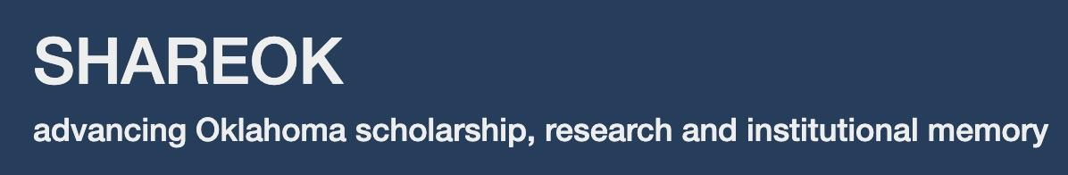


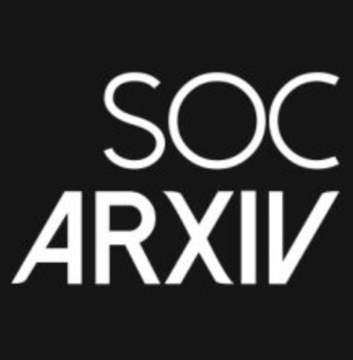

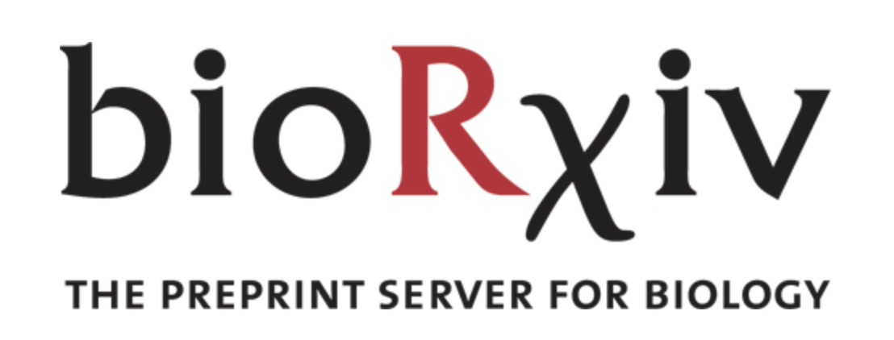
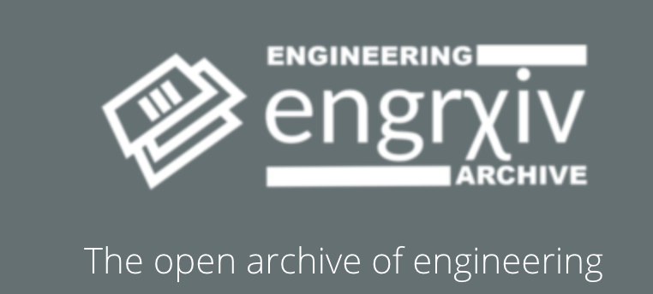


Institutional/Disciplinary Repositories
Notes:
Katherine Pandora
Submitting to an institutional repository is called “green open access,” and – as just mentioned – it is when authors publish in the journal of their choice and deposit a version of their article in an institutional repository, such as OU’s SHAREOK, or a disciplinary repository. Repositories allow readers to freely access articles without the requirement of a subscription. We used to think this access was only important for scholars in low- and middle- income countries, but as library funding is reduced we see scholars in the United States who no longer have subscription access.
Institutional repositories provide access to manuscripts, articles, theses, dissertations, and datasets, among other forms of scholarship. OU scholars depositing their items in SHAREOK also benefit from increased discoverability of their work, because SHAREOK is indexed by major search engines and harvesting efforts.
Certain caveats about repositories should be noted. First, embargoes placed by traditional publishers can mean delays of a year or more before articles can be accessed from a repository. Publishers often allow authors to upload postprints, which is the final submitted manuscript after all peer review has taken place, or preprints – the final draft before peer review – thus achieving the goal of wider dissemination. There are tools to help authors determine which version they can upload, and OU Libraries Office of Open Initiatives and Scholarly Communication can assist, as well.

Slide 16
FACILITATING OA
Managing your rights as an author
Choosing open access publishing
Submitting work to institutional or disciplinary repositories
Creating and instituting open access policies and resolutions
Notes:
J.P. Masly
The fourth mechanism to facilitate open access is by creating and instituting an open access policy.

Slide 17

OPEN ACCESS POLICIES
Notes:
J.P. Masly
Open access policies are most often passed by a vote in faculty senate. These policies provide frameworks for the open dissemination of research, most often through the campus institutional repository, like SHAREOK.
In an open access policy, authors grant permission, or a license, to the institution to upload their articles before they transfer rights to the publishers. Such policies are not monolithic, and every policy the taskforce studied provided an opt-out mechanism for papers in specific circumstances.
Why do we recommend that OU Faculty Senate consider a policy?
Structural changes in academia have impacted the dissemination of scholarly outputs and the manner in which knowledge is shared. These changes have had different impacts on various disciplines. Institutional open access policies can support a common expectation of maximizing public exposure and the impact of faculty and graduate student research.

Slide 18
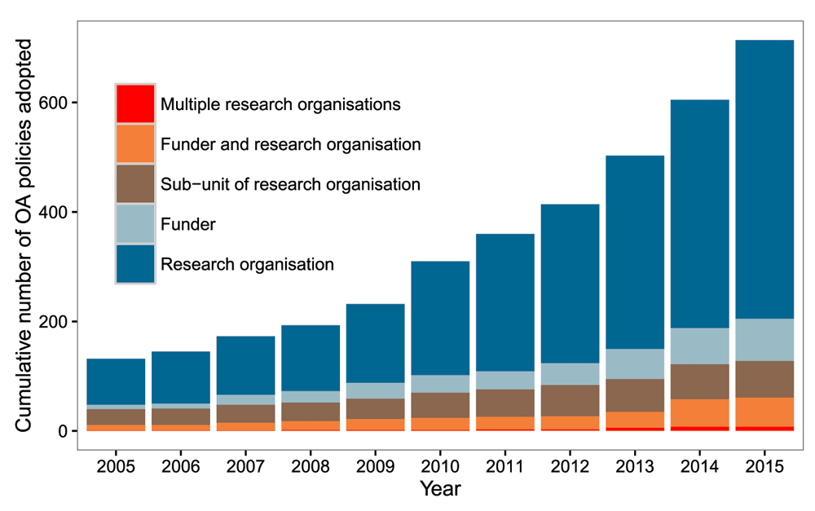

Cumulative number of OA policies adopted by stakeholder groups
Research Organization
Funder
Sub-unit of Research Organization
Funder and Research Organization
Multiple Research Organizations
Source: Tennant JP, Waldner F, Jacques DC et al. The academic, economic and societal impacts of Open Access: an evidence-based review [version 3]. F1000Research 2016, 5:632 (doi: 10.12688/f1000research.8460.3)
Notes:
J.P. Masly
This graph shows that the cumulative number of institutional open access policies has steadily grown since 2005. “Research organization” is generally an academic institution, but it can also mean a research institute associated with an academic institution or a unit, such as a department or college, in an academic institution. Academic institutions are continuing to pass open access policies today, although the majority of them were passed in 2015. Over 900 academic institutions internationally have implemented an open access policy that support making open access to research articles the default mode for their faculty and students.

Slide 19
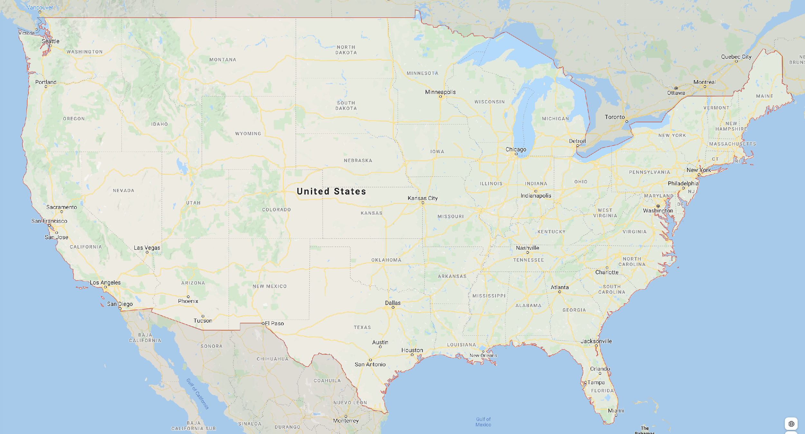




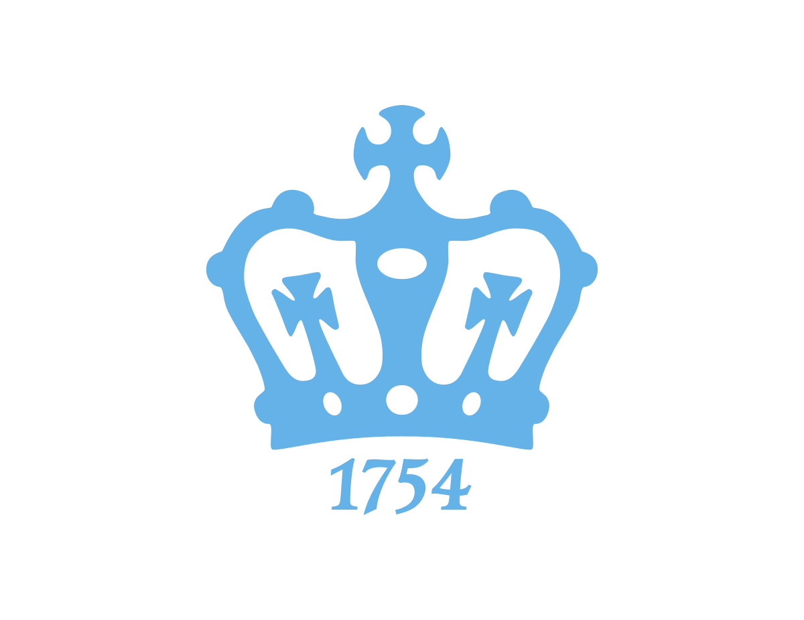




















U.S. Academic Institutions with OA policies
Notes:
J.P. Masly
And this slide zeroes in a bit more. At least 111 academic institutions in the US, including some of our peers and aspirational institutions, have passed open access policies.

Slide 20
OPEN ACCESS POLICIES MAXIMIZE BENEFITS TO SCHOLARS, UNIVERSITIES, AND DISCIPLINARY COMMUNITIES/FUNDERS
Notes:
Claude Miller
The taskforce spent much of its time studying to familiarize itself with the open access landscape. And the literature clearly demonstrates how open access has numerous positive impacts for researchers, universities, disciplinary communities, and funders.

Slide 21
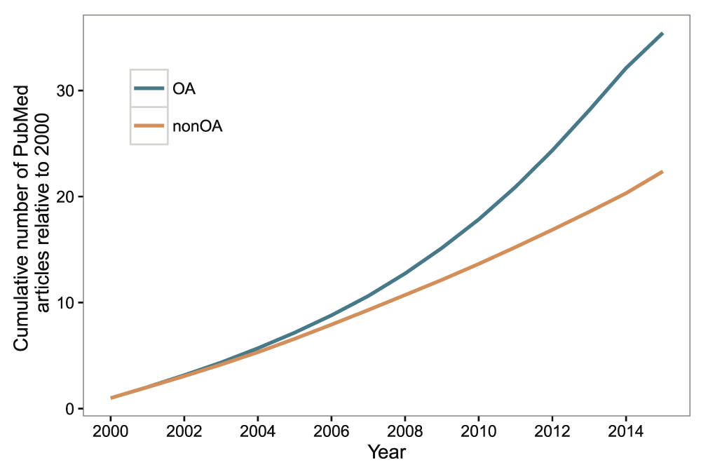
Advantages of Open Access: Increased visibility
Source: Tennant JP, Waldner F, Jacques DC et al. The academic, economic and societal impacts of Open Access: an evidence-based review [version 3]. F1000Research 2016, 5:632 (doi: 10.12688/f1000research.8460.3)
Notes:
Claude Miller
For one thing, publishing open access – whether in a repository, in a gold open access journal, or using hybrid publishing – leads to increased visibility.
Simply put, when your work is openly available, more people can find it.

Slide 22
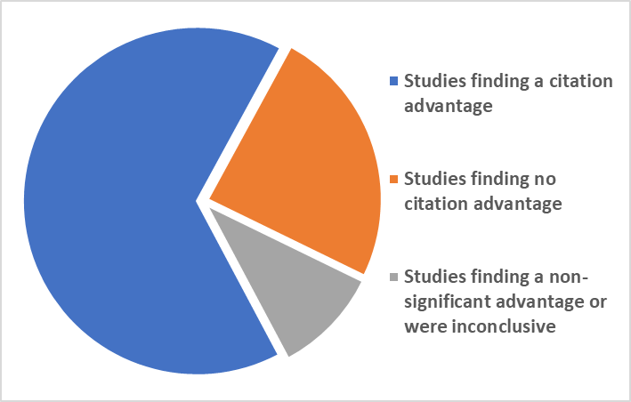
Advantages of Open Access: Increased article citations
Modified from: Tennant JP, Waldner F, Jacques DC et al. The academic, economic and societal impacts of Open Access: an evidence-based review [version 3]. F1000Research 2016, 5:632 (doi: 10.12688/f1000research.8460.3)
Notes:
Claude Miller
Moreover, citation rates are higher for open access articles than for those behind a paywall – which makes good sense – if more people are able to discover and access your article, more people are able to use it and cite it.
This benefit has been demonstrated in research articles across disciplines and in the data found in review articles, such as the one shown here. Additionally, studies have found that making articles open access often leads to greater attention on social media platforms, and greater visibility for authors.
Increased access also addresses concerns about equity in the availability of our research. Remember, one of the benefits of open access is that anyone can discover, read, share, and cite your work regardless of whether or not they are affiliated with an academic institution.

Slide 23

Notes:
Claude Miller
When we refer to equity in access, we’d like you to consider not only who will be able to find and read materials online, but also who will be able to build off of openly available content, and publish their work via open access
Supporting open access also helps to promote OU’s goals in Diversity, Equity, and Inclusion. Open access publishing, such as the open access journals hosted by OU Libraries, allows more voices to be heard – especially voices that have been historically marginalized or under-represented.
Equity in access translates to promotion and tenure considerations as well. By decoupling authors’ impacts from the journals in which they publish, and instead focusing on the merits of contributions at the author or article levels, we can help ensure scholars from traditionally underrepresented communities can publish where their work will make the most impact for those communities, rather than in journals that may not represent them.

Slide 24
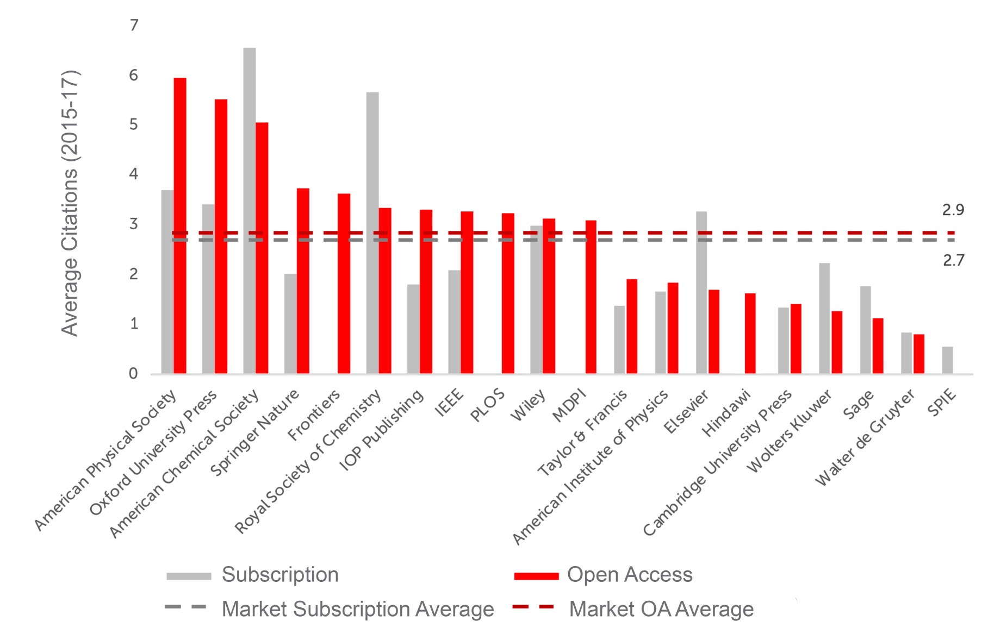
Advantages of OA: Increased article citations
Source: Curno, M. and S. Oeben. (2018) Scientific Excellence at Scale: Open Access journals have a clear citation advantage over subscription journals. Frontiers Announcements, Open Science and Peer Review, Open Science Policy. DOI: https://blog.frontiersin.org/2018/07/11/scientific-excellence-at-scale-open-access-journals-have-a-clear-citation-advantage-over-subscription-journals/
Notes:
Claude Miller
And even traditional, commercial journals have discovered that open access increases their authors’ citation rates. While this study included gold open access publishers such as Frontiers, PLOS, and MDPI (those without a gray bar in this graph), it primarily focused on traditional publishers that now do hybrid publishing. In fact, most of these publishers tout the benefits of open access on their websites.

Slide 25
Benefits of Open Access
For Faculty/Graduate Students
For the University of Oklahoma
Research/creative activity reaches a broader audience, which benefits scholars, funders, policy makers, general public, etc.
Work is made available more rapidly than traditional publishing
Increased citations; Increased impact
Multiple types of scholarly products can be made freely available
    Computer code/software, images, datasets, etc.
Stimulates the pace of research/creative activity, as ideas and results are more rapidly disseminated
Potentially lower publishing costs – external funds are spent more on scholarship versus publication
Private sector has access to the most recent research results, which increases partnership opportunities and stimulates development
Increased visibility of scholarly activity increases institutional prestige
Notes:
Darren Purcell
We’ve listed just some of the benefits of open access here, and we also recognize there are different benefits for different stakeholders.
Some of those benefits for faculty and graduate students include:
Reaching a broader audience
Work being made available more rapidly
An increase in citations
Some of those benefits for OU include:
Stimulating the pace of research and creative activity, since results are more rapidly disseminated
Providing the private sector with access to the most recent research results, which could increase partnership opportunities and stimulate development
An increase in prestige that results from an increase in the visibility of OU’s scholarly activity

Slide 26
FOR MORE INFORMATION, INCLUDING THE FULL REPORT, VISIT
https://bit.ly/SCTFReport OR CONTACT A TASKFORCE MEMBER:
Michael Bemben (Health & Exercise Science)
Lee Fithian (Architecture)
Raphael Folsom (History)
J.P. Masly (Biology)
Claude Miller (Communication)
Katherine Pandora (History of Science)
Darren Purcell (Geography & Environmental Sustainability)
Caroline T. Schroeder (Classics & Letters)
Karen Rupp-Serrano (University Libraries, ex officio)
Jen Waller (University Libraries, ex officio)
Notes:
Darren Purcell
While many disciplines have already embraced open access due to policy changes in funding agencies and recognition of its advantages, the Taskforce recognizes there remain concerns that will need to be addressed. Namely, the differences among various disciplines and concerns over the role of open access in annual faculty evaluations as well as the tenure and promotion process. These concerns tend to center on the impacts of choosing open access outlets that lack specific metrics but, in fact, may be allowing authors to reach audiences more effectively. We address these concerns – and more – in the full report, and we’ve also created a list of recommendations based on our year-long study of this issue and based on the experiences of other academic institutions. We hope you will take the time to read the full report so that OU stakeholders can better contribute their knowledge and be better stewards of our resources – both intellectual and monetary.
We’d like to invite questions now, and we’ll do our best to answer them. We are also creating a FAQ section on the taskforce website, and any of the taskforce members listed here are happy to answer questions as well.

Slide 27
Licensing & Attribution
Unless otherwise specified, this slide deck is licensed CC BY 4.0
Please note the following exceptions and clarifications:
Cycle of Scholarly Publishing (slide 2) © UNC University Libraries
Economics of Publishing (slide 4) © Duke University Libraries licensed CC BY-NC
Sources of Scholarly Journal Revenue (slide 5) © Heather Morrison licensed CC BY-NC-SA
Expenditure Trends (slide 6) © Association of Research Libraries
Cumulative number of OA policies (slide 18) © Tennant, et al. licensed CC-BY
Advantages of Open Access (slide 21) © Tennant, et al. licensed CC-BY
Diversity image (slide 23) from Pixabay, free for use without attribution
Advantages of OA (slide 24) © Frontiers

