Slide 1



Synergistic Opportunities for
Computational Resource Providers
and
Local IT

Slide 2
A.K.A…
“Can’t we all just
get along?”

Slide 3

Relationship Perceptions
Historically, IT organizations perceive their relationship with research as “Give” and “Take”*...
  IT is asked to “Give”
  Research tends to “Take”
  *Your mileage may vary
OU Supercomputing Symposium 2014
3

Slide 4

Relationship Perceptions (cont)
Research organizations perceive their relationship with IT as a mission-oriented “consumer” of services…
  “Central IT should provide!”
“What about the mission?”
  “Doesn’t my grant cover that?”*
  *Current OU Indirect Cost (IDC) rate for grant funding is 52%…
OU Supercomputing Symposium 2014
4

Slide 5

Breaking Perceptions
Get them excited!!!
Sell “opportunities”:
  “Hands-on” with leading-edge technologies!
    Software Defined Networking
    Circuit Services and Fabric Technologies
    IPv6 (you haven’t deployed that yet?!)
  Try out other vendors… (Dell/Juniper/Cisco/etc.)
  Put new protocols and software in place for a NON-PRODUCTION environment.
  Stress-test your production tools at high-capacity.
OU Supercomputing Symposium 2014
5

Slide 6

Breaking Perceptions (cont)
Make them a stakeholder in your success!
Engage early on grants:
  Run your idea by them…
    “I want a solar powered Rasberry Pi cluster in a remote cow pasture for processing weather data. How can I connect it to the Internet?”
  Keep them engaged!
    “Dell says I need 1.12GW of power. We have that in the datacenter, right?”
  Make them part of the grant writing process…
  Use their time as part of “institutional commitment”.
OU Supercomputing Symposium 2014
6

Slide 7

Breaking Perceptions (cont)
Pride in ownership…
Make them part of new deployments :
  Schedule deployments, and extend invitations.
  Be open to their ideas!
    They are experts in their field. We are experts in ours. Together we can build something great.
  Find their thought leaders and exploit them!
  You can lead a horse to water, but you can’t make it drink…
    Some organizations are simply not structured to handle “non-standard opportunities”.
OU Supercomputing Symposium 2014
7

Slide 8
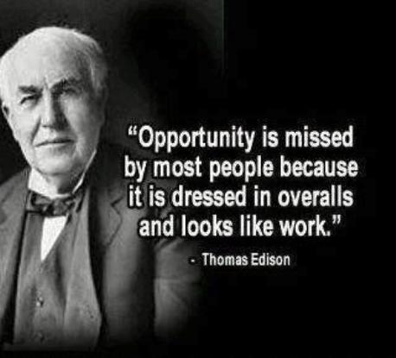
Existing Deployments
But Zane, I already have my compute resources deployed!
Never fear!
Opportunity still abounds…
OU Supercomputing Symposium 2014
8

Slide 9
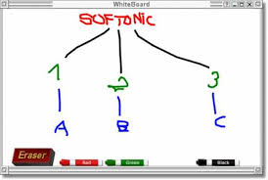
Existing Deployments (cont)
  You don’t know what you don’t know…
  Steps to follow to discover synergies:
  Bring IT to the table.
  Describe your deployment.
  Have IT describe capabilities.
  Look for overlap…
  Use those as opportunities!
OU Supercomputing Symposium 2014
9

Slide 10
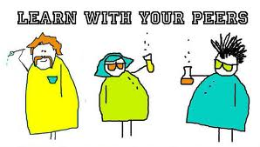
Existing Deployments (cont)
  Reach out to your peers…
  Chances are, if you are facing a problem, someone else has faced the same and discovered a solution…
  Get to know your peers.
  Ask for help when needed.
  Give help where you can:
    Involve local IT as problem solvers!
    Use this to build “relationship currency”.
OU Supercomputing Symposium 2014
10

Slide 11

Existing Deployments (cont)
  Weigh risk/rewards and “level of effort”!
  IT may identify an opportunity! Now what???
  What is the “value” of the opportunity?
  What is the impact of making the change?
  Is the impact worth the effort?
    Don’t make changes for the sake of making changes.
    Look for “immeasurable” rewards (e.g. future grant opportunities)
OU Supercomputing Symposium 2014
11

Slide 12

If you got ‘em, ask ‘em!

Slide 13

The End

