Slide 1
Understanding the Virtue-Relevant Self through Courage
Cynthia Pury, Charles Starkey, & Emily Sullivan
Clemson University

Slide 2
Overview
  Do differences in who we are predict differences in courage?

Slide 3

Who We Are:
The Virtue-Relevant Self (VRS)
  Fundamental Values
  Self-Conception
  Social Roles
  Personality Traits

Slide 4
Courage
The voluntary assumption
of personal risk
in pursuit of a worthwhile or noble goal
Rate, 2010

Slide 5

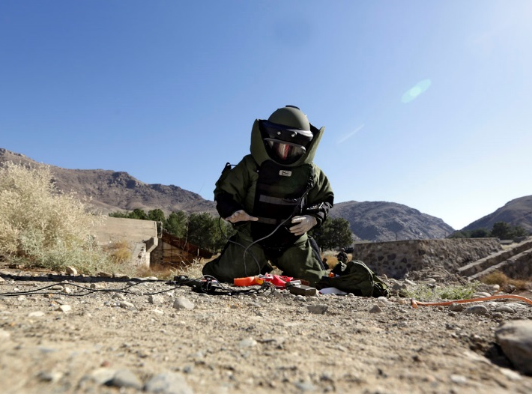
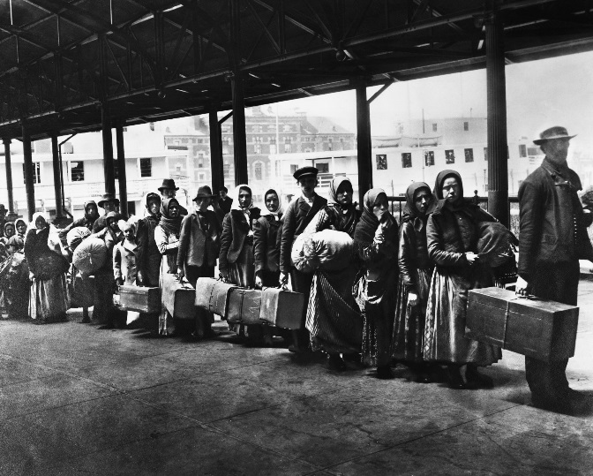

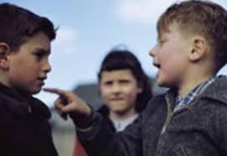
Courage: Types of Courage

Slide 6
Research Questions
How do we measure the Virtue-Relevant Self?
How do aspects of the Virtue-Relevant Self predict courage?

Slide 7
Project Goals
Develop and validate an online measure of the Virtue-Relevant Self
Use this measure to predict
  Perceived courageousness of a variety of actions taken by others
  Types of past personal actions reported as courageous
  Performance in a laboratory courage task

Slide 8
Methodology – Study 1
Development of Virtue-Relevant Self Assessment (VRSA)
  50 – 100 participants
  Online measure of Virtue-Relevant Self
    Written narratives coded for
      Values
      Self Conception
      Social Roles
      Personality Traits
    Self-report measures
  Validated with
    In-person Life Narrative Interview based on McAdams, 1995; Frimer and Walker, 2009

Slide 9
Methodology – Study 1
VRSA Content
    Written narratives (developed for this study)
      Recent Meaningful Actions
      Major Interpersonal Roles
    Self-report measures (adapted from)
      Aspects of Identity Questionnaire (Cheek, Smith, and Tropp, 2002)
      Interpersonal Reactivity Index (Davis, 1983)
      Justice Sensitivity (Schmitt et al, 2005)
      Adapted Good-Self Assessment (Barriga et al 2001)
      Schwartz Value Survey (Schwartz, 1992; 1994)
      Moral Foundations (Graham, Haidt, & Nosek, 2008)
      Social Identities Questionnaire (Jackson, 1981)
      Fear Tolerance (revised Courage Measure, Norton & Weiss 2009)
      Sensation Seeking Scale (Zuckerman et al., 1964)

Slide 10
Methodology – Study 2A
Perceived Courageousness of Actions of Others
  100 online participants
    Recruited from Amazon Mechanical Turk
  VRSA
  Rate courageousness of a variety of courage narratives
    Adapted from 1000+ narratives in our samples and 1000+ news stories
    Varied type and amount of risk
    Varied type and value of goal
  Counterbalanced
  VRSA content match with type of goals and risks should predict higher ratings for courage

Slide 11
Methodology – Study 2B
Perceived Courageousness of Past Actions
  100 online participants
    Recruited from Amazon Mechanical Turk
  VRSA
  Narrative / quantitative rating task describing a past personal courageous action (e.g., Pury et al. 2007)
    Includes coding for types of goals and types of risk
  Counterbalanced
  VRSA content should match type of goals pursued
  Greater matches should predict
    Faster reported action
    Greater risk assumed

Slide 12
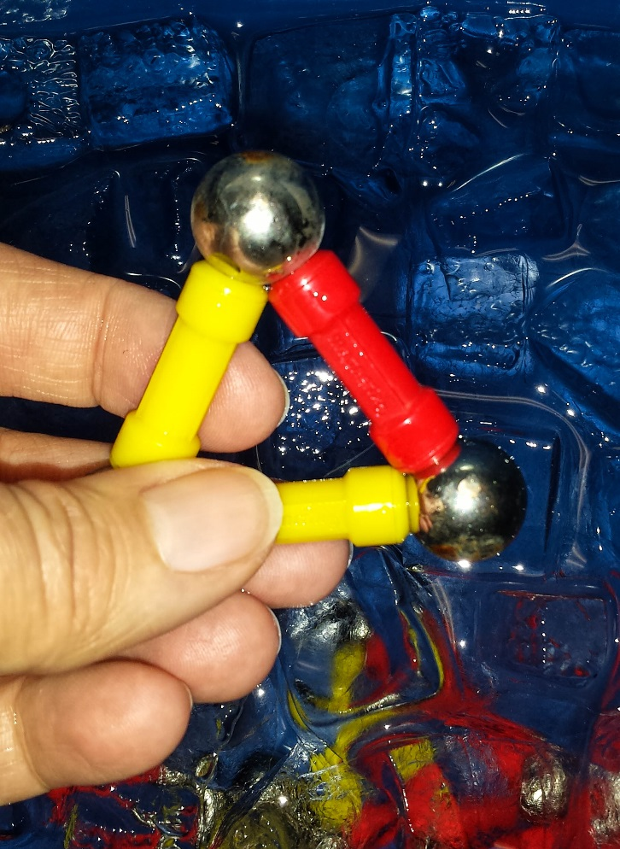
Methodology – Study 2C
Performance in a Laboratory Courage Task
    50 - 100 in-person participants
    VRSA
    In-person laboratory cold pressor performance task to…
      …help people with terminal cancer cope with pain (other-regarding) OR
      …measure likelihood of future personal success (self-regarding)
    VRSA concordance with goal of task should predict
      Greater persistence
      Better task performance
      Greater willingness to sign up for similar studies in the future

Slide 13
Deep Integration
  Virtue-relevant self
    Philosophical issue of sources of moral agency
    Measurement and validation from psychology
    Joint development of each of these aspects
  Courage
    5+ year history of collaboration. Topics include:
      Process vs. Accolade Courage (2010)
      Courage as a Eudaimonic Virtue (2011)
      A Cognitive Appraisal Model of Courage (2013)
      Courage Interventions (2014)
      Bad Courage (2015)

Slide 14
Innovation
Model of the central components of the moral self (VRS)
Relationship of moral self to courage
Assessment tool of VRS
  Measures both scope and strength of contents
  Validation of online assessment procedure
  Can be used to study other virtues

Slide 15
Anticipated Challenges
Online measure might not be validated
Transcribing and scoring interviews is time-intensive
Technical challenges of courage tasks
  Assessment of past courageous actions
  Development of scenarios for rating task
  Development of cold pressor task

Slide 16
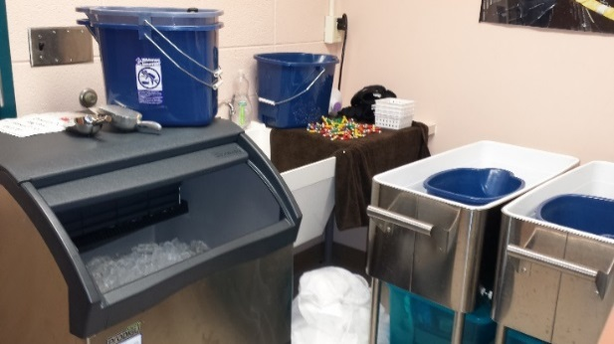
Responses to Challenges
Online measure might not be validated
  In person interview measure of VRS
Transcribing and scoring interviews is time-intensive
  Funded grad student + undergraduate research team
Technical challenges of courage tasks
  Assessment of past courageous actions
    Used in multiple published and in progress studies
  Development of scenarios for rating task
    Bank of 2000+ courageous actions
  Development of cold pressor task
    Pilot testing is complete

Slide 17



Conclusion

