Slide 1
Computing Hydrogen Ion Survival Probability:
Academy Student, Graduate Student, and Faculty Experiences
David Monismith – Independent Researcher
Yixiao (Icy) Zhang – Undergraduate Student, Cornell University
John Shaw – Associate Professor, Northwest Missouri State University
Himadri Chakraborty – Associate Professor, Northwest Missouri State University

Slide 2
Outline
Project Overview
Academy Student Involvement
Graduate Student Involvement
Faculty work completed by Drs. Chakraborty, Monismith, and Shaw
Discussion of current results
Future progress

Slide 3
Project Overview
Introduction
Physics
Parameter Sweeps
Discussion of XSEDE startup allocation

Slide 4
Introduction
Simulating firing a Hydrogen Ion at a Metal Surface.
Goal: compute the survival probability of the ion to determine quantum effects.
Interested in quantum effects on nanostructured surfaces, i.e. catalytic, magnetic, ferroelectric, mechanical, optical, and electronic effects.
Desired findings: technological potential, suitability as templates for “designer surfaces”.
For example large-scale fabrication of functional atomic or molecular assemblies [22-27]

Slide 5
Project Goals
Run multiple instances of the cn2Ds program with varying parameters in a reasonable amount of time.
Understand how parameter variations affect ion-surface interactions [22-27,41].

Slide 6
Definitions
Stampede – Supercomputer at Texas Advanced Computing Center (TACC).
  Consists of 6416 nodes.
Node – one computer (similar to a very fast desktop).
  One node on stampede has 16 CPU-cores and 32 GB RAM.
  Most (about 5500) have one Xeon Phi Accelerator.
SUs – service units.
  One service unit on stampede is equivalent to one CPU-core-hour [43,44].
OpenMP – Open Multiprocessing – a tool for parallelizing computer code using threads (lightweight running programs).
  OpenMP uses thread-based parallelism, which allows for parallelization on one node[35].
  Maximum theoretical speedup on one Stampede node is ~16x using only the standard CPU cores [44].

Slide 7
Firing the Hydrogen Ion at a Surface
The Kronig-Penny potential and the vicinally stepped metallic surface it models
Notes:
Crystalline surface with vicinal stepping.

Slide 8
Computational Methodology
The trajectory of the ion is modeled in two different ways
  Using a broken straight line, and
  Using the Biersack-Ziegler trajectory
The electronic wave function is modeled using a solution of the time-dependent Schrödinger equation
with Hamiltonian:
The Crank-Nicolson method is used to solve the Hamiltonian.
Notes:
V_{ion} and V_{surf} are the ion and surface potentials respectively.

Slide 9
Computational Methodology
For fixed distances between the ion and surface numerical propagation over t is
And the Crank-Nicolson scheme is applied by solving a tridiagonal matrix to obtain an approximate solution to the formula above at every time step over a grid.
The approximation is as follows:

Slide 10
Simulation with cn2Ds
Code developed over 15 years in Fortran IV and 77.
Recently updated to Fortran90.
Designed to simulate surface interaction of a Hydrogen Ion.
Serial code was used to successfully produce 2D results for firing a H- ion at a surface of metal atoms via the Crank-Nicolson method.
Empirical results show the program is compute bound.
Runtimes on local resources range from days to weeks for a single cn2Ds instance.
Used the ifort compiler (v13) with level 3 optimization, which allows for the use of SIMD instructions.

Slide 11
cn2Ds Algorithm - Initialization
cn2Ds Pseudocode
Perform initialization steps including:
- Construct an equidistant time mesh
- Define projectile trajectory
- Construct an equidistant spatial mesh
- Identify initial coordinates
- Add translation phase factors to the
initial wave function
- Build a tri-diagonal matrix for the
Crank Nicolson propagator

Slide 12
cn2Ds Algorithm – Time Loop
Start the time loop
During iteration 1:
Check the norm of the
initial packet and get the
center position.
Copy the initial wave
function into a 2D array
for use in the
autocorrelation integral.
End iteration 1

Slide 13
cn2Ds Algorithm – Time Loop, Continued
During iterations 2 to t:
Add translation phase factors.
Apply the Crank Nicholson method for one
timestep for Φ_{x}.
Apply the Crank Nicholson method again for
the same time step for Φ_{z} + V(x,z).
Apply the Crank Nicholson method a third
time for the same time step for Φ_{x}.
Include absorption at the grid boundary.
Print wave function and check the norm.
End iterations 2 to t.
End time loop.

Slide 14
Parameter Sweep
In order to understand the affect of parameter variations on ion-surface interactions, it is necessary to run the program with varying parameter sets.
A single node on the Stampede supercomputer is sufficient to run multiple serial instances of cn2Ds.
A batch script generator was written for use with the TACC Launcher – a tool to perform parameter sweeps on a supercomputer [36].
Successfully able to execute one job per CPU core on Stampede to perform several modest parameter sweeps using 5 to 6 nodes per sweep [41].

Slide 15
Academy Student Involvement
Student Involved - Yixiao (Icy) Zhang
  A Northwest Academy Student
Understanding the project.
Learning about the command line and parallelism.
Performing OpenMP updates to the code.
Experience with Missouri Academy of Science presentation.
Notes:
The Northwest Academy is an advanced school at NWMSU for high school students.
Academy students complete an associate’s degree in their last two years of high school.

Slide 16
Understanding the Project
Meetings with Drs. Chakraborty and Shaw to understand the Physics of the project.
Virtual attendance at TACC ICERT REU from June 2 – 5, 2014.
  Covered C, Fortran 90, logging on to TACC resources, and more.
  Converted cn2Ds code to Fortran 90 from Fortran 77 and Fortran IV shortly after this meeting.
Meetings with Dr. Monismith to review OpenMP directives.
Attendance at graduate student meetings to understand data management.

Slide 17
Parameters
Listed above are the parameters that were
planned for variation in the cn2Ds simulation.
There are possible 16320 parameter variations.
A file consisting of over 20 lines was used to provide all parameter values to the simulation.
Notes:
Additional parameters were also tested.

Slide 18
Parallelization
Runtimes for serial code (one thread) on Stampede often exceeded the maximum wall time for a program (48 hours).
Thus, code was updated to include parallelism via OpenMP directives.
OpenMP Modifications to cn2Ds performed from 2013 to 2015 and were successfully integrated into existing code.
Parameter sweeps were modified to work with one process (and thus one parameter set) per node and up to 16 threads using OpenMP parallelism without use of the Xeon Phi accelerator.
Benchmarking was performed with 16 threads per job.
Jobs were executed on Stampede supercomputer using the a “startup” allocation (50,000 SUs) through NSF XSEDE.
The “startup” allocation provided enough CPU time to sweep across initial parameter variations for Cu100 and expended the entire allocation.
Notes:
ifort is the Intel Fortran compiler. The version used for this work was 13.0.

Slide 19
Implementing Parallelization
cn2Ds is computationally intensive within the time loop during the three applications of the Crack-Nicholson method.
Each of three nested loops updates the 2D matrix, Φ, to perform different parts of the Crank-Nicholson time step computation.
Parallelization was implemented within each of the three loops, as each depends upon the previous application of the Crank-Nicholson method.
Each nested loop, contains independent inner loop computations.
These were parallelized to allowing for maximum speedup for these sections to be equivalent to the number of available processors.
OpenMP parallel for directives were used to parallelize each of the three Crank-Nicholson loops.
Notes:
OpenMP stands for open multiprocessing. This library allows for direct parallelization of serial code by the application of a directive called a “pragma”.

Slide 20
OpenMP Parallelization Example
!$OMP PARALLEL DO PRIVATE(kx,psiin,psiout)
do kz=1,nzstep
do kx=1,nxstep
psiin(kx)=psi(kx,kz) ! load vector
enddo
call cn1Dpropx(lowerx,diagx,upperx,psiin, &
& psiout,nxstep)
do kx=1,nxstep
psi(kx,kz)=psiout(kx) ! unload vector
enddo
enddo
!$OMP END PARALLEL DO

Slide 21
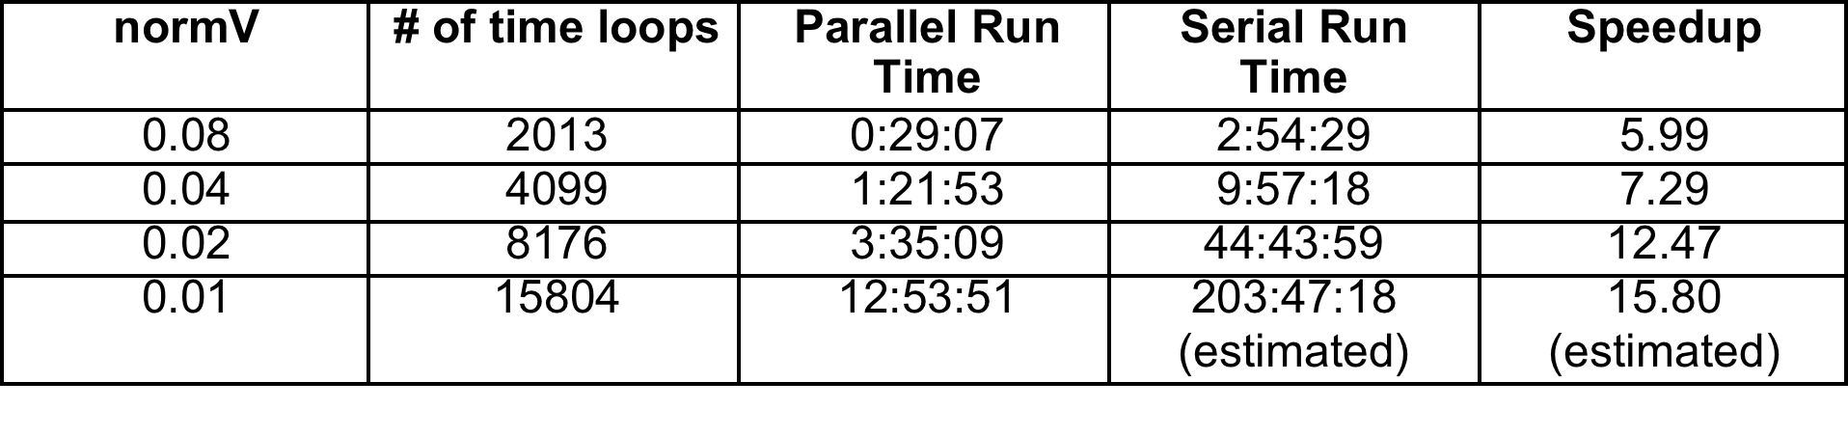
Run Times for Different Values of normV for Li110
Parameter values were vPos = 25, vHeight = 0.054, vWidth = 1, parV = 0.3.
The time step was 0.25 atomic units.

Slide 22
Notes:
cn2Ds speedup vs number of time loops for different values of normV as shown in the previous slide.

Slide 23
Parameter Sweep
Parameter Sweep – running the same code many times with many different parameters for each run.
Run multiple instances of the cn2Ds program with varying parameters in a reasonable amount of time.
Understand how parameter variations affect ion-surface interactions.

Slide 24
Project Experiences
Learned about Schrödinger’s equation and how it is used in the cn2Ds code.
Learned about directive-based parallelism and worked on national supercomputing resources.
Presented results at the Missouri Academy of Science in May 2015.

Slide 25
Graduate Involvement
Students involved:
Anusha Manne Sowmya Chowdary
Deekshith Narsina Vasundhara Pidikiti
Tejaswini Dingari Dedeepya Salla
Rishi Varma Kosuri Vandana Nidasanametla
Graduate students learned about Schrödinger’s equation, Survival Probability, Fortran, Command Line Tools, and Stampede.
They developed two tools for this project
  A backend database program used to upload survival probability data from Stampede to asok.nwmissouri.edu
  A graph generator that would extract and displaying data from asok on a desktop or laptop

Slide 26
Directory Structure
Metal
Target
normV
parV
vHeight
vWidth
vPos
fort.100

Slide 27
Front End Graph Generator
Java Swing GUI
MySQL connection via JDBC to asok.nwmissouri.edu
Graph display via JasperReports

Slide 28
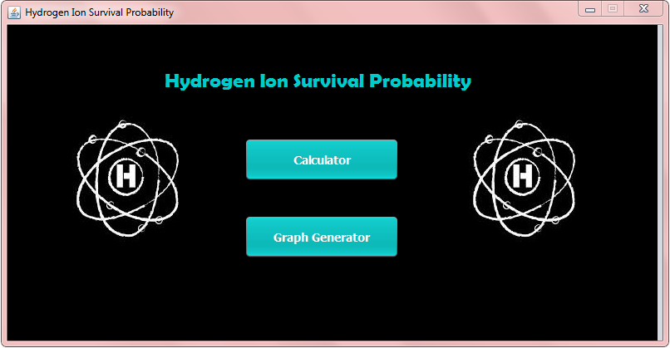
Notes:
Image courtesy of Reference 42

Slide 29
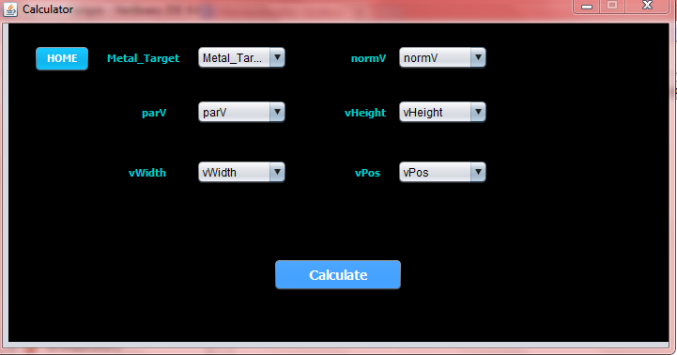
Notes:
Image courtesy of Reference 42

Slide 30
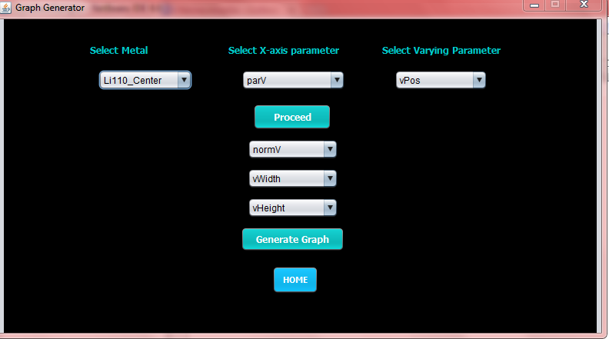
Notes:
Image courtesy of Reference 42

Slide 31
Back End Tools
FilePaths – a Java program and related batch script to traverse directories and upload data created after running a cn2Ds parameter sweep [42].
SurvivalProbabilities
metal_target normV parV vHeight vWidth vPos prob
Notes:
Data to be uploaded is the last number on the last line of the fort.100 file

Slide 32
Workflow Diagram
1. Generate results with TACC Launcher and cn2Ds.
2. Run FilePaths via sbatch.
Laptop
Stampede
Hydrogen Ion Swing GUI
3. Survival Probability Data is sent by FilePaths over port 3306 to MySQL on Asok.
7. Graph generated and sent
to GUI.
4. User requests a graph through the GUI and request is forwarded to Jasper.
5. Data is requested over port 3306.
Asok
JasperReports
API
6. Survival probability data is sent to Jasper.

Slide 33
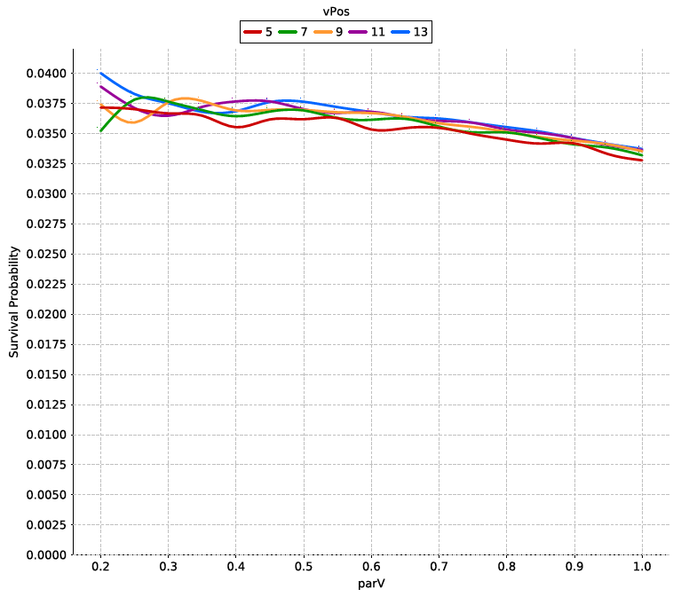
Example Graph

Slide 34
Graduate Student Involvement Recap
Students developed two tools for use on this project
  Backend tool to allow for database connectivity and storage.
  GUI to allow for data retrieval and display of graphs.
Graduate students learned about Linux command line tools, data management, GUI design, and usability.

Slide 35
Faculty Involvement
XSEDE XRAC Allocation
Running large parameter sweeps
Profiling and optimizing the cn2Ds code
Review of updated results

Slide 36
XRAC Allocation
Wrote a proposal describing the project and its physics and a scaling and describing how computational resources would be used in Dec. 2014.
Submitted Jan. 2015
Requested 1.5M SUs to perform a parameter sweep of significant size.
Awarded 624K SUs in March 2015.

Slide 37
Parameter Sweep Updates
After parallelization only one instance of the program could execute per node.
Launcher scripts were updated to reflect this and to run ten parallelized jobs per node in a serial fashion making use of the maximum wall time – 48 hours.
Most jobs took less than 4 hours, so we chose ten total jobs per node as a “safe” number.
Scripts were written to allow for multiple batches to be launched at the same time.
The limiting factor was the number of jobs – a maximum of 50 active jobs can be running at once on Stampede [41].

Slide 38
Updates for Xeon Phi
A smaller allocation and queue limits provided motivation to improve cn2Ds runtimes.
The cn2Ds code was updated for use with the Xeon Phi accelerator.
Half of the independent tridiagonal matrix computations were offloaded in each of three loops where the core computations were performed.
Computations were performed asynchronously [40,41].

Slide 39
Xeon Phi Example Code
psisignal3 = 975
!dir$ offload begin target (mic:0) in(<input parms here>) inout(<inout parms here>) signal(psisignal3)
!$OMP PARALLEL DO PRIVATE(kx,psiin,psiout) SCHEDULE(guided)
do kz=1,xeonNZStep
do kx=1,nxstep
psiin(kx)=psi(kx,kz) ! load vector
enddo
!dir$ attributes offload:mic ::cn1Dpropx
call cn1Dpropx(lowerx,diagx,upperx,psiin,psiout,nxstep)
do kx=1,nxstep
psi(kx,kz)=psiout(kx) ! unload vector
enddo
enddo
!$OMP END PARALLEL DO
!dir$ end offload

Slide 40
Example Code Continued
!$OMP PARALLEL DO PRIVATE(kx,psiin,psiout) SCHEDULE(guided)
! Repeat inner loop code on prev. slide
!$OMP END PARALLEL DO
!dir$ offload_wait target(mic:0) wait(psisignal3)

Slide 41
Runtime Improvement
normV | Number of Time Loops | Xeon Phi Run Time | Parallel Run Time | Serial Run Time
0.08 | 2013 | 00:18:59 | 00:29:07 | 02:54:29
Completed prior to code optimization.
Parameter values were vPos = 25, vHeight = 0.054, vWidth = 1, parV = 0.3.
The time step was 0.25 atomic units [41].

Slide 42
cn2Ds Improved Runtime
Profiling was performed with gprof.
Identified and removed redundant code from pot_surf_2d_h.
Tried different percentages of offloaded computations.
Tried different numbers of Xeon Phi threads.
Used a Biersack Ziegler trajectory and parameters vHeight = 0.027, vWidth = 2.0, vPos = 25, normV = 0.01, parV = 0.05.

Slide 43
gprof Results
Each sample counts as 0.01 seconds.
% cumulative self self total
time seconds seconds calls Ks/call Ks/call name
26.68 9506.92 9506.92 1 9.51 17.60 MAIN__
19.56 16476.99 6970.07 __libm_error_support
16.66 22413.45 5936.45 exp.L
13.06 27066.99 4653.55 2807680531 0.00 0.00 pot_surf2d_h_
6.43 29359.22 2292.22 28776855 0.00 0.00 cn1dpropx_
5.50 31320.13 1960.91 __intel_ssse3_rep_memcpy
4.06 32767.42 1447.30 __svml_cexp2_e9
3.18 33899.82 1132.39 1128246 0.00 0.00 cn1dprop_
1.69 34502.63 602.82 log.L
Notice that a significant amount of time is spent in pot_surf2d_h
Notes:
gprof is a profiler with description available at http://sourceware.org/binutils/docs/gprof
Profilers provide statistics on various assembly instructions and function calls.
Looked at pot_surf2d_h and found redundant code

Slide 44
Runtime Results
normV | Number of Xeon Phi Threads | Lines of data produced per second
0.01 | 60 | 2.475
0.01 | 120 | 2.039
0.01 | 240 | 1.6903
normV | Percentage of computations offloaded to Xeon Phi | Program Runtime
0.01 | 33% | 3.20hrs
0.01 | 50% | 3.18hrs
0.01 | 66% | 4.30hrs
Notes:
With a normV of 0.01, 15804 lines of data are produced.
Runtime results for the first table are based upon 3 minutes of runtime for each execution.
Percentage refers to the percentage of tridiagonal matrix computations that were offloaded to the Xeon Phi.

Slide 45
Additional Code Optimizations
Additional attempts at optimization were made.
Replaced several mathematical statements with faster counterparts.
  E.g. Pre-computed divisions, multiplication instead of exponents, etc.
Attempted Golden Section search for best amount of computations to offload.
  Started with a range of 25% to 83.3% of offloading and narrowed down to the result that produced the best run time for one time loop.
  Not very effective.
Runtime was reduced to 2:57:54

Slide 46
PSC Greenfield Results
Ran cn2Ds on Greenfield with 240 cores on Cu111, Center, vHeight=0.027, vWidth = 2.0, vPos=11, normV=0.03, parV = 1.0
  Runtime was approximately 7 minutes.
Dr. Shaw modified cn3D code to include optimizations.
Dr. Monismith added OpenMP statements to cn3D to run on PSC Greenfield using Au111.
CPU Cores | Speedup | Program Runtime
1 | 1 | 02:11:23 (est.)
120 | 25.11 | 00:05:14
240 | 38.42 | 00:03:31

Slide 47
Future Work
Continued work (debugging) on 3D code.
  Currently results are dissimilar to the 2D results.
Continued work on profiling and optimization
  Recently discovered that removal of Xeon Phi code after optimizations had been completed resulted in 5x speedup on Stampede.
Production of “videos” of firing the ion at the surface.
  Much more data intensive.

Slide 48
References
[1] “Engineering atomic and molecular nanostructures at surfaces”; J.V. Barth, G. Costantini, and K. Kern, Nature 437, 671 (2005).
[2] “Nanostructured surfaces: Challenges and frontiers in nanotechnology”; F. Rosei, J. Phys.: Condens. Matter 16, S1373 (2004).
[3] “Onset of catalytic activity of gold clusters on titania with the appearance of nanometallic properties”; M. Valden, X. Lai, and D.W. Goodman, Science 281, 1647 (1998).
[4] “Bonding of gold nanoclusters to oxygen vacancies on rutile TiO₂(110)”; E. Wahlstroem, N. Lopez, R. Schaub, P. Thostrup, A. Ronnau, C. Afeich, E. Laegsgaard, J.K. Norskov, and F. Besenbacher, Phys. Rev. Lett. 90, 026101 (2003).
[5] “Size- and support-dependency in the catalysis of Gold”; M. Haruta, Catal. Today 36, 153 (1997).
[6] B. Hammer and J.K. Norskov, in Advances in Catalysis (Elsevier, Amsterdam, 2000), Vol. 45, p. 71.
[7] “Electron transmission through molecules and molecular interfaces”; A. Nitzan, Annu. Rev. Phys. Chem. 52, 681 (2001).
[8] “The signature of chemical valence in the electrical conduction through a single atom contact”; E. Scheer, N. Agrait, J.C. Cuevas, A.L. Yeyati, B. Ludoph, A. Martin-Rodero, G.R. Bollinger, J.M. van Ruitenbeek, and C. Urbina, Nature (London) 394, 154 (1998).
[9] “Beyond the surface atlas: A roadmap and gazetteer for surface symmetry and structure”; S.J. Pratt and S.J. Jenkins, Surf. Sci. Rep. 62, 373 (2007).
[10] “Electronic states at vicinal surfaces”; A. Mugarza and J.E. Ortega, J. Phys.: Condens. Matter 15, S3281 (2003).
[11] “Electronic wave function at vicinal surfaces: Switch from terrace to step modulation”; J.E. Ortega, S. Speller, A.R. Bachmann, A. Mascaraque, E.G. Michel, A. Naermann, A. Mugarza, A. Rubio, and F.J. Himpsel, Phys. Rev. Lett. 84, 6110 (2000).
[12] “Nanopatterning the electronic properties of gold surfaces with self-organized superlattices of metallic nanostructures”; C. Didiot, S. Pons, B. Kierren, Y. Fagot-Revurat, and D. Malterre, Nature Nanotech. 2, 617 (2007).
[12a]“Spatial imaging of two-dimensional electronic states in semiconductor quantum wells”; K. Suzuki, K. Kanisawa, C. Janer, S. Perraud, K. Takashina, T. Fujisawa, and Y. Hirayama, Phys. Rev. Lett. 91, 136802 (2007).
[12b]“Wave-function mapping of InAs quantum dots by scanning tunneling spectroscopy”; T. Maltezopoulos, A. Bolz, C. Meyer, C. Heyn, W. Hansen, M. Morgenstern, and R. Wiesendanger, Phys. Rev. Lett. 98, 196804 (2003).
[13] “Fermi surfaces of the two-dimensional surface states on vicinal Cu(111)”; F. Baumberger, T. Greber, and J. Osterwalder, Phys. Rev. B 64, 195411 (2001).
[14] “Step-induced one-dimensional surface state on Cu(332)”; F. Baumberger, T. Greber, and J. Osterwalder, Phys. Rev. B 62, 15431 (2000).
[15] “Image potential states on periodically corrugated metal surfaces”; J. Lei, H. Sun, K. W. Yu, S. Louie, and M.L. Cohen, Phys. Rev. B 63, 045408 (2001).
[16] “Band gap effect on H⁻ ion survival near Cu surfaces”; B. Bahrim, B. Makarenko, and J.W. Rabalais, Surf. Sci. 594, 62 (2005).
[17] “Charge exchange in Li scattering in Si surfaces”; Y. Yang and J.A. Yarmoff, Phys. Rev. Lett. 89, 196102 (2002).
[18] “Role of the 2D surface state continuum and projected band gap in charge transfer in front of Cu(111) surface”; T. Hecht, H. Winter, A.G. Borisov, J.P. Gauyacq, and A.K. Kazansky, Phys. Rev. Lett. 84, 2517 (2000).
[19] “Interaction time dependence of electron tunneling processes between an atom and a surface”; L. Guillemot and V.A. Esaulov, Phys. Rev. Lett. 82, 4552 (1999).
[20] “Electron transfer in the interaction of Fluorine and Hydrogen with Pd(100): The case of a transition metal versus jellium”; E. Sanchez, L. Guillemot, and V.A. Esaulov, Phys. Rev. Lett. 83, 428 (1999).

Slide 49
References
[21] “Relevant effects of localized atomic interactions and surface density of states on charge transfer in ion-surface collisions”; F. Bonetto, M.A. Romerio, E.A. Garcia, R. Vidal, J. Ferron, and E.C. Goldberg, Europhys. Lett. 80, 53002 (2007).
[22] “Resonant neutralization of H⁻ near Cu surfaces: Effects of the surface symmetry and ion trajectory”; H. S. Chakraborty, T. Niederhausen, and U. Thumm, Phys. Rev. A 70, 052903 (2004).
[23] “Effects of the surface Miller index on the resonant neutralization of hydrogen anions near Ag surfaces”; H. S. Chakraborty, T. Niederhausen, and U. Thumm, Phys. Rev. A 69, 052901 (2004).
[24] “On the effect of image states on resonant neutralization of hydrogen anions near metal surfaces”; H. S. Chakraborty, T. Niederhausen, and U. Thumm, Nucl. Instrum. Methods B 241, 43 (2005).
[25] “Band-gap-confinement and image-state-recapture effects in the survival of anions scattered from metal surfaces”; A. Schmitz, J. Shaw, H. S. Chakraborty, and U. Thumm, Phys. Rev. A. 81, 042901 (2010).
[26] “Image potential states of single and multi-walled carbon nanotubes”; M. Zamkov, H. S. Chakraborty, A. Habib, N. Woody, U. Thumm, and P. Richard, Phys. Rev. A 70, 115419 (2004).
[27] “Time-resolved photoimaging of image-potential states in carbon nanotubes”; M. Zamkov, N. Woody, B. Shan, H. S. Chakraborty, Z. Chang, U. Thumm, and P. Richard, Phys. Rev. Lett. 93,156803 (2004).
[28] “Image potential states of metal surfaces: Binding energies and wave functions”; E.V. Chulkov, V.M. Silkin, and P.M. Echenique, Surf. Sci. 437, 330 (1999).
[29] “Model pseudopotential for the (110) surface of fcc noble metals”; S.S. Tsirkin, S.V. Eremeev, and E.V. Chulkov, Surf. Sci. 604, 804 (2010).
[30] “Wave packet study of H⁻ decay in front of a metal surface”; V.A. Ermoshin and A.K. Kazansky, Phys. Letts. A 218, 99 (1996).
[31] “Lifetime of excited electronic states at surfaces: Comparison between the alkali/Cu(111) systems”; A.G. Borisov, J.P. Gauyacq, E.V. Chulkov, V.M. Silkin, and P.M. Echenique, Phys. Rev. B 65, 235434 (2002).
[32] “Probing adsorbate state lifetime with low energy ions”; J. Sjakste, A.G. Borisov, and J.P. Gauyacq, Phys. Rev. Lett. 92, 156101 (2004).
[33] W.H. Press, S.A. Teukolsky, W.T. Vetterling, and B.P. Flannery, Numerical Recipes: The Art of Scientific Computing (Cambridge University Press, Cambridge, 2007).
[34] “Refined universal potentials in atomic collisions”; J.P. Biersack and J.F. Ziegler, Nucl. Instrum. Meth. 194, 93 (1982).
[35] OpenMP Architecture Review Board (2011), OpenMP Application Programmer Interface Version 3.1, Retrieved from http://www.openmp.org/mp-documents/OpenMP3.1.pdf
[36] "Launcher: A Shell-based Framework for Rapid Development of Parallel Parametric Studies"; L.A. Wilson and J.M. Fonner, Proceedings of the Extreme Science and Engineering Discovery Environment: Engaging Communities (XSEDE14), Atlanta, GA, USA, July 2014.
[37] Jaspersoft Corporation (2014), JasperReports Library: Open Source Java Reporting Library, Retrieved from http://community.jaspersoft.com/project/jasperreports-library
[38] Oracle Corporation (2014), Java SE 7 Swing APIs and Developer Guides, Retrieved from http://docs.oracle.com/javase/7/docs/technotes/guides/swing/
[39] Oracle Corporation (2014), MySQL 5.6 Reference Manual, Retrieved from http://dev.mysql.com/doc/refman/5.6/en/
[40] Intel Corporation (2014), User and Reference Guide for the Intel Fortran Compiler 15.0, Retrieved from https://software.intel.com/en-us/compiler_15.0_ug_f
[41] “Computational Simulations of Electronic Motions and Excitations in Nanostructured Surfaces by Ion Surface Charge”; Y. Zhang, J. Shaw, D. Monismith, and H. Chakraborty, Missouri Academy of Science 51st Annual Meeting, Missouri Western State University, St. Joseph, MO, Apr. 18, 2015.
[42] “Graduate Directed Project: Hydrogen Ion Survival, Final Presentation”; A.Manne, D. Narsina, T. Dingari, R.V. Kosuri, V. Nidasanametla, S. Chowdary, V. Pidikiti, D. Salla, Northwest Missouri State University, Maryville, MO, March 2015.
[43] XSEDE (2015), XSEDE User Portal Allocations Policy , Retrieved from https://portal.xsede.org/allocation-policies .
[44] TACC (2015), TACC Stampede User Guide – TACC User Portal, Retrieved from https://portal.tacc.utexas.edu/user-guides/stampede .

Slide 50
Acknowledgement
This work used the Extreme Science and Engineering Discovery Environment (XSEDE), which is supported by National Science Foundation grant number ACI-1053575. Specifically, it used TACC Stampede and the Greenfield system at the Pittsburgh Supercomputing Center (PSC).
The authors acknowledge the Texas Advanced Computing Center (TACC) at The University of Texas at Austin for providing HPC resources that have contributed to the research results reported within this paper.
URL: http://www.tacc.utexas.edu
This research was supported in part by NSF Grant Number PHY-1413799, “Photon Impact Ionization of Fullerene and Endofullerene Molecules: Cross Sections, Resonances, and Time Delays”

